Slide 1


Peer Review Board of ICAI
Eastern India Regional Council of ICAI
One Day Training Program for Peer Reviewers
2nd Technical Session:
Compliance with Ethical Standards
CA Niranjan Joshi
25.04.2025
Restriction on Disclosure and Use of Data
The data in this document contains trade secrets and confidential or proprietary information of my firm, the disclosure of which would provide a competitive advantage to others. As a result, this document shall not be disclosed, used or duplicated, in whole or in part, for any purpose. The data subject to this restriction are contained in the entire document.

Slide 2
Disclaimer
These are my personal views and can not be construed to be the views of the ICAI or my firm.
No representations or warranties are made by the RC/Branch/Study Circle of RC with regard to this presentation.
These views do not and shall not be considered as a professional advice.
This presentation should not be reproduced in part or in whole, in any manner or form, without our written permission.
CA Niranjan Joshi

Slide 3
Coverage
Code of Ethics
Peer Review - Requirements
Resources
CA Niranjan Joshi

Slide 4
Introduction
Ethics / Moral Values – Accountability towards self conscience
Eternal Vigilance is the cost of Independence
Only 1 choice – Ethical or Not Ethical
4
CA Niranjan Joshi

Slide 5
Need for Code of Ethics
  Ensure Credibility of our Profession
  Expectation from Society / Regulators / Users
5
CA Niranjan Joshi

Slide 6
Common Lapses Observed
Good Faith
Weak documentation
Work should not only be done, but it should be seen that it is done
Faintest of ink is stronger than the strongest of memory
Lack of Pro-activeness
Lack of communication Skills – can’t say no
Obsession with Tax Considerations
CA Niranjan Joshi

Slide 7

What to READ
Updated The Chartered Accountants Act, 1949
Updated CA Regulations of 1988
ICAI publication on ‘Code of Ethics’2019
COE FAQs published by ICAI. (February 01, 2012)
Manual for members
ICAI Website for various pronouncements.
ESB website; CA Ethics Plus – handy brochure issued by ESB.
CA Niranjan Joshi

Slide 8
Important Points to remember
Misconduct proceedings - Initiated on receiving a Complaint or information from any source. There can be suo moto action by the Council.
Complainant need not come with clean hands. Council not concerned with the locus standi of Complainant.
Withdrawal of complaint permitted only with permission of BOD / DC.
Council has jurisdiction basically over an individual member; and not over firms; or on outsiders.
Complaint filed beyond period of 7 years may not be entertained at the discretion of the Director Discipline if he/she is satisfied that it would be difficult obtain evidence on account of time lag or that it would be procedurally inconvenient.
Even if Respondent compensates the complainant for any losses, it will not undo the misconduct. Even if nobody is aggrieved due a particular lapse / misconduct of the member, there can be disciplinary proceedings against the member.
There is no time limit for disposal of complaint! Proceedings may continue for years together!
CA Niranjan Joshi

Slide 9
Way Forward
ICAI being member of International Federation of Accountants (IFAC) has considered the Ethics Standards issued by International Ethics Standards Board for Accountants(IESBA) while framing Code of Ethics for CAs.
The existing (2009) edition of ICAI Code of Ethics is based on 2005 edition of IESBA Code of Ethics.
ICAI Code of Ethics has been revised in January, 2019 based on 2018 edition of IESBA Code of Ethics. It is applicable from 1st April, 2020.
CA Niranjan Joshi

Slide 10
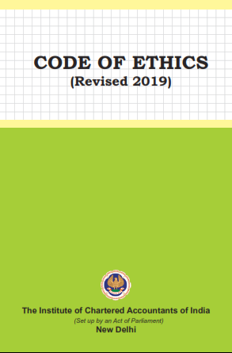
Code of Ethics
Read and Follow
10
CA Niranjan Joshi

Slide 11
Fundamental Principles
I
O
P
C
P
Integrity
Objectivity
Professional Competence and due care
Confidentiality
Professional Behaviour
CA Niranjan Joshi

Slide 12
Fundamental Principles
Integrity –
Straightforward and honest approach, Fair dealing and truthfulness, Do not associate with communication or information containing false or misleading information, Steps to disassociate with above information once known
Objectivity –
Not to compromise professional or business judgment because of bias, conflict of interest or undue influence of others. Not to undertake a professional activity if it unduly influences the accountant’s professional judgment.
CA Niranjan Joshi

Slide 13
Fundamental Principles
Professional Competence and due care –
Attain and maintain professional knowledge and skill, Act diligently and in accordance with applicable technical and professional standards, Ensure appropriate training and supervision of subordinates
Confidentiality –
Maintain confidentiality of information acquired as a result of professional and employment relationships, Disclose information when required by law or authorised by the client, Consider relevant factors while deciding disclosure of confidential information, Maintain confidentiality even after the end of relationship with client
CA Niranjan Joshi

Slide 14
Fundamental Principles
Professional Behaviour –
Avoid activities that impair the reputation of the profession, Do not make exaggerated claims for services offered, and disparaging references or unsubstantiated comparisons with others, Do not advertise any professional/other facts which are in violation of Advertisement Guidelines of ICAI
Threats to Avoid
Self Interest Threat, Self Review Threat, Advocacy Threat, Familiarity Threat, Intimidation Threat.
The Code provides a conceptual framework that professional accountants (PA) are to apply in order to identify, evaluate and address threats to compliance with the fundamental principles
CA Niranjan Joshi

Slide 15
Assessment of Threats
Self-interest threat –
the threat that a financial or other interest will inappropriately influence a professional accountant’s judgment or behaviour;
[e.g. Financial Interest, Loans or Guarantees, Professional Fees – leverage – in excess of 40% - group fees, Business Relationship, Potential of Employment, Contingent Fees – Success Fee, Other assignments – non assurance]
Self-review threat –
the threat that a professional accountant will not appropriately evaluate the results of a previous judgment made; or an activity performed by the accountant, or by another individual within the accountant’s firm or employing organization, on which the accountant will rely when forming a judgment as part of performing a current activity
[e.g. Performed services which is subject to his review, having previous relationships]
CA Niranjan Joshi

Slide 16
Assessment of Threats
Advocacy threat –
the threat that a professional accountant will promote a client’s or employing organization‟s position to the point that the accountant’s objectivity is compromised;
[e.g. Dealing in shares, Assignment for advocate in litigation mattes]
Familiarity threat –
the threat that due to a long or close relationship with a client, or employing organization, a professional accountant will be too sympathetic to their interests or too accepting of their work; and
[e.g. Close relationship with client, Long association, Acceptance of gifts and hospitality, Rotation of Auditors – external and internal]
CA Niranjan Joshi

Slide 17
Assessment of Threats
Intimidation threat –
the threat that a professional accountant will be deterred from acting objectively because of actual or perceived pressures, including attempts to exercise undue influence over the accountant.
[e.g. Threat of replacement, Statutory Auditor cannot be Internal Auditor, Cannot be financial advisor, Independence applies to each partner of the firm.]
A circumstance might create more than one threat, and a threat might affect compliance with more than one fundamental principle.
Identify –-> Evaluate –-> Address
CA Niranjan Joshi

Slide 18
Major Changes in COE 2019
COE 2009 and COE 2019 - Five most important structural changes in new Code
Independence requirements for Audit and Review Engagements and other Assurance engagements differentiated.
Independence sections recharacterized as “International Independence Standards”.
Change in the drafting conventions e.g. “should” to “shall”
New pattern of structuring of sections – Requirements distinguished.
Increased clarity of responsibility for compliance - Firms, network firms, individuals within firms.
CA Niranjan Joshi

Slide 19
Major Changes in COE 2019
    Changes from IESBA Code
    Changes made fall under following broad heads:-
    Where domestic provision stricter than corresponding IESBA provision e.g. total bar on Accounting by the Statutory Auditor
    Where domestic legal requirement governs the issue e.g. “Network” would only refer to Network registered with ICAI
    Where a domestic requirement has no corresponding provisions in IESBA Code e.g. Firm Rotation
    Language changes – for example, “professional accountant in business” mentioned as “professional accountant in service” as per Chartered Accountants Act, 1949
CA Niranjan Joshi

Slide 20
Guide to the COE
Part 1 | Complying with the Code, fundamental principle and conceptual framework | Section 100 to 199
Part 2 | Professional Accountants in service | Section 200 to 299
Part 3 | Professional accountants in public practice | Section 300 to 399
Part 4 | Independence Standards | Section 400 to 999
Part 4 A | Independence for Audit and Review Engagements | Section 400 to 899
Part 4 B | Independence for assurance engagements other than audit and review | Section 900 to 999
CA Niranjan Joshi

Slide 21
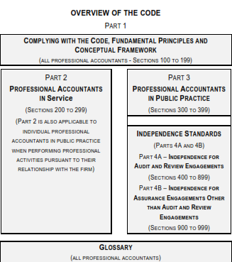
CA Niranjan Joshi

Slide 22
Major Changes in COE 2019
Taxation services to the Audit Clients
ICAI Code Ethics, 2009: Taxation to Audit client include compliance, planning, provision of formal taxation opinions and assistance in the resolution of tax disputes. Such assignments are generally not seen to create threats to independence
ICAI Code of Ethics, 2019 (604): Further guidance on Taxation matters provided. Generally, it states that providing tax services to an audit client might create a self review or advocacy threat –
Tax Return preparation – Usually no threat
Tax Calculations for the Purpose of Preparing Accounting Entries (that will subsequently be audited by the Firm) - Creates a self-review threat
CA Niranjan Joshi

Slide 23
Major Changes in COE 2019
Tax Planning /Other Tax Advisory Services – Might create self-review/advocacy threat- appropriate safeguards to be adopted, E.g. Using professionals who are not audit team members to perform the service; having an appropriate reviewer, not involved in providing the service, review the audit work etc.
Tax Services Involving Valuations – Might perform only where the result of the valuation will not have a direct effect on the financial statements
Assistance in the Resolution of Tax Disputes – Might create a self- review or advocacy threat – appropriate safeguards to be adopted – Not to provide if involves acting as advocate for the audit client OR amounts involved are material to the financial statements on which the firm will express an opinion.
CA Niranjan Joshi

Slide 24
Major Changes in COE 2019
Documentation
2009 Code requires Firms to document their conclusions regarding compliance with independence requirements
In the 2019 Code, the requirements of Documentation given in greater detail
NOCLAR requires all steps in responding with NOCLAR to be documented
Fees – Relative Size
In the revised Code, where for two consecutive years, total gross annual professional fees from the audit client and its related entities represent more than (40% non PIE/ 20% PIE) of total fees, the firm shall disclose to Those charged with Governance (TCWG)*
CA Niranjan Joshi

Slide 25
Major Changes in COE 2019
No such ceiling on total fees of the Firm would be applicable where such fees does not exceed Rs. 5 Lakhs
No such ceiling on the total fees would be applicable in the case of audit of government Companies, public undertakings, nationalized banks, public financial institutions or Government appointments.
Criteria of Indebtedness
IESBA Code of Ethics, 2018 brought concept of materiality of Loans and Guarantees. Whether a loan or guarantee is material would depend on combined net worth of the individual and his immediate family members
Concept adopted in ICAI Code of Ethics, 2019
CA Niranjan Joshi

Slide 26
Major Changes in COE 2019
In the revised Code, the application of safeguards is required, when necessary, to eliminate threats or to reduce them to ‘an acceptable level’ (level which a reasonable and informed third party would conclude, is acceptable). Previously safeguards had to be considered if a threat was other than “clearly insignificant”
Public Interest Entity
2019 edition contains a new term “Public Interest Entity” (PIE)
Enhanced independence requirements for PIE in the new Code
Definition of PIE , as given in IESBA Code of Ethics extended by inclusion of banks and insurance companies in the 2019 Code
CA Niranjan Joshi

Slide 27
Major Changes in COE 2019
Firms encouraged to determine whether to treat an additional entities as PIE because of large number of stakeholders.
Inducements - Gifts and Hospitality
Inducements elaborated
To first see whether prohibited by L and R
Offering also prohibited
Reasonable and Informed Third Party test – To see whether it is with the intent to improperly influence the behavior of the recipient or of another individual.
Clarifications about appropriate boundaries for offering and accepting of inducements.
Extended to PAs in service also.
Total prohibition in case of Audit/Assurance clients to continue.
CA Niranjan Joshi

Slide 28
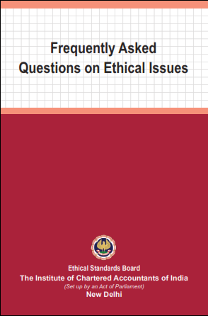
Code of Ethics FAQ
Read and Follow
CA Niranjan Joshi

Slide 29
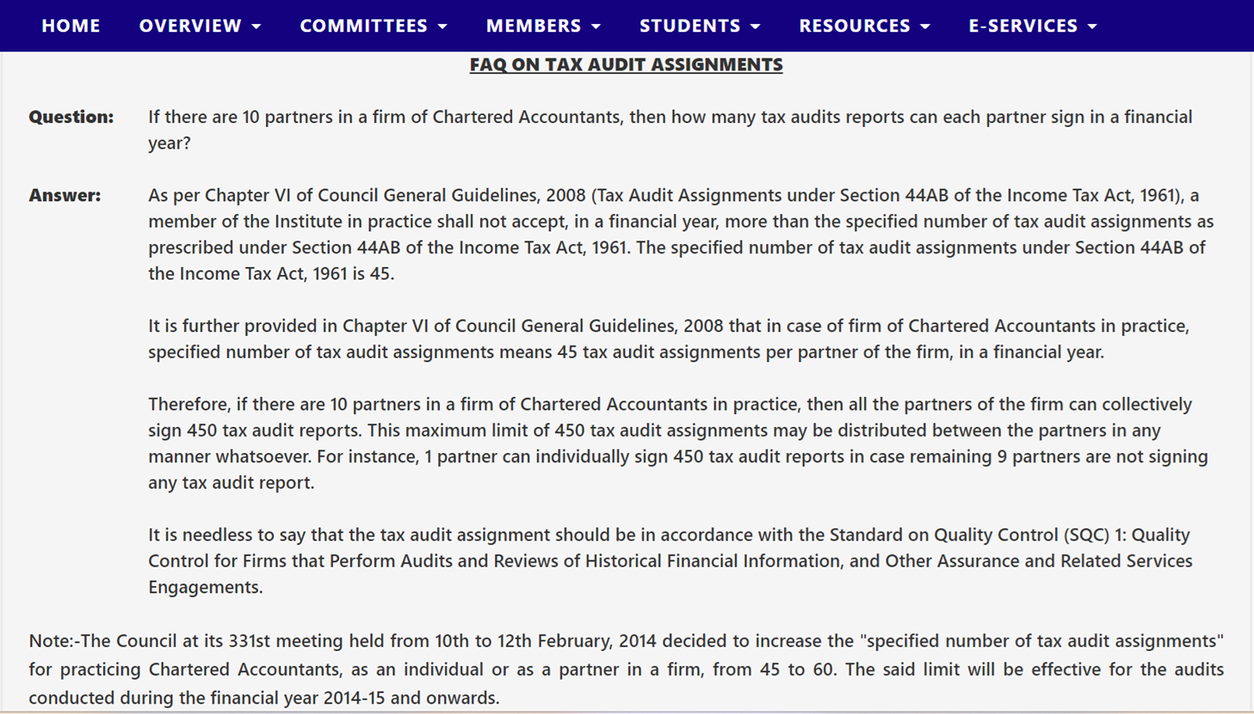
From the ICAI Website
29
CA Niranjan Joshi

Slide 30
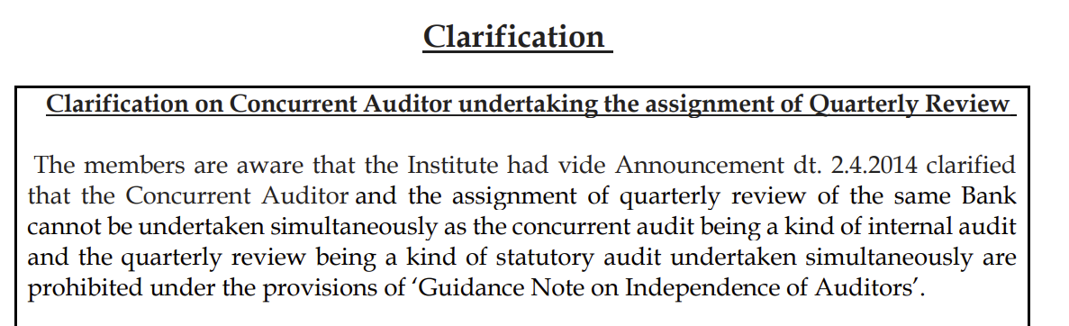
From the ICAI Website
30
CA Niranjan Joshi

Slide 31
FAQ
FAQs released by ICAI related to professional ethics of members pertaining to Bank Assignments
FAQ List document
31
CA Niranjan Joshi

Slide 32
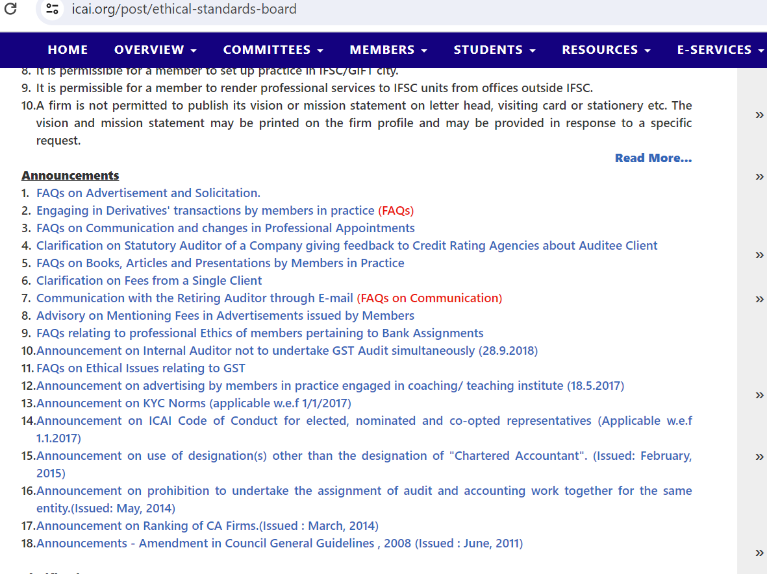
From the ICAI Website
CA Niranjan Joshi

Slide 33
Introduction
Code of Ethics
Peer Review - Requirements
Resources
CA Niranjan Joshi

Slide 34
Peer Review & Code Of Ethics
Part B of Questionnaire requires a PU to submit information about the Ethical Requirements and Peer Reviewer has to check its compliance.
Independence & Ethics Partner
Quality Control Partner
Updated knowledge about Ethics Requirements
Adherence to Ethical Requirements by Partners & Team
Steps taken to mitigate threats to independence
Assignments within the specified limits (Company Audit/Tax Audit)
Fees below minimum recommended
Audit Fees vs Other Fees
Tender Process followed
CA Niranjan Joshi

Slide 35
Peer Review & Code Of Ethics
Sr. No. | Policies and Procedures
1 | Which of the following procedures does the PU have in place for ensuring that the personnel adhere to ethical requirements those contained in the code:
(i) | Designated Independence and Ethics Partner who is responsible for all aspects of independence and ethics of the PUs partners and professional staff
(ii) | If answer to (i) above is yes, name of the Partner
(iii) | Is the Partner same as QC Partner?
(iv) | Has the PU established a system for identifying all services performed for each client and evaluating whether any of the services impair independence?
(v) | Does the PU regularly update itself with the changes in professional ethics and independence standards/ requirements?
(vi) | What checks are put in place to ensure that all personnel follow the independence and ethics policies of the PU?
CA Niranjan Joshi

Slide 36
Peer Review & Code Of Ethics
Sr. No. | Policies and Procedures
2. | Which of the following checks does the PU put in place to ensure that the independence requirements are communicated to its personnel:
(i) | Does the PU maintain a list of entities with which PU personnel and others, if any, are prohibited from having a financial or business relationship?
(ii) | Does the PU make the list available to the concerned personnel so that they evaluate their independence?
(iii) | Are the changes in the list notified to the personnel as soon as such changes occur?
(iv) | Does the PU provide frequent reminders of professional responsibilities to personnel?
CA Niranjan Joshi

Slide 37
Peer Review & Code Of Ethics
Sr. No. | Policies and Procedures
3. | Which of the following policies, procedures and the safeguards the PU has in place to mitigate threats to its independence?
(i) | Do the Engagement Partners provide the PU with relevant information about client engagement to enable it to evaluate the overall impact on independence requirements?
(ii) | Does the PU provide training to partners and professional staff on what constitutes threat to independence and the safeguards that may be taken to reduce the threats to an acceptable level?
(iii) | Accumulating and communicating relevant information to appropriate personnel
(iv) | How and to whom the personnel notify of circumstances and relationships that cause threat to independence?
(v) | What are the steps taken by PU so that the self-interest threat to independence is mitigated?
CA Niranjan Joshi

Slide 38
Peer Review & Code Of Ethics
Sr. No. | Policies and Procedures
(vi) | How the PU is mitigating the self-review threats? Is there any checklist where the steps have been outlined?
(vii) | How the PU is mitigating the risk of advocacy threats? Can the PU demonstrate the same?
(viii) | How the PU is mitigating the familiarity threats? Can PU demonstrate the same? Is the relationship with client personal disclosed in the Independence form?
(ix) | Can the PU demonstrate that professional skepticism was used in the entire assignment? What measures are taken to mitigate the same?
CA Niranjan Joshi

Slide 39
Peer Review & Code Of Ethics
Sr. No. | Policies and Procedures
4. | What policies, processes and safeguards has the PU established with regard to threats to its independence:
(i) | Is it ensured that the PU does not have any financial interests in audit clients, their owners and officials?
(ii) | Does the ethics policy of the PU emphasize that the members of PU must not have other than business relationships in audit clients, their owners and officials?
(iii) | Does the PU have the policy of rotating out senior personnel from the assurance engagements after a certain length of service at a particular engagement? If yes what is the length of service?
(iv) | Whether there is a policy that the personnel declares - the acceptance of gifts & hospitality from clients/owners
(v) | Does the PU have the policy to obtain annual independence declaration from all personnel?
CA Niranjan Joshi

Slide 40
Peer Review & Code Of Ethics
Sr. No. | Policies and Procedures
(vi) | As a step in the engagement program, is the Engagement Partner required to sign a compliance with independence requirements?
(vii) | In case professional service is conducted jointly with other auditor, is the annual independence confirmed for the other auditor?
5. | Are the number of audit assignments held by the PU, at any time, more than the specified number of audit assignments:
A | Under the prevailing Companies Act and/or the limit prescribed by the ICAI.
B | Tax audit assignments as per ICAI notification
6. | Has the PU accepted appointment as Statutory Auditor of – PSU(s)/Government Company (ies) Listed company(ies) and other Public Company(ies) having turnover of more than Rs. 50 crores or more in a year and accepted other work or assignment or service in regard to the same entity(ies) on a remuneration which in total exceeds the fee payable for carrying out statutory audit of the same entity. (If yes, specify reasons)
CA Niranjan Joshi

Slide 41
Peer Review & Code Of Ethics
Sr. No. | Policies and Procedures
7. | Has the PU accepted appointment as an auditor of a concern while it/he is indebted to the concern or has given any guarantee or provided any security in connection with the indebtedness of any third person to the concern, for the limits fixed in the statute and in other cases for amount not exceeding Rs.1,00,000. (If yes, specify reasons).
8. | Has the PU received fees from a client below the minimum scale of fees recommended for audit assignments by the ICAI? If yes, reason for accepting fee below recommended scales
9. | Has the PU, being statutory auditor of a client rendered any services to the same client, as mentioned in section 144 of Companies Act 2013 (if yes, specify reason with name of the entities and year in which such service was rendered)
10. | Has the PU, as incoming auditor for an entity, followed the direction given by the ICAI not to accept an appointment as auditor in the case of unjustified removal of earlier auditor? If no, reasons for non-adherence to the direction
11. | Does the PU or a Network, as a good and healthy practice, make a disclosure of the payment received by it for other services through the medium of a different firm or firms in which the said PU or Network or its partners may have an ownership interest. (If no, specify reasons)
CA Niranjan Joshi

Slide 42
Peer Review & Code Of Ethics
Sr. No. | Policies and Procedures
12. | Has the PU followed the Guidelines issued by the ICAI in respect of engagement/(s) procured through Tender?
13. | Is the website of the PU in conformity with Institute's guidelines/ directions issued on posting of particulars on website by Practice Unit(s)?
14. | Whether your firm has been reviewed by:
(i) | The Quality Review Board (QRB)
(ii) | Financial Reporting Review Board (FRRB)
(iii) | Any regulator (Pls. specify)
(iv) | If yes, details as under: Year of Review / Name of Entity / Broad description of deficiencies / Date of submission of compliance report (wherever required)
15 | Have any Government Bodies/ Authorities evaluated the performance of the firm to the extent of debarment/ blacklisting?
CA Niranjan Joshi

Slide 43
Introduction
Code of Ethics
Peer Review - Requirements
Resources
CA Niranjan Joshi

Slide 44
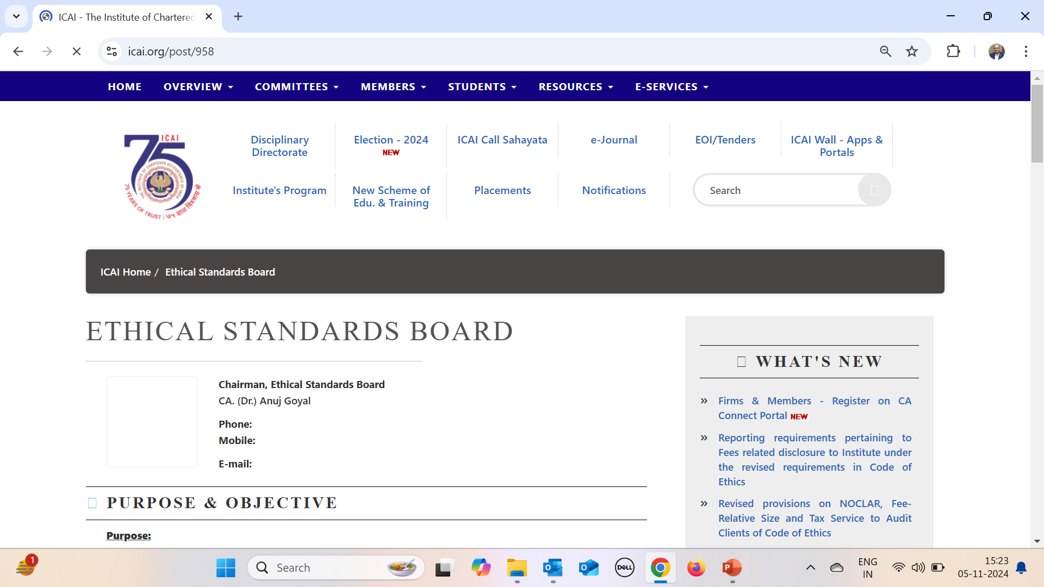
CA Niranjan Joshi

Slide 45

Questions
CA Niranjan Joshi

Slide 46

CA Niranjan Joshi,
B.Com., FCA, DISA (ICAI)
Email: nvjca1@gmail.com
Cell: 8369577210

