Slide 1
THE INSTITUTE OF CHARTERED ACCOUNTANTS OF INDIA-EIRC
By : CA Vikash Kumar Banka
9830985000 vikash_banka@hotmail.com

Slide 2
TOPIC
3CD Vs GST

Slide 3
Contents
1. Relevant Clauses of 3CD
2. How to Report and Reconcile with GST

Slide 4
3CD Vs GST
      Form 3CD: Part A clause 2
      Address (Image attached in next slide)

Slide 5
3CD Vs GST
Form 3CD: Clause 4 Part A
Whether the assessee is liable to pay indirect tax like excise duty, service tax, sales tax, goods and services tax, customs duty, etc. If yes, please furnish the registration number, GST number or any other identification number allotted for the same.
      (Image attached in next slide)

Slide 6
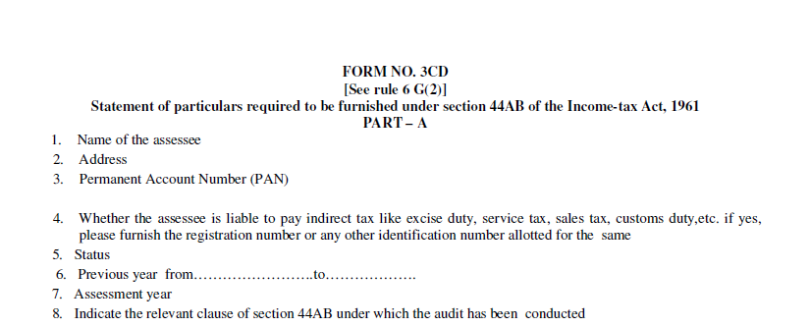
3CD Vs GST

Slide 7
3CD Vs GST
      Form 3CD:Clause 10, Part B
a. Nature of business or profession (if more than one business or profession is carried on during the previous year, nature of every business or profession)
b. If there is any change in the nature of business or profession, the particulars of such change
      (Image attached in next slide)

Slide 8
3CD Vs GST

Slide 9
3CD Vs GST
      Form 3CD: Clause 13(d)
Details of deviation, if any , in the method accounting employed in the previous year from accounting standards prescribed under section 145 and the effect thereof on the profit or loss
      (Image attached in next slide)

Slide 10
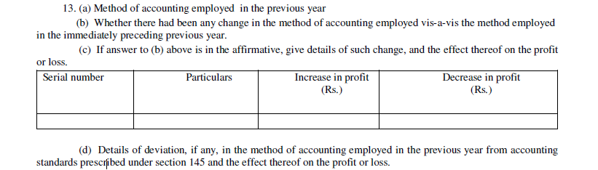
3CD Vs GST

Slide 11
3CD Vs GST
      Form 3CD: Clause 14(b)
In case of deviation from the method of valuation prescribed under section 145A, and the effect thereof on the profit and loss
      (Image attached in next slide)

Slide 12
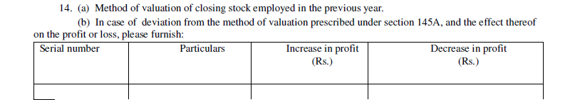
3CD Vs GST
      Reconciliation of inventory u/s. 145A

Slide 13
3CD Vs GST
      Form 3CD: Clause 18
Particulars of depreciation allowable as per the Income Tax Act, 1961 in respect of each asset or block of asset, as the case may be, in the following form-
a. Depreciation of asset/block of assets……
      (Image attached in next slide)

Slide 14
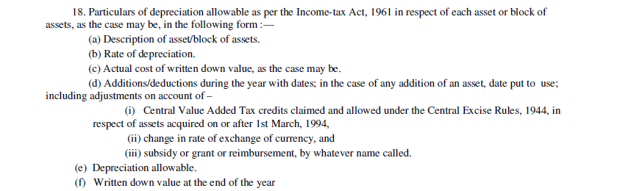
3CD Vs GST
      Form 3CD: Details of depreciation

Slide 15
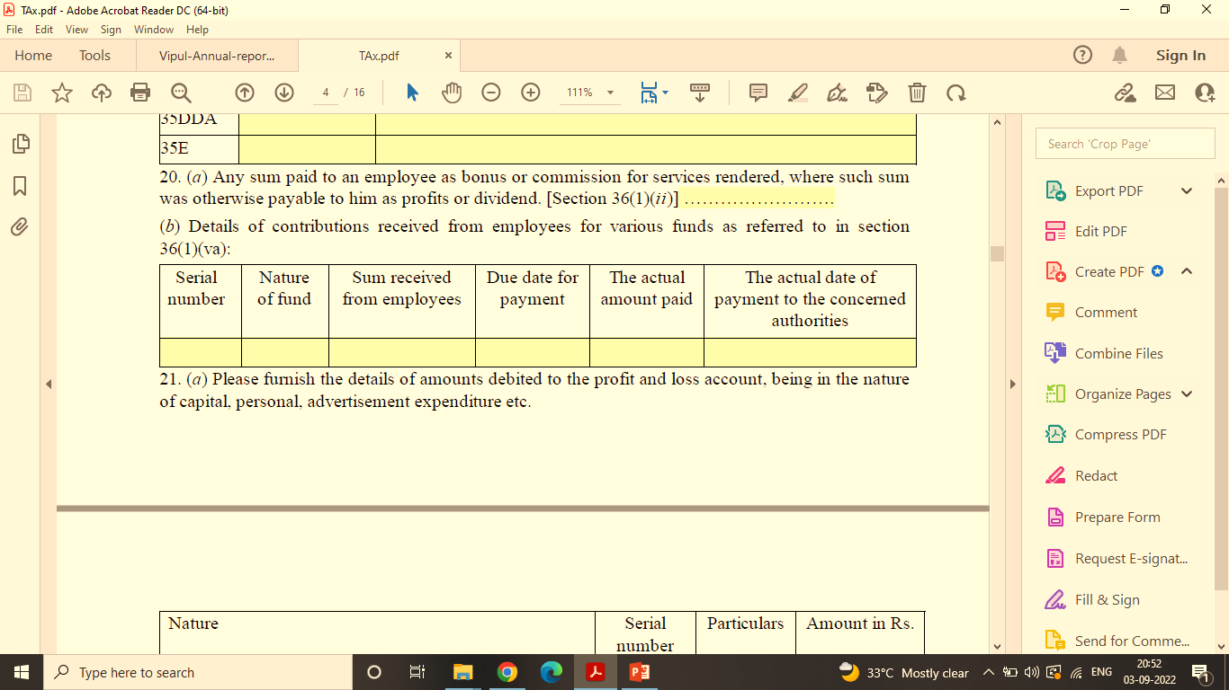
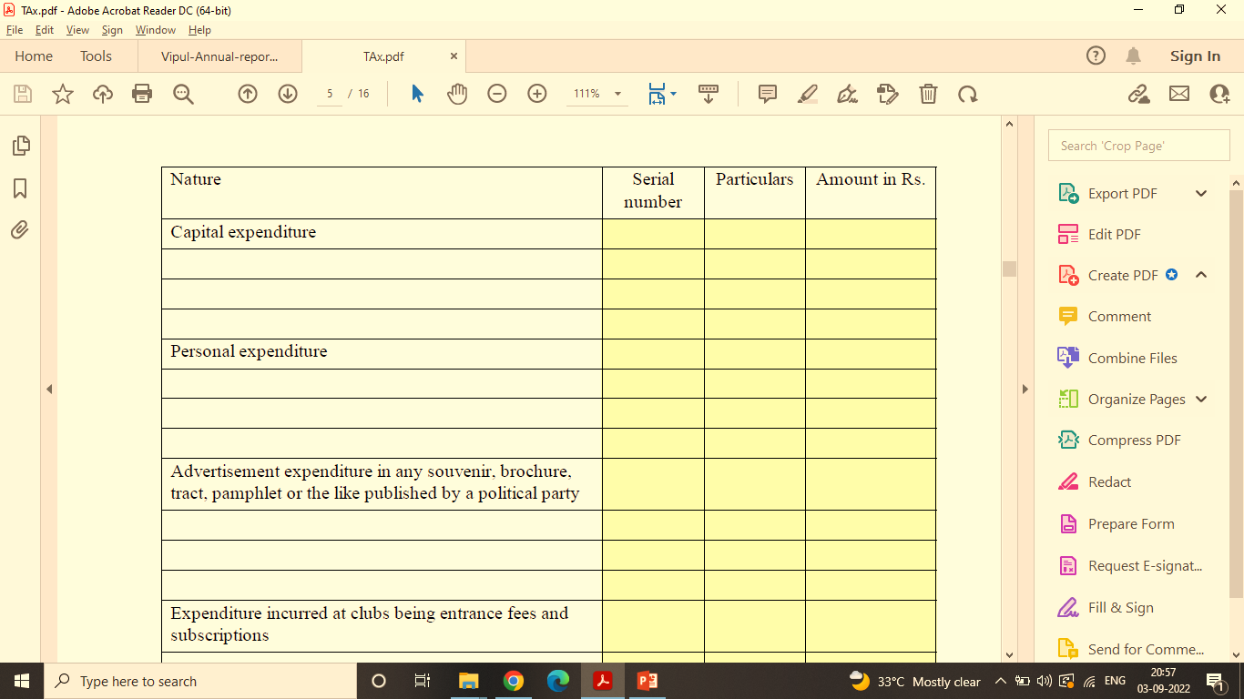
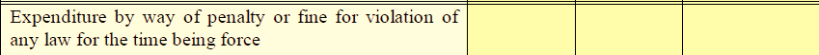
3CD Vs GST
      Form 3CD: Auditor’s Report
      Expenditure of personal nature- no claim of ITC [Clause 21(a)]
      Penalty or fine for any violation [Clause 21(a)]

Slide 16
3CD Vs GST
      Form 3CD: Clause 26
In respect of any sum referred of section 43B, the liability for which:-
Pre exist on the previous year ……
Was incurred during the previous year…..
      (Image attached in next slide)

Slide 17
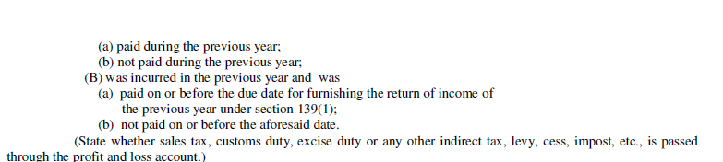
3CD Vs GST
GST payable u/s. 43B

Slide 18
3CD Vs GST
      Form 3CD: Clause 27(a) as per form
Amount of Central Value Added Tax credits availed of or utilised during the previous year and its treatment in the profit and loss account and treatment of outstanding Central Value Added Tax credits in the accounts.

Slide 19
3CD Vs GST
      Form 3CD: Clause 27(a) as per Utility
Amount of Central Value Added Tax Credits/ Input Tax credit (ITC) availed of or utilised during the previous year and its treatment in profit and loss account and treatment of outstanding Central Value Added Tax Credits/Input Tax credit (ITC) in accounts
      (Image attached in next slide)

Slide 20
3CD VS GST
CENVAT/ITC | Amount | Treatment in Profit & Loss/Accounts
Opening Balance
Credit Availed
Credit Utilized
Closing/ Outstanding balance

Slide 21
3CD Vs GST
      Form 3CD: Clause 35 (a)/(b)
In the case of a trading concern, give quantitative details of principal items of goods traded:
In the case of a manufacturing concern, give quantitative details of the principal items of raw materials, finished products and by-products
      (Image attached in next slide)

Slide 22
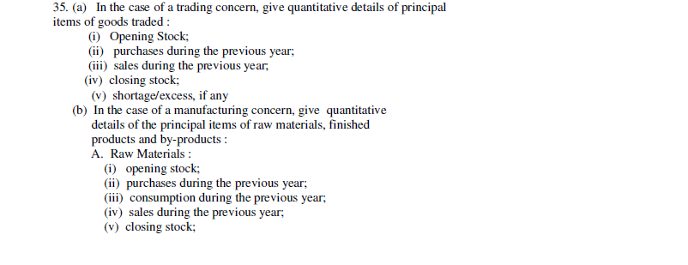
3CD Vs GST
Continued…..

Slide 23
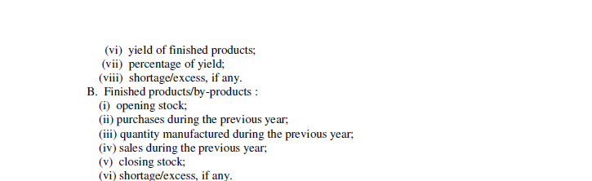
3CD Vs GST

Slide 24
3CD Vs GST
      Form 3CD: Clause 37 as per Utility
Whether any cost audit was carried out, if yes, give the details, if any, of disqualification or disagreement on any matter/item/value/ quantity as may be reported/identified by the cost auditor.

Slide 25
3CD Vs GST

Slide 26
3CD Vs GST
      Form 3CD: Clause 44 as per Utility
Break up of Total Expenditure of entities registered or not registered under the GST.
      (Image attached in next slide)

Slide 27
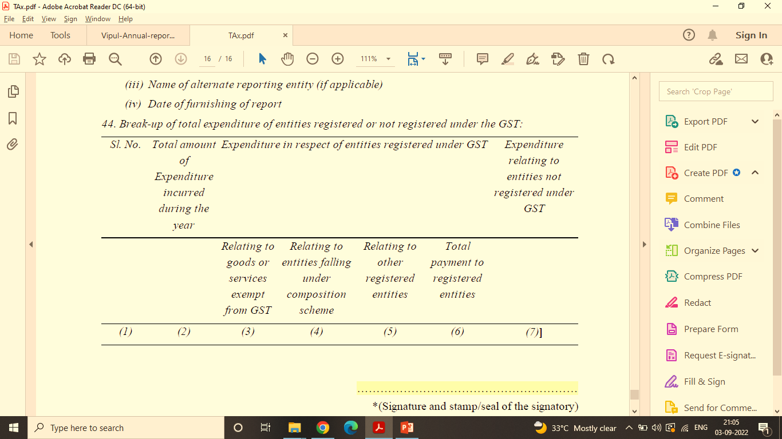
3CD Vs GST

Slide 28
3CD Vs GST
      Form 3CD:
      Other Relevant Clauses-
      Change in Partners [Clause 9(b)]
      Change in Nature of Business [Clause 10(b)]
      BOA Maintained and Examined [Clause 11]
      Method of Accounting and Change [Clause 13]

Slide 29

Any Question ?
29

Slide 30

Thank You
CA Vikash Kumar Banka
9830985000
vikash_banka@hotmail.com

