Slide 1
CONCEPT OF MEDIATION
Manisha T. Karia
Senior Advocate
Supreme Court of India

Slide 2
WHAT IS MEDIATION ?
It is the one of the method of Alternative Dispute Resolution process.
Where a neutral third person (Mediator) assist parties in conflict to resolve amicably.
It’s a collaborative approach to resolve conflict including legal dispute, family matters, commercial conflicts, etc.
It is a professionally and scientifically managed conciliation.
It is a non-binding, non-adjudicatory dispute resolution process.
It is a negotiation facilitated by a trusted neutral person.

Slide 3
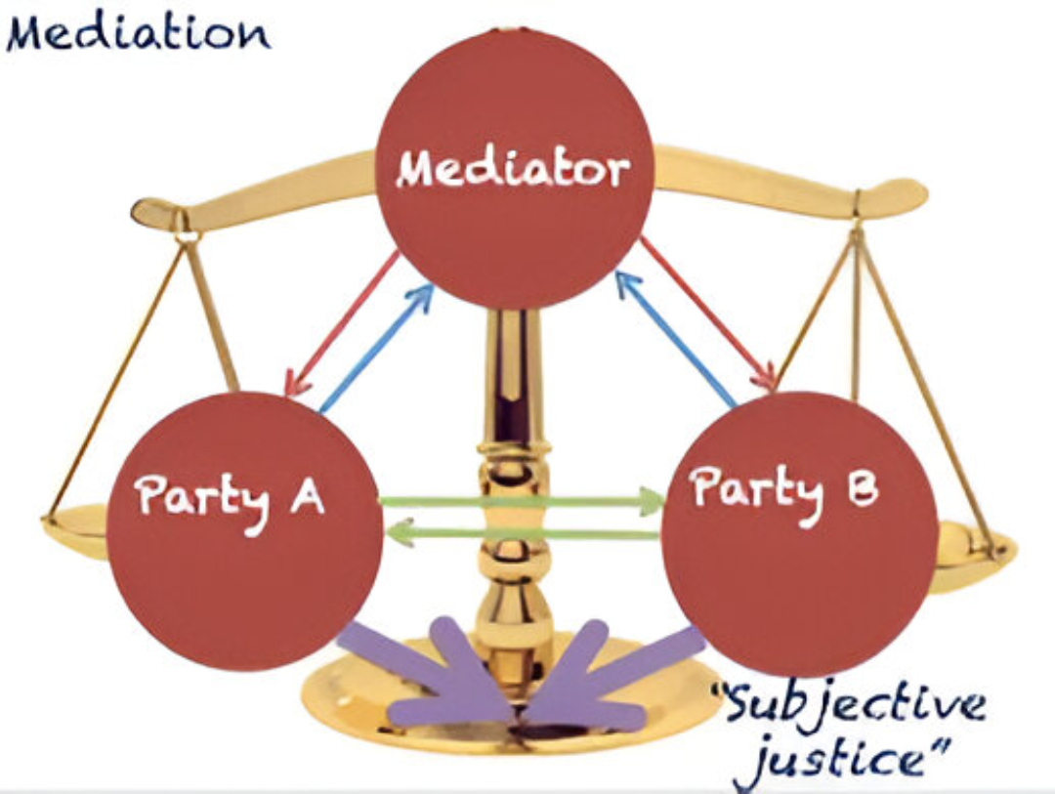

Slide 4
BASICS OF MEDIATION
Voluntary- Process
Party-Centered Negotiation
Informal- No rules of evidence or procedure.
Addresses legal as well as other underlying issues between parties.
Efficient, effective, speedy and less expensive.
Lead by neutral third party who facilitate and evaluate dispute, aiming mutually acceptable resolution.

Slide 5
KEY PRINCIPLES OF MEDIATION
Neutrality: the mediator is not biased towards one party or the other, nor is the mediator biased towards a particular outcome.
Impartiality: when the mediator acts more like a referee and ensures that all sides are treated fairly, yet are also held accountable and adhere to the agreed upon rules of the meditation.
Confidentiality: the mediation proceedings are confidential.

Slide 6
WHY MEDIATION ?
Litigation in courts and tribunals is often delayed, costly, rigid, and uncertain, leaving parties dissatisfied.
The judicial system is overloaded with increasing cases, outdated procedures, and limited resources, making justice slow and elusive.
Civil, commercial, and family disputes drag on for years, damaging businesses, relationships, and public trust.
In this context, there is a pressing need for faster, flexible, and cost‑effective mechanisms.
Mediation and other alternative dispute resolution processes provide a collaborative, efficient, and satisfactory way to resolve conflicts.

Slide 7

PREREQUISITES FOR MEDIATION
Mediation is not about who is right and who is wrong, rather it focuses on interests of parties and not their positions.
Set realistic and reasonable expectations and limits.
Take meditation seriously and devote the proper resources: choosing a mediator, who attends and their mandate.

Slide 8
HOW DOES THE MEDIATION
PROCESS WORKS?
The mediation process is different in every situation and type of case because the process is personalized to the parties involved.
A trained mediator always guides the mediation and is usually paid by the parties involved in the legal dispute.
Unlike a judge, their goal is not to make decisions for the parties, the goal of the mediator is to guide a discussion between the parties.
The mediator facilitates in the exchange of information and helps the parties through an effective bargaining process.

Slide 9
HOW DOES THE MEDIATION
PROCESS WORKS? (CONT.)
The mediator’s expertise is utilized by the parties to communicate more effectively, to frame and reframe issues so they can be more easily decided.
The mediator also aids in identifying creative solutions to complex problems and to help those involved in the case set realistic expectations and find common ground.
Mediators can assist in drafting a settlement agreement upon reaching of a compromise between parties.
However, mediators can’t make decisions and they can’t force you to compromise when you are involved in the mediation process.

Slide 10
TYPES OF MEDIATION
Court Annexed Mediation
Private Mediations
Institutional Mediation
Contractual Mediation

Slide 11
STAGES IN MEDIATION PROCESS
OPENING STATEMENT BY THE MEDIATOR
JOINT SESSIONS
PRIVATE CAUCUS/SESSIONS
FINDING A SOLUTION
SETTLEMENT

Slide 12
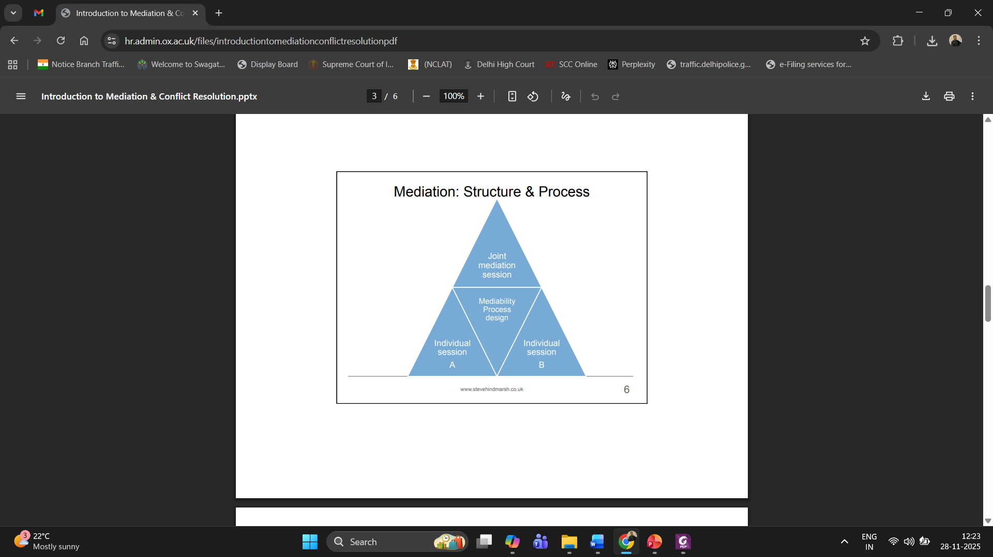

Slide 13

BENEFITS OF MEDIATION
Encourages settlement through cooperation rather than adversarial methods.
Promotes collaboration, preserving personal, professional, and commercial relationships.
Helps reduce the burden on courts.
Faster than litigation or arbitration.
More cost-effective compared to traditional dispute resolution.

Slide 14
BENEFITS OF MEDIATION (CONT.)
It is more convenient because the parties themselves control the time, location, and duration of the proceedings.
It is also highly flexible since there is no fixed formula or procedure, and the parties may terminate the process at any stage without the risk of an ex‑parte judgment or award being passed against them.
It also allows for creative solutions that courts or arbitral tribunals, bound by strict legal rules, may not be able to provide.
Mediation is confidential, ensuring privacy for all parties involved.

Slide 15
WHO IS A MEDIATOR?
A mediator is a impartial third party/ trained professional who acts as a neutral facilitator during the mediation process in the following situations:
  Commercial transactions
  Worker's compensation
  Divorce
  Domestic relations
  Labor or community relations
  Legal depositions or settlements
  Other matters that do not require complex procedural issues

Slide 16
KEY ROLES & FUNCTIONS OF MEDIATOR
Facilitates communication: Creates a conducive environment for discussion, encourages active listening, and helps parties communicate constructively. (Bridge the interest of opposing two parties)
Maintains neutrality: Remains unbiased and impartial throughout the process, ensuring neither party feels favored.
Manages the process: Explains the mediation process and ground rules, and sets the agenda for meetings.
Assists in identifying issues: Helps parties clarify their positions, interests, and the core issues in dispute.

Slide 17
KEY ROLES & FUNCTIONS OF MEDIATOR (CONT.)
Guides negotiation: Encourages parties to explore potential solutions, brainstorm options, and find common ground for compromise.
Empowers parties: Ensures the parties, not the mediator, are the decision-makers and have control over the outcome.
Provides perspective: Can offer an objective assessment of the case and inform parties of potential consequences if they were to go to court, though they do not provide legal advice.

Slide 18
WHO CAN BE A MEDIATOR ?
Anyone with patience, perseverance, and strong listening skills.
A person who is a clear communicator, positive, and optimistic.
Someone committed to justice and dispute resolution.
Professionals such as advocates, judges, Charted Accountants, social workers, psychologists.
Individuals with common sense and sound understanding of people and conflicts.
With the appropriate training, any of these can become an effective mediator.

Slide 19
ETHICS OF A MEDIATOR
The mediator shall assist the parties in an independent, neutral and impartial manner in their attempt to reach an amicable settlement of their dispute.
The mediator shall at all times be guided by the principles of objectivity and fairness and protect the voluntariness, confidentiality and self-determination of the parties, and the standards for professional and ethical conduct.
Confidentiality and the limits of same should be disclosed again during the beginning of a caucus.

Slide 20
ETHICS OF A MEDIATOR (CONT.)
Prior relationships and associations with any of the disputing parties with the mediator should be disclosed either prior to the implementation of the session or during the introduction; the parties can decide whether or not to continue with the process.
Mediators must not manipulate the confidential information gained solely to reach an agreement or settlement.

Slide 21
DUTIES OF A MEDIATOR
Mediator should always have a clear idea of why he or she is calling for a caucus and explain their rationale to the parties prior to going into caucus.
Mediator should remain as a “guardians of the process” within the caucus. Therefore, a mediator should attempt to influence the direction of the caucus only to a limited extent.
Mediators are responsible to ensure the safety of all the parties in caucus.
Mediators must remain aware of any nonverbal messages conveyed by both the disputing parties and the mediator within the caucus.

Slide 22
Mediation Skills
Negotiation:
Balancing stakeholder interests.
Communication:
Effectively handling multi-party communication.
Analytical Skills:
Assessing financial implications.
Problem Solving:
Devising mutually beneficial solutions.
Listening: Understanding The Core Issue.
Building Credibility: Displaying or Detailing Their Credentials

Slide 23
ROLE OF CHARTERED ACCOUNTANTS IN MEDIATION
Financial Expertise: Ability to analyze financial data.
Corporate Restructuring: Experience in negotiation during restructuring or insolvency.
Taxation & Compliance: Resolving tax disputes, compliance-related conflicts.
Financial Settlements: Understanding complex financial settlements in business and family disputes.

Slide 24
Opportunities for CAs in Mediation
Corporate disputes: Shareholder conflicts, mergers, acquisition issues.
Insolvency Resolution: Acting as mediators in IBC matters.
Family business disputes: Structuring settlements.
Tax disputes: Mediation between tax authorities and clients.
Real estate & property disputes: Facilitating settlements over financial disagreements.
Financial fraud: Resolving disputes in fraud investigations.

Slide 25
TRAINING & CERTIFICATION
Why Training is Important for CAs in Mediation?
  Mediation-specific skills: While CAs are well-versed in finance, mediation requires specific skills such as neutrality, emotional intelligence, conflict resolution, and communication.
  Legal framework understanding: CAs need to be familiar with legal aspects of mediation, including relevant laws, institutional frameworks, and the role of mediators in legal disputes.
  Accreditation: A professional credential helps to establish credibility and expertise in the mediation field.
Becoming a Mediator:
  ADR centers, law institutions offering mediation training.
  Certification from recognized bodies like ICAI or Ministry of Law and Justice.

Slide 26
RECOGNITION AND BENEFITS OF CERTIFICATION
Cross-Border Opportunities: For CAs involved in multinational corporations or global financial transactions, international mediation certification opens doors to participate in international commercial disputes.
Increased Credibility: Certification as a mediator adds to a CA’s professional qualifications, offering opportunities to take on high-stakes mediations in corporate and financial matters.
Broader Scope of Work: With formal accreditation, CAs can extend their practice into dispute resolution for corporate insolvency, commercial negotiations, and international arbitrations.
Institutional Engagement: Certified CAs can apply for empanelment with mediation centers attached to courts, international arbitration bodies, and even corporate clients seeking out-of-court resolutions.

Slide 27
LET'S DISCUSS !!

