Slide 1


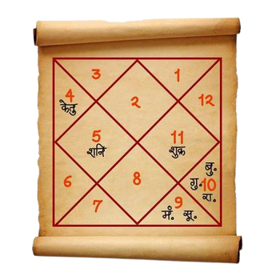

Vijay Jain
Mobile: 9831105888
Knowledge Session by Vijay Jain
Astrologer | Astro Vastu Consultant
Numerologist | Graphologist

Slide 2

KNOWLEDGE SESSION
BASIC VASTU CONSIDERATIONS
Vijay Jain
Mobile: 9831105888

Slide 3
Definition of Vastu
Vastu is the science of balancing the five natural elements (Water, Air, Fire, Earth & Space) to create harmony in life, health, and prosperity.
Vijay Jain
Mobile: 9831105888

Slide 4
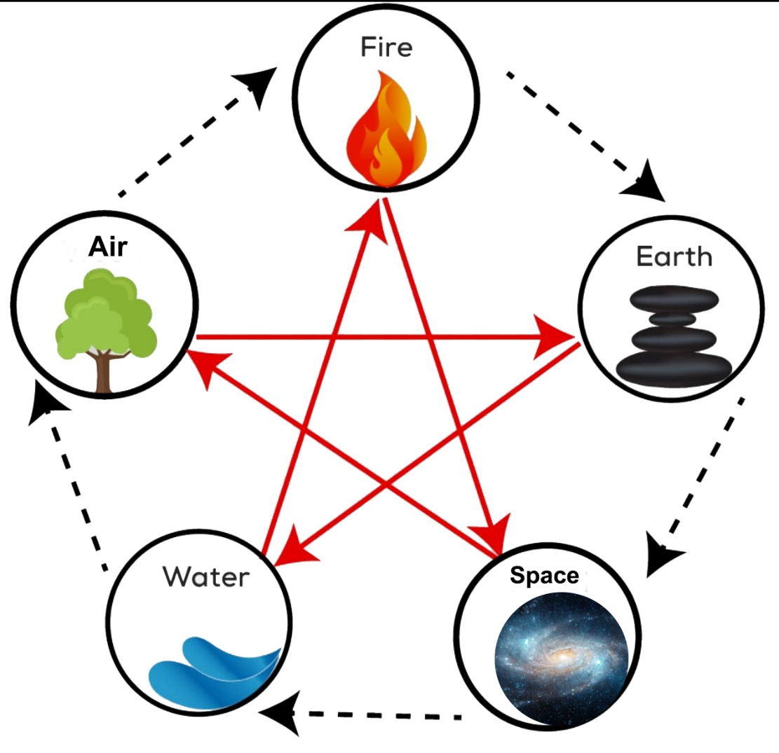
ELEMENTAL DISBALANCING
The human body is also made of the five elements:
Water – Blood & fluids
Air – Breathing & circulation
Fire – Digestion & metabolism
Earth – Bones & muscles
Space – Mind & consciousness
Vijay Jain
Mobile: 9831105888

Slide 5
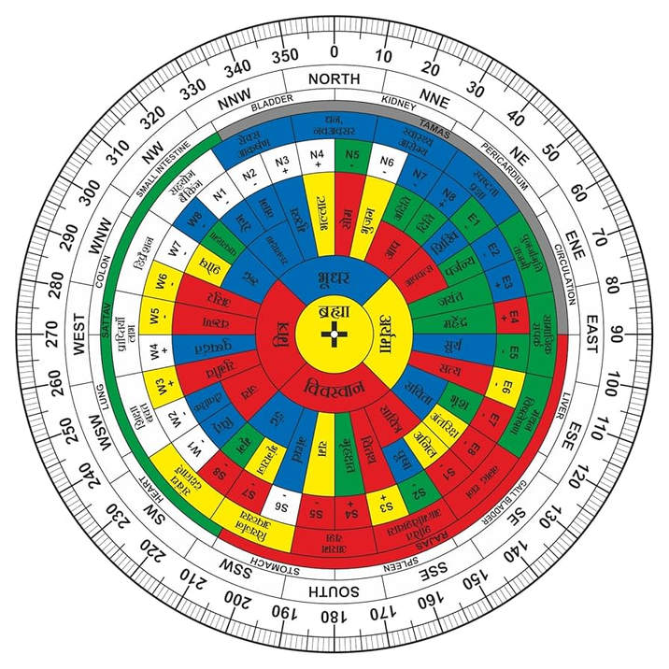
16 Zones in Vastu
Every space is divided into 16 specific zones, and each zone:
Is governed by a particular element
Controls specific aspects of life such as health, wealth, relationships, career, and peace
Vijay Jain
Mobile: 9831105888

Slide 6
SHAKTI CHAKRA
Vijay Jain
Mobile: 9831105888

Slide 7
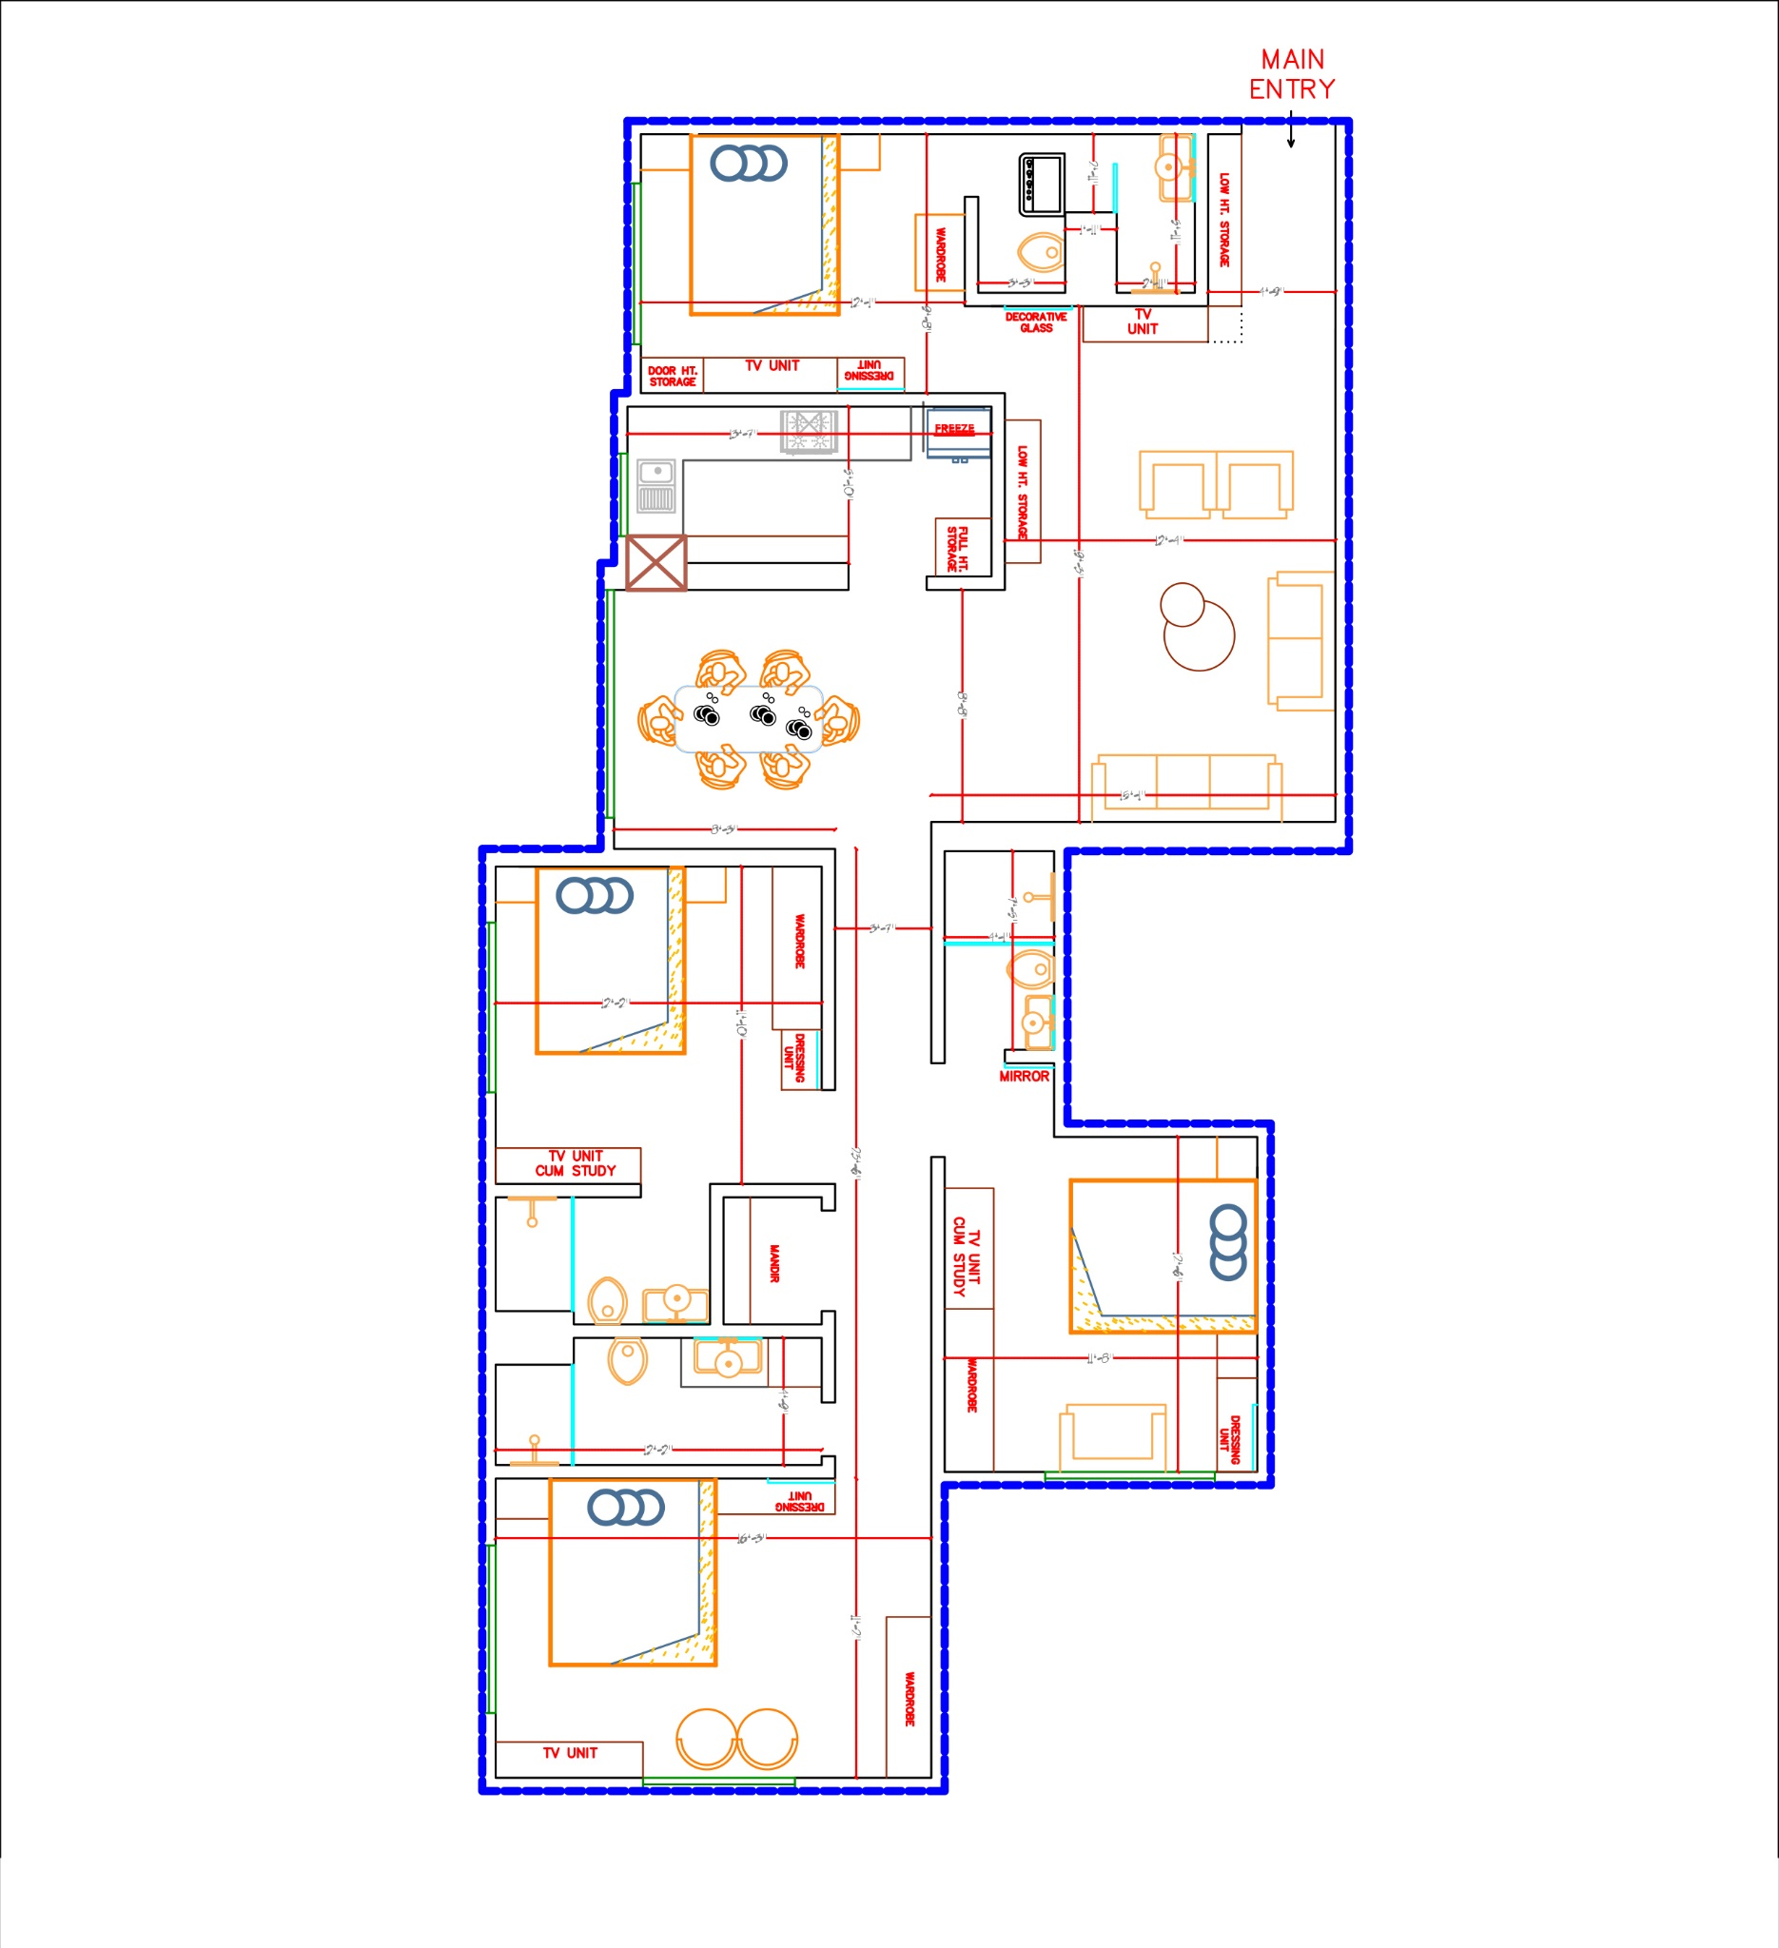
Vijay Jain
Mobile: 9831105888

Slide 8
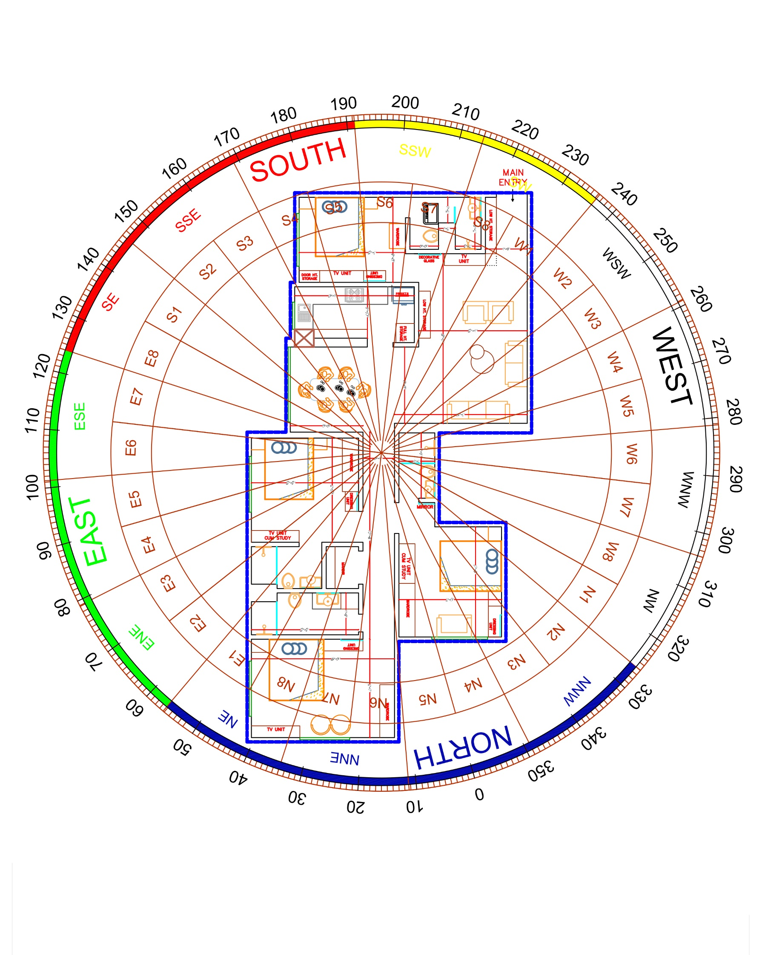
Vijay Jain
Mobile: 9831105888

Slide 9
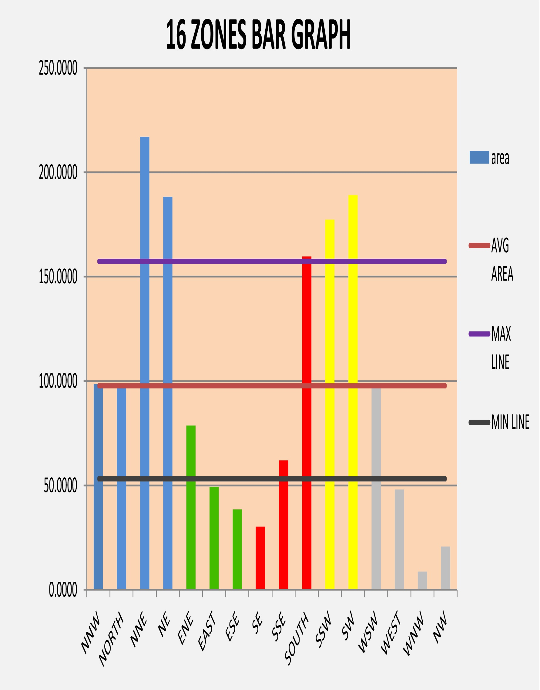
Vijay Jain
Mobile: 9831105888

Slide 10
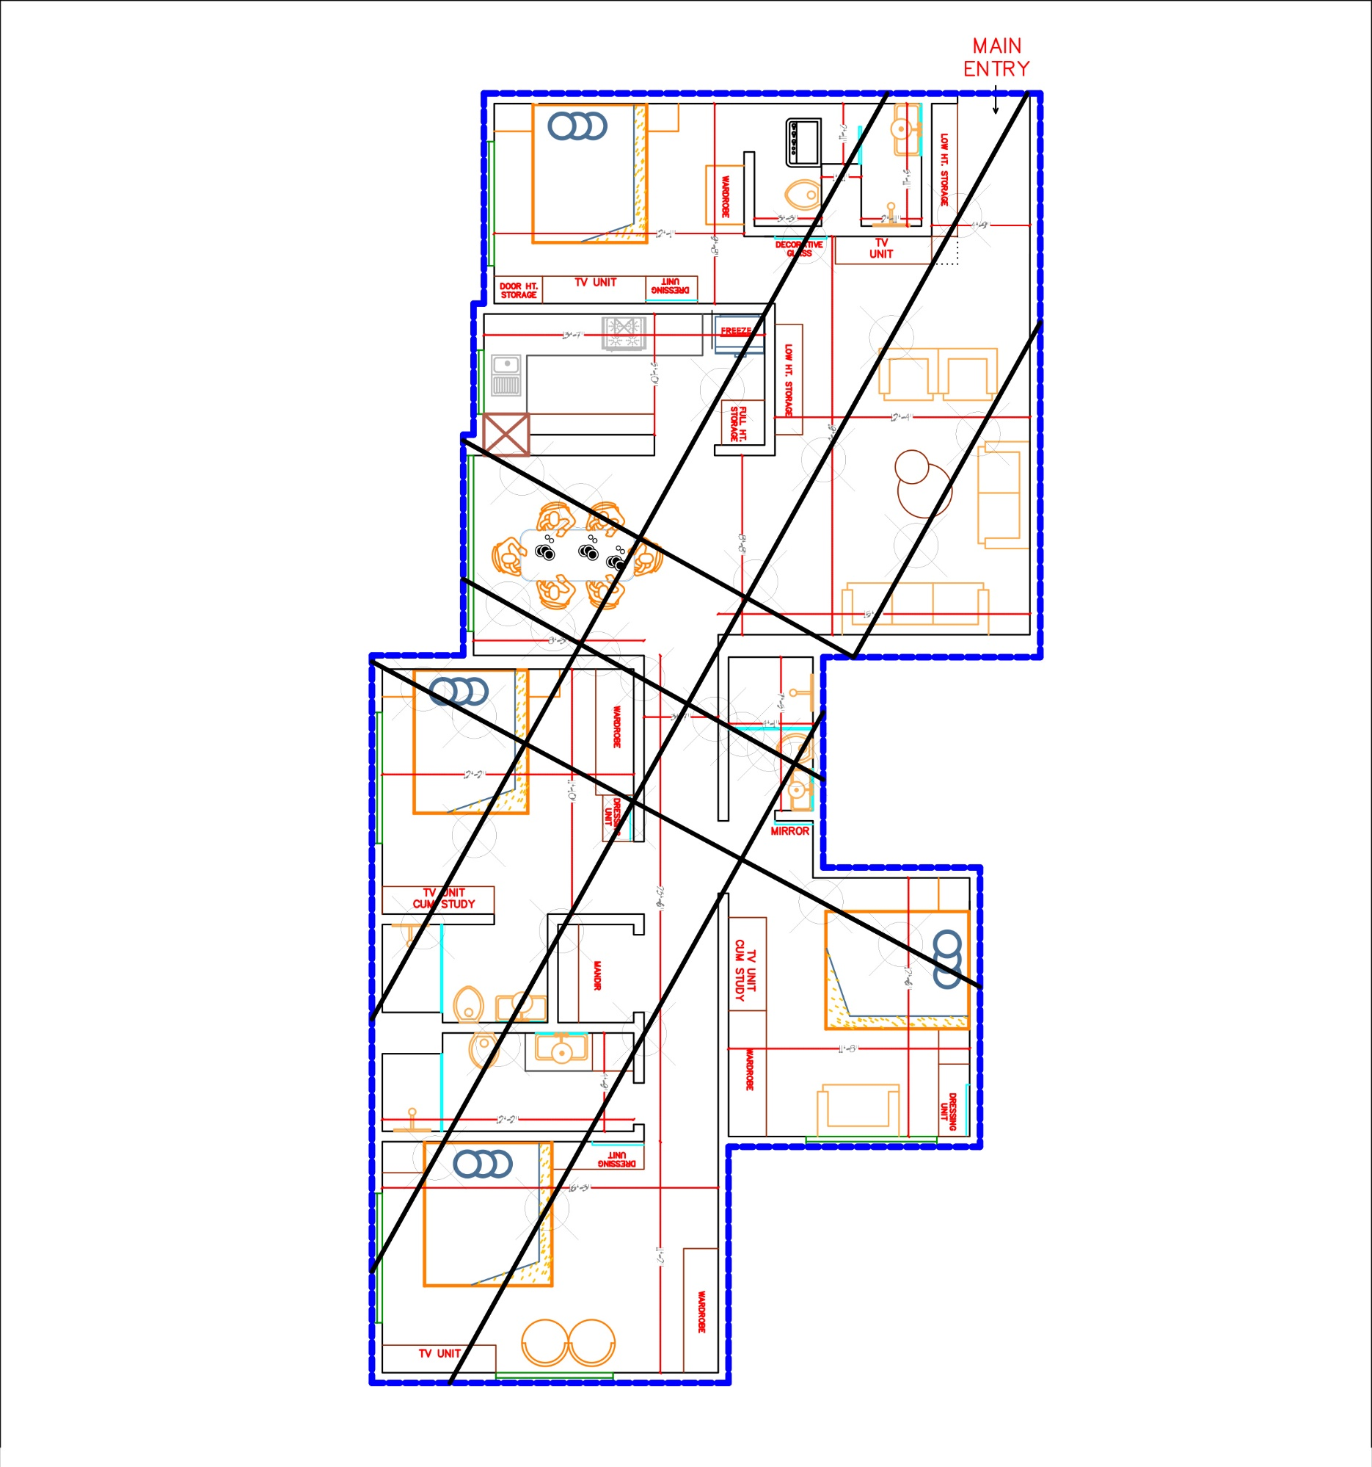
Vijay Jain
Mobile: 9831105888

Slide 11
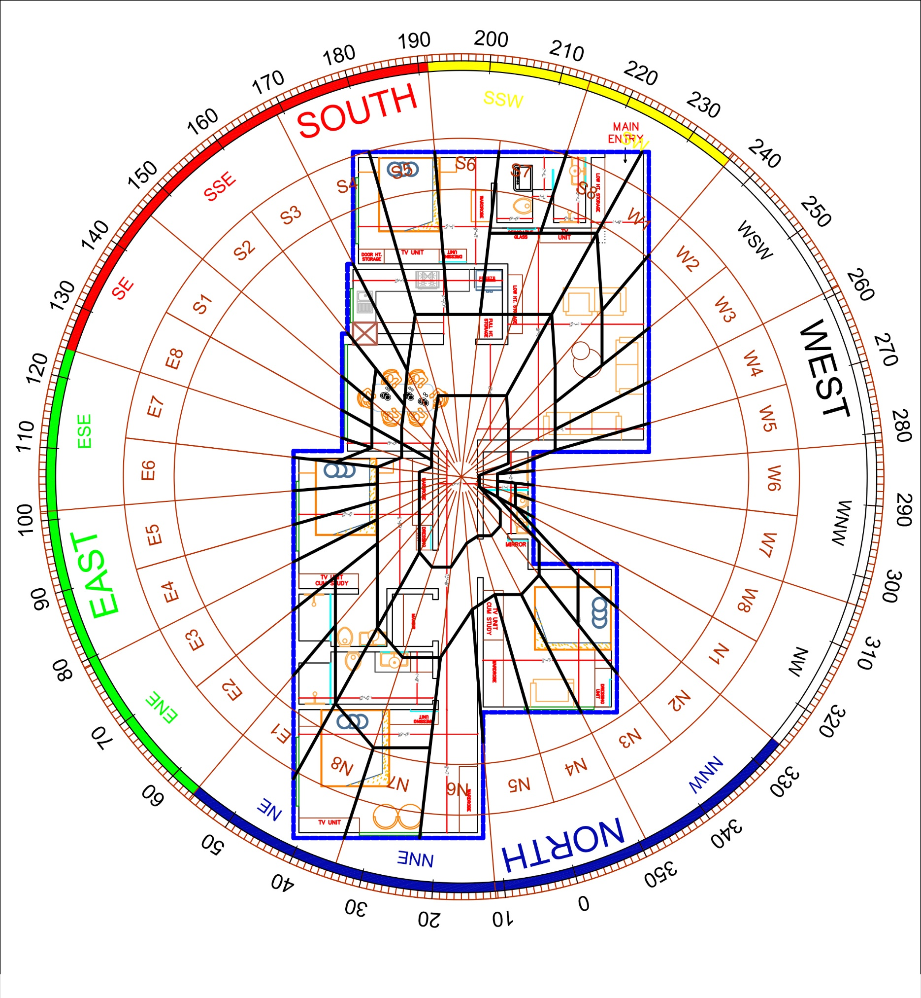
Vijay Jain
Mobile: 9831105888

Slide 12
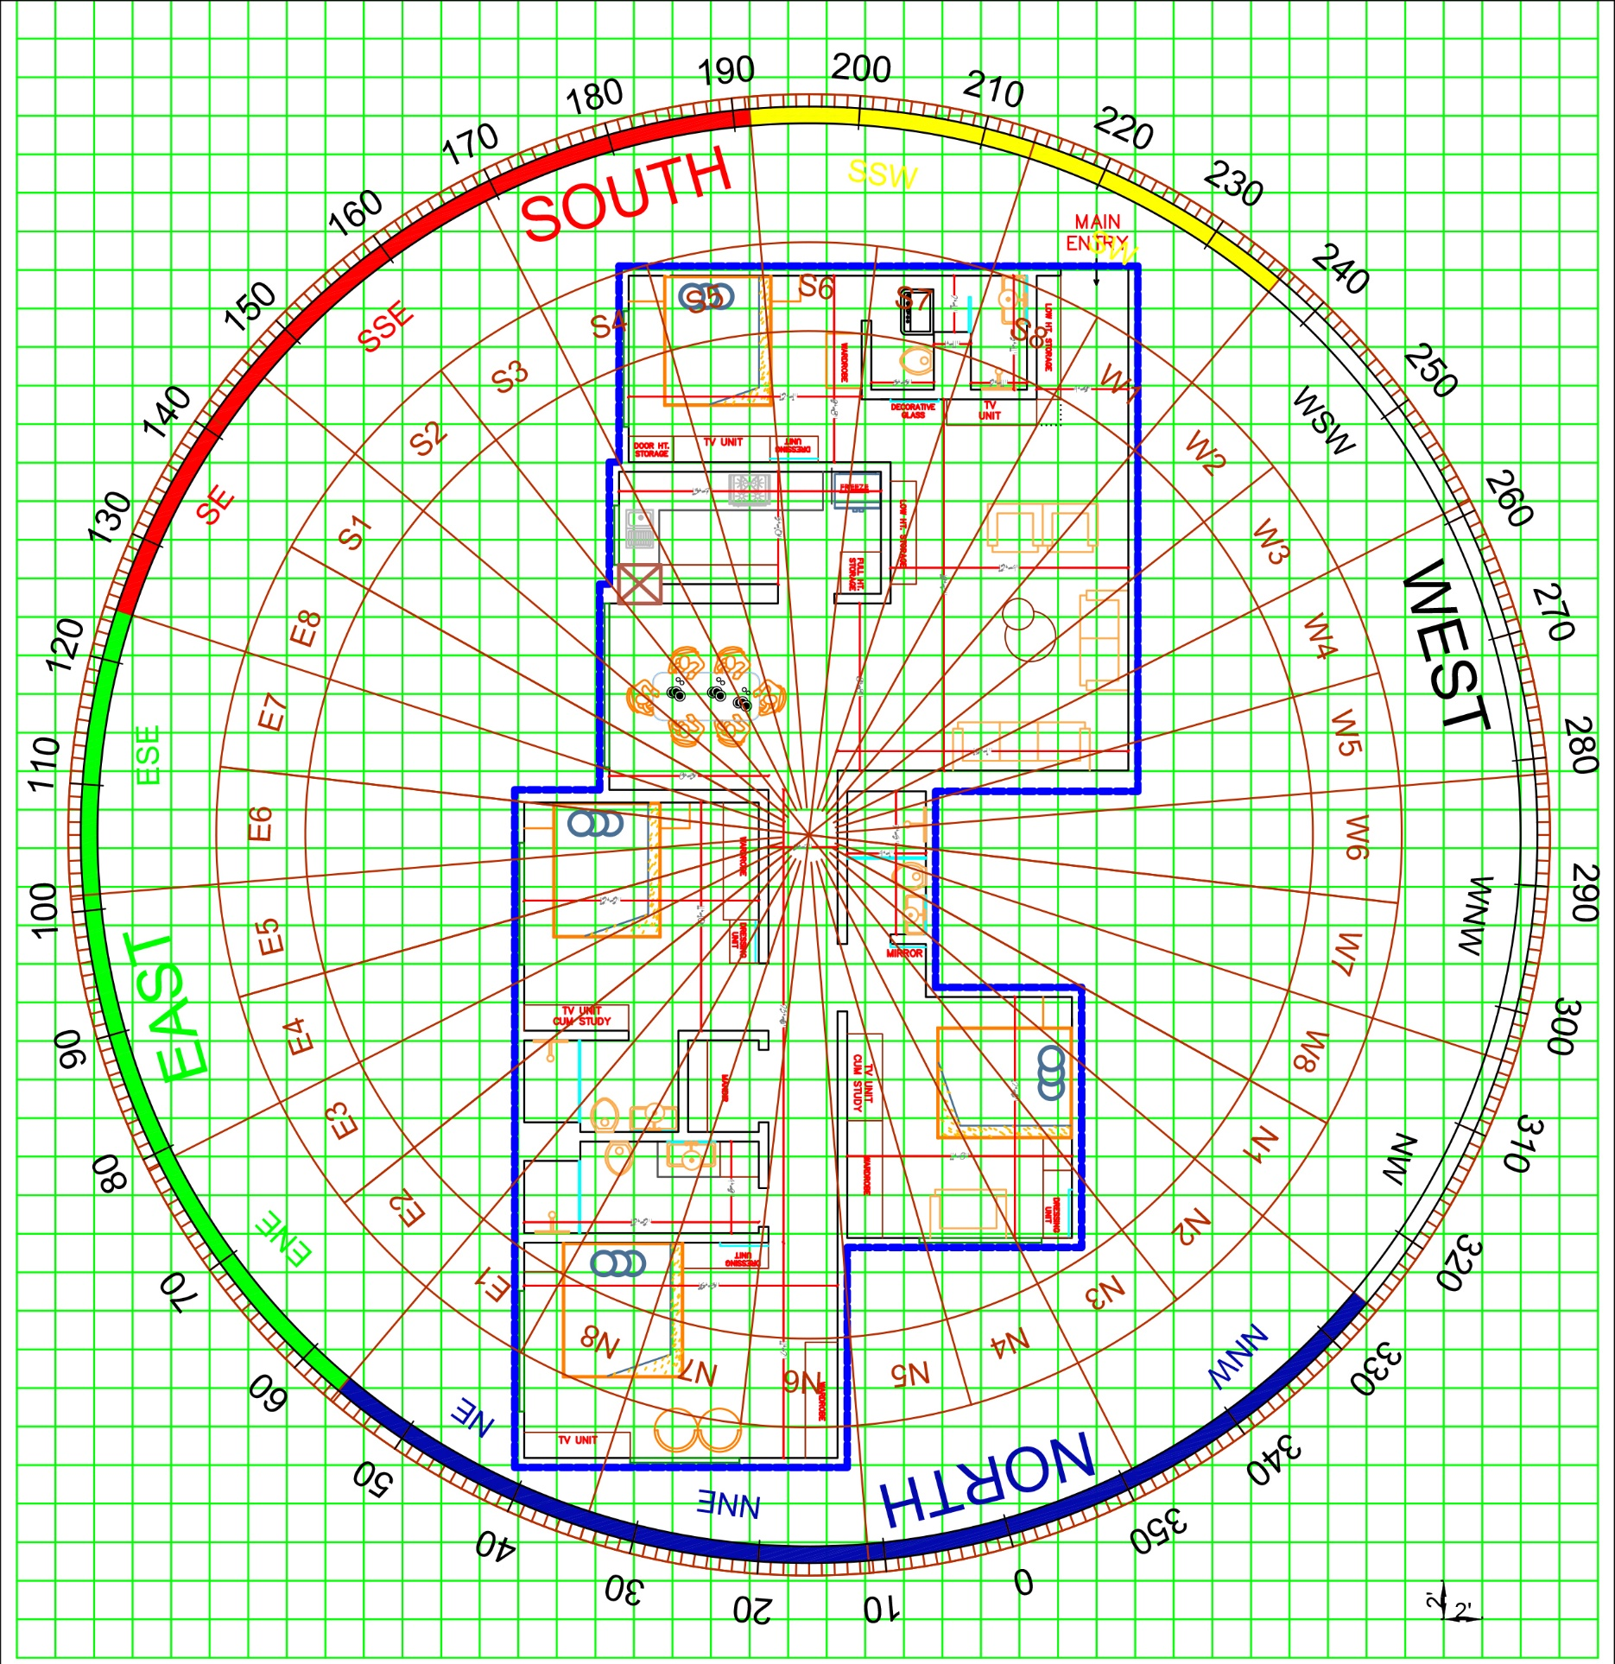
Vijay Jain
Mobile: 9831105888

Slide 13
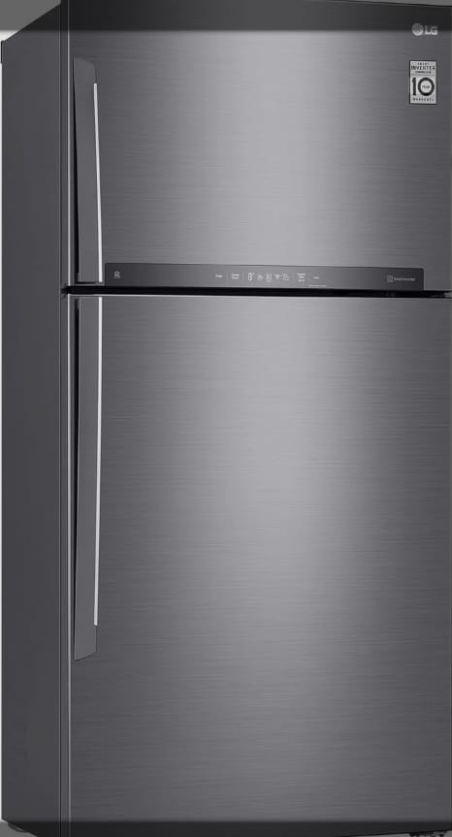
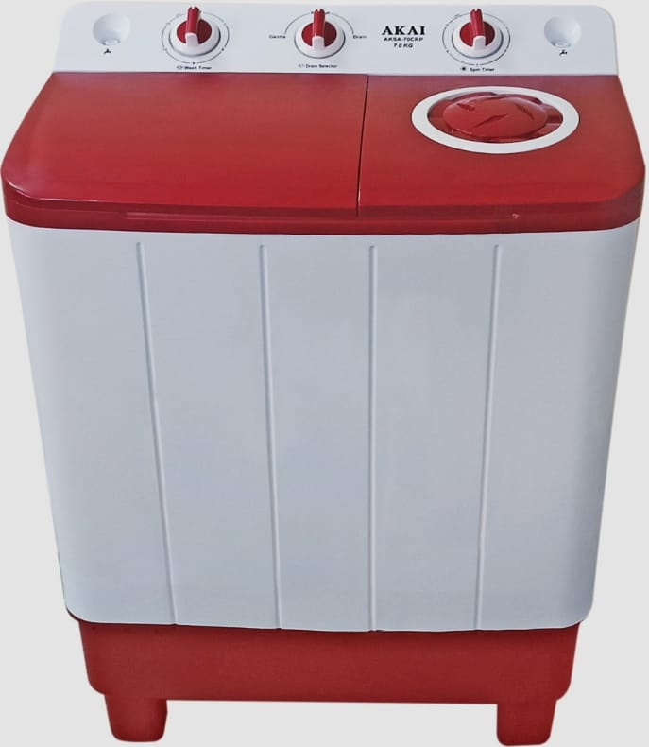

AUDIT OF OBJECTS
EFFECT OF OBJECTS IN The WRONG ZONE
Vijay Jain
Mobile: 9831105888

Slide 14


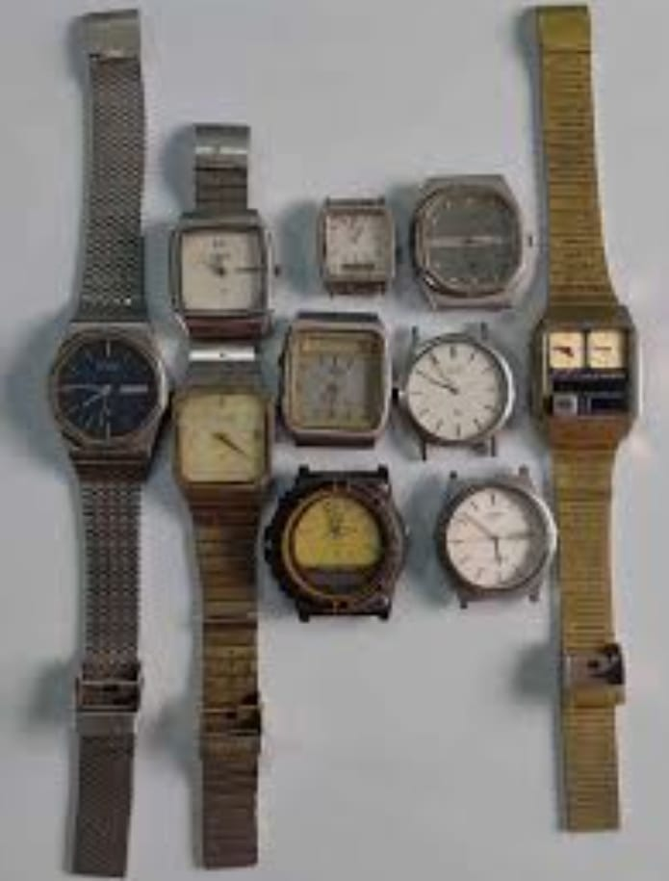
TV Non Working
Stopped Clock
Pen Non Working
Vijay Jain
Mobile: 9831105888

Slide 15
Why Vastu Doesn’t Work in Most Cases
Can you tell me
Why?
Vijay Jain
Mobile: 9831105888

Slide 16
Wrong Direction Degrees
Vijay Jain
Mobile: 9831105888

Slide 17
How much does Vastu Actaully work
Vastu alone works only 20%.
When combined with the Horoscope 80-85%
Balance 15-20% remains in the
Hands of God
Vijay Jain
Mobile: 9831105888

Slide 18

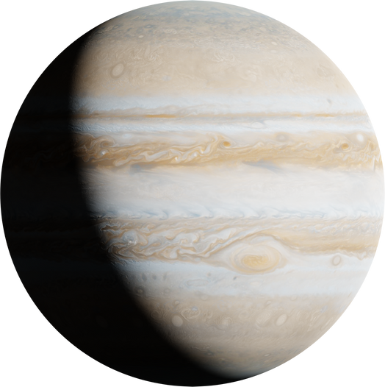
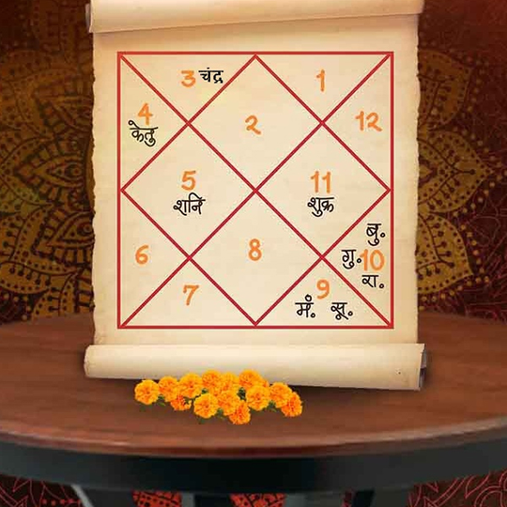
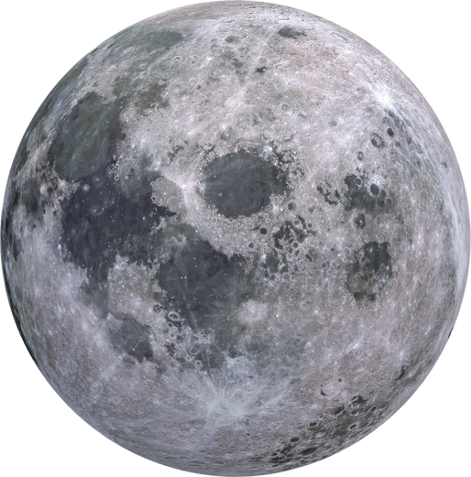
Astrological Factors Not Considered
Vastu Without Horoscope
Incomplete Vastu
Vijay Jain
Mobile: 9831105888

Slide 19


Sometimes even Astro Vastu does not work
Can you tell me
Why?
BTR
Vijay Jain
Mobile: 9831105888

Slide 20
Thank you!
Vijay Jain
Mobile: 9831105888

