Slide 1
Life as an Auditor
Bank Branch Audit
2016

Slide 2

THE CARROT, THE EGG
AND THE
COFFEE BEAN

Slide 3


Put three pots of water over the fire.

Slide 4
In the first pot, put some carrots.

Slide 5
In the second pot, put some eggs.

Slide 6
In the third pot, put some coffee beans (powder).

Slide 7
Boil all three pots for 15 minutes. Take out what you put in.

Slide 8
The carrots went in hard.
They are now soft.
The eggs went in soft inside.
Now they are hard inside.

Slide 9

The coffee powder has disappeared.
But the water has the colour and the wonderful smell of coffee.

Slide 10
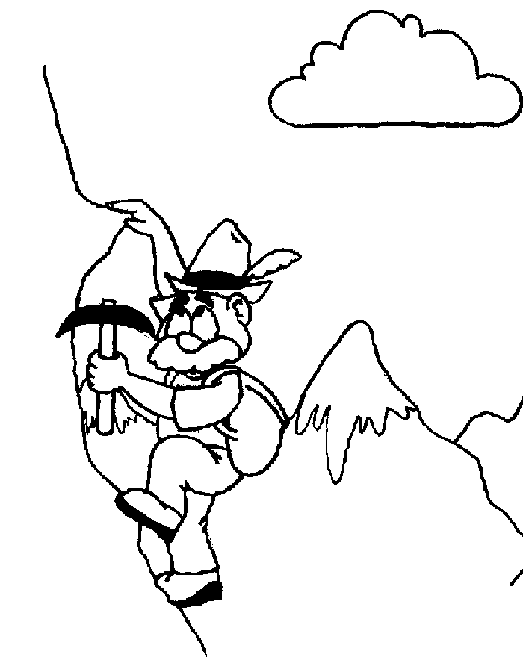
Now think about life.
Life is not always easy.
Life is not always comfortable.
Sometimes life is very hard.

Slide 11
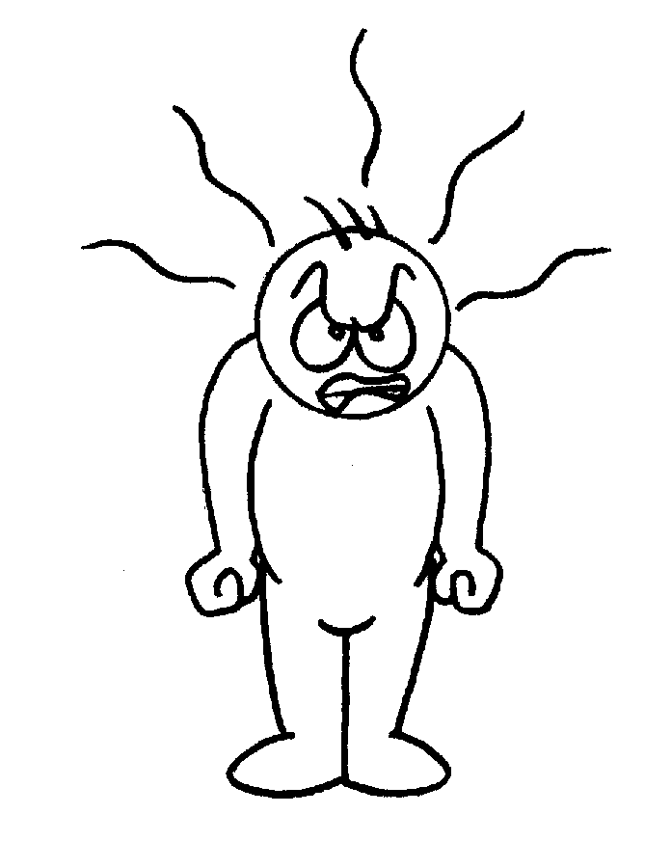
Things don’t happen like we wish.
People don’t treat us like we hope.
We work very hard but get few results.
What happens when we face difficulties?

Slide 12
Now think about the pots.
The boiling water is like the problems of life.

Slide 13
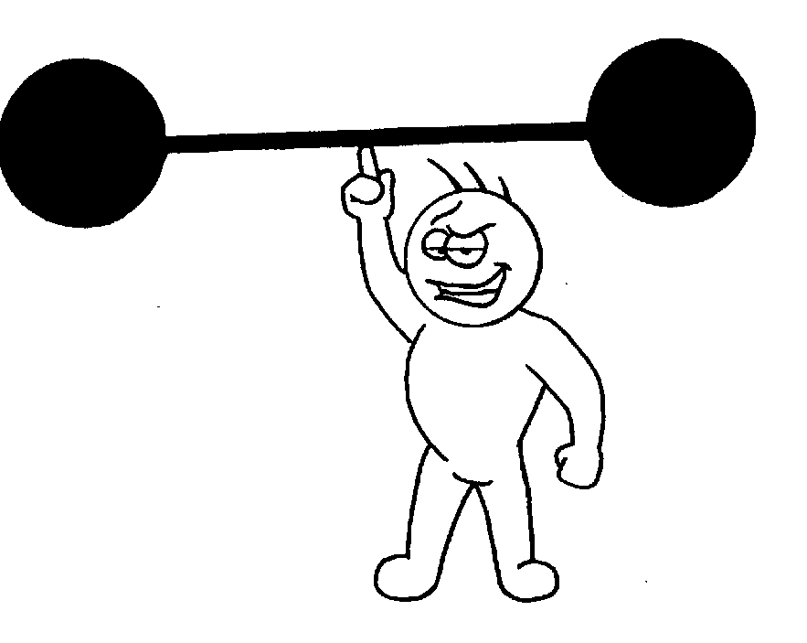
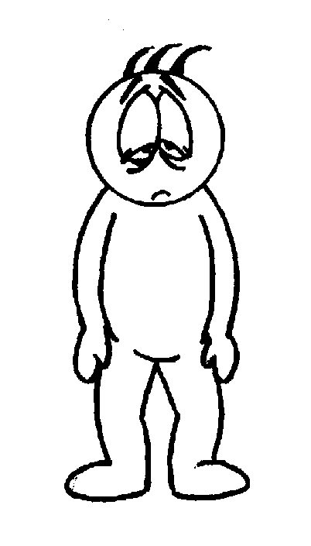
We can be like the carrots.
We go in
tough and strong.
We come out soft & weak.

Slide 14
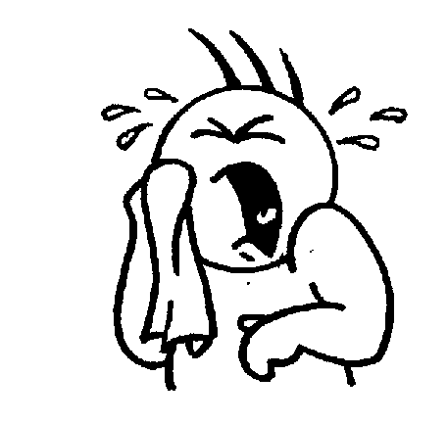
We get very tired.
We lose hope.
We give up.
There is no more fighting spirit.
Don’t be like the carrots!

Slide 15
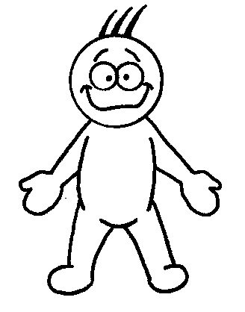
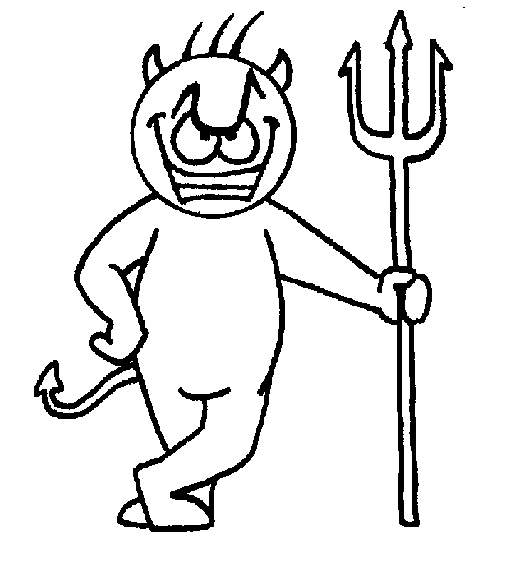
We can be like the eggs.
We start with a soft & sensitive heart.
We end up very hard and unfeeling inside.

Slide 16
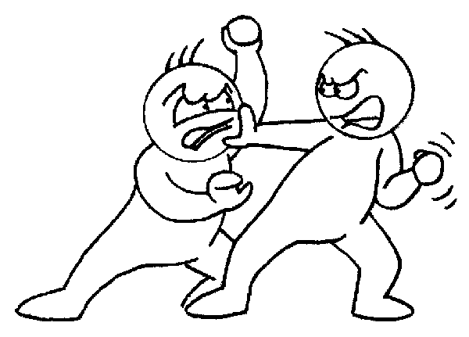
We hate others.
We don’t like ourselves.
We become hard-hearted.
There is no warm feeling, only bitterness.
Don’t be like the eggs!

Slide 17
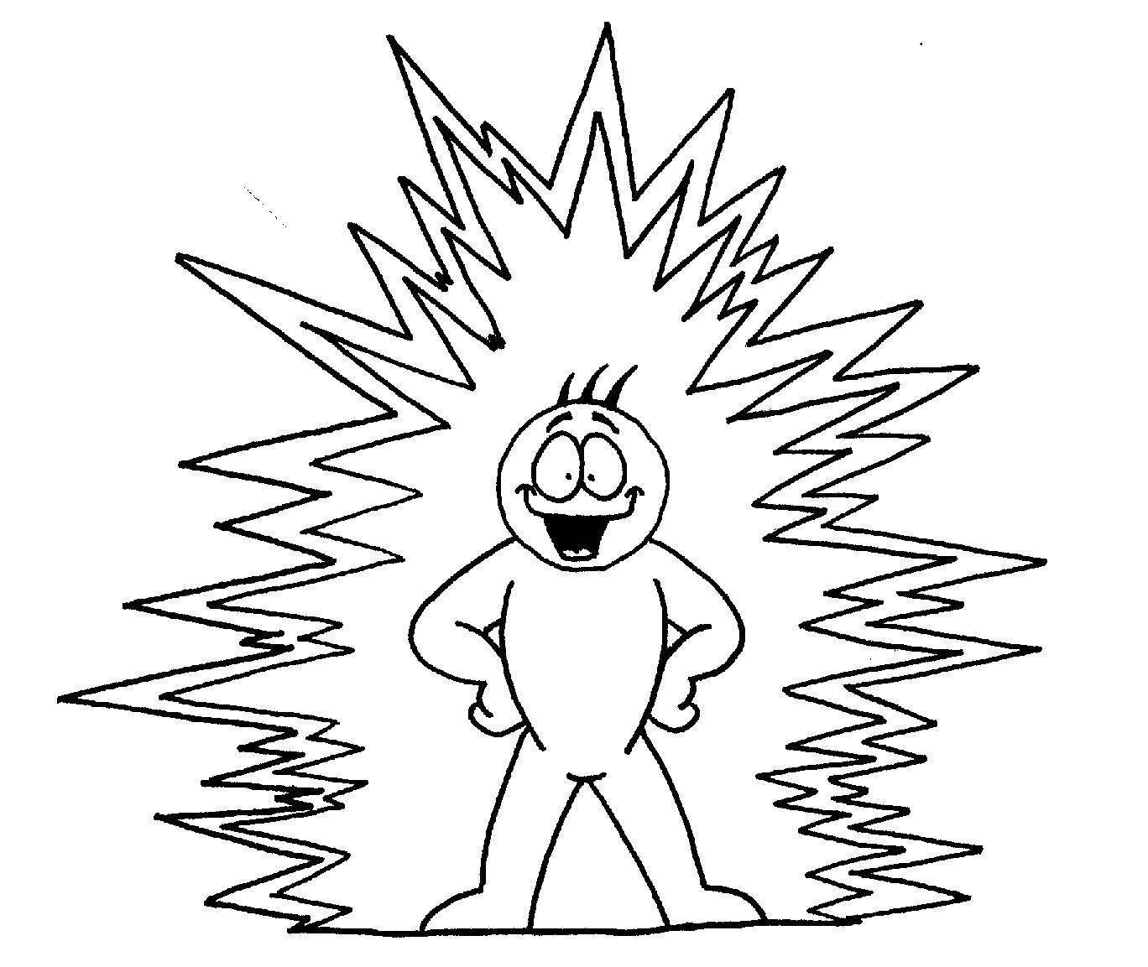
We can be like the coffee beans.
The water does not change the coffee powder.
The coffee powder changes the water!

Slide 18

The water has become different because of the coffee powder.
See it.
Smell it.
Drink it.
The hotter the water, the better the taste.

Slide 19
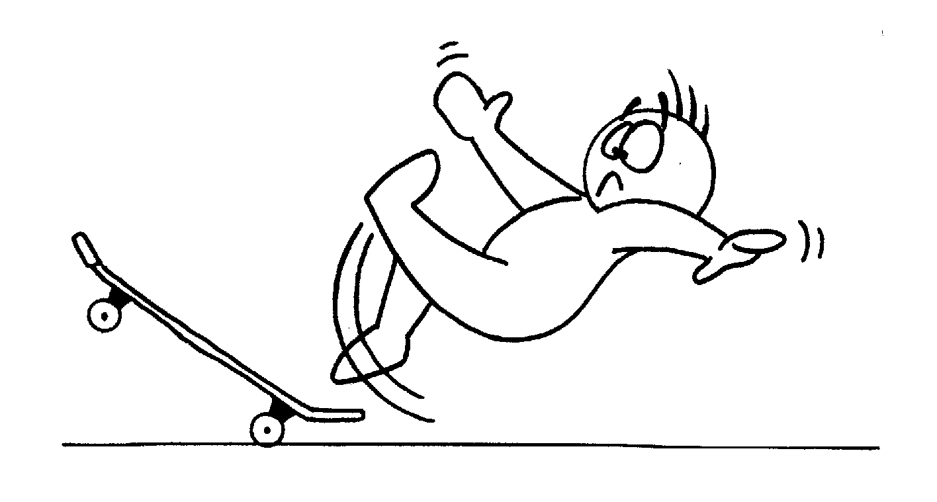
We can be like the coffee beans.
We make something good from the difficulties we face.
We learn new things.

Slide 20
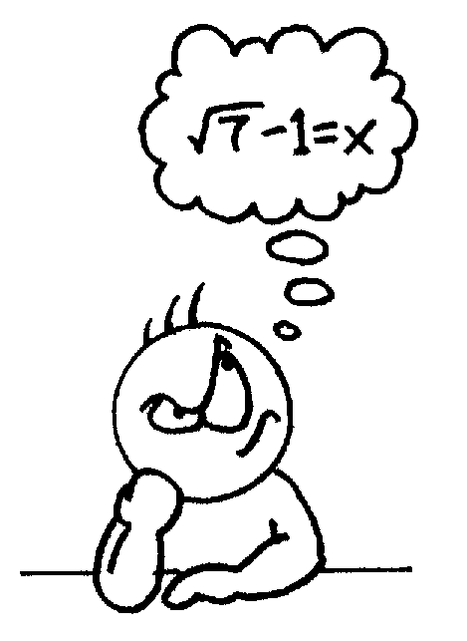

We have new knowledge, new skills, new abilities.
We grow in experience.

Slide 21
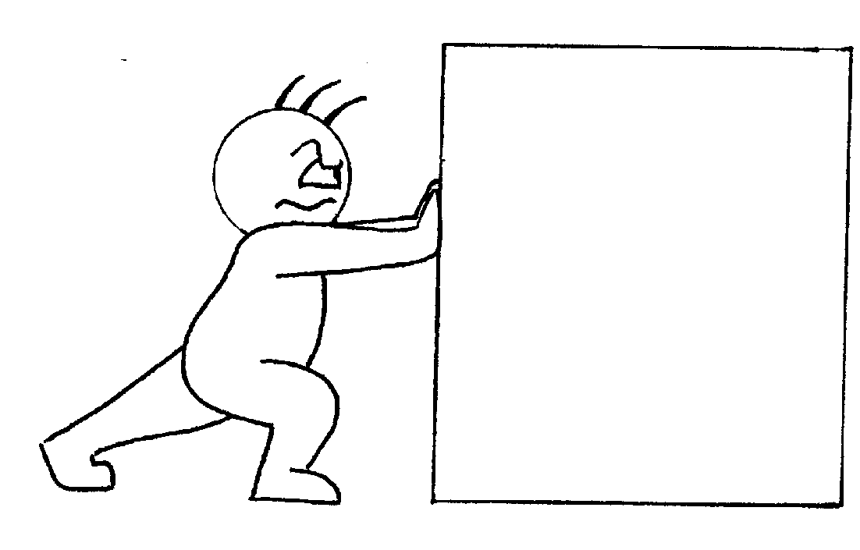
To succeed, we must try… and try again.
We must believe in what we are doing.
We must not give up.
We must be patient.
We must keep pushing.
difficulties
problems
handle with care

Slide 22
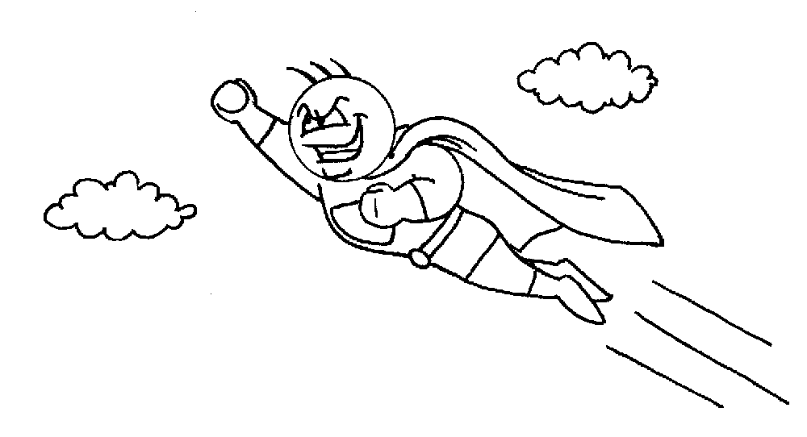
Problems and difficulties give us the chance to become stronger… and better… and tougher.

Slide 23


Be like the coffee bean!

