Slide 1



Training on Audit Module
NACIN, Patna
By________
1
The Institute of Chartered Accountants of India
The Institute of Chartered Accountants of India
GST & Indirect Taxes Committee
EIRC
Seminar on Ecommerce Transaction
Dated 01-08-2026
Topic:
Decoding Accounting Reconciliation: Strengthening Financial Accuracy and Control

Slide 2


Slide 3
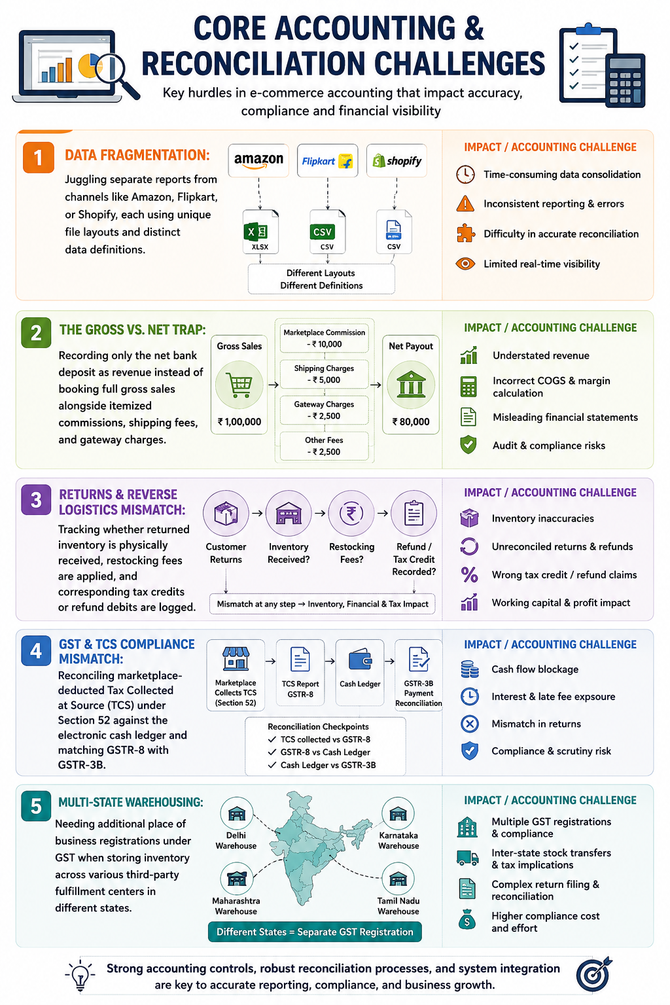

Slide 4
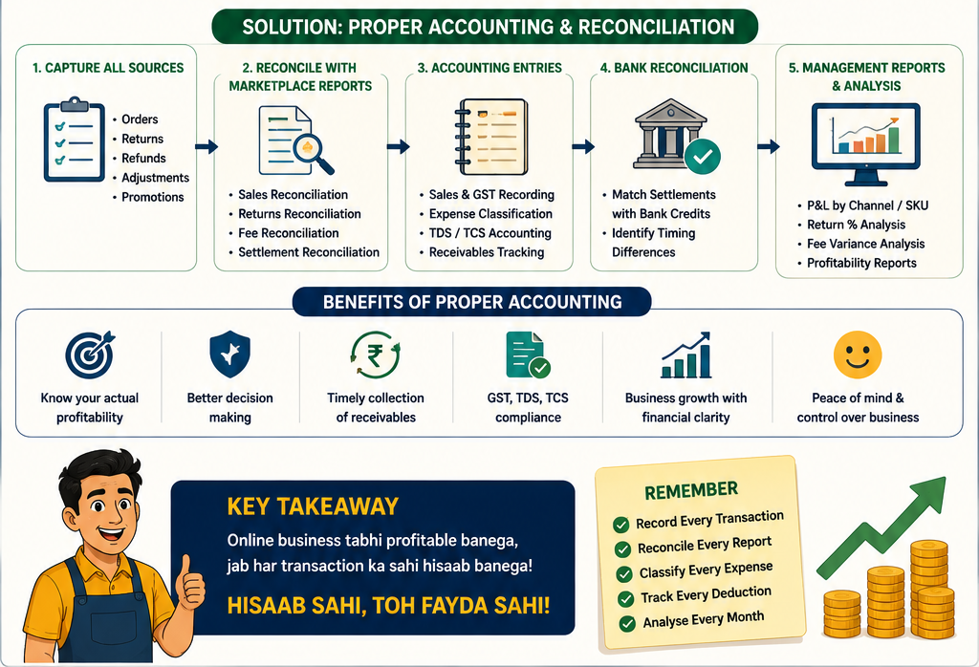

Slide 5
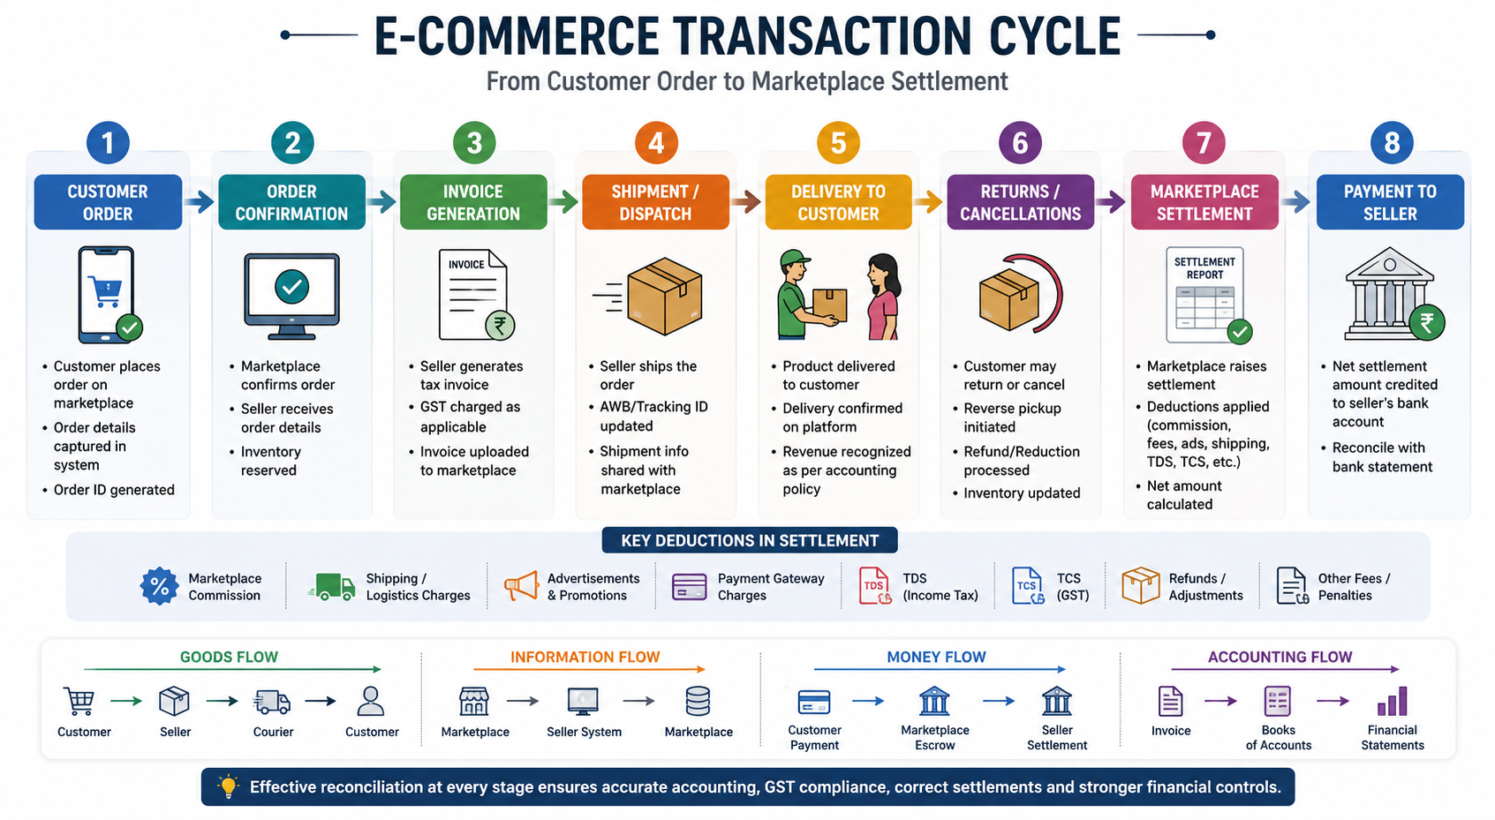

Slide 6
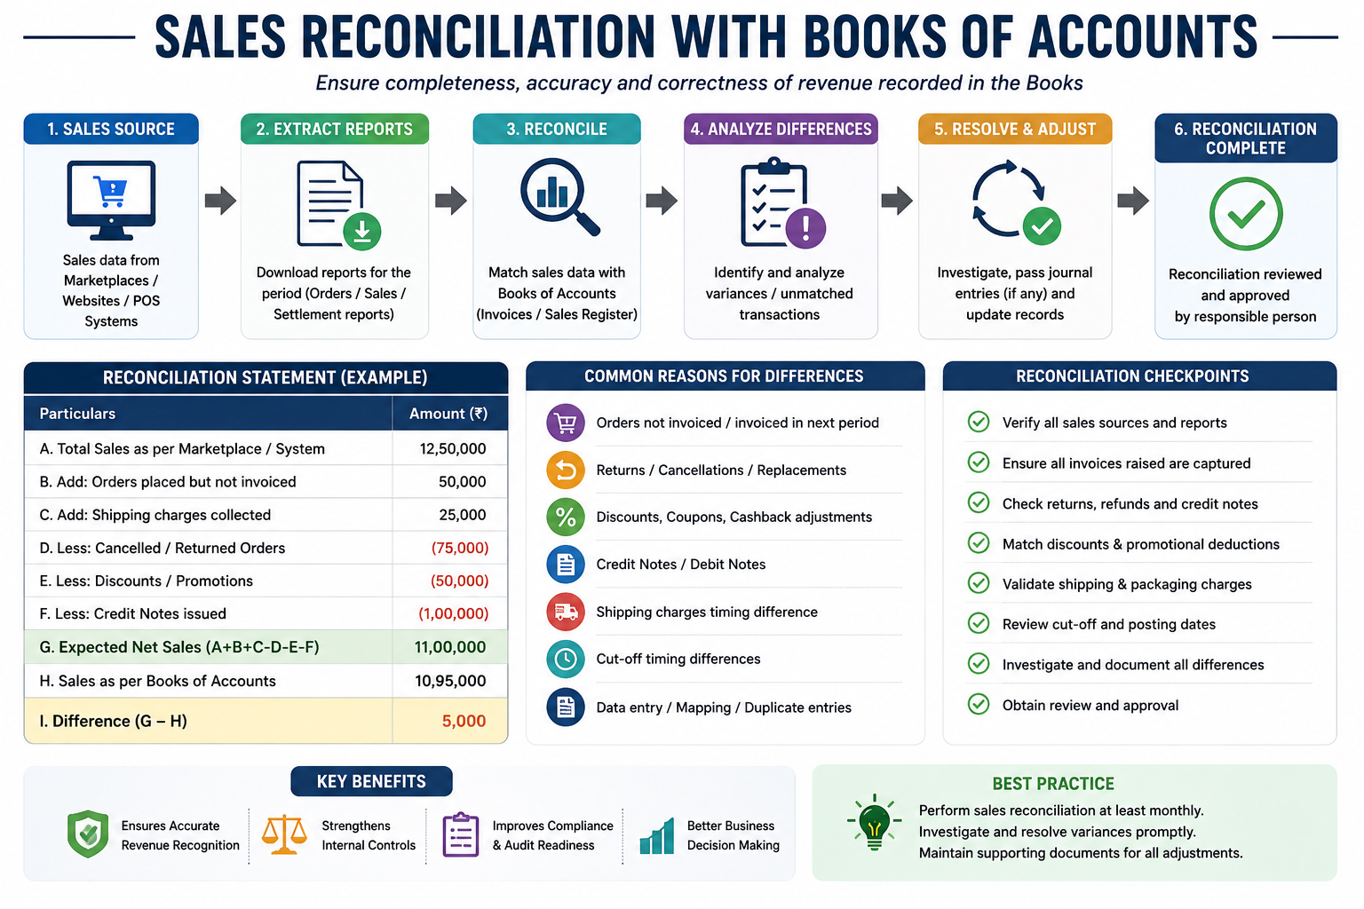

Slide 7
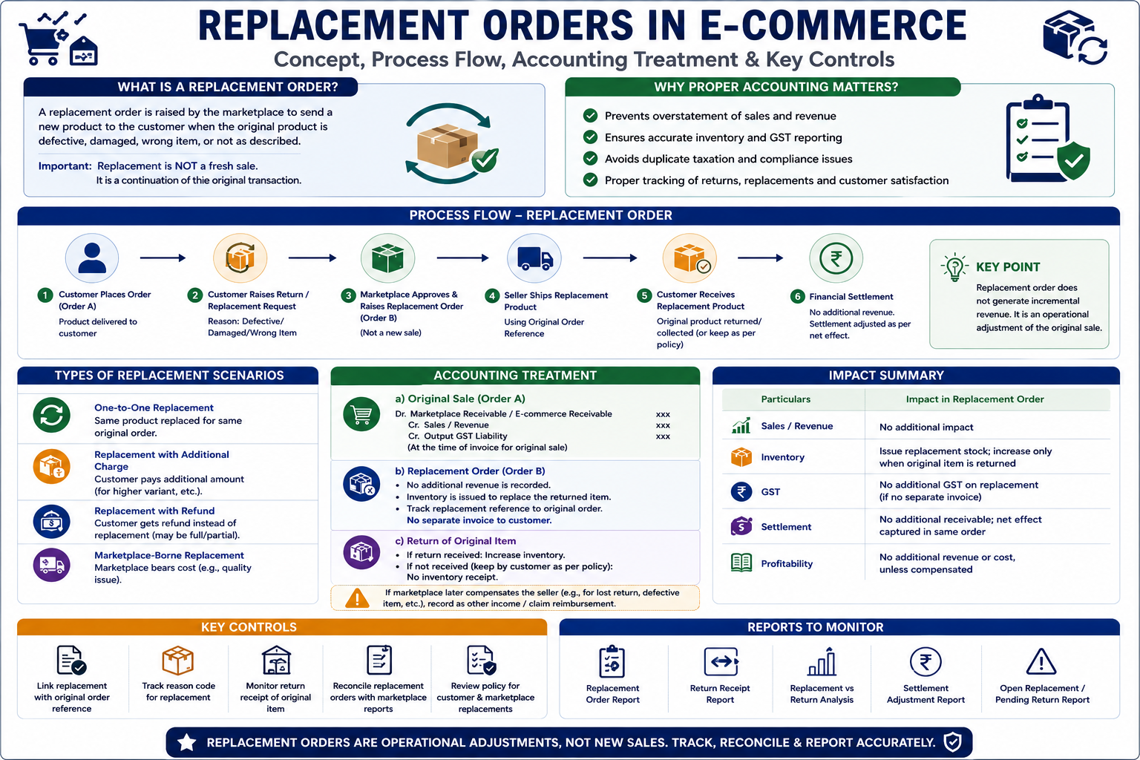

Slide 8
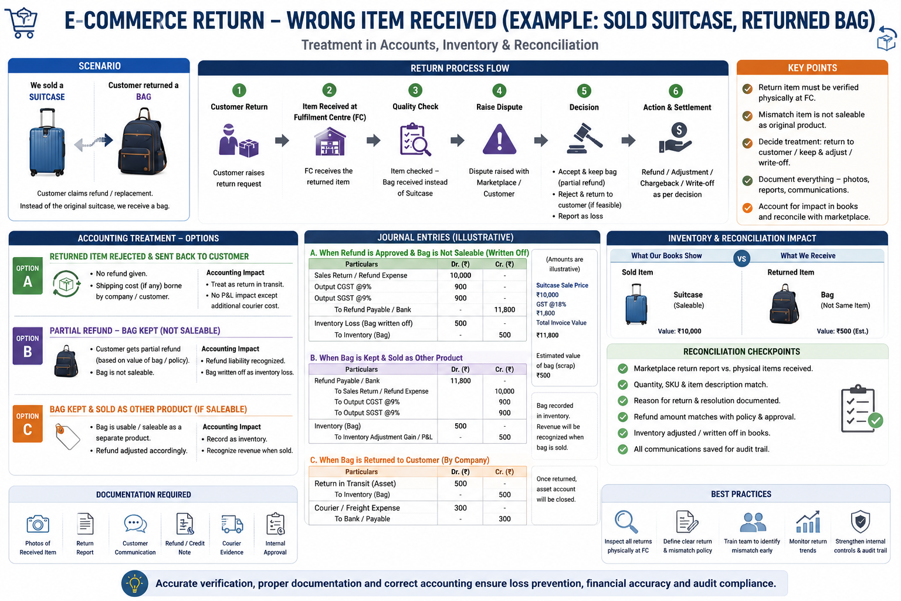

Slide 9
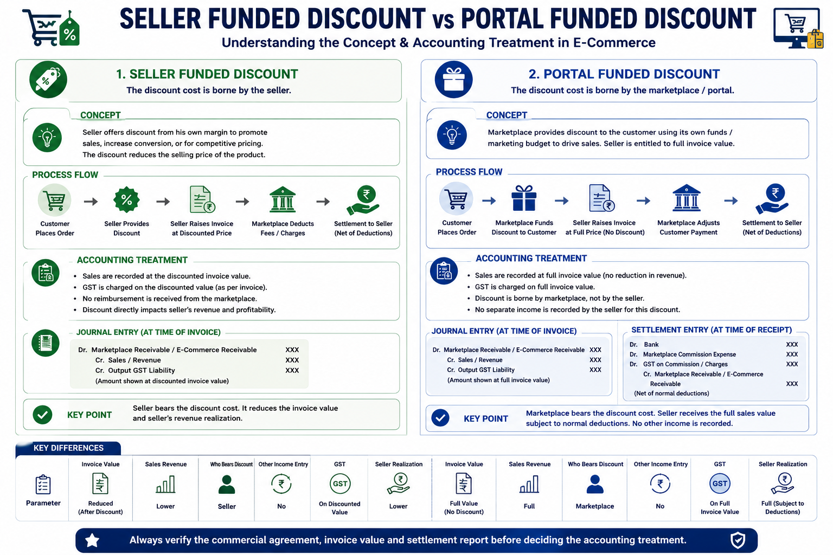

Slide 10
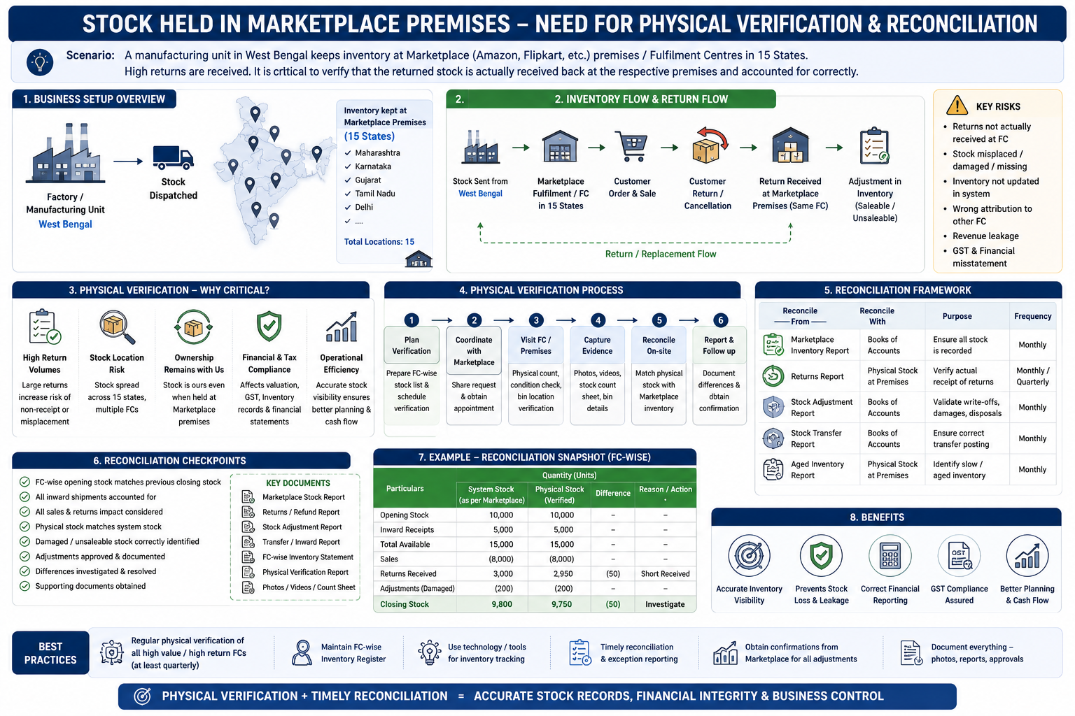

Slide 11
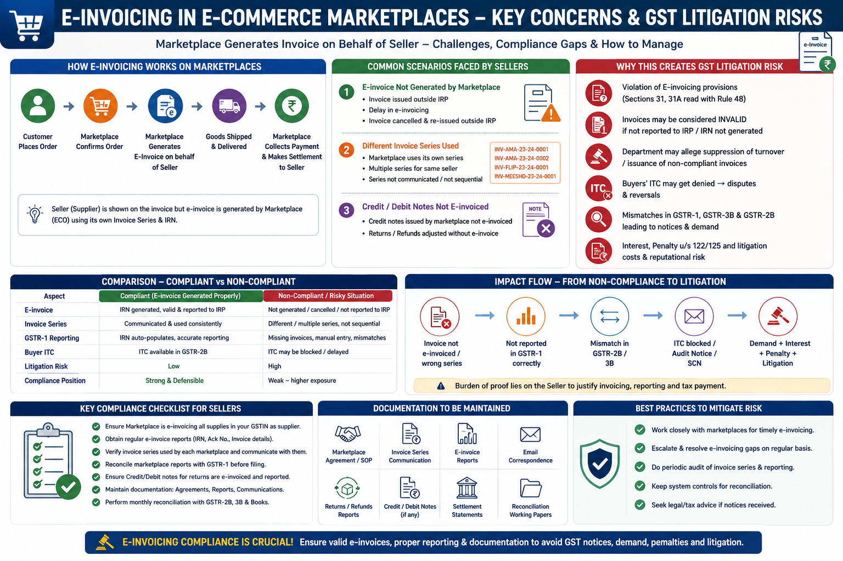

Slide 12
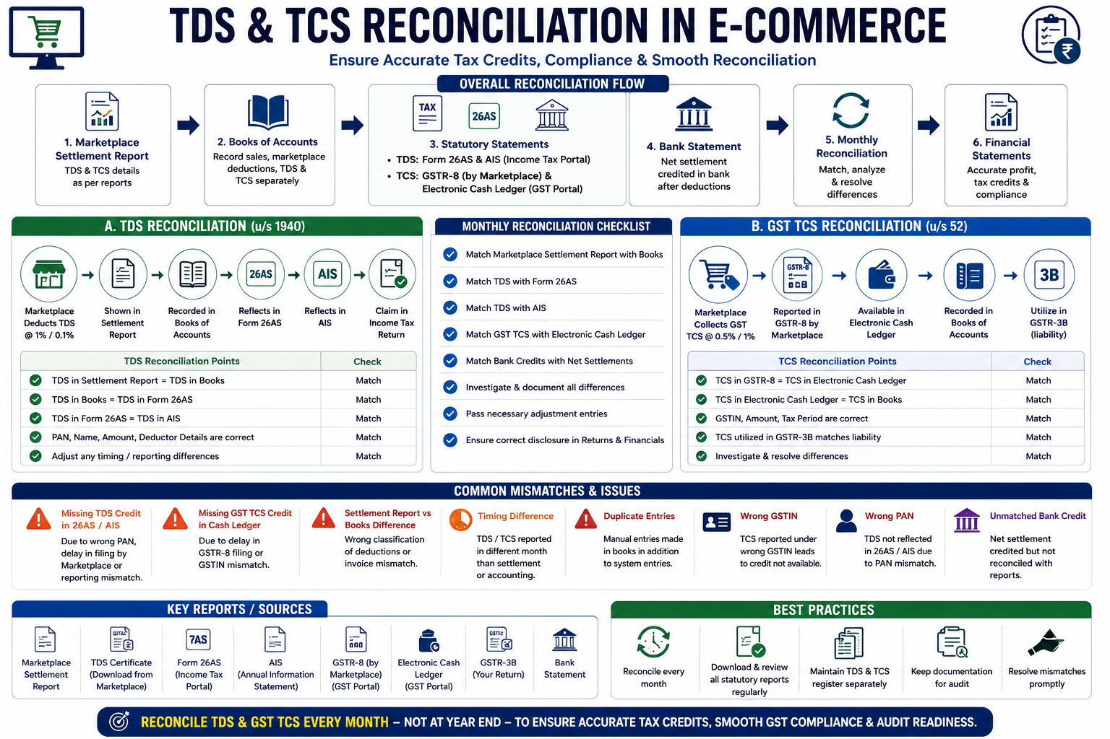

Slide 13
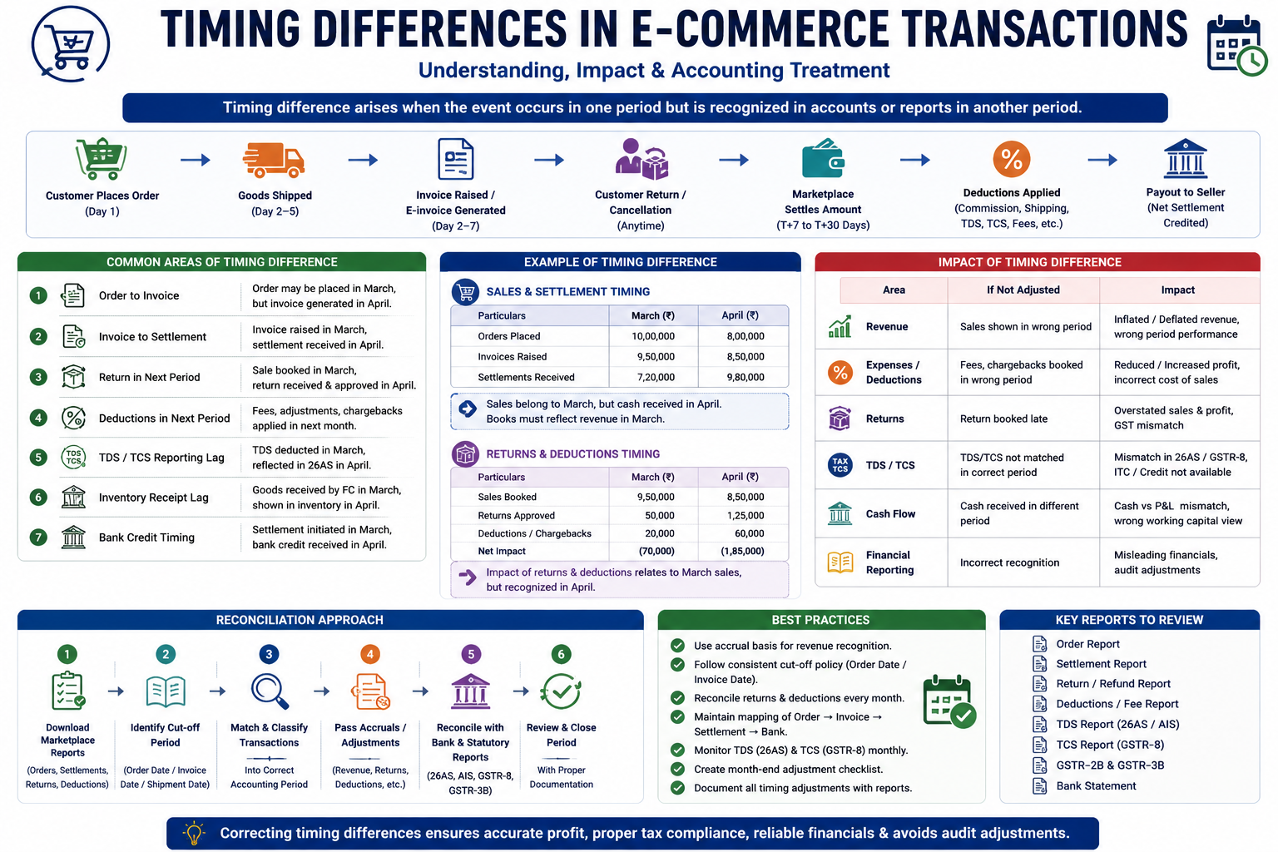

Slide 14
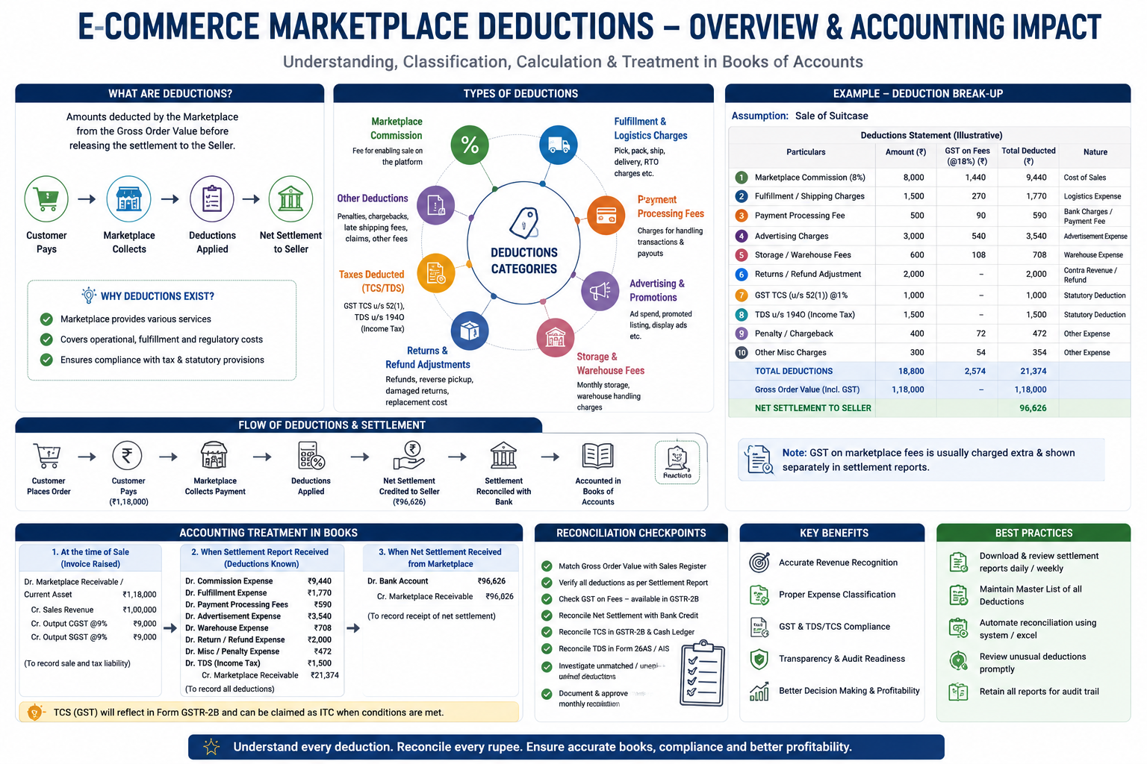

Slide 15
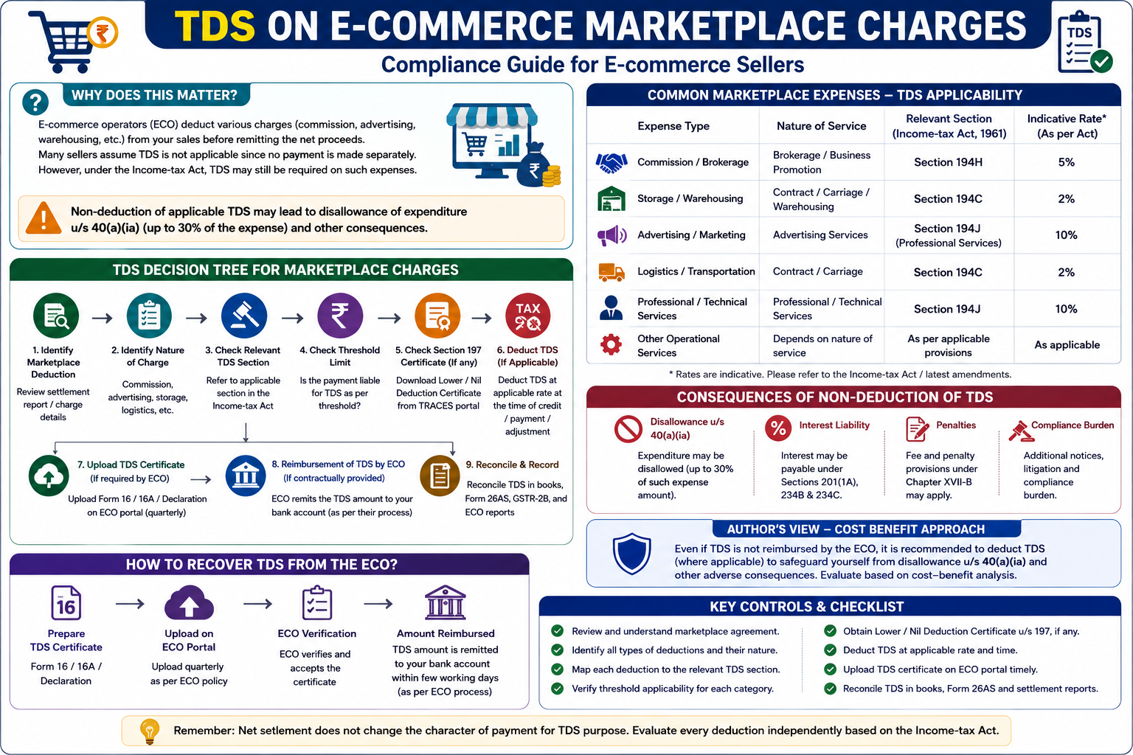

Slide 16
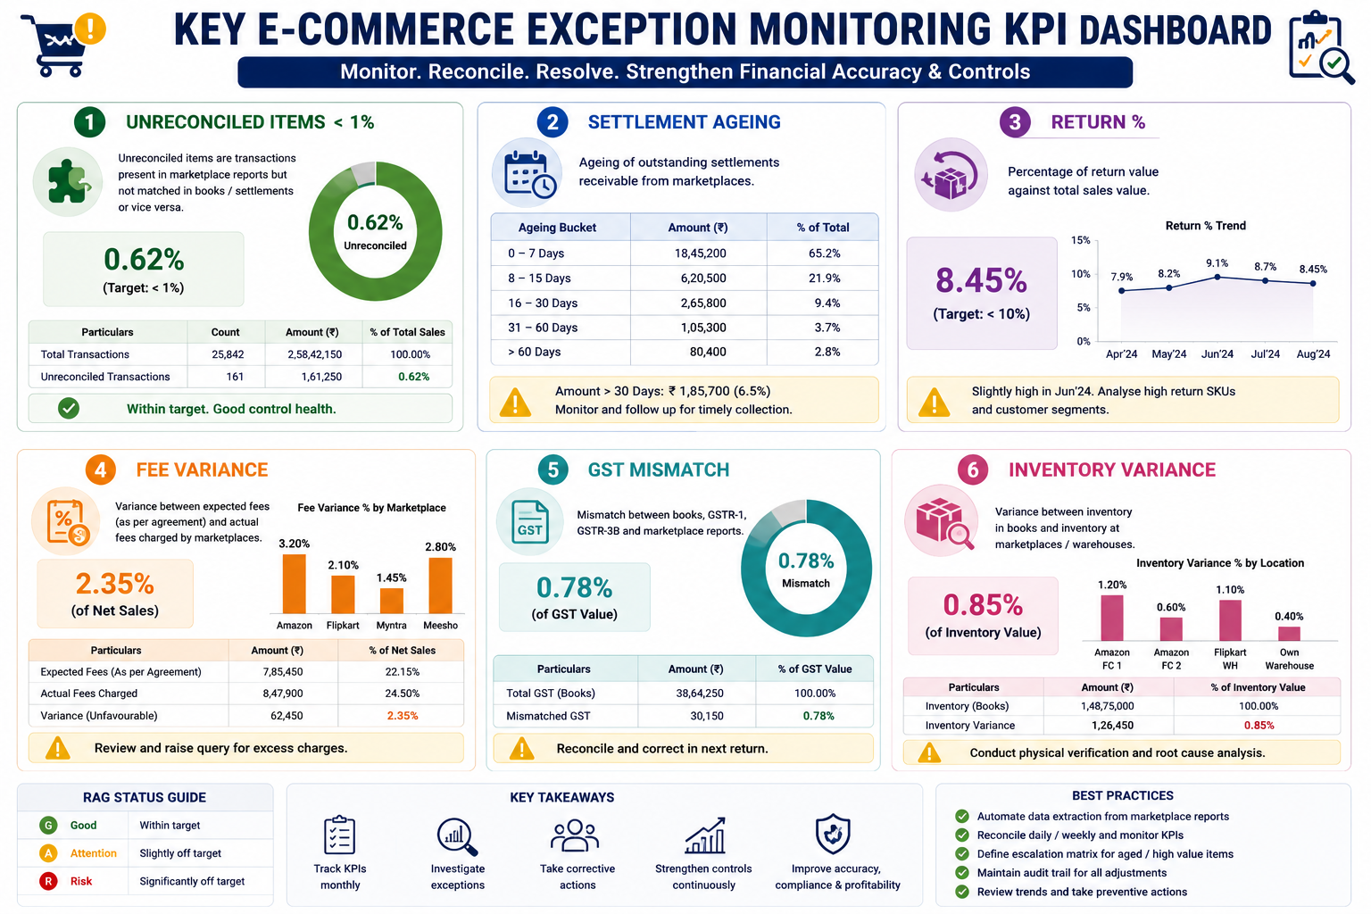

Slide 17

Thank You
Name CA Anuj Lohia
Email anuj@alpassociates.in
Mobile 9836335451

