Slide 1
ESOPs & Management Incentives
Concepts, Structures and the Role of Valuation
August 7, 2026
CA. Gandharv Jain

Slide 2

Who We Are
Finvox Analytics is an international valuation advisory firm that combines the sophistication of global standards with the agility of a boutique practice.
5,000+
Valuation engagements across industries and geographies
Established:
2015
Pioneers in India's specialized valuation firms
Top 10
Valuation Firm in Asia - Asia Business Outlook 2022
50+
100+
Years of experience in corporate finance, valuation and advisory
Experienced Team (CAs, CFAs, CPAs, MBAs)
$1Bn+
Deals executed
500+
250+
Clients including 40+ Listed Companies
Due diligence engagements
Notes:
https://bettermarketing.pub/the-rise-of-startups-in-india-story-until-now-11d143e2ff64

Slide 3
1
Section 1
Introduction

Slide 4
Employee Stock Options
Introduction
What is Employee Stock Options?
Employee stock options are the rights given to certain specified employees
to subscribe to the underlying equity shares of the company
at a pre-determined price,
at or within a specified period of time subject to certain vesting conditions.
In other words, an employee stock option plan is a type of employee benefit plan that gives employees a share of the company’s ownership.
Purpose of Issuing ESOPs
Attract, Reward, Motivate and Retain Employees
Enhances Job Satisfaction
Deferred Compensation Strategy
Alignment with Company’s Goals and Objectives
Notes:
https://bettermarketing.pub/the-rise-of-startups-in-india-story-until-now-11d143e2ff64

Slide 5
Employee Stock Options
Type of Stock Options
Characteristic
Employee Stock Option Plans
Performance Based Incentive Plans
Restricted Stock Units
Phantom / SARs
Option to Buy Shares at Set Price
Units Vest on Achieving Targets
Grant of Shares (no Exercise Price)
Cash/Equity Linked to Share Value
Reward
Ownership
Only after Exercise
After Vesting & Conversion
Yes, once Vested
No Ownership/Votes
Performance Link
N/A – Time Vested
Targets (Revenue, EBITDA, IRR, MOIC)
N/A – Time Vested
Share Value increase
Cost to Employee
Pay Exercise Price
Usually None
None
None
No, if Cash-Settled - but it affects the Share Value
Dilution
Yes (on Exercise)
Yes (if Converted)
Yes (on Issue)
Settlement
Shares
Shares
Shares
Cash or Equity
Objective
Align with Long-term Growth
Reward for performance
Retain Talent
Align with Value, avoid Dilution

Slide 6
Employee Stock Options
Key Terms
Grant
Grant Date
Vesting Period
Exercise Period
Exercise Price/ Exercise Date
Lock-in-Period
Price at which employee exercise the options. Generally, less than FMV
Period for which employee is prohibited from selling shares
Offering of Options
Vesting conditions to be fulfil by employees
Date on which scheme is extended to employees
Employee exercise right to receive shares
employee is eligible to exercise his right of exercising option

Slide 7
2
Section 2
Why ESOPs

Slide 8




Employee Stock Options
A Wealth Creation Tool
From Employees to Millionaires: The Power of ESOPs
“Meet Akriti Chopra, Employee-Turned-Founder of Zomato Who Earned $18.1 Million in ESOP”
Source : News 18
“Swiggy's dollar millionaires: 70 employees to pocket over $1 million each as company delivers IPO”
Source: MoneyControl
“As IPO nears, Alibaba preps employees for $40 billion windfall”
Source: Reuters
“Perfios enables employee wealth creation of ESOPS worth $18.5 million”
Source: IBS Intelligence
Notes:
https://bettermarketing.pub/the-rise-of-startups-in-india-story-until-now-11d143e2ff64

Slide 9




Employee Stock Options
From Equity to Cash
“Flipkart offers $50M ESOP buyback; 7,500 employees to benefit”
Source : Economic Times
“OYO offers to buy shares from employees, ex-workers for up to $7.15M”
Source : Economic Times
“Vijay Shekhar Sharma led Indian digital payment unicorn, Paytm has finally touched $10 Bn valuation with the recent secondary shares sale of ESOPs worth $47.2 Mn”
Source : INC 42
“Ola facilitates ESOP encashment to existing and former executives”
Source : Entrackr
Notes:
https://bettermarketing.pub/the-rise-of-startups-in-india-story-until-now-11d143e2ff64

Slide 10
Employee Stock Options
Why Stock Options Are On The Rise?
Talent Attraction
Employee Retention
Cash Optimization
Top talent is scarce, and every company is competing to hire them; equity incentives enable companies to attract good talent.
Multi-year vesting (typically 3 - 4 years) and offering additional grants over the years tie employees to long-term value creation, lowering churn.
`
Companies trade equity for lower cash burn, extending runway in tighter funding cycles
Wealth Creation
Business Growth
Global Benchmarking
High-visibility windfalls (IPOs, acquisitions, buybacks) have created millionaires across levels, amplifying employee interest and employer adoption.
`
VCs increasingly advocate structured equity programs (option pools, refreshers, performance-based grants) as core to scaling teams responsibly.
With the globalization of the economy, incentive plans have become a crucial component of a company’s cap table
Notes:
https://bettermarketing.pub/the-rise-of-startups-in-india-story-until-now-11d143e2ff64

Slide 11
3
Time Based VS Performance Based Stock Options

Slide 12
Employee Stock Options
Time Based vs Performance Based
Incentive Plans are equity-linked rights granted to senior executives, key employees, and vendors of the company enabling them to enjoy equity upside. These units include:
Time Based Units
Performance/Exit-Based Units
  Right to purchase company shares at a predefined price within a defined period.
  They provide additional shares or cash rewards.
  Typically subject to vesting, enabling gradual ownership.
  Performance-based units are generally granted to senior management.
  They provide additional shares or cash rewards.
  Payouts are triggered when defined performance targets are achieved or upon liquidity event such as an IPO, trade sale, or recapitalization.
Notes:
https://bettermarketing.pub/the-rise-of-startups-in-india-story-until-now-11d143e2ff64

Slide 13
4
Regulatory Scope

Slide 14



Empoloyee Stock Options
Regulatory Scope
Indian Accounting Standard 102: Shared Based Payment
Objective:
Specifies the recognition for share-based-payment transaction.
Requires entities to reflect the impact of such transactions in profit or loss and financial position.
Includes recognition of expenses related to share options granted to employees.
Share-based payment granted
Expense recognized in P&L
Equity or liability recognized on balance sheet

Slide 15
Employee Stock Options
Regulatory Scope
Recognition:
Equity-Settled Share-Based Payment Transactions
Goods or services received are measured at fair value of goods/services, with a corresponding increase in equity.
If fair value of goods/services cannot be estimated reliably, measure indirectly by reference to the fair value of equity instruments granted.
For such transactions, measure the fair value of equity instruments at the measurement date, which is the date of grant.
Cash-Settled Share-Based Payment Transactions
Measure goods/services acquired and related liability at the fair value on the transaction date.
Remeasure liability at each reporting date and settlement date until settled.
Recognize changes in fair value in profit or loss for the period.

Slide 16
Employee Stock Options
Valuation Requirement under IND AS 102
Type of Award
Grant Date Valuation
Revaluation Requirement
Accounting Treatment under IND AS 102
Equity-Settled Awards
(e.g., ESOPs, Share-settled RSUs)
No revaluation after grant date. Expense is based on grant-date fair value, recognized over vesting period
Cost recognized in P&L over vesting. Equity (share-based payment reserve) credited.
Fair value measured at grant date
Cash-Settled Awards (e.g., Phantom Shares, Cash-settled SARs, MIUs)
Re-measured at each reporting date until settlement, with changes flowing through P&L
Recognized as a liability, adjusted to current fair value at each reporting date.
Fair value measured at grant date
Performance / Exit-Linked Awards (Performance Shares, Exit-based MIUs)
Grant date fair value measured considering probability of meeting performance/exit conditions
If conditions become unlikely, previously recognized expense is reversed; if likely, expense continues/amplifies.
Reassessed at each reporting date to update likelihood of meeting conditions

Slide 17
5
Valuation Approaches and Methods

Slide 18
Employee Stock Options
Stock Options as a Derivative
Incentive Plans, including employee stock options and performance-based units, are option-like instruments that allow management or employees to participate once certain conditions are met, such as completion of the vesting period, exceeding a hurdle rate, achieving performance targets, or upon an exit event. As their payoff structure resembles financial options, they are typically valued using option-pricing methodologies.
An option is a derivative contract which
provides the holder with the right to buy or sell
a specified quantity
of an underlying asset
at a fixed price (called a strike price or an exercise price)
at or before the expiration date of the option.
Since it is a right and not an obligation, the holder can choose not to exercise the right and allow the option to expire. The price of the right is known as option premium.
Exercise styles:
European: Gives owner the right to exercise the option only on the expiration date.
American: Gives owner the right to exercise the option on or before the expiration date.

Slide 19
Employee Stock Options
Nature: Call Option or Put Option?
Options are broadly classified into two types:
Call Options - A buyer of a call option has the right to buy the underlying asset for a certain price.
Put Options - The buyer of a put option has the right to sell the underlying asset for a certain price.
Management Incentive Plans confer upon the employee or management the right to purchase company shares at a fixed exercise price in the future. Key characteristics include:
No obligation to exercise: The employee may choose to let the option lapse if the market price is below the exercise price.
Right to buy, not sell: Since the option allows buying (not selling), Management Incentive Plans resemble call options.
Therefore, the valuation of Incentive plans is aligned with the valuation methodology for call options. The price of any asset in the world is Present Value (PV) of future cash flows.
Payoff from Call = S (Underlying Price) – E (Strike Price)
This S is uncertain and we need to model how this evolves over time.

Slide 20
Employee Stock Options
Valuation Models
The following valuation model could be used to calculate “S”
Criteria | Black-Scholes Model (BSM) | Binomial Model | Monte Carlo Simulation
Best Used For | Standard time-based vesting No early exercise behavior | Early exercise features Graded vesting | Performance or market-linked ESOPs Exit-based triggers (IRR/MOIC)
Complexity | Low | Medium | High
Key Assumptions | Constant volatility Risk-free rate Time to expiry No early exercise | Allows for dynamic assumptions Models early exercise probability | Simulates thousands of price paths Customizable to reflect multiple outcomes
Handles Early Exercise? | No | Yes | Yes
Handles Performance Vesting? | No | Indirectly with adjustments | Yes
Ease of Implementation | Easy | Moderate | Complex – needs custom modeling or software

Slide 21
Employe Stock Options
Real World Scenarios
Exit of Investors under Strategic Acquisition
Transaction
Acquisition of Business along with Management
Exit Linked Management Incentive Plan
Nature of
Instrument
Performance – Linked Instrument
Payoff to CXO’s/KMP based on performance matrix linked to IRR/MOIC.
Designed as a Carry Structure.
Simple Performance Matrix.
Buyer agreed to pay sellers additional consideration based on multiple performance parameters including number of users, revenue and EBITDA etc.
Multiple performance milestones and parameter leading to complexity
Instrument
Description
Generated an IRR of approximately 15-16% and MOIC of 2.5x.
Generated windfall gains for the Key Management.
Significant attrition in the acquired company due to misalignment.
Complex performance parameters in the business leading to impairment scenario.
Remarks
Methodology
used for Valuation
Monter Carlo Simulation
Monter Carlo Simulation

Slide 22
Employee Stock Options
Real World Scenarios
Acquisition with Contingent Consideration
Background
Acquirer purchased 70% stake in the target company.
The remaining 30% was structured using call/put options instead of direct acquisition.
The arrangement was designed as a management incentive mechanism, with exercise tied to performance (initially at 7× EBITDA).
Instrument Description
Call Option: Held by acquirer on the promoter’s remaining 30%.
Put Option: Held by promoter, giving right to sell to acquirer.
Performance Link: Strike price based on a pre-agreed EBITDA multiple.
Accounting Treatment:
  Recognized as a derivative liability on acquirer’s books.
  Remeasured annually through profit and loss.

Slide 23
Employee Stock Options
Real World Scenarios
Acquisition with Contingent Consideration
Impact
On exercise of the call option, the multiple was revised from 7x to 9.9x EBITDA.
This remeasurement led to an additional INR 103.17 million expense in P&L impacting the net income.
Counterfactual: Without the call/put structure, this would have been a simple step-up acquisition, with no P&L impact.

Slide 24

Option Pricing
Option Pricing Models
The price of any asset in the world is Present Value (PV) of future cash flows.
If we talk about call option, future cash flows are payoff:
Payoff from Call = S (Underlying Price) – E (Strike Price)
This S is uncertain and we need to model how this evolves over time. We are discussing following processes for modelling S:
Binomial Model (Discrete)
Black Scholes Merton Model (BSM) (Continuous)
Use of Monte Carlo Simulation in BSM

Slide 25
Option Pricing
Black Scholes Model
Overview :
The formula, developed by three economists – Fischer Black, Myron Scholes and Robert Merton – is perhaps the world's most well-known options pricing model.
It was introduced in their 1973 paper, "The Pricing of Options and Corporate Liabilities," published in the Journal of Political Economy.
The Black Scholes model is a model of price variation over time of financial instruments such as stocks that can, among other things, be used to determine the price of a European call option.
It's used to calculate the theoretical value of European-Style Options using current stock prices, expected dividends, the option's strike price, expected interest rates, time to expiration and expected volatility.

Slide 26
Option Pricing
Black Scholes Model
Assumptions :
The option is European and can only be exercised at expiration.
Perfect continuous time markets: one can trade at any time, there are no transaction costs and taxes, no restrictions on short-selling.
No arbitrage opportunities exist
The underlying asset does not pay any dividend or cash flow during the option’s life.
Markets are efficient (i.e., market movements cannot be predicted).
There are no transaction costs in buying the option.
The risk-free rate and volatility of the underlying are known and constant.
The return on the underlying asset follows a lognormal distribution.

Slide 27
Option Pricing
Inputs in the Black Scholes Model
Input | Description | Source of Data
Striking Price (E) | The lower the striking price for a given stock, the more the option should be worth, because a call option lets you buy at a predetermined striking price. | In case of listed shares, market quotes; in unlisted cases based on a valuation of the shares as on date.
Time Until Expiration (T) | The longer the time until expiration, the more the option is worth. The Option premium increases for more distant expirations for puts and calls. | The price at which the option is exercisable as per the contract / scheme.
Stock Price (𝑆₀) | The higher the stock price, the more a given call option is worth. A call option holder benefits from a rise in the stock price. | As per the scheme or contract.
Volatility (𝜎) | The greater the price volatility, the more the option is worth. The volatility estimate Sigma cannot be directly observed and must be estimated. Volatility plays a major role in determining time value. | Market prices of similar stock.
Dividends | A Company that pays a large dividend will have a small option premium than a Company with a lower dividend, everything else being equal. Listed options don’t adjust for cash dividends. The stock price falls on the ex-dividend date. | Based on historic trend or estimate for the future.
Risk- Free Interest Rate (r) | The higher the risk free interest rate, the higher the option premium, everything else being equal. | Market data on G.Sec yields.

Slide 28
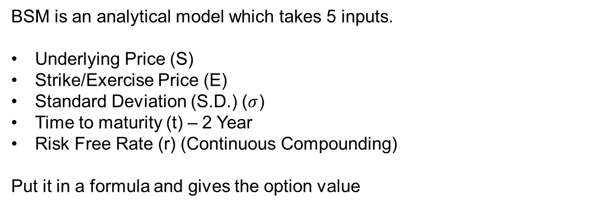
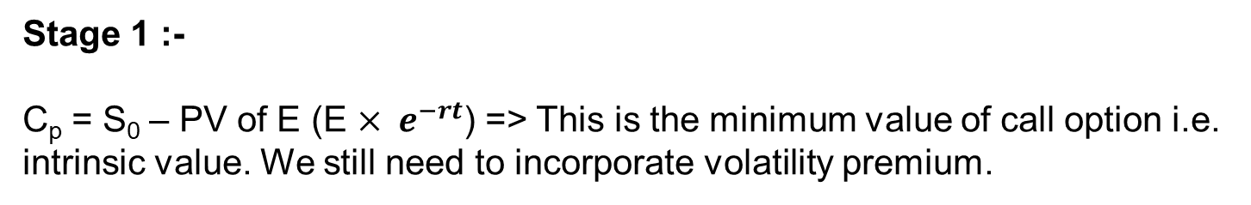
Option Pricing
Derivation: Black Scholes Model (BSM)
BSM is an analytical model which takes 5 inputs.
Underlying Price (S)
Strike/Exercise Price (E)
Standard Deviation (S.D.) ($σ$)
Time to maturity (t) – 2 Year
Risk Free Rate (r) (Continuous Compounding)
Put it in a formula and gives the option value
Discussion of BSM Formula
Stage 1 :-
C_{p} = S₀ – PV of E (E $× e^{−rt}$) => This is the minimum value of call option i.e. intrinsic value. We still need to incorporate volatility premium.

Slide 29
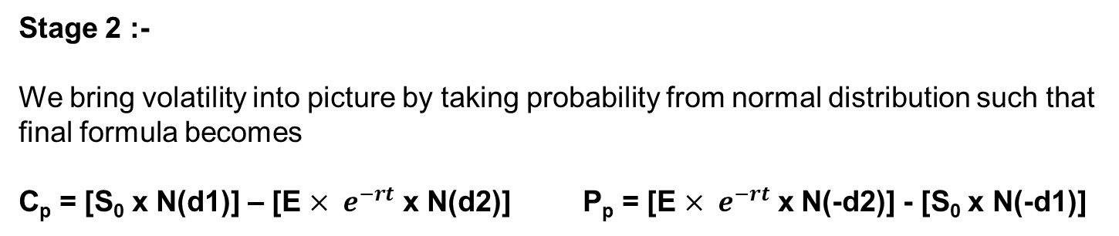
Option Pricing
Derivation: Black Scholes Model (BSM)
Stage 2 :-
We bring volatility into picture by taking probability from normal distribution such that final formula becomes
C_{p} = [S₀ x N(d1)] – [E $× e^{−rt}$ x N(d2)] P_{p} = [E $× e^{−rt}$ x N(-d2)] - [S₀ x N(-d1)]
Let us analyse the formula
C_{p} = [S₀ x N(d1)] – [E $× e^{−rt}$ x N(d2)]
Call Option Delta
Probability that call will land in the money
Intuition:
Call option is equivalent to leveraged stock buying. We borrow present value of E and buy stocks.
Also we can think of a call option as buying delta stock by paying E, however E will be paid only in the cases when the option lands in the money

Slide 30

Option Pricing
Derivation: Black Scholes Model (BSM)
Stage 3 :-
Formula of d1 and d2
$d1= \frac{ln\left(\frac{S_{o}}{E}\right)+\left(R_{f}+ \frac{σ^{2}}{2}\right){t}}{σ√t}$
$d2= \frac{ln\left(\frac{S_{o}}{E}\right)+\left(R_{f}− \frac{σ^{2}}{2}\right){t}}{σ√t}$ Or $d2=d1−$ $σ√t$
Note:
For finding N(x), use excel function =NORMSDIST(Value of x)
N(-x) = 1 – N(x)

Slide 31
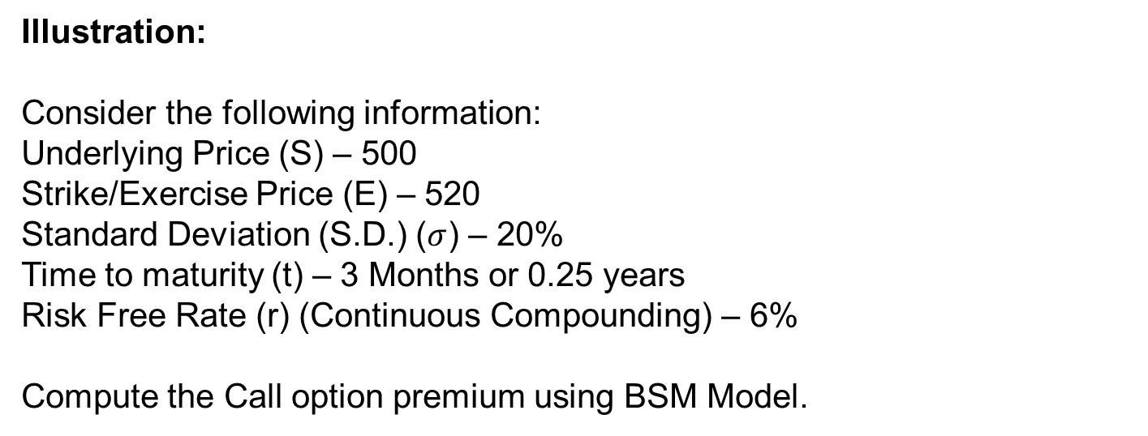
Option Pricing
Illustration: Black Scholes Model (BSM)
Illustration:
Consider the following information:
Underlying Price (S) – 500
Strike/Exercise Price (E) – 520
Standard Deviation (S.D.) ($σ$) – 20%
Time to maturity (t) – 3 Months or 0.25 years
Risk Free Rate (r) (Continuous Compounding) – 6%
Compute the Call option premium using BSM Model.

Slide 32
Option Pricing
Illustration: Black Scholes Model (BSM)
Solution:

Slide 33
Option Pricing
Binomial Model
Overview:
A binomial model is based on the idea that, over the next period, the value of an asset will change to one of two possible values.
To construct a binomial model we need know:
  The beginning asset value
  The size of the two possible changes
  The probability of the changes occurring
The binomial model can be used to value a European as well as an American option.
The number of nodes in the binomial model is determined by the time to expiry of the option.
The life of the option is divided into a large number of small time intervals, i.e. the binomial model values options in discrete time.

Slide 34
Option Pricing
Binomial Model
Assumptions :
• The option is European and can only be exercised at expiration.
• No dividends are paid out during the life of the option.
• Markets are efficient (i.e., market movements cannot be predicted).
• There are no transaction costs in buying the option.
• The risk-free rate and volatility of the underlying are known and constant.
• The returns on the underlying are normally distributed.

Slide 35
Option Pricing
Inputs to Binomial Model
  1. The exercise price of the option
  2. The current price of the underlying stock
  3. The expected term of the option
  4. The expected dividends on the underlying stock for the expected term of the option
  5. The quantum of the expected price up and down move in the stock
  6. The probability of the up and down move

Slide 36
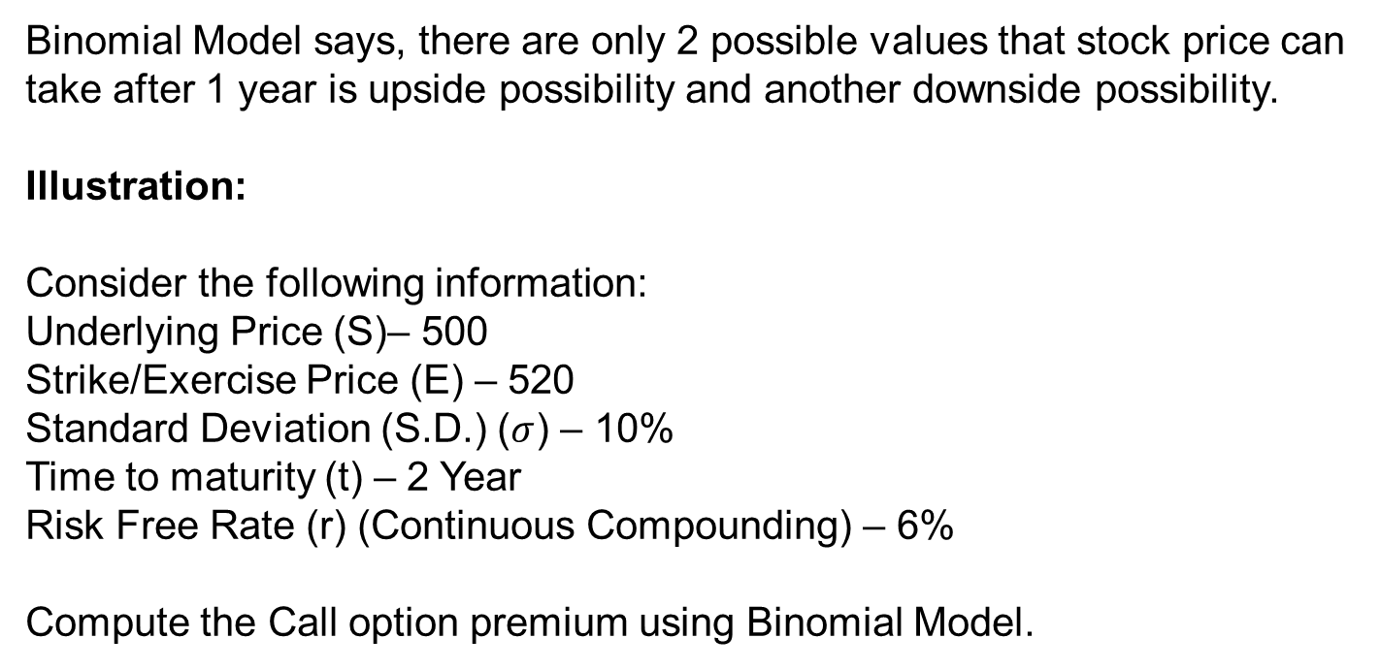
Option Pricing
Illustration: Binomial Model
Binomial Model says, there are only 2 possible values that stock price can take after 1 year is upside possibility and another downside possibility.
Illustration:
Consider the following information:
Underlying Price (S)– 500
Strike/Exercise Price (E) – 520
Standard Deviation (S.D.) ($σ$) – 10%
Time to maturity (t) – 2 Year
Risk Free Rate (r) (Continuous Compounding) – 6%
Compute the Call option premium using Binomial Model.

Slide 37
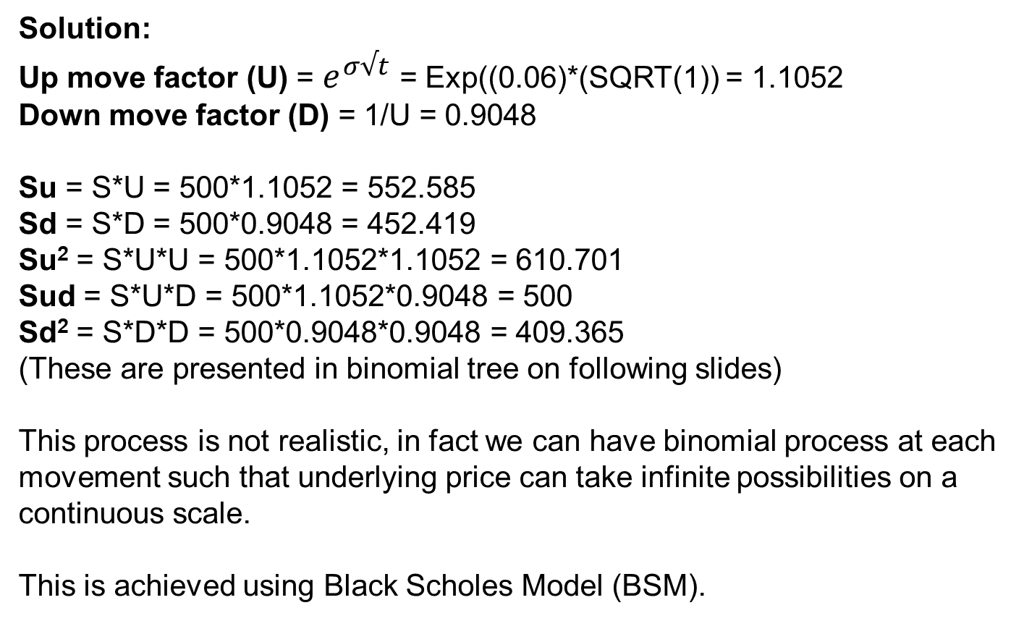
Option Pricing
Illustration: Binomial Model
Solution:
Up move factor (U) = $e^{σ√t}$ = Exp((0.06)*(SQRT(1)) = 1.1052
Down move factor (D) = 1/U = 0.9048
Su = S*U = 500*1.1052 = 552.585
Sd = S*D = 500*0.9048 = 452.419
Su² = S*U*U = 500*1.1052*1.1052 = 610.701
Sud = S*U*D = 500*1.1052*0.9048 = 500
Sd² = S*D*D = 500*0.9048*0.9048 = 409.365
(These are presented in binomial tree on following slides)
This process is not realistic, in fact we can have binomial process at each movement such that underlying price can take infinite possibilities on a continuous scale.
This is achieved using Black Scholes Model (BSM).

Slide 38
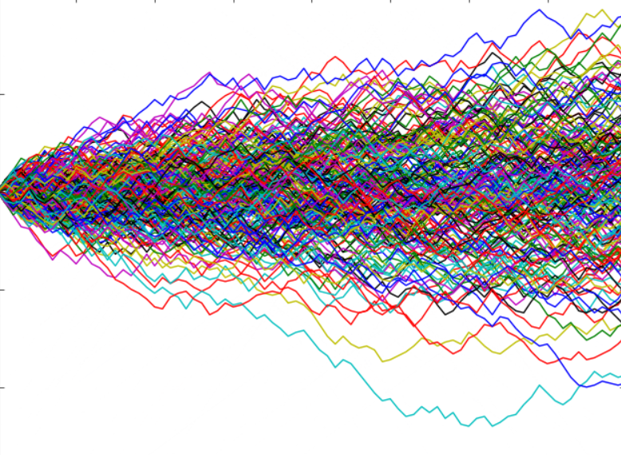
Option Pricing
Illustration: Binomial Model
So Binomial is a discrete process and BSM assumes continuous time case.
610.701
520
520
So = 500
So = 500
409.365
T
T
Binomial
BSM

Slide 39
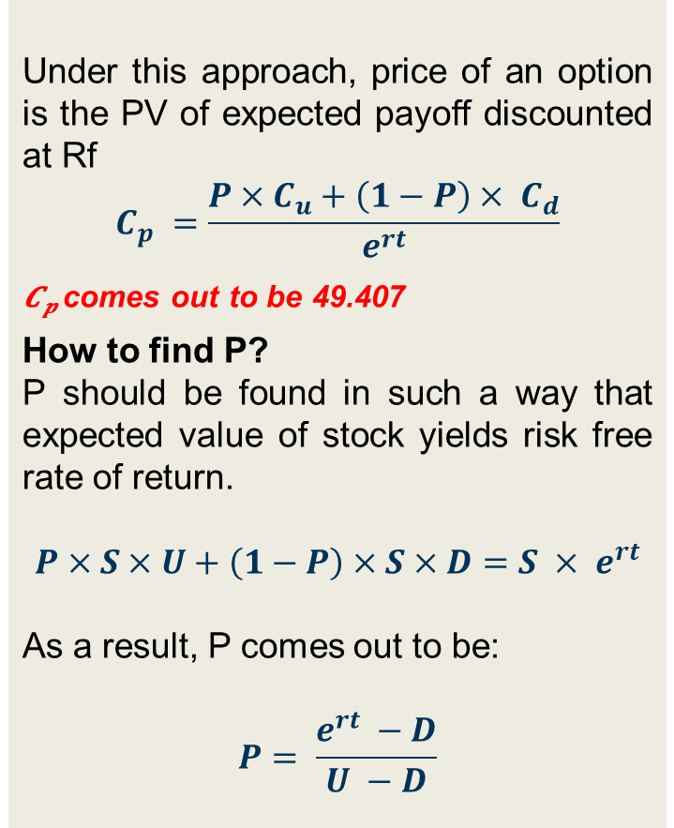
Option Pricing
Illustration: Binomial Model
Valuation of Call Option Premium
Under this approach, price of an option is the PV of expected payoff discounted at Rf
$$C_{p} =\frac{P×C_{u}+\left(1−P\right)× C_{d}}{e^{rt}}$$
𝑪_{𝒑} comes out to be 49.407
How to find P?
P should be found in such a way that expected value of stock yields risk free rate of return.
$$P×S×U+\left(1−P\right)×S×D=S × e^{rt}$$
As a result, P comes out to be:
$$P= \frac{e^{rt} −D}{U −D}$$
Su²
Su
P
Cu²
S₀
P
Sud
Cu
1-P
Sd
P
C_{p}
1-P
Cud
Sd²
Cd
1-P
Cd²
P = Probability of going up which comes out to be 0.7837
(1-P) = Probability of going down comes out to be 0.2163

Slide 40
Option Pricing
Monte Carlo Simulation
Overview :
Monte Carlo Simulations involves assigning a probability distribution to each variable factor
Based on the probability distributions assigned, it generates using random numbers, a range of values for each variable factor
Types of probability distributions include:
  Normal distribution
  Log normal distribution
  Triangular distribution
The model then calculates the results over and over, each time using a different set of random values from the probability functions
.

Slide 41
Option Pricing
Use of Monte Carlo Simulation in BSM
For example,
BSM model is based on normal distribution.
We may do multiple simulations by simulating N(d1) and N(d2) using =NORMSDIST(RAND()) function in excel.
Calculate n number of call option premium value by putting N(d1) and N(d2) derived using Monte Carlo Simulation in the equation given by BSM.
After that, simple average of all call option premiums computed will be the concluded price for the call option.
Please note – highly sophisticated software are required to run Monte Carlo simulations because, it requires around 10 million iterations to get the best scenario which may be difficult to do in excel.

Slide 42
Option Pricing
Monte Carlo Simulation: Pros and Cons
The primary advantage of the Monte Carlo method is also its primary disadvantage.
It can incorporate any assumptions regarding return patterns, correlations, and other factors the analyst believes are relevant. For some portfolios it may be the only reasonable approach to use.
That leads to its downside: the output is only as good as the input assumptions.
This complexity can lead to a false sense of overconfidence in the output among the less informed.
It is data and computer intensive which can make it costly to use in complex situations (where it may also be the only reasonable method to use).

Slide 43
Employee Stock Options
Other Key Considerations
Capital Structure of the Company - ESOP value is impacted by the number and hierarchy of equity classes, including preference shares, convertibles and warrants outstanding at the valuation date.
Liquidation Preferences and Waterfall Mechanics - Exit proceeds may be distributed unevenly across shareholders; ESOP value depends on its position in the liquidation waterfall rather than headline equity valuation.
Participation Rights and Conversion Features - Participating vs non-participating preferences, conversion thresholds and caps materially influence residual value available to ESOP holders.
Embedded Performance Hurdles and Implied IRRs - Certain ESOPs and management incentive plans embed return expectations (IRR / MOIC) that affect probability-weighted payouts and fair value.
Expected Exit Scenarios and Timing - Valuation is sensitive to assumptions around exit route (IPO, strategic sale, secondary) and expected time to liquidity.
Transferability, Lock-ins and Liquidity Constraints - Restrictions on sale, lock-in periods and absence of secondary markets affect realizable value for employees.

Slide 44
Other Structures Instruments
An Overview
Common Instruments in PE-Backed Structures
Share Warrants
OCRPS / CCPS
Performance-linked CCPS
Compulsorily Convertible Debentures (CCDs)
Exit-linked structured instruments
Accounting/Valuation Perspective
Under Ind AS / IFRS:
Under Indian GAAP (AS)
Under US GAAP / IFRS
  Embedded derivatives may require separate recognition.
  Liability vs equity classification impacts balance sheet.
  Fair value through P&L in certain structured instruments.
  Limited fair value guidance; often historical cost-based.
  Ind AS transition may significantly change the measurement approach.
  ASC 815 / IFRS 9 – derivative assessment.
  Complex features may trigger liability classification.

Slide 45
6
About Us

Slide 46
Why Independent Valuation is Critical?
Price Discovery Before Fundraise
Alignment Between Founders, Investors and Management
Regulatory & Accounting Compliance
Managing Dilution & Capital Allocation Decisions
Audit and Investor Scrutiny
Where We Assist as Independent Valuation Specialists
ESOP & Management Incentive Valuation (Grant & Remeasurement)
Pre-Round Independent Price Discovery
Purchase Price Allocation (PPA) under Ind AS / IFRS / US GAAP
Valuation of Warrants, Convertibles & Structured Instruments
Contingent Consideration & Earn-out Valuation
Exit Readiness & Strategic Transaction Support
Portfolio Valuation

Slide 47
Thank You !!
CA. Gandharv Jain
M: +91 9899931962
E: gjain@finvoxanalytics.com
Gurugram - India
108, 2nd Floor,
Udyog Vihar Phase I, Gurugram - 122016, India
New York - USA
122 East 42nd Street
Suite 4500 New York,
NY 110168, USA
Toronto - Canada
Greater Toronto Area
Ontario
Singapore
63 Chulia Street, OCBC
Centre East #15-01
Singapore 049514
Australia
Level 1, 102/14-16
Yarra St, South Yarra
314
www.finvoxanalytics.com

