Slide 1
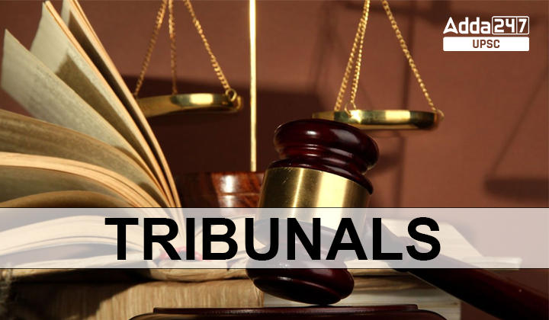
GSTAT – Charting the way forward
A Presentation by
CA. Arun Kumar Agarwal

Slide 2
Index
Sl. No. | Particulars | Slide No.
1. | Stages of Litigation | 3
2. | Introduction to GSTAT | 4
3. | Constitution of AT and Benches | 5 - 8
4. | Qualifications, Appointment and Conditions of service of President and Members | 9 - 11
5. | Procedure before AT | 12 - 13
6. | Appeals to AT | 14 -16
7. | Presentation of Appeal before GSTAT | 17
8. | What to do when there is no Tribunal? | 18 – 20
9. | Steps to make GSTAT Functional | 21
10. | Authorised Representative | 22 - 23
11. | CESTAT Procedure Rules,1982 | 24 – 27
12. | Tips for an Effective Appeal to the GSTAT | 28
13. | A brief checklist to be followed for filing an appeal before GSTAT | 29
14. | Consequences of Non-formation of GSTAT | 30 - 36

Slide 3

Supreme Court [S.118]
High Court [S.117]
Goods and services Appellate Tribunal (GSTAT) [S.112]
First Appellate Authority [S.107]
1. Stages of Litigation
Adjudication (order) [S.73(9)/74(9)]
Show cause notice (DRC-01) [S.73(1)/74(1)]
Pre SCN (Intimation in DRC-01A) [Rule.21]
Verification/Inspection(S.67)
Scrutiny(S.61)
Audit(S.65)

Slide 4
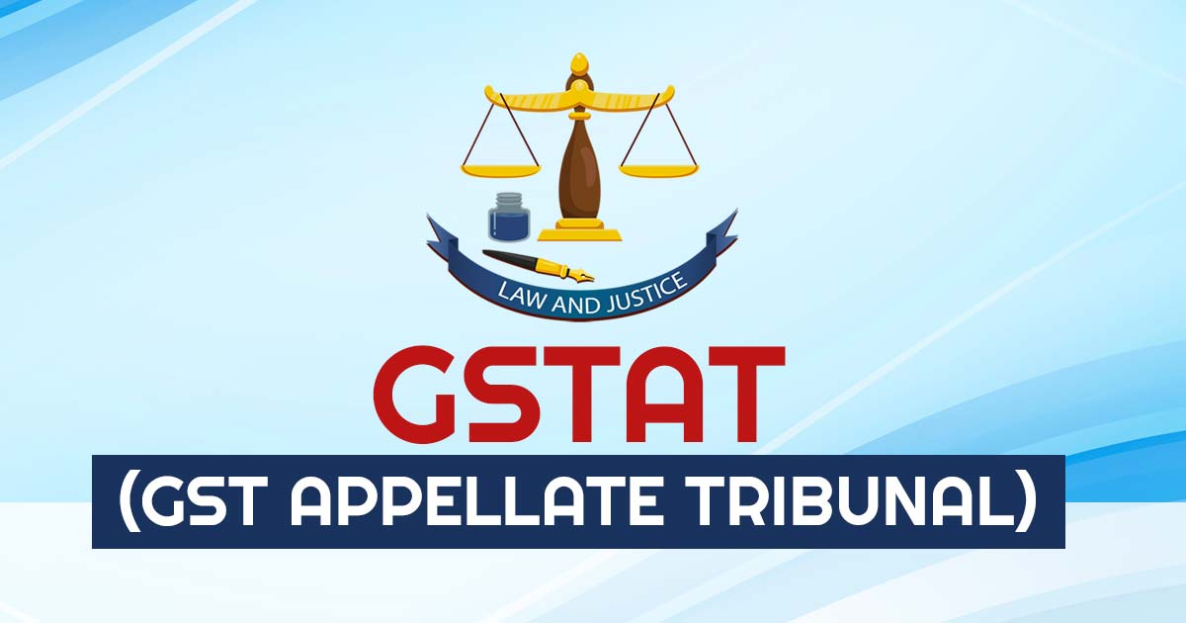
2. Introduction to GSTAT
S. 2(9) of the CGST Act, 2017:
“Appellate Tribunal” means the Goods and Services Tax Appellate Tribunal constituted under section 109;

Slide 5
3. Constitution of AT and Benches [S. 109]
Established by government notification on Council recommendation. Hears appeals against orders from lower authorities. [S.109(1)]
Jurisdiction, authority and powers granted to AT to be exercised by Principal Bench and State Benches constituted u/s-s (3) & (4). [S.109(2)]
Constitution of the appellate tribunal
Principal Bench
State Bench

Slide 6
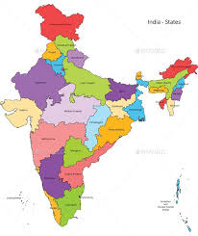
Constitution of Principal Bench
Constitution of State Bench
President
Judicial Member
Technical Member (Centre)
Technical Member (State)
2 Judicial Member
Technical Member (Centre)
Technical Member (State)
Located in New Delhi
Located in Each State
31 State Benches
NN S.O. 4073(E). dated 14-09-2023

Slide 7
Matters to be heard by | Circumstances
Principal Bench | Case, wherein one of the matters involved relates to the place of supply.
Single Member Bench | Where tax/ input tax credit involved, or amount of fine/ fee/ penalty determined in the order appealed against doesn’t exceed INR 50 Lakhs; Or The matter doesn’t involve any question of law. It requires President approval and other specific conditions.
Division Bench (One Judicial Member and one Technical Member) | Other cases
President may distribute cases and transfer them between Benches.
Senior-most Judicial Member acts as Vice-President for their state benches. Holds specific powers and is otherwise considered a regular member.

Slide 8

In case of disagreements between members, differing opinions are referred by the President to another member/ bench. Majority opinion decides the case.
Government can transfer members between benches for efficiency (consultation with President required). State Technical Members can only be transferred within their state (consultation with state government required).
Vacancies or defects in GSTAT composition do not invalidate proceedings.

Slide 9
4. Qualifications, Appointment and Conditions of service of President and Members [S. 110]
Qualifications for Appointment to GSTAT
The President
The Judicial Member
Must be a former SC Judge or HC Chief Justice.
Former HC Judge, or District/Additional District Judge for a combined 10 years, or Advocate with 10 years experience in IDT litigation (High Court, Supreme Court, relevant Tribunals) [inserted via CGST (2nd Amendment Act, 2023, dt: 28.12.2023)].
Minimum age = 50 years.
Term: 4 years, re-appointment able for up to 2 years (age limit 70).
Minimum age = 50 years
Term: 4 years, re-appointment able for up to 2 years (age limit 67).

Slide 10
The Technical Member (Central)
The Technical Member (State)
Member of Indian Revenue (Customs & Indirect Taxes) Service (Group A) with 3+ years experience in GST administration and 25+ years in Group A service, or
State Government officer (not below Addl. Comm. rank) with 3+ years experience in GST/existing tax law and 25+ years in Group A/equivalent service.
State Govt. can relax 25-year service requirement if no one meets it.
All India Service officer with 3+ years experience in GST administration and 25+ years in service.
Preference given to officers from the state the Bench serves.
Minimum age = 50 years
Term: 4 years, re-appointment able for up to 2 years (age limit 67).

Slide 11
Selection process
Search-cum-Selection Committee recommends candidates.
Separate committees for President/ Member and State Technical Member positions.
Committee includes Chief Justices, Secretaries, and relevant government officials.
Other Conditions
Salary and benefits are same as comparable CG positions.
President/ Members cannot have their salary/benefits reduced after appointment, can be reimbursed for higher than standard housing rent under certain conditions, can resign with 3 months notice, can be removed for various reasons (insolvency, misconduct, etc.) with due process, can be suspended during removal proceedings.
Former President/Members cannot practice before the GSTAT Bench they served on.

Slide 12
5. Procedure before Appellate Tribunal [S. 111]
Appellate Tribunal [S. 111(1)]
Not mandatory to follow Code of Civil Procedure, 1908.
Must follow Principles of natural justice.
Make its own rules for procedures within the Act's provisions and rules.
Summoning and questioning
Tribunal can use certain powers under CPC [S. 111(2)]
Demanding documents
Accepting evidence
Requesting public records
Issue commissions to examine
Ex – parte order
Reversing Dismissals
Any power as prescribed

Slide 13

The Tribunal can enforce its orders like a court decree.
It can send the order for enforcement to a local court with jurisdiction:
Where the company's registered office is located (for companies).
Where the person lives, conducts business, or works for gain (for individuals). [S. 111(3)]
Proceedings before the Tribunal are considered judicial proceedings for legal purposes.
The Tribunal is considered a civil court for specific sections of the IPC and the CPC. [S. 111(4)]

Slide 14
6. Appeals to Appellate Tribunal [S. 112]
Who can appeal
Anyone receiving an order under Section 107 or 108 of the Act can appeal to the Appellate Tribunal.
Deadline for appeal
Within 3 months of receiving the order
Tribunal can reject appeals where the disputed tax, input tax credit, fine, fee, or penalty is less than ₹50,000. [S. 112(2)]
Commissioner can call for the records of orders passed by lower authorities and request a subordinate officer to file an application with the Tribunal for review of specific points within 6 months of the order. [S. 112(3)]
How is Commissioner’s review application handled?
The AO makes an application to AT.
AT treats the application as if the appeal is made against order u/s 107(11) & 108(1).

Slide 15
Responding to an appeal
File a memorandum of cross-objections (challenge parts of the original order) within 45 days of receiving the notice, even if they didn't file their own appeal.
Condonation of Delay
Tribunal can admit a delayed appeal or cross-objection if a valid reason exists for the delay (up to 3 months – Delayed Appeal, 45 days – Memorandum of Cross Objections).
Appeals must be in a prescribed format, verified, and accompanied by a fee. [S. 112(7)]
Pre-conditions for filing appeal. [S. 112(8)]
Full amount of undisputed tax, interest, fine, fee, and penalty, as admitted in the order.
The appellant must pay:
20% of the disputed tax amount (capped at ₹50 crore) in addition to any pre-deposit under Section 107(6).

Slide 16
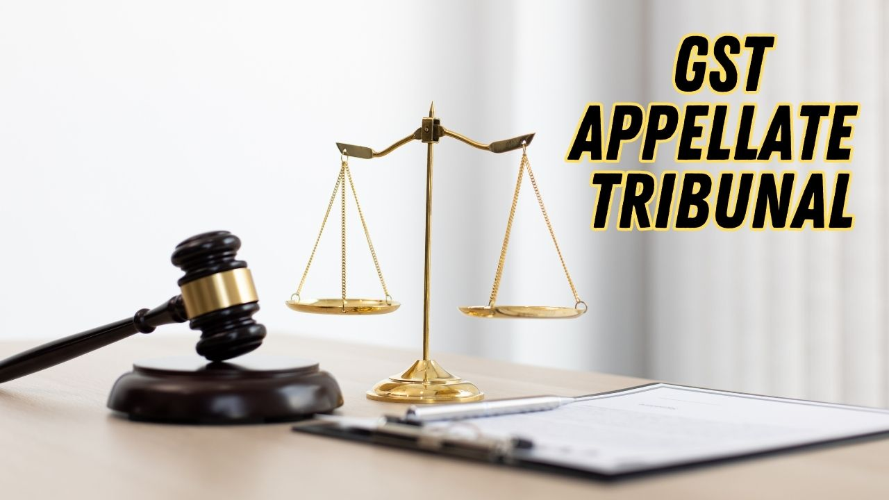
Stay on recovery proceedings:
If the appellant pays as per subsection (8), recovery of the remaining tax is paused until the appeal is decided. [S. 112(9)]
Fees for appeal:
For every Rs. 1 lac involved – Rs. 1,000/- (max Rs. 25,000/-) [R. 110(5)]
No fees for rectification of error.

Slide 17
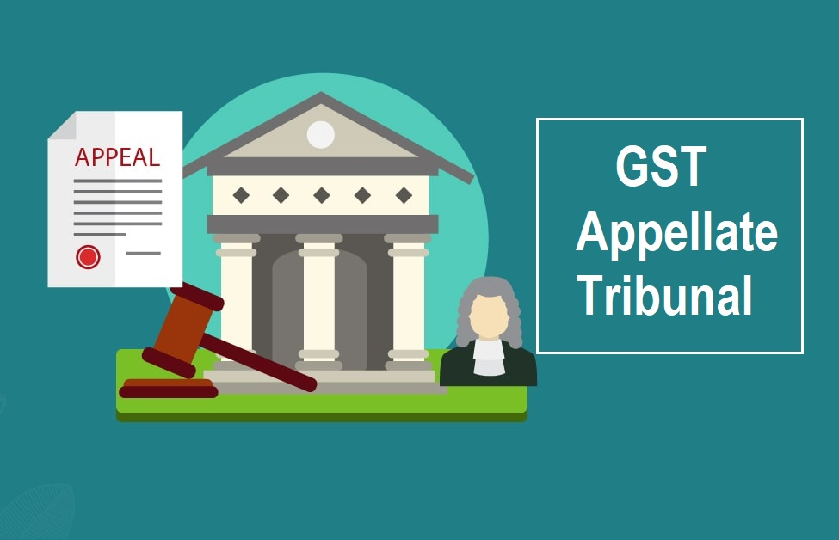
7. Presentation of Appeal before GSTAT
Appellant Details
Order/Decision Appealed Against
Allegations in Show Cause Notice
Defense Submissions made during Proceedings
Findings of the Adjudicating Authority
SOF & GOA
Prayer
Paper Book [Supporting Documents]
Authorization

Slide 18
8. What to do when there is no Tribunal?
Communicate through Letter to the Department that you will file Appeal before Tribunal.
In some cases where the taxpayer filed a writ in HC, the HC directed to deposit 20% of disputed amount.
Sl. No. | Case Name | Finding
1. | Orissa HC - Jaydurga Communication | Where assessee's entitlement to statutory remedies could not be jeopardized due to non-constitution of Appellate Tribunal, it was considered appropriate to provide statutory relief of stay on condition of depositing 20% of disputed tax amount.
2. | Patna HC - Trimurti Pvt. Ltd. | Stay of recovery of balance amount was to be granted on deposit of 20 per cent of tax demanded when GST Appellate Tribunal had not been constituted.

Slide 19
Sl. No. | Case Name | Finding
3. | Calcutta HC - Jaskaran Lunawat | Where assessee filed writ petition challenging appealable order before GSTAT; as GSTAT had not yet been constituted, period of filing appeal before Appellate Tribunal was to be extended and assessee was to be granted stay on recovery.
4. | Allahabad HC - N.G. Enterprises | Where second appeal was lying before Tribunal U/s 112, Tribunal not constituted, recovery proceedings of balance amount of tax to remain stayed till decision of writ petition, subject to deposit of 20% of disputed tax liability.
CBIC Circular 132/2/2020 dated 18.03.2020 –
Three months time limit from the date the President (PB or SB) enters office;
The appellate Authority should mention in Preamble- Appeal may be made within three months whenever the AT is constituted.

Slide 20
Bombay High Court in the case of Gulf Oil Lubricants India Ltd. dt. 08.02.2023 has directed the State Government to consider two measures to reduce inflow of Writ Petitions in the Court due to non-constitution of GST Tribunal and include the said direction.
  The time limit for filing the appeal is extended and if a declaration is filed in terms of Annexure-I within the stipulated period, the protective measure would automatically come into force.
  if recovery is being undertaken in terms of Clause 5 for failure to file a declaration within the time limit, by way of indulgence, to give 15 days period to make such a declaration
Maharashtra GST accordingly issued Trade Circular 20T of 2023 dated 31-Jul-2023 for the same.
Kerala GST has also recently issued similar Circular 01/2024 dated 11-Jan-2024 in this regard.

Slide 21
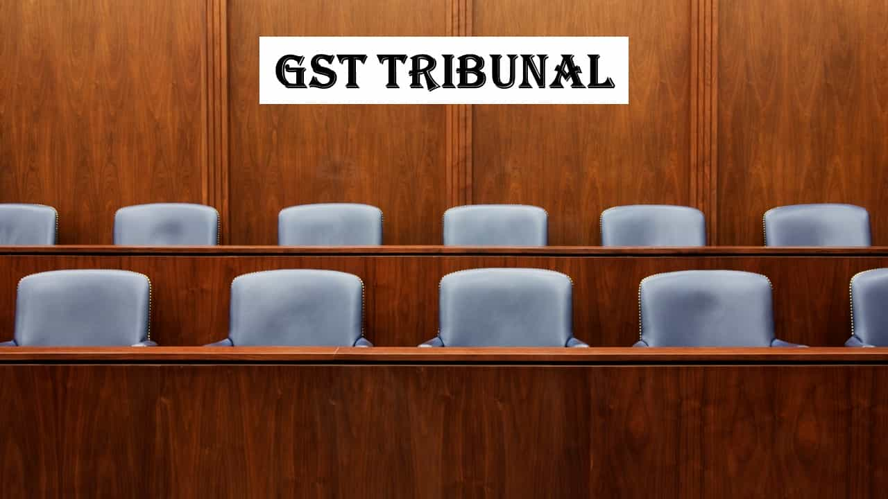
9. Steps to make GSTAT Functional.
S.No. | Section | Description | NN Status | Reference
1. | 109(1) | Establishment of GSTAT | Awaited | NA
2. | 109(3) | Constitution of Principal Bench of the GSTAT at New Delhi | Notified | F. No. A-50050/99/2018-Ad.1CCESTAT(Pt.) - S.O. 1(E) - CGST dated: 19.12.23
3. | 109(4) | Constitution of 31 State Benches of the GSTAT | Notified | S.O. 4073 (E) - CGST dated: 14.09.2023
4. | 110(1) | Appointment and Conditions of Service of President and Members in GSTAT | Notified | G.S.R. 793(E) - CGST dated: 25.10.2023
5. | 112(1) 112(3) | Period of limitation for filing of an appeal before the GST Tribunal | Notified | Order No. 09/2019 – CGST dated: 3.12.2019

Slide 22
10. Authorised Representative [S. 116]
Who can be represented?
Anyone involved in proceedings under the CGST Act can appoint a representative, except when they're required to appear personally for sworn testimony.
Your relative or regular employee.
An advocate licensed to practice in any Indian court (not debarred).
A chartered accountant, cost accountant, or company secretary holding a valid certificate of practice (not debarred).
Retired Commercial Tax Department officer (Group-B Gazetted or higher) who meets service time requirements and hasn't retired/resigned within the last year.
Goods and Services Tax (GST) practitioner.
Who can be an “Authorised representative”

Slide 23

Authorised Representative
Who cannot be a Representative and are not qualified to represent any person under sub-section (1)
People dismissed/removed from government service.
People convicted of offenses related to GST or similar tax laws.
People found guilty of misconduct by the designated authority.
Insolvent individuals (until the insolvency is resolved).

Slide 24
11. CESTAT Procedure Rules,1982
Sl. | Aspect | Details
1. | Location of Bench | Its headquarters or other locations within its jurisdiction, as directed by the President or based on its discretion
2. | Powers of the Bench | Hearing Appeals and Applications Transfer of Cases from one bench to another
3. | Language | Official Language: English Use of Hindi is permitted but Final Order in English.
4. | Date and place of hearing | Tribunal to issue notice and issue of notice means admission of appeal.

Slide 25
Contents of Memorandum of Appeal (MOA)
Grounds of Appeal: numbered consecutively and typed in double space.
On Fool-scape paper, duly paged, indexed, tagged firmly with each paper book in separate folder.
To be signed by and verified by the appellant/ applicant/ respondent/ Principal officer authorised to sign.
Documents produced to be certified to be true.
Four copies (if 2 members bench) with four copies of order in original/ order in appeal (wherever applicable). One copy of order to be certified.
If appeal heard by 1 member- 3 MOA.
President to determine which appeals are to be heard by single member.
MOA
In relevant Form
To be presented by
  person
  or agent
  sent by registered post
Grounds of Appeal
No other grounds except by leave of Tribunal.
Tribunal – not confined by the grounds in deciding appeal
On any grounds – Opportunity of hearing required.
Rejection/ Amendment
Not accept Memorandum if not accompanied by documents.
Reject if not in Time Limit.
Return if not in accordance with Procedure Rules, 1992
Allow to be refilled after removal of defects.

Slide 26
Document for Authorised Representative
If represented by AR- Document authorising to be appended with MOA.
If not able to file immediately- AR may file memo of appearance along with document of authorisation subject to satisfaction of Bench.
Document to indicate – Status of AR, Details of relationship, qualification to act.
If AR is Legal practitioner- Document to be duly executed vakalatnama.
Appellant’s Default
Reply to appeal
Dismiss appeal
Hear and decide on merits
Respondent reply = 1 month
If afterwards, appellant appears and satisfies reason for default
Tribunal may set aside the dismissal and restore the appeal
Appellant’s rejoinder = 1 month, or the period specified.

Slide 27

Paper Book
Copies of Documents
Statement of witnesses
Other Papers
Appellant:
within 1 month of filing of appeal
Respondent:
within one month of the service of the notice of the filing of the appeal
Tribunal may allow after expiry of such period

Slide 28

12. Tips for an Effective Appeal to the GSTAT
Understand the Issue
Identify Grounds for Appeal
Draft a Compelling Appeal Petition
Gather Supporting Documents
Meet with Legal Counsel
Prepare for the Hearing
Present Your Case Effectively
Respond to Counter-Arguments
Await the Tribunal's Decision

Slide 29

13.A brief checklist to be followed for filing an appeal before GSTAT
S.No. | Particulars | Description
1. | Decide Appropriate Bench | Principal Bench or State Benches
2. | Statutory Time Limit | 3 months from the date of communication of Order/ the date of the President assuming office
3. | Ingredients of Appeal – GSTAT | Refer S.No. 1 – 12 from the table (right side)
4. | Ingredients of Paper book | Refer, S.No. 12 on right side of the current slide
5. | Additional submission | if any – may be submitted at a later stage.
S.No. | Particulars
1. | Cover Page
2. | Index
3. | Form GST APL-05
4. | Prayer
5. | Statement of Facts
6. | Grounds of Appeal
7. | Power of Attorney
8. | Certified copy of Order
9. | Copy of proof of pre deposit in Form DRC 03
10. | Appeal filing fees payment details
11. | Non-Judicial Stamp
12. | Preparation of Paper Book
12 A. | Case History
12 B. | Arguments on Merit
12 C. | Arguments on Technical Ground
12 D. | Extract of relevant statutory provisions
12 E. | Documentary Evidence
12 F. | Case Laws

Slide 30

14. Consequences of Non-formation of GSTAT
High Court Burden
Piled up orders
Recovery Pressure
Ad-hoc Pre-deposit
Delayed Justice / Contingent Liability
Interpretation Uncertainty

Slide 31
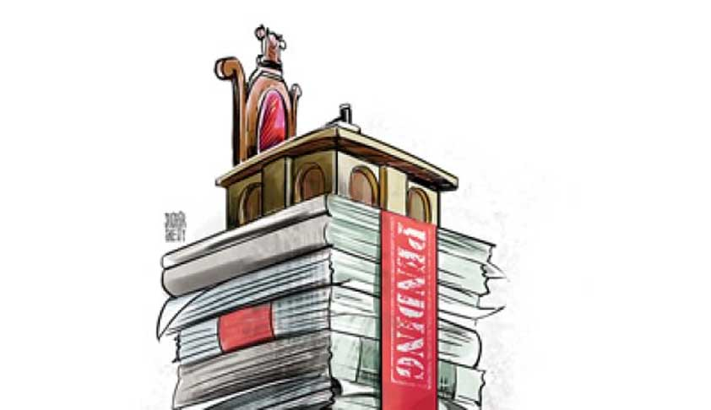
High Court burden
Constrained to move to writ in the respective High Courts which are already over-burdened or paying their GST demands under protest.
Due to backlog, High Courts are unable to dispose off the matters expeditiously.

Slide 32

Piled up Orders
The wheels of justice are meant to turn, but in many jurisdictions, they're grinding to a halt due to a critical missing piece: GSTAT.
This results in a backlog of unresolved cases, frustration for those seeking recourse, and a potential erosion of public trust in the legal system.

Slide 33

Recovery Pressure
Triggering tax recovery actions by the authorities.
Demand immediate payment of disputed taxes without following proper procedures.
Seizure of assets or bank accounts.
Excessive or unreasonable use of power by tax authorities.

Slide 34

Ad-hoc Pre-deposit
Pre-deposit of 10% of the disputed amount made at the stage of Appeal to Appellate Authority had been stuck/ blocked as the taxpayer cannot proceed forward against the Appeal Order due to non-constitution of GSTAT. Hence resulting in loss of opportunity cost.

Slide 35
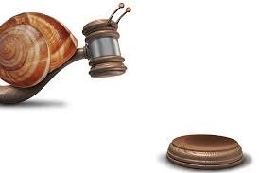
Delayed Justice
The Price of Delay
Loss of faith in the system
Financial hardship
Psychological trauma
Eroding deterrence

Slide 36
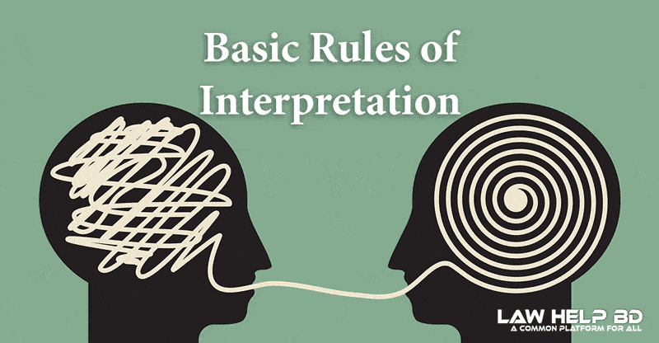
Interpretation Uncertainty
Unpredictable outcomes
Unequal application
Strategic litigation
Lack of Legislative clarification
Undue dependence on Rulings by AAR

Slide 37

CA. Arun Kumar Agarwal
Idt.info@knjainco.com
+91-93310 22438

