Slide 1
Startups and MSME
CA IP SWATI SINGHANIA

Slide 2
Startups

Slide 3
Startups – An Intro

Slide 4

Startup
Entity is working towards innovation, development or improvement of products or processes or services, or if it is a scalable business model with a high potential of employment generation or wealth creation.

Slide 5
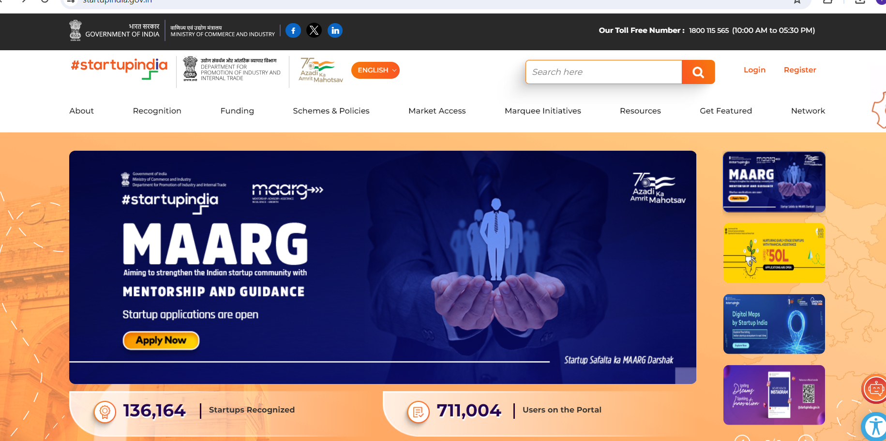
Main Source

Slide 6
Criteria Summary
Sn | Eligibility Criteria for being recognised as a “Startup | Apply
1 | Is a private limited company, or limited liability partnership or Registered Partnership Firm. | ✓
2 | Turnover should be less than INR 100 Crores in any of the previous financial years | ✓
3 | Has not completed a period of ten years from the date of incorporation | ✓
4 | The Startup should be working towards : Innovation/ improvement of existing products, services and processes and Should have the potential to generate employment/ create wealth. | ✓
5 | It is not formed by splitting or reconstructing an existing company. | ✓

Slide 7
HOW TO GET RECOGNISED AS A STARTUP?
DPIIT stands for Department for Promotion of Industry and Internal Trade. Under the Startup India Initiative, eligible companies can get recognised as Startup by DPIIT, in order to access the benefits available to it.

Slide 8
HOW TO GET RECOGNISED AS A STARTUP?
Main Questions to be answered
What is the problem the startup is solving?
How does your startup propose to solve the problem?
What is the uniqueness of your solution?
How does your startup generate revenue?

Slide 9
HOW TO GET RECOGNISED AS A STARTUP?
Name and CIN of the entity | Industry
Incorporation/Registration Date and Certificate | Nature of entity
PAN of company | Mention website link, if any
Address | Current number of employees
Details of Authorized Representative | Details of Directors of Company
Details of Intellectual Property Rights | Attach Pitch Deck
Whether there is new innovation or improvement to an existing product, service or process. | Is the startup creating a scalable business model with high potential of employment generation or wealth creation
Whether any funding has been received by the startup | Details of Awards/Recognition received by the entity
Name and CIN of the entity | Industry

Slide 10
Startups – Tax Benefits

Slide 11
BENEFITS
Exemption from Income Tax u/s 80IAC- The entity registered under Startup India Scheme can avail exemption from payment of income tax for 3 consecutive years out of the first 10 years from the date of incorporation of the entity.
To avail this benefit after getting recognition the Startup has to separately apply to the Inter-Ministerial Board. The said benefit is available for the startups registered on or after 01st April 2016.

Slide 12
BENEFITS
Exemption from Income Tax u/s 80IAC- The entity registered under Startup India Scheme can avail EXEMPTION from payment of income tax for 3 CONSECUTIVE YEARS out of the first 10 years from the date of incorporation of the entity.
To avail this benefit after getting recognition the Startup has to separately apply to the Inter-Ministerial Board. The said benefit is available for the startups registered on or after 01st April 2016. The following are some of the major points to be kept in mind before applying for Startup India tax benefits:
Partnership Firms Not Eligible
Inter-Ministerial Board Approval is needed to avail the exemption
DPIIT Recognition is a must

Slide 13
BENEFITS
Section 54GB Capital Gains Exemption : Section 54GB was amended by the Finance Act, 2016 to provide an exemption of capital gains arising out of the sale of residential property – if the same is invested in shares of startup company.
The main aim of this amendment was to provide relief to an individual or HUF who would like to setup or start a company by selling a residential property. However, this exemption is subject to the condition that the individual or HUF should hold more than 25% of shares of the company. Also that the company uses the amount invested to purchase new assets before the due date of filing of return by the investor.

Slide 14
BENEFITS
Section 56 Exemption- Startups are mainly funded through angel investors but such investment is taxable. To increase the funding for startups, the government has exempted registered startups from the tax levied on angel investors.
When shares are issued more than the Fair Market Value, the same is added to Income under Other Sources.
Investments into eligible startups by Accredited Investors, Non-Residents, AIFs (Category I) shall be exempt under section 56(2)(viib) of Income Tax Act.

Slide 15
Startups – Funding

Slide 16
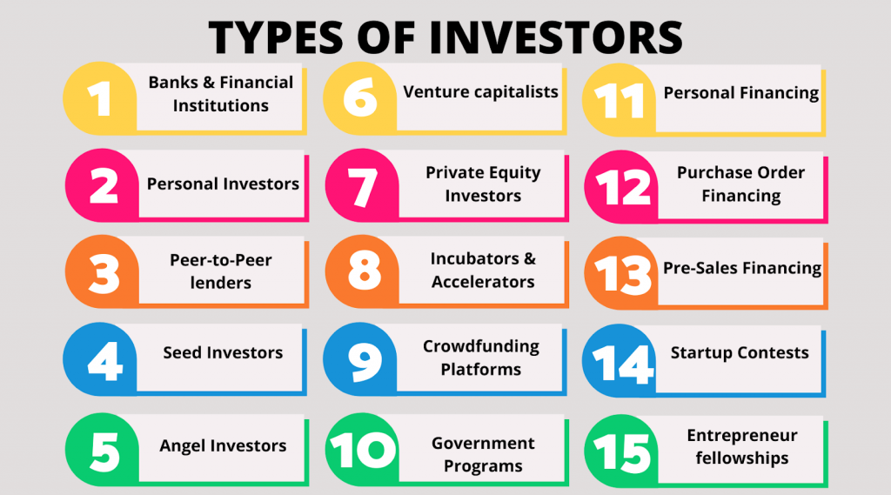
Types of Funding

Slide 17
Types of Funding

Slide 18
MSME
CA SWATI SINGHANIA

Slide 19
MSME
MSME employs more than 11 Cr. Indian population. (FY19)
They contribute almost half of Indian export & around 29% of the India’s GDP. (FY19)
More than 6 Cr. MSMEs actually contribute to this base of the India’s economic pyramid. (FY19)
Revised definition
Earlier only Manufacturing and Services were covered under MSME – but post July 2021 Even Wholesale and Retail Trade is covered under MSME – with few exceptions
Criteria | Capital | Turnover
Micro | 1 cr | 5 cr
Small | 10 cr | 50 cr
Medium | 50 cr | 250 cr

Slide 20
How to Register
CA Swati Singhania
It’s a complete online registration
https://udyamregistration.gov.in
Documents needed :
  Aadhaar Card of Owner / Director
  PAN of the Organisation
  Basic detail like Address, No. of Employees etc
  Current Financials – to fill in various details
  NIC Code ( National Industrial Classification)

Slide 21
MSME Support Schemes
CA Swati Singhania

Slide 22
MSME Scheme - Samadhan
CA Swati Singhania
Details | Who | Purpose | Benefits | Details
The buyer is to pay compound interest to the supplier on the amount at the 3x RBI Rate, in case payment is not made within 45 days of the acceptance of the goods/service. | Any Micro or small enterprise having valid Udyog Aadhar(UAM) can apply. | To get Faster recovery for MSME | MSEFC of the State after examining the case filed by MSE unit will instruct the buyer for payment of due amount along with interest. | Every reference made to MSEFC shall be decided within a period of 90 days. If the Appellant (not being the supplier) wants to file an appeal, shall be entertained by any court unless the appellant (not being supplier) has deposited with it, the 75% of the award amount.
Where Can you Apply:
www.samadhaan.msme.gov.in
Performance till date:
Applications filed :128,047
Cases Mutually Settled: 12,264
Cases Disposed : 21,044
Performance till date:
Applications yet to be viewed :31,993
Applications under consideration:32,124
Applications Rejected : 30,622

Slide 23
MSME Scheme – ISO Certification
CA Swati Singhania
Details | Who | Purpose | Benefits
The scheme provides incentives to those who have acquired ISO 9000/ISO 14001/HACCP certification. The scheme also now includes reimbursement of expenses for acquiring ISO 14001 certification. | Permanent registered micro and small enterprises (MSEs) are eligible to avail the incentive scheme. | The scheme is applicable to those units who have already acquired ISO-9000/ISO-14001/ HACCP certification. | Reimbursement of charges for ISO-9000/ISO- 14001/HACCP certification to the extent of 75% of expenditure - maximum of Rs.75,000.
Where Can you Apply:
https://www.dcmsme.gov.in/

Slide 24
MSME Scheme - SIP-EIT Scheme
CA Swati Singhania
Details | Who | Benefits
Financial support is provided for international filing in Information Communication Technologies and Electronics sector | MSME, Private Ltd Company, must be a technology incubation startup, Registered Software Technology Park unit | Reimbursement of Rs. 15 Lakhs per invention or 50% of the total charges of a patent application, whichever is lesser
Where Can you Apply:
http://www.ict-ipr.in/sipeit/SIPEITForm

Slide 25
MSME Scheme – MSME Innovative
CA Swati Singhania
Details | Who | Benefits
Offers legal and intellectual property filing support including patents, trademarks, copyrights, designs, geographical indications (GI) etc | FMSMEs with UAM/Udyam Registration. | Reimbursement for registration of Patent, Trademark, Geographical Indications (G.I.), Design: Foreign Patent - Rs. 5 Lacs Domestic Patent - Rs. 1 Lacs GI Registration - Rs. 2 Lacs Design Registration - Rs. 15 Thousand Trademark - Rs. 10 Thousand
Where Can you Apply:
https://my.msme.gov.in
Where Can you Apply:
https://innovative.msme.gov.in

Slide 26
MSME Funding Schemes
CA Swati Singhania

Slide 27
MSME Scheme - CGTMSE
CA Swati Singhania
Scheme Name | Who | Purpose | Benefits | Details
Credit Guarantee Scheme for Micro & Small Enterprises (CGTMSE) | Entrepreneurs | Facilitating credit guarantee support for collateral free / third-party guarantee-free loans to the MSME | Credit guarantee for loans up to Rs. 2 crores, without collateral and third-party guarantee. Guarantee coverage : 85% - 75% and Retail : 50% | In case of default, the trust settles the claim up to 75% of the amount in default of the credit facility extended by the lending institution for credit facilities up to 200 Lakhs.
Where Can you Apply:
Most of the Bank and NBFCs : 141
Performance FY22:
Guarantees Approved :Rs.56,172 cr
Guarantees Approved : 7 Lacs
Related Links:
www.udaanformse.in
www.cgtmse.in

Slide 28
MSME Schemes – CGSS
CA Swati Singhania
Scheme Name | Who | Purpose | Benefits | Details
Credit Guarantee Scheme for Start-ups | Start-ups : Registered with DPIIT Stable Revenue in last 12 months No Bank default | Issued as : Venture debt, working capital, subordinated debt, debentures, OCD etc. If OCD getting converted to equity - the debt will be reduced to the extent of conversion. | Maximum Rs. 10 cr Collateral free Balancing gurantee cover, if used some where also | No Default Running Operations / Stable Revenue / DPIIT Registered
Launched in :
October 2022
Also gives Umbrella Guarantee to AIF

Slide 29
MSME Schemes – Stand up India
CA Swati Singhania
Scheme Name | Who | Purpose | Benefits | Details
Stand Up India Scheme / 59 Minutes Scheme | Women or SC/ST. In case non individual entity – they should have at least 51% holding. | Setting up new enterprise in Manufacturing / Trade / Service. Only Greenfield Projects. | Limit - Rs.10 lacs to Rs.1 Crore with discounted interest rate maximum at MCLR+3%. No Collateral | There should be no previous Default of the applicant. Security may be granted by SIDBI. Upto 90% of Funding may be given by Bank
Where Can you Apply:
Most of the Bank and NBFCs : 80
Performance FY22:
Guarantees Approved :Rs.31,520 cr
Guarantees Approved : 1.4 Lacs
Related Links:
www.standupmitra.in

Slide 30
MSME Schemes - PMEGP
CA Swati Singhania
Scheme Name | Who | Purpose | Benefits | Details
Prime Minister’s Employment Generation Programme (PMEGP) | Any individual above 18 years, Society, Charitable Trust New Project Only | Bank-financed subsidy program for setting up new micro-enterprise in non-farm sector | Margin Money subsidy - from 15% to 35% varying for Rural/Urban & General/ Special Category. Manufacturing : Upto Rs.50 Lakh Service : Upto Rs.20 Lakh | Own Cont – 5-10%
Where Can you Apply:
KVIC / KVIBs / DICs
Scheduled Banks
Performance FY22:
Guarantees Approved :Rs.2694 cr
Margin Money Released : 93,358
Related Links:
www.kviconline.gov.in

Slide 31
MSME Schemes – 2nd Loan
CA Swati Singhania
Scheme Name | Who | Purpose | Benefits | Details
2nd Loan for up-gradation of the existing PMEGP/MUDRA units | Existing well performing PMEGP/MUDRA units | Further financial assistance scheme for expansion/ upgrade the existing MEGP/MUDRA units for manufacturing and Service/ Trading units | Maximum subsidy would be 15% of the project cost. The balance amount of the total project cost is provided by Banks as term loan. | First Loan has to be repaid. Max project Cost: Manufacturing : Rs.1.00 crore Service/Trading : Rs.25.00 lakhs
Where Can you Apply:
KVIC / KVIBs / DICs
Scheduled Banks
Related Links:
www.kviconline.gov.in

Slide 32
Questions?
CA Swati Singhania

Slide 33
I am reachable at :
Linkedin : @SwatiSinghania
Youtube : @SwatiSinghaniaFinance
Instagram : @Swatisinghaniamentor
Email : swati@theprimecfo.in

Slide 34
Thank You
CA SWATI SINGHANIA

