Slide 1

Corporate Restructuring – Navigating Exits, Mergers and Buyback
June 2024
Institute of Chartered Accountants – EIRC

Slide 2
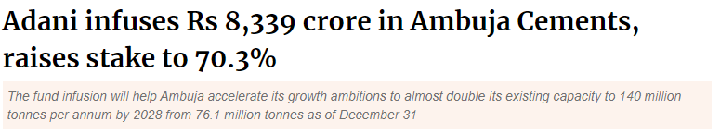
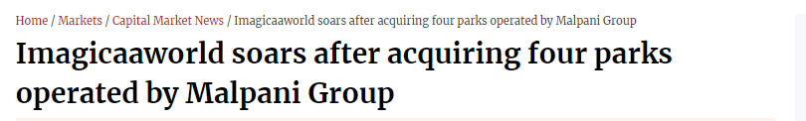



Recent M&A Deals in the News
2

Slide 3
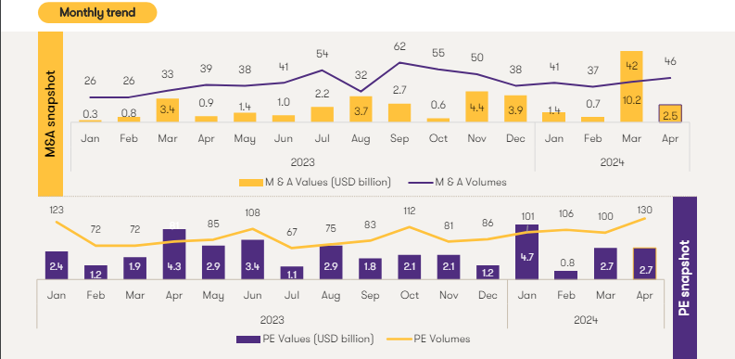
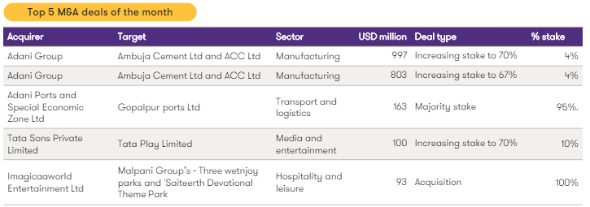
M&A Deal Activity | April ‘24 Snapshot
*Source – Grant Thornton Dealtracker April 2024
3

Slide 4
Major Modes of Transactions
Modes of Transactions
Acquisition
Business Restructuring
Business Transfer
Share Acquisition
Merger / Amalgamation
Demerger
Slump Sale
Itemised Sale
Primary Infusion
Secondary Transfer
Acquisition of business – not the company
Infusion of funds into the company
Funds received by seller shareholder
Consolidation of businesses / entities through NCLT Scheme
Carve out of specified businesses through NCLT Scheme
Slump Sale
Itemised Sale
Share Acquisition
Merger
Demerger
4

Slide 5
M&A | Key Commercial and Other Considerations
Commercial considerations
Accounting considerations
Valuation considerations
Capital / downside protection, Upside sharing
IGAAP vs. Ind AS
IPO Valuation / Market perception
Cash flows / IRR workings
Recording of Goodwill / Intangible
Valuation guidelines under different laws
Put / Call Options
Market Capitalization and Key Ratios
Scheme - Determination of Swap ratio
Exit strategies and Cash repatriation
Accounting of Financial Instruments
Deeming tax provisions in case of inadequate consideration

Slide 6

M&A | Management of conflicts
Tax Issues
Compliance with prescribed conditions for tax neutrality
Integration Management
Transfer of licenses and people
Valuation Considerations
How to deal with valuation mismatches ?
Interpretative variances of the law – Applicability of 56 (2) (x) for primary issuance of shares
Applicability of GAAR for proposed restructuring
Harmonization of policies, software etc.
Measure for smooth transition of control - Retaining KMP
Transfer at Book Value vis-à-vis Fair Value – Implications
Adequacy of consideration in light of deeming tax provisions
Tax Issues
Compliance with prescribed conditions for tax neutrality
Integration Management
Transfer of licenses and people
Valuation Considerations
How to deal with valuation mismatches ?
Interpretative variances of the law – Applicability of 56(2)(x) and 56(2)(viib)
Harmonization of policies, software etc.
Measure for smooth transition of control - Retaining KMP
Transfer at Book Value vis-à-vis Fair Value – Implications
Adequacy of consideration in light of deeming tax provisions
Applicability of GAAR for proposed restructuring
Regulatory Approvals
SEBI, CCI, NCLT
Stamp Duty
Whether setoff will be available in case if inter state mergers ?
Accounting and Commercial Approvals
Whether the transaction could result in recording Goodwill under IND AS ?
Leased Property – Prior approval of leasing authorities like MIDC etc.
Presence of sectoral Regulator such as RBI, IRDA etc.
Does it make sense to execute the transactions in a different location?
Reckoner value vis-à-vis Fair value mismatch
Impact of transactions on Market Capitalization and Key Ratios
Market perception of transaction
Stakeholder Approval
  Majority of Minority shareholder approval whether needed?
  Restrictive debt covenants
Stakeholder Approval
  Majority of Minority shareholder approval whether needed?
  Restrictive debt covenants
6

Slide 7
Modes of Transactions | Key Points for Consideration
Slump Sale
Negative net worth of business undertaking
Itemised Sale
Probable tax outflow in hands of the seller
Tax losses of transferor are not transferred
Tax losses of transferor are not transferred
MAT implications on profit as per the books of accounts
Share Transfer
Deemed income under Section 56(2)(x) if transfer made below fair value (Net Worth).
Step-up in the cost of the underlying business is NOT possible in share purchase.
Valuation of non-cash transaction in case of slump exchange
Transfer of shares of foreign subsidiaries under automatic route whether allowed?
Tax rates for depreciable assets (Short term capital gain)
Transfer pursuant to Offer for Sale → Determination of cost of acquisition under Section 55(2)(ac)
Merger / Demerger
Commercial rationale vis-à-vis tax benefits
Continuity of tax losses
Stamp duty cost
In case of listed entities → Majority of minority approval
Testing the “undertaking” concept in case of demerger
Treatment of non-compete fees
7

Slide 8
Major Modes of Transactions
A
M&A - Select Transactions

Slide 9
Demerger | Grasim Case Study
  Background & Key Issues:
    Under the Transaction, Aditya Birla Nuvo Limited (“Nuvo”) merged into Grasim Industries Limited (“Grasim”), and the consolidated undertaking was demerged into Aditya Birla Capital Limited (“ABCL”, erstwhile Aditya Birla Financial Services Limited), which was listed pursuant to the Demerger
    Issue 1: Deemed dividend upon receipt of shares u/s 2(22)(a) of the Income Tax Act, 1961
    Department’s Contention: As AO believed that the demerger was a non-compliant demerger the receipt of shares is a release of assets by the assessee and that there is a diversion of the profits of the assessee arising upon sale of shares of ABCL which could be treated as a distribution of dividend by the assessee.
    Assesses’ s Contention: The assessee referred to Section 2(22)(v) which specifically excludes distribution of shares upon demerger or merger from the definition of ‘dividend’. In addition, the assessee has made adjustments of the merger and demerger to the capital reserve and not revenue reserve and thus cannot be treated as distribution of accumulated profits.
    ITAT’s Decision: The ITAT relied on Section 2(22)(v) and CBDT circular dated 9th October 1967 which confirmed the view that deemed dividend cannot be invoked upon issuance of shares pursuant to merger and demerger.
Transaction Structure
Amalgamation of Nuvo into Grasim
1
Nuvo
(Listed)
Grasim (Listed)
=
100%
ABCL
2
9.77%
Demerger from amalgamated Grasim into ABCL (including 9.77% stake in ABFL)
90.23%
ABFL (Unisted)
9

Slide 10
Demerger | Grasim Case Study
  Background & Key Issues (Cont.):
    Issue 2: Treating Financial Services Business (“FSB”) as an undertaking for the purposes of Section 2(19AA)
    Department’s Contention: (i) The department opined that the assessee and ABNL (merged entity) was never engaged in FSB (ii) Substantial part of the undertaking transferred was on account of the investment in ABFL making it a non-compliant demerger
    Assesses’ s Contention: (i) The assessee directly indirectly, has been carrying out FSB and has a substantial amount of investment which reflects that the assessee participates in FSB (ii) The assessee provided a list of assets and liabilities that were transferred (i.e. employees, contracts, fixed assets to name a few) and the investment in ABFL is also a part of the same undertaking.
    ITAT’s Decision: (i) The ITAT confirmed that even though FSB was not the main business of the assessee, however, it was one of the business segments and the magnitude of the investment is substantial to justify the same. (ii) The ITAT believes that the assessee has transferred all the assets and liabilities that are pertaining to the undertaking not excluding any asset or liability belonging to such demerged undertaking and thus can be treated as an undertaking making it a tax compliant demerger.
Transaction Structure
Amalgamation of Nuvo into Grasim
1
Nuvo
(Listed)
Grasim (Listed)
=
100%
ABCL
2
9.77%
Demerger from amalgamated Grasim into ABCL (including 9.77% stake in ABFL)
90.23%
ABFL (Unisted)
Applying the facts of the said case, if the value of investments transferred pursuant to the Demerger is a significant component of the Undertaking, there exists a significant GAAR risk that the transaction may be treated as a non-tax neutral demerger and consequent tax implications would follow.
10

Slide 11
Delisting | ICICI Securities - Mechanics
Mechanics
Resultant Structure
Shareholders
Shareholders
Public of ICICI Securities
100%
Issues of shares as consideration
2
ICICI Bank
(Listed Hold Co)
Public Shareholders
ICICI Bank
(Listed Co)
100%
74.85%
25.15%
1
Cancellation of shares to Hold Co
ICICI Securities (Unlisted Co)
ICICI Securities
(Listed Sub Co)
Background
ICICI Bank Limited (‘Hold Co’) is listed on BSE and NSE. Further, Hold Co holds 74.85% in ICICI Securities (‘Sub Co’) which is listed on BSE and NSE. Both Companies are in similar line of business as defined under SEBI Circular SEBI/HO/CFD/DIL1/CIR/P/2021/0585 dated 6th July 2021
Sub Co. intends to delist its shares from the Stock Exchanges.
Special Delisting Regulations
Part C of the Delisting Regulations provide for the delisting of a listed subsidiary having a listed holding company (provided both are engaged in same line of business) through a NCLT Approved Scheme of Arrangement where:
The shares held by the public shareholders in the Listed Sub Co will get cancelled;
In lieu of such cancellation, Hold Co. will issue its own shares. This will result in Sub Co. getting delisted without following the RBB process and becoming a wholly owned subsidiary of Hold Co.
11

Slide 12
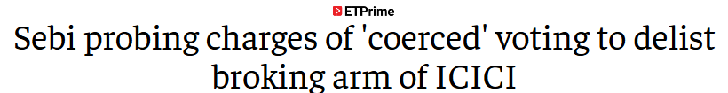
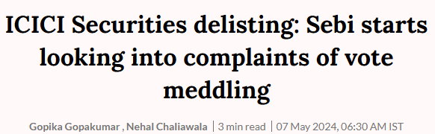
Delisting | ICICI Securities - Salient Features
Salient features of the Scheme
Rationale:
ICICI Bank offers a suite of banking services whereas ICICI Securities offers a suite of investment and personal finance services
Though there are business synergies, consolidation by way of merger is not permissible on account of regulatory restrictions on the Bank from Undertaking securities broking business departmentally. So, with the delisting, the ICICI Securities will become a 100% subsidiary and both entities will be able to capitalize on the synergies better
Consideration:
Equity shares held by the Public Shareholders in ICICI Securities shall stand cancelled and the equity shares of the ICICI Securities shall get delisted.
In lieu of the same, the Public Shareholders of ICICI Securities shall be allotted 67 equity shares of ICICI Bank for every 100 equity shares held in ICICI Securities. As a result, ICIC Securities will become a wholly owned subsidiary of ICICI Bank.
ESOPs:
All employees holding ESOPs in ICICI Securities shall receive ESOPs in ICICI Bank based on the Share Exchange ratio and the ESOPs held in ICICI Securities shall get cancelled
12

Slide 13








Delisting | ICICI Securities - Conditions
Approval by Shareholders
Issue of equity shares by Listed Hold Co
Hold Co – Votes cast in favor by Public SH are more than votes casts against it
Sub Co – Votes cast in favor by Public SH are twice the votes cast against it
The Listed Hold Co. shall issue its own equity shares in lieu of equity shares in the subsidiary company such that Listed Sub Co. shall become a WoS of Listed Hold Co. on delisting
08
01
Relisting of Sub Co.
07
Minimum time of Listing
No relisting of Sub Co. for a period of 3 years from the date of NCLT order approving the Scheme
02
Shares of Listed Hold Co. and Sub Co. are listed for at least 3 years and shall not be suspended while taking this route
Key Conditions for delisting of Subsidiary through NCLT Scheme
Further Restructuring
06
03
Holding-Subsidiary relationship
No further restructuring by the Listed Hold Co. for a period of 3 years from the date of NCLT order approving the Scheme
List Sub Co. should have been a subsidiary of Listed Hold Co. for the past 3 years
05
04
Valuation of Sub Co.
Adverse Orders
Shall not be less than 60 days volume weighted avg price
No Adverse orders passed by SEBI against both cos. in the past 3 years
Notes:
Logic for Conditions
Hold Co voting in line with SEBI Master circular on schemes (majority of minority). Voting of Sub co in line with delisting voting regulations
No Further Restructuring – As per the SEBI Board Agenda – Frequent restructuring indicates that the prospects of the company are unstable. This will lead to fear in public category regarding uncertainty/stability. In order to gain public investor confidence, necessary to provide this condition
Same line of business

Slide 14
Delisting | ICICI Securities – Watch out for…
Taxability in the hands of Public Shareholders on cancellation of shares held in Sub Co and corresponding issue of shares by Hold Co - No specific exemption provided under Section 47 of the Income Tax Act, 1961
No grandfathering of period of holding of shares held in Sub Co. – restart of period of holding from the date of allotment of shares by Hold Co
Considering the words used are ‘Cancelled’ and not ‘Sale/transfer’, Hold Co shall not receive any shares in the Sub Co pursuant to the Scheme – No step up of cost for Hold Co equivalent to the FMV of the shares issued
Post the delisting, ICICI Bank will not be permitted to undertake any further restructuring for a period of 3 years. The term ‘restructuring’ has not been defined – Whether the same include both internal as well as external restructuring?
Deemed dividend implications in the hands of Sub Co on cancellation of shares – Approx INR 2,200 Crs accumulated profits (as per audited FS on 31st March 2022)

Slide 15
Itemised Sale | Case of Mahindra
Issue for discussion:
Mahindra Engineering & Chemical Products (‘Company’) transferred trademarks, copyrights, technical know- how, assets and goodwill pertaining to Sealant and Adhesive Business to Pidilite Industries Ltd. (‘PIL’) for consideration.
Company and PIL entered into 9 agreements:
Main agreement,
Deed of assignment of Trademark, Deed of transfer of part interest in Trademark, Deed of assignment of Goodwill, Deed of assignment of Copyright, Non-compete agreement,
Contract manufacturing agreement,
Assets purchase agreement,
Agreement for purchase of technical know-how.
The tax return treated the sale of assets as an itemised sale. Consideration received towards non- compete fee, sale of goodwill, technical know – how, trademarks, and copyright was not offered to tax in the tax return treating it as capital receipt.
AO passed an order accepting the stand of the assessee. The Commissioner found AO’s order erroneous and against the interest of revenue and passed an order against it.
Should the various transactions of the tangible and intangible assets be considered as Slump Sale as opposed to itemised sale?
Consideration
Mahindra Engineering & Chemical Products Ltd.
Pidilite Industries Limited
Sealants and Adhesive Business (transferred by way of 9 agreements)
Subsequent to CIT (A)’s order, AO issued a fresh notice and held the transaction to be a case of slump sale.
Assessee’s Contention – Various transfers were not in nature of slump sale but were sale of individual tangible and intangible assets of business at Arm’s Length Price.
CIT(A) Order - held that AO was justified in treating the sale of the business division as slump sale.
Conclusion – While the act defines slump sale as a sale of an undertaking for a lumpsum consideration, the Tribunal has looked into the substance of all the agreements read together & considered the transaction to be as slump sale and not itemised sale.

Slide 16
Major Modes of Transactions
A
M&A – Reverse Flipping

Slide 17
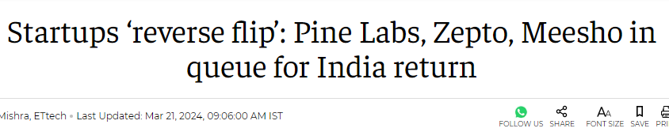
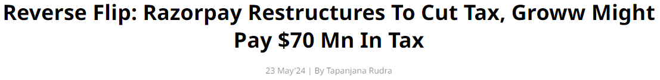

Reverse Flipping | Transactions in the News
Reverse Flipping – Contemplated / Ongoing Transactions
Name of Company | Jurisdiction of Foreign Co. | Mechanics
Razorpay | USA | Inbound Merger
Groww | USA | Inbound Merger
PhonePe | Singapore | Share Swap
Pine Labs | Singapore | Inbound Merger
17

Slide 18
Reverse Flipping | Overseas Listings in India
Structuring Options:
Option 1: Merger of Overseas Entity with Indian Entity
This will be subject to allowability of outbound merger in the jurisdiction of the transferor company
Merger to be tax neutral subject to laws of the overseas jurisdiction
Option 2: Liquidation of Overseas Entity
Shares held by Overseas Entity in Indian Entity to be distributed to the shareholders of Overseas Entity
Tax implication in the hands of Overseas Entity upon liquidation as per the law of the overseas jurisdiction
Capital Gain tax implications in the hands of the Shareholders:
  Indian Shareholder → Liable to Capital gains tax in India
  Foreign Shareholder → Basis the law of the jurisdiction of residency
Option 3: Transfer + Dividend (future event)
Overseas Entity to transfer its stake in Indian Entity at a future date upon trigger of exit event.
  Capital Gain tax implications in the hands of shareholders similar to Option 2 above
  Upstream of proceeds to Shareholders of Overseas Entity as Dividend as under:
  Indian Shareholders → Taxable in India
  Foreign Shareholders → Basis the law of the jurisdiction of residency
Foreign Shareholder
Indian Shareholder
Overseas Entity
Overseas Business
Overseas
India
Indian Entity
Indian Business
Listing opportunities in Indian markets being increasingly explored by foreign Hold Cos.
18

Slide 19
Reverse Flipping | Key Points for Consideration
Tax neutrality of inbound Mergers / Demerger in the Overseas Jurisdiction and in India
Valuation of shares of the Overseas Co. with respect to swap of shares of India Co.
Allowability of migration of Overseas Co. accumulated losses with India Co., if any
19

Slide 20
Major Modes of Transactions
A
M&A – Insolvency and Bankruptcy Code

Slide 21
IBC | Write-back of Unsustainable debt of Corporate Debtor
Erstwhile Stakeholder
Option 1 (routed through P&L)
Extinguishing unsustainable debts through P&L
Resolution Applicant
Option 2 (routed through Balance Sheet)
Converting unsustainable debts into Equity
Undertaking Capital reduction to right size the CD
Corporate Debtor
Equity & Liabilities | INR Crs | Assets | INR Crs
Equity Share Capital | 10.0 | Fixed Assets | 20.0
Reserves | (30.0) | Investments | 5.0
Borrowings/ Loan | 50.0 | Trade Receivables | 10.0
Other Creditors | 15.0 | Inventories | 10.0
Total Liabilities | 45.0 | Total Assets | 45.0
Option 3 (No adjustment in books of CD)
Purchase unsustainable debts from Financial Creditors
Can convert Purchased debt to Equity
B/f Losses of INR 30 Crs
Bid Value – INR 10 Crs (to bank)
Write-back of debt INR 55 Crs

Slide 22


IBC | Write Back of Loans - Tax Implications
Trigger Point
Whether waiver of loan by the Lenders pursuant to resolution plan will be taxable under normal and MAT provisions in the hands of Corporate Debtor?
Landmark Judgements
The tax authorities has contended in past that waiver of loan shall be taxable either under section 41(1) or 28(iv) of the IT Act. Landmark judgments on the same are discussed below:
Mahindra and Mahindra Ltd
- Supreme Court¹
Rollatainers Ltd
-Delhi HC²
Sri Vasavi Polymers (P.) Ltd.
- Vizag ITAT³
JSW Steel Limited
- Mumbai ITAT⁴
Section 28(iv) was not applicable as the amount waived was receipt in the nature of cash/ money (this no longer applies as benefit in the form of cash has been covered under the ambit of section 28(iv) w.e.f. 1.4.24.
Section 41(1) is also not applicable as waiver of loan does not amount to cessation of trading liability and the assessee has not claimed deduction in the earlier years
Waiver of working capital loan utilized towards day to day business operation was taxable under section 41(1) in the year of waiver.
Section 28(iv) was not applicable as the amount waived was receipt in the nature of cash/ money. (this no longer applies as benefit in the form of cash has been covered under the ambit of section 28(iv) w.e.f. 1.4.24.
An amount can be brought to tax under section 41(1) only when benefit received by assessee relating to such expenditure has been claimed and allowed in earlier years
Section 28(iv) of the IT Act does not apply in the present case since the receipt was in the nature of cash or money. (this no longer applies as benefit in the form of cash has been covered under the ambit of section 28(iv) w.e.f. 1.4.24.
It was held that a receipt which could never enter the stream of taxation either under the normal provisions of the Act or under 115JB, then the said receipt neither constitutes profit nor revenue nor income nor any kind of gain which needs to be included in the net profit
¹ CIT vs Mahindra and Mahindra [2018] 404 ITR 1 (SC)
²Rollatainers vs CIT [2011] 15 taxmann.com 111 (Delhi HC)
³ITO vs M/s Sri Vasavi Polymers P.Ltd. [2020] 117 taxmann.com 236 (ITAT Visakhapatnam)
⁴ JSW Steel Limited vs ACIT [2017] 82 taxmann.com 210 (Mumbai)

Slide 23


IBC | Write Back of Loans - Implication u/s 194R
Implications of Section 194R on write back of loans (Inserted from 1st July 2022)
Extract of Section 194R
“(1) Any person responsible for providing to a resident, any benefit or perquisite, whether convertible into money or not, arising from business or the exercise of a profession, by such resident, shall, before providing such benefit or perquisite, as the case may be, to such resident, ensure that tax has been deducted in respect of such benefit or perquisite at the rate of ten per cent of the value or aggregate of value of such benefit or perquisite”
Potential arguments for non-applicability of Section 194R:
Waiver or remission of loan cannot constitute revenue income as it is a capital transaction
Waiver or remission is not in course of business or exercise of profession (but pursuant to OTS)
At the time of execution of the business transaction, the one party should give to the other party some irretrievable benefit or advantage and since waiver of loan is not agreed at the time of its grant, it cannot be treated as a benefit.
Income should be real income and not fictional income (as there is a remission of liability but no accrual or receipt of income perse).

Slide 24
Major Modes of Transactions
A
Initial Public Offer

Slide 25

Initial Public Offer | Why IPO
Raising funds for Company
market perception
Exit for the financial investors
Management control and corporate governance
Value unlocking / price discovery
PE investor vis-à-vis IPO
25

Slide 26
Initial Public Offer | M&A in IPO – Key Triggers
Promoter/ Investor considerations
Trigger Points
Possible Steps to be undertaken
Leaner business structure
Multiple entities with similar businesses/ tiered structure resulting in value discounting
Consolidation of business into a single entity by way of Amalgamation or Slump Sale
Presence of unrelated businesses in the entity
Segregation of unrelated business to another group Co. by way of Demerger or Slump Sale
Non-Core businesses/ Unrelated businesses
Existence of surplus real estate / other assets having substantial market value
Extraction of surplus real estate / other assets into another group co.
Surplus Real Estate/ other assets
Availability of surplus cash balance (not required for core business)
Can be extracted by way of Buyback / Dividend
Surplus Cash / Bank balance
26

Slide 27
Major Modes of Transactions
A
Family Settlement

Slide 28
Godrej Family Settlement | Family Structure
Phirojsha Godrej
Ardeshir Godrej
Burjor
Dosa
Sohrab
Naval
Group A
Godrej Industries Group
Group B
Godrej Enterprises Group
Adi
Nadir
Rishad
Jamshyd
Smita
Tanya
Sohrab
Raika
Freyan
Nisaba
Burjis
Navroze
Nyrika
Phirojsha
Hormazd

Slide 29
Godrej Family Settlement | Key Mechanics (1/2)
2
Promoters
(Group A)
1
Promoters
(Group B)
Public
X
33.11% + 34.05%
Transfer of shares
X
32.84%
30.72% + 30.71%
34.05%
30.71%
Godrej Seeds & Genetics Limited
Godrej Industries Limited
27.42%
23.74%
47.34%
64.90%
Godrej Consumer Products Limited
Godrej Properties Limited
Godrej Agrovet Limited
Other Entities
7.33%
3.83%
64.76%
Innovia Multiventures Private Limited
Astec Lifesciences Limited
Godrej & Boyce Manufacturing Company Limited
X
X
3
Listed
2.68%
X%
40% + 40%
40%
Promoters
(Group A)
Promoters
(Group B)
Unlisted
Godrej Infotech Limited
Godrej Holdings Private Limited
4
Y% + X%

Slide 30
Godrej Family Settlement | Resultant Structure
Promoters
(Group A)
Public
61.43%
80%
67.16%
32.84%
Godrej Seeds & Genetics Limited
Innovia Multiventures Private Limited
Godrej Industries Limited
27.42%
23.74%
2.68%
47.34%
64.90%
Godrej Consumer Products Limited
Godrej Properties Limited
Godrej Agrovet Limited
Other Entities
7.33%
3.83%
64.76%
Astec Lifesciences Limited
Godrej & Boyce Manufacturing Company Limited
Promoters
(Group B)
Listed
Unlisted
Godrej Infotech Limited
Godrej Holdings Private Limited

Slide 31
Godrej Family Settlement | Watch out for…
Tenability of “Family Settlement” principle for non-applicability of capital gains upon transfer of shares
Applicability of Section 56(2)(x) in the hands of the family members (others than those falling under the definition of relatives) upon receipt of capital assets as a consideration to family settlement
Open offer exemption for inter-se promoter transfer – SEBI view
Applicability of GAAR upon family settlement

Slide 32
Major Modes of Transactions
A
M&A - Other Key Factors

Slide 33


Section 56(2)(viib) | Exemptions to Start-up and AIFs
Prohibited Investments
Should not hold the following assets –
residential building / land (except for renting or stock-in-trade in course of business)
land or building (except used for its business or used for purposes of renting or stock-in-trade)
loans and advances (except in course of business)
capital contribution made to any other entity;
shares and securities;
modes of transport exceeding INR 10 Lakhs (other than in the ordinary course of business);
jewelry (except stock in trade)
archaeological collections, drawings, paintings, sculptures, any work of art and bullion
Registration as Start up
56(2)(viib) shall not apply to Companies which have obtained registration with DPIIT as start up
Consideration
Consideration received by eligible Start-ups for shares issued or proposed to be issued shall be exempt up to an aggregate limit of Rs. 25 crore.
The aggregate limit of Rs. 25 crore will exclude consideration received by eligible Start-up for the following classes of persons:
i. Non-Residents
ii. Alternative Investment Funds (Category-I) registered with SEBI
iii. Listed company having a net worth of Rs.100 Crores or turnover of at least Rs. 250 crore provided that its shares are frequently traded.
Investment by VCF
venture capital undertaking from a venture capital company or a venture capital fund or a specified fund

Slide 34
Section 56(2)(viib) | Valuation on Primary Infusion - Angel Tax
Provision under Sec 56 (2) (viib)
To tax any excess premium received by a closely held company upon the issue of shares
Not applicable - Money received by registered Start-up or Money received from following prescribed entities:
Prescribed entities
Methodologies Prescribed (Valuation Price)
Venture Capital Funds;
Alternative Investment Funds (Category I and II)
Government related investors like Central Bank, SWFs, International and multilateral organization;
Banking and Insurance entities;
Cat I Foreign Portfolio Investors;
Pension Funds;
Investment Funds with more than 50 investors;
At the option of the assessee:
Net asset method
Discounted Cash Flow method (as per the merchant banker)
Receipt of consideration from a (i) VCF or (ii) venture capital company or (iii) specified fund → The price of equity shares corresponding to such consideration to be taken as fair market value (FMV shall not exceed the aggregate investment value)
At the option of the non-resident assessee (in addition to the three aforesaid valuation methods):
Comparable Company Multiple Method
Probability Weighted Expected Return Method
Option Pricing Method
Milestone Analysis Method
Replacement Cost Methods
  Further, for the consideration received from any investor, by an amount not exceeding 10% of the Valuation Price, the issue price shall be deemed to be the fair market value of such shares.

Slide 35
Section 281
Section 281 of the IT Act requires an assessee to obtain the permission of the assessing officer before creating a charge on certain assets or transfer of certain assets in the event there are ongoing tax proceedings or pending claims/demands against such assessee.
The seller shall have a no - objection certificate issued by the AO, under the provisions of Section 281 for the transfer of Sale Shares.
Practical Approach : Obtain status of Tax Demands etc. from auditor/ accountant.
The Income Tax Department can deem any transaction by sale, gift, exchange or mortgage as void if one fails to get prior permission and certificate.
In most cases, in a M & A or in a secondary sale of securities, the purchaser insists on Section 281 Certificate to de-risk a possibility of a tax claim which in turn would impact legal title of the assets transferred.
Requirement of 281 Certification in case of Slump Sale?
Details of Section 281 Application Form
PART A : General Particulars
PART B : Status of outstanding Demand
PART C : Particulars of Assets
PART D : Particulars of Proposed Transaction
Procedure for obtaining certificate u/s 281
Assessees should send the application form in a prescribed format, titled ‘Application u/s 281 of the IT Act, 1961.’
The filing of the form should take place at least 30 days before the proposed transaction date.
An Assessing Officer can grant prior permission or a no-objection certificate subject to fulfillment of certain conditions.
35

Slide 36
Major Modes of Transactions
A
Overseas Direct Investment

Slide 37
Overseas Direct Investment | Summary
Relaxations with respect to Round Tripped Structures subject to compliance with prescribed conditions
Limits of Investment unchanged; 400% of net worth; or
USD 1 billion;
whichever is lower
ODI on Deferred Basis now permissible upto definite period provided in Agreement and subject to Pricing Guidelines
Investments in Startups can only be made from internal accruals from the Indian Entity or Group / Associate Companies
ODI REGULATORY FRAMEWORK
Corporate Guarantees now under Automatic Route to Second Level SDS
(earlier under Approval Route if 51% stake held)
Cash OPI Investments still not permissible for Unlisted Entities; OPI by way of swap, M&A, capitalization of profits and rights / bonus allotment allowed upto 50% of net worth
Amended definition of “Net Worth”:
Now Securities Premium is included (as it refers to 2(57) of Companies Act, 2013)
Net Worth of Holding / Subsidiary Companies may not be considered from now onwards

Slide 38

Overseas Direct Investment | Round Tripping
  Permissibility of Round Tripping
Erstwhile Law
FAQ 64 placed a blanket prohibition on any and every scenario of Round Tripping i.e. on investments by Indian Party, in JV / WOS, having direct / indirect investment in India.
New Law
Rule 19(3) restricts round tripped structures having more than two layers of subsidiaries:
“(3) No person resident in India shall make financial commitment in a foreign entity that has invested or invests into India, at the time of making such financial commitment or at any time thereafter, either directly or indirectly, resulting in a structure with more than two layers of subsidiaries:”.
Effectively, round tripping upto two layers of subsidiaries is permissible under the new law.
Round Tripping guidelines are applicable qua financial commitment and not only with respect to equity investments.
Above restriction is not applicable to certain financial and insurance companies
Structure
Indian Entity
Indian Entity
Foreign Entity 1
Foreign Entity 1
Foreign Entity 2
India Co
India Co
“Two Layers”; to be construed with respect to the Indian Entity or the Foreign Entity?

Slide 39
Overseas Direct Investment | Gift of Shares & Family offices
Gift of Shares
Internaltional Family offices
Receipt of shares as gift from NR does not require RBI approval
Financial service companies
Nominal gift tax implications on Book Value of shares received
International Family offices
Choice of jurisdiction
POEM issues

Slide 40
Major Modes of Transactions
A
GIFT City

Slide 41
GIFT City | Overview
What is GIFT City?
India’s first operational Greenfield Smart City
Established with an aim to help India realize its potential in the international financial services industry
A Global Financial & IT Hub with a Domestic Tariff Area & a Multi Services SEZ
Domestic tariff area (DTA) for business related to India operations
What is IFSC?
An IFSC caters to the customers outside the jurisdiction of domestic economy which deals with the flow of finance, financial products and services across the borders
IFSC “is a jurisdiction that provides financial services to non residents and residents ( in any currency other than Indian Rupee(INR)”
GIFT Business platforms
Notified International Financial Service Centre (IFSC)
What is IFSC Authority?
IFSCA established as a Unified financial regulator under the IFSCA Act, 2019 combining powers of RBI, SEBI, PFRDA and IRDAI
IFSCA is mandated to develop and regulate financial institutions, financial services and financial products within the IFSC in India
Multiservice Special Economic Zone (SEZ)
Key Features – IFSC Unit:
Treated as a ‘non-resident’ under FEMA and as a ‘Tax Resident’ under the Income Tax Act
Several tax benefits on transactions in the GIFT City including 10 year Tax Holiday on the business income and lower rate of MAT @ 9% on book profits
Several relaxations on the applicability of the Companies Act, 2013
IT and ITeS, Other services export

Slide 42
GIFT City | IFSC – Business Activities
BANKING
Indian Banks
Foreign Banks
CAPITAL MARKETS
Stock Exchanges
Clearing Corporation
ASSET MANAGEMENT
Fund Management Entities
Alternate Investment Funds
Global Administrative Office
Rep. Offices
International Depository
Broker Dealers
Investment Bankers
Investment Advisers
Portfolio Managers
Distribution Services
INSURANCE
Indian & Foreign Insurer
Indian & Foreign Reinsurer
NICHE INSTITUTIONS
International Bullion Exchange
Finance Companies
EMERGING BUSINSESS
Global Fintech Hub
Global in-House Centres
Insurance Intermediaries
Insurance Web-Aggregators
Global Treasury Centre
Ship Leasing & Financing
Aircraft Leasing & Financing
Sustainable Finance
Foreign Universities & Institutions
Professional Service Providers

Slide 43
Major Modes of Transactions
A
Budget 2023-24 – Expectations

Slide 44


