Slide 1

Financial Reporting Review Board (FRRB)
An Overview
The Institute of Chartered Accountants of India
(Setup by an Act of Parliament)

Slide 2



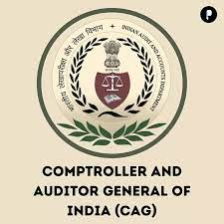





Partner in Nation Building – Supporting Regulators
MCA
SEBI
IRDAI
RBI
C&AG
ECI
NABARD
NITI AAYOG
CBDT
Undertakes review of cases referred by Regulators (MCA, SEBI, CAG, ECI)
Refer cases to Regulators where significant non-compliances affecting true and fair view of the financial statements are found (MCA, SEBI, RBI, IRDA)
Submits presentation to MCA on significant non-compliances observed
Special invitees from various Regulators (NABARD, CBDT, Niti Aayog) on Board
ICAI’s alliance with regulators proves to be instrumental in improving the financial reporting practices in India.

Slide 3

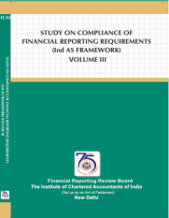
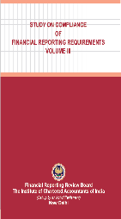
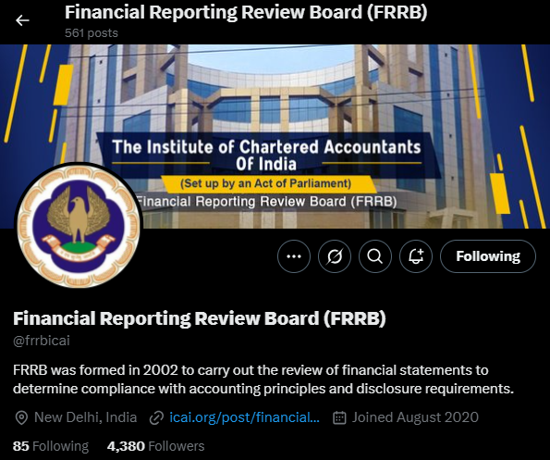

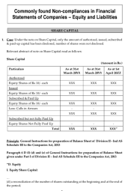

Scope of FRRB
Review of General-Purpose Financial Statements
Compliance with the generally accepted accounting principles
Compliance with the disclosure requirements prescribed by statues/ rules and regulations
Compliance with the reporting obligations
Publications:
Study on Compliance of Financial Reporting Requirements
X Handle: @frrbicai
More than 536 tweets and 4380 followers
Articles in ICAI Journal/ Mass Mails
Programs:
Webinar Series and Awareness Programs on Financial Reporting Practices
Spreading Awareness on pertinent observations

Slide 4
Composition and Independence of the Board
SECURITIES AND EXCHANGE BOARD OF INDIA (SEBI)
COMPTROLLER AND AUDITOR GENERAL OF INDIA (C&AG)
CENTRAL BOARD OF DIRECT TAXES (CBDT)
INSURANCE REGULATORY AND DEVELOPMENT AUTHORITY (IRDA)
NITI AAYOG
CENTRAL BOARD OF EXCISE AND CUSTOM (CBEC)
NATIONAL BANK FOR AGRICULTURE AND RURAL DEVELOPMENT (NABARD)
Members having Professional and Regulatory experience like:
Central Council Members of ICAI
Government of India Nominees
Representatives from Regulatory Bodies
For ensuring INDEPENDENCE the following are excluded:
President and Vice President of ICAI
Members of Disciplinary Committees
Co-opted Members

Slide 5
Enterprises within the purview of FRRB
Entities whose equity or debt securities are listed or are in the process of listing on any stock exchange, whether in India or outside India
Banks (including co-operative banks), financial institutions or entities carrying on insurance business
All commercial, industrial and business reporting entities, whose ‘net worth’ exceeds rupees two hundred & fifty crore in the immediately preceding accounting year
Holding and subsidiary entities of given entities.
Such other enterprise which in the opinion of the Board may be undertaken for public interest, including the enterprises referred by regulators and undertaken based on media reports.

Slide 6
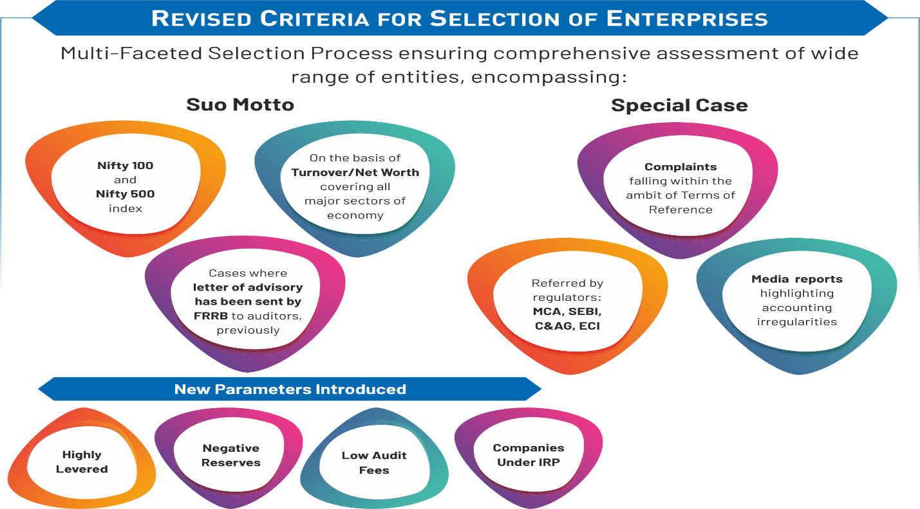
Selection of Enterprises for Review

Slide 7
Selection of Enterprises for Review (2025-26)
Selection Criteria | Number of Cases
Existing criteria:
Random Selection | 20
Nifty 500 | 25
Based on previously sent Advisories to auditors (Having highest number of observations in previous advisory) | 5
Insurance Companies (from database available on IRDA website) | 2
Additional criteria:
Highly Levered (Based on high Debt/Equity Ratio) | 5
Based on Negative General Reserve | 5
Based on Audit Fees to Turnover Ratio Enterprises having Total Income between:
Rs. 50 crores – Rs. 100 crores | 3
Rs. 100 crores – Rs. 200 crores | 3
Rs. 200 crores – Rs. 300 crores | 3
Companies under IRP (Not having modified opinion) | 4
Total | 75
Notes:
According to a global survey conducted by IFAC in 2022, the average audit fee to revenue ratio in major economies like the United States, Canada, and across Europe stands at approximately 0.27%.
However, in India, the scenario is quite different. An analysis of 1,000 active listed companies revealed that in most cases, the audit fee to total income ratio was significantly lower—below 0.05%.
To explore this further, FRRB selected companies with the lowest audit fee ratios across three revenue categories: ₹50–100 crores, ₹100–200 crores and ₹200–300 crores. Strikingly, in these segments, in 50 to 100 crores category, the lowest ratio was just 0.01% (approx.), while in case of 100-200 and 200-300 categories, it was as low as 0.003% (approx.). These findings raise critical questions about audit quality and fair remuneration for audit professionals in India.

Slide 8

Selection of Enterprises for Review
Reviews considered by the Board so far
Total Cases
1269
Special Cases
263
(21%)
Suo-Motto Cases
1006
(79%)

Slide 9
Review Mechanism – Three Tier Review
Level III
Level II
Review by the Financial Reporting Review Board
Level I
Review by a group of 5 Chartered Accountants (Financial Reporting Review Group) generally based in same city
Review by a Chartered Accountant known as Technical Reviewer

Slide 10
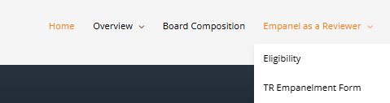
Review Mechanism – Three Tier Review
Empanelment of Technical Reviewer
Constitution of Financial Reporting Review Groups (FRRGs)
Given the critical role played by the TRs and FRRGs in the overall review process, the Board is implementing certain evaluation criteria for measuring the performance of TRs and FRRGs through the FRRB web portal.
This evaluation is aimed at assessing the quality of the reports submitted by the TRs and FRRGs.
A member, to be empaneled as a Technical Reviewer for Ind AS Financial Statements, needs to satisfy the following conditions:
Possessing minimum 7 years’ experience of audit and who are either currently active in the practice of accounting and auditing or are in Industry having comparable experience in the fields of Accounting and Auditing; and having exposure in preparation and finalisation or audit of Ind-AS based Financial Statements and
Qualified the Certificate Course on Ind-AS
Convenor of the FRRG, who shall be a member of the Board;
One member of the Institute, not being a member of the Council, who possess at least fifteen years of experience in practice and are active in the practice;
Members of the Institute, not being members of the Council, who have relevant Ind AS experience and possess at least 7 years of experience in practice and are active in the practice.
One member who has minimum three years’ post qualification experience, provided he/ she has done Ind AS Certification Course (from ICAI or other recognized Institution)
One academician of eminence from the fields of accounting and auditing; and
One representative from trade and industry/ users of the financial statements who need not be a member of the Institute.
*A maximum of 5 members, excluding Convenor, can be included in each FRRG.
The Technical Reviewer is being given honorarium of Rs. 20,000 per Annual Report
Each FRRG member is being given honorarium of Rs. 7,500 per financial statement

Slide 11
Action Taken Based on Review
Action taken after review
Material Non-compliance affecting True & Fair view of the Financial Statements
Action against the Auditor(s): Refer the case to the Director (Discipline)
Action against the Enterprise : Inform irregularity to the regulatory body relevant to the enterprise
Non-compliance, which are not material and does not affect the True & Fair view of the Financial Statements
Bring the non-compliance to the attention of the auditor by way of advisory. To make regulatory mechanism of the Institute more effective share relevant details with Peer Review Board so that it may accordingly be considered during the Peer Review

Slide 12
Audit Quality Maturity Model ( version 2.0)
AQMM v 2.0 is a cross –functional evaluation model to enable Audit firms to evaluate their current level of Audit Maturity and also identify areas where competencies need to be strengthened. The competency basis includes ‘Advisory issued by FRRB’ as well as ‘Held guilty by Director (Discipline) in cases referred by FRRB’.
Section | Competency Basis | Score Criteria | Score Basis | Maximum Score
i | Has any advisory been issued by FRRB or TAQRB and received by the firm/ any partner of the firm during the review period and the firm/ partner of the firm accepts the non compliances in the advisory and the reviewer confirms them while conducting the review? | Scoring based on Presence or Not. Yes/ No Answers | For Yes – (-5) Points for each advisory received subject to maximum of (-25) Points For No – 0 Point | Negative Points
ii | During the review period, has the firm/ any partner of the firm been held guilty in the PFO in case reference to Director (Discipline) was made by any of the following: • FRRB • TAQRB • PRB • QRB • C&AG • any other Government body other than NFRA | Scoring based on Presence or Not. Yes/ No Answers | For Yes – (-10) Points per order subject to maximum of (-50) Points For No – 0 Point | Negative Points
Notes:
The table indicates the competency basis related to Practice Management- Assurance on which the firm has to assign a score to itself. The score criteria define the factors on the basis of which the score basis has been arrived.

Slide 13
Action Taken by the Board Since Inception (Statistics)
Cases considered and finalised by the Board till date | Cases referred to Director (Discipline) of ICAI for further action where serious non-compliances observed* | Cases referred to Regulators (MCA, SEBI, IRDAI, RBI) relevant to the enterprises* | Reports sent to ECI on financial statements of political parties | Issued advisories to Auditors where major non-compliances observed
1269 | 201 | 179 | 35 | 788
* Cases reported under column 2 and 3, includes some of the cases which are mutually inclusive.
Note: Out of 1269 cases, 236 cases were filed.

Slide 14

Actions Taken by the Board Since Inception: Graphical

Slide 15
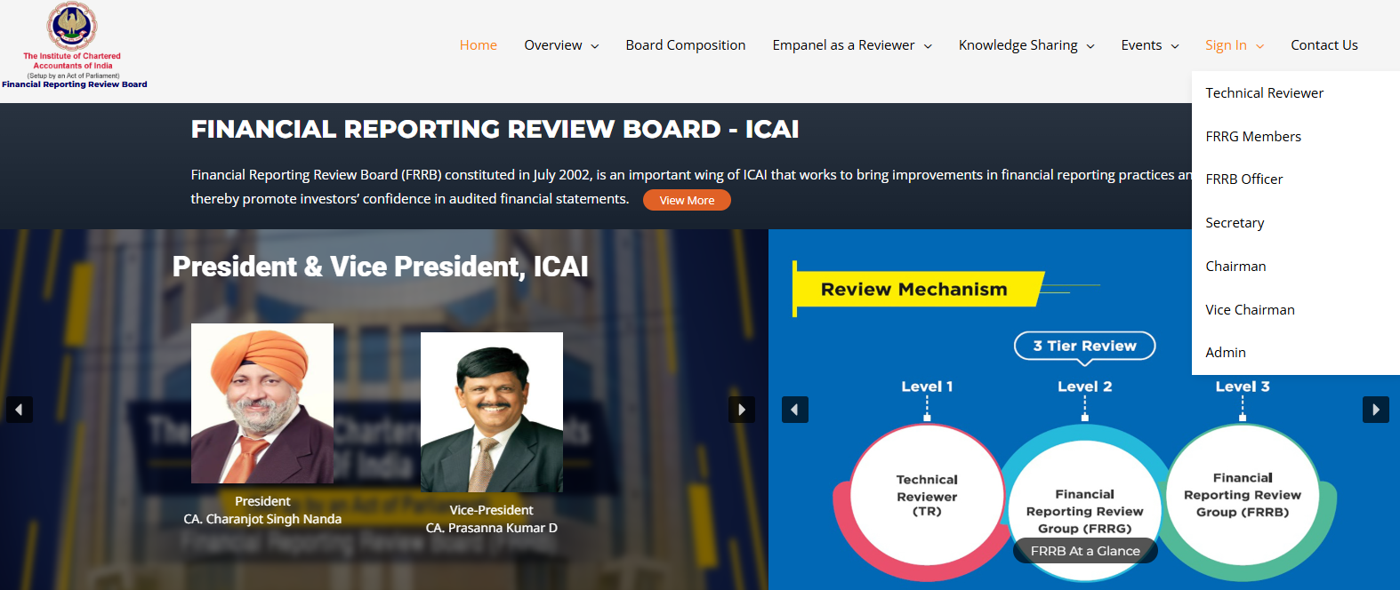





Web Portal of FRRB
Rule-Based Analytics
Work Flow Automation
Key Features of the Portal
Repository
Monitoring Work Progress
Advanced Search

Slide 16

Spreading Awareness among the Members
Released Volume III of FRRB Publication (Ind AS)
NOTABLE HIGHLIGHTS
More than 200 non-compliances
Covering 88 financial statements
Largest volume of Ind AS Publications of FRRB
From Insight to Impact
Contains graphical presentation on ‘Deficiencies Observed’
Ind AS wise analysis
Comprehensive Coverage
Well structured content with logical flow and conclusion
Inclusive concepts and their relevant technical requirements
Help auditors to identify potential red flags
Empowering Our Members
Real case studies from listed companies of various industries
Enhancing technical expertise to ensure compliances
Simple and concise language
Analysis based on elements of financial statements
Study on Compliance of Financial Reporting Requirements (IND AS Framework) Volume III (2024)

Slide 17
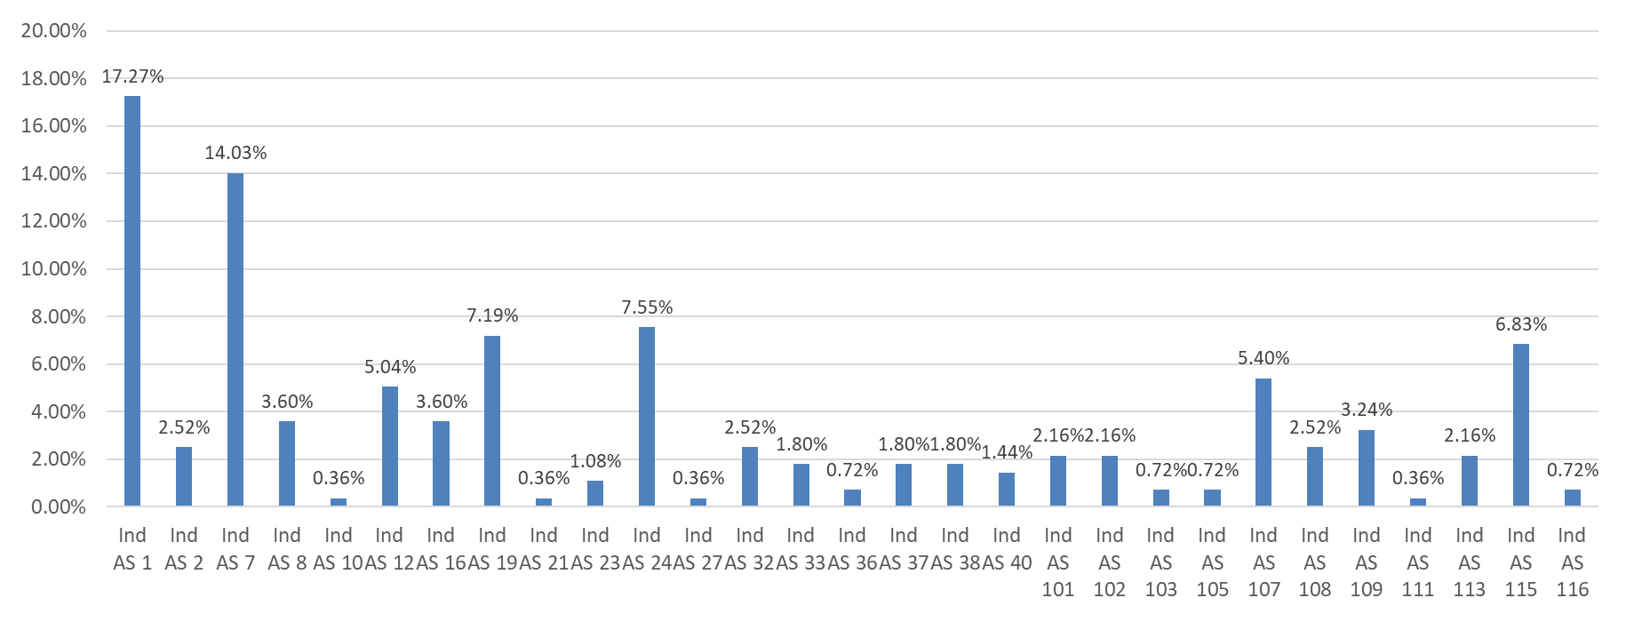
At a Glance: Non-compliances Observed by the Board During the Course of Review (Ind AS)
Detailed observations are available in “Study on Compliance of Financial Reporting Requirements (Ind AS Frame work) Volume III at Publication_Ind AS Framework

Slide 18
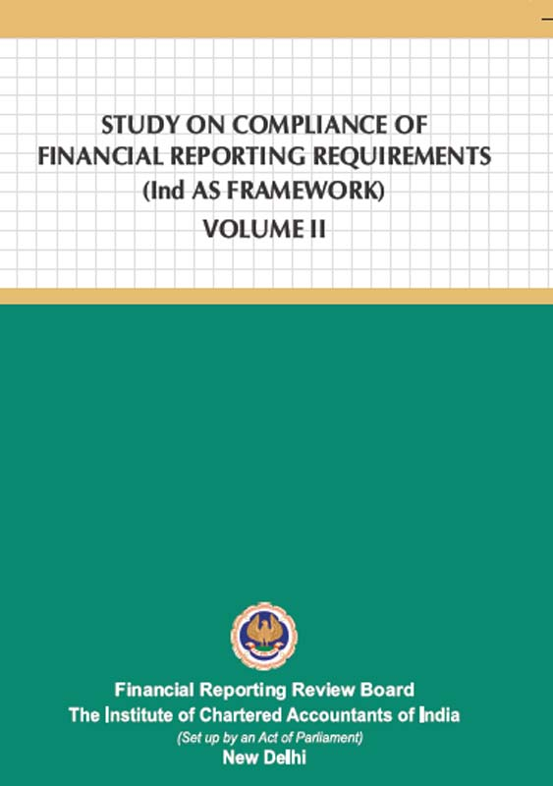
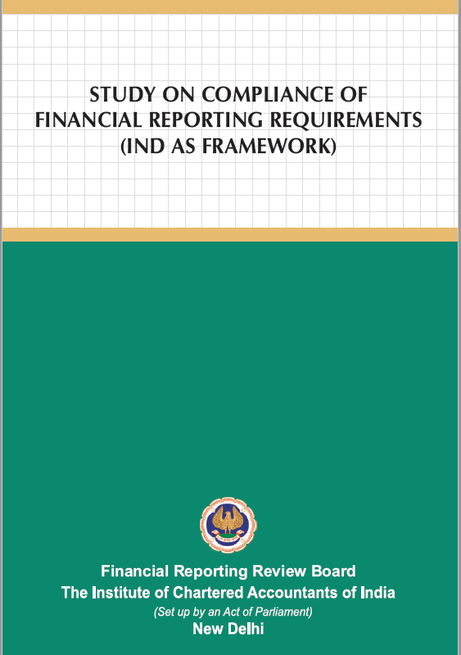
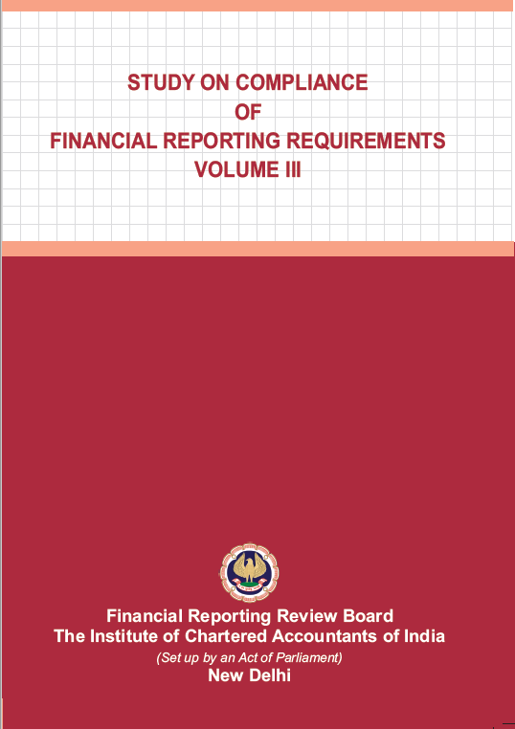
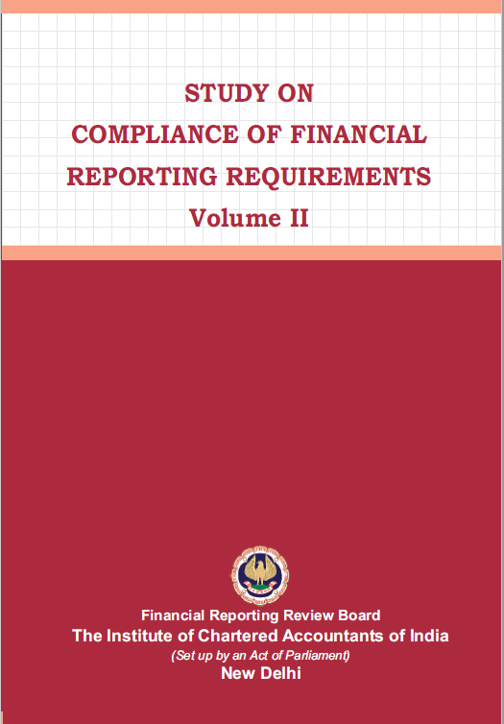
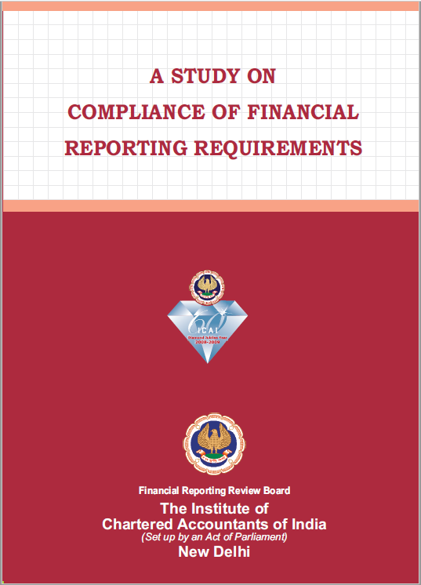
Spreading Awareness among the Members
Publications
Study on Compliance of Financial Reporting Requirements (IND AS Framework) Volume II (2022)
Study on Compliance of Financial Reporting Requirements (IND AS Framework)
(2021)
Study on Compliance of Financial Reporting Requirements Volume III
(2018)
Study on Compliance of Financial Reporting Requirements Volume II
(2014)
Study on Compliance of Financial Reporting Requirements Volume I
(2010)
To refer: https://frrb.icai.org/publications/

Slide 19
At a Glance: Non-compliances Observed by the Board During the Course of Review ( IGAAP)
“Detailed observations are available in “Study on Compliance of Financial Reporting Requirements, Volume III” at Publication_Indian-GAAP
Notes:
As discussed in previous slide, this publication Study on Compliance of Financial Reporting Requirements, Volume III covers observations pertaining to financial Statements prepared under AS framework

Slide 20
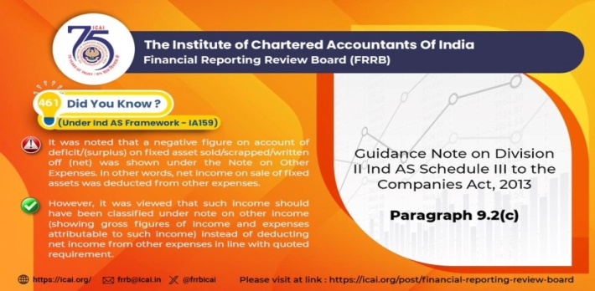
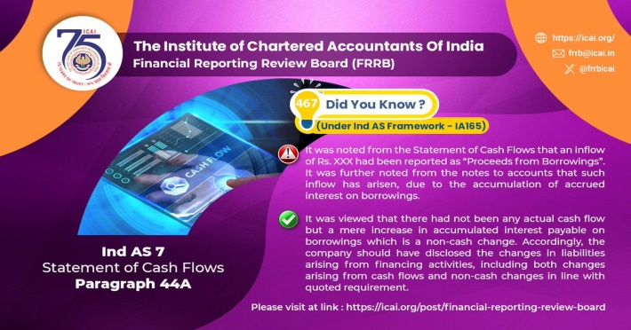
Spreading Awareness among the Members
X Handle-FRRB
222 on Ind AS
4380 Followers
536 Tweets posted
203 on AS (IGAAP)
111 on Schedule III, SA & CARO
Notes:
For regular updates on non compliances, you can Follow FRRB on twitter, our twitter handle is frrbicai

Slide 21
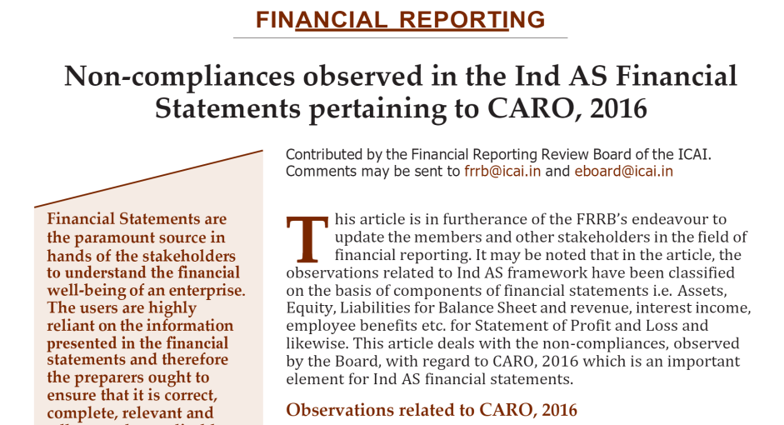
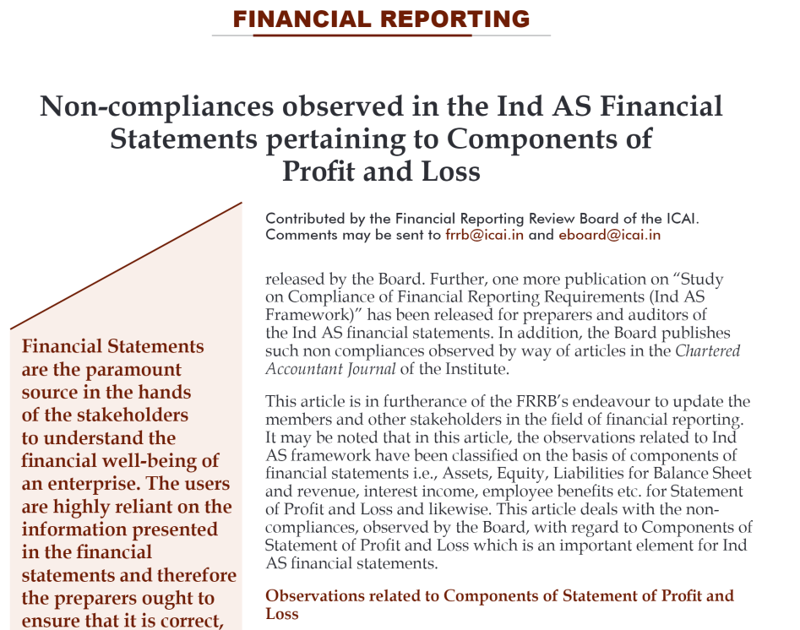
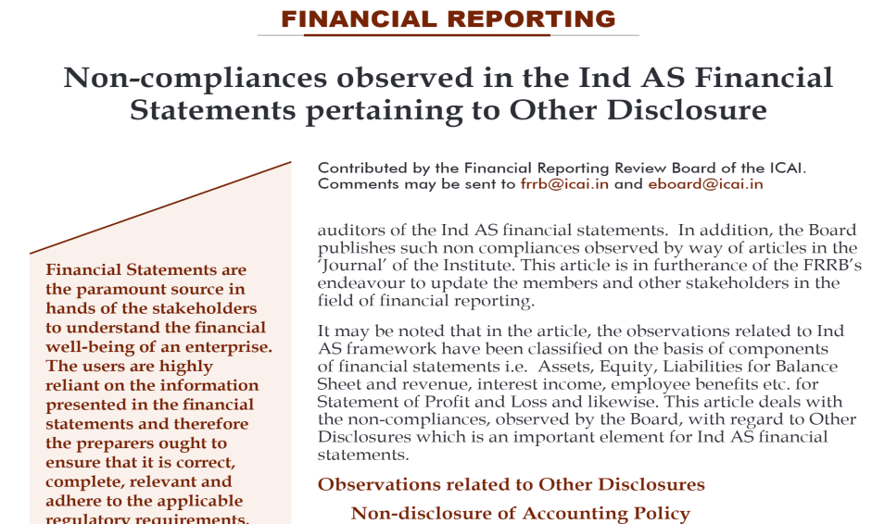
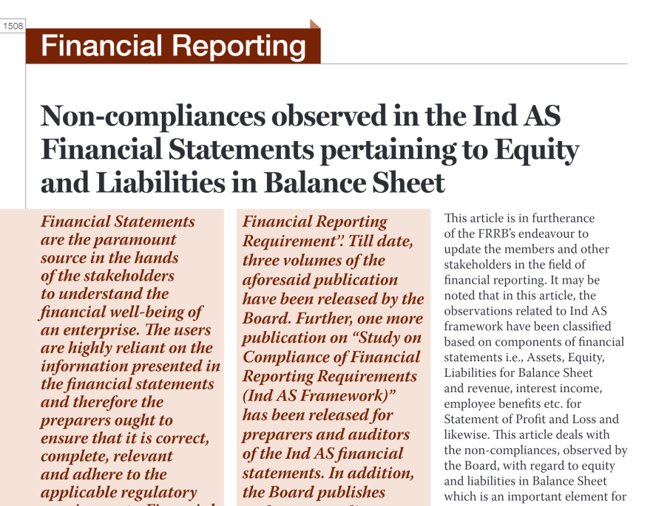
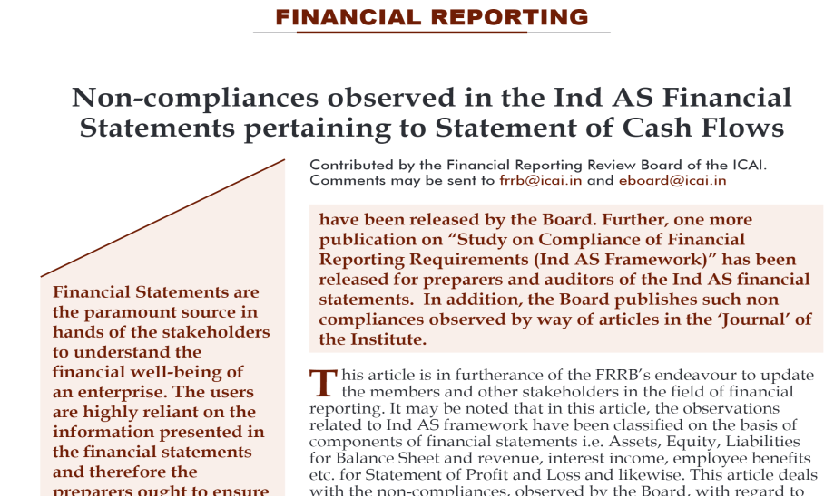
Spreading Awareness among the Members
Articles in Journal
To refer: https://frrb.icai.org/elementor-1218/

Slide 22
Spreading Awareness among the Members
Organise Webinars, Awareness Programs and Training Programs
- To spread the awareness amongst the members and
- To apprise them about the common non-compliances observed by the Board during the review of financial statements
- FRRB jointly with National Institute of Security Market (NISM)-SEBI organized a webinar on ‘Expectations from Listed Companies on Financial Reporting’.
- A joint training program was organized for officers of SFIO engaged in Corporate Fraud Investigation Department
- To strengthen the review mechanism and
- To acquaint TRs and FRRGs with major non-compliances observed by the Board
Webinars and Awareness Programs for Members
Training Programs for FRRB- Reviewers (TRs and FRRGs)
Awareness Programs jointly with Other Regulators
Till date, FRRB has organized 130 programmes (physical mode as well as virtual mode) which have benefitted over
15,207 participants.

Slide 23


THANK YOU
Financial Reporting Review Board
The Institute of Chartered Accountants of India
A- 29, Sector 62, Noida, Uttar Pradesh 201309
Office Phone+ 91-0120-3045882/962/982
Email: frrb@icai.in
Website : https://frrb.icai.org/
X Handle: @https://twitter.com/frrbicai

