Slide 1

Buy-back of Shares & Capital Reduction
A deep dive into the Companies Act, 2013, focusing on regulatory nuances and practical challenges.
Gopal Kumar Khetan
(FCA, FCS, LLB, M.Com)

Slide 2



Understanding Share Buy-back
Sections 68, 69, and 70 of the Companies Act, 2013, along with Rule 17 of the Companies (Share Capital and Debentures) Rules, 2014, govern share buy-back.
Companies Act 2013
Rule 17
Applicability
Governs the framework for share buy-backs.
Details specific rules for buyback of securities
All companies

Slide 3
Sources of Buy-back (Sec 68(1))
A company can buy back its own shares or specified securities from various sources, with certain prohibitions to ensure financial stability.
Free Reserves
Securities Premium Account
Proceeds of New Issues
Funds from the issue of any shares or other specified securities (but not the same kind).
Funds generated from issuing shares at a premium.
Prohibition: No buy-back from proceeds of an earlier issue of the same kind of shares/securities.

Slide 4
Pre-Conditions for Buy-back (Sec 68(2))
Before a company can buy back its shares, several critical conditions must be met to ensure compliance and financial prudence.
Authorized by Articles of Association.
Authorized by Special Resolution in General Meeting (unless ≤ 10% of paid-up equity capital and free reserves, then Board Resolution suffices).
Quantum of Buy-back: ≤ 25% of aggregate paid-up capital and free reserves. (In case of buyback of equity shares - 25% limit
applies to total paid-up equity capital)
Only fully paid-up shares can be bought back.
Post Buy-back Debt-Equity Ratio: Debt should not exceed twice (2:1) paid-up capital + free reserves. (For Government Company - NBFC/Housing Finance – 6:1).
Cooling-off period: No buy-back within 1 year from the closure of the preceding offer.

Slide 5



Explanatory Statement for General Meeting (Sec 68(3))
The notice for a General Meeting must include an explanatory statement with comprehensive disclosures regarding the proposed buy-back.
Material Facts & Necessity
Buy-back Details
Financials & Timeline
Complete disclosure of all relevant facts and reasons for the buy-back.
Class, number, method, price, and basis of arriving at the buy-back price.
Amount to be invested, sources of funds, and completion time limit.

Slide 6
Promoter & Director Disclosures
The explanatory statement must also detail the shareholding and past transactions of promoters, directors, and Key Managerial Personnel (KMP).
Shareholding Details
Promoters
Directors of promoter (if promoter is a company)
Directors & KMP
Past Transactions
Intent to Tender Shares
Buy/sell of equity shares 12 months before Board approval.
Confirmation of intent to tender shares.
Quantum of shares proposed to be tendered.
Transactions until the date of GM notice.
Past 12-month transaction history (number, price, date).
Maximum and minimum price with dates.

Slide 7




Confirmation of No Default
The company must confirm that it has not defaulted on various financial obligations.
Deposits & Interest
Debentures & Preference Shares
No default in repayment of deposits or interest.
No default in redemption.
Dividend Payments
Term Loans
No default in dividend payments.
No default in repayment to financial institutions/banks.

Slide 8
Board's Solvency Confirmation
The Board must confirm, after full inquiry, that the company will remain solvent for at least one year post-buy-back.
Immediately after the general meeting, there shall be no grounds on which the company could be found unable to pay its debts.
Considering management intentions and financial resources for the next year.
Company will meet liabilities as they fall due and not become insolvent within one year.
Directors have considered all liabilities (including prospective and contingent) as if the company were being wound up.

Slide 9
Auditor's Report to the Board
A statutory auditor's report is required, confirming the company's financial state and the permissible capital payment for the buy-back.
01
02
Inquiry into Affairs
Permissible Capital Payment
Auditors must confirm necessary inquiries into the company's state.
Certification that the buy-back amount is correctly determined as per the Act.
03
04
Financial Statements Age
Un-audited Statements
Audited accounts must not be older than six months from the Letter of Offer date.
If audited accounts are older, unaudited statements (not older than six months) subjected to limited review are required.

Slide 10
Timeline & Modes of Buy-back
The buy-back process must adhere to a strict timeline and can be executed through various prescribed modes.
Completion Timeline (Sec 68(4))
Modes of Buy-back (Sec 68(5))
Buy-back must be completed within 1 year from the date of passing the Special Resolution or Board Resolution.
From existing shareholders on a proportionate basis.
From the open market.
By purchasing securities issued to employees (ESOP or sweat equity).

Slide 11
Filing the Offer Letter
Companies must adhere to strict rules when filing the offer letter for share buy-backs.
Form SH-8
Declaration of Solvency
Dispatch of Letters of Offer
File the offer letter with the Registrar of Companies (ROC) in Form SH-8, signed by at least two directors.
File Form SH-9 (Declaration of Solvency) to confirm financial capability.
Dispatch the Letter of Offer to the shareholders immediately (not later than 20 days of filing with ROC) ensuring accuracy and transparency.

Slide 12
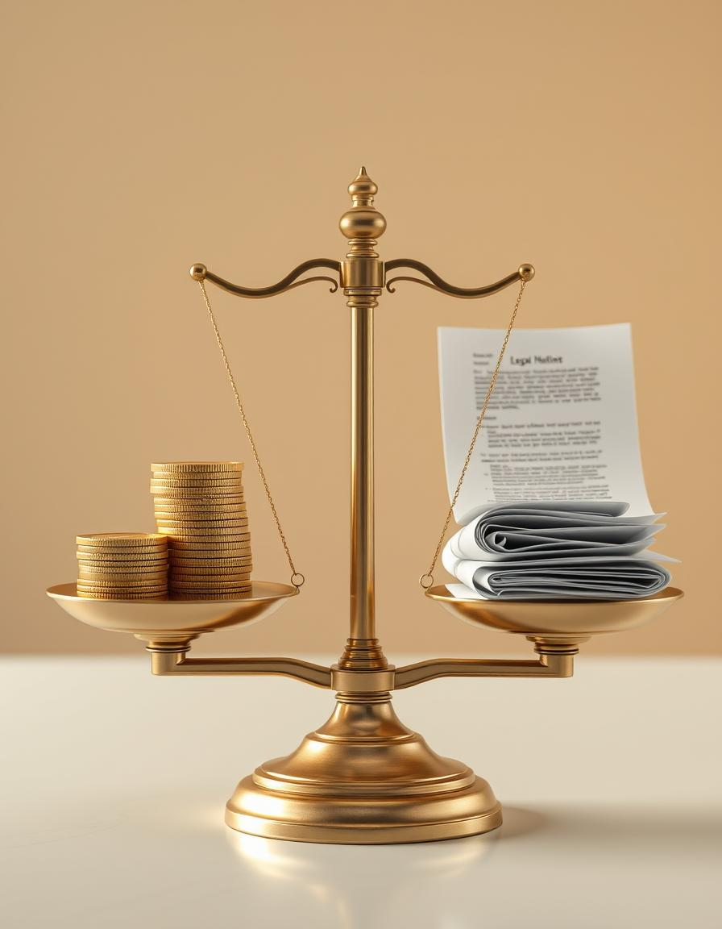
Declaration of Solvency
A critical step, ensuring the company's financial health post-buy-back.
01
Official Filing
File Form SH-9 with the Registrar of Companies (ROC).
02
Authorized Signatures
The declaration must be signed by at least two directors, including the Managing Director where applicable.
03
Verification by Affidavit
It must be formally verified through an affidavit to attest to its accuracy and truthfulness.
04
Financial Assurance
Confirms the company's ability to meet all its liabilities and it will not face insolvency within one year.

Slide 13
Offer Period and Restrictions
Key timelines and limitations governing the buy-back process.
1
2
3
Offer Duration
Reduced Period
No New Issues
The buy-back offer must be open for 15 to 30 days.
Can be shorter than 15 days with unanimous shareholders consent.
No new shares (including bonus) from resolution date until offer closure, except for conversions.

Slide 14
Verification and Payment
Ensuring timely processing and secure payment to the shareholders.
01
02
Verification
Escrow Account
Complete buy-back offer verification within 15 days of closure.
Open a separate bank account immediately after offer closure to deposit full payment sum.
03
04
Payment
Return Certificates
Pay consideration in cash within 7 days of verification completion.
Return share certificates for unaccepted or partially accepted shares within 7 days.

Slide 15
Post-Buy-Back Actions
Mandatory steps to finalize the buy-back process and maintain compliance.
Destruction of Shares
Restriction on Further Issue
Extinguish and destroy bought-back shares within 7 days of completion.
No new issues of the same kind of shares/securities for 6 months, with specific exceptions like bonus issues or ESOPs.

Slide 16
Maintaining the Register of Buy-Back
Detailed record-keeping is essential for transparency and compliance.
Form
Maintained in Form SH-10.
Location
Kept at the company's registered office.
Custody
Under the custody of the company secretary or authorized person.
Authentication
Entries authenticated by the company secretary or authorized person.

Slide 17
Return of Buy-Back and Penalties
Final reporting and consequences of non-compliance.
1
2
3
Return Filing
Compliance Declaration
Penal Provisions
File Form SH-11 with ROC within 30 days of completion.
SH-11 must include a declaration signed by two directors, certifying compliance with the Companies Act, 2013.
Non-compliance incurs fines of ₹1 lakh – ₹3 lakh for both the company and officer in default.

Slide 18
Capital Redemption Reserve (CRR) (Sec 69)
Purpose of CRR
Usage of CRR
When a company buy-back shares using Free Reserves or Securities Premium Account, an amount equal to the nominal value of shares bought back must be transferred to the Capital Redemption Reserve (CRR) account.
The CRR account can only be used for issuing fully paid-up bonus shares to existing members.

Slide 19
Prohibited Buy-back Scenarios (Sec 70)
Companies are prohibited from buying back shares in certain situations.
Subsidiary Involvement
Investment Companies
Buy-back is prohibited through any subsidiary company, including wholly-owned subsidiaries.
Prohibited through any investment company or group of investment companies.

Slide 20


Default Prohibitions
Buy-back is not allowed if the company has defaulted on specific financial obligations.
Repayment Defaults
Deposits, interest on deposits, term loans, or interest.
Redemption Failures
Debentures or preference shares.
Dividend Payment
Payment of dividend to any shareholder.
Exception: If the default is fully remedied and 3 years have passed, buy-back is permitted.

Slide 21
Non-Compliance with Key Sections
Companies must comply with specific sections of the Companies Act, 2013 to undertake a buy-back.
1
2
Section 92
Section 123
Annual Return
Declaration of Dividend
3
4
Section 127
Section 129
Punishment for failure to distribute declared dividend
Financial Statements

Slide 22
Key Regulatory Conditions
SEBI Regulations: Buy-back of listed shares must comply with SEBI regulations.
Offer Withdrawal: A company cannot withdraw a buy-back offer once announced to shareholders.
Borrowed Funds: Companies cannot use borrowed funds from banks or financial institutions for buy-back.
Previous Issue Proceeds: Proceeds from a previous issue of the same kind of shares cannot be used for buy-back.
Proportional Acceptance: If shares offered exceed the limit, acceptance is proportional.

Slide 23

Income Tax on Share Buy-back
Prior to 1st October 2024, the taxation of share buy-back by unlisted companies was governed by Section 115QA, under which the tax liability was borne by the company. However, with effect from 1st October 2024, the tax treatment has shifted, and buy-back proceeds are now taxable in the hands of shareholders as deemed dividend under Section 2(22)(f).

Slide 24
Income Tax on Share Buy-back
Effective October 1, 2024, tax treatment shifted, making buy-back proceeds taxable for shareholders.
2(22)(f)
NIL
8
Deemed Dividend
Capital Gains
Loss Carry Forward
Amount received by shareholders is considered deemed dividend and taxable under the head "Income from Other Sources."
Consideration received is deemed 'NIL' for capital gains, leading to a capital loss equal to acquisition cost.
Capital loss can be carried forward for 8 subsequent financial years and set off against other capital gains.

Slide 25
Tax Rate:
Individuals / HUFs | As per applicable slab rates
Companies | Corporate tax rates (22%/25%/30% as applicable)
LLPs/Firms | Flat 30% + surcharge + cess

Slide 26
Section 66: Core Principles
Tribunal Confirmation
Special Resolution
Requires approval from the National Company Law Tribunal (NCLT).
Mandates a special resolution passed by shareholders.
Creditor Safeguards
Excludes Buy-back
Ensures compliance with conditions protecting creditors.
Does not apply to share buy-back under Section 68.

Slide 27

Permitted Modes of Reduction
Companies limited by shares or guarantee with share capital can reduce it via special resolution and NCLT confirmation.
Extinguish or reduce liability on unpaid shares.
Cancel paid-up capital lost or unrepresented by assets.
Pay off excess paid-up capital.
No reduction if the company is in arrears of deposit repayments or interest.

Slide 28
Application to NCLT (Form RSC-1)
Companies must file an application with the NCLT, verified by affidavit and accompanied by crucial documents.
1
2
Creditor List
Auditor's Certificate
Form RSC-2, certified by MD/two directors, verified by the Statutory auditor.
Form RSC-3, confirming no arrears on deposits/interest and correctness of creditor list.
3
4
Director's Declaration
Other Documents
Confirming no default in deposit repayment.
Copies of Board and Special Resolutions and MOA/AOA.

Slide 29
Mandatory Notices and Representations
Upon application, the Tribunal issues notices to relevant authorities and creditors.
Authorities Notified
Creditors Notified
Affidavit of Service
CG, RoC, SEBI (for listed companies)
Form RSC-4.
Individual notices and public advertisements in newspapers Form RSC-4.
Company files Form RSC-5 confirming proper dispatch and publication.
All notified parties have 3 months to submit objections; otherwise, no objection is deemed.

Slide 30

Tribunal's Confirmation
The NCLT holds a hearing after the objection period to
confirm the capital reduction.
NCLT confirms if creditors' debts are discharged/secured and
no one is prejudiced.
All relevant notices must have been properly served.
NCLT issues an order in Form RSC-6.
Terms and conditions may be imposed by the Tribunal.
Confirmation requires compliance with Section 133 (Accounting Standards) and an auditor's certificate.

Slide 31
Key Takeaways
1
Strict Compliance
2
Creditor Protection
3
Transparency
Capital reduction is a highly regulated process requiring adherence to Section 66 and NCLT Rules.
Safeguarding creditors' interests is paramount throughout the procedure.
The process emphasizes transparency through mandatory notices and auditor certifications.

Slide 32
Publication & Filing Requirements
Tribunal Order Publication
Filing with Registrar
The Tribunal may direct the company to publish the confirmation order (e.g., newspaper, website).
Company must file with RoC within 30 days of NCLT order in Form INC-28, including certified order and approved minute.

Slide 33
Member Liability & Creditor Protection
Limited Liability of Members
Creditor Not on List – Special Protection
Past or present members are not liable for contributions exceeding the difference between the amount paid and the amount fixed by the reduction order.
If a creditor is missed due to ignorance or lack of clarity, and the company defaults, members are liable to contribute as in a winding-up scenario.

Slide 34

Penal Consequences for Officers
Concealing Creditors
Misrepresenting Debt
Aiding or Abetting
Knowingly concealing a creditor's name who could object.
Knowingly misrepresenting the nature or amount of any debt/claim.
Aiding or abetting the above actions.
Officers committing these acts are liable under Section 447 (punishment for fraud).

Slide 35

Case Background: Ulundurpet Expressways
Ulundurpet Expressways Pvt. Ltd. vs Regional Director, WR
Court: National Company Law Appellate Tribunal (NCLAT)
Bench: Principal Bench, New Delhi Judgment
Date: 06 January 2025

Slide 36

NCLAT Conclusion
Section 66 permits reduction can be “in any manner”.
No objection from RD, ROC, or creditors required.
100% shareholder approval.
Proposed reduction does not violate Section 66.
NCLT took an overly narrow view.
Company is permitted to reduce capital even based on anticipated surpluses.
A company may reduce its capital not necessarily on a pro rata basis, but may instead target specific groups of shareholders for exclusion or reduction.

Slide 37

Thank You
We appreciate your attention and are happy to answer any questions you may have.
Gopal Kumar Khetan
(FCA, FCS, LLB, M.Com)

