Slide 1
MCA V3 Annual Filing
CA (IP) ANIMESH MUKHOPADHYAY
Emai ID: animesh_fca@yahoo.co.in
Mobile: 9830107220

Slide 2
DISCLAIMER
THIS PRESENTATION IS ACADEMIC IN NATURE AND IS NOT INTENDED TO BE USED AS LEGAL ADVICE.
READERS/ USERS ARE REQUESTED TO TAKE APPROPRIATE LEGAL ADVICE RELATING TO THEIR SPECIFIC SITUATIONS.
MCA AND/OR AUTHORITY/ OTHER COURTS IN INDIA MAY NOT AGREE WITH THE INTEPRETATIONS REVEALED HERE.

Slide 3
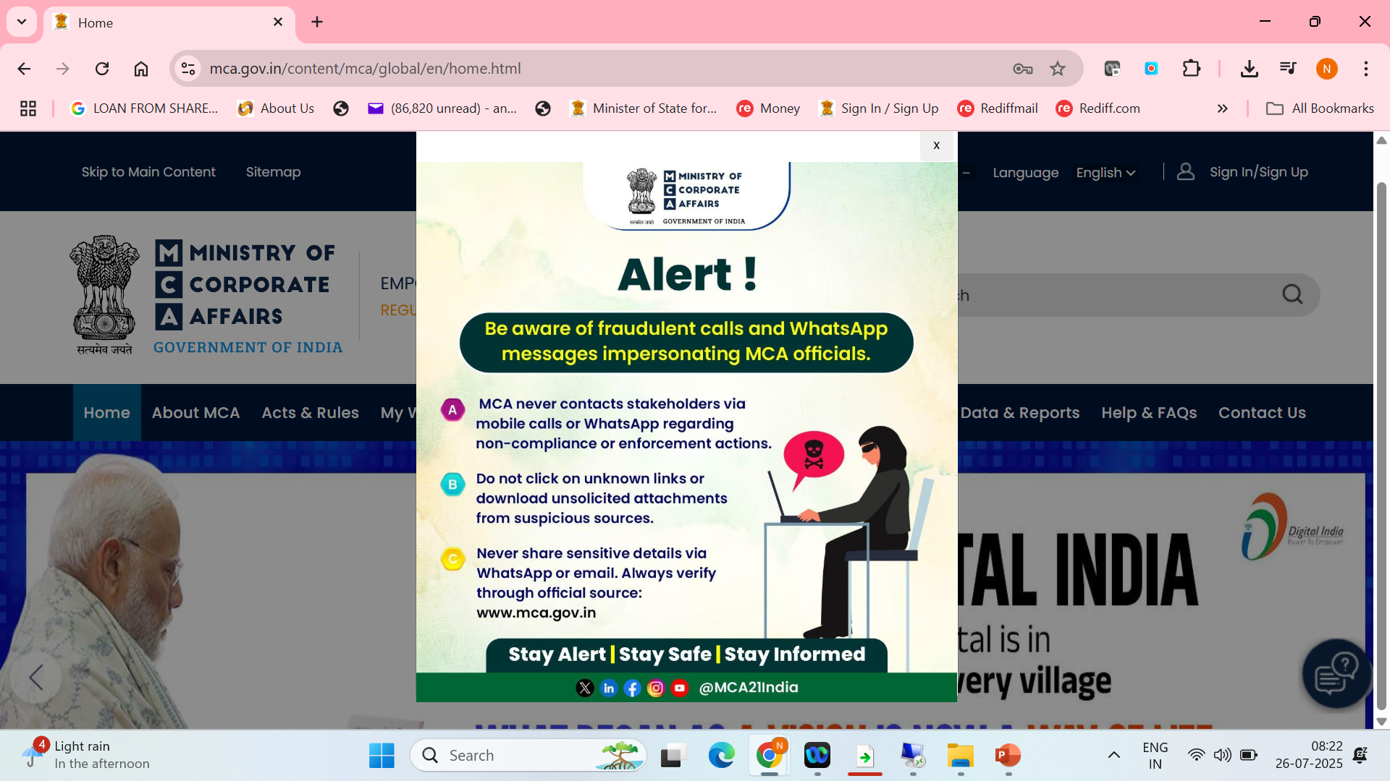
Be cautious !

Slide 4
ICAI’s initiative
For supporting the members in the V3 transition process, the Corporate Laws & Corporate Governance Committee of ICAI, in association with MCA and its technology partner LTI, has set up dedicated helplines to address issues faced in relation to filing these forms.
Committee is running the following helplines from 11:00 am to 5.30 pm.
Helpline No. Teams Link
Helpline 1 https://bit.ly/4kFhvBY
Helpline 2 https://bit.ly/46G5rgq
Helpline 3 https://bit.ly/4m095Xb
Members are kindly requested to raise a ticket with the MCA for their respective issues prior to joining the Chat Rooms.
Additionally, to help us address your concern effectively, please submit the details of your issue using the following ink: Submit Your Issue Here
For unresolved issues beyond 10 days, write with details at clcgcmca21@icai.in

Slide 5
Introduction : Amendment Rules, 2025
The Ministry of Corporate Affair (MCA) vide separate amendment notifications released on May 30, 2025, introduced several notifiable changes – The launch of final set of the 38 Company Forms, formerly on the MCA V2 Portal and proposed to be completely migrated to the V3 Portal.
As a part of the transition, the V2 Portal was completely disabled (except V2 VPD Function) from June 18, 2025. The V3 Portal was disabled from July 09, 2025, 12:00 AM to July 11, 2025, 11:59 P.M. and was made available for filing from 12:00 AM on 14th July 2025.

Slide 6
Purpose of the change
The changes reflect a strong push towards digital compliance, increased transparency, stricter penalties for non-compliance, and enhanced corporate governance under the Companies Act, 2013.

Slide 7
Why Did We Need a V3?
V2 served us for nearly two decades — but it was beginning to creak under the weight of today’s digital and regulatory expectations.
PDF uploads, physical dependencies, static registers, and fragmented data defined V2.
The system was largely reactive: it caught non-compliance after the fact.

Slide 8
Why Did We Need a V3?
Enter MCA V3: The Evolution
MCA V3 is not just an upgrade. It is:
AI-powered, cloud-native, and analytics-driven
Built for scale, speed, and self-correction
A platform that enables, not just enforces
It brings in:
Smart web-based forms
Role-based user architecture
Dynamic compliance dashboards
Integrated adjudication and consultation systems
Notes:
Integrated adjudication and consultation system. MCA V3 ecosystem carries this. This is actually regulatory technology model. Role-Based Architecture refers to a user management system where access to data, operations, and system modules is governed by predefined roles (e.g., Company, Professional, Regulator).
Each role has:
Specific permissions
Tailored dashboards

Slide 9
Why Did We Need a V3?
What the Ministry of Corporate Affairs envisioned was a platform that could:
✅ Promote Ease of Compliance
✅ Enable Real-Time Governance
✅ Encourage Preventive Regulation
Notes:
Preventive Regulation refers to a forward-looking regulatory approach that focuses on anticipating risks, detecting early warning signs, and ensuring compliance before violations occur. It is a key pillar of modern RegTech frameworks like MCA V3, where regulation evolves from being reactive to proactive and predictive.

Slide 10
Key Pillars of “V3 and Beyond”
A. From Prosecution to Persuasion
Shift to adjudication, compounding, and in-house resolution
Decriminalization of over 60 procedural offences
B. AI and Analytics in Governance
Predictive alerts on non-compliance
Red flag systems for fraud detection
MCA 21 V3 as a RegTech framework
Notes:
Decriminalisation - Delay in filing of annual returns (MGT-7), financials (AOC-4), Non-compliance in board meetings, register maintenance, Failure to file resolutions, disclosures
Procedural lapses in share issuance, charge registration

Slide 11
Key Pillars of “V3 and Beyond”
C. Stakeholder-Driven law making
Public consultation model for rule-making - smart regulations, consensus-based law-making, and adaptive compliance systems.
Digital feedback on draft laws and amendments

Slide 12
Key Pillars of “V3 and Beyond”
D. Risk-Based & Event-Driven Filing
No longer annual ritual—trigger-based compliance (e.g., resignation, default, board change) - instantly prompt regulatory actions, alerts, or filings. It’s a move from passive, deadline-based compliance to a real-time, event-driven model.
Event tracking for significant beneficial owners, related party transactions

Slide 13
Key Triggers
Loan Default or NPA Classification
→ Generates alert to concerned authorities (e.g., RBI, ROC); may trigger reporting obligations.
Change in Board Composition
→ Auto-validation of board constitution; ensures minimum directors, resident directors, women directors.
Capital Restructuring (e.g., allotment, buyback, conversion)
→ Triggers compliance forms like PAS-3, SH-7, MGT-14.
Auditor Resignation
→ Prompts ADT-3 filing and checks for new ADT-1 within the time frame.
CSR Spend Default
→ System flags CSR non-compliance for further scrutiny.

Slide 14
How It Works Under MCA V3:
Smart Workflow Engines monitor the MCA database for changes (e.g., DIR-12, SH-7 filings).
Event-tracking algorithms validate interlinked compliances (e.g., a resignation must be followed by an appointment to avoid Board vacancies).
Alerts and pre-emptive nudges are sent to stakeholders before non-compliance escalates.
Auto-verification helps detect missing filings or incomplete documentation in real-time.

Slide 15
What Lies Ahead: Beyond V3
A. Integrated Corporate Compliance Hub
Real-time linkage between MCA, GSTN, ITD, SEBI
Unified dashboard for all regulatory obligations
B. Mandatory ESG Reporting Framework
MCA + SEBI harmonizing disclosures on Environment, Social, Governance (ESG)
Company law may soon require Sustainability Reporting

Slide 16
What Lies Ahead: Beyond V3
C. Cross-border Filing Standards (XBRL 2.1, IFRS)
Global standardization of disclosures
AI bots reading and auto-scrutinizing filings
D. Blockchain & Smart Contracts for ROC Processes
Immutable registers, auto-verifiable compliance certificates

Slide 17
What Lies Ahead: Beyond V3
An immutable register refers to a digital ledger that, once created, cannot be altered, deleted, or tampered with. This is typically enabled through blockchain technology, which uses cryptographic hashing and distributed consensus to maintain data integrity.
Example:
Register of Members (Sec 88)
Register of Directors and KMP (Sec 170)
Register of Charges (Sec 85)
Register of Significant Beneficial Owners (SBO)

Slide 18
The possibilities ….
A compliance certificate is digitally issued by a CA/CS.
It is hashed and recorded in an immutable blockchain ledger.
MCA can auto-read, verify, and compare it against form filings and backend registers.
Any discrepancy (like false director appointment) is flagged by the system before filing is accepted.
This is RegTech 3.0 – self-governing compliance aided by AI and blockchain.

Slide 19
Highlights – Key Changes in Forms
Introduction to web-based forms, thereby reducing manual efforts.
Auto Pre-filling of common fields across forms, ensuring data consistency and effort reduction.
Minimization of attachments by introducing of fields/ declaration in the form of digital attachments.
Maximum size of individual attachments increased to 2 MB & overall form size increased to 10 MB except for a few forms.

Slide 20
MCA LAUNCH OF FINAL SET OF 38 COMPANY FORMS

Slide 22
Notes:
Who will do XBRL Filing - Every public company listed and their Indian subsidiaries, Every company with a turnover of or more than Rs.100 crore, Every company with a paid-up capital of or more than Rs.5 crore, Every company who follows Ind AS Exception: NBFC, Insurance Co, Housing Co

Slide 26
ANNUAL FILINGS
Form | Purpose | Applicability | Processing Type
AOC-4 | Filing financial statements | All companies | Conditional STP
AOC-4 CFS | Consolidated financial statements | Companies with subsidiaries/associates | Linked/Conditional STP
AOC-4 XBRL | Financials in XBRL format | Certain listed/public companies | Conditional STP
AOC-1 | Salient features of subsidiary financials | If company has subsidiaries | Linked
AOC-2 | Related party transactions disclosure | If applicable | Linked
CSR-2 | Corporate Social Responsibility report | Companies under CSR provisions | Linked/STP
Extract of Auditor’s Report (Standalone) | Auditor’s report extract | Mandatory | Linked
Extract of Auditor’s Report (Consolidated) | Auditor’s report for consolidated financials | If applicable | Linked
Extract of Board’s Report | Board’s report extract | Mandatory | Linked
MGT-7 | Annual Return (non-OPCs/small companies) | All other companies | STP
MGT-7A | Abridged Annual Return (OPCs/small companies) | OPCs and small companies | STP
MGT-15 | Report on AGM proceedings | Listed companies | STP

Slide 27
AUDITOR RELATED FORMS
Form | Purpose | Processing Type
ADT-1 | Appointment of statutory auditor | STP (Straight Through Processing)
ADT-2 | Application for removal of auditor | Non-STP
ADT-3 | Auditor’s resignation notice | STP
ADT-4 | Report to Central Government | Non-STP
CRA-2 | Appointment of cost auditor | STP
CRA-4 | Filing of cost audit report | STP
23B | Intimation by statutory auditor (legacy form) | STP
23C | Application for appointment of cost auditor (legacy form) | Conditional STP
23D | Intimation by cost auditor | STP

Slide 28
EVENT BASED FORMS
Form ID | Description | Purpose
SH-7 | Notice of alteration of share capital | Increase/decrease in authorized capital
PAS-3 | Return of allotment | Allotment of shares to new/existing shareholders
DIR-12 | Particulars of appointment/resignation of directors | Change in board composition
INC-22 | Notice of situation or change of registered office | Shifting office within or outside state
MGT-14 | Filing of resolutions and agreements | Board/shareholder resolutions
STK-2 | Application for strike-off | Voluntary closure of company
MSC-3 | Return of dormant company compliance | Annual return for dormant entities
GNL-1 | Application to RoC for miscellaneous matters | Special approvals or clarifications
GNL-2 | Submission of documents not covered under other forms | Attachments like resignation letters, etc.
CRL-1 | Disclosure of number of layers of subsidiaries | Applicable to companies with multiple layers
LEAP-1 | Submission of prospectus | For companies listing equity shares abroad
Complaint Form | Investor grievance redressal | Filing complaints with MCA

Slide 29
Gen Circular 1/ 2025 dated 16.06.2025
Due to system migration, all E-forms were temporarily unavailable from 18th June 2025 to 13th July 2025.
In view of this, any form whose due date or resubmission date (without additional fee) fell within this period shall now be permitted to be filed without additional fee up to 15th August 2024

Slide 30
Forms allowed

Slide 31
Difference: V2 and V3 Portal
V2 Portal | V3 Portal
Forms had to be downloaded, filled in offline, and then uploaded to the portal. | Forms are now web-based, allowing users to fill them directly online. This enables features like auto-save, pre-filled details, and real-time validation, improving user experience.
In Version 2, there was only a “My Workspace” section which had a list of notices and circulars issued by MCA. | In Version 3, a new personalized feature called “My Application” has been added. This feature allows users to view all the forms filed by them so far along with the current status of each form such as pending for DSC upload, Under Processing, Pay fees, Resubmission etc.

Slide 32
Difference: V2 and V3 Portal
V2 Portal | V3 Portal
In V2, Log in is possible with the user id. | When a user logs into V3, the login is through the email id.
V2 Portal had validation checks in place, however, the forms had pre fill checks only in few select places. | V3 introduces pre-filling based on linked records, reducing manual entry. Fields have been reorganized for better clarity and usability.

Slide 33
Form ADT-1 – Auditor Appointment
To be processed under STP Mode
Auditor details are fetched from PAN/Membership Number and validated with ICAI database.
Mandatory fields:
  Tenure start and end
  Nature of appt
  Membership No and name of the signing auditor
  Declaration of compliance with Sec 141 mandatory.
  Recommendation of the Audit committee u/s 177

Slide 34
Form ADT-1 – Auditor Appointment
1. Form has been made web-based.
2. Dropdown options enhanced to include “Auditor appointed by Central Government” and “Appointment / Re-appointment by C&AG” in nature of appointment.
3. Separate fields got added for ‘Auditor firm’ and ‘Membership Number of Auditor signing the balance sheet of the company’.[Existing V2 form has merged section for Firm and individual auditors]
4. New field added to capture SRN of INC-28 for Notice of order of the Tribunal for appointment of Auditor.

Slide 35
Form ADT-1 – Auditor Appointment
5. New field ‘Whether the recommendation of the Audit Committee constituted u/s 177 of the Companies Act, 2013 has been considered by the Board of Directors before the appointment’
6. Companies which are ‘Under Liquidation/Under CIRP’ can file the form.
7. Signing of the form by ‘IRP/RP/Liquidator’ is enabled for the companies which are ‘Under Liquidation/Under CIRP’.

Slide 36
Form ADT-1 – Auditor Appointment
8. Business rule introduced to check if auditor being appointed does not hold appointment in more than 20 companies
9. Other enhancement (pre-filling of data, repositioning of fields, additional data fields added, additional checks introduced etc.)

Slide 37
Limit of 20 companies
GSR 464 (E) dated 5.6.2025 clarified 20 cos restriction in terms of Sec 141(3)(g)- the following are not counted-
One Person Companies (OPCs)
Small Companies (as per Companies Act definition)
Dormant Companies
Private companies having pd-up share capital less than ₹100 crores (earlier ₹10 crores, but now increased to ₹100 crores by amendment vide MCA Notificn 7th May 2018)

Slide 38
Rotation of auditors
Sec 139(2) – No listed company and Co belong to such classes shall appoint or reappt (a) an individual auditor for more than one term of 5 consecutive years, and
(b) an audit firm, for more than 2 terms of 5 consecutive years of each term
Applicable to : All Listed Companies, Unlisted Public Companies having Paid-up share capital of ₹10 crore or more, Private Companies having Paid-up share capital of ₹50 crore or more, All Companies (public or private) having Public borrowings from financial institutions, banks, or public deposits of ₹50 crore or more

Slide 39
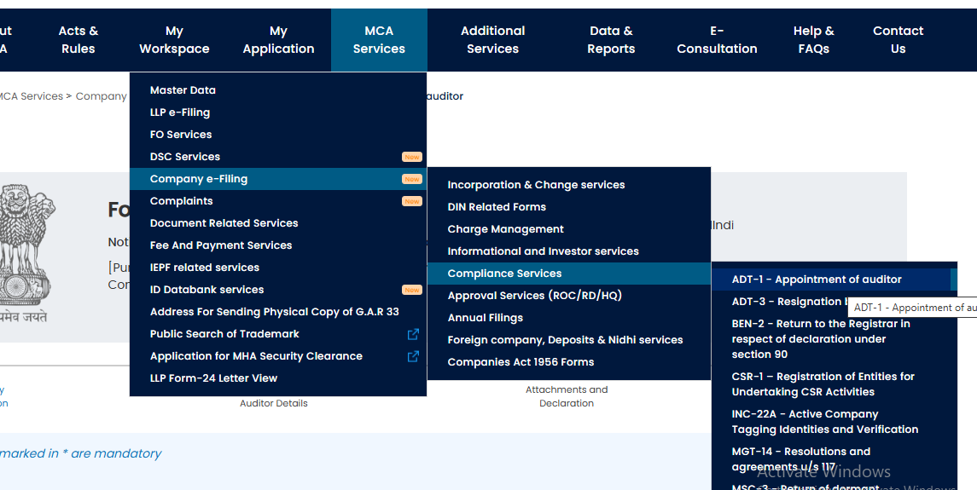
Form ADT-1 – Auditor Appointment
https://www.mca.gov.in/content/mca/global/en/mca/e-filing/complianceServices/ADT-1.html

Slide 40
Form ADT-2 – Auditor’s termination
The processing will be done under Non-STP mode
1. Form has been made web-based.
2. Firm registration number and membership number of the auditor got split into 2 different fields.
3. Whether accts are qualified in the last 3 years
4. Other enhancement (pre-filling of data, repositioning of fields, additional data fields added, additional checks introduced etc.)
5. Mentioning on the books lying with the auditor and not returned
6. Unpaid fee 7. Pendency of the accounts
Notes:
Pt No: 3a – Grounds of removal , 3b Qualification in last 3 years, 3c –details , 3d – Natural justice to auditors, , 3e – Civil or criminal proceedings pending Grey areas – Who is the officer

Slide 41
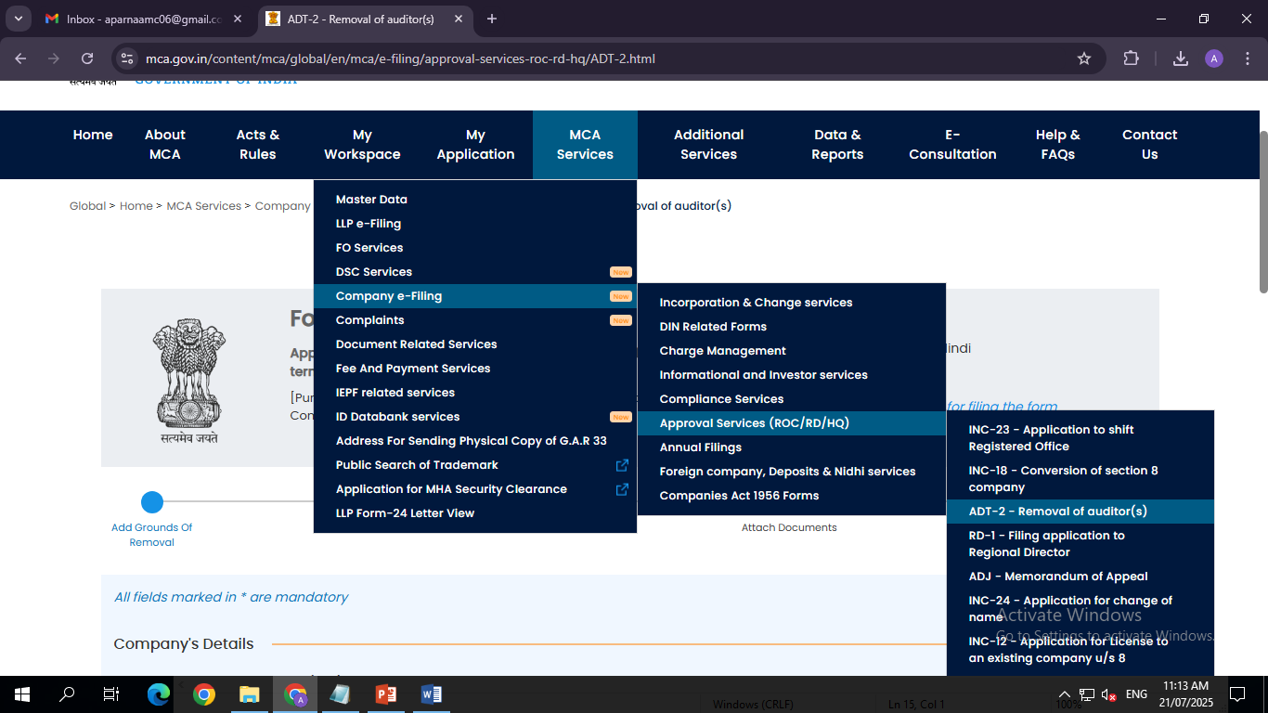
Form ADT-2 – Auditor’s termination
https://www.mca.gov.in/content/mca/global/en/mca/e-filing/approval-services-roc-rd-hq/ADT-2.html

Slide 42
Form ADT-3 – Resignation of Auditor
To be proceed in STP mode
Enhanced disclosures: Specific reason for resignation Date of resignation and acceptance by the company
Upload of resignation letter mandatory
Cross-verification with AOC-4 filing timelines
Signing Partner of the Resigning Firm, Mem No, PAN

Slide 43
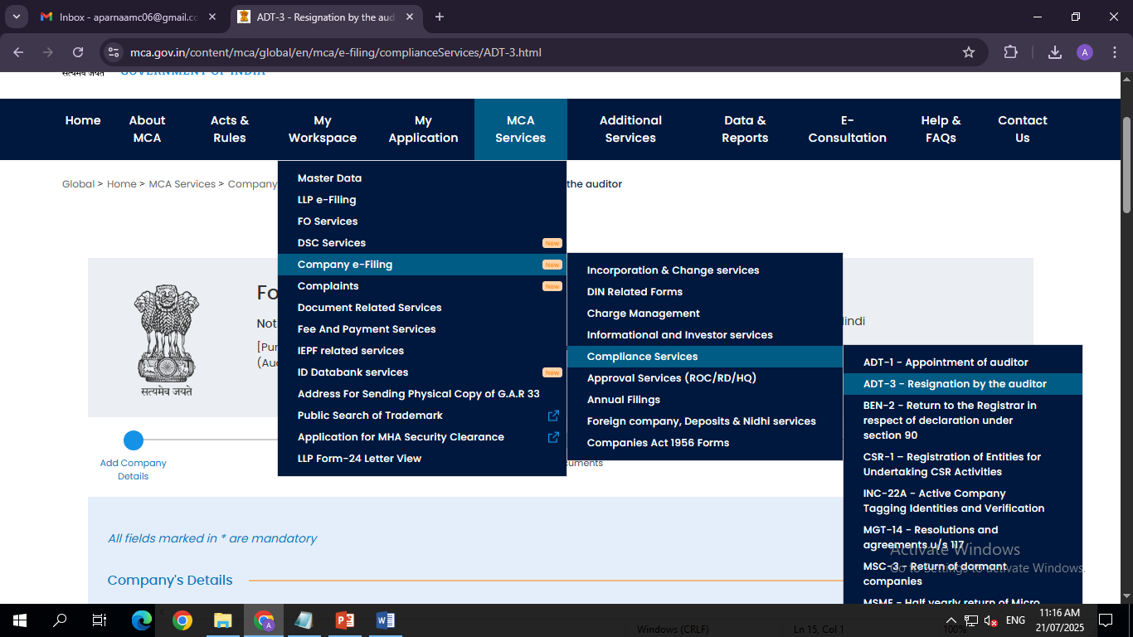
Form ADT-3 – Resignation of Auditor
https://www.mca.gov.in/content/mca/global/en/mca/e-filing/complianceServices/ADT-3.html

Slide 44
Form ADT-4 – Report to Central Govt
To be processed in Non- STP mode
This form can now be filed by Stat Auditor/ Cost Auditor or Secretarial Auditor
Entire details of the complaints
Full details of suspected offence, in which office.

Slide 45
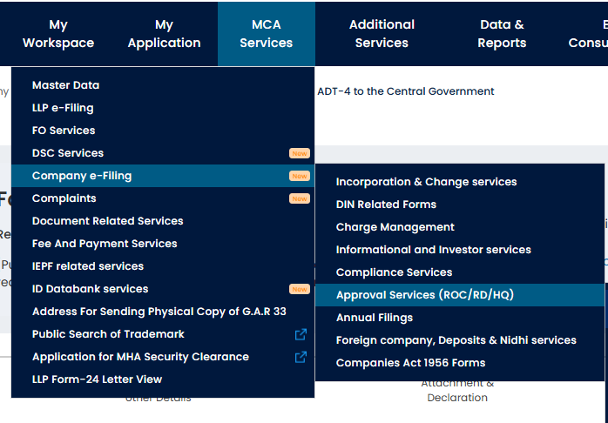
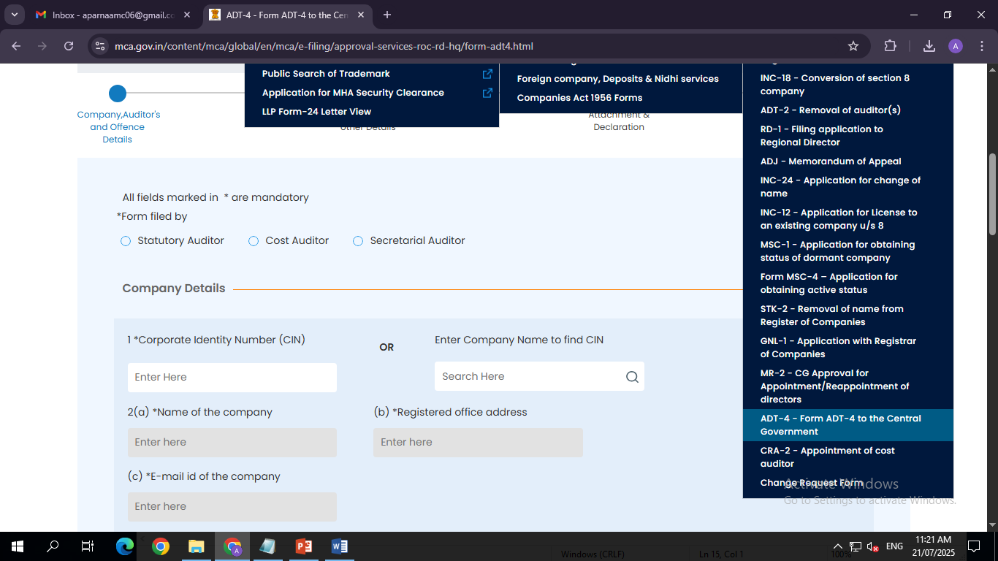
Form ADT-4 – Report to Central Govt
https://www.mca.gov.in/content/mca/global/en/mca/e-filing/approval-services-roc-rd-hq/form-adt4.html

Slide 46
Linked Forms
The following 6 new forms are launched as a part of the V3 Form rollout, which were not available in the V2 Portal.
AOC -1 Linked form
AOC-2 Linked form
Extract of Auditor’s Report (Consolidated)
Extract of Auditor’s Report (Standalone)
Extract of Board’s Report
ADT 4

Slide 47
What is the applicability of linked filings?

Slide 48
1. AOC-4/AOC-4 NBFC (Ind AS)

Slide 50
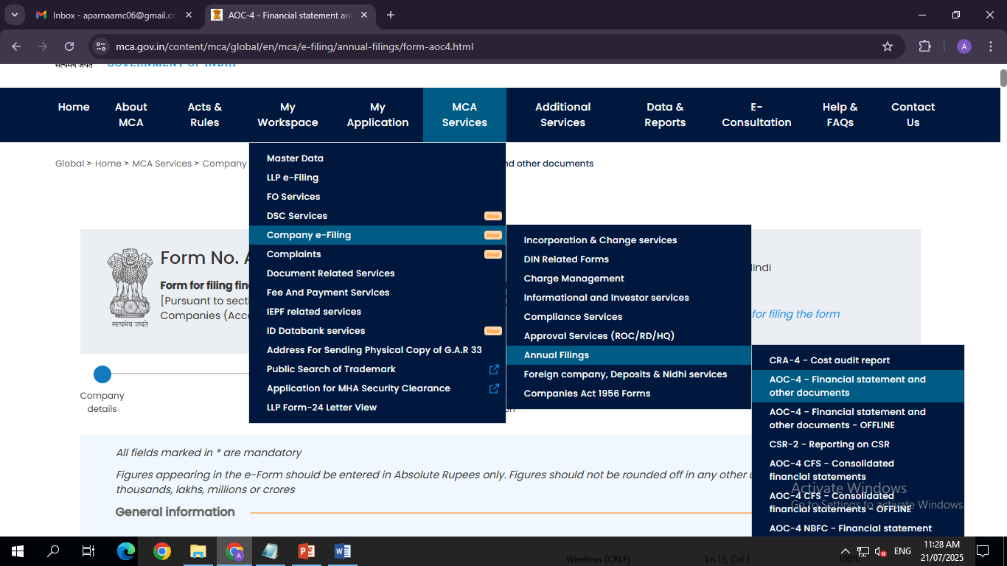
1. AOC-4
https://www.mca.gov.in/content/mca/global/en/mca/e-filing/annual-filings/form-aoc4.html

Slide 51
2. AOC-4 XBRL
https://www.mca.gov.in/content/mca/global/en/mca/e-filing/annual-filings/aoc-4-xbrl.html

Slide 52
3. AOC-4 CFS
https://www.mca.gov.in/content/mca/global/en/mca/e-filing/annual-filings/form-aoc4cfs.html

Slide 53
4. AOC-4 CFS NBFC (Ind AS)
https://www.mca.gov.in/content/mca/global/en/mca/e-filing/annual-filings/form-aoc4cfsnbfc.html

Slide 54
The sequence of filing of linked filings to AOC-4/AOC-4 NBFC:
AOC-4-CFS/AOC-NBFC CFS [If applicable]
AOC-1 [If applicable]
AOC-2 [if applicable]
CSR-2 [if applicable]
Extract of Auditor’s report (Standalone) [Mandatory for all cases]
Extract of Auditor’s report (Consolidated) [if applicable
Extract of Board’s report [Mandatory for all cases]

Slide 55
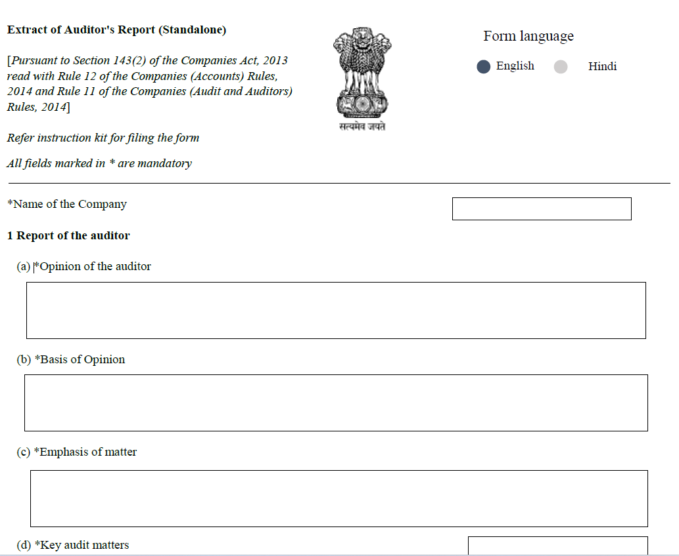
Extract of Auditor’s Report

Slide 56
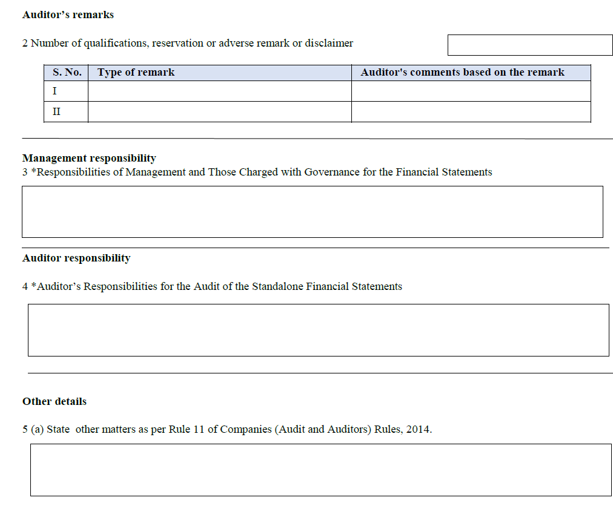
Extract of Auditor’s Report

Slide 57
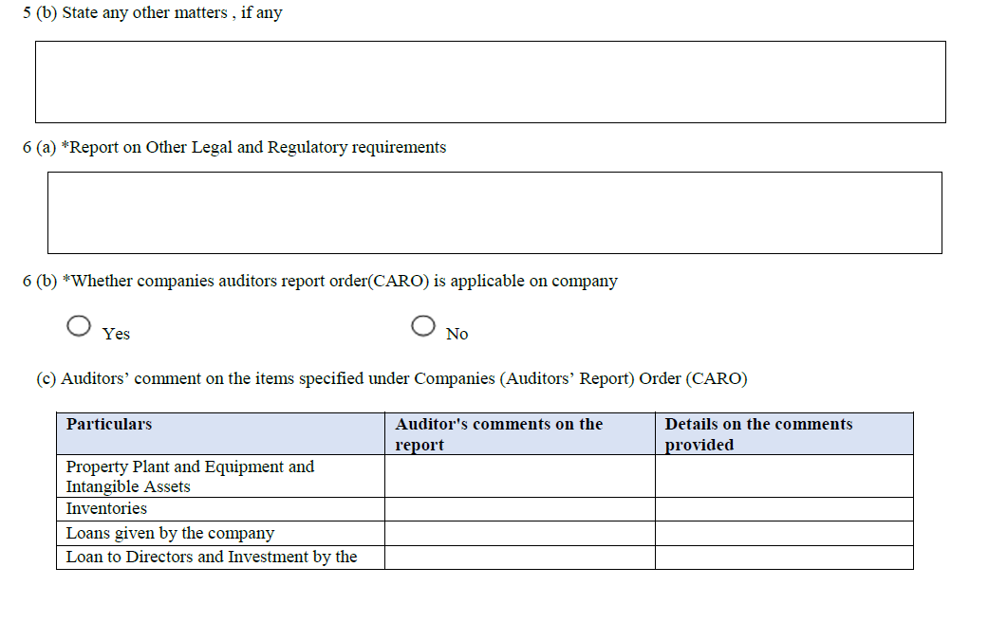
Extract of Auditor’s Report

Slide 58
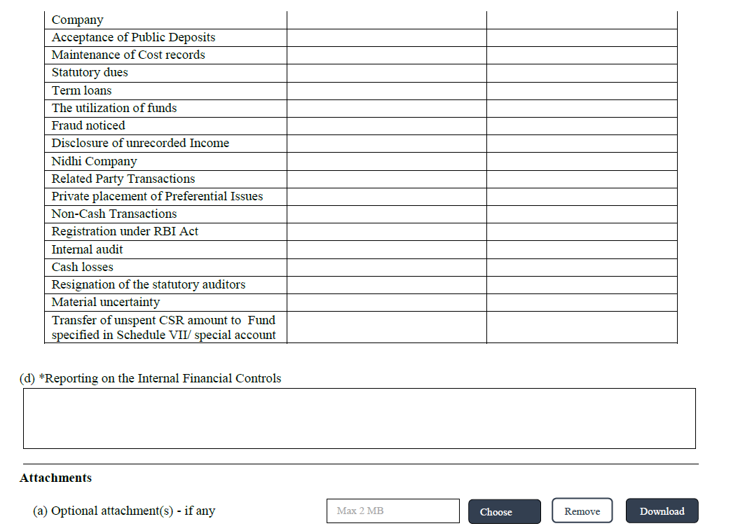
Extract of Auditor’s Report

Slide 59
Companies were required to file CSR-2 independently (not as a linked form) till June 30, 2025 and since the V2 portal was disabled till July 14, 2025, the MCA vide general circular no. 02/2025 had granted an opportunity to file e-form CSR 2 as an independent form with V2 SRN of form AOC-4/AOC-4 XBRL/AOC-4 (NBFC) on the V3 portal from July 14, 2025, to August 15, 2025.
Additionally, by way of the Amendment notifications, there is a change with respect to signatories of the e-forms, in line with facilitating filing by the authorized officers under IBC. The e-forms now recognize liquidator/ interim resolution professional/resolution professional, as authorized signatories for companies undergoing CIRP or liquidation process.

Slide 60
Attachment ‘Directors’ report as per sub-section (3) of section 134’ got removed in AOC-4, AOC-4 CFS, AOC-4 NBFC and AOC-4 NBFC CFS. Is it required to include ‘Boards report’ while attaching ‘Financial Statements’ to these forms?
Yes. Copy of financial statements duly authenticated as per section 134 (including Board‘s report, auditors‘ report and other documents) to be attached mandatorily while filing AOC-4, AOC-4 CFS, AOC-4 NBFC and AOC-4 NBFC CFS.
Also, above mentioned attachment is required to be attached while filing AOC-4 XBRL in addition to XBRL financial statements.

Slide 61
AOC-1, AOC-2, Extract of Board’s Report, Extract of Auditors Report [Standalone] and Extract of Auditors Report [Consolidated] are not applicable in the case of AOC-4 XBRL filing. Only CSR-2 form can be filed as linked form to AOC-4 XBRL.

Slide 62
All pending forms of V2 will be transitioned to V3. In case any form is currently under ‘Resubmission required’ status or gets marked under ‘Resubmission required’ status post go-live, it must be resubmitted in V3 system by 15th August 2025.
Forms that are in “Pending payment” status in version 2 will be marked as cancelled in Version 3.

Slide 63
Which forms can be filed in Offline mode?

Slide 64
What are the steps involved in filing the form in Offline mode?
Access the form through MCA services – E-filing – Annual forms
Fill up the Parent form with basic information e.g. CIN,
Click on Save and submit
Accordion/Panel for applicable linked forms will be enabled for the user.
Fill up the basic information of linked forms as applicable (AOC-1, AOC-2, AOC-4 CFS, CSR-2, Extract of Auditor’s Report [Standalone], Extract of Auditor’s Report [Consolidated], Extract of Boards report)
Click on Proceed button to submit Parent and linked forms with basic information
Excel gets generated, and download excel option would be displayed to the user.

Slide 65
Upload one by one filled excel against each form section and when the first excel is uploaded and successfully validated, then only the next form related ‘Choose file’ button will get enabled.
In case of excel validation errors, the user will be displayed error messages in a txt file and will be required to make necessary changes in the Excel.
The user can download individual excel once it is uploaded by clicking ‘Download’ button which is corresponding to excel attachment. If user is clicking on ‘download’ button the last uploaded will get downloaded.
Once all excels are successfully validated, click on “Proceed” action button.
Attach required attachments of Parent and linked forms.
Click on ‘Submit’ action button against each form after attaching mandatory attachments.
System performs all server-side validations on click of each ‘Submit’ action button.

Slide 66
Can I choose Offline mode for parent form and Online mode for linked forms or vice-versa?
No. Option to choose between Online and Offline mode is applicable only to the Parent form.
If the Parent form is filed in Online mode, all the linked filings must also be submitted in Online mode. Conversely, if the Parent form is filed in Offline mode, all linked filings must be filed in Offline mode.

Slide 67
What is excel functionality in Online web form?
Excel functionality in Online web form refers to providing details which are in the format of Table through macro enabled excel. Once user enters the number in the relevant field, excel download option would be enabled to fill in the details in excel with required validation.

Slide 68
What are the key points to be considered while filing AOC-4/AOC-4 NBFC?
The company for which the form is filed shall have a valid and active/Under CIRP/Under Liquidation CIN.
The DSC attached in the form is registered on MCA portal against the DIN/PAN/Membership number as provided in the form.
The applicant of the form is registered as Business User at the MCA portal before filing the web form.
The signing authority of the form shall have valid and non-expired/non-revoked DSC.
The authorized signatories of the company shall have an approved DIN or valid PAN or valid membership number as applicable.
The company is not flagged for the non -filing of
Form No. INC-22.
The company has not already filed another Form AOC-4 which is either pending for payment or pending for approval in respect of the same financial year end date.

Slide 69
Previous years filings are allowed to be filed in V3 system subject to payment of required additional fee as applicable

Slide 70
Standalone AOC 4/AOC-4 NBFC is submitted on V2
The Companies are not required to cancel the Standalone AOC 4/AOC-4 NBFC SRN to file CSR-2 form.
AOC-4 CFS/AOC-4 NBFC CFS can be filed independently only for those SRNs for which AOC-4/AOC-4 NBFC were filed in V2. For all the prospective filings, it will be mandatorily filed as a linked form with AOC-4/AOC-4 NBFC.

Slide 71
Is it mandatory to file Annual filing forms in sequential manner in V3 system?
No. It is advisable to file the forms in a sequential manner so that previous year figures would get auto populated in subsequent years filing.

Slide 72
Whether new annual filing forms will accept rounded off values [in thousands/millions/ lakhs/crores]?
No. Figures in New annual filing forms to be provided in absolute figures in Rupees instead of Round off figures
In case there is any variation in the details of previous year figures prefilled in the current year filings, will system allow to change it?
Yes. Previous year values prefilled in Balance Sheet and Profit and Loss Account are editable.

Slide 73
In Form AOC-4, is it mandatory to provide the reason for change in pre-filled figures of previous reporting period in Balance sheet including Annual filing forms?
No. it is not mandatory.
If ADT-1 filed for 5 yrs., will system allow entering the SRN in 5 FYs?
Yes, ADT-1 SRNs filed for multiple FYs can be entered in AOC-4 form. However, stakeholders are ensured to check that the FY start date and end date should fall between Period from and Period To entered in field no. 4(i) in Form ADT-1.

Slide 74
ADT-1 is not mandatory for the appointment of first auditor. How to file AOC-4 form without ADT-1 SRN?
Although Rule 4(2) of the Companies (Audit and Auditors) Rules, 2014, only mentions Section 139(1) – appointment of auditors and not Section 139(6) – appointment of the first auditor, it is recommended that companies file Form ADT-1 even for the appointment of the first auditor. In case ADT-1 SRN is not available for first auditor, Z99999999 SRN can be entered.

Slide 75
ENHANCED DISCLOSURES IN THE BOARD'S REPORT
(APPLICABLE FROM JULY 14, 2025) vide COMPANIES (ACCOUNTS) SECOND AMENDMENT RULES 2025

Slide 76
Changes in the Board’s Report
Rule 8(1) of Co (Accts) Rule – Matters to be included in the Board’s Report.
Relevant Rule 8(5)(x) – Relating to PoSH
Rule 8A – Matters to be included for OPC and Small Co

Slide 77
In the Companies (Accounts) Rules, 2014, in Rule 8 (5)(x)
Amendment made to include the following
In regard to Internal Complaints Committee under POSH Act 2013

Slide 78
1. Number of complaints of sexual harassment received during the year.
2. Number of complaints disposed of during the year.
3. Number of cases pending for more than ninety days (the stipulated timeline for inquiry completion under the PoSH Act).

Slide 79
Amended Rule e 8(5)(xiii)
The Board’s Report shall also include:
a statement by the company with respect to the compliance of the provisions relating to the Maternity Benefit Act 1961.
Notes:
Company must ensure full compliance with all provisions of the Maternity Benefit Act, including paid maternity leave, medical bonuses, nursing breaks, and creche facilities where applicable[2][4]

Slide 80
NON APPLICABILITY
Not applicable for One Person Company or small Company.
Maternity Benefit Act, 1961 and the Employees' State Insurance Act, 1948 does not apply concurrently to the same employee for the same benefits.

Slide 81
INTERPLAY BETWEEN MATERNITY BENEFIT ACT, 1961
AND EMPLOYEES' STATE INSURANCE ACT, 1948
Section 61 of the Employees' State Insurance (ESI) Act, 1948 prohibits duplicate claims:
An employee cannot claim maternity benefits under both the ESI Act and the Maternity Benefit Act for the same event.
If the employee is covered under ESI and eligible, the ESI scheme prevails.
The Maternity Benefit Act applies only to those not covered under the ESI framework
The Act continues to apply to women who: -
Are employed in an establishment to which the ESI Act applies, but the woman employee earns wages exceeding the ESI wage threshold (thus not covered under ESI) of Rs 21000 per month. And has worked for at least 80 days in the preceding 12 months, as required by Section 5(2) of the Maternity Benefit Act[1].

Slide 82
Materinity benefits
Applicable to establishments having 10 or more employees
Paid maternity leave: 26 weeks – 1st/ 2nd Child, 12 weeks – 3rd onwards. 8 weeks prior and 18 weeks post delivery
Adopting/ commissioning mother – 12 weeks
Medical termination/ miscarriage – 6 weeks
Nursing breaks – 2 breaks per day till 15 months
Creche facility – mandatory > 50 employees
Min Service requirement – 80 days in prior 12 months
No dismissal or termination during this period

Slide 83
MGT- 7A [Abridged Annual Returns for OPCs and Small Companies]
HEADER | DETAILS
TYPE OF PROCESSING | THIS FORM SHALL BE PROCESSED IN STP MODE
ENHANCEMENT PROPOSED | This form can be filed through online or offline mode Excel functionality has been added at several fields through which user can download the template in excel format and provide details in the excel List of shareholder /debenture holder will now be attached in the form of pre-defined excel Added new fields for declaration under 9(4) of the Companies (Management and Administration) Rules, 2014 for the declaration of Beneficial Owner New fields added to capture name of the company and address at the fy end date.

Slide 84
HEADER | DETAILS
ENHANCEMENTS PROPOSED | 6. New table added to capture gender wise number of shareholders. 7. New attachment ‘photograph of the registered office of the company showing external building and name prominently visible’ added. 8. Companies which are ‘under liquidation/under CIRP’ can file the form. 9. Signing of the form by ‘IRP/RP/liquidator’ is enabled for the companies which are ‘under liquidation / under CIRP’. 10. Other enhancement (pre-filling of data , repositioning of fields, additional data fields added, additional checks introduced etc.) 11. Several checks/business rules are put in place to check compliance with chapter VII the companies (management and administration) rules , 2014.

Slide 85
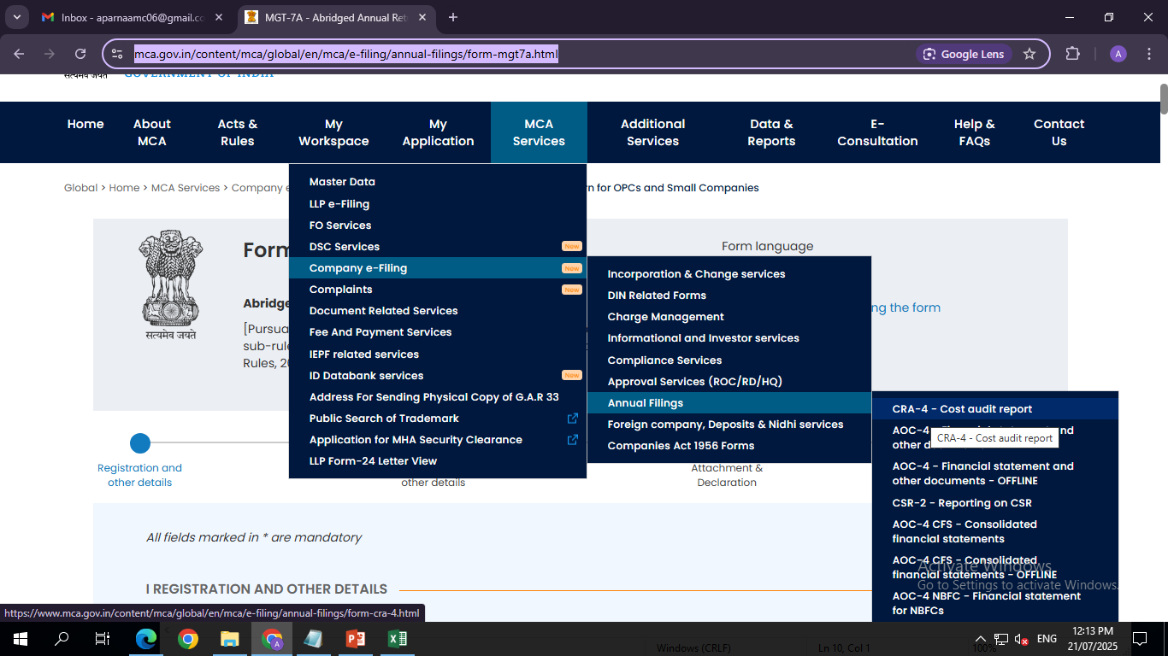
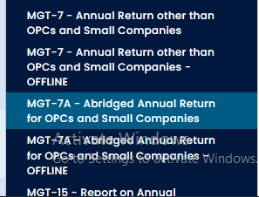
MGT- 7A [Abridged Annual Returns for OPCs and Small Companies]
https://www.mca.gov.in/content/mca/global/en/mca/e-filing/annual-filings/form-mgt7a.html

Slide 86
MGT- 7[ANNUAL RETURN (OTHER THAN OPCs AND SMALL COMPANIES)]
HEADER | DETAILS
TYPE OF PROCESSING | THIS FORM SHALL BE PROCESSED IN STP MODE
ENHANCEMENT PROPOSED | This form can be filed through offline or online mode. Excel functionality has been added at several fields through which user can download the template in excel format and provide details in the excel List of shareholder /debenture holder will now be attached in the form of pre-defined excel Upload or investor details FO service is deprecated. List to be attached while submitting the form only. Added new fields for declaration under 9(4) of the companies (management and administration) rules, 2014. New fields added to capture name of the company and address as at the fy end date.

Slide 87
HEADER | DETAILS
ENHANCEMENTS PROPOSED | 7. New table added to capture gender wise number of shareholders. 8. New attachment ‘photograph of the registered office of the company showing external building and name prominently visible’ added. 9. MGT- 8 attachment got removed and required fields got added within the form including DSC of company secretary. 10. Companies which are ‘under liquidation/under CIRP’ can file the form. 11. Signing of the form by ‘IRP/RP/liquidator’ is enabled for the companies which are ‘under liquidation / under CIRP’. 12. Other enhancement (pre-filling of data , repositioning of fields, additional data fields added, additional checks introduced etc.) 13. Several checks/business rules are put in place to check compliance with chapter VII the companies (management and administration) rules , 2014.

Slide 88
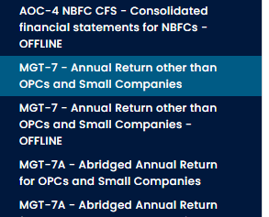
MGT- 7[ANNUAL RETURN (OTHER THAN OPCs AND SMALL COMPANIES)]
https://www.mca.gov.in/content/mca/global/en/mca/e-filing/annual-filings/form-mgt7.html

Slide 89
MGT-8 is part of MGT-7 now
Form MGT-8, previously a separate certification by a Company Secretary in Practice, is now embedded within MGT-7 for companies meeting the criteria under Section 92(2) of the Companies Act, 2013—i.e., listed companies or those with paid-up capital ≥ ₹10 crore or turnover
≥ ₹50 crore. Further, the embedded MGT-8 portion includes a certification statement by the Company Secretary. While this is mostly structured, any qualifying remarks about compliance can presently be added in the ‘Optional Attachment field.

Slide 90
What is the process of uploading Shareholder/Debenture holder details in MGT-7/MGT-7A?
List of Shareholders/Debenture holders [if applicable] shall be attached within the form while filing MGT-7/MGT-7A.
This attachment can be uploaded either in macro-enabled pre-defined sheet or normal excel sheet.
For MGT-7, excel files are allowed up to 300 MB [15 files of 20 MB each]and for MGT-7A, excel file size should be up to 2 MB only.
Whether all the Company filed Forms (From beginning to till date) can be viewed and downloaded in Public Search" in this Version V3?
Yes. All Public document of Companies/LLPs forms [from the beginning to till date] can be viewed under VPD/GCC service in V3 system.

Slide 91
It is mandatory to attach latest ‘Photograph of the registered office of the Company showing external building and name & address prominently visible’ as aligned with the requirements specified in Section 12(3)(a) of the Companies Act-2013.
PHOTOGRAPH OF THE REGISTERED OFFICE OF THE COMPANY WHILE FILING MGT-7/MGT-7A

Slide 92
Class, category, sub-category got prefilled as on date in MGT-7/MGT-7A.
All these fields are prefilled based on as on date information and are editable.

Slide 93
Increased Authorised Capital While Filing MGT-7/MGT-7A
The increased authorised capital entered in MGT-7/MGT-7A will not automatically update the master data in the MCA system. The MGT-7/MGT-7A forms are annual returns, and while they capture the capital structure for reporting purposes, they do not trigger Master data update for Authorised capital.
To update the authorised capital in MCA records, companies must file Form SH-7 (Notice of increase in share capital) or INC-28 (Notice of order of the court/competent authority) (if applicable).

Slide 94
NEW CLASS OF SHARE IN FORM MGT-7/MGT-7A
If your company does not have a share class-wise master in V3 then the system will not create a new class-wise master during MGT-7/MGT-7A filing. Only the company capital master will be updated with the new class details.
If your company already has a share class-wise master in the MCA V3 system, then the value of previously created class wise master, will get updated based on Form MGT-7/MGT-7A filing for both the share class-wise master and the company capital master subject to the paid event date condition.
New classes created through MGT-7/MGT-7A would not update Company master/Class wise capital master. Companies are requested to file SH-7 to add a new class

Slide 95
Can I delete a class of shares which got prefilled in Form MGT-7/MGT-7A that was added after the FY end date as the same is not applicable as at the end of the relevant FY for which form is filed?
Yes.

Slide 96
I have not filed any Form SH-7/PAS-3 in V3 system till now. Will my share class wise master gets created based on Form MGT-7/MGT-7A?
No. For the companies that do not have a share class wise master in the V3 system, Form MGT-7/MGT- 7A will not create a share class wise master. It can only be created through the first filing of Form SH- 7/PAS-3.

Slide 97
What if the number of business activities exceeds 15 in Form MGT-7/MGT-7A?
A maximum of 15 business activities must be reported in the form and the user is required to upload any additional business activities in the Optional Attachment section of the form.

Slide 98
This can be revised now
REVISE A PREVIOUSLY FILED FORM MGT-7/MGT-7A

Slide 99
Whether CSR-2 is required to be filed separately or independently?
Independent filing of CSR-2 is allowed only for the FY 2020-21, 2021-22, 2022-23, 2023-24 and FY 2024- 25[already filed in V2] which are required to report CSR as per relevant rules.
From Financial year 2024-25 onwards in V3, form to be filed as linked filing with AOC-4/AOC-4 NBFC/AOC-4 XBRL.

Slide 100
Form No. GNL-1 for extension of AGM due date, and it was pending in V3. Now, it is showing as “Resubmission Required” but there are no remarks mentioned.
This change has been done due to the transition from V2 to V3. You are required to resubmit the form along with all attachments in V3 portal.

Slide 101
Form GNL-1 filed for Scheme of Arrangement, or Amalgamation by a government company will be processed at jurisdictional ROC in V3
Is the Refund form available in both the V2 and V3 system?
No, after 14th July 2025, the refund form can be filed only in V3 system

Slide 102
How do we file multiple forms from one User ID as in V2 we were able to download the forms from the portal and multiple people can prepare simultaneously?
What are different modes of filing available in MCA V3?
A concept of Offline Utility has been introduced in V3 for annual filing forms to handle this issue and make the process easier. In this option user will provide basic details in web form basis which they can download a prefilled excel and will provide rest of the data in excel itself. After filling in the excel, user will have to upload the excel in the web form.
All the forms in V3 are web-based and require users to log in to the MCA system in order to access, fill out, and submit the relevant forms except for a few annual filing forms.

Slide 103
logic of paid-event date for updating Paid-up Capital through Annual filing forms
Paid-up capital in MCA system gets updated only when event date mentioned in the current form is greater than or equal to the event date available in the system.

Slide 104
Event dates for different forms:
PAS-3 – Date of allotment
SH-7 – Date of redemption [Redemption of preference shares]
SH-11 – Date of completion of buy back
INC-28 – Date of issue of certified copy of order [for reduction of share capital]
Annual filing forms [MGT-7/MGT-7A]: FY end date
Ex. Company has filed PAS-3 on 10th May 2024 for allotment of shares with allotment date 01 May 2024 without giving effect of buy back which happened on 01 April 2024. on 01 Jun 2024, Company has filed SH-11 with event date 01 April 2024. In this case, paid-up capital shall not get updated based on SH-11 as existing event date available in the system is higher than the event date mentioned in the form.

Slide 105
What are the key points to be considered while filling excels for CSR projects?
Section 7(b)(i) – Details of CSR amount spent against ongoing projects for the financial year/Section 10(c)(iii) - Details of amount spent against new ongoing CSR project in the financial year:
In case number entered is greater than zero, ‘Download’ excel option would be enabled.
Download the excel and fill the required details. Below are the important points to be considered while updating the excel:
If One project belongs to Multiple locations viz. multiple states or single State having multiple Districts, please provide the details in separate row for each such locations.
Please ensure to provide same serial number and other details except the locations for the project stated hereinabove.
The excel submission will be restricted if unique Serial numbers in the excel does not match with ‘Number of Ongoing Projects for the financial year’ entered in the webform.
In case the excel has same serial number with multiple rows [due to Multiple States or single State to multiple Districts], value entered in the first row will be considered.
‘Total’ field shall be displayed only in the PDF by taking CSR amount spent value from excel. Please check that correct ‘Total amount’ is displayed in the PDF file before uploading.

Slide 106
Section 7(b)(ii) – Details of CSR amount spent against other than ongoing projects for the financial year/Section 10(c)(iv) - Details of amount spent against new other than ongoing projects in the financial year:
In case number entered is greater than zero, ‘Download’ excel option would be enabled.
The excel submission will be restricted if unique Seral numbers in the excel does not match with ‘Number of Projects for the financial year’ entered in the web form.

Slide 107
Section 10(b) - Details of CSR amount spent in the financial year for ongoing projects of the preceding financial year(s):
Number of ongoing projects:
This field shall be enabled and mandatory in case 'Yes' is selected in field number 10 i.e. “Whether any unspent amount of preceding three financial years (financial year ending after 22nd January 2021) has been spent in the financial year.
In case number entered is greater than zero, ‘Download’ excel option would be enabled.
Please ensure to download the excel and fill the required details
Shall be in the format FY<Financial year end date>_Sr No for each company.
Please ensure that the Project Id entered in the excel file is valid and associated with the Company.
Name of the Project:
The value shall be pre-filled based on the Project-Id entered, when excel is uploaded.
Amount spent for the project at the beginning of the Financial Year (in INR):
Please enter the value. However, if entered amount does not match with 'Unspent master'. Cumulative Amount then the said value shall be pre-filled based on the Project-Id, when excel is uploaded. Upon prefill of the value, spent value will also change accordingly.
Project ID:

Slide 108
COMPLIANCE CHALLENGES ON MCA V3 PORTAL
ISSUE | IMPACT | RESOLUTION PROVIDED
Login, OTP, and DSC Errors | Users unable to log in due to failed OTP delivery via email/SMS Inability to associate or validate DSCs DSCs not detected or flagged as invalid even when valid Login sessions timing out mid-process | MCA released updated DSC Management Utility with new drivers Recommended using Chrome/Edge browsers with proper Java settings Users advised to clear cache, reset passwords, and re-verify emails/mobile Users advised to clear cache, reset passwords, and re-verify emails/mobile

Slide 109
COMPLIANCE CHALLENGES ON MCA V3 PORTAL
ISSUE | IMPACT | RESOLUTION PROVIDED
Data Migration & Sync Errors | Company or LLP details not prefilled correctly in web forms DIN-PAN mismatch in DIR-3-KYC and MGT-7 Master data (Company/Director) inconsistencies Issues in verifying CIN/DIN at the form level | Backend scheduled syncing to ensure updated information across systems Users advised to raise Grievance Tickets for company-specific mismatches Helpdesk provided targeted resolution support for faulty DIN/CIN records

Slide 110
COMPLIANCE CHALLENGES ON MCA V3 PORTAL
ISSUE | IMPACT | RESOLUTION PROVIDED
Payment Gateway and SRN Issues | Payments debited but SRN not generated Failed redirection to banks or payment timeout Duplicate payments due to unclear status Delay in getting receipts or acknowledgment for filings | - MCA implemented Centralized Payment System (CPS) with real-time status tracking Auto-refund mechanism activated for failed or duplicate payments Option to track payment status by SRN provided on the portal Recommended to wait 24–48 hours before reattempting failed

Slide 111
COMPLIANCE CHALLENGES ON MCA V3 PORTAL
ISSUE | IMPACT
Auto log out and inability to save data | While filling Form AOC-4 online on the V3 portal, the profile gets logged out automatically in between. The changes made in the form does not get saved

Slide 112
COMPLIANCE CHALLENGES ON MCA V3 PORTAL
ISSUE | IMPACT
Unable to input multiple entries under Point 24 (i) “Number of other matters to be included in Board’s Report” section of offline AOC-4 utility—only one editable head activates despite instructions to include all points. | While filling Form AOC-4 offline, users are unable to add additional points in the Boards Report under point 24(i). A note has been provided stating that any part of the report that has not been covered anywhere else in the form must be mandatorily specified here. Only one head gets enabled for editing even upon mentioning more than one ‘other matters’

Slide 113
NON- COMPLIANCES AND THEIR CONSEQUENCES
Non-compliances | Consequences | Impact on Company
Late / Non-filing of Annual Forms (AOC-4, MGT-7, ADT-1) Not Filing Form INC-22A (ACTIVE) Registered Office Non-Compliance (wrong address, no signage, etc.) Missed Director KYC (DIR-3 KYC / Web-KYC) | Late fees + adjudication penalties Company marked "ACTIVE–non-compliant"; directors flagged Notice from ROC; penalty order under Sec 454 DIN invalidation | Loss of good standing; disqualification risk after 3 years Cannot file SH-07, PAS-03, DIR-12, INC-22, INC-28 Business address invalid; filings, notices, banking affected Director cannot sign filings or resolutions

Slide 114
NON- COMPLIANCES AND THEIR CONSEQUENCES
Non-compliances | Consequences | Impact on Company
Secretarial Standards Non-Adherence (e.g., minutes, notices) Failure to Appoint Auditor & Filing Form ADT-1 Not Filing DPT-3 | Penal Order u/s 454 Auditor disqualification ; compliance notice Penal action by ROC | Invalid resolutions and compliance audit failures Possible invalidation of Statutory Audit Non-disclosure of loans can flag fraud risk

Slide 115
THANK YOU

