Slide 1


Presentation on F&O, STT and VDA
Eastern india regional council
22-08-2025
CA. Avijit dutta

Slide 2
Index-Session Agenda
Sl. No. | Topic | Sl. No. | Topic
1 | Derivative Transactions | 12 | Salary and F&O
2 | Examples of Derivative transactions | 13 | How to Prepare Financial Statements?
3 | Classification of Derivative Transactions | 14 | Books of Accounts u/s 44AA
4 | Types of Financial Derivative Transactions | 15 | Expenses that can be claimed
5 | Speculative v. Non-speculative | 16 | Special Case: Multiple Businesses
6 | Taxability of Futures & Options | 17 | One business audited & other u/s 44AD?
7 | Capital Gains v. PGBP | 18 | Income below taxable limit
8 | Section 44AD | 19 | F&O Businesses for Practicing CAs
9 | Audit Requirement for F & O | 20 | Securities Transaction Tax
10 | Determination of Turnover | 21 | Securities Transaction Tax-Taxability
11 | Example of Turnover Determination | 22 | Virtual Digital Asset-Taxability

Slide 3
Derivative Transactions
  Section 2(ac) of Securities Contracts (Regulation) Act, 1956 defines derivative as under:
  “Derivative” includes—
  (A) a security derived from a debt instrument, share, loan, whether secured or unsecured, risk instrument or contract for differences or any other form of security,
  (B) a contract which derives its value from the prices, or index of prices, of underlying securities.

Slide 4
Derivative Transactions
  Derivatives are
  financial instruments.
  does not have its own physical existence.
  emerges out of the contract between the buyer and seller of the derivative instrument.
  value depends upon the value of the underlying asset.
  The underlying assets can be real assets such as commodities, gold etc. or financial assets such as index, interest rate etc.

Slide 5
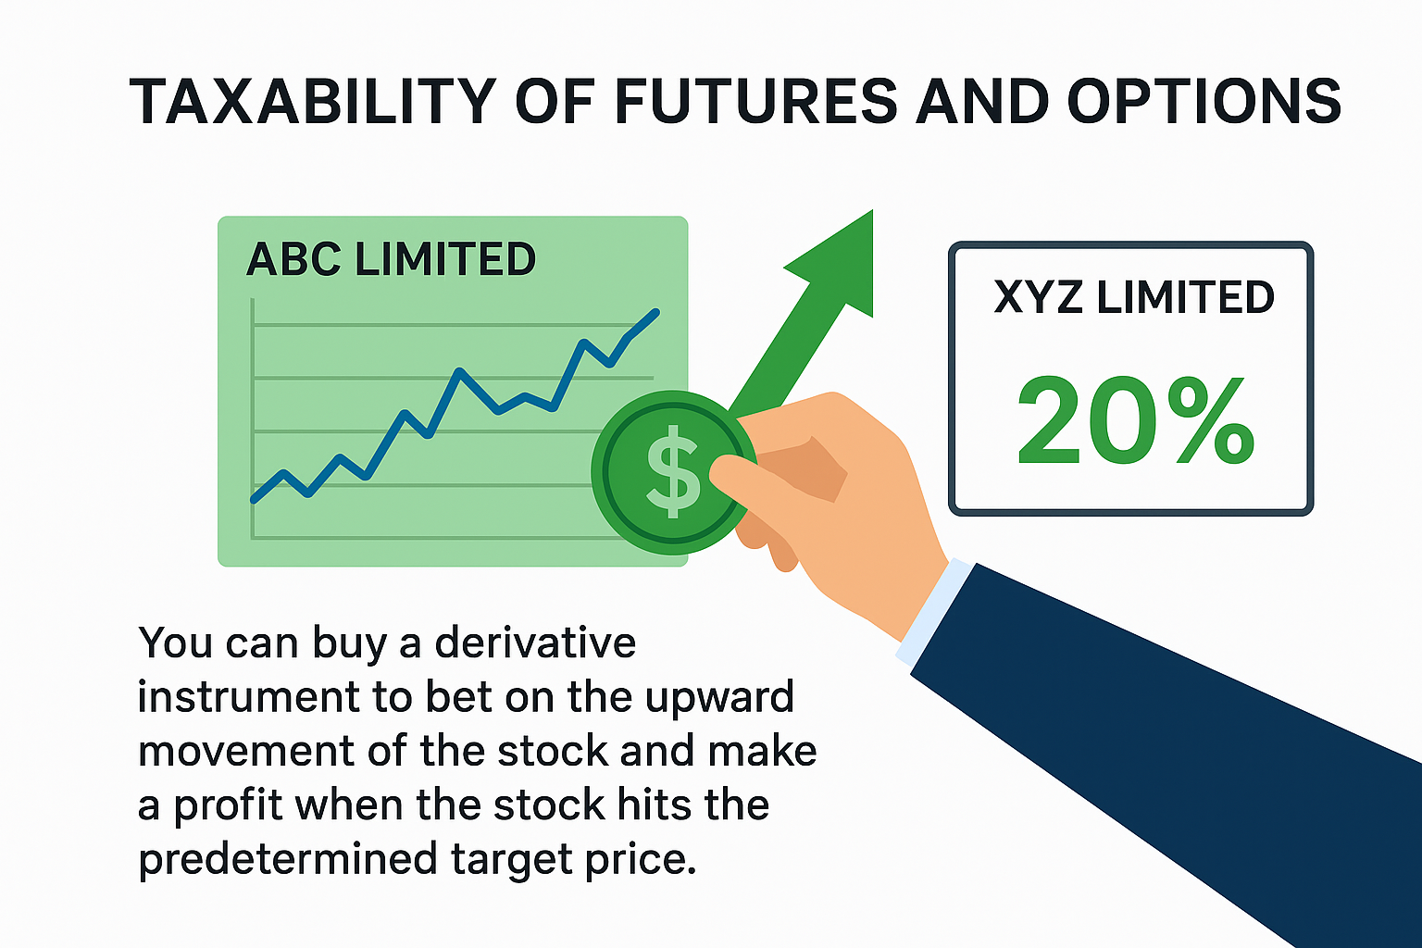
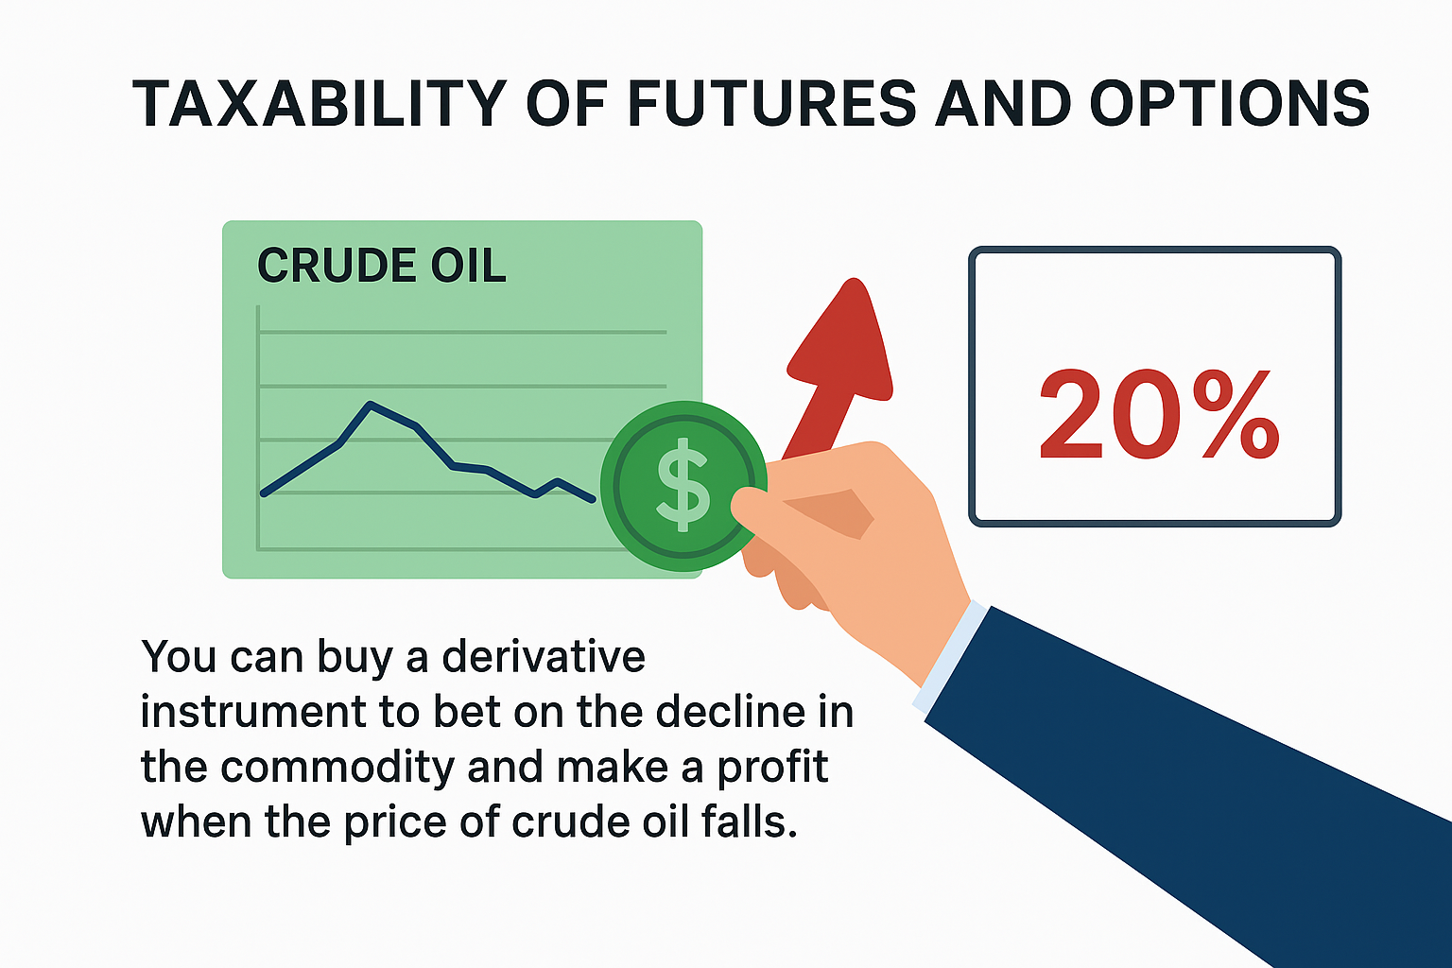
Examples of Derivative Transactions
  We know that the value of assets keeps fluctuating in response to market dynamics. Derivative contracts allow investors to speculate on the price movement of the assets and benefit from it.

Slide 6
Classification of Derivative Transactions
Derivatives can be classified into broad categories depending upon the type of underlying asset.
Commodity derivatives and Financial derivatives
Commodity Derivative: Underlying is a physical asset or a real asset
Financial Derivative: Underlying is a financial asset
Exchange traded derivatives and Over The Counter (OTC) derivatives
ETD: Standardised derivative product
OTC Derivative: Private bilateral contracts between two parties and are non standardized

Slide 7
Type of Financial Derivative Transactions
Futures | Options
A futures contract is a contract to buy or sell a specified asset (physical or financial asset) at a specified price on a specified future date. | A contract that gives its buyer (holder) a right (but not obligation) to buy or sell a specified asset at a specified price (exercise price) on or before a specified future date.
Futures contracts are generally traded on an exchange which sets the basic standardized rules for trading in the futures contracts. | The holder of the options can exercise the option at specified price or may allow it to lapse. The specified price is also termed as strike price or exercise price.

Slide 8
Speculative v. Non-Speculative
  Section 43(5): "speculative transaction" means a transaction in which a contract for the purchase or sale of any commodity, including stocks and shares, is periodically or ultimately settled otherwise than by the actual delivery or transfer of the commodity or scrips:
  Provided that for the purposes of this clause—
  (a) a contract in respect of raw materials or merchandise entered into by a person in the course of his manufacturing or merchanting business to guard against loss through future price fluctuations in respect of his contracts for actual delivery of goods manufactured by him or merchandise sold by him; or
  (b) a contract in respect of stocks and shares entered into by a dealer or investor therein to guard against loss in his holdings of stocks and shares through price fluctuations; or

Slide 9
Speculative v. Non-Speculative
  (c) a contract entered into by a member of a forward market or a stock exchange in the course of any transaction in the nature of jobbing or arbitrage to guard against loss which may arise in the ordinary course of his business as such member; or
  (d) an eligible transaction in respect of trading in derivatives referred to in clause (ac) of section 2 of the Securities Contracts (Regulation) Act, 1956 (42 of 1956) carried out in a recognised stock exchange; or
  (e) an eligible transaction in respect of trading in commodity derivatives carried out in a recognised stock exchange, which is chargeable to commodities transaction tax under Chapter VII of the Finance Act, 2013 (17 of 2013),
  shall not be deemed to be a speculative transaction:

Slide 10
Speculative v. Non-Speculative
  Section 43(5): Speculative transactions are transactions where the sale of stocks and commodities is settled without their actual delivery to the buyer.
  However, there is a list of exceptions mentioned in this section, which includes commodity trade to hedge future risks of losses. This exception includes Futures and Options trading as well.
Intra-day Trading of Shares
Classified as Speculative
Futures & Options, Forwards, etc.
Not Classified as Speculative

Slide 11
Speculative v. Non-Speculative
Speculative Transactions | Non-Speculative Transactions
Only Intra-day trading of shares without actual delivery is considered as Speculative Transactions. | All other transactions are considered as Non-speculative transactions.
Taxable under “PGBP” only. | Taxable under “Capital Gains” or “PGBP”.
Speculative Loss can be set-off only against speculative gain. | If shown under PGBP, loss can be set-off against gain in any head other than Salary
Carry forward of loss only for 4 years. | Carry forward of loss for 8 years.

Slide 12
Taxability of Futures & Options
  Capital Gains: If the derivative is held as investment, sale proceeds do not form a part of turnover for business [Ref Para 5.7 of Guidance Note on Tax Audit under Section 44AB of the Income-tax Act, 1961 (Revised 2023)]
  If the derivative is held as an investment, income from such transactions may be offered for taxation under Capital Gains.
  However, Section 111A/112A is not attracted in this case.

Slide 13
Taxability of Futures & Options
  Business Income: If the derivative is held as stock-in-trade, sale proceeds form a part of turnover for business [Ref Para 5.7 of Guidance Note on Tax Audit under Section 44AB of the Income-tax Act, 1961 (Revised 2023)]
  If the derivative is held as an stock-in-trade, income from such transactions may be offered for taxation under PGBP.

Slide 14
Capital Gains v. PGBP
  Benefits of PGBP:
  Easier set-off provisions
  Lesser Litigations
  Lower taxes
  Circulars for Reference:
  Instruction No. 1827 dated 31-08-1989
  Circular No. 4/2007 dated 15-06-2007
  Circular No. 6/2016 dated 29-02-2016

Slide 15
Capital Gains v. PGBP
Reference No. | Key Content & Purpose
Instruction No. 1827 | Clarified distinction between shares held as stock-in-trade (business income) and shares held as investment (capital gains). Field officers should consider multiple factors jointly to determine classification
CBDT Circular No. 4/2007 | Reiterated and updated the principles of Instruction 1827. Included Supreme Court decisions like Associated Industrial Development Co. Ltd. and H. Holck Larsen as guiding precedents for AO’s evaluation
CBDT Circular No. 6/2016 | Introduced clarity to reduce litigation specifically for listed shares/securities. Allowed assessors to accept certain taxpayer-designated treatments without dispute

Slide 16
Capital Gains v. PGBP
      Further, an issue may arise whether such transactions of purchase or sale of stocks and shares undertaken by the assessee are in the course of business or as investment. The answer to this issue will depend on the facts and circumstances of each case taking into consideration the nature of the transaction, frequency and volume of transactions etc. For this, attention is invited to the following judgments where this issue has been considered.
      CIT v. P.K.N. and Co Ltd (1966) 60 ITR 65 (SC)
      Saroj Kumar Mazumdar v. CIT (1959) 37 ITR 242 (SC)
      CIT v. Sutlej Cotton Mills Supply Agency Ltd. (1975) 100 ITR 706 (SC)
      G. Venkataswami Naidu & Co. v. CIT (1959) 35 ITR 594 (SC)

Slide 17
Section 44AD
      Special provision for computing profits and gains of business on presumptive basis.
      44AD. (1) Notwithstanding anything to the contrary contained in sections 28 to 43C, in the case of an eligible assessee engaged in an eligible business, a sum equal to eight per cent of the total turnover or gross receipts of the assessee in the previous year on account of such business or, as the case may be, a sum higher than the aforesaid sum claimed to have been earned by the eligible assessee, shall be deemed to be the profits and gains of such business chargeable to tax under the head "Profits and gains of business or profession" :

Slide 18
Section 44AD
      Explanation.—For the purposes of this section,—
      (a) "eligible assessee" means,—
      (i) an individual, Hindu undivided family or a partnership firm, who is a resident, but not a limited liability partnership firm as defined under clause (n) of sub-section (1) of section 2 of the Limited Liability Partnership Act, 2008 (6 of 2009); and
      (ii) who has not claimed deduction under any of the sections 10A, 10AA, 10B, 10BA or deduction under any provisions of Chapter VIA under the heading "C.—Deductions in respect of certain incomes" in the relevant assessment year;

Slide 19
Section 44AD
      (b) "eligible business" means,—
      (i) any business except the business of plying, hiring or leasing goods carriages referred to in section 44AE; and
      (ii) whose total turnover or gross receipts in the previous year does not exceed an amount of two crore rupees.
      Provided that where the amount or aggregate of the amounts received during the previous year, in cash, does not exceed five per cent of the total turnover or gross receipts of such previous year, this sub-clause shall have effect as if for the words "two crore rupees", the words "three crore rupees" had been substituted:

Slide 20
Audit Requirement for F&O
      44AB. Every person-
      (a) carrying on business shall, if his total sales, turnover or gross receipts, as the case may be, in business exceed or exceeds one crore rupees in any previous year;
      Provided that in the case of a person whose—
      (a) aggregate of all amounts received including amount received for sales, turnover or gross receipts during the previous year, in cash, does not exceed five per cent of the said amount; and
      (b) aggregate of all payments made including amount incurred for expenditure, in cash, during the previous year does not exceed five per cent of the said payment:

Slide 21
Audit Requirement for F&O
      this clause shall have effect as if for the words "one crore rupees", the words "ten crore rupees" had been substituted;
      Provided further that for the purposes of this clause, the payment or receipt, as the case may be, by a cheque drawn on a bank or by a bank draft, which is not account payee, shall be deemed to be the payment or receipt, as the case may be, in cash;

Slide 22
Determination of Turnover
      The turnover in such types of transactions is to be determined as follows (This is only and only for the purpose of computing ‘turnover’ for tax audit):
The total of favourable and unfavourable differences in case of squared off transactions shall be taken as turnover.
Premium received on sale of options is also to be included in turnover. However, where the premium received is included for determining net profit for transactions, then such net profit should not be separately included.
In respect of any reverse trades entered, the difference thereon should also form part of the turnover.

Slide 23
Determination of Turnover
      In case of an open position as at the end of the financial year (i.e., trades which are not squared off during the same financial year), the turnover arising from the said transaction should be considered in the financial year when the transaction has been actually squared off.
      In case of delivery-based settlement in a derivatives transaction, the difference between the trade price and the settlement price shall be considered as turnover. Further, in the hands of the transferor of the underlying asset, the entire sale value shall also be considered as business turnover where the underlying asset is held as stock in trade.

Slide 24
Examples of Turnover Determination
Security name | Type | Qty | Option Premium Paid | Option Premium Received | Strike price | Spot/ Settlement price | Profit/ (Loss) | Remarks
Cipla | Futures | 500 |  |  | 1495 | 1610 | 57,500 | Squared Off
BHEL | Futures | 200 |  |  | 208 | 104 | -20,800 | Squared Off
IOC | Put (Sell) | 100 |  | 5 | 50 |  | - | Open (Note 1)
ITC | Put (Sell) | 100 | 40 | 10 |  |  | -3,000 | Squared Off
Axis Bank | Futures | 200 |  |  | 1229 |  | - | Open (Note 1)
TCS | Call (Buy) | 100 | 20 |  | 1500 | 1600 | 8,000 | Delivery Settlement
Infosys | Call (Buy) | 100 | 10 |  | 1000 | 950 | -1,000 | Expired (Note 2)
GAIL | Put (Buy) | 50 | 4 |  | 100 | 90 | 300 | Delivery Settlement

Slide 25
Examples of Turnover Determination
Note 1 – Mr. A has an open position in underlying put option as on 31st March 2025. Thus, the turnover from such options shall be computed in the financial year in which the transaction is squared off or settled for delivery.
Note 2 – Delivery-based settlement in a Call (Long) option transaction can be made only if the option is “in the money”, which means the market price (settlement price) is above the strike price (trade price). However, if there is a profit/loss in the option premium amount, then it shall be considered in the calculation of turnover.

Slide 26
Examples of Turnover Determination
Security Name | Turnover
Cipla | 57,500
BHEL | -20,800
IOC | -
ITC | -3,000
Axis Bank | -
TCS* | 10,000
Infosys | -1,000
GAIL* | 500
Total Turnover | 92,800
*As the amount of premium received is already considered for computing the profit or loss from the transaction, it is not included again while computing the turnover

Slide 27
Salary and F&O
For example, during the year, Mr. A has earned salary income and incurred losses from trading in futures and options (F&O). The details of his transactions are as follows:
Transaction | Buy Value | Sell Value | Realised P & L | Computation of Turnover
Transaction 1 | 40,00,000 | 50,00,000 | 10,00,000 | 10,00,000
Transaction 2 | 60,00,000 | 30,00,000 | (30,00,000) | 30,00,000
Transaction 3 | 75,00,000 | 60,00,000 | (15,00,000) | 15,00,000
Transaction 4 | 3,20,00,000 | 2,00,00,000 | (1,20,00,000) | 1,20,00,000
Transaction 5 | 2,30,00,000 | 1,30,00,000 | 1,00,00,000 | 1,00,00,000
Total | 7,25,00,000 | 4,70,00,000 | (55,00,000) | 2,75,00,000

Slide 28
Salary and F&O
The turnover, in this case, shall be Rs. 2,75,00,000, and the loss from F&O shall be Rs. 55,00,000. The tax audit requirement arises if the business turnover from F&O exceeds Rs. 1 crore. However, the tax audit shall not be required if more than 95% of business transactions are done through banking channels and turnover is less than Rs. 10 crores.
Since in F&O transactions, the trading shall be through digital means only, the enhanced limit of Rs. 10 crores shall apply to determine the applicability of tax audit. Thus, the tax audit shall not be required in this case.

Slide 29
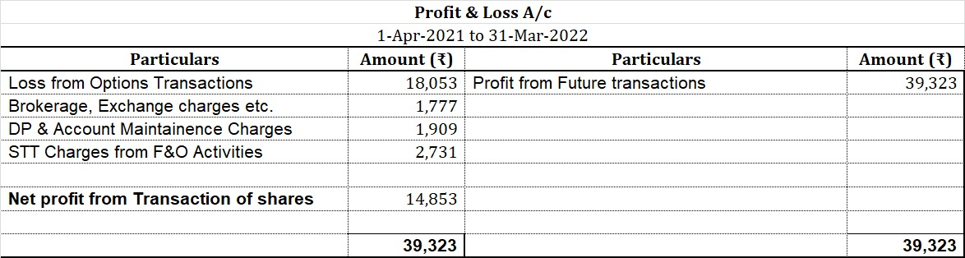
How to Prepare Financial Statements?

Slide 30
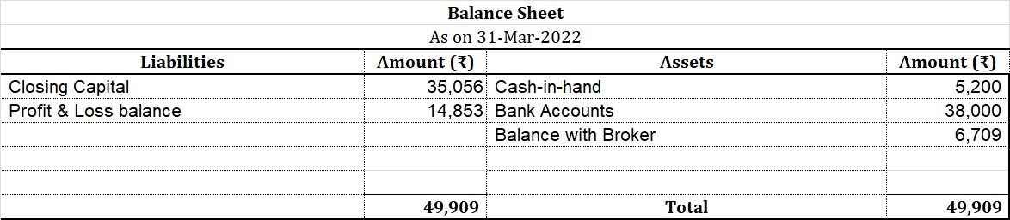
How to Prepare Financial Statements?

Slide 31
Books of Accounts u/s 44AA
44AA (2) Every person carrying on business or profession [not being a profession referred to in sub-section (1)] shall,—
(i) if his income from business or profession exceeds one lakh twenty thousand rupees or his total sales, turnover or gross receipts, as the case may be, in business or profession exceed or exceeds ten lakh rupees in any one of the three years immediately preceding the previous year; or
(ii) where the business or profession is newly set up in any previous year, if his income from business or profession is likely to exceed one lakh twenty thousand rupees or his total sales, turnover or gross receipts, as the case may be, in business or profession are or is likely to exceed ten lakh rupees, during such previous year; or

Slide 32
Books of Accounts u/s 44AA
(iii) where the profits and gains from the business are deemed to be the profits and gains of the assessee under section 44AE or section 44BB or section 44BBB, as the case may be, and the assessee has claimed his income to be lower than the profits or gains so deemed to be the profits and gains of his business, as the case may be, during such previous year; or
(iv) where the provisions of sub-section (4) of section 44AD are applicable in his case and his income exceeds the maximum amount which is not chargeable to income-tax in any previous year,
keep and maintain such books of account and other documents as may enable the AO to compute his total income in accordance with provisions of this Act.

Slide 33
Books of Accounts u/s 44AA
keep and maintain such books of account and other documents as may enable the Assessing Officer to compute his total income in accordance with the provisions of this Act:
Broker Ledger
Bank Statements
Contract Notes
Details of Charges Deducted, etc.

Slide 34
Expenses that can be claimed
Brokerage
GST on Brokerage
Stamp Duty
Securities Transaction Tax (sale/purchase)
Interest Incurred
Consultancy Fees
Profit Sharing
Office Rent/Expenses
Staff Salary
Depreciation
Electricity
Printing & Stationery, etc.

Slide 35
Special Case: Multiple Businesses
[Ref Para 5.16 & 5.17 of Guidance Note on Tax Audit under Section 44AB of the Income-tax Act, 1961 (Revised 2023)]
It may, however, be noted that in cases where the assessee carries on more than one business activity, the results of all business activities should be clubbed together. A question may arise in the case of an assessee carrying on business and at the same time engaged in a profession as to what are the limits applicable to him under section 44AB for getting the accounts audited.
In such a case, it is essential to check individual limits for business and profession. Even if a single limit is breached, both the business and profession will be liable for audit.

Slide 36
Special Case: Multiple Businesses
Turnover from F&O | Turnover from Other Business | Total Turnover from Business | On Individual Analysis, is Tax Audit of Business required? | Gross Receipts of Profession | On Individual Analysis, is Tax Audit of Profession required? | Is Tax Audit Applicable as a whole?
72 Lakhs | 0 | 72 Lakhs | No | 54 Lakhs | Yes | Yes
72 Lakhs | 0 | 72 Lakhs | No | 42 Lakhs | No | No
72 Lakhs | 250 Lakhs | 322 Lakhs | Yes | 0 | No | Yes
72 Lakhs | 250 Lakhs | 322 Lakhs | Yes | 42 Lakhs | No | Yes
850 Lakhs | 0 | 850 Lakhs | No | 0 | No | No

Slide 37
Special Case: Can one business be audited & other be declared in 44AD?
[Ref Para 5.17 of Guidance Note on Tax Audit under Section 44AB of the Income-tax Act, 1961 (Revised 2023)]
Where the business is covered by section 44B or 44BBA, turnover of such business shall be excluded. Similarly, where the business or profession is covered by section 44AD or 44ADA or 44AE or 44BB or 44BBB and the assessee opts to be assessed under the respective sections on presumptive basis, the turnover thereof shall be excluded.
Hence, the question is answered!

Slide 38
Special Case: Exempt Income & Income below taxable limit
[Ref Para 6.1, 6.2 & 6.3 of Guidance Note on Tax Audit under Section 44AB of the Income-tax Act, 1961 (Revised 2023)]
It may be appreciated that the object of audit under section 44AB is only to assist the Assessing Officer in computing the total income of an assessee in accordance with different provisions of the Act.
It appears that neither section 44AB nor any other provisions of the Act stipulate exemption from the compulsory tax audit to any person whose income is exempt from tax.

Slide 39
Special Case: Exempt Income & Income below taxable limit
This section makes it mandatory for every person carrying on any business or profession to get his accounts audited where conditions laid down in the section are satisfied and to furnish the report of such audit in the prescribed form.
Section 44AB does not make any distinction between a resident or non-resident. Therefore, a non-resident assessee is also required to get his accounts audited and to furnish such report under section 44AB if his turnover/sales/gross receipts exceed the prescribed limits. However, it would be confined only to the Indian operations carried out by the non-resident assessee.

Slide 40
F&O Businesses for Practicing CAs
Clause 11 of Part 1 of the First Schedule: A Chartered Accountant in Practice shall be deemed to be guilty of professional misconduct if he engaged in any business or occupation other than profession of Chartered Accountant unless permitted by Council so to engage.
According to ethical standard board of ICAI, derivatives transactions are considered in the nature of business or occupation other than the profession of chartered accountant, not in the nature of investment. it simply means that trading of future and options are not to be considered as an investment.

Slide 41
F&O Businesses for Practicing CAs
Hence, practicing CAs don’t have the option to declare income from Futures & Options under capital gains. But the question remains – Can a Practicing CA be engaged in the business of Futures & Options?
Also, we need to understand that the same is not covered in the list of General Permissions Granted under regulation 190A of the CA Regulations, 1988, as amended from time to time.

Slide 42
F&O Businesses for Practicing CAs
However, the Ethical Standards Board vide notification dated 04-08-2021 has declared that-
It is permissible for a member in practice to engage in derivative transactions in his personal capacity, but not in professional capacity i.e., for clients. Such engagement in derivatives would not be violative of provisions of Clause (11) of Part-I of First Schedule to The Chartered Accountants Act, 1949.

Slide 43
F&O Businesses for Practicing CAs
Question | Answer
Whether a member in practice can transact in derivatives’ transactions? | Yes. It is permissible for a member in practice to transact in derivatives in his individual capacity (and not for clients or any other person).
What are the types of derivative instruments allowed to be transacted in by members in practice? | Members in practice are allowed to transact only in future and options derivatives.
Which products of derivatives are permissible to be transacted by members in practice? | Members in practice are allowed to transact in equity and currency derivatives.

Slide 44
F&O Businesses for Practicing CAs
Question | Answer
Whether members in practice are allowed to transact in commodity derivatives? | No. It is not permissible for members in practice to transact in commodity derivative transactions.
Whether members in practice are allowed to transact in derivatives’ transactions in the name of his proprietary firm or partnership firm ? | No. Members in practice are not allowed to transact in derivatives in the name of his proprietary firm or partnership firm.

Slide 45
F&O Businesses for Practicing CAs
Question | Answer
Whether members in practice allowed to transact in Index derivatives? | Members in practice are allowed to transact in Index derivatives with respect to equity and currency.
Whether members in practice are required to seek permission from the council to transact in derivative transactions? | No, there is no requirement to take permission from the Council.
Whether member not holding Certificate of Practice can transact in Derivative Transaction on behalf of others? | There is no restriction for members not holding Certificate of Practice to transact in Derivatives transaction on his own account or on behalf of others.

Slide 46
F&O Businesses for Practicing CAs
Question | Answer
Can members in practice advice their clients on investment in securities or other financial instrument? | Yes, in view of the entry number (xx) of Management Consultancy and other Services u/s 2(2)(iv) of Chartered Accountants Act, 1949, member in practice is generally permitted to provide Investment counseling in respect of securities [as defined in the Securities Contracts (Regulation) Act, 1956 and other financial instruments. ] These services can only be advisory in nature.

Slide 47
Securities Transaction Tax
Tax levied on the value of securities traded through a recognized stock exchange;
Similar to TCS;
Leviable on taxable securities including equity, derivatives, and unit of equity-oriented mutual fund;
Also includes unlisted shares sold under an offer for sale to the public included in IPO and where such shares are subsequently listed in stock exchanges;
Payable to the government on or before the 7th of next month;

Slide 48
Securities Transaction Tax
Taxable securities transaction | Rate | Value on which STT is calculated
Delivery-based purchase of equity share | 0.1% | Price at which share is purchased
Delivery-based sale of an equity share | 0.1% | Price at which share is sold
Delivery-based sale of a unit of oriented mutual fund | 0.001% | Price at which unit is sold
Sale of equity share or unit of equity-oriented mutual fund in a recognized stock exchange otherwise than by actual delivery or transfer and intra day traded shares | 0.025% | Price at which share or unit is sold
Derivative – Sale of an option in securities. | 0.1% | Option premium
Derivative – Sale of an option in securities where the option is exercised | 0.125% | Settlement price
Derivative – Sale of futures in securities. | 0.02% | The price at which such futures are traded

Slide 49
Securities Transaction Tax-Taxability
7th Proviso to Section 48: Provided also that no deduction shall be allowed in computing the income chargeable under the head "Capital gains" in respect of any sum paid on account of securities transaction tax under Chapter VII of the Finance (No. 2) Act, 2004.
STT not allowed for capital gains;
STT allowed for PGBP transactions.

Slide 50
Virtual Digital Asset-Taxability
Section 115BBH: (1) Where the total income of an assessee includes any income from the transfer of any virtual digital asset, notwithstanding anything contained in any other provision of this Act, the income-tax payable shall be the aggregate of,—
(a) the amount of income-tax calculated on the income from transfer of such virtual digital asset at the rate of thirty per cent; and
(b) the amount of income-tax with which the assessee would have been chargeable, had the total income of the assessee been reduced by the income referred to in clause (a).
(2) Notwithstanding anything contained in any other provision of this Act,—
(a) no deduction in respect of any expenditure (other than cost of acquisition, if any) or allowance or set off of any loss shall be allowed to the assessee under any provision of this Act in computing the income referred to in clause (a) of sub-section (1); and
(b) no set off of loss from transfer of the virtual digital asset computed under clause (a) of sub-section (1) shall be allowed against income computed under any provision of this Act to the assessee and such loss shall not be allowed to be carried forward to succeeding assessment years.

Slide 51
Virtual Digital Asset-Taxability
Gain on transfer taxable @ 30% (plus surcharge and cess) u/s 115BBH
Intra-head loss allowed to be set-off against gain from VDA only;
No carry forward of losses for successive assessment years;
TDS @ 1% on value of transfer u/s 194S
Can be shown under PGBP or Capital gains depending on whether investment or stock
Taxable under IFOS if received as gift and value more than ₹50,000/- (Section 56(2)(x))

Slide 52

Floor is now Open for Knowledge Sharing!

