Slide 1


2-Day Seminar on Governance, Risk, and Compliance:
Role of Chartered Accountants in Autonomous & Local Bodies
Professional opportunities for Chartered Accountants (CAs) in Public Finance:
Emerging Development in Financial Sustainability
👥 Organized by : Committee on Public & Government Financial Management, ICAI
👥 Hosted by: Eastern India Regional Council of ICAI
Notes:
MAD, KASH for CASH, Seekhna band to jeetna band

Slide 2
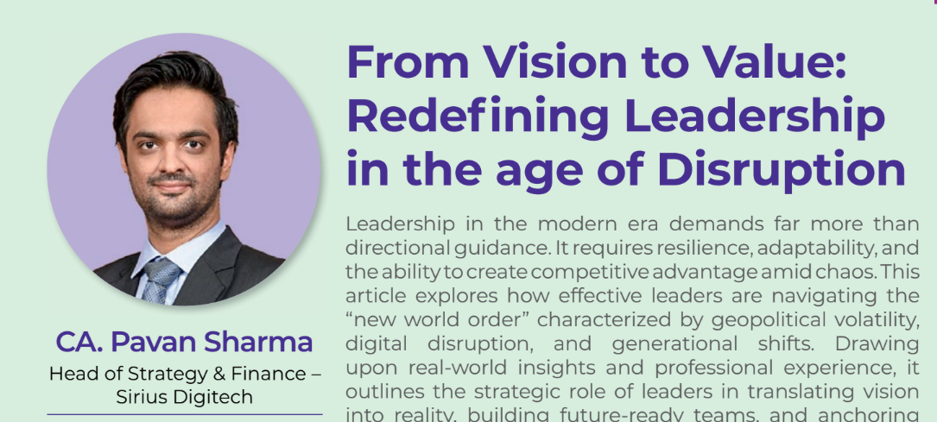
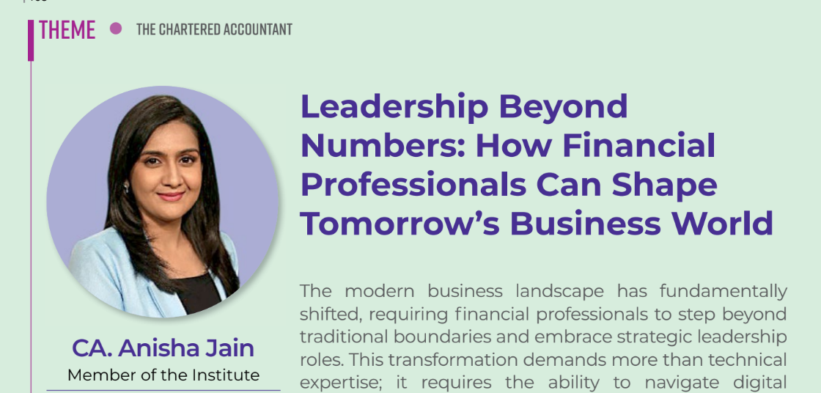
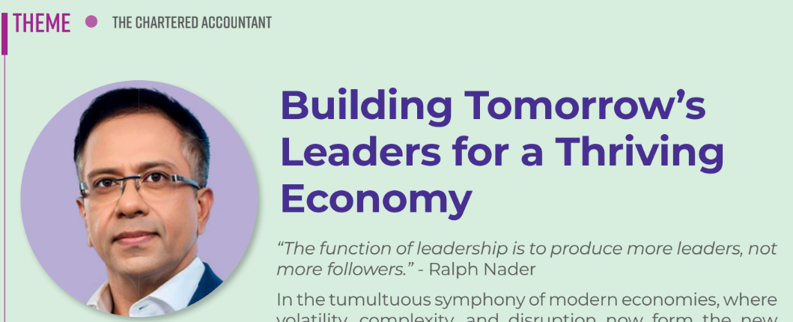

Slide 3

Time has come to MAD

Slide 4


Make a Difference
MAD
Flexibility of anytime, anywhere and any mode of payment
Periodic real-time status updates through SMS, WhatsApp, email
Timely resolution of Grievance in case of Dispute
Mechanism of surveillance in case of harassment
Strategies such as rebates to ensure timely payments
Increased transparency and accountability
Principle of Equity in place

Slide 5
K.A.S.H. Framework for
Chartered Accountants in Public Finance
K.A.S.H. = Knowledge + Attitude + Skills + Habits
KASH to CASH
Knowledge of Governance and Risk,
Attitude of accountability
Skills in forecasting, digitization, Habits of continuous learning

Slide 6
How CA Can be a change maker
Indore’s cleanliness success started with audited property tax reforms.
A rural school couldn’t build toilets
until a CA-certified fund was released.
Accounting is the language of business. But for Public Finance, it is the language of trust
From 3 Idiots: “Success ke peeche mat bhaago, excellence ke peeche bhaago.”
Don’t just chase corporate roles, public finance excellence will follow with huge impact.

Slide 7

CA IN PUBLIC FINANCE:
FROM BALANCING BOOKS TO TRANSFORMING LIVES
What’s common between, Mohan from Swades, and a CA in public finance?”
“Did you know 1 CA signature can unlock ₹1,000 crore of public funding?”
“Ek signature se sirf fund release nahi hota, pura sheher badal sakta hai
A Chartered Accountant in Public Finance Can:
Suggest new tax measures or improve compliance (Skills + Knowledge)
Redesign financial reporting formats for ULBs or SPVs (Knowledge + Skills + Habits)
Advise on municipal bonds or PPP structuring (Knowledge + Attitude)
Audit welfare schemes for leakages (Habits + Attitude)
CA’s role is not just counting money – it’s about changing lives by ensuring money reaches where it matters

Slide 8


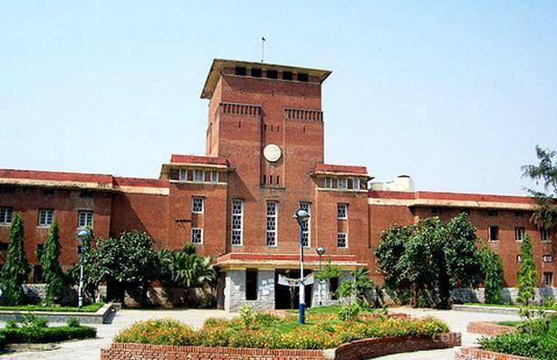


CA Pankaj Goel– Financial Management Specialist, The World Bank Consultant, Ernst &Young Alumnus
(Exp of 22yrs +)
All India Topper in Mathematics & Accounting in Class XII,1994
Financial Consultant for Numerous assignment of The World Bank/Asian Development Bank
Have worked in various assignments in municipalities of Uganda, Bangladesh and Afghanistan
Instrumental in designing Smart City and AMRUT Guidelines
Topped Class XII CBSE exams in 1994
National Level winner in Painting Competition
2002
B Com: SRCC 1997
1999
M Com/MPhil:1999/2003

Slide 9


You think Public Finance is boring? Let me tell you — one signature by a CA can make a village get water, a city get clean streets, or a state build a hospital. That’s not boring. That’s power."
Fact: 70% of India’s GDP will come from cities by 2030 — but municipal revenue is just 1%.
Question: “Who will fix this gap?”
Jahan hisaabon ki baat ho, wahan sapne bhi sajte hain;
CA ke haath se, sirf khate nahi, zindagiyan bhi badalte hain
Public finance isn’t about numbers; it’s about people. Behind every audited figure is a child in school, a farmer with irrigation, a city cleaner than yesterday.

Slide 10
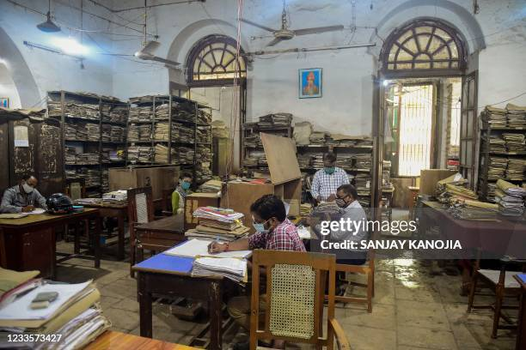



Slide 11
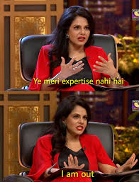
Often, when confronted with governance and compliance challenges in Public Finance, professionals may feel, ‘Yeh meri expertise nahi hai, I am out.’
This seminar intends to change that perception by building capacity and confidence among Chartered Accountants to engage in these new area of Public Finance as now Time is Changed to Focus on key Skills instead of all
What gets measured, gets managed." – Peter Drucker
And in Public finances, measurement is huge IMPACT with Good Money

Slide 12
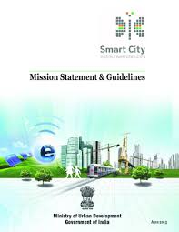




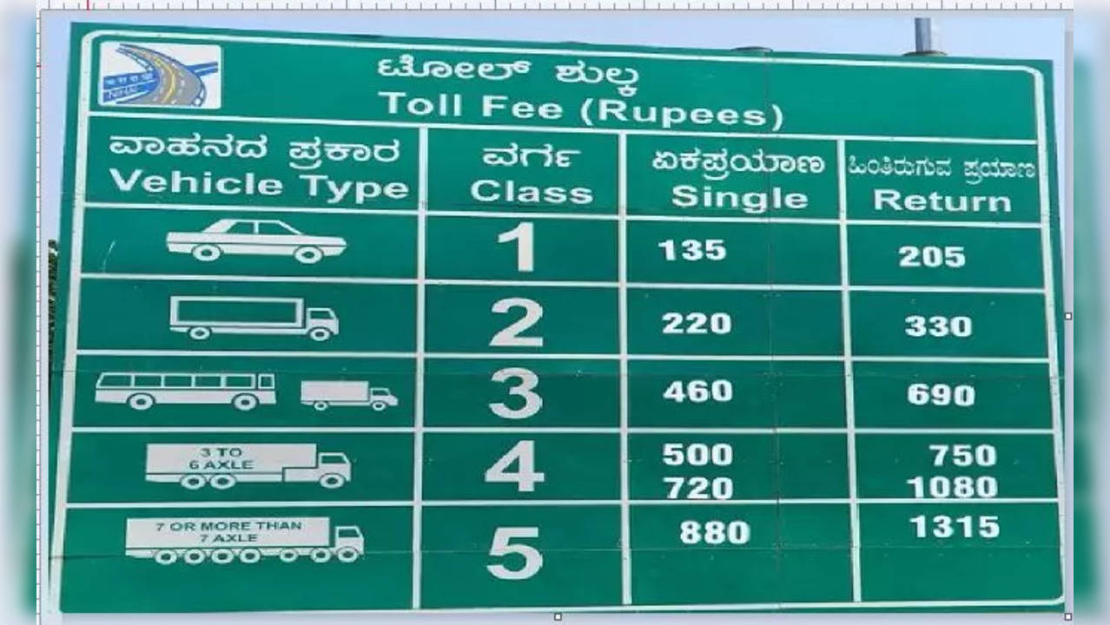
SMART CITY
Who designed?
Who Decides Method of Valuation
SPV
Financial Statements; Who Prepares?
Who Decides Rates etc

Slide 13
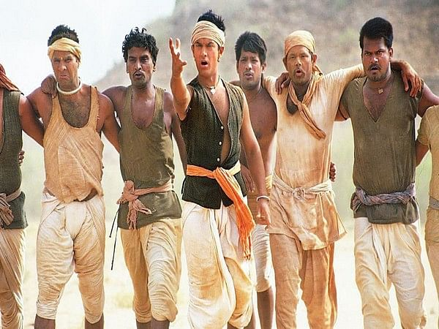
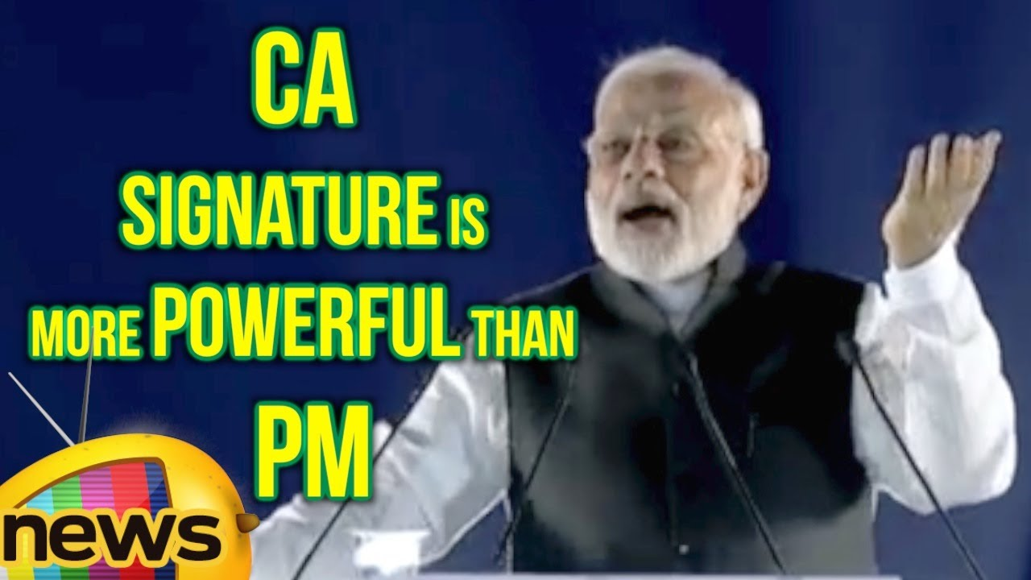
A single CA’s signature can unlock trust, enable bonds, and release grants — transforming public finance from paper to progress, and numbers to impact
Villagers uniting for fair taxation
Ek dastakhat sirf kagaz par nahi,
Balki logon ke jeevan par bhi chhap chhodta hai

Slide 14
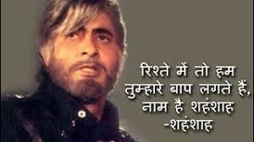
TEST YOUR KNOWLEDGE
Question:
Which institution in Indian Public Finance fits this line?
Which institution in Municipal Finance fits this line?

Slide 15
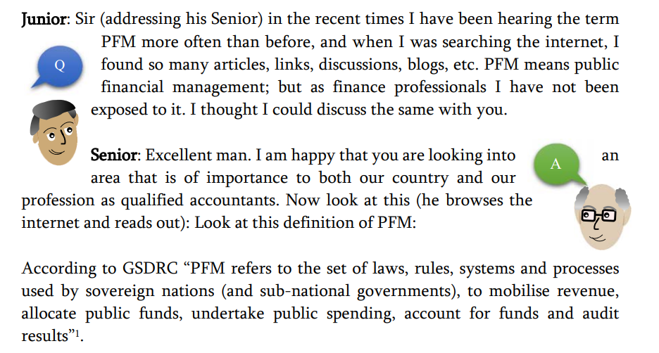
ROLE OF PROFESSIONAL ACCOUNTANTS IN PUBLIC FINANCIAL MANAGEMENT:
SOURCE ICAI(CP&GFM)

Slide 16
Why This Topic Matters
Rising fiscal stress in governments.
Making Cities atam Nirbhar
Major Milestones-2030,2047,2070
Sustainable development = new financial skill demand.
CA ke liye yeh sirf naukri nahi, yeh rashtra nirman hai.

Slide 17
Public Finance Today
1. Urban Growth Demands Financial Discipline
  India’s urban population will contribute over 70% of GDP by 2030, requiring infrastructure investment of ₹1 trillion+.
  Municipal revenues contribute just ~1% of GDP, indicating a major fiscal gap and poor creditworthiness of ULBs.
    This, Cities need additional Funds from capital markets
2. Capital Market Readiness Hinges on Financial Reporting
  ULBs must meet Financial Reporting standards for additional Funds from capital markets through Municipal Bonds and access to the Urban Challenge Fund.

Slide 18
WHAT DOES GOVERNMENT COVERS
Central Government: Ministries
State Government
Others Like Local Government, DTC, Delhi Jal Board, Delhi University, PSUs, Banks, Income Tax Office
PSUs

Slide 19
What do u Mean by Autonomous and Local Bodies?
Autonomous Bodies (Central/State level)
Indian Council of Medical Research (ICMR) – National biomedical research body.
All India Institute of Medical Sciences (AIIMS) – Premier medical education and hospital institution.
Urban Development Authorities – e.g., Delhi Development Authority (DDA), Bangalore Development Authority (BDA) for planned urban development.
National Institute of Fashion Technology (NIFT) – Specialized education body with autonomy.
Indian Institute of Technology (IITs) – Higher technical education institutions governed by their own councils.
Local Bodies (Urban/Rural governance)
Municipal Corporations – e.g., Brihanmumbai Municipal Corporation (BMC), Delhi Municipal Corporation.
Municipal Councils/Nagar Parishads – e.g., Smaller towns like Hazaribagh Municipal Council.
Zila Parishad (District level Panchayat) –
Block Panchayats (Panchayat Samiti) – Intermediate tier of rural governance.
Gram Panchayats – Village-level elected bodies.
Solution of Grievances by reaching at Citizen Place
Fast Redressal of Citizen Grievances

Slide 20
PUBLIC FINANCE
Public Finance deals with finances of Government of any Country or State covering revenue, expenditures, and debt load through various government and quasi-government institutions. It covers:
Urban Finance dealing with finances of parastatal bodies like PHED/TWAD/CMWSSB etc
Rural Finance dealing with finances of Rural Local Bodies like Gram Panchayat
Municipal Finance dealing with Finances of Municipality :third tier of Government
Public Finance
Municipal Finance
Urban Finance
Rural Finance
“From local panchayat to global boards – a CA’s skill speaks everywhere.

Slide 21
TEST YOUR KNOWLEDGE
1:
Which of the following is the major share of receipts for ULBs in India’s current context?
  A) Grants from the Centre/State
  B) Property Taxes
  C) Municipal Bonds
  D) User Charges
2
Which of the following is the major share of own revenue source for ULBs in India’s current context?
  A) Grants from the Centre/State
  B) Property Taxes
  C) Municipal Bonds
  D) User Charges

Slide 22
Role of CAs in Public Finance
v
PPP,Bond market,infra financing.
Public Financial Management (PFM) reforms.
Local bodies Financial/revenue reforms

Slide 23

Picture Baaki Hai
Huge Opportunities
Coming in next 20 Years

Slide 24
Opportunities in Financial Sustainability
v
Green Operating Surplus
Green bonds, climate finance, SDG budgeting.
Debt sustainability advisory

Slide 25
Multilateral & Global Roles-Roles in World Bank, ADB, UNDP:
v
Projects like Audit etc
Consultant .
Staff

Slide 26

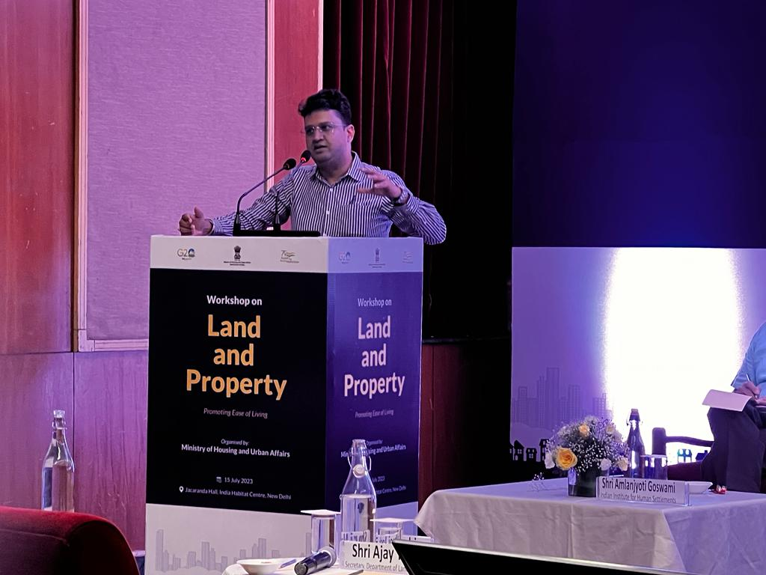

CHARTERED ACCOUNTANTS :PIVOTAL ROLE ACROSS THE SPECTRUM OF PUBLIC FINANCE

Slide 27
TEST YOUR KNOWLEDGE
For municipal bonds, what is min Credit Rating?
For municipal bonds, which city has issued recently Bond of Rs 25 Cr
Why are cities issuing so many municipal bonds in the last one year?

Slide 28
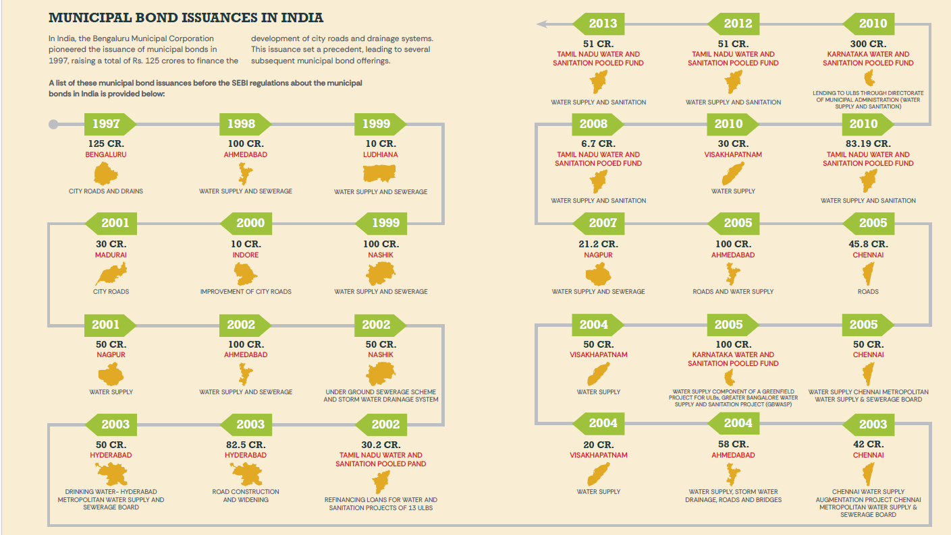
Before SEBI 2015 Guidelines and GoI flagship
Notes:
27+ 22 after 2015

Slide 29
Municipal Bonds: Key Benefits
Incentive Benefits
Municipal bond issuance should not be viewed as a standalone financial activity, but rather as a strategic enabler for long-term urban transformation. It serves as
Gateway to Future GoI Scheme Eligibility
Financial discipline and transparency
Bridge to Blended and Market-Based Financing
Tool to Enhance Creditworthiness and Investor Confidence
AMRUT 2.0 Incentive Encourages bond issuance with a Rs. 520 crore incentive Fiscal incentives :₹13 crore per ₹100 crore raised via bonds. Additional incentives: ₹10 crore for Green Bonds ₹5 crore for Yellow Bonds
Urban Challenge Fund Offers dual grants for projects financed by municipal bonds
Align with GoI Vision to make Cities Investible Improved Financial Discipline with relaxed SBI norm with Bond environment in nation in the last 1-2 years

Slide 30
Urban Challenge Fund (UCF)
UCF of Rs 1 lakh crore aims to encourage states to think innovatively towards attaining sustainable urbanization and redevelopment goals in existing cities. Fund is to implement the proposals for
Cities as Growth Hubs
Creative Redevelopment of Cities and
Water & Sanitation
Rs 10,000 crore is allocated to the Urban Challenge Fund for FY 2025-26.
Financing Mechanism
Mandatory Condition
50% of the Project Cost funded from
Bond
Bank Loan
PPP
50% Funded By
25% funded by the Central Government
Remaining 25% can be funded by State or Own (ULB)

Slide 31
ICAI ROLE IN PUBLIC FINANCE
CPFGM
ACCOUNTING REASERACH FOUDNATION
COURSES
Researches

Slide 32
Key areas where CA working
Conversion of Accounts to Accrual Based Double Entry Accounting System
Auditing and Assurance Services
Management Consultancy Services
Trainer

Slide 33

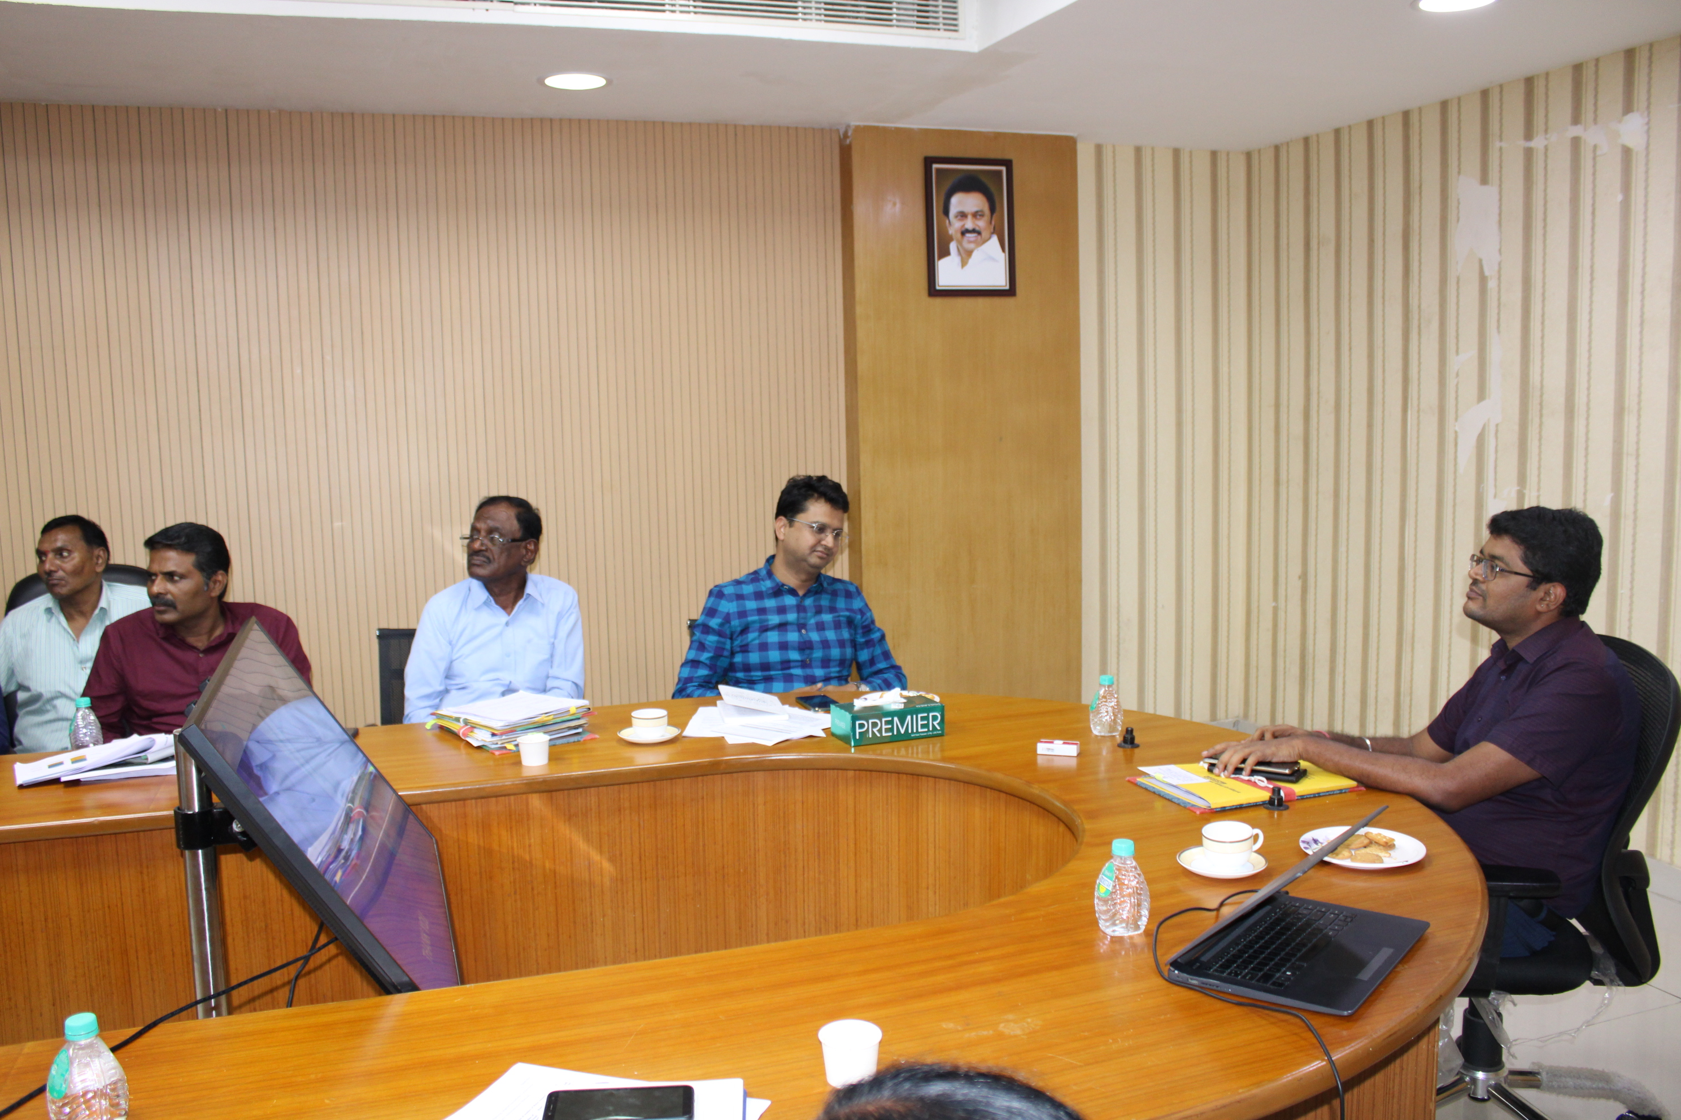
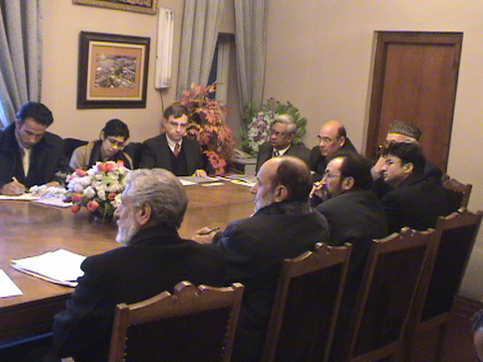
TRIPLE ROLE
Consultant
Employee
Entrepreneur

Slide 34
QUALIFICATION AND SKILLS REQUIRED
Public Sector Consulting
Graduation/Post Graduation
Professional Degree:
CA/CS/LLB/MBA etc
Technical Skills: MS Office
Communication Skills

Slide 35
HOW TO ENTER

Slide 36
1. Hire or enter retainer ship with experienced professional
2. Take Membership of tender websites
3. Bid Preparation is skill
4.Enter in to JV for credential
5.HAVE PATIENCE

Slide 37

Be the Hanuman of Public Finance – leap beyond compliance, ensure sustainability.
Carry fiscal “Sanjivani” → revive trust, enable growth.

Slide 38

Thank You
This decade is YOUR 70 minutes to transform India’s finances.

