Slide 1
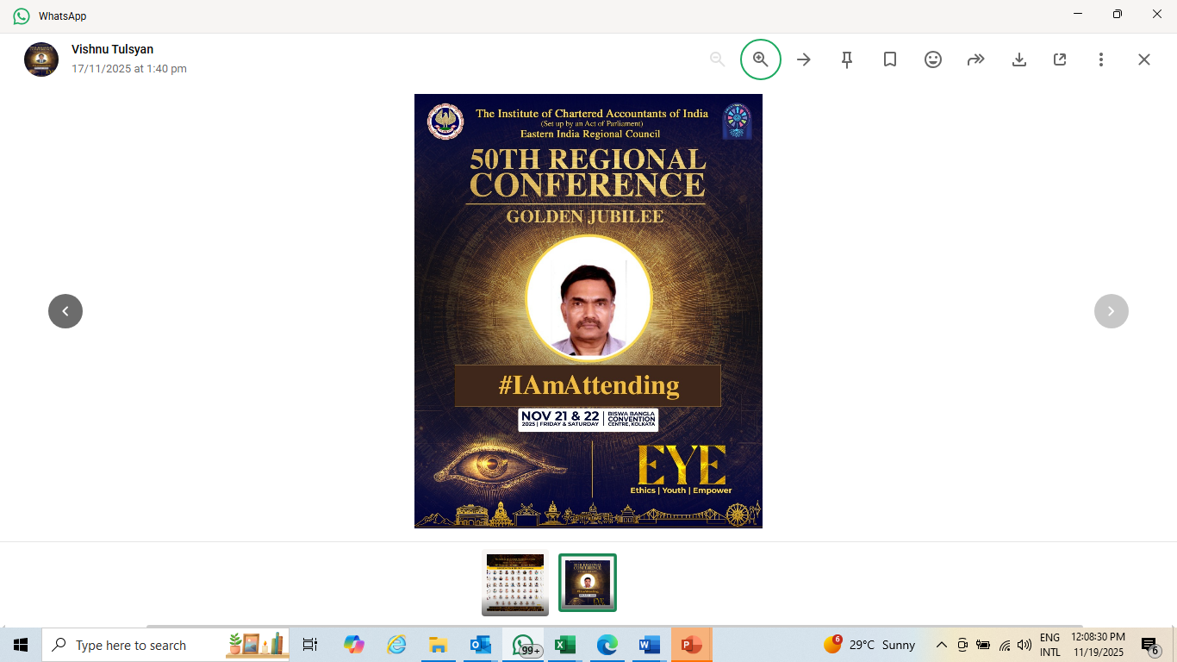
Session III day 1: Advanced Case Studies in Forensic Audit – Chetan Dalal

Slide 2

DISCLAIMER
All case studies / exhibits / example are classroom adaptations of real-life situations for academic purposes, and they are not descriptions of any fraud anywhere. Any resemblance to any entity anywhere is for academic purposes or purely accidental/ imaginary and has no implication of fraud in any entity referred to anywhere

Slide 3


Two options for my session:
Completely theoretical, or,
2. Practical with entertainment- jokes, films, music, fun tests

Slide 4
Agenda
Recent case studies in business fraud
Digital tools including AI in audit and financial crimes investigations
Opportunities in forensic audit

Slide 5
3. Recent Case studies

Slide 6
Recent Case Studies – take aways
Creation of Secret Reserves
Materiality- what exactly is material?
Common warning bells and concerns in ERP system where a fraud of Rs 6 crores took place.
Amazing case of a disappearing inventory 5 crores

Slide 7
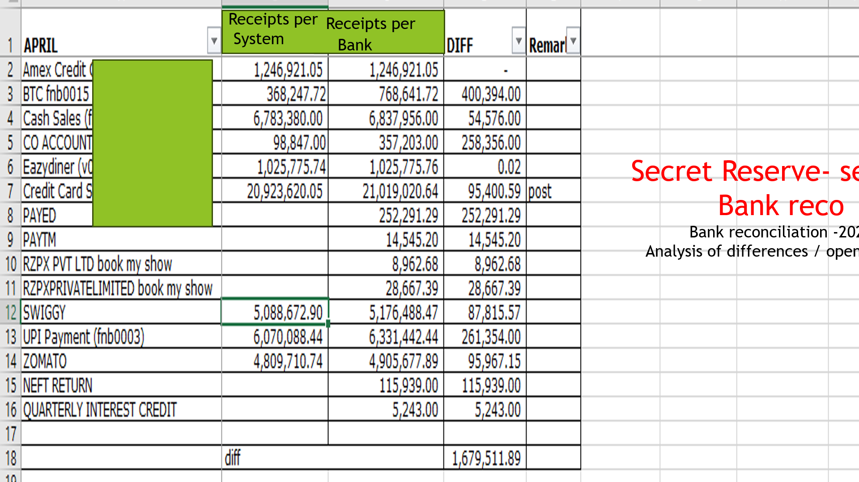

Slide 8
The accountant was using the secret reserve at opportune time
Pay accomplices
Do teeming and Lading or kiting practices
Other temporary transfers to hide other matters

Slide 9
Materiality: what exactly is material with respect to fraud?

Slide 10

FRAUD IN A TEMPLE IN A HOSPITAL

Slide 11
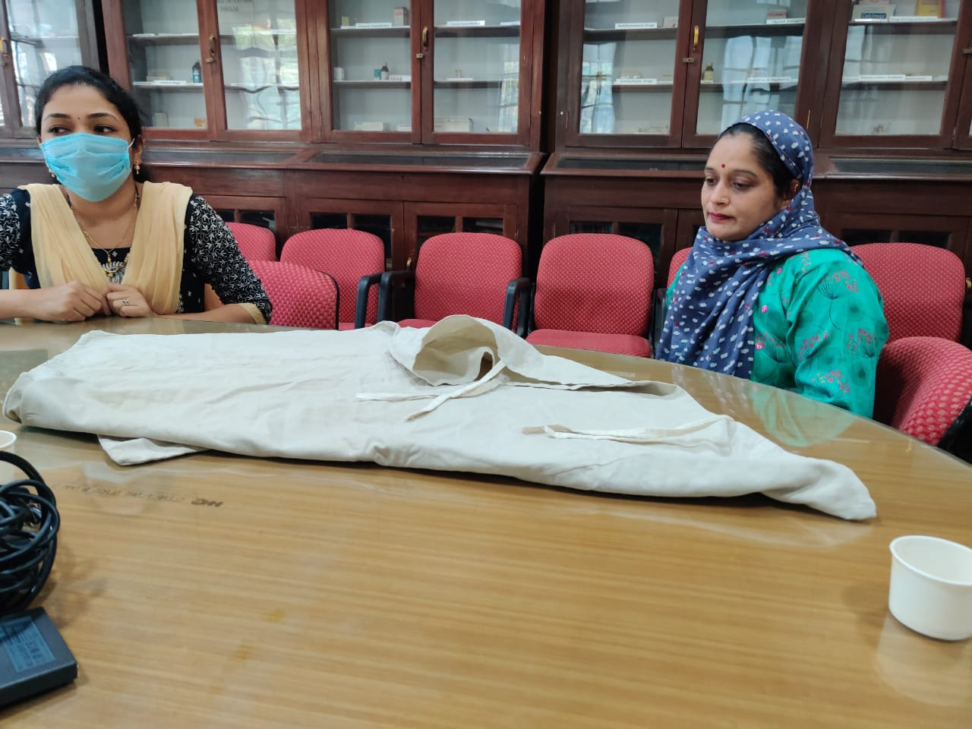
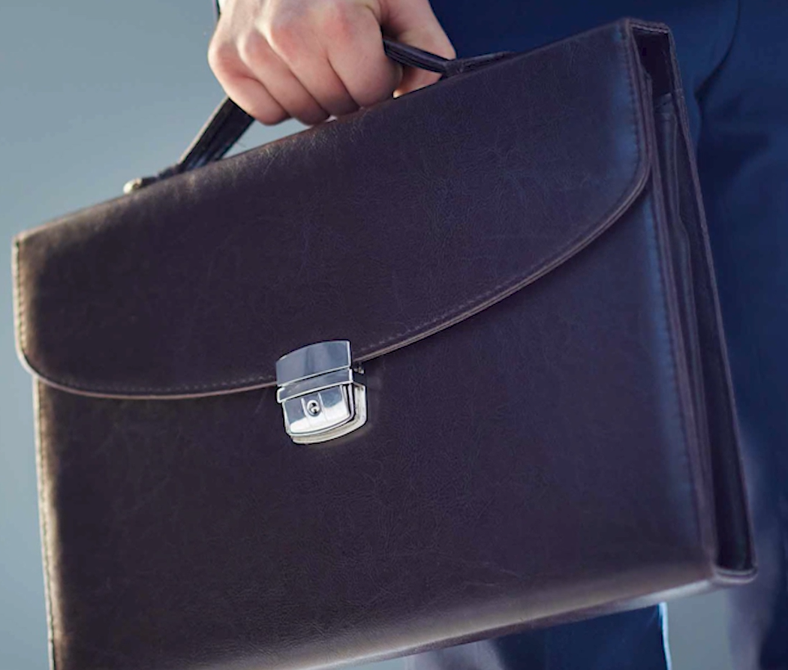

Slide 12

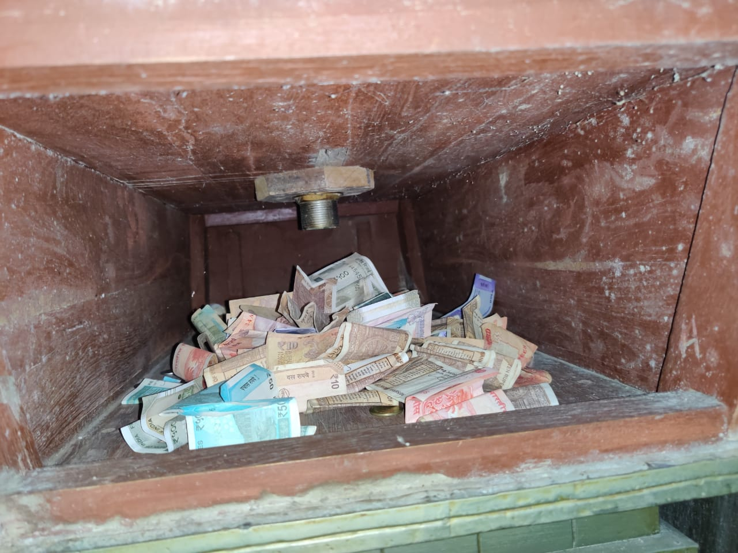

Slide 13
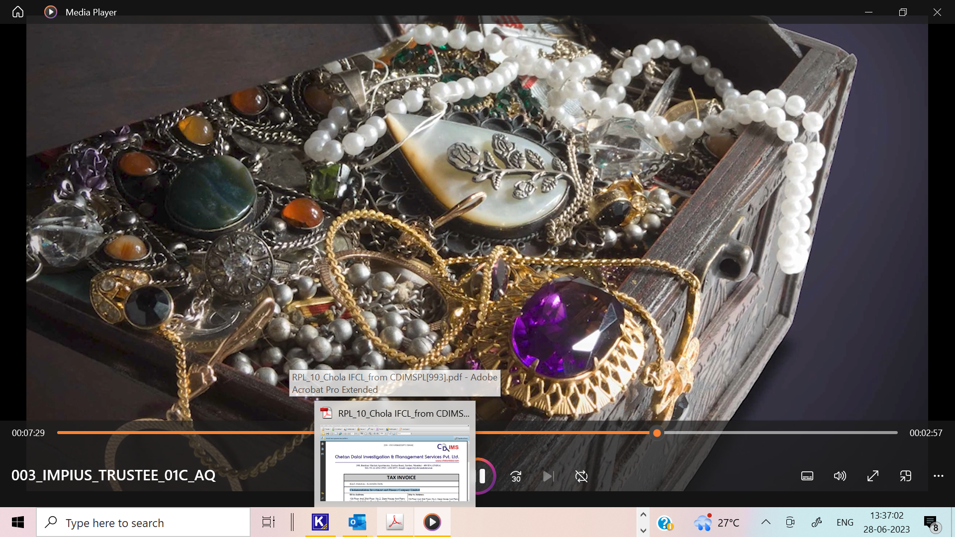

Slide 14
Common warning bells and concerns – ERP
Fraud of over Rs 6 crores
Backdrop of the case: Customized advanced inhouse developed ERP system for:
Turnover of over 100 crores
Manufacture of gold and diamond jewellery of world class
Reputed auditors
Corporate governance of a high order

Slide 15
Comparison of audit checks for fraud in erstwhile days of physical documents and modern day ERP systems. Same issues but even more devastating
Audit checks for fraud during erstwhile physical documentary systems
Is there a practice of providing blank signed cheques or Papers
Do Sequential checks reveal vouchers or documents out of sequence and date
Is there a checks and balance system?Absence of maker checker concept in approving transactions
Are there omissions such as Cash receipts missed out
Control of challans/dispatch notes for inventory movement- weaknesses
Comparative audit checks for fraud in ERP and what we found
Is there a practice of password sharing: We found use of passwords freely exchanged
Sequential control: no; Backdating and postdating entries seen
Absence of maker checker concept in invoices accounting. An invoice of Rs 1,43,000 was entered in the system as 143,00,000. Vendor was given the credit. Another case was a permissible wastage of .376 was entered as 376 crediting the vendor much more.
Omission of entries of delivery challans in the system since manual challans were permitted parallelly
Jobwork challans were not monitored for return of stocks. Vendors agreed to return over a kilo of gold not returned earlier

Slide 16
Based on these audit checks in the ERPt Rs 6 crores worth of gold theft reported based on shortage seen. Investigation revealed
4 kgs of gold lying with jobwork vendors were forgotten to be returned
Backdating entries showed deletion of gold receipts to camouflage stock shortages
Absence of maker checker concept in invoices accounting. An invoice of Rs 1,43,000 was entered in the system as 143,00,000. Vendor was given the credit. Another case was a permissible wastage of .376 was entered as 376 crediting the vendor much more. Huge amount was recoverable from the concerned vendors and more than that a trusted employee involved in the fraud were identified as the culprit
Stock verifications revealed excess stocks kept aside which were NOT in the ERP system, these were receipt of gold kept for being smuggled out later
A new way of smuggling out gold was admitted- throwing down gold dust in garbage bags from the toilet window.

Slide 17
Fraud in a mall – use of tiger team test

Slide 18
For all electronic and digital gadgets to control theft, the ground realities are different
One company into retail mall stores business wanted a fraud risk assessment.
We performed ‘Tiger Team’ teats

Slide 19
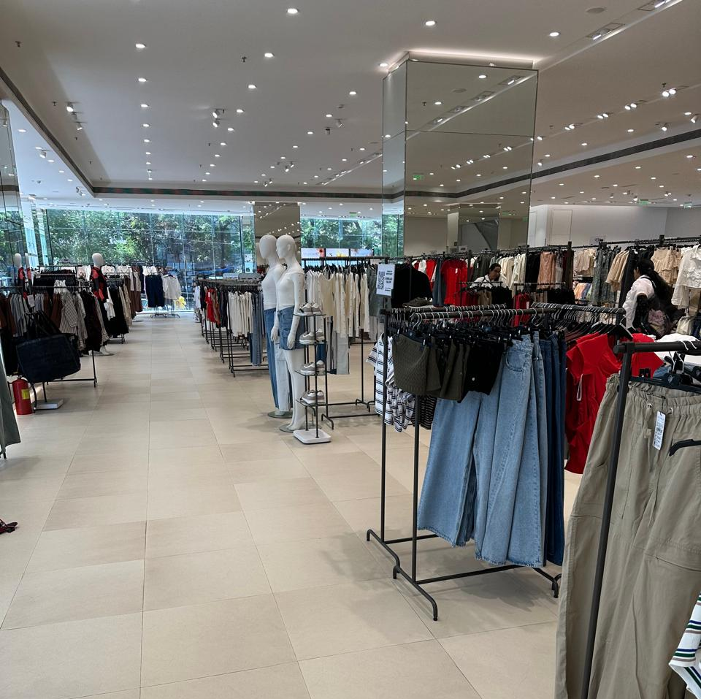
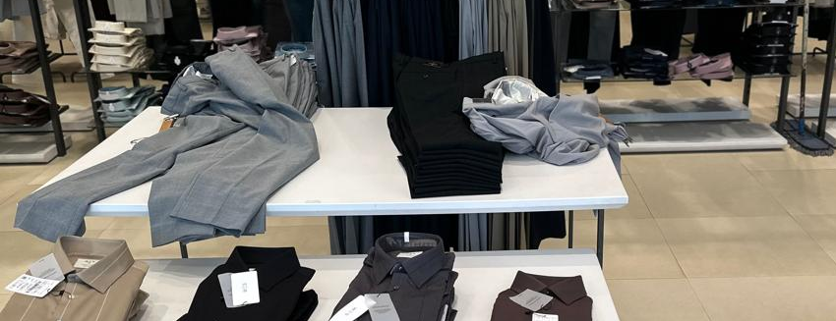
Risk review in a departmental store- tiger team test
A typical store:
Store Manager was very confident that all was well. Everything was computerised and well controlled :
Price tags generated by computer
Sensor beams at gates to sound an alert if someone smuggled out anything without payment
Heavy security round the clock

Slide 20
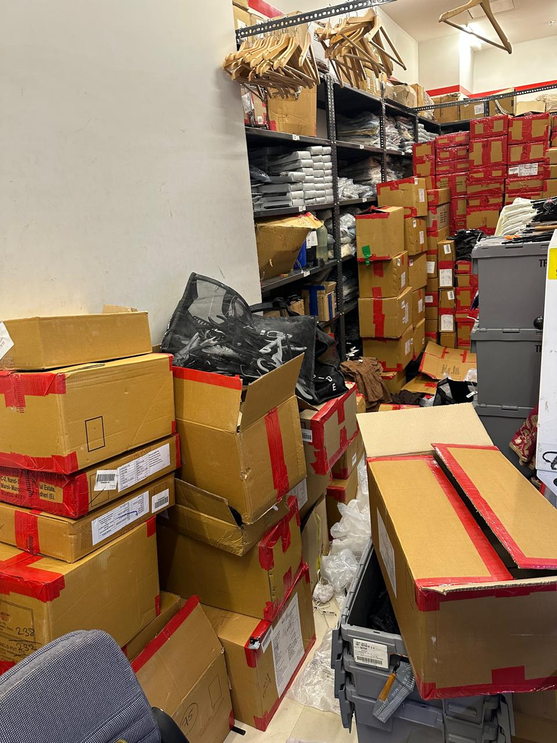
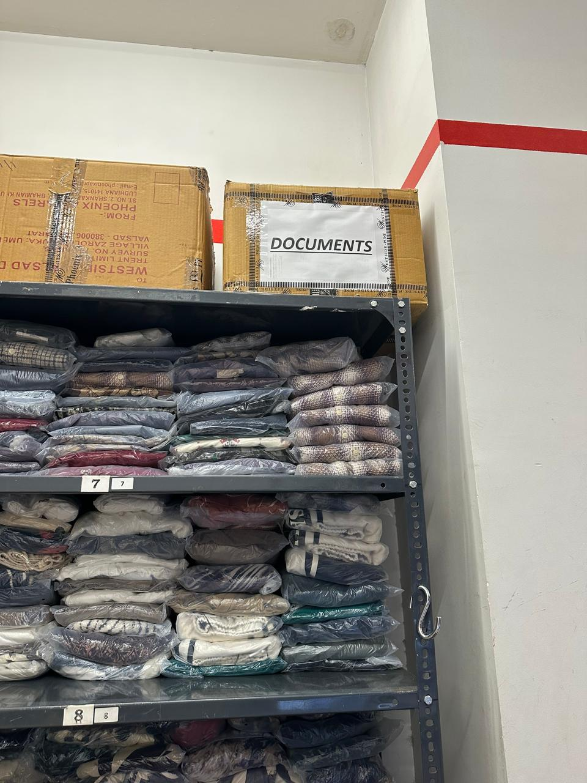
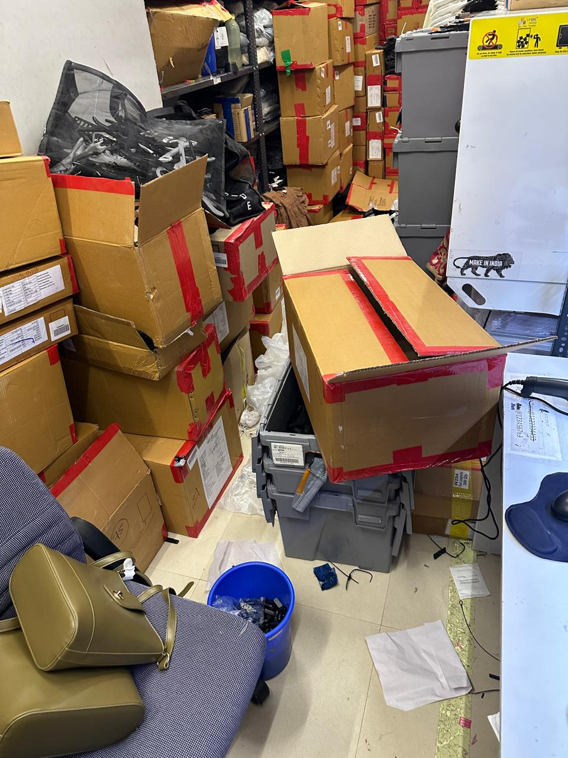
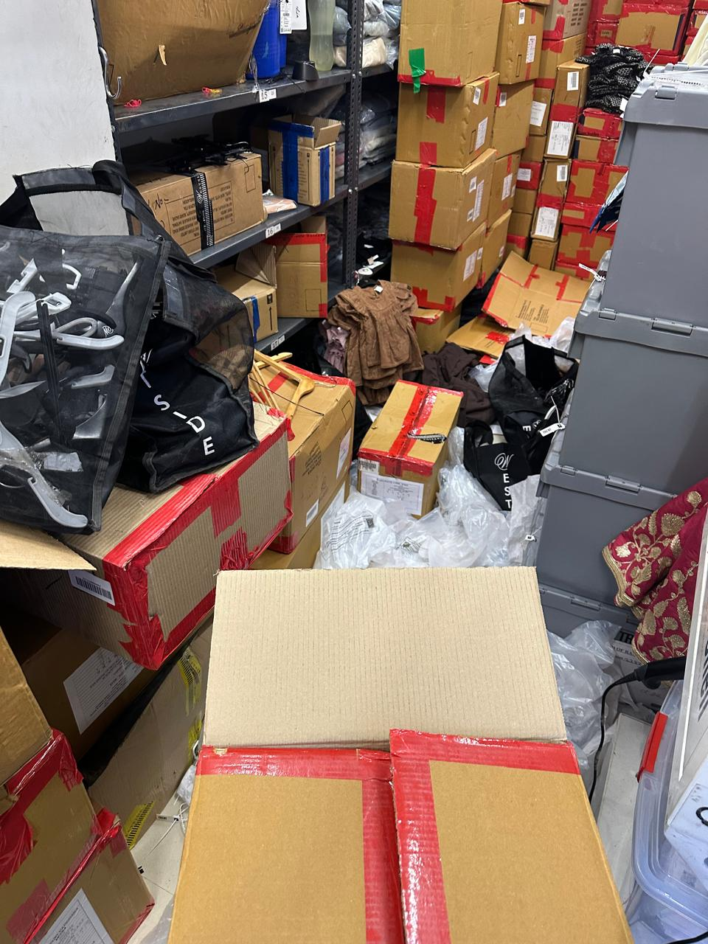
Observations in detail – Stocks
There was a room with space for stocks to be stored.
Completely chaotic and disorderly
Manned by a storekeeper employee who did not have an id card. Just next to the fire exit which does not have a security guard.
Contained a box of documents which he could not explain. It is recommended to have a senior person examine the contents of the box for abundant caution

Slide 21
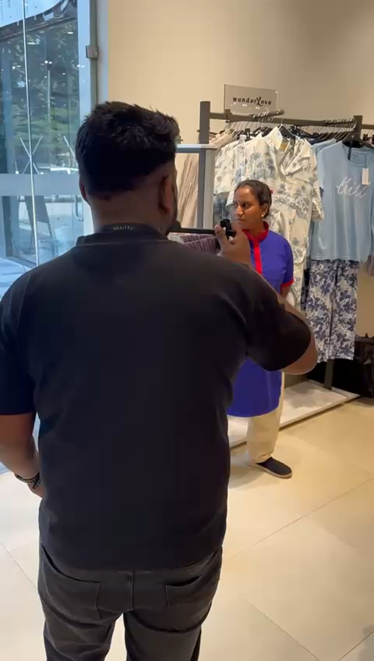
Field Visit to a retail outlet in a mall,
Controls:
Full security
Beeper Tags to ensure that no item could be smuggled out
What we found: All items are not monitored by sensor tags. The video shows that an employee could take out an item we selected at random could be taken without a beep

Slide 22
Store Manager had the usual excuse- the godown keeper had gone away and replacement was still not sent by HO
Store Manager was very confident that otherwise all was well. Price tags generated by computer
He took me for a round in the store to demonstrate the controls

Slide 23
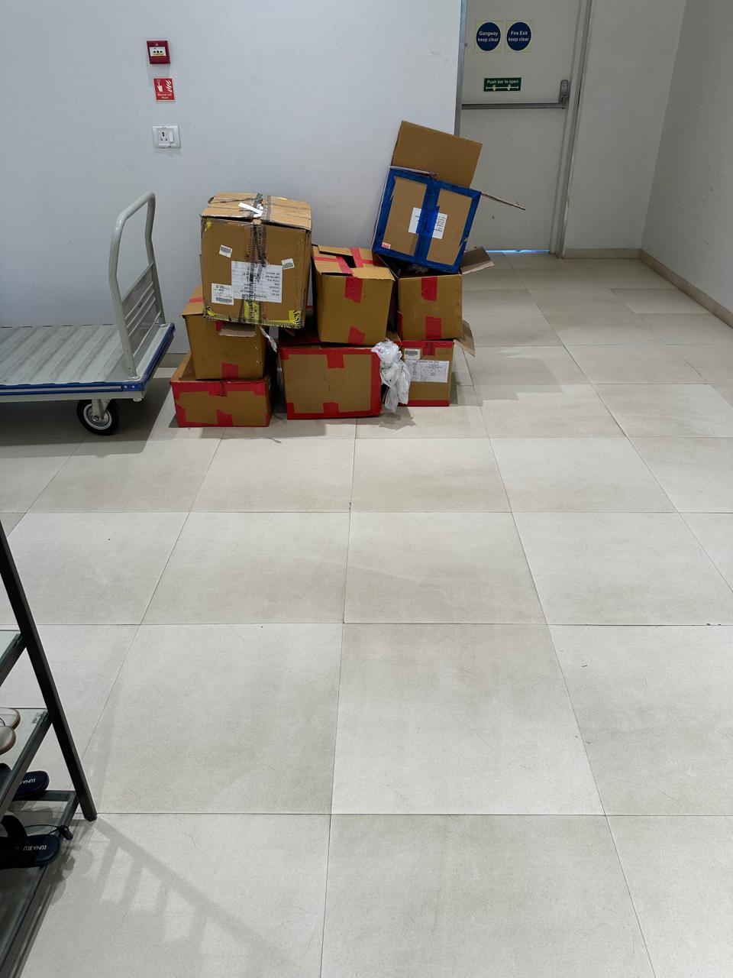
An unguarded exit spotted
Not even locked

Slide 24
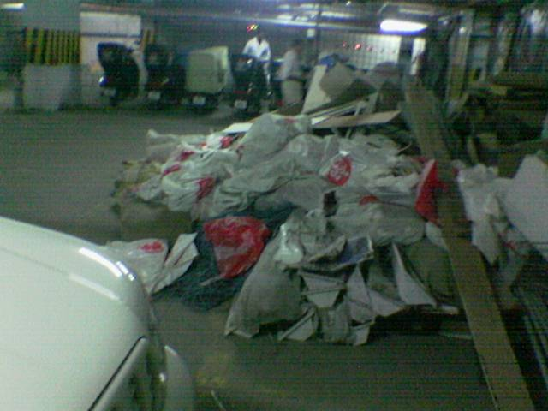
Garbage dump behind the store

Slide 25
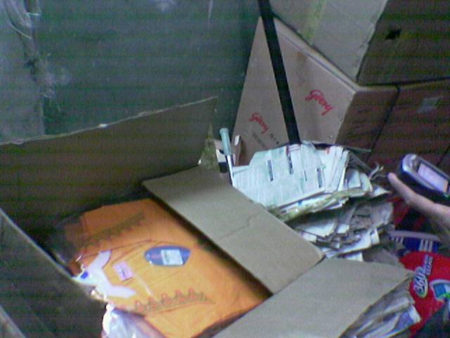
Under the garbage-
Good Stocks smuggled
out

Slide 26



Starting point: Auditors report a massive stock shortage of inventory of Rs 5 crores on physical verification
Board of Directors was shocked and a forensic audit was mandated since theft was suspected

Slide 27

Initial explanation of the Factory Management : Stock shortage was illusionary
Reasons
Consumption norms were old, and actual consumption was greater than what was recorded in inventory, thereby giving rise to shortage
Physical verification was not accurate as the factory was spread over 20 acres and stock movements criss-crossed and many items were missed out
ERP system had certain limitations, and some inventory reports were unreliable and giving misleading information

Slide 28
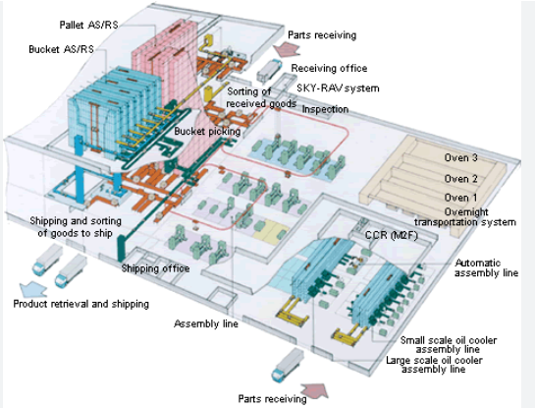
Forensic Auditors studied the huge layout where inventory items were spread over

Slide 29
Forensic Auditors studied the case:
It was indeed a large factory with stocks all over the place; accurate physical verification would certainly have been difficult.
It produced customised large automotive-parts governed by an ERP system monitoring stock movements in and out
Some machines were old, had undergone a lot of wear and tear, and possibly consumption norms needed to be revised.
Auditors reports did point out several control shortcomings and discrepancies in stock records but were unable to provide any concrete information about possible pilferage, possible culprits, or modus operandi in case there was pilferage.
The fundamental question remained: was there foul play leading to theft or was this merely a stock miscount and improper inventory accounting showing a shortage of Rs 5 crores?

Slide 30
This is where a forensic audit comes in to provide penetrative results.
While auditors rely on documentary evidence, a forensic auditor even evaluates the documentary evidence to go to a logical end.

Slide 31

Forensic auditors found the following further evidence using investigation techniques and digital forensics
The ERP had a control weakness of permitting backdating of entries. There were massive back dated entries noticed by multiple users
There were several deletions of logs, of modifications of entries which removed traces of important inventory data that was either deleted or revised
The password sharing culture showed that inspite of an IT policy, due to urgency or emergency needs, management had turned a blind eye to this multiple user sharing of passwords. The inventory logins had been shared by several people who were not authorized as well.
A physical walk through test showed that some manual challans and gate passes were used in place of ERP challans in emergency situations. All manual challans were not recorded in ERP

Slide 32
Issues like backdating, deletion, password abuse considerably supported the theory of theft
But it still did not provide any evidence of when the theft took place, how it was done and who all were involved

Slide 33

The forensic auditor hunted for more evidence
After a painstaking effort, he came across another evidence which had not been examined earlier
CCTV footages!

Slide 34
Huge Data of CCTV footages
The factory had over 135 cameras across various locations in the factory
Data of CCTV footages had been preserved for a year
Data was available in soft form to view for the forensic auditors
Data size was massive since there was almost an infinite GB of footage available
The forensic auditor, in this case had an overdose of data to study. In such cases an analytical approach using digital forensics is very useful

Slide 35
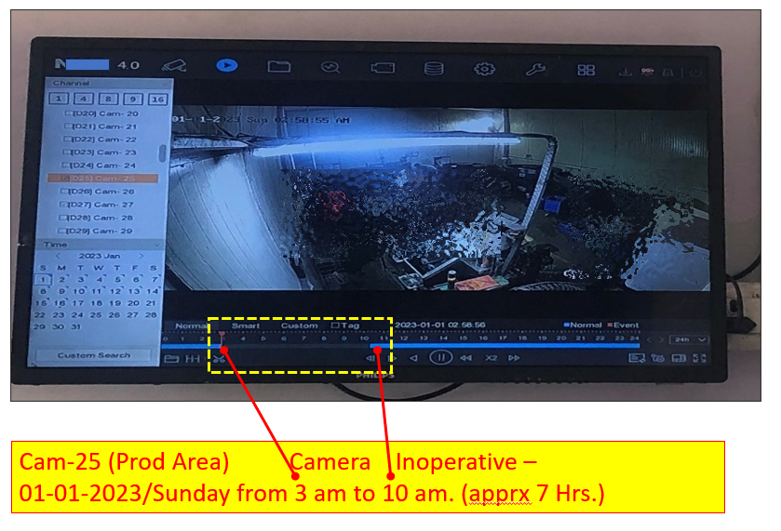
Forensic Audit Finding - there were occasional breaks in the CCTV footages
CCTV footages data were analysed and there were dates on which there were breaks or gaps in the footages.
There were legitimate reasons like power tripping, camera malfunction which lead to the cameras blinding out on their own. Sometimes for camera or network servicing the deactivation could also be done
Break in footage

Slide 36
Forensic Audit takes a penetrative X Ray vision of given situations
Digital Technology helps in providing a nano technological approach.

Slide 37
The forensic auditor decided to analyze the breaks to see if any of them could be deliberate to shield or cover physical theft
Digital analysis was done of all the breaks of the CCTV footages in a kaleidoscopic way as follows:
Breaks of CCTV footage date-wise, camera-wise
Duration of the breaks of the footage camera-wise
Comparison of start and ending timings of the breaks of the footages
Many other analytical approaches.

Slide 38
Amazing findings based on the digital analysis: Weird Congruency of days and duration of some breaks
5 Cameras in the month of December 2022 on 3 dates 11, 18 and 25 had footage breaks at exactly 4 pm
These breaks lasted for exactly 3 hours and 45 minutes; all of them revived together at 7.45 pm
Further analysis showed that all these dates were Sundays when the top management had weekly offs.
The cameras were located at 4 warehouses and one security entry-exit gate
On Sundays only that particular gate was kept open
On making inquiries with the IT team, it was found that there was no legitimate reason for these breaks the cameras had deliberately manually shut off without any reason. Logs were deleted
Therefore, an investigation of that security gate records as well as the 4 warehouses records was done.

Slide 39
Penetrative follow up forensic audit was done - the Exit Gate/ warehouse records and it exposed the fraud
Vehicle movement records at the gate: On each of the days 11, 18 and 25 Dec a vehicle number ABCD 2024 would come a few minutes after 4 pm and leave at about 7.15 pm
The same guards would be on the duty on those dates and the vehicle would go those 4 warehouses as per the warehouse records
The Vehicle belonged to a supplier who was friendly with the senior stores manager.
The security guards were interrogated, and they admitted to allowing the vehicle to smuggle out goods on Sundays as per instructions from the Senior Stores Manager
The Stores Manager arranged for the cameras to be switched off during this process as also manipulations of entries in the ERP system

Slide 40
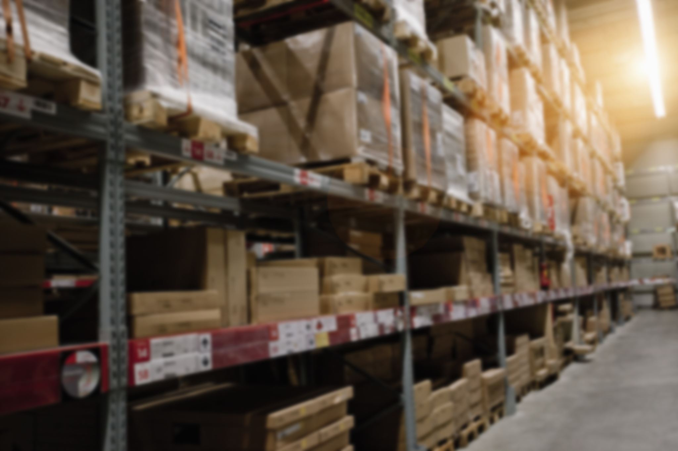

It was a fraud engineered by the stores manager with support from the security guards and two assistants

Slide 41
Use of AI in fraud detection and forensic audit.
Extract of presentation in 2025 WOFA by Chetan Dalal

Slide 42
AI:
What are the important features of AI
Powerful tool to quickly perform given task
Self learning and improving
Mimic human intelligence

Slide 43
2. Kinds of AI (capability wise)
There are 3 simple classifications
Narrow or Weak AI
General or Strong AI
Super intelligent AI

Slide 44
3. AI case study.
Performing analytics and preparing a new age forensic audit report.
An illustration of a simple AI tool used in a forensic audit

Slide 45
Case study: A fire claim investigation: A forensic auditor had to verify a claim and confirm the claimed quantity and value and issue a report. He has some limited data about quantity boxes claimed and the dimensions of the warehouse. In this can he use an AI tool?

Slide 46
Yes: A simple AI tool in a situation of this kind can be used to perform some analytics and facilitate preparation of the report
The three broad steps in the illustration are:
The forensic auditor will feed the AI tool with limited facts (or information) available and instruct it about what he wants (his objective)
He will instruct the AI tool to provide the results by using its built in intelligence, conduct relevant research and perform suitable analytics to enable the forensic auditor to achieve his objectives
To facilitate preparation of a report in an audio visual form

Slide 47
Step 1: The forensic auditor will provide all the facts that he has gathered to verify the reliability of the claim

Slide 48
Facts available fed into the AI tool. The stock lost quantity and value, certain details of the warehouse and the objectives of the auditor
A situation where an insurance claim was made for 275 boxes of valuable stocks lost by fire. It was imperative to compute the maximum number of boxes that could be stored in that warehouse 20 feet tall, 20 feet long and 10 feet wide. The ware house had a gangway 2 feet wide across the length. The boxes were 2 feet long, 1 foot wide and 1 foot tall.
Weight restrictions permitted only 10 boxes to be stacked in one column. It was also learnt that 25 boxes were empty because of unusable stock removed and 10 boxes were outside the warehouse and saved from the fire. There was a theft of 10 boxes one day before the fire.
How many boxes could have been stored at maximum and what was the quantum of excess claim in terms of the number of boxes and in value if each box was $ 25.

Slide 49
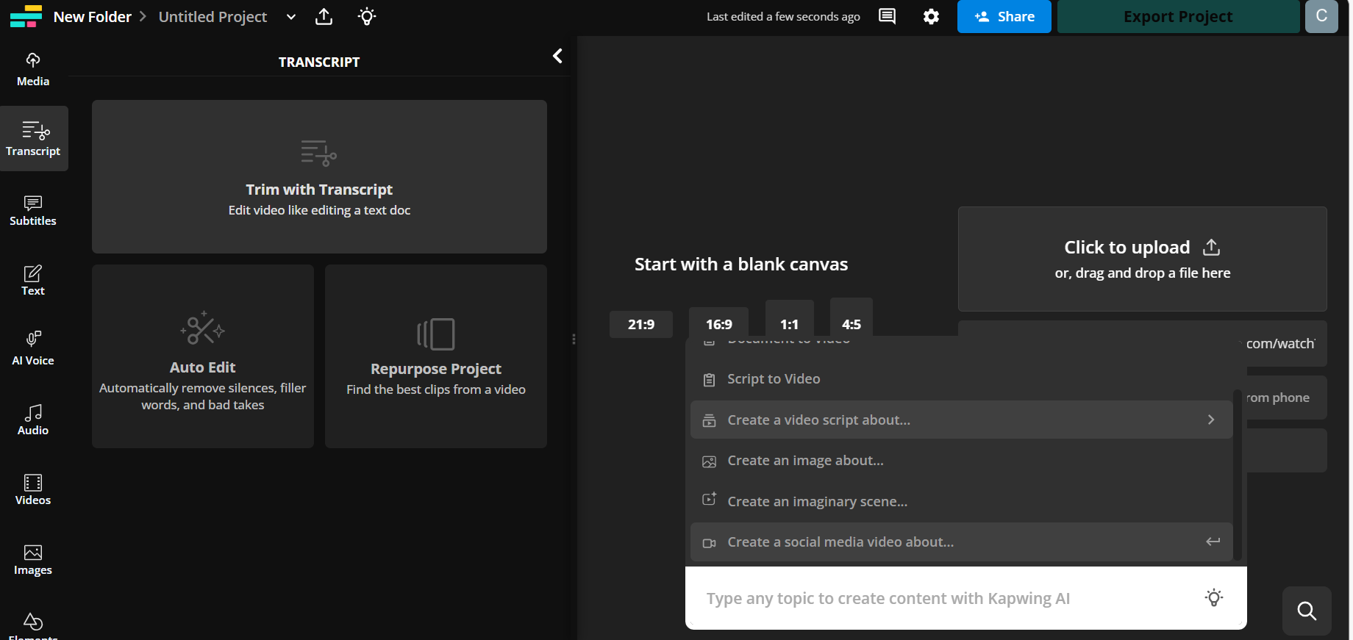
Screen shot of an AI tool: it was asked to perform the analysis and present the results

Slide 50
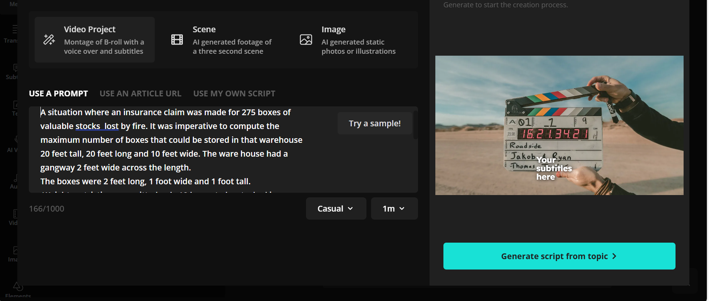
The facts are copy pasted on the tool
And the generate script is clicked

Slide 51
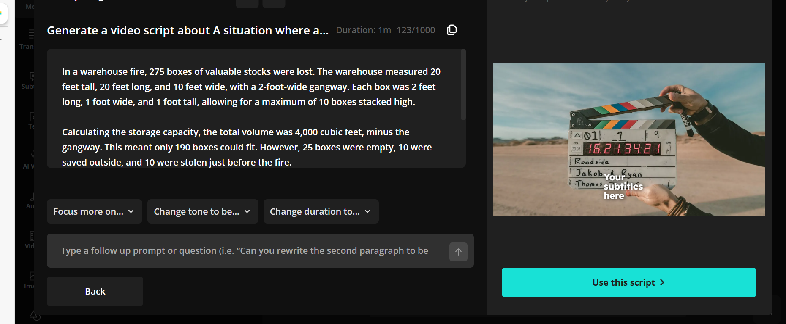
Step 2: The AI tool perfoms the analytics and calculates the boxes that could fit and possibly
been stored considering all information available. It also adjusts the constraining matters of
empty and stolen boxes etc

Slide 52
Step 2 AI performs the analytics and provides the desired information for the forensic auditor: In a warehouse fire, 275 boxes of valuable stocks were lost. The warehouse measured 20 feet tall, 20 feet long, and 10 feet wide, with a 2-foot-wide gangway. Each box was 2 feet long, 1 foot wide, and 1 foot tall, allowing for a maximum of 10 boxes stacked high. Calculating the storage capacity, the total volume was 4,000 cubic feet, minus the gangway. This meant only 190 boxes could fit. However, 25 boxes were empty, 10 were saved outside, and 10 were stolen just before the fire.
So, only 145 boxes were actually stored. The claim for 275 boxes resulted in an excess claim of 130 boxes, worth $3,250. A digital twin was also needed to visualize the stock before the fire.

Slide 53
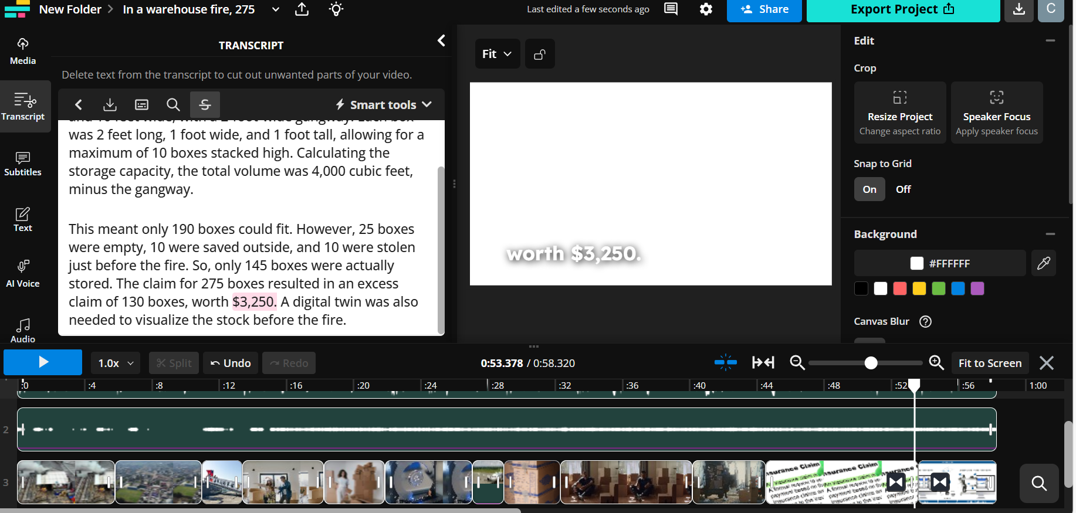
Step 3: The AI tool creates a new age report as an audio visual

Slide 54
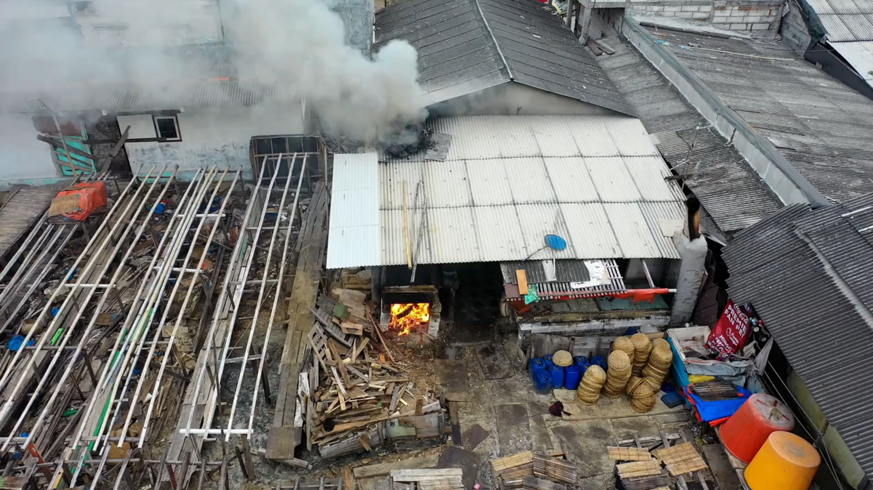

Slide 55
Fraud detection using AI
Amazing capabilities.
- Algorithms used as and when needed
Predicting fraud (expert system in Credit Card)
Risk Analysis

Slide 56
Caution about AI
For all its power,
- It is only a tool to perform tasks precisely and efficiently
But, it cannot replace HI

Slide 57
Emerging opportunities in forensic audit
Empanelments
Police
SEBI
SFIO
IBA
2. Corporate whistleblower complaints
3. Individual banks and financing institutions
4. Risk Assessments in companies
5. Systems study

Slide 58


Slide 59
How to tap opportunities
Research
Articles
Talks and discussions
Working on subcontract basis
Groups and networks with distribution of work

Slide 60
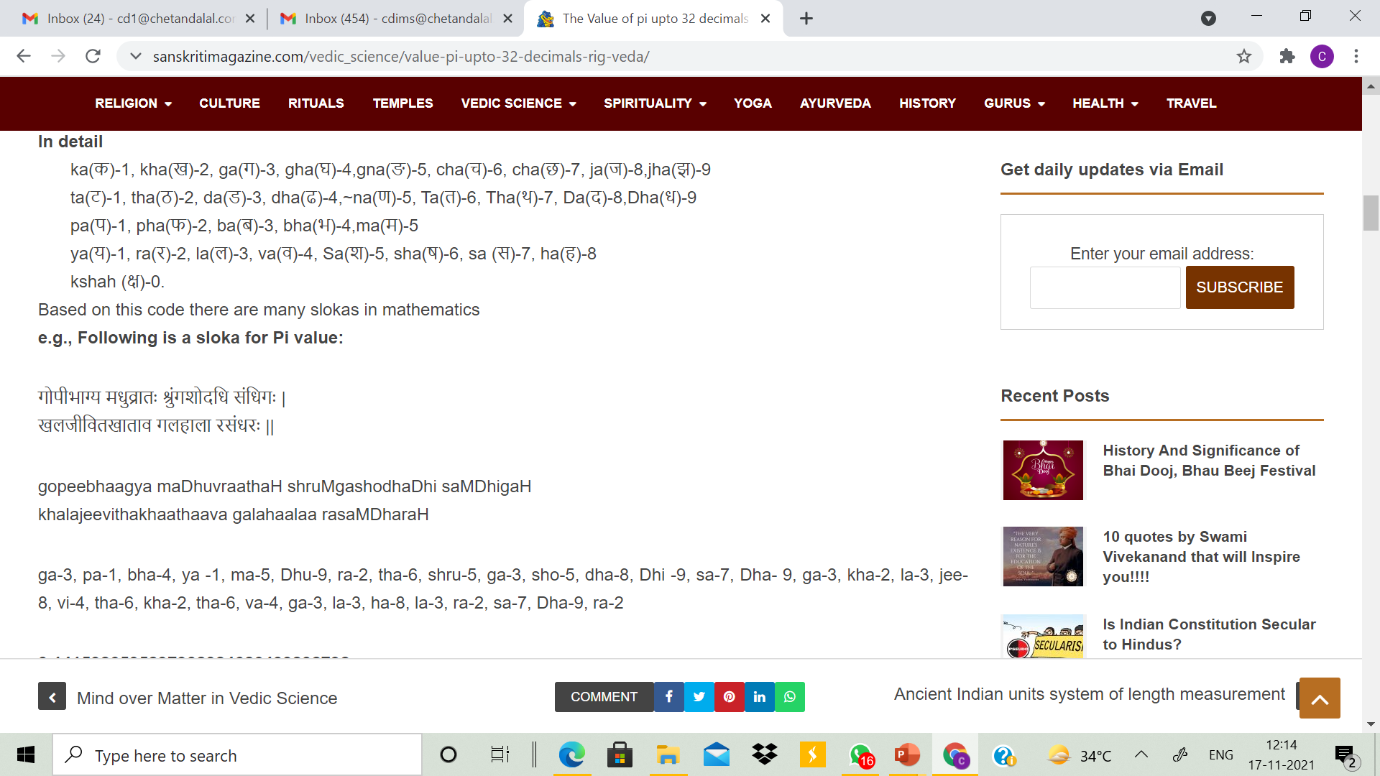
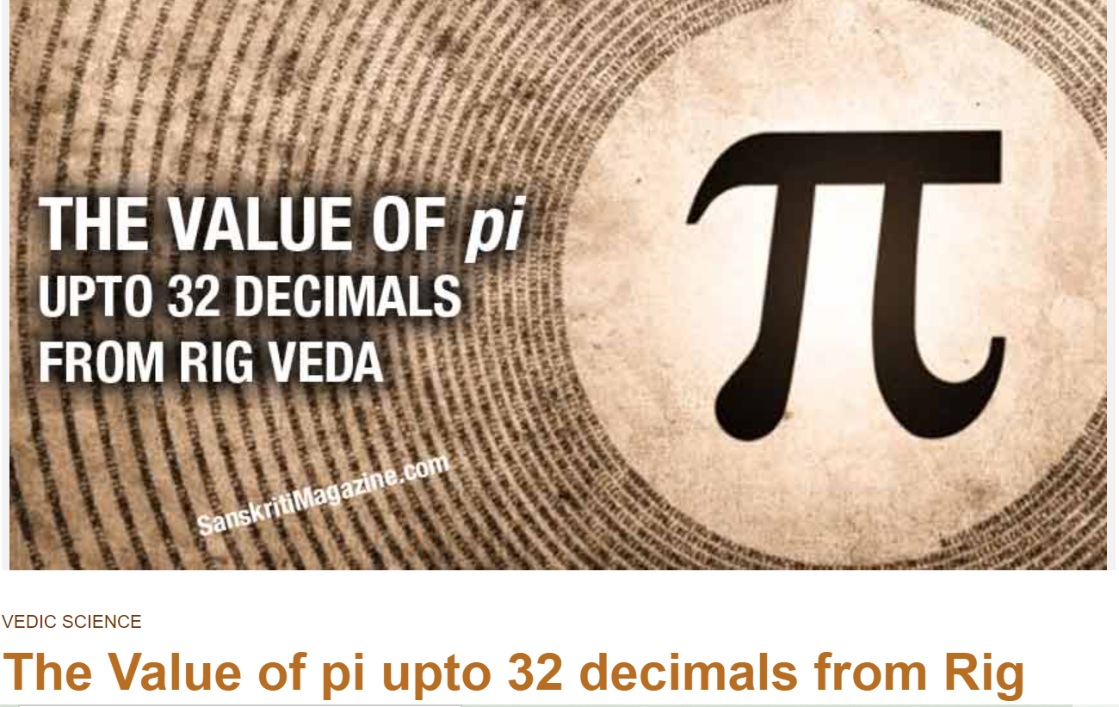

Slide 61

A good clean and honest mind will work wonders on the efficiency of the human brain.
Thank you
Chetan Dalal
www.chetandalal.com
Youtube Channel: Chetan Dalal
https://www.youtube.com/@chetandalal5649

