Slide 1


Life Skills Development for Students
AN INTRODUCTION TO OUR PROGRAMS

Slide 2
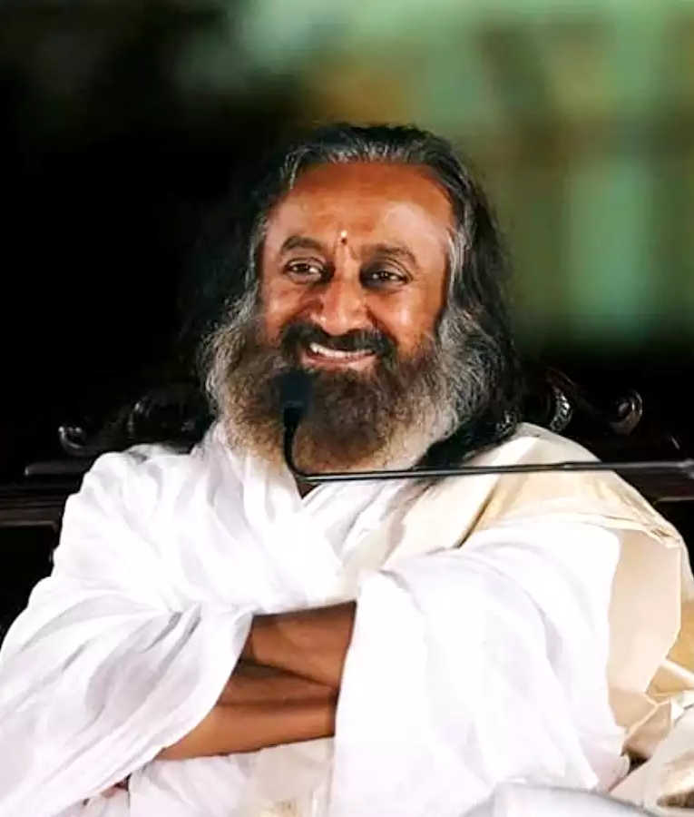

“Education is not just information.
It is where a child grows up in values of
non-violence, multiculturalism &
with a sense of belongingness.”
- Gurudev Sri Sri Ravishankar ji

Slide 3
The Approach
3 Stake Holders to a Child’s/Youth’s Growth
Child/
Youth
Peer Group
School/
Teachers
Parents/Home
Environment
UTKARSH YOGA (8 – 13 years)
MEDHA YOGA (14 – 18 years)
MEDHA YOGA – 2 (14 – 18 years)
INTUITION PROCESS ( 5 – 18 years)
Know Your Child
Know Your Teen
HAPPINESS PROGRAM
HAPPINESS PROGRAM
For Teachers

Slide 4
CHILDREN AND TEEN PROGRAMS
UTKARSH YOGA – 8 to 13years (Grades 3 – 7):
THROUGH SIMPLE TECHNIQUES, GAMES AND ACTIVITY STUDENTS LEARN VALUABLE LESSONS IN SHARING WITH OTHERS, WORKING AND PLAYING IN HAMONY AND DEVELOPING A SENSE OF BELONGING WITH OTHERS.
MEDHA YOGA 1 & 2 – 13 to 18years (Grades 8 – 12):
PRACTICAL TOOLS AND FOR A HEALTHY BODY, MIND AND LIFESTYLE. LIFESKILLS TO MANAGE STRESS AND EMOTIONS
INTUITION PROCESS – 5 to 18years (Grades 1 – 12):
ENABLE THEM TO ACCESS AND UTILISE THEIR INHERENT INTUITIVE CAPABILITY. ENHANCE THE ABILITY TO GET THE RIGHT THOUGHT AT THE RIGHT TIME.
A Disease Free Body.....
A Quiver Free Breathe…
A Stress Free Mind………
An Inhibition Free Intellect….
An Obsession Free Memory…
An Ego that Includes All …
A Soul that is free from sorrow is a true sign of health
The ability to have the right thought at the right time is Intuition. This is a very important skill which can be developed in children and adolescent youth.
This can remove the fear of the unknown and open them to a new level of learning…

Slide 5











The Art of Living
Our journey through the years
40+
500+
100+
180
4,000,000+
Grassroots impact in Years
Million lives touched globally
Independent research studies
Countries
Students reached through the Life Skills program in India

Slide 6
Research Findings
www.artofliving.org
SSIAR research - 2019
Accuracy
  50% Increase in scores with above 75% accuracy
  22% jump in average accuracy with which the child performs
Mental Well-being
  29% increase in mental well-being scores
  237% jump in the reporting of higher mental well-being
Emotional Problems
  69% decrease in emotional problems reported by children
Hyperactivity
  67% decrease in hyperactivity of the children
Peer Problems
  50% decrease in the effect of peer pressure
Conduct Problems
  78% decrease in conduct problems associated in children

Slide 7
How do participants benefit?
www.artofliving.org
Children & Teens show a remarkable improvement
Handle Anger & Aggression calmly
Overcome anger, aggression, and depression with special techniques to relieve stress & reduce anxiety
Improve Focus
Learn to direct your efforts with greater focus, multiplying your output while optimizing your inputs
Handle Pressure Effectively
Peer pressure, competitions, appearance, hormones, relationship issues - learn to sail through all the challenges of adolescence
Boost immunity
Our exercises and activities improve appetite, increase energy, & enhance sense of wellness & wellbeing
Improve attention span
Our research-backed techniques help children become calm, enhancing concentration, memory & retention
Enhance joy
Through our fun interactions, children drop their inhibitions, & discover their true, natural, and joyous self!

Slide 8
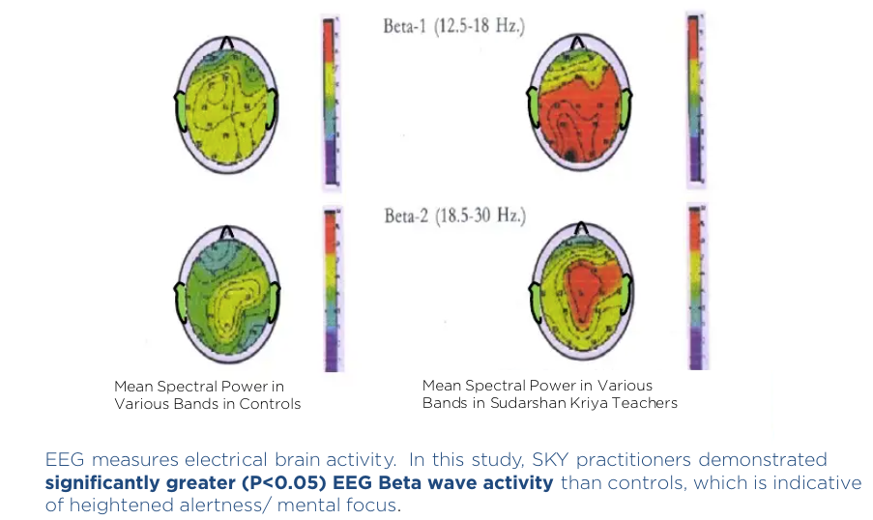
Sudarshan Kriya (SKY)
Benefits Practitioners

Slide 9
SCHOOL PROGRAMS
PROGRAMS FOR CHILDREN AND TEENS
Name of the Program | Classes Eligible in School | Schedule
 |  | Number of Sessions | Number of Days - Consecutive | Duration (Hrs)
Utkarsh Yoga (UY) | Grades 3 – 7 | 3 | 3 | 3
Medha Yoga (MY) | Grades 8 – 12 | 3 | 3 | 3
Intuition Process | Grades 2 – 12 | 2 | 2 | 3
PROGRAMS FOR PARENTS
Name of the Program | Classes Eligible in School | Schedule
 |  | Number of Sessions | Duration (Hrs)
Post Course Meeting | Parents of Children Who did the course | 1 | 1
KYC – Know Your Child | Grades 3 – 7 | 1 | 3
KYT – Know Your Teen | Grades 8 – 12 | 1 | 3
PROGRAMS FOR TEACHERS – Stress Free Teaching 1.5Hrs Session
RECONNECT SESSIONS FOR STUDENTS
2 Hrs Each 6 Sessions Over a Period of 3 Months

Slide 10
SCHOOL PROPOSAL
PROGRAMS FOR CHILDREN AND TEENS
Name of the Program | Classes Eligible in School | Schedule
 |  | Number of Sessions | Number of Days - Consecutive | Duration (Hrs)
Utkarsh Yoga (UY) | Grades 3 – 7 | 3 | 3 | 3
Medha Yoga (MY) | Grades 8 – 12 | 3 | 3 | 3
Intuition Process | Grades 2 – 12 | 2 | 2 | 3
PROGRAMS FOR PARENTS
Name of the Program | Classes Eligible in School | Schedule
 |  | Number of Sessions | Duration (Hrs)
Post Course Meeting | Parents of Children Who did the course | 1 | 1
KYC – Know Your Child | Grades 3 – 7 | 1 | 3
KYT – Know Your Teen | Grades 8 – 12 | 1 | 3
PROGRAMS FOR TEACHERS – Stress Free Teaching 1.5Hrs Session
RECONNECT SESSIONS FOR STUDENTS
2 Hrs Each 6 Sessions Over a Period of 3 Months
FEE INR 9000/- Per Student
Logistics to be Provided by the School.
Fee Collection from students to be done by School.

Slide 11
SCHOOL PROGRAMS SUMMARY
PROGRAMS FOR CHILDREN AND TEENS
Name of the Program | Classes Eligible in School | Schedule
 |  | Number of Sessions | Number of Days - Consecutive | Duration (Hrs)
Utkarsh Yoga (UY) | Grades 3 – 7 | 3 | 3 | 3
Medha Yoga (MY) | Grades 8 – 12 | 3 | 3 | 3
Intuition Process | Grades 2 – 12 | 2 | 2 | 3
PROGRAMS FOR PARENTS
Name of the Program | Classes Eligible in School | Schedule
 |  | Number of Sessions | Duration (Hrs)
Post Course Meeting | Parents of Children Who did the course | 1 | 1
KYC – Know Your Child | Grades 3 – 7 | 1 | 3
KYT – Know Your Teen | Grades 8 – 12 | 1 | 3
PROGRAMS FOR TEACHERS – Stress Free Teaching 1.5Hrs Session
RECONNECT SESSIONS FOR STUDENTS
2 Hrs Each 6 Sessions Over a Period of 3 Months

Slide 12
Our Impact in Schools
aoliv.in/schoolprograms

Slide 13
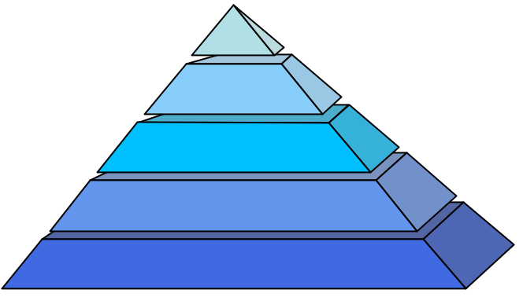

Our School Programs
An overview - last 20 years
4000+ Schools
50,000+ Teachers
100,000+ Parents
4,000,000+ Students

Slide 14
Program Benefits
aoliv.in/schoolprograms

Slide 15

Emotional & Social Skills
Behavioural Changes
REDUCED
  Fear
  Anxiety
  Depression
IMPROVED
  Self Confidence
  Leadership Qualities
  Creativity
  Sensitivity to environment
  Relationships

Slide 16

Thinking Skills
Improved Academic Performance
REDUCED
  Distractions
  Confusion
IMPROVED
  Clarity
  Focus & Concentration
  Retention
  Application of knowledge

Slide 17

Health Benefits
Physical & mental health
REDUCED
  Stress
  Imbalances
IMPROVED
  Sleep
  Immunity
  Lung-capacity
  Mind-body coordination
  Flexibility & tone of the body

Slide 18
Service Initiatives
& Projects
www.artofliving.org

Slide 19
Our free service activities...
...for Children & Teens
  Juvenile homes, orphanages, government schools, villages & tribal areas
  Reached more than 20+ lakh children and teens through various life-skill, stress-management & educational activities
  Covid care programs for over 4.5 lakh+ students

Slide 20
Some of our projects in Schools
Across India
Himachal Pradesh (Covid Care Programs)
4.5 lacs + Students
25000 Teachers
Eklavya Model Residential Schools
(EMRS)
50+ Teachers
Across 2 states
Programs in Blind Schools
125 Schools
5000+ Students
In talks with -
Sarva Shiksha Abhiyaan Punjab
DEO, Haryana
Jammu & Kashmir Govt.
Maharashtra Govt.
Tamil Nadu - Government Schools
68 Schools
39500+ Participants
11 Districts of Tamil Nadu

Slide 21

Testimonials - 1

Slide 22
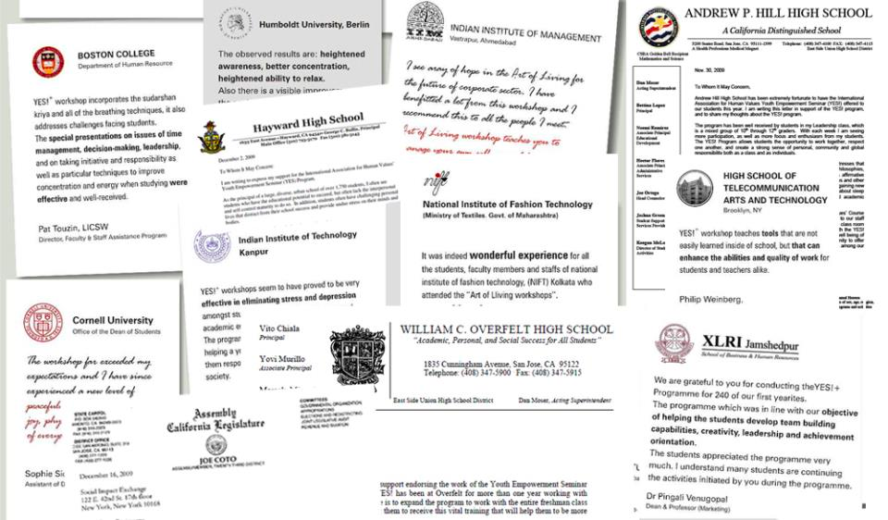
Testimonials - 2

Slide 23
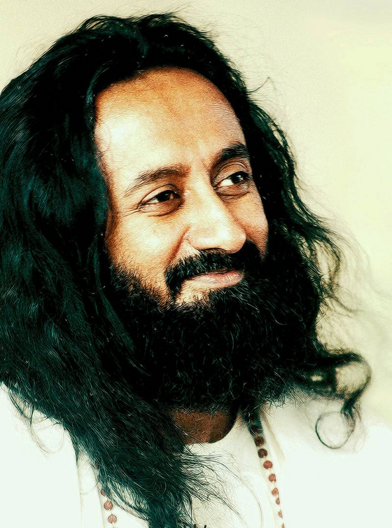
Gurudev Sri Sri Ravi Shankar ji
Our Founder
www.srisri.org
Gurudev Sri Sri Ravi Shankar ji is a globally revered spiritual and humanitarian leader. He has spearheaded an unprecedented worldwide movement for a stress-free, violence-free society. Through a myriad of programs and teachings, a network of organizations and a rapidly growing presence across 156 countries, Gurudev Sri Sri Ravi Shankar has reached an estimated 450 million people.
Founded in 1981, the Art of Living is an educational and humanitarian movement engaged in stress-management and service initiatives. The Art of Living movement has spread peace across communities through diverse humanitarian projects, including education for all, conflict resolution, disaster relief, and sustainable rural development, empowerment of women, prisoner rehabilitation and environmental sustainability.
The vision of The Art of Living Trust is to enable far-reaching social transformation in India through the Art of Living programs, and implementing a broad range of service projects to uplift and empower individuals, families and communities.

Slide 24
Thank you
www.artofliving.org

