Slide 1




New Search Assessment Procedure
- Ved Jain

Slide 2
1. Block period [Section 158B(a)]
1. Block period [Section 158B(a)]
Current Definition
158B. In this Chapter, unless the context otherwise requires,—
(a) "block period" means the period comprising previous years relevant to six assessment years preceding the previous year in which the search was initiated under section 132 or any requisition was made under section 132A and also includes the period starting from the 1st day of April of the previous year in which search was initiated or requisition was made and ending on the date of the execution of the last of the authorizations for such search or such requisition;
Definition in the earlier block regime
158B. In this Chapter, unless the context otherwise requires,—
"block period" means the period comprising previous years relevant to six assessment years preceding the previous year in which the search was conducted under section 132 or any requisi­tion was made under section 132A and also includes the period up to the date of the commencement of such search or date of such requisition in the previous year in which the said search was conducted or requisition was made :
Provided that where the search is initiated or the requisition is made before the 1st day of June, 2001, the provisions of this clause shall have effect as if for the words "six assessment years", the words "ten assessment years" had been substituted

Slide 3
….contd.
Notable differences/issues in pre-amended and post-amended definition:
Period reduced from 10 years to 6 years- Earlier, proviso to section 158B provided that in respect of search undertaken prior to 01.06.2001, block period shall include 10 preceding AYs. In the section 153A regime also, assessment for 4 years beyond the 6 previous years could be undertaken s.t specified conditions. Similarly, even in the reassessment regime, assessment beyond 3 and up to 10 previous years could be undertaken s.t specified conditions. Thus, in all the cases, income up to 10 preceding years could have been assessed. However, now, the definition of block period has been restricted to 6 years only.
Period till conclusion of search covered- In respect of the previous year in which search was undertaken, earlier, the block period included the period only up to the date of commencement of search. But now, the period from 1st April of such previous year till the date of execution of last authorization warrant (i.e. conclusion of search has been included).
Period can be 7+1 years, instead of 6+1 years- Due to the inclusion of the period from 1st April of previous year till conclusion of search, apart from search year, 6 preceding years, 1 additional year can also get added. For instance, if search is undertaken on 25.03.2025, and concluded on 02.04.2025, then period from 25.03.2025 to 02.04.2025 (i.e. FY 2024-25 & FY 2025-26) will be covered, and apart from that, 6 years preceding to AY 2025-26, i.e. AY 2019-20 TO 2024-25 will be covered. As a result, instead of merely 6+1 years, even 7+1 years may be covered. In view of the period getting extended, it will be in the interest that search is completed at the earliest.

Slide 4
….contd.
….contd.
Notable differences/issues in pre-amended and post-amended definition:
Words ‘conducted’ replaced by ‘initiated’- Earlier, the block period included preceding years based on the year in which search was ‘conducted’; but now, they include the period in which search is ‘initiated’. It has been held by Karnataka High Court in CIT vs Wipro Finance Ltd. [2010] 323 ITR 467 (Kar.) that initiation means date of commencement of search. Delhi High Court in MDLR Resorts Pvt. Ltd. vs CIT [2014] 361 ITR 407. Therefore, no major difference may arise due to this substitution.
Multiple years to single block- Block period has been defined as a single consolidated block, instead of year-wise.
Multiple tax rate of different AYs to single rate of 60%- The entire block period shall be assessed at a single tax rate of 60%, instead of assessment year-wise.

Slide 5
2. Undisclosed Income [Section 158B(b) and 158BB(2)]
2. Undisclosed Income [Section 158B(b) and 158BB(2)]
Current Definition
158B. In this Chapter, unless the context otherwise requires,—
(b) undisclosed income" includes any money, bullion, jewelry, virtual digital asset or other valuable article or thing or any expenditure or any income based on any entry in the books of account or other documents or transactions, where such money, bullion, jewelry, virtual digital asset, valuable article, thing, entry in the books of account or other document or transaction represents wholly or partly income or property which has not been or would not have been disclosed for the purposes of this Act, or any expense, exemption, deduction or allowance claimed under this Act which is found to be incorrect, in respect of the block period.
Definition in the earlier block regime
158B. In this Chapter, unless the context otherwise requires,—
"undisclosed income" includes any money, bullion, jewellery or other valuable article or thing or any income based on any entry in the books of account or other documents or transactions, where such money, bullion, jewellery, valuable article, thing, entry in the books of account or other document or transaction represents wholly or partly income or property which has not been or would not have been disclosed for the purposes of this Act, or any expense, deduction or allowance claimed under this Act which is found to be false.
New definition includes virtual digital asset and expenditure, deduction, allowance which were not covered in the previous definition.
However, it is pertinent to note that no corresponding amendment has been introduced in section 132(1)(c). This omission may create ambiguity in drafting of a satisfaction note/’reason to believe’ which is a sine qua non to initiate a search action.

Slide 6
contd…..
contd…..
Material to be referred for computation of undisclosed income
158BB(2) The undisclosed income falling within the block period, shall be computed in accordance with the provisions of this Act, on the basis of evidence found as a result of search or survey or requisition of books of account or other documents and any other material or information as are either available with the Assessing Officer or come to his notice during the course of proceedings under this Chapter.

Slide 7
3. Computation of undisclosed income [Section 158B(1)]
3. Computation of undisclosed income [Section 158B(1)]
158BB. (1) The total undisclosed income referred to in sub-section (1) of section 158BA of the block period shall be the aggregate of the following, namely:—
(a) undisclosed income declared in the return furnished under section 158BC;
(b) undisclosed income determined by the Assessing Officer under sub-section (2)
(1A) The following income shall not be included in the total undisclosed income of the block period, namely:—
the total income determined under sub-section (1) of section 143 or assessed under section 143 or section 144 or section 147 or section 153A or section 153C or assessed earlier under clause (c) of sub-section (1) of section 158BC or sub-section (4) of section 245D, prior to the date of initiation of the search or the date of requisition, in respect of any of the previous year comprising the block period;
the total income declared in the return of income filed under section 139 or in response to a notice under sub-section (1) of section 142, prior to the date of initiation of the search or the date of requisition, in respect of any of the previous year comprising the block period, and not covered under clause
the income computed by the assessee, in respect of—
a previous year, where such previous year has ended and the due date for furnishing the return for such year has not expired prior to the date of initiation of the search or the date of requisition, on the basis of entries relating to such income or transactions as recorded in the books of account and other documents maintained in the normal course before the date of initiation of search or the date of requisition;
the period commencing from the 1st day of April of the previous year in which the search is initiated or requisition is made and ending on the day immediately preceding the date of initiation of search or requisition, on the basis of entries relating to such income or transactions as recorded in the books of account and other documents maintained in the normal course for such period on or before the day immediately preceding the date of initiation of search or the date of requisition;
the period commencing from the date of initiation of the search or the date of requisition and ending on the date of the execution of the last of the authorizations for search or requisition, on the basis of entries relating to such income or transactions as recorded in the books of account and other documents maintained in the normal course for such period on or before the date of the execution of the last of the authorizations:
(d) the total income referred to in sub-section (5) of section 115A or section 115G or sub-section (1) of section 194P.]

Slide 8
contd…..
(4) For the purposes of determination of undisclosed income,--
of a firm, such income assessed for each of the previous years falling within the block period shall be the income determined before allowing deduction of salary, interest, commission, bonus or remuneration by whatever name called to any partner not being a working partner;
……….
(7) For the purposes of assessment under this Chapter, losses brought forward from the previous year (prior to the first previous year comprising the block period) under Chapter VI or unabsorbed depreciation under sub-section (2) of section 32 shall not be set off against the undisclosed income determined in the block assessment under this Chapter but may be carried forward for being set off in the previous year subsequent to the assessment year in which the block period ends, for the remaining period, taking into account the block period and such assessment year, and in accordance with the provisions of this Act.

Slide 9
contd…..
Notable differences/issues in undisclosed income:
The word ‘false’ replaced with incorrect- Earlier, expense, deduction or allowance could be treated as undisclosed income if they were treated as ‘false’ by the AO, but the now they can be treated as undisclosed income, if they are treated as incorrect.
Computation of undisclosed income appears to be expanded even more than definition of undisclosed income- While we are talking about material to be referred for computation of undisclosed income u/s 158BB(2), we are restricting to search-based material. The any other material referred therein should also be implemented ejusdem generis. But this is not so while making the computation above in section 158BB(1). Earlier, computation was based on income identified during the course of search, but as against this, now the objective apparently is to assess both disclosed and undisclosed income.
Even seized material may relate to any year within the block, and not each year- With the block assessment concept and expanded scope of computation of income which allows AO to use information available with him and the power to assess undisclosed income of block period, AO will now be in a position to extrapolate findings on the basis of documents found during the course of search in 1 AY to those AYs where assessments have already been completed and no adverse document has been found in respect of those AYs during search. With the concept of block AY vis-à-vis assessment of each year, it may now be difficult to contend that in the absence of any adverse material in respect of an AY, addition in respect of that year cannot be made in block assessment.
Another important issue to be kept in mind is that maintaining updated books of accounts is very important, and not to keep the books pending.
The computation of total undisclosed income u/s 158BB provides that (i) income shall be aggregate of undisclosed income declared in the return furnished by the assessee and (ii) undisclosed income determined by the AO as per sub-section (2). Sub-section (2) provides that income shall be computed on the basis of evidence found as a result of search, survey etc. Suppose, a search is conducted under the erstwhile provisions on some other person and notice issued to assessee based on that search was challenged in High Court which was quashed. The AO has some information based on that search. Can he use that information for making addition in my case?

Slide 10
contd…..
….contd.
Exclusions in section 158BB(1)(c) on the basis of entries in books of accounts- Now the three exclusions in clause (c) of section 158BB(1) are on the basis of the entries relating to income as recorded in the books of accounts maintained in the normal course for such period. Thus, in case any income or transaction has been recorded in books of accounts, then the same is not to be considered as undisclosed income. Accordingly, if the assessee, as a matter of practice, records all income/transactions in the regular books of accounts, irrespective of whether it is to be disclosed, and the time period for filing of return for such transactions has not expired, then the same cannot be considered as undisclosed income. So, in case an assessee keeps/records all transactions, and after filing return, deletes those transactions, then it may be outside the scope of undisclosed income.
Period from initiation to conclusion of search excluded from computation of undisclosed income- Another interesting aspect is the exclusion of period from the initiation of search to completion of search (i.e. last drawn panchnamas) in the computation of undisclosed income. Accordingly, if the assessee records an income during this period, then the same will obviously be outside the scope of undisclosed income. The issue will be to justify that such income pertains to the period post initiation of search but before the conclusion of search. Thus, the transactions happening during the course of ongoing search can go out of the purview of undisclosed income on being recorded in the regular books of accounts.
Interest to non-working partner should be allowable as deduction- Not allowing salary, etc. to non-working partner may apparently be justified, but interest on capital of partner in any case has to be allowed as deduction.
Non-allowability of set-off of losses- The apparent idea of not allowing set-off of brought forward losses and unabsorbed depreciation is to treat the undisclosed income as a concealed income. This will mean that undisclosed income will not include normal disallowances in respect of expenses incurred in the course of business or any exemption which is denied to the assessee. However, in case the meaning of the undisclosed income, as expanded by using the words incorrect instead of false and also abatement of the ongoing assessment, suggest that the block assessment will be the only assessment and there will be no regular assessment in respect of block period once search has been carried out except for the year of search for which there is specific exclusion, then the normal disallowances, capital vs revenue expense, etc. will go to enhance the business income and accordingly, the set off of unabsorbed depreciation and brought-forward losses needs to be considered. Thus, the important Issue is to clear the scope of the word undisclosed income.

Slide 11
Assessment of undisclosed income
[Section 158BA(1)]
Assessment of undisclosed income
[Section 158BA(1)]
Assessment of total undisclosed income as a result of search.
158BA. (1) Notwithstanding anything in any other provisions of this Act, where on or after the 1st day of September, 2024, a search is initiated under section 132, or books of account, other documents or any assets are requisitioned under section 132A, in the case of any person, then, the Assessing Officer shall proceed to assess or reassess the total undisclosed income of the block period in accordance with the provisions of this Chapter.

Slide 12
5. Abatement [Section 158BA(2)]
5. Abatement [Section 158BA(2)]
158BA. (2) The assessment or reassessment or recomputation under the provisions of this Act (other than this Chapter), if any, pertaining to any assessment year falling in the block period, pending on the date of initiation of the search under section 132, or making of requisition under section 132A, as the case may be, shall abate and shall be deemed to have abated on the date of initiation of search or making of requisition.
Post 2025 amendment, the objective appears to assess only undisclosed income. However, there is a provision that all pending assessments shall abate. If that be so, then regular assessments which are ongoing and assessments reopened u/s 147/263, these will also get abated and issue will be whether in block assessment, the issue arising in those regular assessments can be considered to be undisclosed income so as to be liable for taxation at higher rate of 60% but with an additional advantage of an option to assessee to include such disputed issue in the block return, with the result of no interest and no penalty.

Slide 13
6. Notice for filing return and assessment post search
[Section 158BC]
6. Notice for filing return and assessment post search
[Section 158BC]
Procedure for block assessment.
158BC. (1) Where any search has been initiated under section 132 or books of account, other documents or assets are requisitioned under section 132A, in the case of any person, then,—
(a) the Assessing Officer shall, in respect of search initiated, or books of account or other documents or any assets requisitioned, on or after the 1st day of September, 2024, issue a notice to such person, requiring him to furnish within such period, not exceeding a period of sixty days, as may be specified in the notice, a return in the form and verified in the manner, as may be prescribed, setting forth his undisclosed income, for the block period:
Provided that such return shall be considered as if it was a return furnished under the provisions of section 139 and notice under sub-section (2) of section 143 shall thereafter be issued:
Provided further that any return of income, required to be furnished by an assessee under this section and furnished beyond the period allowed in the notice shall not be deemed to be a return under section 139:
………….
(b) the Assessing Officer shall proceed to determine the total undisclosed income of the block period in the manner laid down in section 158BB and the provisions of section 142, sub-sections (2) and (3) of section 143, section 144, section 145, section 145A and section 145B shall, so far as may be, apply;
(c) the Assessing Officer, on determination of the total undisclosed income of the block period in accordance with this Chapter, shall pass an order of assessment or reassessment and determine the tax payable by him on the basis of such assessment or reassessment:
…………

Slide 14
Contd..
Contd..
…………
(3) The Assessing Officer, before issuance of notice under clause (a) of sub-section (1), shall take prior approval of the Additional Commissioner or the Additional Director or the Joint Commissioner or the Joint Director, as the case may be.
Incriminating material test- Now the issue is in case search is carried out and no incriminating material or adverse information Is found, whether in such cases, AO has an option to not issue notice asking the assessee to file return of block period. This interpretation is obvious from the fact that while seeking approval, the AO will now be required to state reasons that why notice u/s 158BC is required to be issued. One interpretation can be the AO simply states that a search has been carried out, and hence, notice is to be issued, and the other can be that a search has been carried out and this is the information which shows undisclosed income, and hence notice is to be issued. In the first interpretation, there would have been no reason for seeking approval. The legislature having mandated AO to take prior approval before issue of notice, the 2nd interpretation would be suitable, and accordingly, the satisfaction recorded by the AO while seeking approval even in the case of person searched will be open for judicial review.
The return filed under section 158BC cannot be revised. Any errors made during initial filing are final for that process, increasing pressure on taxpayers to get it right for the first time to avoid penalties.

Slide 15
7. Subsequent search
[Section 158BA(4)]
7. Subsequent search
[Section 158BA(4)]
158BA. (4) Where any assessment under the provisions of this Chapter is required to be made in the case of an assessee in whose case a subsequent search is initiated, or a requisition is made, such assessment shall be duly completed, and thereafter, the assessment in respect of such subsequent search or requisition shall be made under the provisions of this Chapter:
Provided that in a case where the period of completing the assessment in respect of subsequent search is less than three months such period shall be extended to three months from the end of the month in which the assessment in respect of the earlier search was completed.

Slide 16
8. Revival
[Section 158BA(5)]
8. Revival
[Section 158BA(5)]
158BA. (5) If any proceeding initiated under this Chapter or any order of assessment or reassessment made under clause (c) of sub-section (1) of section 158BC has been annulled in appeal or any other legal proceeding, then, notwithstanding anything in this Chapter or section 153, the assessment or reassessment or recomputation or reference or order relating to any assessment year]which has abated under sub-section (2) or sub-section (3), shall revive with effect from the date of receipt of the order of such annulment by the Principal Commissioner or Commissioner:
Provided that such revival shall cease to have effect, if such order of annulment is set aside.

Slide 17
9. Assessment of search year
[Section 158BA(6)]
9. Assessment of search year
[Section 158BA(6)]
158BA. (6) The total income (other than undisclosed income) of the assessment year relevant to the previous year in which the last of the authorizations for a search is executed or a requisition is made, shall be assessed separately in accordance with the other provisions of this Act.
As per this section, the income of the year in which last of authorizations is executed will be assessed separately as a regular assessment. Now, meaning thereby, income of the assessment year other than the last year, there will be no regular assessment. This is so because all pending assessment as on the date of initiation of search will get abated. This means that those assessment will now be taken up in block assessment. The block assessment is meant for assessing undisclosed income only. Thus, the issue arises is what happens to those assessments which get abated and there is no issue of undisclosed income in those assessment years but those assessment years were subject matter of normal scrutiny assessment.
Eg: take a case where search has been initiated on 30.05.2025, and last of authorizations is issued on 02.07.2025. As on 30.05.2025, asst for AY 2023-24 was going on and for AY 2025-26, the notice for scrutiny has been issued on 28.06.2025. Now both these assessments will get abated in view of the provisions of section 158BA(2) and this will be part of block assessment. The issue is whether in block assessment, AO will be entitled to make normal disallowances which he could have made in a regular assessment. If the answer is yes, then whether such normal disallowances can be considered to be undisclosed income so as to be liable to higher rate of tax. If the answer is no, then the Revenue will lose its right to make such normal disallowances. The objective of only 1 assessment and not for 1 particular AY appears to be well intended, but as explained hereinabove, seems to be quite contradictory either way. Further, for the search year, there will be 2 assessments, one will be covered under the block assessment of undisclosed income, and the other will be a regular assessment. If that be so, there is no reason why the same concept will not apply in respect of pending assessment other than the search assessment.
Another interesting issue will arise where the year of initiation of search and issue of last panchnama are different Take a case where search has been initiated on 25.03.2026 and last of authorization is issued on 02.04.2026. For AY 2027-28, there will be regular assessment in view of section 158BA(6), but AY 2026-27 in which search has been initiated will be covered in block assessment whereby both normal assessment and assessment of undisclosed income will be subject matter. This issue will be equally applicable un respect of person other than searched person.

Slide 18
10. Rate of tax [Section 158BA(7) and 113]
10. Rate of tax [Section 158BA(7) and 113]
158BA. (7) The total undisclosed income relating to the block period shall be charged to tax, at the rate specified in section 113, as income of the block period irrespective of the previous year or years to which such income relates.
113. The total undisclosed income of the block period, determined under section 158BC, shall be chargeable to tax at the rate of sixty per cent:
Provided that the tax chargeable under this section shall be increased by a surcharge, if any, levied by any Central Act.

Slide 19
11. Assessment of person other than searched person
[Section 158BD]
11. Assessment of person other than searched person
[Section 158BD]
158BD.Where the Assessing Officer is satisfied that any undisclosed income belongs to or pertains to or relates to any person (herein referred to as the "other person"), other than the person (herein referred to as the "specified person" for the purposes of this section) with respect to whom search was initiated under section 132 or requisition was made under section 132A, then any money, bullion, jewelry, virtual digital asset or other valuable article or thing or any books of account or other documents seized or requisitioned or any other material or information relating to the aforesaid undisclosed income shall be handed over to the Assessing Officer having jurisdiction over such other person and that Assessing Officer shall proceed under section 158BC against such other person and the provisions of this Chapter shall apply accordingly:
Provided further that in case of such other person, for the purposes of abatement under sub-sections (2) and (3) of section 158BA, the reference to the date of initiation of the search under section 132 or making of requisition under section 132A shall be construed as reference to the date on which such money, bullion, jewelry, virtual digital asset or other valuable article or thing or any books of account or other documents seized or requisitioned or any other material or information relating to the aforesaid undisclosed income were received by the Assessing Officer having jurisdiction over such other person.

Slide 20
contd……
contd……
Issues:
Date of abatement- Abatement in respect of pending assessment in case of other person shall be on the date when the seized assets, documents, etc. is handed over. Though it has been stated that abatement in case of other person shall be on the date when seized assets are handed over, but the block period being linked to the block period of searched person, even in case any assessment has been completed of the other person and such assessment year is falling within the block period, the same can again be subject matter of examination and addition can be made by the AO so as to fall within the meaning of undisclosed income and to be taxed at higher rate of 60%. This is more so as now while assessing block period, the requirement of incriminating material for that particular AY is not relevant.
Satisfaction- AO of the searched person is required to record the satisfaction that undisclosed income belongs or relates to other person other than the searched person. This satisfaction has to be recorded during the course of assessment of searched person or within a reasonable period thereafter, which has been held to be 6 months from the completion of assessment of searched person [Apex Court in the case of Calcutta knitwear (Civil Appeal No. 3958 of 2014), Manish Maheshwari Construction P. Ltd. (924 of 2007 and 925 of 2007) and the Circular No. 24/2015 dated 31.12.2015 issued by the Board]. Thus, said landmark judgements and circular will again be relevant.
Approval- The notice for return has to be issued by the AO after obtaining approval of Addl. CIT. However, the significance of this is not understood as the Act mandates that the moment search is initiated, the AO has to issue a notice asking the assessee to file return of block period.

Slide 21
12. Limitation
[Section 158BE]
12. Limitation
[Section 158BE]
Limitation in case of searched Person:
158BE. (1) Notwithstanding the provisions of section 153, the order under section 158BC shall be passed within twelve months from the end of the quarter in which the last of the authorizations for search under section 132, or requisition under section 132A, was executed or made, as the case may be:
Provided further that in a case where in pursuance to fifth proviso to clause (a) of sub-section (1) of section 158BC, the time allowed under the said clause for furnishing return is extended by a further period of thirty days, the provisions of this sub-section shall have effect, as if for the words "twelve months", the words "thirteen months" had been substituted.
(2) In computing the period of limitation under sub-section (1), the period (not exceeding one hundred and eighty days) commencing from the date on which a search is initiated under section 132 or a requisition is made under section 132A and ending on the date on which the books of account, or other documents or money or bullion or jeweler or other valuable article or thing seized under section 132 or requisitioned under section 132A, as the case may be, are handed over to the Assessing Officer having jurisdiction over the assessee, in whose case such search is initiated under section 132 or such requisition is made under section 132A, as the case may be, shall be excluded:

Slide 22
Contd…
Contd…
Limitation in case of Other Person:
158BE(3) The period of limitation for completion of assessment or reassessment for the block period in the case of the other person referred to in section 158BD shall be twelve months from the end of the quarter in which the notice under section 158BC in pursuance of section 158BD, was issued to such other person:

Slide 23
13. No Interest u/s 234A/B/C and Penalty u/s 270A
[Section 158BF]
13. No Interest u/s 234A/B/C and Penalty u/s 270A
[Section 158BF]
158BF. No interest under section 234A, 234B or 234C or penalty under section 270A shall be levied or imposed upon the assessee in respect of the undisclosed income assessed or reassessed for the block period.

Slide 24
14. No interest in case return is filed within time
[Section 158BFA(1)]
14. No interest in case return is filed within time
[Section 158BFA(1)]
158BFA. (1) Where the return of undisclosed income for the block period, in respect of search initiated undersection 132, or books of account, other documents or any assets requisitioned under section 132A, on or after the 1stday of September, 2024, as required by a notice under clause (a) of sub-section (1) of section 158BC, is not furnished within the time specified in such notice, or is not furnished, the assessee shall be liable to pay simple interest at the rate of one and one-half per cent of the tax on undisclosed income determined under clause (c) of sub-section (1) of section 158BC, for every month or part of a month comprised in the period commencing on the day immediately following the expiry of the time specified in the notice, and ending on the date of completion of assessment under clause (c) of sub-section (1) of section 158BC.
Return filing within due time is most significant- If return is filed within the time allowed by the AO, then no interest can be levied even in respect of undisclosed income not admitted by the assessee in the return so filed.

Slide 25
15. No Penalty on income disclosed- 30% on income assessed
[Section 158BFA(2)]
15. No Penalty on income disclosed- 30% on income assessed
[Section 158BFA(2)]
(2) The Assessing Officer or the Commissioner (Appeals) in the course of any proceedings under this Chapter, may direct that the person shall pay by way of penalty a sum which shall be equal to fifty per cent of tax so leviable in respect of the undisclosed income determined by the Assessing Officer under clause (c) of sub-section (1) of section158BC:
Provided that no order imposing penalty under this section or sub-section (1) of section 271AAD or section 271D or section 271DA or section 271E shall be made for the block period in respect of a person if—(i) such person has furnished a return under clause (a) of sub-section (1) of section 158BC;(ii) the tax payable on the basis of such return has been paid or, if the assets seized consist of money, the assessee offers the money so seized to be adjusted against the tax payable;(iii) evidence of tax paid is furnished along with the return; and(iv) an appeal is not filed against the assessment of that part of income which is shown in the return:
Provided further that the provisions of the first proviso shall not apply where the undisclosed income determined by the Assessing Officer is in excess of the income shown in the return and in such cases the penalty shall be imposed on that portion of undisclosed income determined which is in excess of the amount of income shown in there turn.

Slide 26
contd…
contd…
No immunity in case of belated return of income In case return is delayed, then even after declaring income in such return and paying taxes, the immunity from penalty shall not be available.
Benefit of income disclosed in the block return voluntarily by the assessee- No interest, no penalty of 50% on undisclosed income and no penalty under section 270A (Penalty for under reporting and under reporting of income), 271AAD (penalty for false entry in books of accounts), 271D (failure to comply with 269SS), 271DA (failure to comply with 269ST), 271E (failure to comply with 269T) shall be levied if undisclosed income is declared in the return of income. This is subject to the condition that return is filed, tax is paid which will include cash seized and offered by assessee to be adjusted against the tax payable on the basis of the block return, evidence of tax paid is furnished along with the return of income and no appeal is filed by the assessee.
Penalty on Undisclosed income not declared in block return- As per second proviso, where undisclosed income is in excess of income declared by the assessee then penalty is to be imposed on that portion of the undisclosed income which is in excess. Thus 50% penalty will be leviable on difference between the undisclosed income determined by the AO and the income declared by the assessee. The 2nd issue arises is what happens to the penalty u/s 271AAD, etc. which are not on the basis of income. One interpretation can be where the income on the basis of such transactions has been offered in the block return, then obviously penalty shall not be leviable.

Slide 27
16. Approval [Section 158BG]
16. Approval [Section 158BG]
Authority competent to make assessment of block period.
158BG. The order of assessment for the block period shall be passed by an Assessing Officer not below the rank of a Deputy Commissioner or an Assistant Commissioner or a Deputy Director or an Assistant Director, as the case may be:
Provided that no such order shall be passed without the previous approval of the Additional Commissioner or the Additional Director or the Joint Commissioner or the Joint Director, as the case may be, in respect of search initiated under section 132, or books of account, other documents or any assets requisitioned under section 132A, on or after the 1st day of September, 2024.
As per this provision, order of block assessment is required to be passed by the Deputy Commissioner or Assistant Commissioner or Deputy Director or Assistant Director with the previous approval of the Additional Commissioner or Additional Director or the Joint Commissioner or the Joint Director. The approval of the Addl. Commissioner has to be with the application of mind and judgements pronounced on the issues of 153D will equally be applicable here.

Slide 28
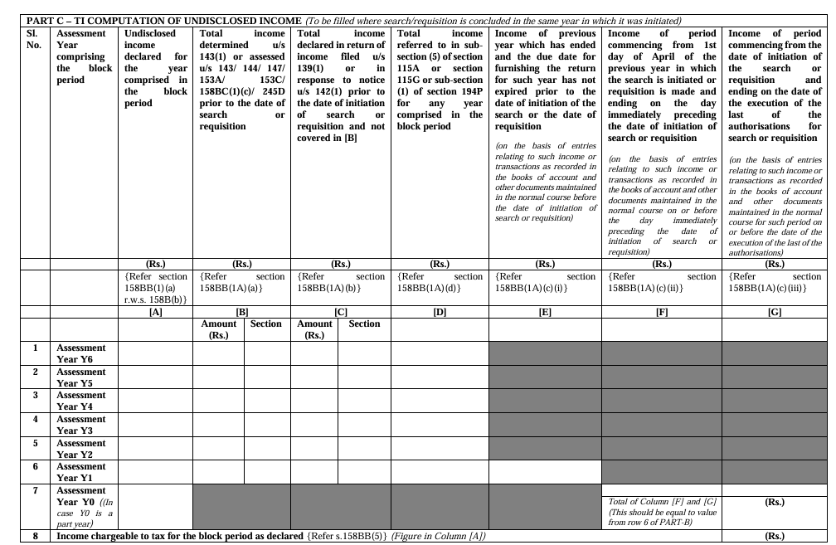
17. Snippets of ITR form
17. Snippets of ITR form
.Part C of tax return

Slide 29
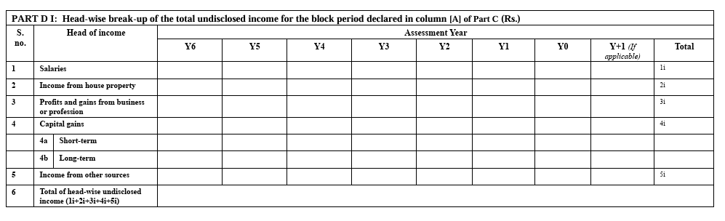
contd…..
contd…..
Part DI of tax return

Slide 30
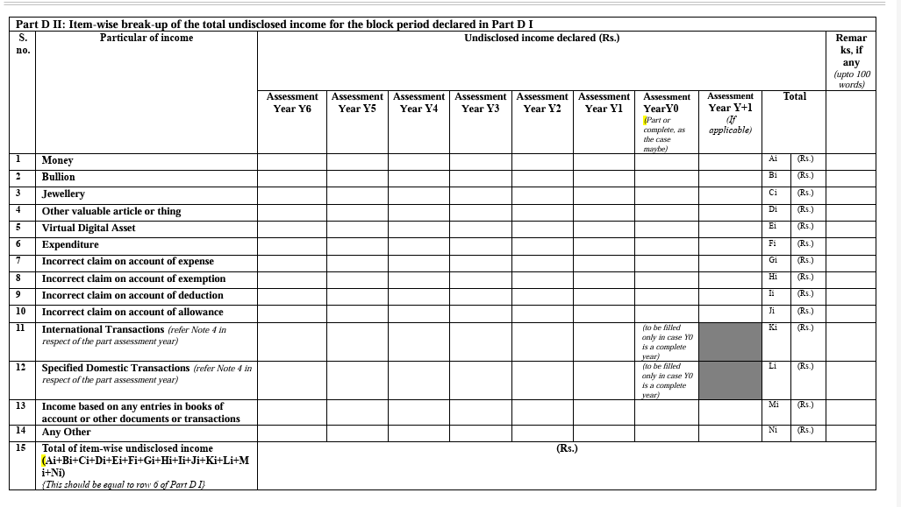
contd…..
contd…..
Part DII of tax return

Slide 31
contd…..
contd…..
Some issues w.r.t disclosure of undisclosed income in ITR form:
As per Form B notified by the CBDT, though the assessment is to be made for undisclosed income of block period and despite the objective that the purpose is to have a consolidated assessment so as to remove ambiguity to which year an income pertains, the Form B requires the assessee to compute undisclosed income for each of the years separately, as is evident from Part C TI of the block return.
Further, Part D1 requires income to be computed under the various heads such as salary, house property, etc. This will again create possible issues with assessees where dispute is whether income is taxable under one head or other, such as business or capital gains.
And thirdly, in DII and most importantly, the assessee has to give item-wise break up of income represented in the form of money, bullion, incorrect claim or expense, etc. The total of undisclosed income mentioned in DII has to match with the break-up of various heads. The computation of undisclosed income in respect of a search itself is a complex issue, and then to expect that such computation will be so precise that not only the heads of income but also the item-wise break-up matches each of the AYs; it may be important to point-out that when we look at this chart in D1 and D2, it is again asking money bullion, etc. for each AY separately. If cash is found during search and the same has been earned out of business in earlier years and to reconcile the same in this manner may not be practically possible.
This apparently appears to be a concept picked up from the SOF which normally used to be filed with the Settlement Commission. The challenge will now be assessee having disclosed the income and prepared this chart as per his own understanding, AO having not agreed with the same understanding, will not only make his own addition, but also on the basis of declaration made by the assesese will also add the same. Further, as to which AY income pertains to or which particular head or such income represented in which form or item, the issue of immunity from penalty to that extent of undisclosed income declared by the assessee will again be a subject matter of dispute, unless the CBDT comes out with a guidance and issues a clarification. In case such disclosure is required, then the assessee shall be asked to submit SOF on the basis of which undisclosed income has been computed and offered in the tax return. And in case of difference, only the differential amt will be subject matter of further adjudication/appeal. The assessee will get immunity to the extent of income offered in the block return.

Slide 32
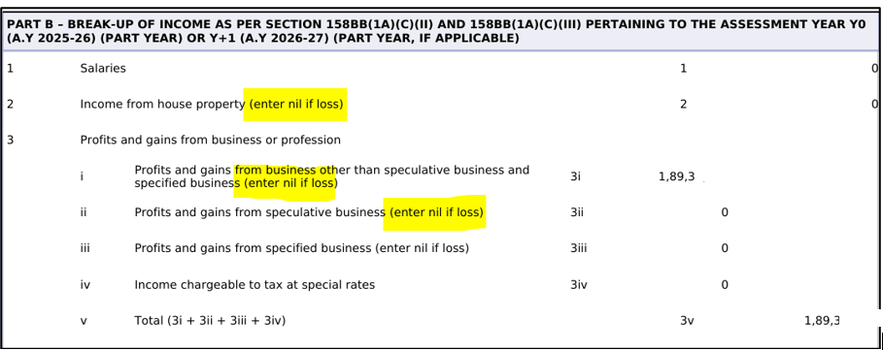
contd…..
contd…..
While calculating the total income for the part year or the full year of the year in which the search or requisition was initiated), it is not permitted to adjust or reduce the income by setting off any losses, even if those losses are otherwise permissible under the normal provisions of the Income Tax Act. The screenshot of Part B is produced hereunder:

Slide 33
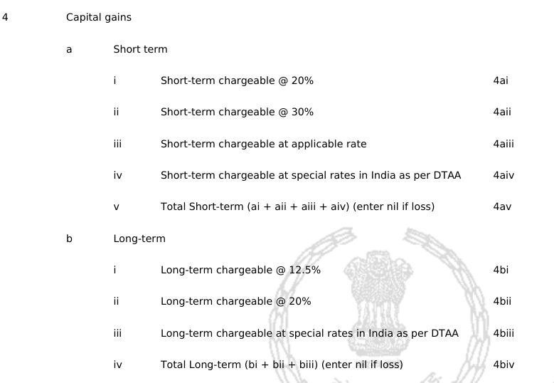
contd…..
contd…..
There is a lack of clarity on whether standard income tax adjustments (specifically, statutory allowances and disallowances applicable to business and other income heads under the Income Tax Act, 1961) must be applied while calculating the income for the part or full year of Y0 (the year of search/requisition) as reported in Part B of Form ITR-B.
ITR-B have excluded the fields for the old 15% (STCG u/s 111A) and 10% (LTCG u/s 112A) rates for that year's (part year or the full year of Y0) computation, even if the actual transactions being reported in Part B occurred before July 23, 2024, and were legally subject to the lower rate at that time

Slide 34
DISCLAIMER
The contents of this presentation are solely for informational purpose. Neither this presentation nor the information contained herein constitutes a contract or will form the basis of a contract. The material contained in this presentation does not constitute/substitute professional advice that may be required before acting on any matter. While every care has been taken in the preparation of this presentation to ensure its accuracy at the time of publication, Ved Jain & Associates assumes no responsibility for any errors which despite all precautions, may be found herein. In no event shall we be liable for direct or indirect or consequential damages, if any, arising out of or in any way connected with the use of this presentation or the information contained herein.
22nd Nov. 2025

Slide 35

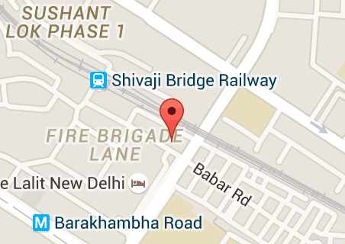
CONTACT INFORMATION
VED JAIN & ASSOCIATES
CHARTERED ACCOUNTANTS
Landline - 011-23354546, 23354547, 23354548
Head Office - 100 Babar Road, Opposite The Lalit, New Delhi, India-110001
Branch Offices- In Chandigarh and Mumbai
For more details visit our website www.vedjainassociates.com
Feedback/queries can be sent to mail@vedjainassociates.com
22nd Nov. 2025

Slide 36

THANK YOU

