Slide 1
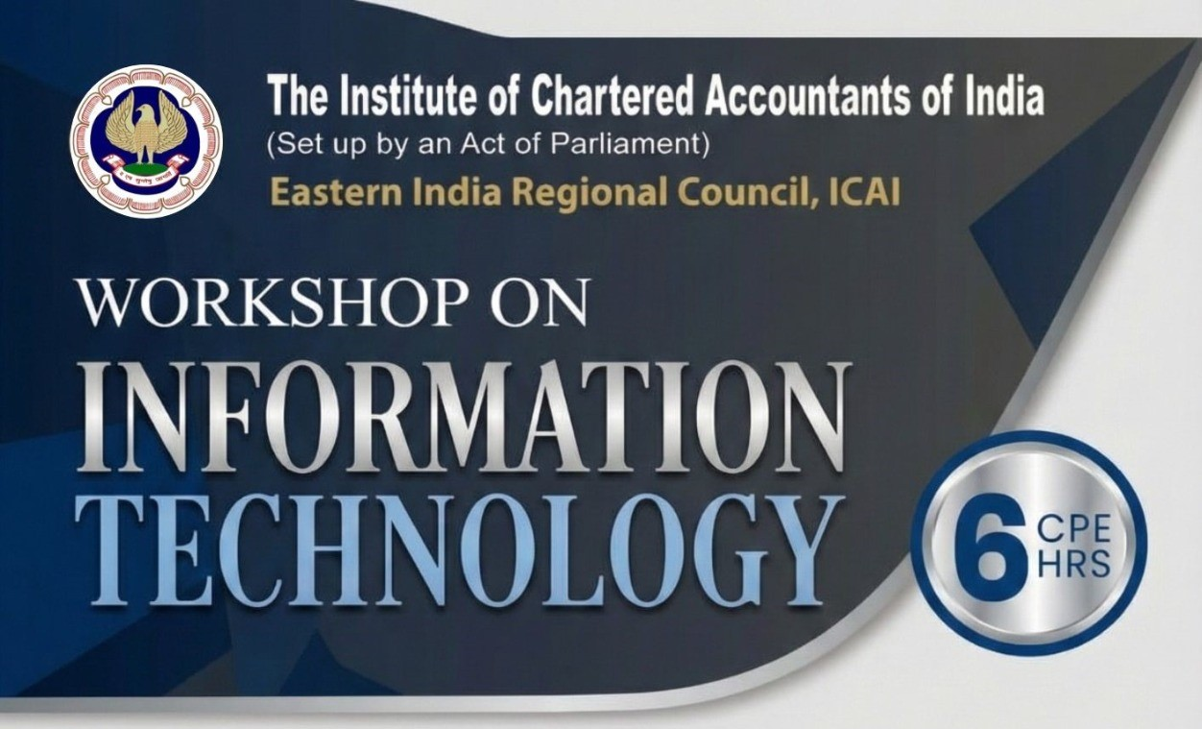
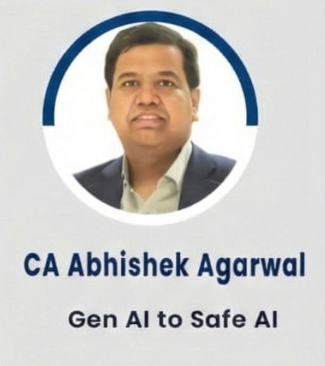
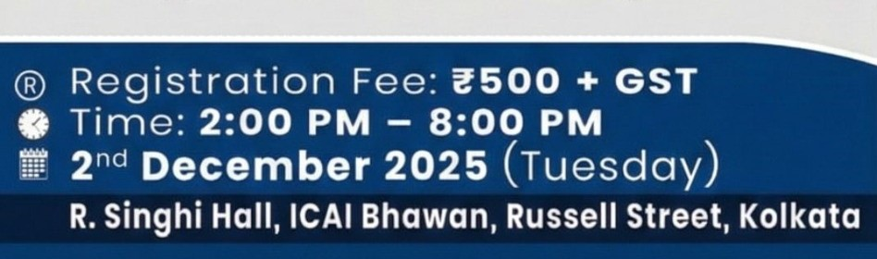
GEN AI to SAFE AI:
We live in a world where your voice, your face, your data everything can be copied by AI in seconds. Today, we learn how to use AI smartly AND safely. This session is designed for chartered accountants and finance professionals who want to harness the transformative power of Generative AI while maintaining absolute control over their data and security.

Slide 2

The Reality Check
Who Uses AI Daily?
Today’s Learning
The learning is simple: By the end of this presentation, you'll understand how to harness AI's superpowers while keeping your data fortress impenetrable.
How many of you worry that AI can misuse your data?
Here's the paradox: we're simultaneously fascinated and frightened by AI.
The good news? In Today's session we will learn not just how to use AI, but how to control it, secure it, and make it work for us without compromising the confidentiality that's sacred in our profession.
AI is not here to replace Chartered Accountants it's here to replace those CAs who don't use AI. The future belongs to professionals who combine technical expertise with intelligent automation.
This isn't about blind adoption it's about informed empowerment. Let's transform concern into confidence.

Slide 3
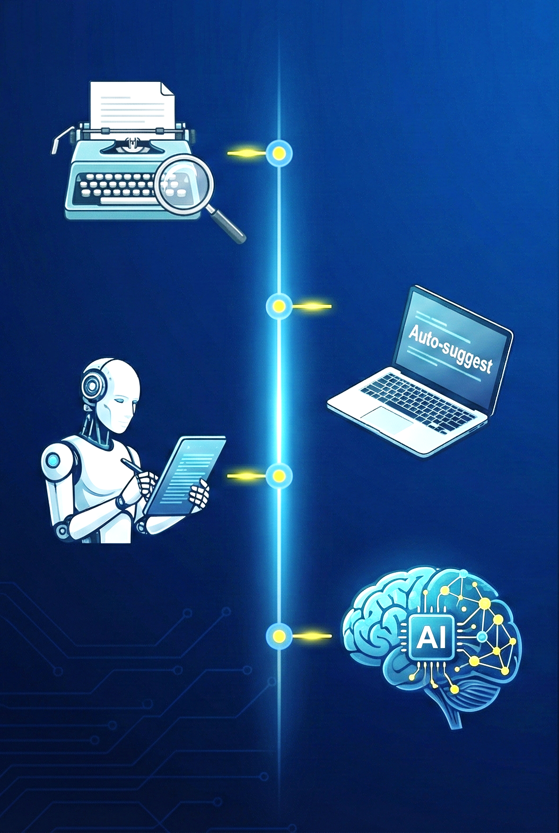
The Evolution: From Spell-Check to AI Creation
1
10 Years Ago
Basic spell-check corrected typos. Technology assisted but didn't think.
2
5 Years Ago
Auto-suggest predicted your next word. Algorithms learned patterns from your behavior.
3
Today
AI writes complete reports, contracts, notices, replies, and proposals — from scratch.
4
Tomorrow
AI will become an integrated thinking partner, handling routine analysis while
you focus on strategic decision-making and client relationships.
Understanding this evolution is crucial. AI represents not just an incremental improvement but a fundamental shift in how we interact with technology. Machine Learning learns from data, Natural Language Processing understands language, and Generative AI creates entirely new content. Prompting has become the new typing, a core professional skill for the modern accountant.

Slide 4
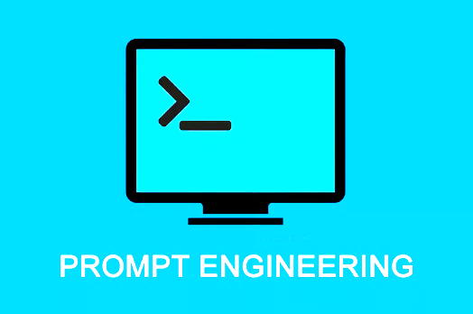
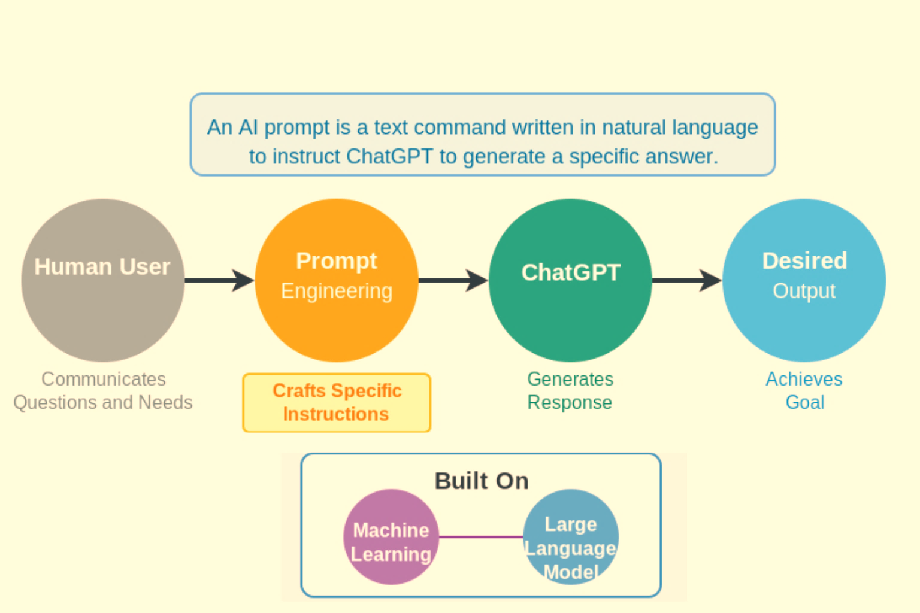
Prompt Engineering
= Craft of guiding AI to produce desired outcomes, efficiently using natural language instructions.

Slide 5
Prompt Engineering: Structured Thinking, Not Just English
AI doesn't know what you want until you tell it exactly. The quality of your output depends entirely on the clarity of your input. Effective prompting isn't about perfect grammar, it's about structured, strategic communication.
The 4W Model for Perfect Prompts
WHO : Give AI a Role
WHAT : State the Task
"Act as a Finance Executive" or "You are a Tax Consultant"
"Draft an email explaining project finance delay"
Defining perspective shapes the response style and expertise level.
Be specific about the deliverable you need.
WHY : Provide Context
WAY : Define Output Format
"Due to regulatory approval pending"
"Professional tone, 150 words, three paragraphs"
Background information ensures relevance and appropriateness.
Structure specifications deliver exactly what you need.

Slide 6

From Gen AI to Safe AI
"AI gives superpowers. Safe AI keeps those powers in your control."
The same technology that empowers you can be exploited you as well. Understanding risks isn't about fear, it's about intelligent preparation. If AI can help you, scammers can use AI to fool you. This section transforms awareness into actionable defense strategies.

Slide 7

Powerful Use Cases for Finance Professionals
If it involves typing, reading, summarizing, or drafting AI can handle 60–70% of the work immediately. Here's how chartered accountants are already transforming their practice with intelligent automation.
Drafting & Documentation
Financial Analysis
Generate notices, replies, grounds of appeal, CSR proposals, SOPs, and comprehensive audit documentation. AI accelerates document creation while maintaining professional standards and regulatory compliance.
Analyze stocks and mutual funds, summarize financial statements, and highlight risks in complex agreements. Transform hours of manual review into minutes of intelligent insights.
Process Automation
Professional Creativity
Convert PDFs to Excel with OCR, extract invoice data, clean up Tally narrations, and generate MIS reports automatically. Eliminate repetitive tasks that consume valuable time.
Design posters, brochures, LinkedIn content, and event banners. Enhance your professional brand with AI-powered creative tools that require no design experience.

Slide 8


Understanding AI Risks: The Five Critical Threats
01
02
Data Leakage
Deepfakes
Sensitive financial information accidentally shared with cloud-based AI systems that store and potentially expose your clients' confidential data.
Fake images, videos, and voice recordings so realistic they're indistinguishable from authentic content used for fraud and impersonation.
03
04
AI-Generated Scams
Hallucinations
Too-perfect emails, fraudulent documents, fake bank calls with cloned voices, and sophisticated phishing attempts designed by AI.
AI confidently presenting false information as fact — dangerous when making financial or legal decisions without verification.
05
Unverified Sources
AI pulling information from unreliable sources, creating professional-looking but factually incorrect analysis and recommendations.
Warning Signs: Over-polished language in unexpected emails, fake GST portal screenshots, urgent requests from "executives," and documents that look too perfect. Trust your instincts, if something feels off, it probably is.

Slide 9
The Three-Layer Defense System
Protection isn't about avoiding AI, it's about using it intelligently. This framework ensures you maintain complete control while maximizing AI's benefits.
Verification Safety Layer
Behavioral Safety Layer
Use reverse image search to detect fake visuals. Check metadata on documents and images. Verify email domains carefully. Call official numbers directly rather than using contact information from suspicious messages.
Technical Safety Layer
Never trust unknown files, links, or attachments. Verify sender identities through independent channels. Question messages that sound "too perfect" or create artificial urgency. Scammers attack confidence, not just technology.
Deploy offline AI solutions like Ollama that run entirely on your local machine. No data transmitted to external servers, no cloud storage, no third-party access. Your information stays within your infrastructure.
Remember: Never trust a message that sounds too perfect. Legitimate communications typically contain minor imperfections. Absolute polish often signals AI generation.

Slide 10
Language Red Flags
Overly Perfect Text
Generic Greetings
Over-Explanation
Suspiciously flawless grammar and corporate jargon that sounds too polished for the context.
"Dear User" or "Dear Customer" instead of your actual name shows automated generation.
Unnecessarily long, detailed explanations that feel robotic or repetitive in nature.
Prevention Tactics
1
Verify Sender Details
2
Demand Personalization
3
Call Official Numbers
Cross-check email domains, phone numbers, and sender information against official sources
Genuine institutions address you by name, account number, or specific details only they would know
When in doubt, contact the organization directly using numbers from their official website

Slide 11

Visual Warning Signs
Distorted Logos
Uncanny Valley Faces
Stock-Perfect Images
Company logos that appear blurry, stretched, or have inconsistent sizing - AI struggles with precise branding details.
People in images may have asymmetrical features, extra fingers, or unnaturally perfect skin that looks artificial.
Photos that look too polished or completely unrelated to the message content being sent.
Verification Steps
01
02
03
Zoom and Inspect
Reverse Image Search
Compare with Official Sources
Examine images and logos closely for distortions, especially in text and fine details
Use Google Images or TinEye to check if the image appears elsewhere online
Check company websites and verified social media pages for authentic branding

Slide 12
Deepfake Audio & Video Alerts
Audio Inconsistencies
Video Mismatches
Voice recordings that sound too clean, lack natural breathing, or have accents that don't match the speaker's appearance.
Lip movements slightly out of sync with speech, unnatural eye movements, or facial expressions that seem robotic.
Behavioral Red Flags
24/7 Instant Responses
Emotional Manipulation
Vague Answers
Immediate replies at any hour suggest automated systems rather than real customer service representatives.
Messages that combine fear tactics with greed appeals but provide no clear human contact information.
When you ask unexpected questions, responses are circular or don't actually address what you asked.

Slide 13






Verification Techniques
Reverse Image Search
Check File Metadata
Ask Human-Only Questions
Use Google's reverse image search. If the image doesn't appear elsewhere online, it might be AI-generated for the scam.
AI-generated images and documents often lack the normal creation history that authentic files contain.
Request specific account details or ask about recent transactions. AI systems typically fail at accessing real personal data.
Advanced Verification Tools
AI Detection Software
Code Word Systems
Direct Portal Access
Tools like GPTZero and Originality.ai can help identify AI-generated text when authenticity is crucial for important communications.
Establish unique verification phrases with family, colleagues, and business contacts for sensitive communications.
Always use bookmarked official websites instead of clicking links in suspicious emails or messages.

Slide 14

Your Defense Strategy
Verify Before Acting
Trust Your Instincts
Always confirm through official channels before sharing sensitive information or making payments.
If something feels off, it probably is. Take time to investigate suspicious communications.
Stay Updated
Scam techniques evolve rapidly. Keep learning about new threats and protection methods.
Remember: The best defense against AI scams is a healthy skepticism combined with systematic verification. When in doubt, hang up, log out, and verify independently. Your security is worth the extra step.

Slide 15

Offline AI: Your Private, Powerful Assistant
Why Offline Matters
It's ChatGPT installed on your laptop, no internet required, no data leakage, full privacy. Offline AI solutions like Ollama provide enterprise-grade capabilities while keeping your sensitive financial data completely under your control.
Zero Cloud Dependency: No data transmitted externally
Audit-Ready Security: Perfect for tax, legal, and confidential work
Internet-Independent: Works anywhere, anytime
Model Flexibility: Choose and control which AI models you deploy
Safe AI isn't less powerful — it's simply more responsible. You decide what runs, when it runs,
and what data it accesses.
This approach transforms AI from a potential security risk into a trusted, private assistant.

Slide 16
Your Action Plan: Responsible AI Mastery
Gen AI gives you speed. Safe AI gives you security. Offline AI gives you control. Redaction gives you privacy. And prompt engineering gives you accuracy. Together, these elements create a comprehensive framework for professional excellence.
Before Sharing Any Document
The 5-Second Verification Rule
Your Competitive Advantage
Redact. Then React. Use redaction tools to mask PAN numbers, addresses, account details, and other sensitive information in ITD scrutiny replies, TDS filings, client-confidential papers, and bank statements. One-click protection prevents accidental disclosure.
Check email domain authenticity
In 2025, knowing AI is optional. Using AI is optional. But being replaced by someone using AI is not optional. Your data is your biggest asset, protect it like your bank balance. Use AI responsibly with offline solutions, safeguards, and redaction protocols.
Analyze grammar and tone for AI polish
Look for visual inconsistencies
Reverse search suspicious images
Call official numbers directly, never use contact info from messages
You're now equipped to be 10X more powerful without compromising privacy or security. The future belongs to professionals who master both capability and responsibility.

Slide 17

Thank You & Q&A
I appreciate your participation.

Slide 18


