Slide 1
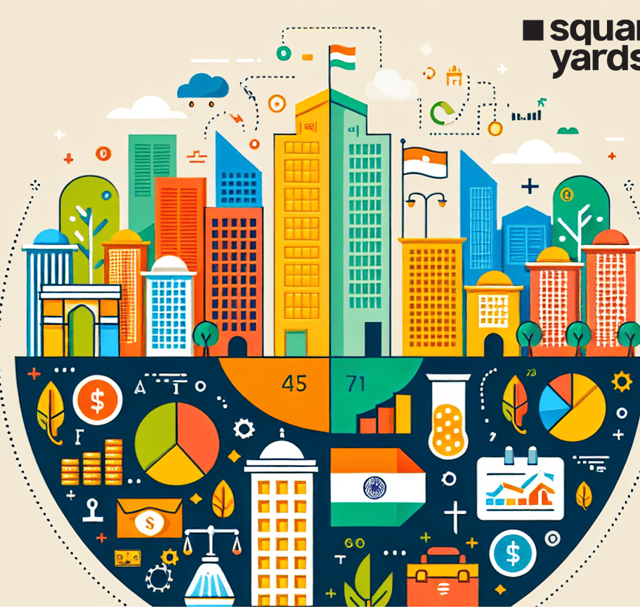
RERA:
Compliance AND JUDICIAL DEVELOPMENTS
Presented by: CA. Amit Kumar Kedia, Partner, M/s Gopal Sharma & Co.

Slide 2
RERA’s Evolution – The Genesis and Key Milestones

Slide 3

The Genesis of RERA
What is RERA?
  The Real Estate (Regulation and Development) Act, 2016, aims to regulate and promote the real estate sector, ensuring transparency, accountability, and efficiency.
  Objective: To protect the interests of consumers, ensure transparency, and promote fair practices in the real estate sector.
Key Provisions of RERA:
    Establishment of a Real Estate Regulatory Authority.
    Regulation of builders and developers to ensure timely delivery of projects.
    Standardization of contractual terms.
    Standardization of Carpet Area.
    Mandatory registration of real estate agents and projects.
    Safeguarding Buyer’s Money
Notes:
© Copyright PresentationGO.com – The free PowerPoint and Google Slides template library

Slide 4
Evolution of RERA Implementation & Impact (2016–2025)
2016
RERA Act notified in March; states required to set up regulatory authorities by May. Various states begin drafting rules.
2017
Maharashtra establishes the first RERA in January. By December, states like Gujarat, Rajasthan, Uttar Pradesh, and Karnataka establish their RERA, while West Bengal opts for HIRA.
2018
RERA implementation expands across states, increasing awareness among consumers and developers. States refine regulations to address local needs.
2019
RERA continues expanding across states, improving consumer awareness and regulatory frameworks.
2020
RERA tackles project delays and financial transparency, with states enhancing online systems for project registration and post-registration compliance, especially during COVID-19.
2021
Supreme Court ruling in May declares West Bengal’s HIRA Act “repugnant” to RERA, affirming RERA’s precedence.
2022-2024
States modify RERA rules to improve enforcement, transparency, and consumer protection.
2025
March analysis shows increased consumer confidence and more rigorous project approvals.

Slide 5

All States/UTs have notified Rules under RERA except Nagaland, which is under process to notify the Rules.
32 States/UTs have set up Real Estate Regulatory Authority (Regular - 27, Interim – 05). Ladakh, Meghalaya, Nagaland and Sikkim are yet to establish Real Estate Regulatory Authority.
28 States/UTs have set up Real Estate Appellate Tribunal (Regular -24, Interim – 04). Arunachal Pradesh, Jammu & Kashmir, Ladakh, Meghalaya, Mizoram, Nagaland, Sikkim and West Bengal are yet to establish Appellate Tribunal.
Regulatory Authorities of 30 States/UTs have operationalized their websites under the provisions of RERA. Arunachal Pradesh and Manipur are yet to operationalize.
26 States/UTs have appointed Adjudicating Officer. 10 States/UTs i.e., Arunachal Pradesh, Bihar, Manipur, Meghalaya, Nagaland, Sikkim, Uttarakhand, West Bengal, Jammu & Kashmir, Ladakh are yet to appoint Adjudicating Officer.
1,42,506 Real Estate Projects and 98,236 Real Estate Agents have registered under RERA across the Country.
1,40,384 Complaints have been disposed-off by the Real Estate Regulatory Authorities/ Adjudicating Officer across the Country.
Progress of RERA Implementation Across India: March 2025 Insights

Slide 6
IMPORTANT SECTIONS of RERA Act, 2016

Slide 7

Some Important Definitions From – Section 2
Section 2(b) "advertisement“: means any document described or issued as advertisement through any medium and includes any notice, circular or other documents or publicity in any form, informing persons about a real estate project, or offering for sale of a plot, building or apartment or inviting persons to purchase in any manner such plot, building or apartment or to make advances or deposits for such purposes;
Section 2(c) "agreement for sale“: means an agreement entered into between the promoter and the allottee;
Section 2(d) "allottee“: in relation to a real estate project, means the person to whom a plot, apartment or building, as the case may be, has been allotted, sold (whether as freehold or leasehold) or otherwise transferred by the promoter, and includes the person who subsequently acquires the said allotment through sale, transfer or otherwise but does not include a person to whom such plot, apartment or building, as the case may be, is given on rent;
Section 2(e) "apartment“: whether called block, chamber, dwelling unit, flat, office, showroom, shop, godown, premises, suit, tenement, unit or by any other name, means a separate and self-contained part of any immovable property, including one or more rooms or enclosed spaces, located on one or more floors or any part thereof, in a building or on a plot of land, used or intended to be used for any residential or commercial use such as residence, office, shop, showroom or godown or for carrying on any business, occupation, profession or trade, or for any other type of use ancillary to the purpose specified;
Section 2(j) "building“: includes any structure or erection or part of a structure or erection which is intended to be used for residential, commercial or for the purpose of any business, occupation, profession or trade, or for any other related purposes;
Section 2(k) "carpet area“: means the net usable floor area of an apartment, excluding the area covered by the external walls, areas under services shafts, exclusive balcony or verandah area and exclusive open terrace area, but includes the area covered by the internal partition walls of the apartment. Explanation.— For the purpose of this clause, the expression "exclusive balcony or verandah area" means the area of the balcony or verandah, as the case may be, which is appurtenant to the net usable floor area of an apartment, meant for the exclusive use of the allottee; and "exclusive open terrace area" means the area of open terrace which is appurtenant to the net usable floor area of an apartment, meant for the exclusive use of the allottee;

Slide 8
Some Important Definitions From – Section 2
Section 2(m) "commencement certificate“; means the commencement certificate or the building permit or the construction permit, by whatever name called issued by the competent authority to allow or permit the promoter to begin development works on an immovable property, as per the sanctioned plan;
Section 2(q) "completion certificate“: means the completion certificate, or such other certificate, by whatever name called, issued by the competent authority certifying that the real estate project has been developed according to the sanctioned plan, layout plan and specifications, as approved by the competent authority under the local laws;
Section 2(t) "development works“: means the external development works and internal development works on immovable property;
Section 2(v) "estimated cost of real estate project“: means the total cost involved in developing the real estate project and includes the land cost, taxes, cess, development and other charges;
Section 2(n) "common areas“: mean— (i) the entire land for the real estate project or where the project is developed in phases and registration under this Act is sought for a phase, the entire land for that phase; (ii) the stair cases, lifts, staircase and lift lobbies, fire escapes, and common entrances and exits of buildings; (iii) the common basements, terraces, parks, play areas, open parking areas and common storage spaces; (iv) the premises for the lodging of persons employed for the management of the property including accommodation for watch and ward staffs or for the lodging of community service personnel; (v) installations of central services such as electricity, gas, water and sanitation, air-conditioning and incinerating, system for water conservation and renewable energy; (vi) the water tanks, sumps, motors, fans, compressors, ducts and all apparatus connected with installations for common use; (vii) all community and commercial facilities as provided in the real estate project; (viii) all other portion of the project necessary or convenient for its maintenance, safety, etc., and in common use;

Slide 9
Some Important Definitions From – Section 2
Section 2(z) "immovable property“: includes land, buildings, rights of ways, lights or any other benefit arising out of land and things attached to the earth or permanently fastened to anything which is attached to the earth, but not standing timber, standing crops or grass;
Section 2(zh) "planning area" : means a planning area or a development area or a local planning area or a regional development plan area, by whatever name called, or any other area specified as such by the appropriate Government or any competent authority and includes any area designated by the appropriate Government or the competent authority to be a planning area for future planned development, under the law relating to Town and Country Planning for the time being in force and as revised from time to time;
Section 2(za) "interest“: means the rates of interest payable by the promoter or the allottee, as the case may be. Explanation.—For the purpose of this clause— (i) the rate of interest chargeable from the allottee by the promoter, in case of default, shall be equal to the rate of interest which the promoter shall be liable to pay the allottee, in case of default; (ii) the interest payable by the promoter to the allottee shall be from the date the promoter received the amount or any part thereof till the date the amount or part thereof and interest thereon is refunded, and the interest payable by the allottee to the promoter shall be from the date the allottee defaults in payment to the promoter till the date it is paid;
Section 2(zf) "occupancy certificate“: means the occupancy certificate, or such other certificate by whatever name called, issued by the competent authority permitting occupation of any building, as provided under local laws, which has provision for civic infrastructure such as water, sanitation and electricity;

Slide 10
Some Important Definitions From – Section 2
Section 2 (zk) "promoter“: means,— (i) a person who constructs or causes to be constructed an independent building or a building consisting of apartments, or converts an existing building or a part thereof into apartments, for the purpose of selling all or some of the apartments to other persons and includes his assignees; or (ii) a person who develops land into a project, whether or not the person also constructs structures on any of the plots, for the purpose of selling to other persons all or some of the plots in the said project, whether with or without structures thereon; or (iii) any development authority or any other public body in respect of allottees of— (a) buildings or apartments, as the case may be, constructed by such authority or body on lands owned by them or placed at their disposal by the Government; or (b) plots owned by such authority or body or placed at their disposal by the Government, for the purpose of selling all or some of the apartments or plots; or (iv) an apex State level co-operative housing finance society and a primary co-operative housing society which constructs apartments or buildings for its Members or in respect of the allottees of such apartments or buildings; or (v) any other person who acts himself as a builder, coloniser, contractor, developer, estate developer or by any other name or claims to be acting as the holder of a power of attorney from the owner of the land on which the building or apartment is constructed or plot is developed for sale; or (vi) such other person who constructs any building or apartment for sale to the general public. Explanation.—For the purposes of this clause, where the person who constructs or converts a building into apartments or develops a plot for sale and the persons who sells apartments or plots are different persons, both of them shall be deemed to be the promoters and shall be jointly liable as such for the functions and responsibilities specified, under this Act or the rules and regulations made thereunder;
Section 2 (zn) "real estate project“: means the development of a building or a building consisting of apartments, or converting an existing building or a part thereof into apartments, or the development of land into plots or apartment, as the case may be, for the purpose of selling all or some of the said apartments or plots or building, as the case may be, and includes the common areas, the development works, all improvements and structures thereon, and all easement, rights and appurtenances belonging thereto;
Section 2 (zm) "real estate agent": means any person, who negotiates or acts on behalf of one person in a transaction of transfer of his plot, apartment or building, as the case may be, in a real estate project, by way of sale, with another person or transfer of plot, apartment or building, as the case may be, of any other person to him and receives remuneration or fees or any other charges for his services whether as commission or otherwise and includes a person who introduces, through any medium, prospective buyers and sellers to each other for negotiation for sale or purchase of plot, apartment or building, as the case may be, and includes property dealers, brokers, middlemen by whatever name called;

Slide 11
Registration of Real Estate Project
Section 3
Section 4
Section 5
Extension of Real Estate Project
Section 6
Section 7
Revocation of Real Estate Project
Section 8
Registration of Real Estate Agents
Section 9
Section 10
Functions And Duties Of Promoter
Section 11
Section 12
Section 13
Section 14
Transfer of A Real Estate Project To A Third Party
Section 15
Insurance of Real Estate Project
Section 16
Transfer of Title (Handover of Possession)
Section 17
Return of Amount And Compensation
Section 18
Rights And Duties of Allottees
Section 19

Slide 12
OFFENCES, PENALTIES AND ADJUDICATION
Section 60
Section 61
Section 62
Section 63
Section 64
Section 65
Section 66
Section 67
Section 68
Section 69
Section 70
Section 71
Section 72
Section 59

Slide 13
Sections 59–68: Penalties for Non-Compliance
Section | Focus | Who is Penalized | Reason for Penalty
59 | Penalty for non-registration | Promoter | Failure to register a project
60 | Penalty for contravening Section 4 | Promoter | Incorrect or incomplete info in application for registration
61 | Penalty for other contraventions | Promoter | Breach of Act provisions not covered in previous sections
62 | Penalty for non-registration / contravention | Real estate agent | Failing to register or violating Section 9 & 10
63 | Penalty for non-compliance with RERA orders | Promoter | Disobeying orders/directions of the Authority
64 | Penalty for non-compliance with Tribunal orders | Promoter | Disobeying Real Estate Appellate Tribunal (REAT) orders/directions
65 | Penalty for non-compliance with RERA orders | Real estate agent | Disobeying orders/directions of the Authority
66 | Penalty for non-compliance with Tribunal orders | Real estate agent | Disobeying orders/directions of the REAT
67 | Penalty for non-compliance with RERA orders | Allottee | Disobeying Authority’s orders/ directions
68 | Penalty for non-compliance with Tribunal orders | Allottee | Disobeying REAT orders/directions

Slide 14
Sections 69–72: Offences and Adjudication
Section | Focus | Key Points
69 | Offences by companies | Fixes responsibility on directors, managers, etc., unless proven unaware or not involved
70 | Compounding of offences | Allows certain offences to be compounded (settled) with specified fines
71 | Power to adjudicate | Empowers adjudicating officer (usually a judicial officer) to settle disputes related to compensation
72 | Factors in adjudication | Officer considers factors like amount of gain, loss to allottee, nature of default, etc., while deciding penalty or compensation

Slide 15
PROJECT RERA REGISTRATION COMPLIANCE

Slide 16
When is Project RERA Registration Required Under the Act?
Real Estate Projects Covered Under RERA
Residential, Commercial, Mixed-Use & Plotted Development Projects
Real Estate Projects Not Covered Under RERA
Projects with Completion Certificate issued before RERA commencement
Projects where:
Land Area > 500 sq.m., OR
No. of Units > 8 (inclusive of all phases)
Phased Development: Each phase must be registered separately
Ongoing projects without a Completion Certificate on the date RERA came into force
Any additional categories notified under State-specific RERA Rules
Redevelopment projects with no new allotments
Renovation/repair works not involving marketing, advertising, selling, or allotment
Resale of an already completed and ready-to-occupy property
Exemptions additionally provided in State RERA Rules
States may reduce the exemption threshold or introduce additional conditions under their RERA Rules
No promoter may advertise, market, book, sell, or offer for sale any unit in a project without RERA registration

Slide 17
WBRERA Decreases Project RERA Registration Threshold Limit
Notification No: 42-H4/2M-01/2023 |Date: 6th June 2023
⚠ Registration is now MANDATORY under RERA 2016 and WB RERA Rules 2021 if ANY of the following criteria is met:
*Meeting either criterion triggers mandatory RERA registration requirements
Land Area Criterion
Land area proposed to be developed exceeds 200 sq. meters
Units Criterion
Number of apartments proposed exceeds 6 units in the project

Slide 18
Mandatory Registration & CC/OC Linkage
WBRERA Circular Dated: 19-09-2024
No Completion Certificate (CC), Partial CC (PCC), or Occupancy Certificate (OC) will be issued by:
Municipal Corporations
Municipalities
Panchayat Bodies
A valid WBRERA Registration Certificate is submitted, OR
An Own-Use Declaration is submitted (only for exempted projects).
Unless:

Slide 19
CATEGORIES OF PROMOTERS AND THE ROLE AND STATUS OF LANDOWNER UNDER RERA, ACT 2016

Slide 20
Concept of Multiple Promoters Under RERA
Promoters Under RERA
The Act does not restrict a project to having only one promoter.
Types of Promoters:
Developer-Promoter: Constructs buildings / develops plots for sale.
Seller-Promoter: Sells apartments or plots (even if not involved in construction).
Liability of Multiple Promoters
Each promoter is liable up to the full extent of the relevant obligation.
If a written agreement between promoters delineates specific roles, each promoter is liable only for those agreed functions.
Inter-Se Disputes Between Promoters
RERA cannot adjudicate disputes between promoters regarding apportioning liability.
Such disputes must be resolved outside RERA before the appropriate forum.
Where No Agreement Exists
If there is no agreement, no understanding, or no forum decision on role-sharing:
→ RERA Authority will hold that promoter liable who, in its opinion, was responsible for the act or omission.

Slide 21
When a Landowner Becomes a “Promoter” Under RERA
Landowner Has a Builder/Developer Role
If the Development Agreement assigns the landowner any role as builder, colonizer, developer, contractor, or estate developer → Landowner = Promoter
Exception: If a Power of Attorney holder performs these roles, the POA holder becomes the Developer-Promoter.
Landowner Markets or Sells Units
If allowed to market or sell units before completion, the landowner becomes a Seller-Promoter.
If allowed to sell only after completion → Not a promoter.
If not allowed to sell at all → Not a promoter.
Landowner Must Sign Agreements/Sale Deeds
When the developer is not given full powers of sale/conveyance and the landowner must sign ATS/sale deeds → Landowner is a Promoter.
Profit or Loss Sharing
If landowner shares profit or loss of the project → must be named and treated as Promoter.
Contractual Designation
If Development Agreement expressly states that landowner shall be named and treated as promoter → RERA will recognise him as Promoter.
Privity of Contract With Allottees
If clauses in the Development Agreement create direct privity between landowner and allottees, the landowner must be impleaded as a party in complaints filed by allottees against the promoter.

Slide 22
Under these circumstances, it is unfair to hold landowner responsible for obligations like timely completion.
Extent of Liability of Landowner as a Promoter
When Landowner Should NOT Be Treated as Fully Liable Promoter
If all the conditions below exist:
Landowner has no say in day-to-day project management.
Landowner does not finance development cost nor share profit/loss.
Developer-promoter does not give access to project expenditure accounts.
Principle
The landowner’s interest is generally aligned with homebuyers, not with developer-promoter.
If project delays occur due to developer’s failure, the landowner should not be treated as responsible for such failures.
Extent of Liability
When landowner is named or treated as a promoter, he is jointly liable only to the extent of functions assigned to him under the Development Agreement and under the Act.
Some Supporting Regulatory Directions
Rajasthan RERA: Circular No. F.1(152)RJ/RERA/LAND/2020/1202 dated 30.06.2020 – Categories of Promoters & Role/Status of Landowner under RERA
Karnataka RERA: Circular No. KRERA/CIRCULAR/03/2019 – Landowners with area/revenue share in a project
70% of sale proceeds of the entire saleable area must be deposited in a single RERA project bank account whether the landowner is a promoter or not.

Slide 23
What Is Carpet Area Under RERA Act, 2016?

Slide 24
Carpet Area means the net usable floor area of an apartment, excluding areas covered by external walls, services shafts and exclusive balcony/verandah/terrace areas.
Includes
Area covered by internal partition walls
Usable spaces within the apartment only
Excludes
External walls
Balconies, verandahs, terraces (even if exclusive to the apartment)
Service shafts
Purpose Under RERA
Standardizes how builders disclose area
Ensures transparent pricing based only on actual usable space
Prevents inflation of saleable area by adding non-usable spaces

Slide 25
POST REGISTRATION RERA COMPLIANCE

Slide 26




Not so fast, my friend. While registration is a crucial step, it's just the beginning. There are several compliances you need to fulfill between registration and project completion. And even after completion, there are some RERA compliances that promoters must adhere to. Let me walk you through the RERA compliances beyond project completion, to ensure a smooth and successful outcome.
I've finally registered my project with RERA. Now that it's done, I can breathe a sigh of relief and take it easy.

Slide 27

RERA Guidelines for Advertising Real Estate Projects
Advertisement Content Must include:
  Registration Number of the project must be displayed prominently.
  Website address of the Real Estate Regulatory Authority must be included.
  Font size of RERA Registration No. and Website address must be:
    Equal to or larger than the contact details of the proposed project
    Not less than half of the size used for the name of the project
Advertising Guidelines:
  Pictures must be clear, actual, and without false or misleading information.
  Testimonials must be original and genuine.
  Specifications promised must form part of the Agreement for Sale.
  Information provided must not contravene any RERA provisions.
  Project website must be updated periodically based on development progress.
  Disclaimers must be appropriate and not deny responsibilities and duties.
No advertisement without Obtaining RERA registration.
Compliance with RERA guidelines is mandatory for advertising real estate projects. Additionally, note that state-specific regulations and guidelines may vary. It is essential to follow separate guidelines issued by states, if any.

Slide 28
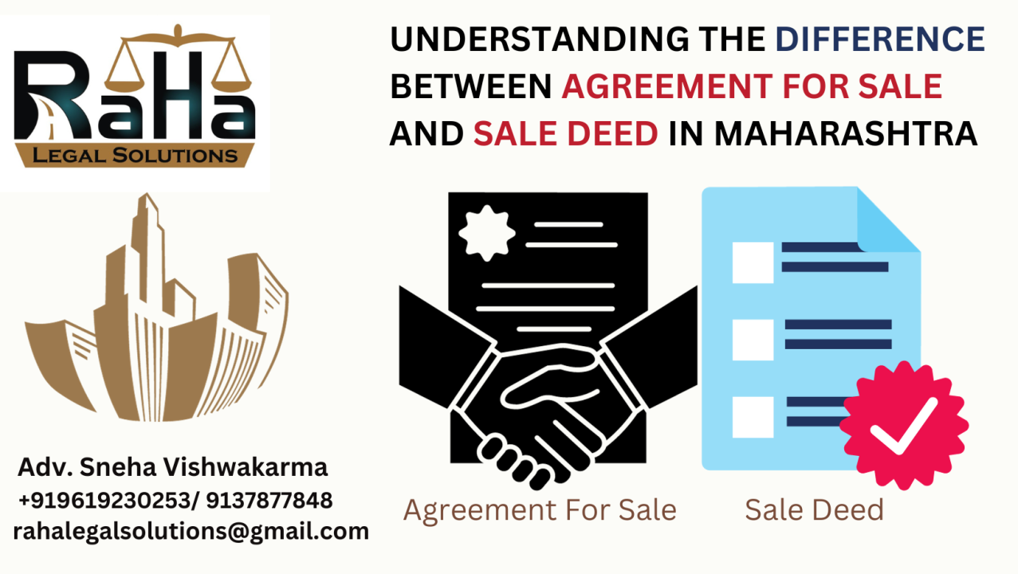
Agreement for Sale: Promoter's Obligations
Definition: "agreement for sale" means an agreement entered into between the promoter and the allottee;
A promoter cannot accept more than 10% of the property's cost as an advance payment or application fee without first:
Entering into a written Agreement for Sale with the allottee
Registering the Agreement for Sale under applicable laws
This requirement aims to protect the interests of the allottee and ensure transparency in the transaction.

Slide 29

Project Separate Bank Account
Opening of the Account Before Registration
Deposits in Account
Withdrawals from the RERA Separate Account
Forms of Certificates
Reporting to the Authority
Authority Powers
Changing RERA Account (if any)
Closure of the RERA Account
For state-specific guidelines, refer to the respective state RERA authority's guidelines.

Slide 30
Certificates Under RERA Act, 2016
Reference Section 4(2)(l)(d), RERA Act, 2016 which states -
“that seventy per cent. of the amounts realised for the real estate project from the allottees, from time to time, shall be deposited in a separate account to be maintained in a scheduled bank to cover the cost of construction and the land cost and shall be used only for that purpose: Provided that the promoter shall withdraw the amounts from the separate account, to cover the cost of the project, in proportion to the percentage of completion of the project: Provided further that the amounts from the separate account shall be withdrawn by the promoter after it is certified by an engineer, an architect and a chartered accountant in practice that the withdrawal is in proportion to the percentage of completion of the project: Provided also that the promoter shall get his accounts audited within six months after the end of every financial year by a chartered accountant in practice, and shall produce a statement of accounts duly certified and signed by such chartered accountant and it shall be verified during the audit that the amounts collected for a particular project have been utilised for the project and the withdrawal has been in compliance with the proportion to the percentage of completion of the project.”
Certificate by Architect
Confirms stage-wise completion of construction as per the sanctioned plan.
Certificate by an Engineer
Certifies actual on-site physical progress corresponding to cost incurred.
Certificate by Chartered Accountant in Practice
Validates the proportionate withdrawal is in line with receipts and progress.
Certificate by Chartered Accountant in Practice (Auditor of Promoter)
Audits annual accounts and verifies project funds have been utilized and withdrawn as per law.
Note: Names and formats of these certificates may vary in different states as per state-specific RERA Rules.

Slide 31
Chartered Accountant’s Certificates Under RERA – Types and Purpose
Withdrawal Certificate:
Issues before promoter withdraws funds from project dedicated separate bank account in which 70% of allottee receipts are deposited. This certificate can be issued by any CA with a valid Certificate of Practice (COP).
Annual Audit Certificate:
Prepared annually, within six months post financial year or as per state regulation, validating project funds utilization and statutory compliance. This certificate must be issued by the statutory auditor.
Overall goal: Align financial withdrawals with project physical progress ensuring safety of allottee’s money.

Slide 32
When and How Often are Certificates Required
Withdrawal Certificates
Typically issued quarterly for RERA quarterly report filing
Annual Certificates
To be filed within 6 months after the end of the financial year, Or as per specific timelines defined by state regulations
Or before every fund withdrawal, linked to project progress
May be required on demand by the authority in certain states
Sometimes asked for at the time of project registration or extension
Mode of Filing of Certificates to RERA:
Primarily through RERA online portals
Some states may still allow manual submissions

Slide 33
Estimated Cost of Real Estate Project
“Section 2(v) states "estimated cost of real estate project" means the total cost involved in developing the real estate project and includes the land cost, taxes, cess, development and other charges”
Estimated Land Cost
  Land Value: Ascertained from the Annual Statement of Rates (ASR).
  Development Rights Premium: Payable for obtaining FSI, additional FSI, fungible areas, or incentives under DCR.
  TDR Acquisition Cost: If applicable.
  State/Local Authority Fees: Stamp duty, transfer charges, registration fees.
  Land Premium for Redevelopment: Under ASR for public authority land.
  Under Rehabilitation Scheme:
    Rehabilitation Construction Costs: Certified by engineer, including site development.
    Land Clearance Costs: Removal of encumbrances, costs for transit accommodation, and payments to slum dwellers/tenants.
    Additional Fees: ASR-linked premiums, fees, security deposits for rehabilitation projects.
    Interest on Borrowing for Rehabilitation: Estimated cost of borrowed funds.
Estimated Development Cost
  Construction Costs: Certified by an engineer.
  Additional Items: Costs not included in construction estimate (as per engineer’s certification).
  Development Expenditures: Salaries, consultants' fees, site overheads, services (water, electricity, sewerage, roads, etc.), machinery/equipment maintenance, consumables, etc.
  Statutory Authority Fees: Taxes, cess, charges, premiums, etc.
  Interest on Construction Funding: From financial institutions, banks, or NBFCs.

Slide 34

Handling Discrepancies in Both Withdrawal & Audit Certificates
Documenting and reporting all deviations transparently in certificates.
Advising promoters to file necessary amendments with proper evidences.
Maintaining professional independence and resisting undue influence.
Emphasizing consequences of inaccurate certification for both promoters and auditors.
We CAs are key gatekeepers of transparency, accountability, and regulatory compliance in real estate projects under RERA.

Slide 35

Legal & Professional Implications of Erroneous Certification
Potential penalties, fines, and legal action against promoter and CA.
Risk of suspension or cancellation of the CA’s certificate of practice.
Damage to professional reputation and client trust.
Role of RTI Act making certificates public increasing professional accountability.

Slide 36

Guiding Promoter on Maintenance of Separate Project Bank Account
Group → Multiple Entities
Each Entity → Multiple Projects
Each Project → May have multiple Phases/Towers
RERA-Registered Project requires a designated separate bank account
Understanding the Structure
A designated separate bank account is required for each RERA-registered project.
This separate account must be a no lien account.
70% of the amounts collected from allottees must be deposited in the RERA Separate Account.
These funds must be used only for land and construction costs of that specific project.
No funds should be collected from allottees prior to RERA registration.
Withdrawals are permitted only upon certification from professionals: COA-registered Architect, Qualified Engineer & Practicing Chartered Accountant (excluding statutory auditor)
Banks may provide automated fund segmentation (e.g., 70% and 30% accounts).
If a 30% account is opened by bank, promoters may use it to deposit own funds or external borrowings.
Promoter’s own funds or external funding must not be mixed with the 70% RERA account.
If FDs are made from the fund in RERA Project Separate account, verify no lien/charge exists on the FD.
The account must be maintained from opening to closure in accordance with the RERA Act and relevant State Rules & Regulations.

Slide 37

How Long Are CA Certificates Required?
Certificates must be issued until the completion of the project as per RERA definitions.
RERA Quarterly Compliance (Withdrawal Certificate)
First Certificate: Due at the end of the quarter in which project is registered
Last Certificate: Due at the end of the quarter in which project is completed
RERA Annual Compliance (Annual Audit Certificate):
First Certificate: Due at the end of the financial year in which project is registered
Final Withdrawal: On project completion, the entire balance in the RERA-designated bank account can be withdrawn by the promoter upon
Submission of required completion certificates and other documents
Last Certificate: Due at the end of the financial year in which project is completed
Fulfilment of all other RERA compliance obligations

Slide 38

What Constitutes Project Completion under RERA?
Internal Development Works (Section 2(zb))
External Development Works (Section 2(w))
Obligation of Promoter (Section 11)
Transfer of Title (Section 17)
Other Applicable Provisions
Roads, footpaths, drainage, sewers, water supply
Parks, tree planting, street lighting, fire safety systems
Community buildings, waste & energy management, water conservation
Social infrastructure (e.g., schools, health centers)
Roads and landscaping
Sewerage, drainage, water supply systems
Electricity, transformers, sub-stations
Solid waste management
Other peripheral infrastructure as per local laws
Obtaining Completion/ Occupancy Certificate (CC/OC)
Formation of Association of Allottees
Transfer of unspent funds and collected deposits
Payment of dues and statutory liabilities
Handover of project documents to the association
Handover of Common Areas to the allottees’ association
Compliance with State RERA Rules
Adherence to all applicable laws, bye-laws, and regulations
Formalization of the Association of Allottees as per legal requirements
Completion of a project under RERA is not just about construction - it includes statutory, developmental, and regulatory compliances
Only after meeting all above conditions can the project be treated as complete under RERA, enabling final withdrawal and closure of compliance responsibilities.

Slide 39

Extension of Project Registration
Construction of project complete?
YES
Handover Possession of Unit and common areas
NO
Submit Application for Extension
Submit Completion & Occupancy Certificate

Slide 40

Extension of Project Registration
The registration granted under section 5 may be extended by the Authority on an application made by the promoter due to force majeure, in such form and on payment of such fee as may be specified by regulations made by the Authority:
Provided that the Authority may in reasonable circumstances, without default on the part of the promoter, based on the facts of each case, and for reasons to be recorded in writing, extend the registration granted to a project for such time as it considers necessary, which shall, in aggregate, not exceed a period of one year:
Provided further that no application for extension of registration shall be rejected unless the applicant has been given an opportunity of being heard in the matter.

Slide 41
WBRERA Project Extension Framework
Section 6 | Rule 7(1) & 7(2) | Memo No. 921-RERA (19.08.2025)
Standard Extension Rule 7(1) & 7(2)
Timeline: Apply 3 months before registration expiry
Extension Period: Up to 1 year from declared original completion date
Application Form: Submit Form 'E' with explanatory note & other supporting documents
Extension Fee: 2x Registration Fee
No additional penalties if applied on time
Late Applications - WBRERA Extension - Memo No. 921-RERA | Dated: 19.08.2025
Eligibility Criteria
Best interest of allottees
Sufficient proof of reason for delay
Affidavit for reason for delay and new completion date
Delay beyond developer's control
80-90% construction complete
Additional Late Filing Fee will be charged
Application Filed Up to 3 months late : +50% of Extension Fee
Application Filed 3-6 months late : +100% of Extension Fee
Application Filed 6-12 months late: +150% of Extension Fee
Application Filed Beyond 1 year: Case to Case basis
Authority's Discretion:
May reject extensions beyond 1 year
Can impose up to 5% of project cost for extensions beyond 1 year
Case-by-case evaluation of extension applications
Approval depends on outcome of hearing with stakeholders (promoter and allottees)
Additional Penalty may be imposed along with Late Fee (on Extension Period)
3 months extension: +30% of Extension Fee
3-6 months extension: +60% of Extension Fee
6-12 months extension: +90% of Extension Fee
Beyond 1 year: Depends on Case to Case Basis, either reject or Up to 5% of project cost
*Extension Fee: 2x Registration Fee
This is also Base fee applicable to all late filing fee and penalty calculation

Slide 42

Timely Reporting and Updates on RERA Web Portal
Project Extension: updates regarding estimated project finish date
Quarterly Progress Report
Annual Progress Report
Updation of Revised Sanctioned Map
RERA Project Separate Account Change
Project Encumbrance Status Change
Project Profile Modification
Promoter Profile Modification
Project Completion Documents Update
RWA Documents or Details Upload
Any Other Documents / Details Upload
Promoters must update the RERA Authority about all changes and file progress reports in a timely manner.
Regular updates ensure transparency and compliance with RERA regulations.
For state-specific guidelines, refer to the respective state RERA authority's guidelines.

Slide 43

Insurance of Project
16. (1) The promoter shall obtain all such insurances as may be notified by the appropriate Government, including but not limited to insurance in respect of —
(i) title of the land and building as a part of the real estate project; and
(ii) construction of the real estate project.
(2) The promoter shall be liable to pay the premium and charges in respect of the insurance specified in sub-section (1) and shall pay the same before transferring the insurance to the association of the allottees.
(3) The insurance as specified under sub-section (1) shall stand transferred to the benefit of the allottee or the association of allottees, as the case may be, at the time of promoter entering into an agreement for sale with the allottee.
(4) On formation of the association of the allottees, all documents relating to the insurance specified under sub-section (1) shall be handed over to the association of the allottees.

Slide 44

Completion Certificate and Occupancy Certificate
11 (4) (b) be responsible to obtain the completion certificate or the occupancy certificate, or both, as applicable, from the relevant competent authority as per local laws or other laws for the time being in force and to make it available to the allottees individually or to the association of allottees, as the case may be.

Slide 45

17. (2) After obtaining the occupancy certificate and handing over physical possession to the allottees in terms of sub-section (1), it shall be the responsibility of the promoter to hand-over the necessary documents and plans, including common areas, to the association of the allottees or the competent authority, as the case may be, as per the local laws:
Provided that, in the absence of any local law, the promoter shall handover the necessary documents and plans, including common areas, the association of the allottees or the competent authority, as the case may be, within thirty days after obtaining the occupancy certificate.

Slide 46

Formation of Association of Allottees
11(4) (e) enable the formation of an association or society or co-operative society, as the case may be, of the allottees, or a federation of the same, under the laws applicable:
Provided that in the absence of local laws, the association of allottees, by whatever name called, shall be formed within a period of three months of the majority of allottees having booked their plot or apartment or building, as the case may be, in the project;

Slide 47

Liability of Outgoings till Possession
The promoter is liable to pay all outgoings until physical possession is transferred to the allottee or association.
  Outgoings include:
    Land cost
    Ground rent
    Municipal or local taxes
    Water or electricity charges
    Maintenance charges
    Mortgage loan and interest
    Other liabilities payable to authorities, banks, and financial institutions
  If the promoter fails to pay these outgoings before possession, they remain liable even after transferring the property:
    The promoter's liability continues even after property transfer if outgoings are not paid.
    The promoter is responsible for paying penal charges and legal costs if outgoings are not paid.

Slide 48

Execution of Conveyance Deed
The promoter must execute a registered conveyance deed in favor of the allottee.
The deed must include the undivided proportionate title in common areas.
Physical possession of the property must be handed over to the allottee.
Common areas must be handed over to the association of allottees or the competent authority.
This process must be completed within a specified period as per sanctioned plans.
In the absence of local laws, the conveyance deed must be carried out within three months from the date of issue of the occupancy certificate.

Slide 49
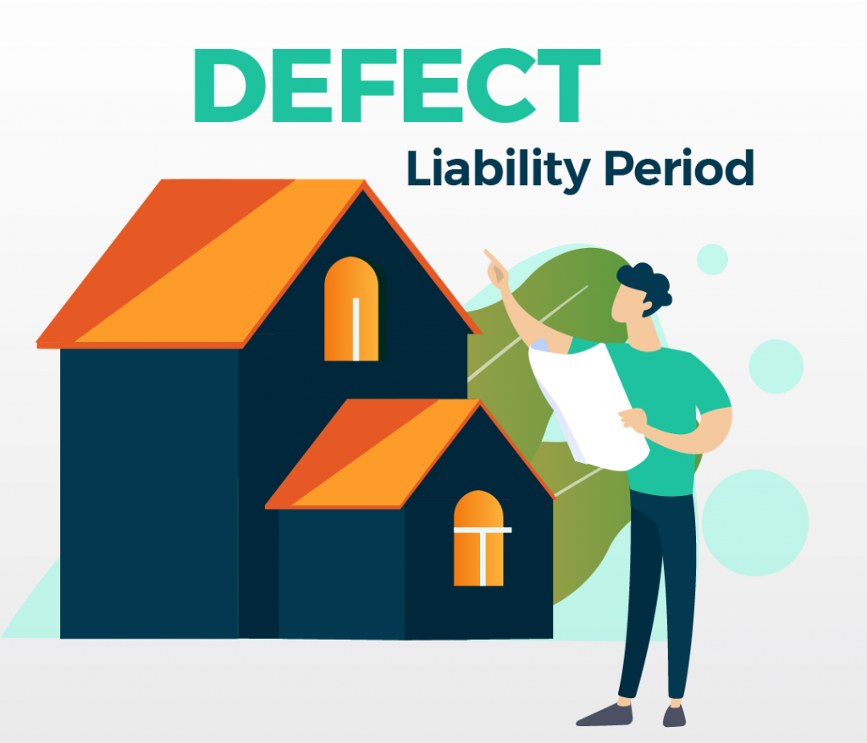
Liability after Transfer of Possession
Any structural defect or defect in workmanship, quality, or provision of services must be reported to the promoter within 5 years from the date of possession.
The promoter must rectify such defects without additional charge within 30 days.
If the promoter fails to rectify the defects within the specified time, the allottee is entitled to receive appropriate compensation.

Slide 50

Takeover of Project
The promoter cannot transfer or assign majority rights and liabilities to a third party without:
  Prior written consent from two-thirds of the allottees
  Prior written approval from the RERA Authority
The new promoter assumes all pending obligations and liabilities of the erstwhile promoter.
The transfer or assignment does not affect existing allotments or sales.

Slide 51

Penalty on Non-fulfillment
Punishment for contravening any provision of the Act or rules or regulations thereunder, except provisions of Sections 3 and 4 in respect of which consequences are provided separately in terms of Section 61. Such contravention is made punishable with penalty which can be up to an amount equal to 5% of the estimated cost of the project as determined by the RERA.
DEVELOPER

Slide 52
WBRERA: Current Challenges & Compliance Preparedness
Current Gap: No Clear SOP
WBRERA currently do not have standardized procedures for:
Project Modifications: No defined process for updating project details in RERA
Promoter Detail Changes: Unclear guidelines for promoter information updates on RERA Portal
Takeover of Project by Third Party: Unclear guidelines for such update on RERA Portal
Bank Account Updates: No standard procedure for updation of project bank account changes on RERA Portal
Map Revisions: Lack of clarity on update processes for updating revised sanctioned map on RERA
Project Completion Compliance: Undefined requirements for completion documentation for updating project completion status on RERA Portal
Association of Allottees: No clear process for updating details about Association of Allottees
Expected Development: WBRERA will introduce comprehensive SOPs with clear fee structures for all update processes in near future
Action Plan: Be Prepared
Promoters & consultants must maintain comprehensive documentation:
Complete Modification Records: Document every change, from minor to major project modifications
Allottee Consents: Obtain and preserve allottee approvals for relevant changes
Professional Certifications: Bank account changes, withdrawal and other certificates from authorized professionals
Completion Documentation: Occupancy Certificate, completion certificates per building bye-laws
Association Formation Proof: Evidence of allottee association formation and common area handover
Project-Specific Records: All other applicable documents as per project requirements
🎯 Strategic Advantage: Proactive documentation today ensures seamless RERA compliance when SOPs are released

Slide 53
RERA: Latest Judgements

Slide 54
Punjab National Bank vs. Asish Kumar Pradhan & Another
(17 November 2025)
Appeal No 26/2024, OREAT
Facts and Background
Project was to be completed within 24 months, i.e., by November 2015, but remained incomplete.
Buyer filed complaints before Orissa RERA seeking possession, interest for delay, and compensation.
ORERA’s Directions: Developer to accept the balance consideration and complete the project within 2 months, along with issuance of Completion Certificate/Occupancy Certificate. Developer to pay interest until actual delivery. Bank restrained from auctioning the flat.
A subsequent appeal by the bank was also rejected; both RERA and REAT upheld the bar on auctioning.
Buyer paid ₹41,33,538 through deposits made in November 2013.
Homebuyer purchased Flat No. 55 (Type-E) in the project “Ganapati Homes”; Agreement executed on 14.11.2013.

Slide 55
Flat not completed despite 10+ years; no occupancy/completion certificate issued
Issues and Observations
Promoter agreed to compensation Rs.10,000/month (Nov 2016) but paid nothing
Promoter mortgaged project to Punjab National Bank (Rs.460 lakhs) on 08.02.2014, triggering SARFAESI proceedings
Key Question: RERA Act vs SARFAESI Act conflict – Which prevails?
Fraudulent Mortgage: Bank proceeded despite knowledge of prior sale agreement (deemed collusive)

Slide 56
Conclusion and Impact
RERA Act overrides SARFAESI Act when transactions are collusive
Bank cannot auction flat under SARFAESI Section 13(4)
ORERA to oversee completion via external developer through public tender
Homebuyer rights prioritized over secured creditor claims when collusion exists
Precedent Set: Confirms homebuyer protection is paramount in RERA jurisdiction
This landmark decision provides relief to buyers, ensuring that their long-awaited homes may still be delivered and that banks cannot ignore the rights of existing allottees when recovering a builder's debt.

Slide 57
Mantri Developers Pvt. Ltd. v. Snil Pathiyam Veetil
(31 October 2025)
Writ Petitions No. 17821, 18348 & 19184 of 2025,
High Court of Karnataka, Bengaluru
Facts and Background
Parties: Mantri Developer Pvt. Ltd. (Petitioner/Judgment Debtor) vs. three homebuyers - Snil Pathiyam Veetil, Indi Vivekananda, and Mudit Saxena (Respondents)
Background: Homebuyers approached RERA seeking relief and obtained favorable orders on 30-06-2023 and 03-08-2023
Execution: Respondents filed execution petitions in Civil Court to enforce RERA orders
Challenge: Petitioner filed Section 47 CPC applications contesting the Court's jurisdiction to execute RERA orders

Slide 58
Issues and Observations
Petitioner's Argument: RERA Act is self-contained code; Section 79 bars civil court jurisdiction; Section 40 mandates recovery as land revenue arrears
Court's Finding: RERA orders are NOT decrees under Section 2(2) CPC because proceedings are complaint-based, not suit-based
Key Principle: Recovery must follow RERA's prescribed mechanism - execution before Tahsildar as land revenue arrears, not civil court execution
Core Issue: Whether RERA orders can be executed through civil court execution petitions under Order XXI CPC

Slide 59
Conclusion and Impact
Outcome: Writ Petitions ALLOWED; impugned orders dated 17-04-2025 QUASHED
Ruling: Civil courts lack jurisdiction to execute RERA orders; execution must follow RERA's statutory mechanism (Section 40 & Rule 26)
Impact: RERA orders must be enforced through revenue recovery (arrears of land revenue) or RERA's execution machinery, not civil court proceedings
Remedy: Respondents retain all remedies available in law under RERA Act framework

Slide 60
Surendra G. Shankar vs. Esque Finamark Pvt. Ltd.
(22 January 2025)
Civil Appeal No. 928 of 2025, Supreme Court of India
Facts and Background
The appellants were homebuyers in Mumbai real estate projects “Lodha Venezia” and “Lodha Azzuro.” They filed complaints before Maharashtra RERA seeking possession of their flats. RERA discharged one developer citing no privity of contract, and subsequently dismissed the complaints. The appellants filed appeals, which were delayed. Both the Maharashtra Real Estate Appellate Tribunal and Bombay High Court refused to condone the delay and commented on the merits of the case.

Slide 61
Courts should generally condone delays unless bad faith or deliberate negligence is shown.
The High Court wrongly commented on merits while only the delay issue was before it.
Supreme Court set aside previous orders refusing delay condonation and restored the appeals.
Appellate courts deciding delay condonation must focus only on delay, not merits of the case.
Issues and Observations

Slide 62
Conclusion and Impact
Appellate Tribunal directed to hear appeals on merits afresh.
Protects homebuyers from dismissal on procedural grounds ensuring substantive justice

Slide 63
Uttar Pradesh Real Estate Regulatory Authority vs. Larsen & Toubro Limited
2025 SCC OnLine SC 1750, Judgment dated 13 August 2025
Facts and Background
Larsen & Toubro (L&T) was the sole developer of the Green Reserve project in Noida. The project registration application was pending with UPRERA beyond the mandated 30-day period. UPRERA issued a notice alleging violations for selling flats without registration. L&T challenged the notice in the Allahabad High Court.

Slide 64
Whether L&T alone qualifies as the “promoter” under RERA or if the landowner must also be added.
Issues and Observations
Whether the project is deemed registered under Section 5(2) due to UPRERA’s delay in decision-making beyond 30 days.
Validity of UPRERA’s notice alleging sale without registration and restrictions on sales.
Supreme Court upheld Allahabad High Court’s finding that L&T is solely responsible as promoter for construction, sale, and marketing.
Confirmed project deemed registered due to UPRERA’s failure to decide within statutory timeframe.

Slide 65
Conclusion and Impact
Strengthens developers’ rights when regulatory delays occur.
Affirms automatic project registration if RERA fails to timely respond under Section 5(2).
Protects ongoing sales during administrative delays, offering market stability.
Directs UPRERA to comply with High Court orders within 3 weeks

Slide 66
Amit Garg vs Karnataka Real Estate Regulatory Authority & Anr.
Writ Petition No.34471 of 2024, Karnataka High Court, Judgment dated 10 April 2025
Facts and Background
Amit Garg, a homebuyer, filed a complaint under Karnataka RERA alleging deviations from sanctioned building plans. The Karnataka RERA Registry rejected the complaint via email on maintainability grounds without placing it before the RERA Authority. Amit Garg challenged this rejection, arguing that the Registry lacked jurisdiction to decide maintainability.

Slide 67
Whether the RERA Registry has the power to decide the maintainability of complaints.
Issues and Observations
The Registry’s rejection by email was held illegal and without jurisdiction.
The Court relied on Supreme Court precedent (P. Surendran v. State, 2019) affirming that the Registry can perform only administrative functions.
Maintainability is a judicial function reserved for the RERA Authority, not an administrative function of the Registry.

Slide 68
Conclusion and Impact
The Court quashed the Registry’s rejection email and restored the complaint for proper hearing by the RERA Authority. This ruling protects homebuyers’ rights to fair adjudication, prevents administrative overreach, and strengthens procedural safeguards in RERA proceedings.

Slide 69
Rajnesh Sharma v. M/s Business Park Town Planners Ltd.
Civil Appeal No. 3988 of 2023 | Supreme Court of India | Judgment Date: 24 September 2025
Facts and Background
Rajnesh Sharma booked a residential plot in the “Park Land” project in March 2006 for about ₹36 lakh, paying over ₹43 lakh including extra charges. Possession was promised within two years but was not delivered even after multiple delays and alternative plot allotments. The builder charged 18% penal interest on late payments by Sharma but failed to compensate him at the same rate for delay caused by the builder. Sharma terminated the agreement in 2017 and filed a consumer complaint seeking refund and compensation.

Slide 70
The Supreme Court sharply increased the refund interest to 18% per annum, doubling the 9% interest earlier awarded by the NCDRC.
Observations and Judgment
The Court noted the builder charged 18% interest on Sharma for delays but sought to escape liability by offering only 9% interest on its delay — a one-sided bargain rejected by the Court.
The decade-long delay, arbitrary alternative allotment, and harassment to the buyer warranted the enhanced interest rate.
The builder must refund the entire amount paid along with 18% interest and pay ₹25,000 litigation costs within two months.

Slide 71
Conclusion and Impact
The ruling significantly strengthens homebuyer protection by holding builders accountable for delayed possession with a matching penal interest rate. It sets a precedent preventing builders from escaping higher compensation liability while charging buyers heavy penal interest for payment delays.

Slide 72
Mansi Brar Fernandes v. Shubha Sharma & Anr.
2025 SCC OnLine SC 1518601 | Judgment Date: 12 September 2025
Facts and Background
The Supreme Court declared the right to housing as a fundamental right under Article 21 of the Constitution, going beyond mere contractual entitlements. The case involved speculative investors disguised as homebuyers, with the Court distinguishing genuine allottees entitled to possession. It highlighted the widespread crisis of unfinished housing projects affecting millions of middle-class Indians, leading to financial distress and loss of dignity.

Slide 73
The Court underscored that Governments and RERA authorities must actively protect homebuyers and be adequately empowered.
Observations and Judgment
States are required to ensure full staffing, resources, and accountability for RERA authorities.
The Court ordered the formation of a high-level committee for systemic reforms in real estate regulation and resolution.
Real estate insolvency processes must protect homebuyers on a project-by-project basis.
Speculative investors cannot abuse insolvency laws but may recover the principal amount.

Slide 74
Conclusion and Impact
This landmark ruling elevates housing to a constitutional right to life, demanding stronger RERA enforcement and regulatory reforms to protect genuine homebuyers. It signals a paradigm shift connecting urban development, economic policy, and constitutional mandates, with a binding call for systemic reform.

Slide 75
Revanta Multistate CGHS Ltd. v. Sunny Sapen
Delhi High Court | RERA Appeal No. 1/2024 | Judgment Date: 30 May 2025
Facts and Background
The appellant Society challenged a Real Estate Appellate Tribunal order which dismissed their appeal against a Real Estate Regulatory Authority (RERA) order. The original complaint involved disputes over allotment and possession issues related to the Society’s real estate project in NCT Delhi.

Slide 76
The Delhi High Court evaluated the scope of RERA authority and Appellate Tribunal powers concerning consumer and allottee complaints.
Observations and Judgment
The Court emphasized strict compliance with RERA procedural mandates and the importance of adhering to statutory timelines.
It held that the Tribunal’s order lacked sufficient grounds and deserved reconsideration based on the merits.
The appeal was dismissed with costs, emphasizing the need for proper cause in disputes before RERA authorities.

Slide 77
Conclusion and Impact
This judgment underscores the crucial role of procedural fairness and reasoned adjudication at RERA authorities and appellate levels. It highlights that while RERA protects homebuyers, appeals to higher fora must be properly substantiated to avoid frivolity.

Slide 78
Key Professional Opportunities for Chartered Accountants under RERA

Slide 79


Eligibility and Role of CA in RERA Certification
Eligibility Criteria: Only Chartered Accountants (CAs) with a valid COP are authorized to issue the RERA certification.
Role of CAs in RERA Certification:
Different CAs must be appointed for withdrawal certification and annual audit certification to ensure independence and impartiality.
Involvement of the same CA in both roles (audit and withdrawal certification) can lead to conflicts of interest, impacting the credibility of the certification.
The CA issuing withdrawal certification ensures that withdrawals are aligned with the project's progress.
The statutory auditor conducts the annual audit and ensures: Maintenance of project’s separate bank account, Correct use of allottee funds as per RERA regulations, Verifies accuracy of all certificates issued by professionals during the year
These certifications are crucial for stakeholders to assess project progress.
They can also be used as evidence in court in case of disputes or legal scrutiny.

Slide 80
Pre-RERA Registration: Project Cost Estimation
Assist developers in preparing accurate cost estimations for projects before RERA registration.
Help developers plan project budgets and financial projections to ensure financial viability.
RERA Registration Compliance
Ensure compliance with RERA registration requirements, including documentation and submission.
Support developers in completing the registration process for projects under RERA guidelines.
Post-RERA Registration Compliance
Quarterly & Annual Project Reports: CAs assist developers in filing quarterly and annual project reports as required by RERA.
Certification: Provide annual and quarterly certifications verifying project progress and compliance with RERA.
Maintenance of Project Accounts: Ensure accurate maintenance of separate bank accounts for each project.
Drafting of Legal Documents
Assist in the drafting of legal documents such as:
Joint Development Agreements
Agreements for Sale
Sale Deeds
Ensure that these documents comply with RERA regulations and protect the interests of all parties involved.
Project Completion Compliance
Ensure compliance with RERA requirements for project completion.
Assist in the preparation and certification of project completion reports if any to be submitted with RERA at the time of completion as per specific state RERA regulations.

Slide 81
Formation of Association of Allottees (AOA)
Guide in the formation and registration of the Association of Allottees (AOA) as per RERA requirements.
Support in ensuring smooth handover of the project and resolving issues related to the allottee’s rights.
Litigation and Dispute Resolution
Represent developers, allottees, or real estate agents in RERA-related litigation.
Provide expert advice and support in handling RERA disputes regarding project delays, payments, and contractual matters.
Real Estate Agent Compliance
Registration and Renewal: Help real estate agents comply with RERA registration and renewal requirements.
Books of Accounts: Ensure agents maintain proper books of accounts for their transactions and business activities.
Consumer Protection and Support for Investors
Assist allottees and investors in understanding their rights under RERA.
Provide advisory services on investment in real estate projects, helping investors navigate legal complexities and avoid potential risks.
Cost Management and Financial Advisory for Developers
Advise developers on cost control, budgeting, and financial planning throughout the project lifecycle.
Ensure effective financial management, helping developers stay within budget and meet RERA timelines.

Slide 82

Skills Needed for CAs to Capitalize on RERA Opportunities
In-depth Knowledge of RERA Act & State RERA Regulations:
  Chartered Accountants must keep themselves updated on the latest amendments and rules under RERA.
In-depth Knowledge of Building Bye Laws & Other Real Estate Sector Related Regulations:
  Chartered Accountants must be familiar with state-specific real estate sector regulations.
Financial Management Skills:
  Ability to manage, audit, and certify large-scale real estate projects and transactions.
Legal and Contractual Understanding:
  Familiarity with real estate contracts, joint ventures, and builder-buyer agreements.
Real Estate Valuation Skills:
  Understanding of property valuation, project costing, and land assessments.
Chartered Accountants need to possess a combination of technical, financial, and legal skills to capitalize on RERA opportunities.

Slide 83
Q&A
Session

Slide 84


Thank you
Scan to Connect on Linkedin
Disclaimer
Every effort has been made to provide an overview of the key provisions of the law. However, the material presented is not exhaustive and may include generalizations. For the most up-to-date provisions and notifications, it is advised to refer to the latest legal texts. The presenter does not accept responsibility for any loss or damages incurred as a result of actions taken based on the information provided in this presentation.
CA. Amit Kumar Kedia
(Partner)
Gopal Sharma & Company
Mobile: +91 94140 46121
Email: ca.amitvkedia@gmail.com

