Slide 1
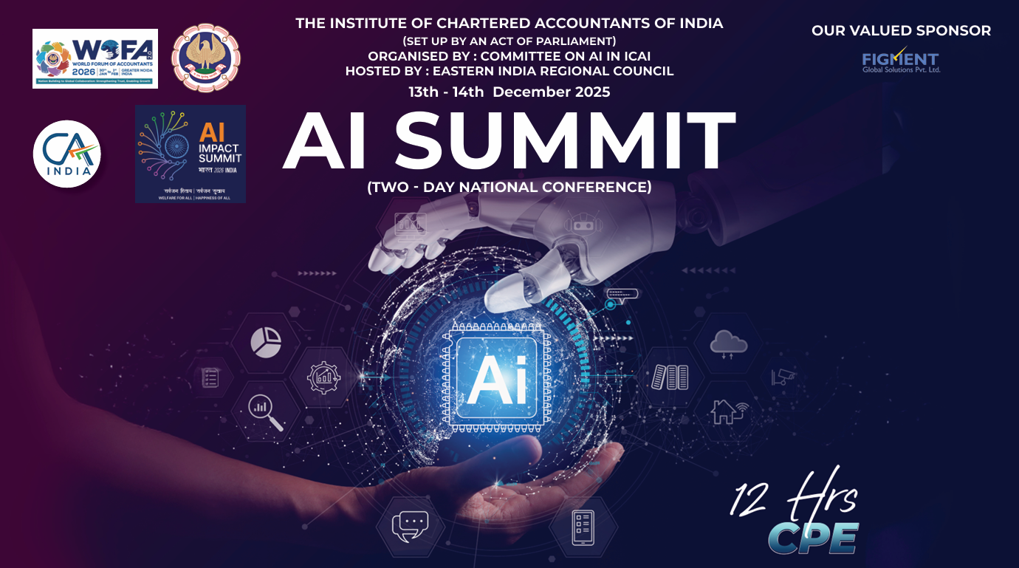

Slide 2

Day 1

Slide 3
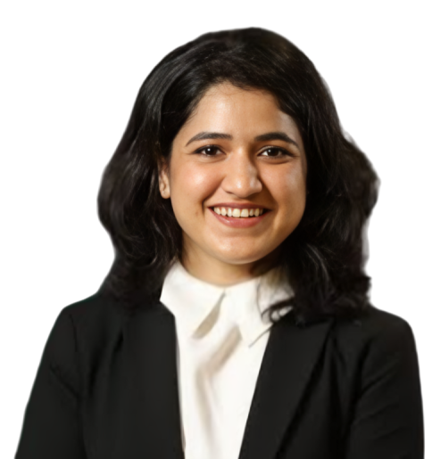
CA Vanika Choudhary, ACA, DISA, and Certified CSR Professional, is a Partner at VCH & Co., where she specializes in statutory audits and financial due diligence across the mining, manufacturing, services, and restaurant sectors. She leverages AI automation, Excel, Power Query, and Google Automation to enhance audit precision, streamline processes, and deliver data-driven insights that support sound business decisions, particularly for startups and MSMEs. Known for her ability to simplify complex audit procedures and identify the minimum effective approach for maximum accuracy, she also serves as a trainer and speaker, having conducted workshops for over 300 Chartered Accountants on integrating AI and Excel to automate tasks, improve data analysis, and strengthen audit quality. A Commerce graduate and technology-driven professional, she is committed to helping practitioners adopt proven systems and audit playbooks that boost efficiency and free up time for higher-value work.
CA. Vanika Choudhary

Slide 5
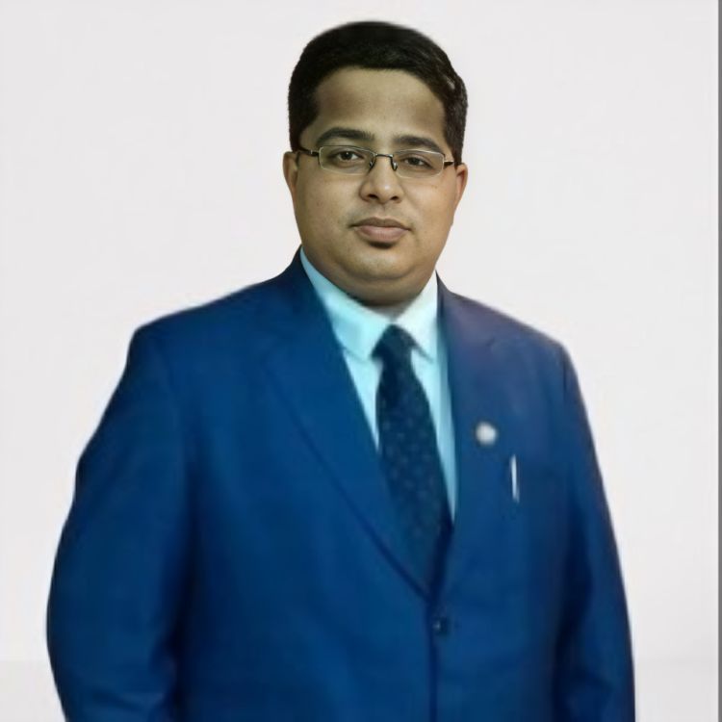
CA Shreyansh Kothari, FCA, CS, and B.Com (Hons.), is a Fellow Chartered Accountant, qualified Company Secretary, and Commerce graduate, with an ICAI Certificate in Artificial Intelligence (Level 1). He is a Partner at M/s R. K. Kankaria & Co., Kolkata, and has over seven years of post-qualification experience in statutory and tax audits, GST analytics, corporate restructuring, and independent representations before the NCLT in merger and amalgamation matters. Known for his strong technology orientation, he integrates Excel automation, Power Query, VBA, Python, Google Apps Script, and AI-driven workflows into audit, compliance, and reporting processes, and has developed a range of automation tools for GST extraction, reconciliation, audit analytics, and financial statements. He leads the firm’s digital transformation initiatives through practice-management systems, SOP development, and structured training on AI and automation. He also serves as Faculty for ICAI’s AURA Programme (BoS–Operations) and is a regular speaker at ICAI platforms on AI, automation, and data-driven compliance.
CA. Shreyansh Kothari

Slide 7
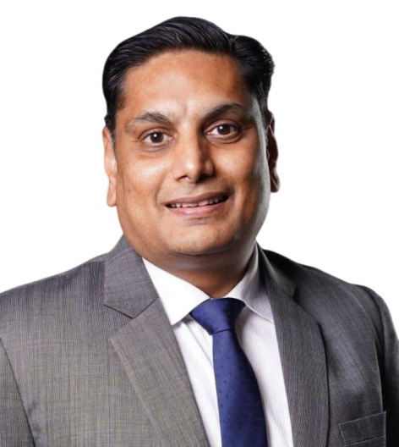
Treasurer, EIRC
CA. Aditya Maheshwari

Slide 9
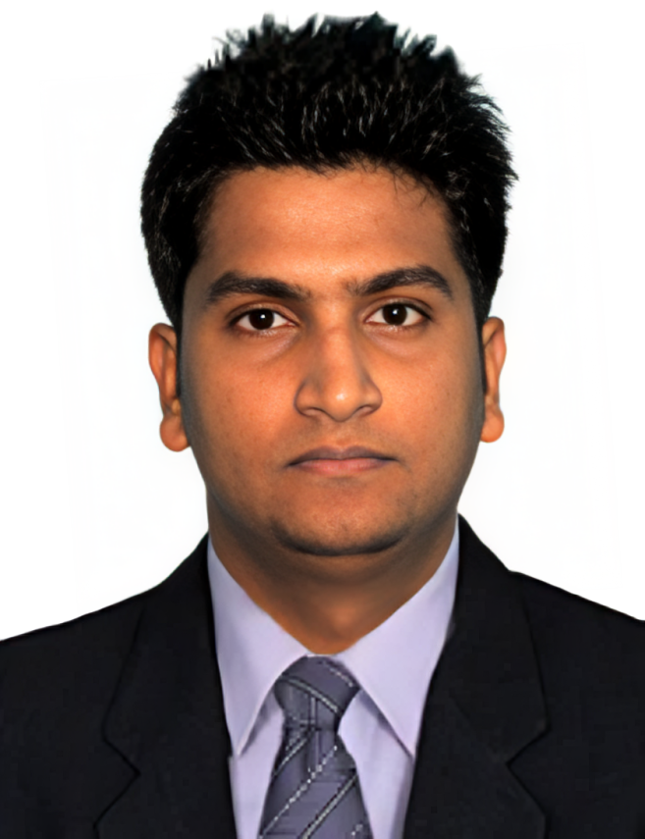
CA Prateek Kumar Khemka is a seasoned finance professional with strong expertise in Artificial Intelligence, Robotics, Data Analysis, and Business Intelligence tools such as Excel and Power BI. A Fellow Chartered Accountant (FCA) and a Bachelor of Commerce (Honors) graduate, he is also a Certified Concurrent Auditor and an Associate Member of the Association of Certified Fraud Examiners (ACFE), underscoring his capabilities in risk management, auditing, and financial analysis. As the founder of Khemka Prateek and Co., established in 2017, he has been instrumental in delivering strategic financial and technological insights to businesses, seamlessly integrating financial acumen with advanced analytical tools to support data-driven decision-making. His professional interests include AI-driven financial solutions, automation in auditing, and business intelligence reporting, with a particular focus on transforming raw data into actionable insights. While relatively new to the speaker circuit, he is committed to sharing his practical knowledge of AI, data analytics, and automation with professionals and students, simplifying complex concepts and offering practical strategies to enhance accuracy and efficiency in financial reporting and business decision-making.
CA. Prateek Kumar Khemka

Slide 11

Day 2

Slide 13
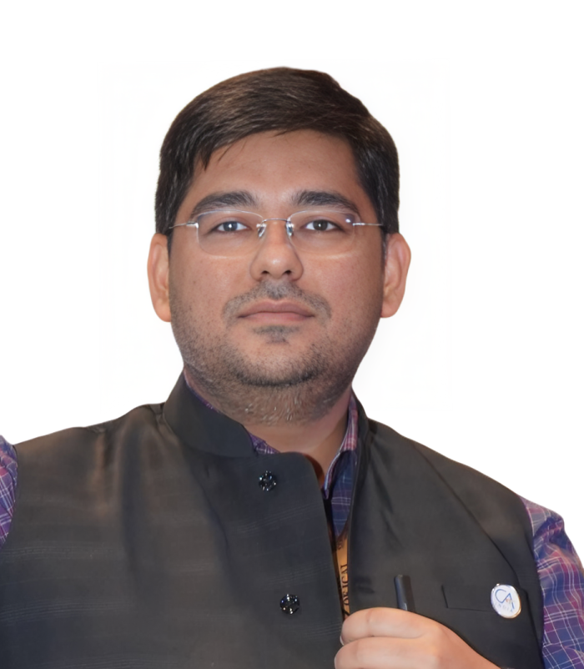
CA Sumit Bihani, FCA, DISA, is a seasoned Practising Chartered Accountant and a Partner at MBRM & Associates, where he has been associated since 2014. He holds additional professional credentials from the Institute of Chartered Accountants of India, including certifications in Forensic Audit and Fraud Detection (FAFD) and Concurrent Audit of Banks. His professional expertise spans Internal Audits, shared CFO services for startups, and Third-Party Audits, and he has played a key role in facilitating fund-raising for a client featured on Shark Tank India. CA Bihani has conducted numerous seminars and training programmes on Generative AI, MS Office, and Google Workspace, empowering over 1,000 finance professionals to automate processes and significantly reduce manual effort. He has also contributed to the profession through committee roles, serving as a Co-opted Member of the Committee on AI in ICAI (2024–25) and being associated with several committees of the Eastern India Regional Council of ICAI.
CA. Sumit Bihani

Slide 15
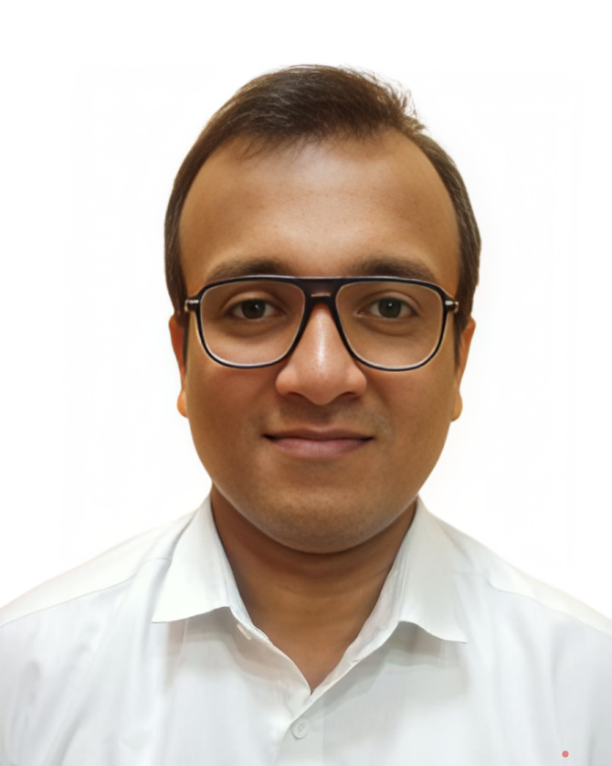
CA Sunny Agarwal, qualified as a Chartered Accountant in November 2015 and has developed a robust expertise in the field of taxation, with a focus on Goods and Services Tax (GST). After gaining valuable experience for two years in the iron and steel manufacturing company, he embarked on a new journey by establishing his own practice.
He has specialized in tailoring his services to meet the needs of a diverse client base, including Public Sector Units, the hospitality industry, and companies in the metals and pharmaceutical sectors.
CA. Sunny Agarwal

Slide 17
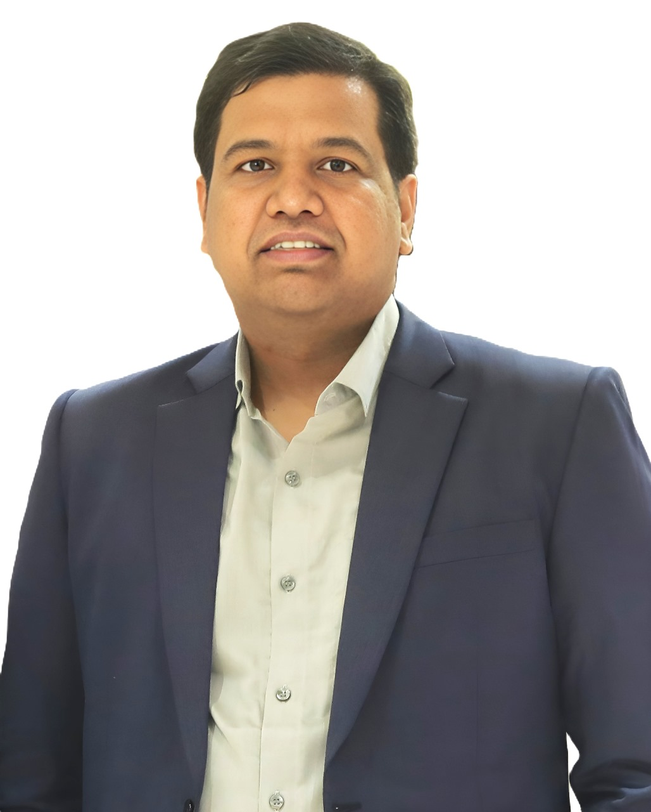
CA Abhishek Agarwal is a Practicing Chartered Accountant and proprietor of A B Agarwal & Associates, with professional experience since 2018. He is DISA-qualified and has completed the Diploma in Insurance Risk Management (DIRM), along with certifications as a Certified Concurrent Auditor and in Forensic Accounting & Fraud Detection (FAFD), in addition to being AICA Level-1 certified. He has also pursued multiple advanced certifications in Artificial Intelligence, Generative AI, and Prompt Engineering. His practice focuses on providing Accounting Services to MSMEs, with a specialization in Office Automation and System Implementation. He has a strong professional interest in Internal Audits, Forensic Audits, Fraud Investigations, and Systems Audits, and remains committed to continuous learning in the evolving domains of finance and technology. An enthusiastic advocate of AI, he firmly believes in its potential to transform the accounting profession and empower professionals to achieve exceptional outcomes.
CA. Abhishek Agarwal

