Slide 1
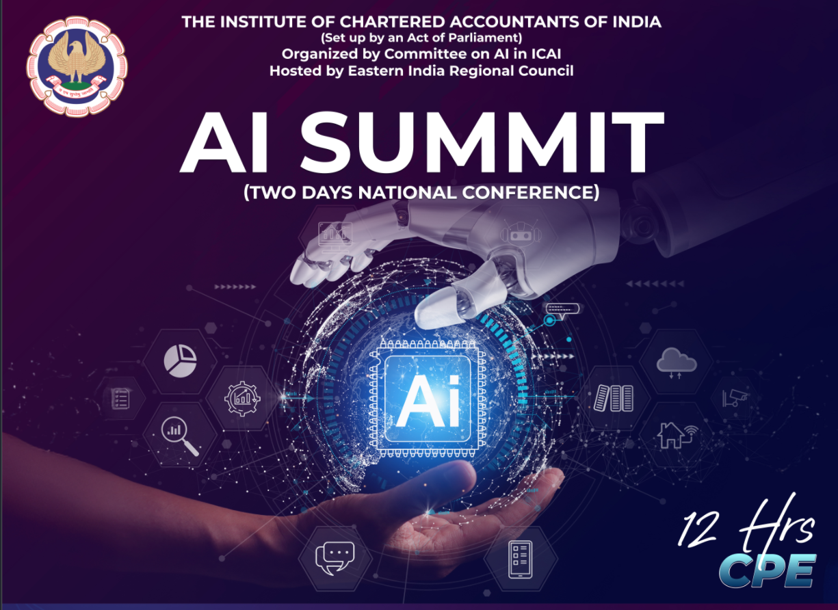

Slide 2
Role of AI
In GST
Compliance & Litigation
AI Summit
2 Days National Conference
14th Dec 2025
CA Venugopal Gella
Venu and Vinay
Chartered Accountants

Slide 3


Agenda
2
Compliance Improvement
Notice Types
Cases in Litigation
Use of AI

Slide 4
Technology is the Future and, it is
Integral part of GST Practice
Lets begin with basics
Notes:
How should the compliance system be, lets explore

Slide 5
Overview of GST Advanced Compliance
GST Return Compliance means
  timely and accurate filing of all GST returns prescribed under the law,
  ensuring correct tax reporting and reconciliation.
Importance:
  Avoids penalties, late fees, and interest.
  Ensures uninterrupted Input Tax Credit (ITC) flow.
  Builds trust with vendors & authorities.
Key GST Return Forms
Filing | Viewing/Compliance
GSTR 1 | IMS
GSTR 1A | GSTR 2A
GSTR 3B | GSTR 2B
GSTR 9/9C | TDS and TCS Credit received

Slide 6
Overview of GST Advanced Compliance
Compliance Requirements:
  File within due dates as per turnover & return type.
  Ensure reconciliation between GSTR-1, GSTR-3B, GSTR-2B, and books of accounts.
  Pay tax promptly at the time of filing GSTR-3B to avoid late fees & interest.
  Report NIL returns if there is no business activity.
  Maintain records for at least 6 years from the due date of annual return
Penalties for Non-Compliance:
  Late fee: ₹50/dayper return. (₹20/day for NIL return)
  Interest @ 18% p.a. on delayed tax payment.
  Possible ITC reversal & blocking of e-way bill generation.
Automation is the Future of GST Compliance

Slide 7
What is Artificial Intelligence (AI)?
Simulation of human intelligence by machines
Includes learning, reasoning, problem-solving
Subsets: Machine Learning, NLP, Computer Vision
Used across governance, finance, and compliance
Notes:
“AI simulates human intelligence. It learns from data, recognizes patterns, and predicts outcomes.
Think of it like a smart officer who remembers every case file, learns from past patterns, and instantly connects the dots.
AI includes branches like:
Machine Learning – systems that learn from data without explicit programming.
Natural Language Processing – reading and summarizing documents or circulars.
Computer Vision – interpreting scanned invoices or signatures.
Example: The Income Tax AIS portal uses AI to automatically show all your incomes — salary, interest, dividends — by reading data from multiple sources.”

Slide 8
Understanding new Compute
Traditional Computing
DATA
COMPUTER
OUTPUT
PROGRAM
Artificial Intelligence Computing
DATA
COMPUTER
PROGRAM
OUTPUT

Slide 9
Why AI?
Use cases in daily activites of audit assessments and adjudication

Slide 10
Smart Reconciliations
A. Types of Reconciliation
  GSTR-2B vs Purchase Register
  GSTR-1 vs GSTR-3B (outward supplies)
  E-invoice vs GSTR-1
  E-way bill vs GSTR-1 & GSTR-3B
B. Intelligent Matching Logic
  Exact match vs fuzzy match (name, GSTIN, invoice number)
  Handling invoice number variations (spaces, slashes, leading zeros)
  Partial matching for consolidated invoices
Manual>>Software>>Integrated

Slide 11
Smart Dashboards
Turnover & tax liability trends
Vendor compliance scoring (based on filing history)
Input tax credit utilisation patterns
Detecting anomalies & fraud risks
Dashboards for management – Power BI, Google Data Studio

Slide 12
Why AI in GST?
Handle Volume
  Large data volume – millions of invoices monthly – Single client
  Business Expansion – Handle multiple clients
Be Vigilant and better Tax Compliance
  AI helps analyze anomalies in filings
  Detects fake invoices and suspicious behavior
  Improves tax compliance and enforcement
ASP / GSP Tools in the Market
  GSTZen, Cygnet, IRIS, Clear Tax
Notes:
Highlight how AI improves the effectiveness of GSTN and SGST officers by providing actionable insights.
“In GST, we have:
Enormous data (returns, e-way bills, invoices).
Complex compliance rules.
Need for early fraud detection.
AI helps bridge these. For instance:
When a taxpayer claims high ITC compared to turnover, AI flags it for scrutiny.
Invoices from suspicious networks are auto-identified for officers’ attention.
AI is not here to replace us, but to make our decision-making faster, more precise, and data-driven.”

Slide 13
Applications of AI in GST
Monitoring system currently implemented by GST Department
  Registration risk profiling
  Invoice-level anomaly detection
  E-way bill and return reconciliation
  Predictive analytics for tax evasion
  Risk-based audit selection
Notes:
Use examples: GSTN’s risk rating system, AI-based return validation, and predictive models for non-filers.
“Here’s where AI is already being applied:
1️⃣ Risk profiling of registrations — AI checks PAN, Aadhaar, address, past history, and cross-verifies documents to approve or flag.
2️⃣ Invoice Anomaly Detection — AI finds mismatches in invoice number sequences or tax computation errors.
3️⃣ Return Reconciliation — cross-verifies GSTR-1 vs GSTR-3B vs 2B automatically.
4️⃣ Predictive analytics — predicts sectors likely to default next month based on past data.
Example: GSTN’s AI engine recently identified over 10,000 suspicious taxpayers whose filings showed signs of circular trading.”

Slide 14
AI for Risk Assessment & Compliance
ASP Tools can help in
  Pattern recognition to detect irregularities
  Automated compliance validation
  Fraud detection using ML models
  Adaptive risk management for evolving threats
Notes:
Discuss how AI identifies high-risk taxpayers and anomalies. Mention real-world examples like Rule 86B, 88C alerts.
“AI assists in four key compliance areas:
Pattern Recognition: Finds hidden relationships among entities, e.g., common directors across fake firms.
Automated Compliance Checks: Flags non-filers, mismatch cases, or Rule 86B violations.
Fraud Detection: Machine Learning models analyze high-value transactions and compare with historical norms.
Adaptive Learning: The model continuously learns — if new fraud tactics appear, AI evolves.
Example: During GST audit selection, AI helps officers focus on high-risk cases instead of random selection.”

Slide 15
Predictive Analytics in GST
Suggested approaches for the tax payer
  Forecast revenue trends
  Identify sectors with growing non-compliance
  Suggest corrective policy interventions
  Improve data-driven decision making
Notes:
Mention ARIMA or ML models predicting tax revenues. Highlight how AI can aid in resource allocation and policy adjustments.
“Predictive analytics answers — ‘What will happen next?’
Using models like ARIMA or Regression, we can forecast revenue or detect unusual trends.
Example:
If AI sees a consistent dip in output tax from a region while e-way bills remain high, it predicts possible under-reporting.
The finance department can plan resource allocation or inspections accordingly.
Globally, tax agencies like HMRC (UK) and IRS (US) already use such models to improve audit yield.”

Slide 16
Natural Language Processing (NLP)
Use in Litigation Practice
  Summarizes GST notices, circulars
  Translates multi-language taxpayer communication
  Converts voice to inspection notes
How to use
  Client Communication and Reporting
  Training and Development
  Case Preparation
Notes:
Show example: Use AI tool like ChatGPT or Gemini to summarize an SCN or translate a tax circular.
“NLP is AI that understands language — written or spoken.
For officers, this means:
Automatic summarization of SCNs or orders.
Translation of notices between English and regional languages.
Voice dictation for inspection reports.
Example: You can upload a 20-page judgment into ChatGPT and get a 10-line summary of key findings.
It saves time and helps you focus on insights rather than reading every page.”

Slide 17
Tools to explore
NoteBook LM
Dante Ai / BOT Press
Chat GPT
Claude

Slide 18
Watch for ?

Slide 19
Key Don'ts of AI Implementation
Don't Rely Solely on AI
Don't Expect Perfection
Don't Ignore Ethical Considerations
Don't Neglect Data Privacy and Security
Don't Overlook the Human Factor
Don't Assume AI is a Silver Bullet
Don't Ignore the Need for Continuous Monitoring

Slide 20
Risks in AI Implementation
Prompt injection involves manipulating AI systems by injecting malicious instructions into user prompts.
Sensitive Information Disclosure

Slide 21
Responsible AI and Data Privacy
DPDP Act 2023 ensures data protection
  Imposes penalties up to ₹250 Crores for non-compliance.
Ethical use of taxpayer data
Transparency and accountability
Compliance with ISO 42001 AI management standards
Notes:
Stress importance of secure and explainable AI systems in government tax departments.
“As AI becomes powerful, we must use it responsibly.
The Digital Personal Data Protection Act (DPDP) 2023 ensures taxpayer data isn’t misused.
Key principles include:
Collect only necessary data.
Use anonymization when training AI models.
Keep an audit trail of how data is used.
ISO 42001 now provides a framework for ‘AI Management Systems’.
Example: If AI flags a taxpayer, there must be explainability — we should know why it was flagged, not just trust the machine blindly.”

Slide 22
Summary & Way Forward
AI augments CA’s/ GST officers,
  not replaces them
Helps identify risks, ensure compliance
Future:
  integrated AI dashboards and fraud detection engines
Stay curious, stay adaptive
Notes:
Close with an inspiring message — AI is a tool for smarter governance. Encourage officers to explore practical AI tools.
“Let’s summarize:
AI helps detect risk early.
It improves compliance efficiency.
It supports faster and more objective decision-making.
But remember — AI is only as good as the data we feed it.
Our role as officers is to ensure data integrity, interpret AI insights with professional judgment, and make fair decisions.
Think of AI as your junior officer who never sleeps, never forgets, and keeps learning.
The future of tax administration will be hybrid — human intelligence powered by machine intelligence.”

Slide 23


THANK YOU
Clarifications mail to venu@vnv.ca
9341979798
For GST UPDATES https://chat.whatsapp.com/LYx7qHWefQkBXwnsVgqqQH
Learning is the quiet power that outlives every trend.

