Slide 1
Application of AI in Fraud and Risk Management of Digital Payments
AI National Conference
14th December, 2025
www.rssoftware.com
Notes:
Monthly UPI Transaction: Vol = 20B, Val = ₹25 LC
Decline: Vol = 10.2%, Val = 16%
Alert: Vol = 0.6%, Val = 0.6%

Slide 2
Fraudsters are Ready ! We better be
AI powered fraud attempts
42% - 50%
Signicat 2024
Feedzai 2025
Account takeover attacks aided by AI
59%
Sift 2024
Account opening attacks executed with or aided by AI tools
58%
KYC bypass/using deepfakes to fool KYC systems
54%
Generative AI email fraud losses projected to reach $11.5 billion by 2027
Notes:
AI powered fraud attempts : 42% - 50% [Signicat 2024, Feedzai 2025]
Phishing emails written with AI tools : 61% [Sift 2024]
Account takeover attacks aided by AI : 59%
Account opening attacks executed with or aided by AI tools : 58%
Synthetic identity fraud using AI-generated identities grew 45% recently.
KYC bypass/using deepfakes to fool KYC systems : 54%
Payment fraud executed with or aided by AI tools : 49%
Deepfake technology aids in approximately 7% of social engineering scams
Generative AI email fraud losses projected to reach $11.5 billion by 2027

Slide 3
Customer Lifecycle on Digital Platforms
AUTHORIZE
SETTLEMENT
Onboard
Transact
Offboard
Risk
Risk
R
Identity Fraud : 78%
Account Take Over
Increased by 13% between 2023 and 2025
Final Cash-Out
Data Exfiltration
Notes:
https://www.alloy.com/blog/2025-financial-fraud-statistics
https://medium.com/@mumbaiyachori/evaluation-metrics-for-onboarding-fraud-detection-what-matters-d9fb076ca471
“how is ai being used for detecting synthetic identities during onboarding”
https://link.pymnts.com/click/42887384.28546/aHR0cHM6Ly93d3cucHltbnRzLmNvbS9mcmF1ZC1wcmV2ZW50aW9uLzIwMjUvdmlzYS1yZXBvcnRzLWxlYXAtaW4tc3VzcGVjdGVkLWZyYXVkLWF0dGVtcHRzLW9uLWJsYWNrLWZyaWRheQ/632e23d278480e72781daf32B54baca4d
https://link.pymnts.com/click/42887384.28546/aHR0cHM6Ly93d3cucHltbnRzLmNvbS9mcmF1ZC1wcmV2ZW50aW9uLzIwMjUvYWktZnJhdWRzdGVycy1jcmFzaC1pZGVudGl0eS1zeXN0ZW1zLWJ1aWx0LWZvci15ZXN0ZXJkYXkv/632e23d278480e72781daf32Cfbcc6b10

Slide 4
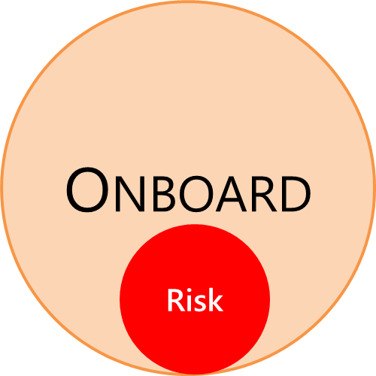
Deep Fake
Regional deepfake fraud surges
Canada: 3,400%
Hong Kong: 1,900%
Singapore: 1,500%
Mainland China: 1,183%
Germany: 1,100%
United Kingdom: 900%
United States: 700%
Deepfake Fraud
1100%
+
ID Doc Fraud
300%
+
Sumsub Q1 2025 identity fraud trends in USA
Faking even Blinking, Head Movements, Eye Following, Voice …
Notes:
https://www.middesk.com/blog/how-fraudsters-are-using-ai-to-bypass-traditional-kyb-checks#:~:text=AI%20makes%20it%20easier%20than,checks%20at%20banks%20and%20fintechs.
https://sumsub.com/newsroom/synthetic-identity-document-fraud-surges-300-in-the-u-s-sumsub-warns-e-commerce-healthtech-and-fintech-at-risk/

Slide 5
Identity
Fraud Risk Index (FRI) services
Telecom : New Mobile Phone SIM
Telecom : Phone SIM in Compromised List
Score
Telecom : New Device
Post Office : Address Change
Bank : New Account
Government ID: Face in Suspect List
Government ID : Fingerprint in Suspect List
Crime Branch : Bank Account in Suspect List
Credit Check : EMI Payment Defaulter
Using dependable signals in near real-time improves protection
Notes:
https://www.pymnts.com/fraud-prevention/2025/ai-fraudsters-crash-identity-systems-built-for-yesterday/

Slide 6
Approach
Matching faces against a large set of suspect stock data
Fast Detection Filter
Candidate Match
Exact
(Light & Expression Var)
Haar Cascade
CNN: FaceNet, Siamese Network
Local Binary Patterns Histograms
Matching fingerprint against a large set of suspect stock data
Traditional
(Minutiae, Ridge-Based)
Deep Learning
(CNN, SVM, R-Forest)
Military Grade
(DeepPrint, CNNAI, AFIS,)
Matching addresses with valid address
Fuzzy String Match
(Levenstein, DL, Jaro-W)
Machine Learning
(SVM, LR, ESIM)
NLP
(CRF, N-Gram, Word Em)
Notes:
Matching faces against a large set of suspect stock data
CNN-based
FaceNet (Google) – Distance Based - uses 128-D Euclidian “embedding space”
Siamese Network – Similarity Based – uses dual CNN engine
Local Binary Patterns Histograms (LBPH)
Texture based – Fast + Resilient (handle variations in light and expressions)
Haar Cascades
Initial fast detection even from video streams

Slide 7
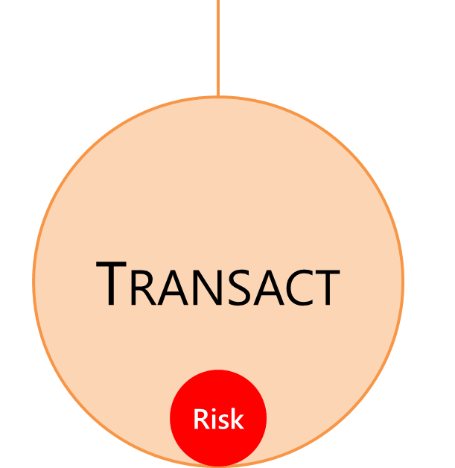















Behavioural Biometrics
Device Fingerprint
OS Type & Verification
Screen
Size
Geo
Location
Device Handling
In Active
Call
Bot
Activity
Navigation
Click
Speed
Typing Dynamics
Hand Eye Coordination
Date &
Time
Account Profile
Personal
Profile
Personal / Business Profile
Notes:
https://www.pymnts.com/fraud-prevention/2025/ai-fraudsters-crash-identity-systems-built-for-yesterday/

Slide 8
Building and Using Profiles
Payer
Payee
Multiple Dimensions
  Day of the Week
  Time of the Day
  Merchant Category Code
  Merchant Location
  Festive Season Variations
  Weather Impact
  Frequent Merchants
High Frequency
  Day of the Week
  Time of the Day
  Brand / Reputation
  Average Ticket Size & Variability
  Cluster Average based on
    Location
    Merchant Category Code
    Festive Season
Needs Stream Analytics, Telescopic Summaries, Multi-D Aggregates and more …
Challenge is Reading and Writing same information at Scale

Slide 9
Building Rules and Models
Rules
  PROS: Explainable – Human Interpretable – Reuse Human Experience – Zero Day
  CONS: Static – Difficult to Maintain
  Maintenance : Regular review of rule efficacy and retiring of unproductive rules
Models
  PROS: Dynamic
  CONS: Explainability – Need Labelled Data (Takes Time to Build) – Drifts with Time
  Maintenance : Build Shadow Models and replace when drift is detected
Hybrid
  Structure by Human + Thresholds set by AI
  Maintenance : Regular review of rule efficiency, build new thresholds in shadow
AI with Human-in-Loop is the right strategy as of now …

Slide 10
Explainability
SHAP Algorithm
  Provide a single, consistent importance value (SHAP value) for each feature in a specific prediction, explaining how much each feature contributed to pushing the prediction away from the average
Time of the day: 40%
Model
Fraud Probability 85%
New SIM and Phone: 30%
# Transaction at MCC: 20%

Slide 11
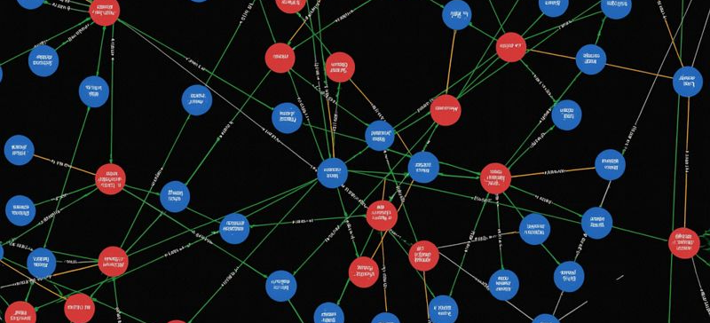
Anti Money Laundering

Slide 12
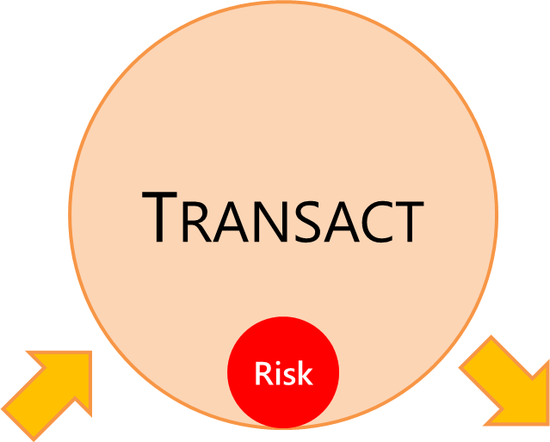

Mule Account Pattern
Hop through layers of mule accounts to hide the source and destination
Mule Account Characteristics
Sudden Influx of Funds
Rapid Fund Movement
Atypical Transaction Volume/Value
Layering Transactions (Smurfing, Multi-currency)
Round Number Deposits/Withdrawals
Multiple Incoming Sources, One Outgoing Destination
Unusual Account Holder Behavior Pattern
Reserve Bank Innovation Hub has introduced MuleHunter AI — an advanced AI/ML-based system – trained on 19 laundering patterns

Slide 13
Takeaways
Fraudsters are perfecting their act leveraging AI → Enterprise needs to gear up
The impact of fraud is maximum in the Onboarding and Transacting Phases
Addressing AI-based guard against AI-led Fraud is a necessity
Using AI to protect during Transacting is a better and matured strategy
Explainability is improving, however, lack of that should not limit its application
Using AI to detect mule accounts / money laundering will disincentivize fin-crime

Slide 14
RS IntelliEdge™
Protecting the digital payments of India in which includes rails like UPI, AEPS, IMPS, RuPay, FASTag, BBPS, and more with 20+ billion transactions a month with average latency of 100 milliseconds.
It has graph-based analytics engine to detect mule account and laundering activities almost in real time

Slide 15
Thank You sumit@rssoftware.co.in

