Slide 1

CODE OF ETHICS
(Practical Approach)
1

Slide 2
Disclaimer :
The views expressed in the presentation is exclusively that of the author.
The information contained herein is of a general nature and is not intended to address the circumstances of any particular individual or entity.
Although we endeavour to provide accurate and timely information, there can be no guarantee that such information is accurate as of the date it is received or that it will continue to be accurate in the future.
The presenter is in no case liable for any damages incurred by relying on the ideas implemented without adequate consultation.

Slide 3
Objective of Chartered Accountants Act
The Chartered Accountants Act,1949 was enacted to constitute an autonomous association of accountants to maintain the standards of professional competence and for regulating the profession of chartered accountants.
It maintains the standards of the professional qualifications and conduct required of the members of the profession.

Slide 4
ETHICS
The term “Ethics” means moral principles which governs a persons behaviour or the conducting of an activity. It is the branch of knowledge that deals with moral principles,
“professional ethics” consists of personal, organisational and corporate standards of behaviour expected for professionals.
There can be different moral codes to different sections of the Society or professionals.

Slide 5
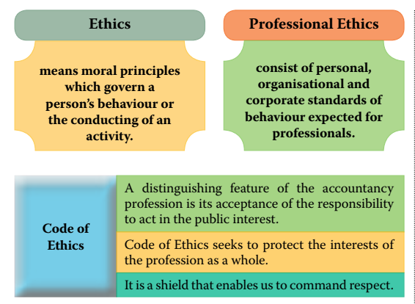
Ethics

Slide 6
Ethics
Chartered Accountants as professionals are engaged in building trust to vast verities of users, whether shareholders, government, banks, investors, employees or others, which imposes a public interest responsibility on their profession. Like other professionals Chartered Accounts have also some set of Code of Ethics.
The Chartered Accountant, either in practice or in service , has to abide by these ethical behaviours . The Service users should be able to feel secure that there exists a framework of professional ethics which governs the provisions of those services. Any deviation from ethical responsibilities brings the disciplinary mechanism into action against the Chartered Accountants

Slide 7
Therefore, we need to Comply or get them complied, as the case may be. The relevant Laws and Regulations, Code of Ethics (earlier also known as Code of Conduct)
For compliance we must know
    Which Laws and Regulations etc are to be complied
    What are to be complied

Slide 8
The Relevant Laws and Regulations
Code of Ethics (Vol I) (2019 Edition)- on the basis of International Ethical Standard Board (Under revision)
Code of ethics (Vol II) (2020 Edition) (under revision)
Code of Ethics (Vol III) (Case Law Referencer) (March 2020 Edition)(under revision)
Frequently asked Questions on Ethical Issues (February 2021edition)
Compendium on Disciplinary case studies (February 2022 Edition)
The Chartered Accountants, the Cost and Works Accountants and the Company Secretaries (Amendment) Act, 2022. Dated 18th April 2022

Slide 9
The Relevant Laws and Regulations (Contd)
The Chartered Accountant Act, 1949 (as amended)
The Chartered Accountants Regulations, 1988 (amended upto 15th February 2023)
The Chartered Accountants (Procedure of Investigations of professional or other misconduct and Conduct of Cases) Rules, 2007.
Various guidelines issued by Council from time to time (General Guidelines 2008, Revised Guidelines on advertisement, Tender Guidelines, Corporate form of Practice guidelines, Logo Guideline, UDIN Guidelines, Net-working Guidelines, Multi- disciplinary practice guideline etc.)

Slide 10
The Relevant Laws and Regulations (Contd)
Booklet on Important decisions of Ethical Standard Board/ Council (June 2022 edition)
The Important Orders of NFRA (which will give an idea the areas where auditors miss out or ignore) and NFRA is able to impose penalty running into Lakhs and crores and debarment from auditing/ internal auditing for some years.
SQC – Standards on Quality Control (series 1 to 99)- (SQM in coming days)
Various SA – Standards on Auditing (Series 100 onwards)
Avoid “After thought” Stigma

Slide 11
The Relevant Laws and Regulations (Contd)
  SREs- Standards on review Engagements (3000 series)
  SRSs- Standards on Related Services (4000 series)
  Various Accounting Standards including IND AS
  The relevant Laws applicable to the Clients
  Self Regulatory measures recommended by ICAI
  Multi disciplinary Partnership (Notification dated 8th July 2021)

Slide 12
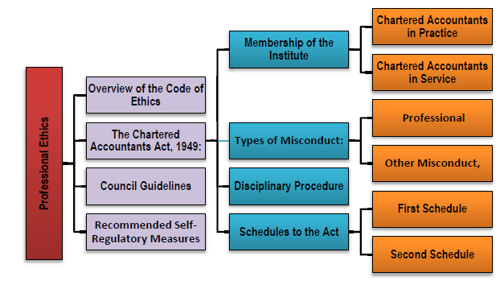
Image Source- ICAI –Study Material

Slide 13
How Many schedules and how many Sections in The Chartered Accountants Act,1949?
There are Two Schedules- First Schedule and Second Schedule depending on the gravity of offence and quantum of punishment.
There are 32 Sections in The Chartered Accountants Act, 1949
  Q: Whether the offences are confined to Two schedules to Chartered Accountants Act only?
  No, Section 8(v) and Chapter VII of the Chartered Accountants Act having Sections 24, 24A, 25 to 28 also provides for penalties under various circumstances.
  Section 132(4) of the Companies Act, 2013 provides for penalty where professional or other misconduct is proved.

Slide 14
Professional or other misconduct defined
‘22. For the purposes of this Act, the expression “professional or other misconduct” shall be
deemed to include any act or omission, on the part of any member of the Institute either in his individual capacity or as partner or owner of a firm, as mentioned in any of the Schedules,
but nothing in this section shall be construed to limit or abridge in any way the power conferred or duty cast on the Director (Discipline) under sub-section (1) of section 21 to inquire into the conduct of such member or firm, under any other circumstances.’.

Slide 15
Professional or other misconduct defined (contd..)
The definition is not exhaustive but inclusive one, as such may include many more criteria.
Any act or omission on the part of the member as mentioned in any of the schedules. (presently First and Second Schedule)
Misconduct may either in his individual capacity
Misconduct may be as a partner of the firm
Misconduct may be as a proprietor of the Firm

Slide 16
Professional or other misconduct defined
the Director (Discipline) has vast power and duty to inquire into the conduct of the
    >member or
    >Firm or
    >Member and firm
Under any other circumstances also (i.e. in addition to circumstances stated in schedules)
This Section cannot limit or curtail, in any way, the power or duty conferred to the Directorate.

Slide 17
What constitutes `misconduct
under any other circumstances’ has to be determined on case to case basis
keeping in view the facts of the circumstances of each case.
Fraud, intention to deceive and committing an act which affects the public or society at large could be in the ambit of such misconduct.

Slide 18
Misconduct
MISCONDUCT can be broadly divided into two categories
  Professional Misconduct
  Other misconduct.
Broadly 35 items of Misconduct are there in the Schedules
  First schedule-in Four Parts has 19 items (Rationale behind dividing schedules I Parts)
  Second Schedule-in three parts has 16 items

Slide 19
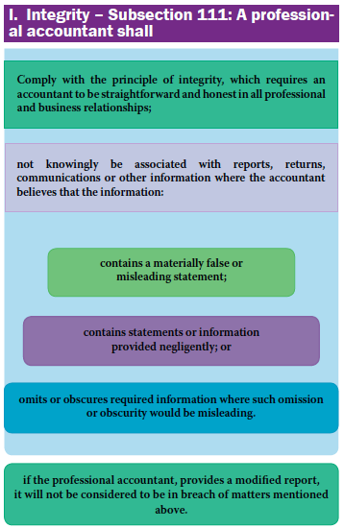
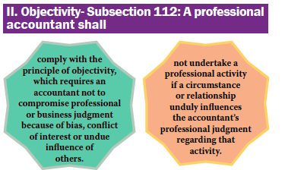
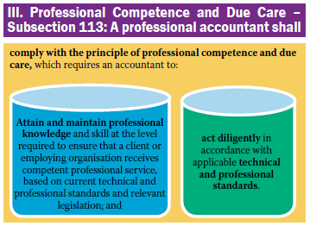
Few Important Extracts from CA Act
Image Source- ICAI –Study Material

Slide 20
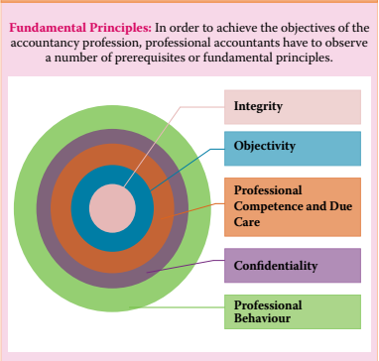
Image Source- ICAI –Study Material

Slide 21
Some non compliances may occur due to
      Lack of knowledge
      Indifference
      Laxity
      leniency
      Negligence
      Simple copy past
      Improper audit planning and improper follow ups.
      Lack of time to review the Financial Statements.
      Lacklustre attitude

Slide 22
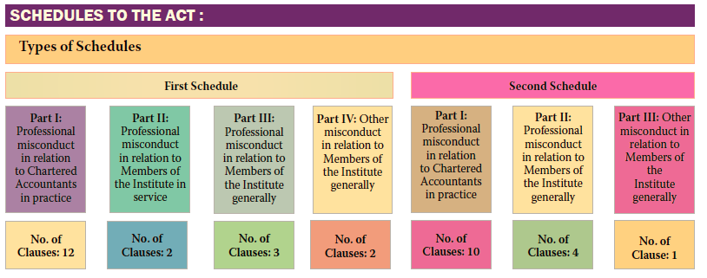
No of Clauses 5
Image Source- ICAI –Study Material

Slide 23
WHAT IS THE RATIONAL BEHIND DIVIDING SCHEDULES INTO PARTS?
First Schedule
Part I- 12 items-Professional misconduct-members in Practice
Part II- 2 items - Professional misconduct-members in Service
Part III-3 items – Professional misconduct -generally (all members)
Part IV-2 items- other misconduct -generally (all members)

Slide 24
WHAT IS THE RATIONAL BEHIND DIVIDING SCHEDULES INTO PARTS? Contd….
Second Schedule
Part I- 10 items-Professional misconduct-members in Practice
Part II-5 items - Professional misconduct- generally (all members)
Part III-1 items -other misconduct -generally (all members)

Slide 25

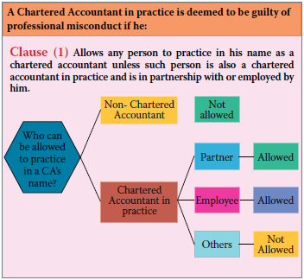
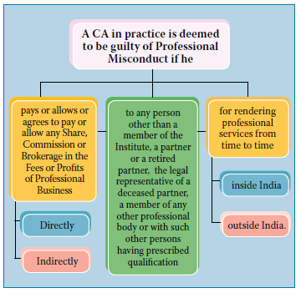
FIRST SCHEDULE
Part I- Professional misconduct-Members in Practice
Sch I-Part I
Clause 1& 2
Clause 1 -Practice by non-CA
Clause 2 –Sharing Fees with Non- Member
Image Source- ICAI –Study Material
Image Source- ICAI –Study Material

Slide 26
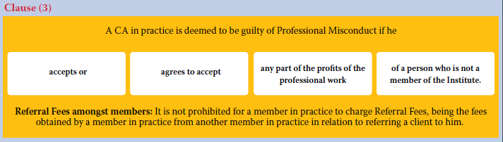
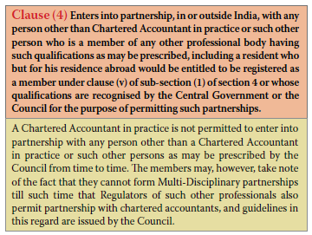
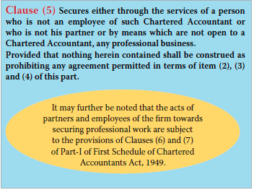
FIRST SCHEDULE - Part I- Professional misconduct-Members in Practice
Sch I-Part I
Clause 3,4,5
Clause 3 –Accepts Fees from NON MEMBERS
Clause 4 –Partnership with Non Member
Clause 5 –Secures professional business through non- employee/non-partner or unlawful means
Multidisciplinary – an Exception

Slide 27
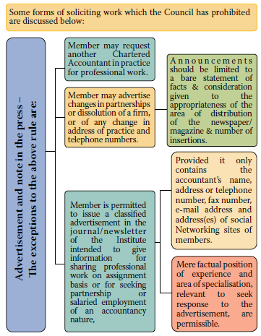
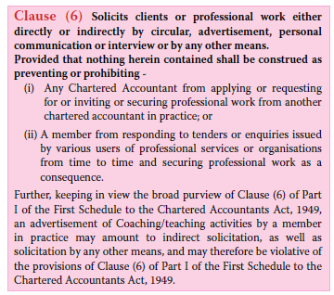
FIRST SCHEDULE - Part I- Professional misconduct-Members in Practice
Sch I-Part I
Clause 6
Clause 6 –Solicits professional work

Slide 28
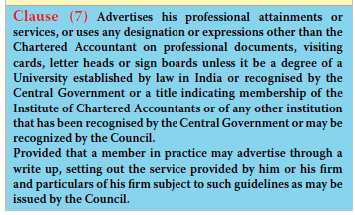
FIRST SCHEDULE - Part I- Professional misconduct-Members in Practice
Sch I-Part I
Clause 7
Clause 7 –Advertises professional attainment

Slide 29
Sch I-
Part I
FIRST SCHEDULE.. In brief
  Part I- 12 items-Professional misconduct-members in Practice
Practice by non-chartered accountant
Shares fees with non-Member
Accepts fees from non-Member
Enters into partnership with non-Member
Secures professional business through non- employee/non-partner or unlawful means

Slide 30
FIRST SCHEDULE .. In brief (CONTD)
  Part I- 12 items-Professional misconduct-members in Practice… contd….
Solicits professional work
Advertises professional attainment
Fails to communicate with outgoing auditor – Refer New FAQ by ICAI- clarifying certain aspects
Non compliance of Sec 139 to 141 of Co Act, 2013
Charging fees based on percentage/ contingency
Sch I-
Part I

Slide 31
Sch I-
Part I
FIRST SCHEDULE .. In brief (CONTD)
  Part I- 12 items-Professional misconduct-members in Practice
Engages in any other occupation
Allows non - Member/non-partner to sign documents on his behalf.

Slide 32
Sch I-
Part II
FIRST SCHEDULE .. In brief (CONTD)
  Part II- 2 items - Professional misconduct-members in Service
Shares his emoluments with others
Accepts commission or gratification from a lawyer etc engaged by the employee.

Slide 33
Sch I-
Part III
FIRST SCHEDULE .. In brief (CONTD)
  Part III- 3 items – Professional misconduct -generally (all members)
Acts falsely as FCA
Does not supply information to the Institute and its other functionaries.
Gives false information under Clause (6) and (7) of the First Schedule

Slide 34
Sch I-
Part IV
FIRST SCHEDULE .. In brief (CONTD)
  Part IV- 2 items - other misconduct -generally (all members)
Becomes guilty of any offence punishable with imprisonment upto 6 months, either in civil or criminal case
Bring disrepute to the profession/Institute as a result of his action.

Slide 35
Sch II-Part I
SECOND SCHEDULE .. In brief
  Part I- 10 items - Professional misconduct-members in Practice
Discloses information acquired without Client’s consent
Certifies/submits report without examining the related records
Permits to use name for vouching the accuracy of future contingent earnings
Opines on Financial Statement where substantial interest involved.

Slide 36
Sch II-Part I
SECOND SCHEDULE .. In brief (Contd)
  Part I- 10 items - Professional misconduct-members in Practice
Fails to disclose any material fact in Financial Statements.
Fails to report a known material misstatement appearing in Financial Statements.
Performs professional duties without due diligence/grossly negligent
Fails to obtain sufficient information for expressing an opinion.

Slide 37
Sch II-Part I
SECOND SCHEDULE .. In brief (Contd)
  Part I- 10 items - Professional misconduct-members in Practice
Fails to invite attention to any material departure from the generally accepted procedure of audit.
10. Keeps client’s money without opening separate bank account.

Slide 38
Sch II-Part II
SECOND SCHEDULE (Contd)
  Part II- 5 items - Professional misconduct- generally (all members)
Contravenes any of the provisions of the Chartered Accountants Act/Regulations & Guidelines issued by the Council. (Brahmastra)
Discloses employer’s information without permission.
Provides false information to the Institute and its different authorities.

Slide 39
Sch II-Part II
SECOND SCHEDULE (Contd)
  Part II- 5 items - Professional misconduct- generally (all members)
Defalcates/embezzles money received in professional capacity.
acts as an auditor of the company in contravention of the provisions of the Companies Act, 2013.

Slide 40
Sch II-Part I
Clause 7
SECOND SCHEDULE (Contd)-some clauses
  Part I- Clause (7) Performs professional duties without due diligence/grossly negligent
  Clause (7): does not exercise due diligence, or is grossly negligent in the conduct of his professional duties;
  Though very simply worded, it is a vital clause which unusually gets attracted whenever it is necessary to judge whether the accountant has honestly and reasonably discharged his duties. Diligence means care; caution; attention and care required from a person in a given situation and the expression ‘due diligence’ means a measure of prudence, activity, or alertness, as is proper to be expected from, and ordinarily exercised by, a reasonable and prudent member in practice under the particular circumstance
  The expression ‘negligence’ covers a wide field and extends from the frontiers of fraud to collateral and minor negligence.

Slide 41
Sch II-Part I
Clause 7
SECOND SCHEDULE Part I Clause (7)(Contd)-some clauses
  The meaning and significance of this clause is well contained in the following passage quoted from the judgement of the Karnataka High Court in a disciplinary case
  “It is the duty of an auditor to bring to bear on the work he has to perform that skill, care and caution which a reasonably competent, careful, and cautious auditor would use. What is reasonable skill, care and caution must depend on the particular circumstances of each case. An auditor is not bound to be a detective, or, as was said, to approach his work with suspicion or with a foregone conclusion that there is something wrong. He is a watch-dog but not a blood-hound. If there is anything calculated to excite suspicion he should probe it to the bottom; but in the absence of anything of that kind he is only bound to be reasonably cautious and careful.”

Slide 42
Sch II-Part I
Clause 7
SECOND SCHEDULE Part I Clause (7)(Contd)-some clauses
  Another observation in a disciplinary case
  Professional misconduct on the part of a person practising one of the technical professions cannot fairly or reasonably be found merely on a finding of a bare non-performance of a duty or some default in performing it. The charge is not one of inefficiency but of misconduct. Imputation of certain mental condition is always involved. The test must always be whether in addition to the failure to do the duty, there has also been a failure to act honestly and reasonably

Slide 43
Sch II-Part I
Clause 8
SECOND SCHEDULE Part I Clause (8)-some clauses
Clause (8): fails to obtain sufficient information which is necessary for expression of an opinion
or its exceptions are sufficiently material to negate the expression of an opinion
The chartered accountant should not express an opinion before obtaining the required data and information. The latter part of the clause enjoins that where due to inadequacy of information or data the report has to be circumscribed to an extent that it would cease to be of any expression of a categorical opinion, the auditor should clearly express his disclaimer in no uncertain terms. For example, if the auditor has not seen any evidence of the existence and/or valuation of the investment which constitute the only asset of a Company, he should not say that:-
“Subject to the verification of the existence and value of the investments the Balance Sheet shows a true and fair view.....etc.”

Slide 44
Sch II-Part I
Clause 9
SECOND SCHEDULE Part I Clause (9)-some clauses
A chartered accountant in practice shall be deemed to be guilty of professional misconduct, if he
Clause (9): fails to invite attention to any material departure from the generally accepted
procedure of audit applicable to the circumstances.
This clause implies that the audit should be performed in accordance with “generally accepted procedure of audit applicable to the circumstances” and if for any reason the auditor has not been able to perform the audit in accordance with such procedure, his report should draw attention to the material departures from such procedures.
What constitutes “generally accepted audit procedure” would depend upon the facts and circumstances of each case, but guidance is available from the various pronouncements of the Institute issued from time to time by way of Engagement and Quality Control Standards, Statements, General Clarifications, Guidance Notes Technical Guides, Practice Manuals, Studies and Other Papers.

Slide 45
Sch II-Part II
Clause 1
SECOND SCHEDULE Part II Clause (1)-some clauses-applicable to all
A member of the Institute, whether in practice or not, shall be deemed to be guilty of professional misconduct, if he:-
Clause (1): contravenes any of the provisions of this Act or the regulations made
thereunder or any guidelines issued by the Council:
This clause requires every member of the Institute to act within the framework of the Chartered Accountants Act and the Regulations and guidelines made by the Council thereunder. The Council so far has issued guidelines under this Clause, as appearing in Chapter 4 of Vol II. Any violation either of these guidelines or the Act or the Regulations by a member would be covered as a professional misconduct under this part.
It is an authority for the Council to issue guidelines for extending the scope of misconduct to cover “acts or omissions” not already dealt with in the various clauses of the two schedules.

Slide 46
Sch II-Part III
Clause 1
SECOND SCHEDULE Part III Clause (1)-some clauses-applicable to all
A member of the Institute, whether in practice or not, shall be deemed to be guilty of professional misconduct, if he:-
Clause (1): he is held guilty by any civil or criminal court for an offence which is
punishable with imprisonment for a term exceeding six months.
This clause states that any member of the Institute ,shall be deemed to be guilty of professional
misconduct if he is held guilty by any Civil or Criminal court for an offence which is punishable
with imprisonment for a term
exceeding six months – the member will be tried under Second Schedule
upto six months – the member will be tried under Clause (1) of Part IV of First
Schedule

Slide 47
QUESTIONS ????
Any further Questions ???

