Slide 1

Browser Plugins to Boost Productivity
CA Rahul Rungta
AI 20-20 PowerPlay

Slide 2

Boomerang
Never Forget a Follow-up.
Send Emails at the Perfect Time.
Achieve Inbox Zero.

Slide 3

Grammarly
Spelling & grammar Checker.
Premium also suggests improved writing.
Free Alternatives: Wordtune, Hemingway Editor

Slide 4

Scribed How
Create guided, step-by-step tutorials directly in your browser.
Save time and streamline documentation processes.

Slide 5

Awesome Screen Screenshot
Capture a screenshot of the page you visit, full page, selected area or visible part.
Resize or crop a screenshot to the size you need.
Record your Desktop (Entire Screen or Window), Current Tab or Include your voice in recording with the Microphone option on.
Instantly get a shareable link of a video after finishing recording.

Slide 6

Monica - YouTube Summary Tool
Summarise YouTube videos, web articles, and PDFs to save time.
Get video transcripts as well in no time!

Slide 7
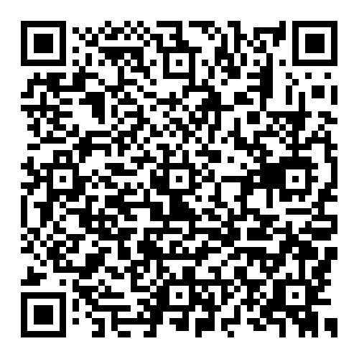
Google Prompt Guide
A quick-start handbook for effective prompts
The four main areas to consider when writing an effective prompt are:
• Persona
• Task
• Context
• Format
You are a program manager in [industry]. Draft an executive summary email to [persona] based on [details about relevant program docs]. Limit to bullet points.

Slide 8


Slide 9
Other Useful Tools
1
Krisp
Reduce background noise while recording videos
2
Dictionary by Google
Instantly get to know the meaning of unfamiliar words
3
NaturalReader
AI Text To Speech Reader - Incl Emails, Articles etc
4
Prompthackers.co
Exhaustive guide to many useful prompts

Slide 10
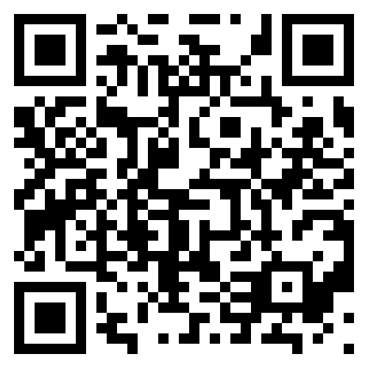
Thank You!
Let’s connect on LinkedIn

