Slide 1

Type 1 NBFC exemption proposals
Draft RBI Amendment Directions
Vinod Kothari & Anita Baid
Vinod Kothari Consultants P. Ltd
Kolkata:
B-42, Metropolitan Cooperative Housing Society,
Kolkata- 700105
Phone: 033 2281 3742
Email: info@vinodkothari.com
New Delhi:
Nukleus, 501 & 501A, 5th Floor, Salcon Rasvilas, District Centre, Saket, Delhi 110017
Phone: 011 41315340
Email: delhi@vinodkothari.com
Mumbai:
403-406, Shreyas Chambers
175, D N Road, Fort
Mumbai- 400 001
Phone: 022 2261 4021/ 3044 7498
Email: bombay@vinodkothari.com
Bangalore:
4, Union Street, Infantry Rd,
Shivaji Nagar,
Bengaluru- 560 001
Phone: 033 40010157/ 2281 3742
Email: bengaluru@vinodkothari.com
Website: www.vinodkothari.com

Slide 2
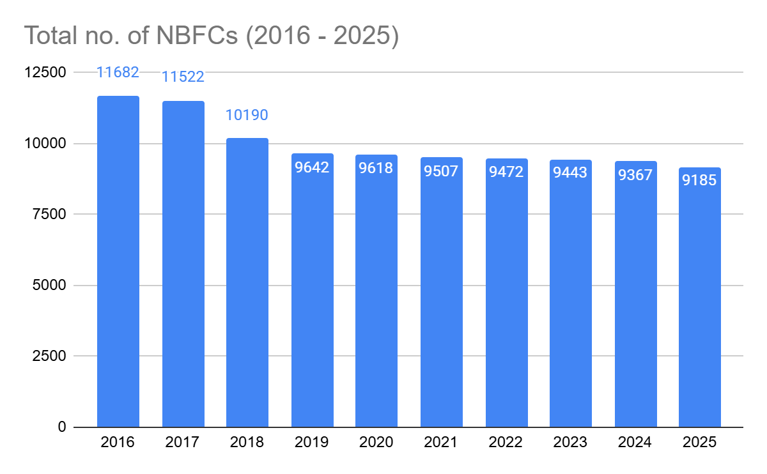
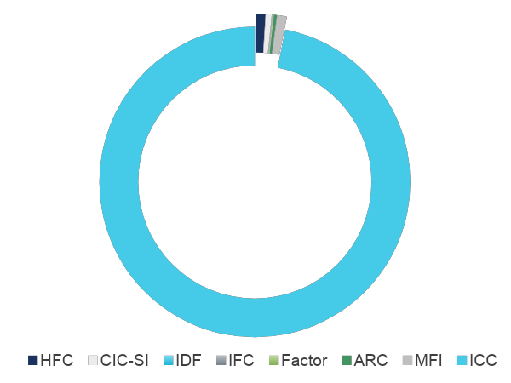
Overview of Non-Banking Sector in India
  NBFCs are growing more and more relevant to the Indian financial sector, they are the largest receiver of funds followed by HFCs
  Traditionally, NBFCs operated as a alternative lender, reaching out to customers that were beyond the reach of banks
    But the lending model was same as that of bank
  New age NBFCs have introduced innovative models that incorporate the best offerings of the world of fintech and conventional credit features.
  The traditional modes of lending are being replaced with new innovative models.
  They also leverage alternative data for assessing incomes, efficiently incorporate technology into their operations, and possess a highly astute workforce.
  They are bridging the gap in the Indian financial ecosystem by empowering budding business communities and entrepreneurs.
Over 95% of the registered NBFCs are ICCs
Data Source: RBI

Slide 3
Legal Definition of NBFCs & Meaning of Financial Activities
Definition of NBFC
Definition of financial institution
Activities which are not financial activities
Section 45I(f) of RBI Act, 1934
Financial institution which is a company;
NBI which is a company and whose principal business is accepting of deposits
such other class of companies, as the RBI may notify
Section 45I(c) of RBI Act, 1934
A NBI which carries on the following activities
1. Financing
2. Acquisition of shares, stocks or securities
3. Hire purchase
4. Insurance – excluded by notification
5. Management of chits, kuries, etc
6. Money circulation schemes
Section 45I(c) excludes the following activities from the purview of financial activities:
Agricultural activities
Industrial activities
Purchase or sale of goods, or provision of services
Purchase, construction or sale of immovable properties, provided that the income from such activities do not arise from financing of purchase or sale of construction of immovable properties

Slide 4
Principal Business Test
Quantitative factors
Qualitative factors
Press Release 1998-99/1269 dated April 8, 1999
nature of the business of an entity,
Financial assets> 50% of its total assets
its principal thrust areas,
Principal business test
Income from financial assets> 50% of the gross income
schematic and consistent distribution of assets, resources and activities.

Slide 5
NBFC classification based on activity
Core Investment Company
Unregistered
(<100cr or no PF)
Investment activities
Investment and Credit Company
Non-Operative Financial Holding Company
Registered
Micro Finance Institution
Based on the nature of activities
Factors
Housing Finance Companies
Infrastructure Finance Company
Lending or similar activities
Infrastructure Debt Fund
Peer-to-Peer Lending Platform
Standalone Primary Dealers
Mortgage Guarantee Company
Other activities
Account Aggregator

Slide 6
Classification based on PF and CI
Before the SBR Framework, NBFCs were classified based on the systemic importance into SI and NSI as well as based on acceptance of deposit into deposit taking and non-deposit taking NBFCs
The concept of Type 1 NBFCs was introduced in 2016, basically for easing the registration process {Refer Press Releases - Reserve Bank of India]
Type I - NBFC-ND
  not accepting public funds/ not intending to accept public funds in the future and
  not having customer interface/ not intending to have customer interface in the future
Definition of PF and CI was provided under the Master Directions
Type I
  No PF and
  No CI
Type II
  With PF or
  With CI

Slide 7
Meaning of PF and CI
“Public funds" shall include
  funds raised either directly or indirectly through public deposits,
  commercial paper,
  Debentures,
  inter-corporate deposits and
  bank finance
but excludes funds raised by issue of instruments compulsorily convertible into equity shares within a period not exceeding 10 years
Any funds received from outside sources and which constitute outside liability are treated as public funds for ‘Type I NBFCs’
Loans from directors and/ or shareholders will be classified as public funds
Indirect receipt of public funds means funds received not directly but through associates and group entities which have access to public funds
“Customer interface” means interaction between the NBFC and its customers while carrying on its NBFI business
As per the proposal,
  Customer interface can be through an account-based relationship, lending relationship or interaction with the customers as part of business of the NBFC.
  Any customer-oriented activity like lending or providing guarantee, including to ‘entities in the Group’, its shareholders, its directors
  Providing any other product or service to a customer would constitute ‘customer interface’.
  Activities like distribution of mutual funds, credit cards, acting as Point of Presence for NPS, etc., since these activities entail interaction with customers.
  However, loans to employees as per terms of employment condition/ contract and not on commercial terms, shall not be treated as customer interface.

Slide 8
Exemption from registration to type 1 NBFC

Slide 9
Conditions for Exemption and Conditions Subsequent
Assets less than Rs 1000 crores
  Aggregation required?
Liability side - no public funds
  Directly or "indirectly"
    Indirectly elaborated to say borrowings “through associates and group entities”
    Meaning of “through”
  Even borrowings from shareholders and directors
Asset side - no customer interface
  CI defined in FAQs. says includes loans to group entities; however does not include employee loans
  Includes activities like MF distribution, credit cards, etc., since these activities entail interaction with customers
Last 3 years financial statements
  Does it mean, at no stage in the last 3 years, these conditions should be breached?
  Meaning of “Statutory Auditors Certificate certifying that the company does not have public funds and also not have customer interface as on date”
    Implies these should not be as on date; however if there is any isolated breach, that should not disentitle.

Slide 10







Conditions Precedent: Deregistration Conditions as per Para 38A
Asset Size: Less than ₹1,000 crores
Public Funds : Must not be accepting or intending to accept “public funds”, including from within the group.
Customer Interface: Must not have or intend to have any customer interface. This includes lending or providing guarantees to group entities.
Statutory Auditors Certificate: SAC certifying that the company does not have public funds and also not have customer interface as on date.
Governance: a. The Board must pass an upfront resolution, as also annually thereafter, confirming the entity will not avail PF or have CI during the year
b. Undertaking from the Board that the NBFC shall disclose its status of being ‘Unregistered Type I NBFC’ and status of PF and CI as part of Notes to Accounts to the FS
Business Model: Non-acceptance of funds and having no customer interface.
Other Documents: Original CoR, Audited Financial Statements (last 3 FYs), Report on the status of public funds and customer interface (last 3 FYs)
No overseas investment in financial services sector

Slide 11

Conditions Subsequent: Para 66A for Unregistered Type I NBFCs
Business Model: Operates without public funds and without customer interface, as their conscious and durable business model on a long-term basis.
Asset Size: Asset size is less than ₹1,000 crore.
Board Resolution: Passes an annual Board Resolution that it will not avail public funds and not have customer interface during the year.
Disclosure in Financials: Discloses in its Notes to Accounts to the financial statements that it is an ‘Unregistered Type I NBFC’, along with the status of public funds and customer interface
Exception Report: Statutory Auditors shall submit Exception Report to the Reserve Bank in case of violation of conditions on public funds and/or customer interface
Other Compliances: Compliance with Chapter IIIB of RBI Act and any other conditions that the RBI may lay down

Slide 12
Is it mandatory to opt out or apply for deregistration?
No, it is optional to apply for deregistration
Company may weigh the pros and cons
  Pros
    If the Company is thinking of growing the asset size, it will not have to go through the rigour of a fresh application
    Some of the exemptions are linked with NBFC registration
  Con
    Compliance burden

Slide 13
Analysis of options available to Type 1 NBFCs
Type of NBFC | Options Available
NBFCs holding Type I Registration as on April 1, 2026 | Option 1: Apply for deregistration Option 2: Continue to remain as Type I NBFC
Entities that fulfil the conditions for Unregistered Type I NBFC, after April 1, 2026 | Option 1: Satisfy the conditions under 66A and remain unregistered [see box on Conditions Subsequent] Option 2: Apply for registration as Type I NBFC
NBFCs not having a customer interface and public funds and having an asset size below ₹1000 crores, but not registered as Type I | Option 1: Apply for deregistration Option 2: Apply for registration as Type I NBFC to avail regulatory exemption Option 3: Maintain status quo
NBFCs not having a customer interface and public funds and having asset size above ₹1000 crores, but not registered as Type I | Option 1: Apply for registration as NBFC Type I Option 2: Apply for registration as NBFC Type II, in case of changes in business model

Slide 14
Moving from Type 1 to Type 2
Regulator has consistently said that if the company have either of public funds or customer interface, move to Type 2
How to move to type 2?
  Surrender registration for Type 1 to RBI
  Apply for registration as Type 2

Slide 15
What will happen to Type 1 NBFCs now?
With the stringent conditions, if there is a type 1 NBFC, with either less than 1000 crores or more, expect regulations to be quite light touch
  Base Layer Classification
  NOF- 2cr
Existing exemptions:
  Section 186(2) of the CA, which deals with the limits on loans and investments, provided exemption to NBFCs registered under Chapter III-B of the Reserve Bank of India Act, 1934. However, an exemption is also provided separately to investment companies and therefore unregistered type 1 NBFCs will fall under this category.
  Section 73 of the CA which deals with deposits provides exemption to NBFCs as defined under the RBI Act. Hence, the exemption will continue to apply for unregistered type 1 NBFCs
  Section 36(1)(viia) of IT Act provides that NBFCs can claim a deduction of up to 5% of their total income for provision made for bad and doubtful debts. However, it refers to NBFC as defined in the RBI Act..
  Section 42 of CA r.w sub-rule (2) of rule 14 of PAS Rules which sets the limit on number of offerees in case of a private placement is not applicable to a NBFC registered with the RBI. Therefore, unregistered Type 1 NBFCs will not be able to avail this exemption.
  Section 17(4) of the CGST Act allows NBFCs to avail 50% of eligible ITC in a tax period, with the balance to be reversed. While the provision uses the term “NBFC”, it does not expressly state “registered under the RBI Act”.

Slide 16
Exemptions under RBI regulations
Available to NBFCs registered as Type-1
Investment in AIFs, Insurance Business, MF Distribution
Elements of Tier 1 and 2 capital, RWA, ICAAP
Digital Lending, Loan against Gold and Silver Collateral, MFI Loans, Project Finance, PCE, LAS, CRE, loan against own shares, SSE
Lending to related parties
Guidelines on Credit Default Swaps
LEI for Borrowers
Filing of Security Interest in CERSAI
Concentration risks and thresholds
Regulations in respect of Accounting and Income from Investments by NBFCs
Investment by NBFCs in AIFs, and Participation in Currency Options, Futures etc
LRM and LCR Framework
Asset classification, income recognition and provisioning
Formats for disclosures in financial statements
Available to NBFCs having PF but not having CI
Registration with CICs, Credit Reporting to CICs
KYC
Fair Lending Practices
Norms for acceptance of Public Deposit
Available to NBFCs having CI but not having PF
Investments in AIF
Elements of Tier 1 and 2 capital, RWA, ICAAP
Lending to related parties
Guidelines on Credit Default Swaps
LEI for Borrowers
Filing of Security Interest in CERSAI
Concentration risks and thresholds
Regulations in respect of Accounting and Income from Investments by NBFCs
Investment by NBFCs in AIFs, and Participation in Currency Options, Futures etc
LRM and LCR Framework
Asset classification, income recognition and provisioning
Formats for disclosures in financial statements

Slide 17
Will it be a good idea to seek exemption, do a change of control and then go to Type 1 registration?
Possibly yes, but then the at the time of registration, the rigour applied may be the same
Can unregistered Type 1 NBFC invest in an LLP?
The bar is only on registered NBFCs.
Will investment in NCDs be said to be customer interface?
In view of FAQ 8, it is neither a lending relationship nor an account-based relationship. Unless the debenture is a structured credit instrument, it should not be seen as customer interface, as the debenture issuer cannot be regarded as “customer”.

Slide 18
Can an exempt NBFC act as LSP?
If it is “NBFC”, it cannot have customer interface at all - hence, it cannot carry any customer centric activity
However, if it is not an NBFC at all, then the question of any nbfc-related regulations does not apply
Will the 50:50 test become irrelevant?
The 50: 50 test is the very starting point of RBI regulations. If the entity is not an NBFC at all, the question of it falling under the scope of RBI regulations does not apply.
Hence, the conditionalities in the exemption notification apply only if the entity is an NBFC

Slide 19
Comparative Analysis (1/2)
Basis | Type 1 unregistered | Type 1 registered | Type 2 registered
Asset Size | Less than ₹1000 | >=₹1000 (mandatory) | No prescription
Registration | Not required | Required | Required
Classification as BL/ML | Does not arise | Base layer | May be BL or ML (based on asset size)
Maintenance of NOF | Not Applicable | Applicable (2 Crs) | Applicable (10 Cr by March 2027)
Disclosures in financial statements/ NTA | Applicable to the extent they come from the CA 2013. In addition, the declaration that the Company is an unregistered type 1 NBFC along with the status of public funds and customer interface. | Applicable as per CA and RBI Directions | Applicable as per CA and RBI Directions
Transfers of profits to reserves under 45-IC | Applicable | Applicable | Applicable

Slide 20
Comparative Analysis (2/2)
Basis | Type 1 unregistered | Type 1 registered | Type 2 registered
Exception report by the auditor | Applicable | Not Applicable | Not Applicable
Customer interface | No | No | Yes
Public funds | No | No | Yes
Fair lending practices | Not Applicable | Not Applicable | Applicable, if has customer interface
Prudential Regulations | Not Applicable | Not Applicable | Applicable, for Base Layer if having “public funds”
Capital adequacy requirement | Not Applicable | Not Applicable | Applicable, if Middle layer
KYC | Not required | Not required | Required
CIC Reporting | Not required | Not required | Required

Slide 21
Snapshot of Applicability of Various Requirements
 | NBFC-BL with PF | NBFC-BL without PF | NBFC-ML with PF | NBFC-ML without PF | Unregistered CIC | Registered CIC
Concentration Norms | Internal limits | Not Applicable | Applicable | Not Applicable | Not Applicable | Not Applicable
Capital Adequacy | Not Applicable | Not Applicable | Applicable | Applicable | Not Applicable | Applicable (ANW)
Provisioning norms | Applicable | Not Applicable | Applicable | Applicable | Not Applicable | Applicable
Asset Classification | Applicable | Not Applicable | Applicable | Applicable | Not Applicable | Applicable
Statutory Auditor Certificate | Applicable | Applicable | Applicable | Applicable | Not Applicable | Applicable
Leverage Ratio | Applicable | Not Applicable | Not Applicable | Not Applicable | Not Applicable | 2.5 times
Corporate Governance Norms | Not Applicable | Not Applicable | Applicable | Applicable | Not Applicable | Not Applicable
KYC Norms | Applicable (with CI) | Applicable (with CI) | Applicable (with CI) | Applicable (with CI) | Applicable | Applicable
CIC Reporting | Applicable (with CI) | Applicable (with CI) | Applicable (with CI) | Applicable (with CI) | Applicable | Applicable

Slide 22
Consolidation of Master Directions
RBI has consolidated more than 9000 existing circular/ guidelines administered by Department of Regulation into 238 function-wise Master Directions
Out of these, 35 Master Directions have been issued for NBFCs, streamlining regulatory frameworks across various NBFC categories whilst maintaining robust governance and prudential standards
Regulatory references to the applicable extant Directions have been updated with the relevant proposed Directions.
FAQs have been consolidated with the respective Master Directions.
In the RBI (Non-Banking Financial Companies – Credit Cards: Issuance and Conduct) Directions, 2025, reference has been made to Reserve Bank of India (NBFCs – Interest Rates on Advances) Directions, 2025, however, this Direction has not been issued.
Master Direction - Non-Banking Financial Companies Auditor’s Report (Reserve Bank) Directions, 2016 although repealed have not been consolidated

Slide 23
Overview of Consolidated Master Directions
Existence/ Operations
Category of NBFC
Risk
Financial Activity
Event Specific
Registration, Exemptions and Framework for Scale Based Regulation
Housing Finance Companies
Asset Liability Management
Undertaking of Financial Services
Acquisition of Shareholding or Control
Governance
Standalone Primary Dealers
Credit Risk Management
Classification, Valuation and Operation of Investment Portfolio
Voluntary Amalgamation
Prudential Norms on Capital Adequacy
Core Investment Companies
Concentration Risk Management
Credit Cards: Issuance and Conduct
Branch Authorisation
Prudential Norms on Declaration of Dividends
Account Aggregator
Managing Risks in Outsourcing
Credit Facilities
Resolution of Stressed Assets
Acceptance of Public Deposits
Mortgage Guarantee Companies
Climate Finance and Management of Climate Change Risks
Know Your Customer
Treatment of Wilful Defaulters and Large Defaulters
Financial Statements: Presentation and Disclosures
Peer to Peer Lending Platform
Responsible Business Conduct
Transfer and Distribution of Credit Risk
Miscellaneous
Microfinance Institution
Income Recognition, Asset Classification and Provisioning
Securitisation Transactions
Non-Operative Financial Holding Companies
Credit Information Reporting

Slide 24
Circulars not repealed and still applicable
Issued by Department of Supervision (illustrative list):
  Master Directions on Fraud Risk Management in Non-Banking Financial Companies (NBFCs)
  Master Direction - Non-Banking Financial Companies Auditor’s Report (Reserve Bank) Directions, 2016
  Master Direction – Reserve Bank of India (Filing of Supervisory Returns) Directions - 2024
  Master Direction on Information Technology Governance, Risk, Controls and Assurance Practices
  Master Direction - Information Technology Framework for the NBFC Sector (Part B)
  Compliance Function and Role of Chief Compliance Officer (CCO) - NBFCs
  Implementation of ‘Core Financial Services Solution’ by Non-Banking Financial Companies (NBFCs)
  Fair Practices Code for Lenders – Charging of Interest
Reserve Bank of India (Non-Banking Financial Companies - Internal Ombudsman) Directions, 2026
Reserve Bank - Integrated Ombudsman Scheme (RB-IOS), 2026
Reserve Bank of India (Commercial Banks – Undertaking of Financial Services) Directions, 2025 (for Banking Group NBFCs)
Master Direction – Reserve Bank of India (Commercial Paper and Non-Convertible Debentures of original or initial maturity upto one year) Directions, 2024

Slide 25




Thank You!
Vinod Kothari Consultants Pvt. Ltd.
Connect with us!

