Slide 1


Income Tax Act
From 1961 to 2025
Handling the Transition

Slide 2
Applicability Timeline
General Provisions- effectively from 2027
TDS/TCS, Advance Tax, 15CA/CB, Form 13- Immediate
Act
Rules
Forms
Utility

Slide 3
Broad Spectrum of Changes
More Structural
Less Conceptual

Slide 4
Broad Spectrum of Changes
Renumbering
44AB is now 63
139 is now 263
37 is 34
New 37 is old 43B
Grouping and Consolidation
All TDS – 193 to 195 are now in 393
Sec. 29- Deductions related to employee welfare
Sec. 58 – All 3 presumptive taxation
Sec. 66- All definition related with Business Income – Plant, Rural Branch, Scientific Research
Schedules and Tables
Sec. 10 – Now Schedule II to Schedule VII
All TDS : Table to Sec. 393
Sec. 49 - Cost with reference to certain modes of acquisition : Converted into Table with 24 line items
Terminology
“AY/PY” to “TY”
“Notwithstanding” to “Irrespective of”
Proviso and explanation – converted into sub sections - Sec. 48 1st proviso is now Sec. 72(6)

Slide 5
Mental Rewiring of Numbers
New Section | Provision | Corresponding Old Section
Sec. 15 to 19 | Salaries | 15 to 17
Sec. 20 to 25 | Income from House Property | 22 to 27
Sec. 26 to 66 | Profits and Gains from Business or Profession | 28 to 44DB
Sec. 67 to 91 | Capital Gains | 45 to 55
Sec. 92 to 95 | Income from Other Sources | 56 to 59
Sec. 391 to 402 | TDS /TCS | 192 to 206CC

Slide 6
Referencing
TDS :
  Earlier : Sec. 194J
  Now : Sec. 393(1)-Table Sl. No. 6 (ii)(a)
Sec. 72(2) : For the purposes of item B of the formula in section 197(3)…….:
  Item B of the Formula in Sec. 197(3) is “indexation of cost”.
Holding period of previous owner :
  Earlier – Clause (hc) of Expl. 1 to Sec. 2(42A)
  Now - Sec. 2(101)(c)(B)(I)

Slide 7
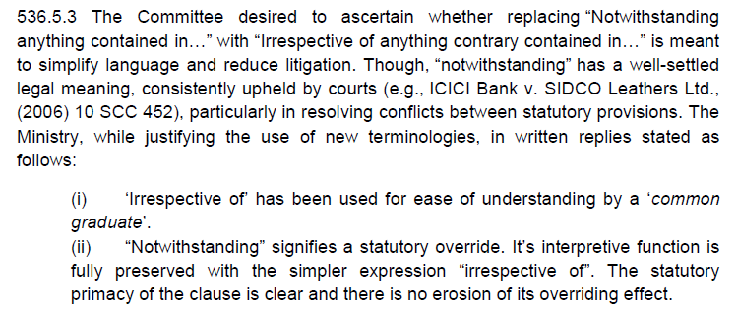
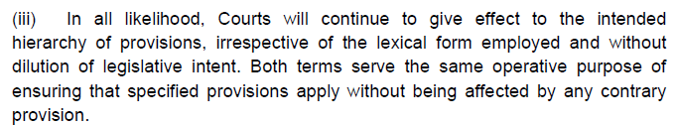
“Irrespective of” Vs. “Notwithstanding”

Slide 8
Impact - AY to TY
PY is TY
AY is now “Financial Year Succeeding the relevant Tax Year”.
  Sec. 286- Completion of scrutiny assessment – “One Year from the end of the Financial Year succeeding the Tax Year”.
Various time lines now with tax year and hence increased by 1 year.
  Sec. 282 – Reassessment notices 4y3m/6y3m from the end of tax year
Office chaos in 26-27
  TDS Challans of 30-04 and of 07-05
  TDS returns of 31-07 and Non Audit ITRs of 31-07
  Advance tax on 15-06 and Self Assessment Tax on 31-07
In 28-29 - we might be handling one assessment/appeal of AY 26-27 and another assessment/appeal of TY 26-27.

Slide 9
AY/PY to TY
No change in other related legislation e.g. Black Money Act :
  Sec. 3(1) of BMA
    There shall be charged on every assessee for every assessment year commencing on or after the 1st day of April, 2016, subject to the provisions of this Act, a tax in respect of his total undisclosed foreign income and asset of the previous year at the rate of thirty per cent. of such undisclosed income and asset.

Slide 10
Relevance of Old Act
Returns
Updated Returns
Procedures
Pending Proceedings
New Proceedings – For T.Y. beginning before 01.04.26- Reassessments, Penalties, Appeals…
Rights, Liabilities, Options
148 Returns
TDS returns filed late
Losses
MAT Credits
Tax Regime Options
No body should think that old Income tax Act is going into oblivion after new act. Act of 2025 is referring to 1961 Act at more than 100 places.

Slide 11
Income Tax Act 2025
Provisions of Profits and Gains From Business
Discussion At
EIRC-ICAI, Kolkata
5th March,2026

Slide 12
Income from Salary
Income from House Property
No major changes
Structurally improved presentation

Slide 13
Income from Salaries
Sec. 15 | Charging Provision | 15
Sec. 16 | Inclusion in salary | 17(1)
Sec. 17 | Perquisite | 17(2)
Sec. 18 | Profits in lieu of salary | 17(3)
Sec. 19 | Deductions from salaries | 16
Incomes which were part of exemption u/s. 10 till now are part of deduction u/s. 19 :
Gratuity
Commutation of Pension
Leave Encashment
VRS Compensation
Meaning thereby that these income would be first added to the salary and then would be allowed as deduction

Slide 14
Income from House Property
Sec. 20 | Income from house property | 22
Sec. 21 | Determination of annual value | 23
Sec. 22 | Deductions from income from house property | 24
Sec. 23 | Arrears of rent and unrealised rent received subsequently | 25A
Sec. 24 | Property owned by co-owners | 26
Sec. 25 | Interpretation | 27

Slide 15
Business Income
Major Reshuffling of Provisions
No Conceptual Change

Slide 16
Coverage
New 26 to 66
Old 28 to 44DB

Slide 17
Income under head “Profits and gains of business or profession”
Present Section 28- clause (i) to clause (vii)
New Section 26 – s.s. 2(a) to 2 (k)
2 Existing Explanations regarding
speculative business to be treated as a separate business and
income from letting out of a residential house property not to be treated as business income
Converted into sub section 3 and sub section 4.

Slide 18
Manner of computing profits and gains of business or profession
Old Act :
New Act :
Sec. 29 : Income from profits and gains of business or profession, how computed.
The income referred to in section 28 shall be computed in accordance with the provisions contained in sections 30 to 43D.
Sec. 27 : Manner of computing profits and gains of business or profession.
The income referred to in section 26 shall be computed as per the provisions of sections 28 to 60, except section 58.

Slide 19
Allowable Deductions- Revenue Exp.
All allowable revenue expenditure- grouped into 6 sections: 28 to 34
Section 28 to Section 31- 4 Specific categories of Expenditure
Section 32 – Other Deductions
Section 34- Residuary General Deduction

Slide 20
Allowable Deductions- Revenue Exp.
Sec. 28 : Rent, rates, taxes, repairs and insurance
Exp. Related with Premises, Machinery, Furniture
Present Sec. 30,31
Sec. 29 : Deductions related to employee welfare
PF/Superannuation/Gratuity/NPS Contributions
Present Sec. 36
Sec. 30 : Deduction on certain premium
Stock Insurance, Employee Health Insurance
Present Sec. 36
Sec. 31 : Deduction for bad debt and provision for bad and doubtful debt
General Assessee, Banks, NBFCs
Present Sec. 36
4 Specific Categories of Deductions
Employee Contribution deposited upto ITR due date is allowed as deduction (FA 2026)

Slide 21
Allowable Deductions- Revenue Exp.
Sec. 32 : Other Deductions
Bonus
Interest
Special Reserves for Banks, HFCs etc.
STT for business income
etc.
Part of present Sec. 36
Sec. 34 : General Deduction
  Present Sec. 37

Slide 22
Depreciation
Sec. 33
Deduction for depreciation
Present Sec. 32
Sec. 39
Computation of actual cost
Present Sec. 43
Sec. 41
Written down value of depreciable asset
Present Sec. 43

Slide 23
Deductions Disallowed
Sec. 35 - Amounts not deductible in certain circumstances (present sec. 40)
Sec. 37 : Certain deductions allowed on actual payment basis only (present Sec. 43B)
Sec. 36 : Expenses or payments not deductible in certain circumstances (present Sec. 40A)

Slide 24
Deductions Disallowed :
Sec. 35 - Amounts not deductible in certain circumstances (present sec. 40)
Irrespective of any other provision of Chapter IV-D, the following amounts shall not be allowed as deduction in computing the income chargeable under the head “Profits and gains of business or profession”:—
35(a) – Tax paid on Income
    – Tax paid on non monitory perquisites of employees
    – Tax paid in other country for which FTC relief is eligible
35(b) – 30% of without TDS Payment to Resident
    – 100% of without TDS Payment to Non Resident
35(c) – Salary paid to NR without TDS
35(d) – Royalty etc. paid by State Govt. undertaking to State Govt.
35(e) – Salary and Interest paid by firm to partners- exceeding the limit
35(f) – Salary and Interest paid by AOP to members

Slide 25
Deductions Disallowed :
Sec. 36 : Expenses or payments not deductible in certain circumstances (present Sec. 40A)
The provisions of this section shall have effect irrespective of anything to the contrary contained in any other provision of this Act relating to computation of income under the head “Profits and gains of business or profession”:—
S.S. (2) and (3) – Payment to “Specified Persons”
S.S. (4) to (8) – Payment exceeding Rs. 10,000 “not made through specified banking or online mode”
S.S. (9)- marked to market loss or other expected loss

Slide 26
Sec. 37 - Certain deductions allowed on actual payment basis only
2025 ACT- Sec. 37
The sums payable, as specified in sub-section (2), which are otherwise allowable as a deduction under this Act, shall be allowed as a deduction while computing the income chargeable under section 26 only in the tax year in which such sums are actually paid irrespective of––
(a) any provision to the contrary in this Act; or
1961 Act- Sec. 43B
Notwithstanding anything contained in any other provision of this Act, a deduction otherwise allowable under this Act in respect of—
Whether present Sec. 43B overrides Sec. 44AD/ADA/AE- Good Luck Kinetic v/s ITO[2015] 58 taxmann.com 267 (ITAT Panaji).
Whether new Sec. 37 overrides Sec. 58 ?

Slide 27
Sec. 38 : Deemed Profits (Present Sec. 41)
Value of any benefit accruing to the assessee by way of cessation or remission of trading liability, including a unilateral act of write-off of such liability.
Any amount obtained by the assessee, in respect of loss or expenditure allowed earlier.
Recovery of bad debts allowed earlier
Etc.

Slide 28
Cost/WDV of Assets
Cost/WDV of Assets (Sec. 43 of 1961 Act)
Sec. 39 : Actual Cost of asset used for business
Sec. 40 : Cost of asset acquired through amalgamation/gift/will etc. and sold as stock in trade
Sec. 41 : WDV of depreciable asset

Slide 29
Special Cases
Sec. 42 | Special provisions consequential to change in rate of exchange of currency | 43A
Sec. 43 | Taxation of foreign exchange fluctuation | 43AA
Sec. 44 | Amortization of certain preliminary expenses | 35D
Sec. 45 | Expenditure on scientific research | 35
Sec. 46 | Capital expenditure of specified business | 35AD
Sec. 47 | Expenditure on agricultural extension project and skill development project | 35CCC,35CCD
Sec. 48 | Tea development account, coffee development account and rubber development account | 33AB

Slide 30
Special Cases
Sec. 49 | Site Restoration Fund | 33ABA
Sec. 50 | Special provision in the case of trade, profession or similar association | 44A
Sec. 51 | Amortisation of expenditure for prospecting certain minerals | 35E
Sec. 52 | Amortisation of expenditure for telecommunications services, amalgamation, demerger, scheme of voluntary retirement, etc. | 35AB, 35DD, 35DDA
Sec. 53 | Full value of consideration for transfer of assets other than capital assets in certain cases. | 43CA
Sec. 54 | Business of prospecting for mineral oils | 42
Sec. 55 | Insurance business | 44
Sec. 56 | Special provision in case of interest income of specified financial institutions | 43D
Sec. 57 | Revenue recognition for construction and service contracts | 43CB

Slide 31
Presumptive Taxation
Three In One

Slide 32
Presumptive Taxation
Sec. 58 | Special provision for computing profits and gains of business or profession on presumptive basis in case of certain residents | 44AD, 44ADA, 44AE
Sec. 59 | Chargeability of royalty and fee for technical services in hands of non-residents | 44D,44DA
Sec. 60 | Deduction of head office expenditure in case of non-residents | 44C
Sec. 61 | Special provision for computation of income on presumptive basis in respect of certain business activities of certain non-residents | 44B, 44BB, 44BBA, 44BBB

Slide 33
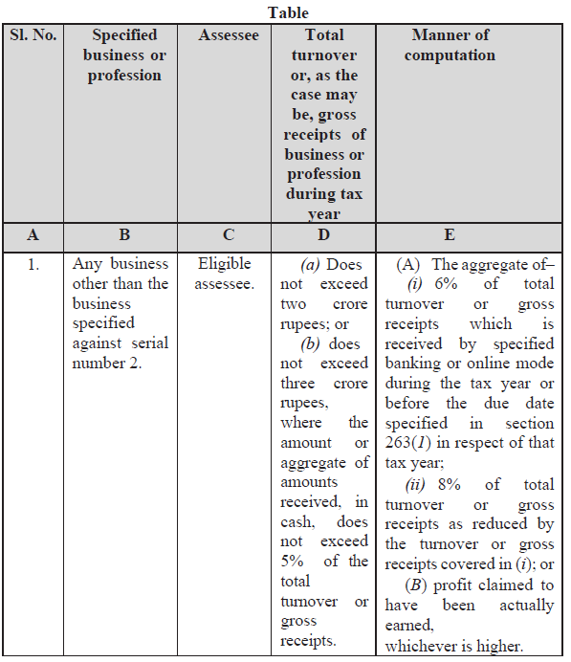
Presumptive Taxation
Tabular Presentation
  (2) The profits and gains of any specified business or profession as mentioned in column B of the Table below, carried on by an assessee specified in column C of the said Table, having total turnover or gross receipts of business or profession during the tax year specified in column D and computed in the manner specified in column E thereof, shall be deemed to be the profits and gains of such business or profession chargeable to tax under the head “Profits and gains of business or profession”.

Slide 34
Presumptive Taxation
Section 58(4) of the new Income Tax Act-
  Any loss, allowance or deduction allowable under the provisions of this Act, shall not be allowed against the income computed in the manner specified in sub-section (1).
  There is no restriction on adjustment of losses till now.

Slide 35
Presumptive Taxation-Overriding Effect
1961 Act- Sec. 44AD,ADA,AE- (1)
Notwithstanding anything to the contrary contained in sections 28 to 43C (Sec. 44AD)
Notwithstanding anything contained in sections 28 to 43C (Sec. 44ADA)
Notwithstanding anything to the contrary contained in sections 28 to 43C (Sec. 44AE)
2025 Act- Sec. 58(1)
The provisions of sections 26 to 54, to the extent contrary to this section, shall not apply to the manner of computation of profits and gains of the specified business or profession in sub-section (2)

Slide 36
Accounts and Audit

Slide 37
Accounts and Audit
Sec. 62:
Maintenance of books of account
(Present Sec. 44AA)
Sec. 63
Tax Audit
(Present Sec. 44AB)

Slide 38
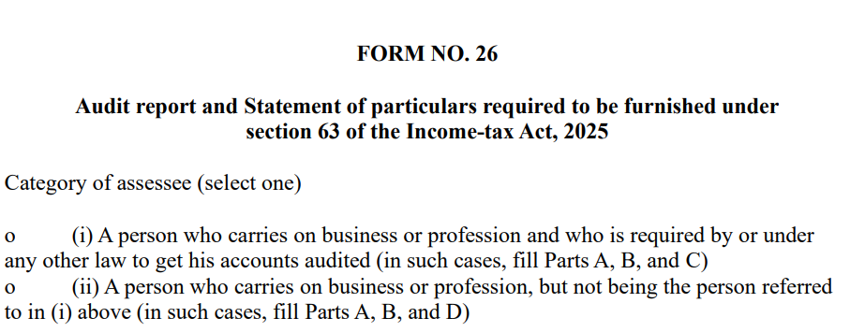
Audit Report
Rule 47
Form no. 26 : Existing forms 3CA,3CB and 3CD all merged into one.
Form 3CA/3CB is Part C/ Part D of form 26.
Form 3CD is Part A and B of form 26.

Slide 39
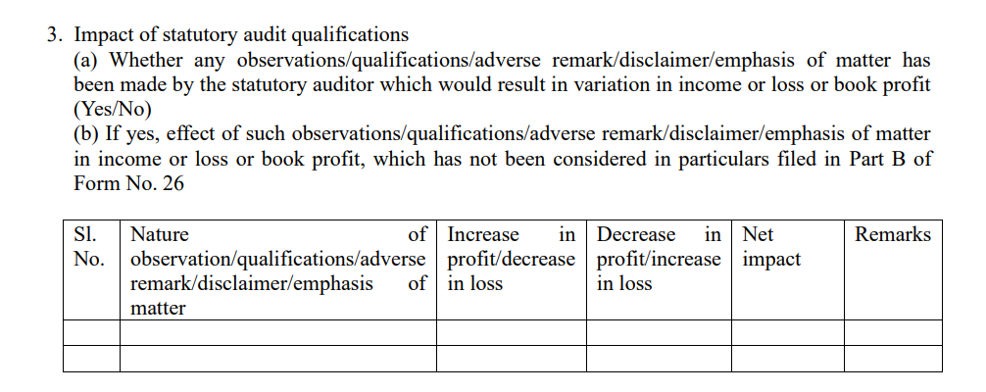
Audit Report : Expanded Scope
Part C/ Part D of Form 26 : Impact of Statutory Audit Qualifications

Slide 40
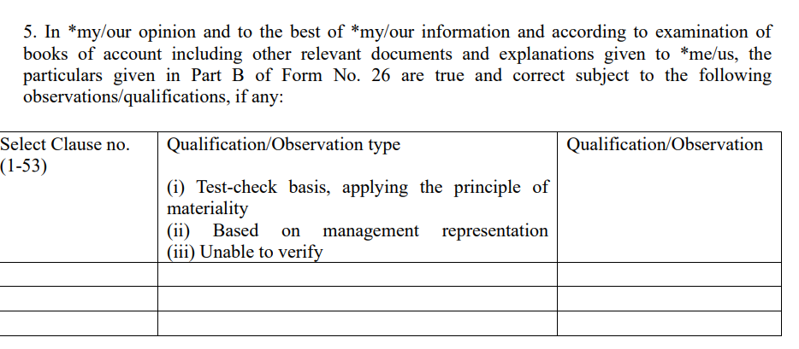
Audit Report : Pin Pointed Reporting
Part C/ Part D of Form 26 :

Slide 41
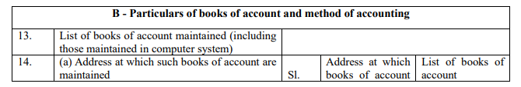
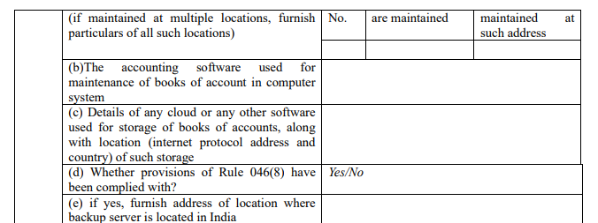
Audit Report : Additional Reporting

Slide 42
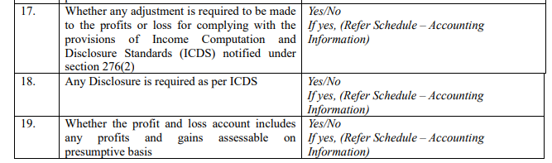
Audit Report : Changed Pattern

Slide 43
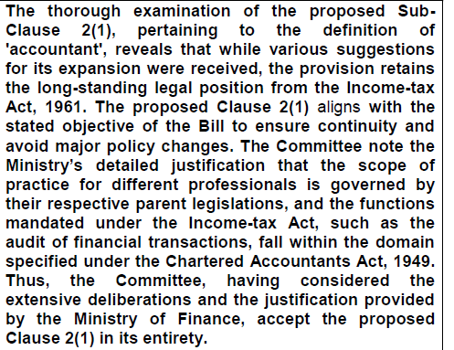
Tax Audit
Only C.A. are eligible

Slide 44
Profits and Gains of Business and Profession
Sec. 26 | Income under the head "Profits and Gains of Business or Profession" | 28
Sec. 27 | Manner of computing profits and gains of business or profession | 29
Sec. 28 | Rent, rates, taxes, repairs and insurance | 30, 31
Sec. 29 | Deductions related to employee welfare | 36
Sec. 30 | Deduction on certain premium | 36
Sec. 31 | Deduction for bad debt and provision for bad and doubtful debt | 36
Sec. 32 | Other deductions | 36
Sec. 33 | Deduction for depreciation | 32

Slide 45
Profits and Gains of Business and Profession
Sec. 34 | General conditions for allowable deductions | 37
Sec. 35 | Amounts not deductible in certain circumstances | 40
Sec. 36 | Expenses or payments not deductible in certain circumstances | 40A
Sec. 37 | Certain deductions allowed on actual payment basis only | 43B
Sec. 38 | Certain sums deemed as profits and gains of business or profession | 41
Sec. 39 | Computation of actual cost | 43
Sec. 40 | Special provision for computation of cost of acquisition of certain assets | 43C
Sec. 41 | Written down value of depreciable asset | 43

Slide 46
Profits and Gains of Business and Profession
Sec. 42 | Special provisions consequential to change in rate of exchange of currency | 43A
Sec. 43 | Taxation of foreign exchange fluctuation | 43AA
Sec. 44 | Amortization of certain preliminary expenses | 35D
Sec. 45 | Expenditure on scientific research | 35
Sec. 46 | Capital expenditure of specified business | 35AD
Sec. 47 | Expenditure on agricultural extension project and skill development project | 35CCC,35CCD
Sec. 48 | Tea development account, coffee development account and rubber development account | 33AB

Slide 47
Profits and Gains of Business and Profession
Sec. 49 | Site Restoration Fund | 33ABA
Sec. 50 | Special provision in the case of trade, profession or similar association | 44A
Sec. 51 | Amortisation of expenditure for prospecting certain minerals | 35E
Sec. 52 | Amortisation of expenditure for telecommunications services, amalgamation, demerger, scheme of voluntary retirement, etc. | 35AB, 35DD, 35DDA
Sec. 53 | Full value of consideration for transfer of assets other than capital assets in certain cases. | 43CA
Sec. 54 | Business of prospecting for mineral oils | 42
Sec. 55 | Insurance business | 44
Sec. 56 | Special provision in case of interest income of specified financial institutions | 43D

Slide 48
Profits and Gains of Business and Profession
Sec. 57 | Revenue recognition for construction and service contracts | 43CB
Sec. 58 | Special provision for computing profits and gains of business or profession on presumptive basis in case of certain residents | 44AD, 44ADA, 44AE
Sec. 59 | Chargeability of royalty and fee for technical services in hands of non-residents | 44D,44DA
Sec. 60 | Deduction of head office expenditure in case of non-residents | 44C
Sec. 61 | Special provision for computation of income on presumptive basis in respect of certain business activities of certain non-residents | 44B, 44BB, 44BBA, 44BBB
Sec. 62 | Maintenance of books of account | 44AA
Sec. 63 | Tax audit | 44AB

Slide 49
Profits and Gains of Business and Profession
Sec. 64,65 | Special provision for computing deductions in case of business reorganisation of co-operative banks | 44DB
Sec. 66 | Interpretation | -

Slide 50
Capital Gains
Same Story… Continue

Slide 51
Sec. 67 -Charging Provisions (Present Sec. 45)
S.s. 1 - Normal Transfers
S.s. 6- Conversion into stock in trade
S.s. 9- Transfer by partner
S.s.10- Reconstitution of Partnership
S.s. 14- Joint Development Agreement

Slide 52
Sec. 70- Transactions not regarded as transfer (Present Sec. 47)
De-cluttering of presentation
No more clause (via), (viaa), (viab),(vib) etc.
Neatly numbered clauses- from clause (a) to clause (zl)

Slide 53
Sec. 72- Computation (Present Sec. 48)
Indexation is now history.
  No more a part of computation.
  Reference now available only for limited purposes of Sec. 197 (Present Sec. 112)- for computation of long term tax in specified case.
For all purposes like Set off/Carry forward of losses, exemptions u/s. 82 to 86 (present sec. 54 to 54F), computation has to be without indexation.
Cases where date of transfer is in 1961 Act but year of taxability is in 2025 Act – like conversion of capital asset into stock in trade- whether indexation would be allowed?

Slide 54
Deductibility of Interest
(3) In computing the income chargeable under the head “Capital gains”, the following amounts shall not be allowed as a deduction:—
  the interest claimed as deduction under section 22(1)(b) or under Chapter VIII;….
Whether any interest which is not covered in above, can be claimed as deduction?

Slide 55
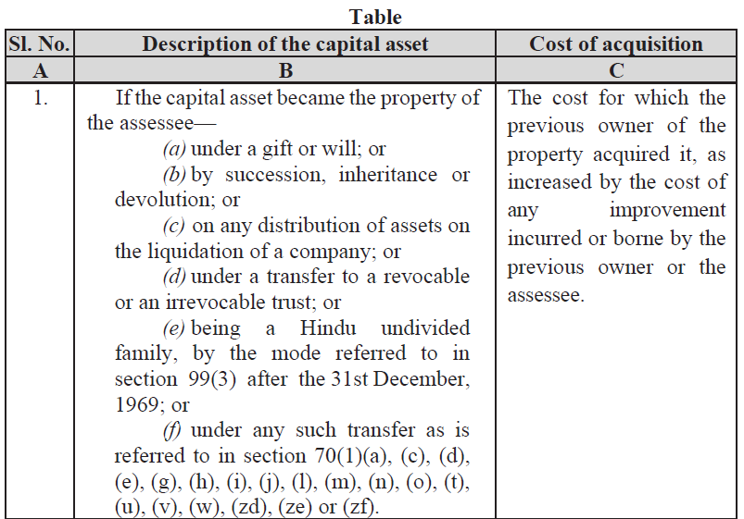
Sec. 73- Cost of acquisition in Previous Owner cases etc. (Present Sec. 49)
All cases converted into 24 Table Entries

Slide 56
Special Provisions : Sec. 50 to 50D of present act
Sec. 74 | Special provision for computation of capital gains in case of depreciable assets | 50
Sec. 75 | Special provision for cost of acquisition in case of depreciable asset | 50A
Sec. 76 | Special provision for computation of capital gains in case of Market Linked Debenture | 50AA
Sec. 77 | Special provision for computation of capital gains in case of slump sale | 50B
Sec. 78 | Special provision for full value of consideration in certain cases | 50C
Sec. 79 | Special provision for full value of consideration for transfer of share other than quoted share | 50CA
Sec. 80 | Fair market value deemed to be full value of consideration in certain cases | 50D

Slide 57
Deductions
Sale of Residential House (Old 54, New 82)
Sale of Agri. Land (Old 54B, New 83)
Capital Gain Bonds (Old 54 EC, New 85)
Sale of Other Long Term Assets (Old Sec. 54F, New 86)
Deductions

Slide 58
Rate of Tax
STT paid STCG (old 111A, New 196)
L.T.C.G (old 112, new 197)
STT Paid LTCG (old 112A, new 198)
One wonders why there is a need of separate Sec.197(112) and Sec. 198 (112A) now ?
No change in discriminatory treatment of STT paid STCG

Slide 59
Transfer before 23.07.24
Presently u/s. 112(a)(ii) , there are 2 rates of tax :-
  if the date of transfer is before 23.07.24- the rate of tax is 20%.
  if the date of transfer is on or after 23.07.24- the rate of tax is 12.5%.
In new Sec. 197, there is no mention of Transfers before 23.07.2024. Rate of tax is 12.5% for all transfers.
So cases where date of transfer is prior to 23.07.24 but year of taxability has got deferred – like conversion of capital asset into stock in trade- would also be taxed @12.5%.

Slide 60
Capital Gains
Sec. 67 | Capital gains | 45
Sec. 68 | Capital gains on distribution of assets by companies in liquidation | 46
Sec. 69 | Capital gains on purchase by company of its own shares or other specified securities | 46A
Sec. 70 | Transactions not regarded as transfer | 47
Sec. 71 | Withdrawal of exemption in certain cases | 47A
Sec. 72 | Mode of computation of capital gains | 48
Sec. 73 | Cost with reference to certain modes of acquisition | 49
Sec. 74 | Special provision for computation of capital gains in case of depreciable assets | 50

Slide 61
Capital Gains
Sec. 75 | Special provision for cost of acquisition in case of depreciable asset | 50A
Sec. 76 | Special provision for computation of capital gains in case of Market Linked Debenture | 50AA
Sec. 77 | Special provision for computation of capital gains in case of slump sale | 50B
Sec. 78 | Special provision for full value of consideration in certain cases | 50C
Sec. 79 | Special provision for full value of consideration for transfer of share other than quoted share | 50CA
Sec. 80 | Fair market value deemed to be full value of consideration in certain cases | 50D
Sec. 81 | Advance money received | 51

Slide 62
Capital Gains
Sec. 82 | Profit on sale of property used for residence | 54
Sec. 83 | Capital gains on transfer of land used for agricultural purposes not to be charged in certain cases | 54B
Sec. 84 | Capital gains on compulsory acquisition of lands and buildings not to be charged in certain cases | 54D
Sec. 85 | Capital gains not to be charged on investment in certain bonds | 54EC
Sec. 86 | Capital gains on transfer of certain capital assets not to be charged in case of investment in residential house | 54F
Sec. 87 | Exemption of capital gains on transfer of assets in cases of shifting of industrial undertaking from urban area | 54G
Sec. 88 | Exemption of capital gains on transfer of assets in cases of shifting of industrial undertaking from urban area to any Special Economic Zone | 54GA

Slide 63
Capital Gains
Sec. 89 | Extension of time for acquiring new asset or depositing or investing amount of capital gains | 54H
Sec. 90 | Meaning of "Adjusted", "Cost of Improvement" and "Cost of acquisition" | 55
Sec. 91 | Reference to Valuation Officer | 55A

Slide 64
Other Sources

Slide 65
Income from Other Sources
Sec. 92 | Income from other sources | 56
Sec. 93 | Deductions | 57
Sec. 94 | Amounts not deductible | 58
“relative” means—
(i) in case of an individual—
(A) spouse;
(B) brother or sister;
(C) brother or sister of the spouse;
(D) brother or sister of either of the parents;
(E) any lineal ascendant (maternal as well as paternal) or
descendant;
(F) any lineal ascendant (maternal as well as paternal) or
descendant of the spouse;
(G) spouse of the person referred to in items (B) to (F); and
Suggestion of uniform treatment to reciprocal relations NOT accepted by Select Committee.
  Uncle to nephew is exempt
  Nephew to Uncle is taxable.

Slide 66
TDS/TCS
Sec. 392 to 402

Slide 67
Deduction and Collection at Source (TDS/TCS)
Sec. 392 | Salary and accumulated balance due to an employee | 192,192A
Sec. 393 | Tax to be deducted at source | 193-196D
Sec. 394 | Collection of tax at source | 206C
Sec. 395 | Certificates | 197, 203
Sec. 397 | Compliance and reporting | 200, 206
Sec. 398 | Consequences of failure to deduct or pay or, collect or pay | 201
Sec. 400 | Power of Central Government to relax provisions of this Chapter | -
Sec. 402 | Interpretation | -

Slide 68
Salary TDS
Present Sec. 192, 192A
New Act : Sec. 392
No specific change

Slide 69
Non Salary TDS
Major Structural Changes :-
Tabular Consolidation
Significant Change of Language

Slide 70
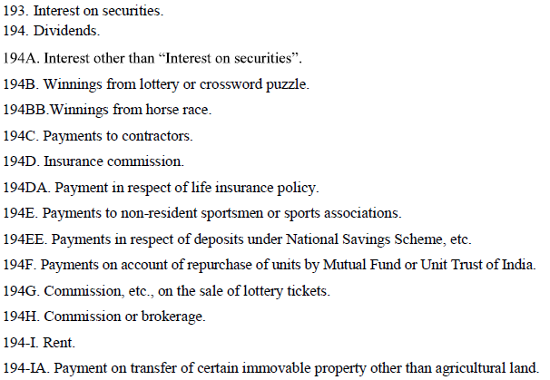
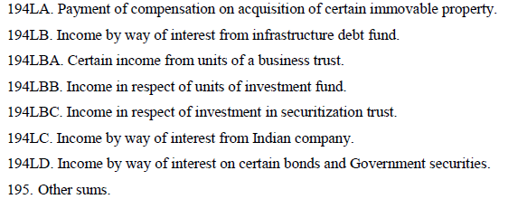

TDS : The Grand Consolidation
Sec. 393

Slide 71
Language Changes
Present
Any person, not being an individual or a Hindu undivided family, who is responsible for paying to a resident any sum by way of—
  …….
shall, at the time of credit of such sum to the account of the payee or at the time of payment thereof in cash or by issue of a cheque or draft or by any other mode, whichever is earlier, deduct an amount equal to … per cent of such sum as income-tax on income comprised therein :
Provided that no deduction shall be made under this section—
New Act
Where any income or sum of the nature specified in column B of the Table below, is credited or paid or distributed by the person specified in column C during the tax year, to a resident, the person responsible for paying such income or sum shall deduct income-tax,—
  on the entire amount of such income or sum, where the amount or aggregate of amounts exceeds the threshold limit specified in column D, or on sum as per Note 1 for serial number 8(ii), as the case may be;
  at the rate specified in column D;
  at the time of credit of such income or sum to the account of the payee or at the time of its payment in cash or by way of a cheque or a draft or by any other mode, whichever is earlier; and
  subject to the provisions of sub-sections (4), (5), (6), (8) and (9)……

Slide 72
Sec. 393 : Overall Structure
All TDS provisions –other then salary- are in one section
Section contains 4 tables
  Table to Sec. 393(1) – for payments to residents
    All cases covered in 8 different categories
  Table to Sec. 393(2) – for payments to non-residents
    17 Table entries
  Table to Sec. 393(3) – for payments not linked with residential status of payee :
    7 Table entries
  Table to Sec. 393(4) – Exemptions from TDS
    18 Table entries
Notes below the tables- to provide further clarifications
Single section spanning over 25 pages
Definition of relevant terms in separate section of Interpretation – Sec. 402

Slide 73
Decoding New Act
TDS will now be known by Sr. No. instead of Section No.
  Commission or Brokerage – Sr. no. 1
  Fees for professional services- Sr. no. 6(ii)(b)
Presently all provisions related with one particular payment are at one place- in one section.
Now threshold and rates are in separate table, exemptions are in separate table, some clarifications are there in notes and some further provisions are there in interpretation section.

Slide 74
Sec. 393(1)
Payments to Residents

Slide 75
Sec. 393(1)- 8 Cases of payment to Residents
Commission or brokerage.
Rent.
Payment on transfer of certain immovable property other than agricultural land.
Income from capital market.
Interest income.
Payments to contractors, fees for professional and technical services, etc.
Dividend.
Other cases.

Slide 76

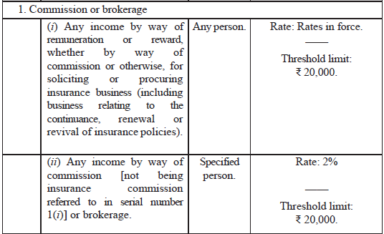
Sec. 393(1) : Commission or brokerage

Slide 77

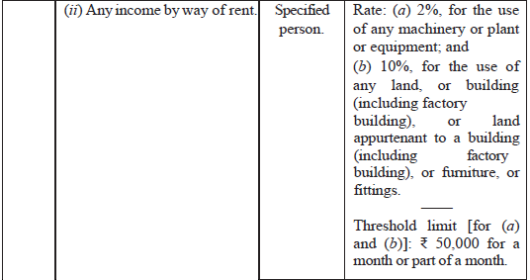
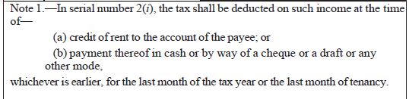
Sec. 393(1) : Rent

Slide 78
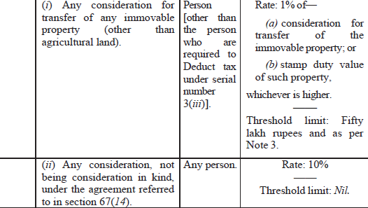
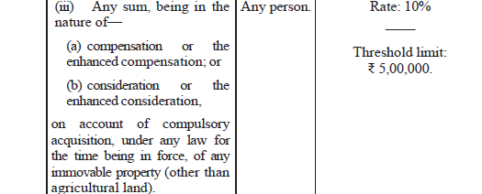
Sec. 393(1) : Payment on transfer of certain immovable property other than agricultural land

Slide 79
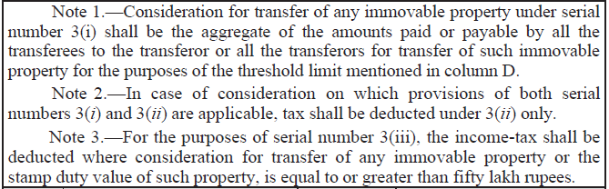
Sec. 393(1) : Payment on transfer of certain immovable property other than agricultural land

Slide 80
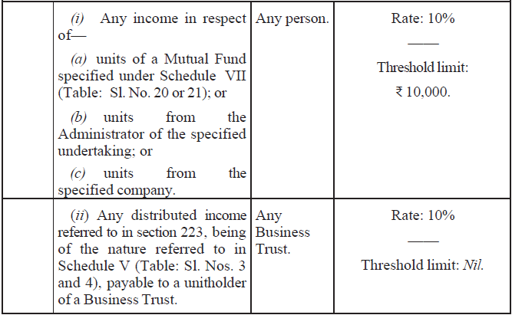
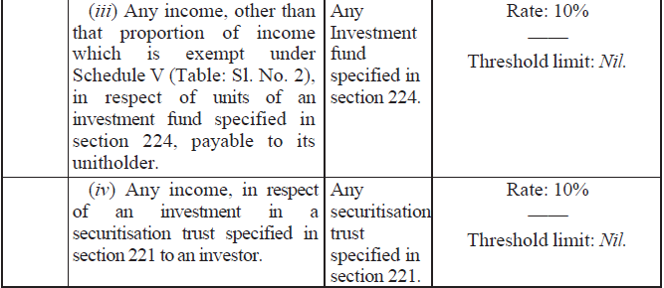
Sec. 393(1) : Income from capital market

Slide 81
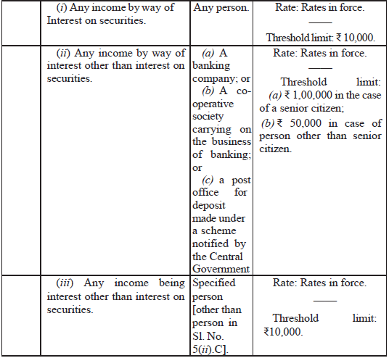
Sec. 393(1) : Interest
"Cont."

Slide 82
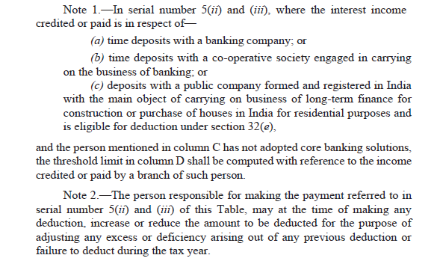
Sec. 393(1) : Interest income

Slide 83
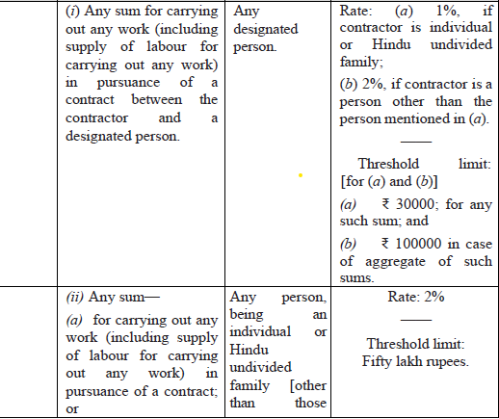
Sec. 393(1) : Payments to contractors, fees for professional and technical services, etc.

Slide 84
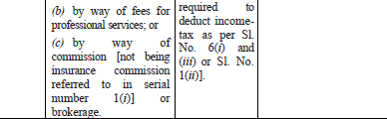
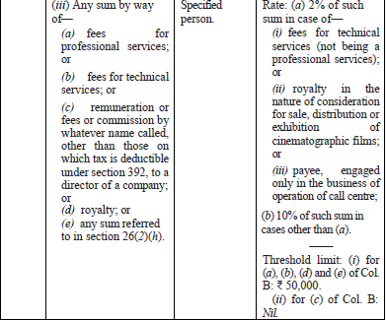
Sec. 393(1) : Payments to contractors, fees for professional and technical services, etc.

Slide 85

Sec. 393(1) :Dividend
.

Slide 86
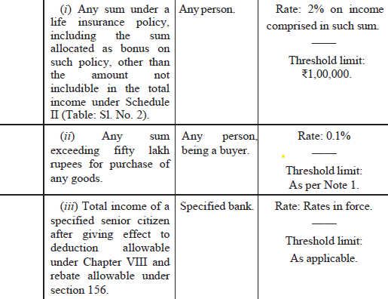
Sec. 393(1) :Other cases
.

Slide 87
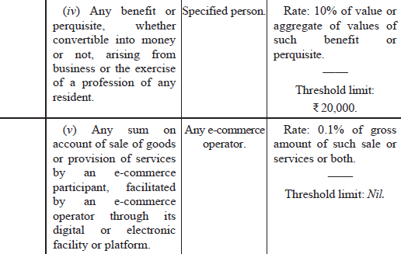

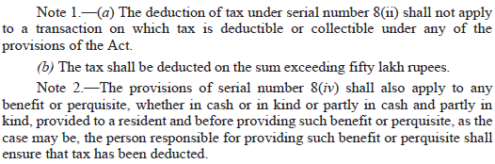
Sec. 393(1) :Other cases

Slide 88
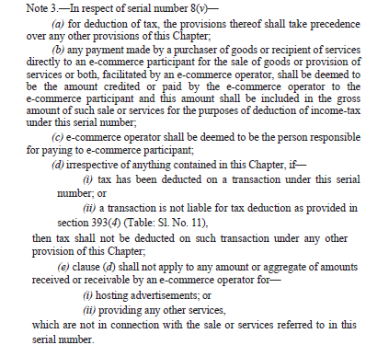
Sec. 393(1) :Other cases

Slide 89
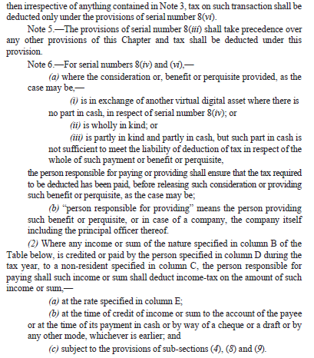
Sec. 393(1) :Other cases

Slide 90
Sec. 393(2)
17 Cases of Payments to Non Residents

Slide 91
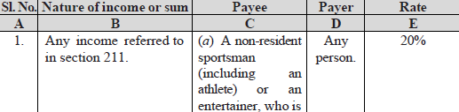
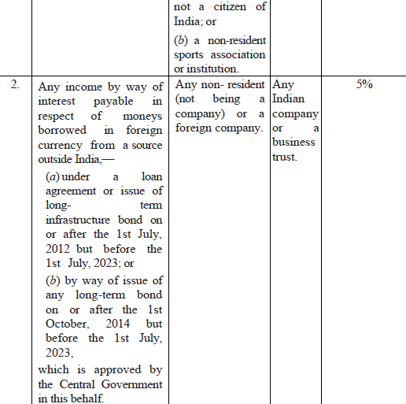
Sec. 393(2) :Payments To Non-Residents

Slide 92
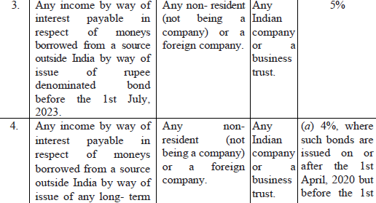
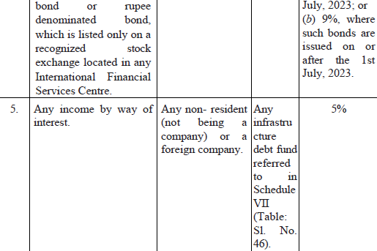
Sec. 393(2) :Payments To Non-Residents

Slide 93
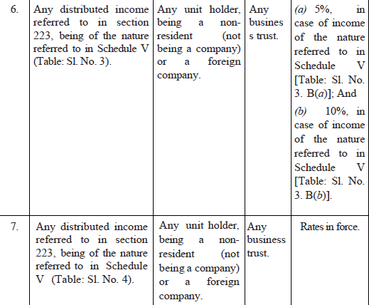
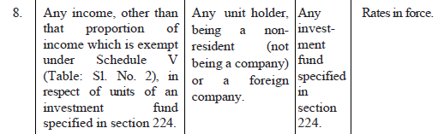
Sec. 393(2) :Payments To Non-Residents

Slide 94
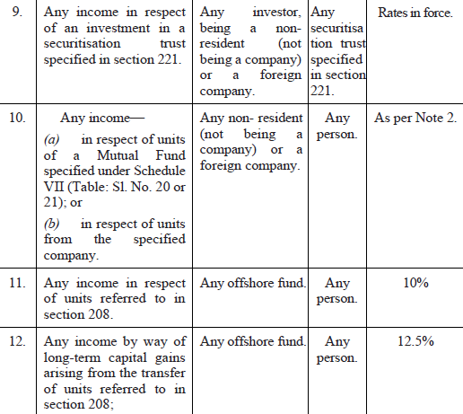
Sec. 393(2) :Payments To Non-Residents

Slide 95
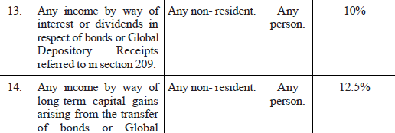
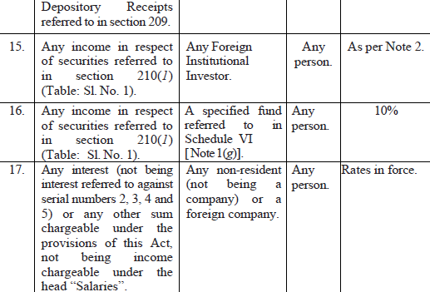
Sec. 393(2) :Payments To Non-Residents

Slide 96
Sec. 393(3)
7 Cases of TDS-
-Irrespective of Residential Status

Slide 97
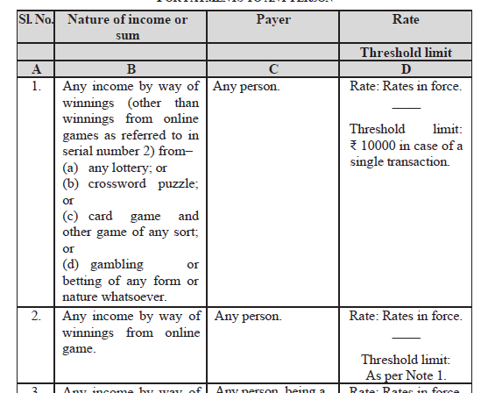
Sec. 393(3) :Payments To Any Person

Slide 98

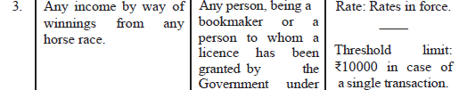
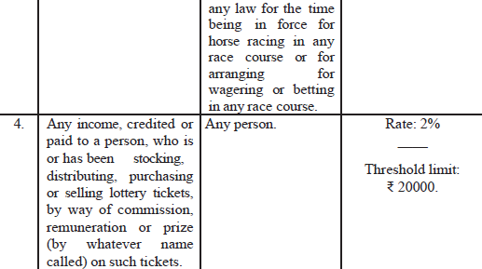
Sec. 393(3) :Payments To Any Person

Slide 99
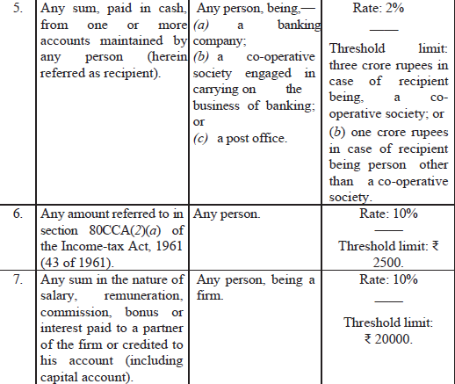
Sec. 393(3) :Payments To Any Person

Slide 100
Sec. 393(4)
No TDS Cases

Slide 101
Sec. 393 (4) : No Deduction At Source
19 Table entries
Linked with table entries in 393(1) to 393(3)
Provides situations where TDS u/s. 393(1)/393(2)/393(3) is not required.

Slide 102

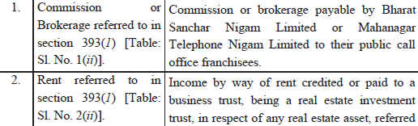
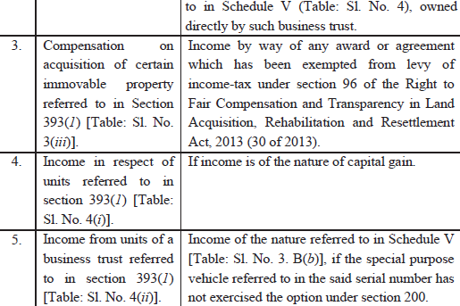
Sec. 393(4): No Deduction At Source

Slide 103
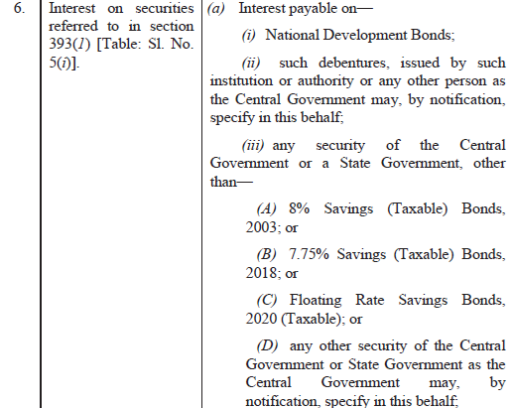
Sec. 393(4): No Deduction At Source

Slide 104
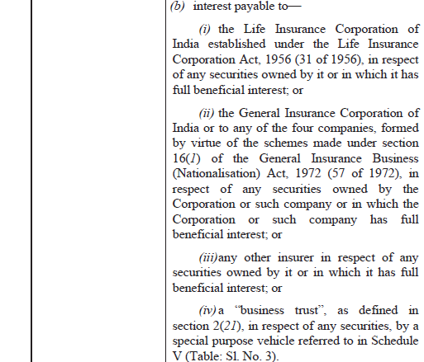
Sec. 393(4): No Deduction At Source

Slide 105
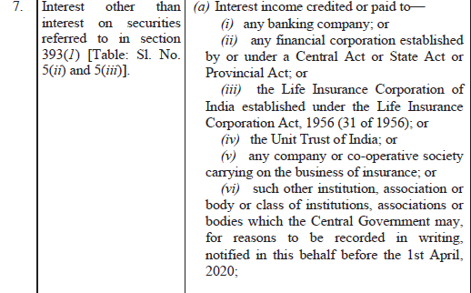
Sec. 393(4): No Deduction At Source

Slide 106
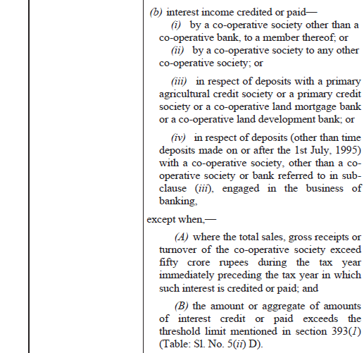
Sec. 393(4): No Deduction At Source

Slide 107


Sec. 393(4): No Deduction At Source

Slide 108


Sec. 393(4): No Deduction At Source

Slide 109


Sec. 393(4): No Deduction At Source

Slide 110


Sec. 393(4): No Deduction At Source

Slide 111


Sec. 393(4): No Deduction At Source

Slide 112


Sec. 393(4): No Deduction At Source

Slide 113


Sec. 393(4): No Deduction At Source

Slide 114

Sec. 393(4): No Deduction At Source

Slide 115
TCS
Sec. 394

Slide 116

Sec. 394 : TCS

Slide 117

Sec. 394 : TCS

Slide 118


Sec. 394 : TCS

Slide 119
Sec. 402
Interpretation of Terms used in Chapter XIX-B

Slide 120
Sec. 402 : Interpretation
Table entries need to be read with this section.
  TDS from commission is u/s. 393(1) : Table Sl. No. 1, Meaning of Commission : U/s. 402(7).
  (7) “commission or brokerage” includes any payment received or receivable, directly or indirectly, by a person acting on behalf of another person,––
    (a) for services rendered (not being professional services); or
    (b) for any services in the course of buying or selling of goods; or
    (c) in relation to any transaction relating to any asset, valuable article or thing, not being securities.

Slide 121
Procedural
Sec. 395 | Certificates | 197, 203
Sec. 397 | Compliance and reporting | 200, 206
Sec. 398 | Consequences of failure to deduct or pay or, collect or pay | 201

Slide 122
Correction Statement
Sec. 397(f) :
Every person referred to in clause (b) or (e) may correct any discrepancy or update the information furnished, in the statement delivered under the said clauses, by delivering a correction statement in such form and verified in such manner as may be prescribed, to the prescribed authority under the said clauses, within two years from the end of the tax year in which such statement is required to be delivered under the said clauses or under section 200 of the Income-tax Act, 1961.

Slide 123
Immediate Issues
Out of whole of 2025 Act, TDS would be the first issue on the block, requiring immediate implementation.
  New Challans?
  New “Form 13”?
  Revised Accounting Codes, Accounting software updations
On 7th of May, assessee would be paying challan for T.Y. 26-27 and then on 31st of May, challans of A.Y. 26-27 would get paid.

Slide 124
Thank You
Knowledge and Happiness –
Only Two Things Increase By Sharing
CA. Manish Dafria, Indore
mdafria@gmail.com
98260 46463

