Slide 1

Notes:
Kolkata – Bardman – Durgapur - Asansol
You are a bus driver, at the 1st stop 8 people get on, the road is bumpy and the bus is on its way to Asansol. At the 2nd stop 2 people get off and 2 more people get on. There is an infant on the bus who starts crying. The bus reached another stop where 1 person gets off. Finally, the bus is about to reach Asansol, on the 2nd last stop 3 more people get on and 2 get off again.
The question for all of you is - How old is the bus driver?

Slide 2
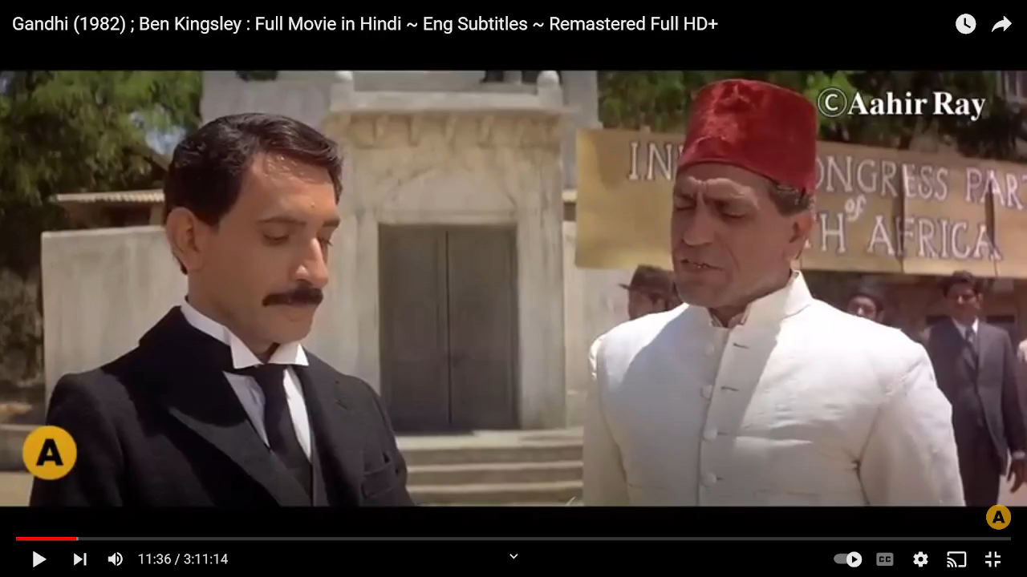

Slide 4
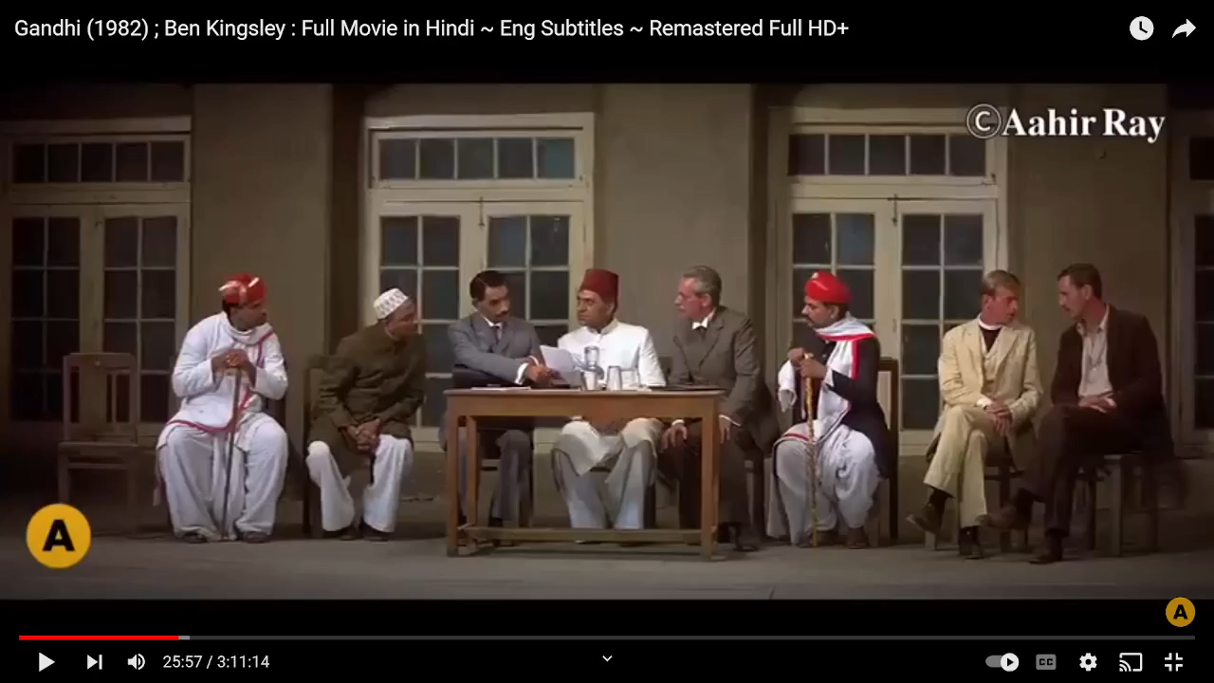

Slide 5
Notes:
Lead the discussion on how the speaker expressed concern towards the deepest fears of the audience – Compassion
Ask Participants to note down how they can show compassion towards their team members

Slide 6
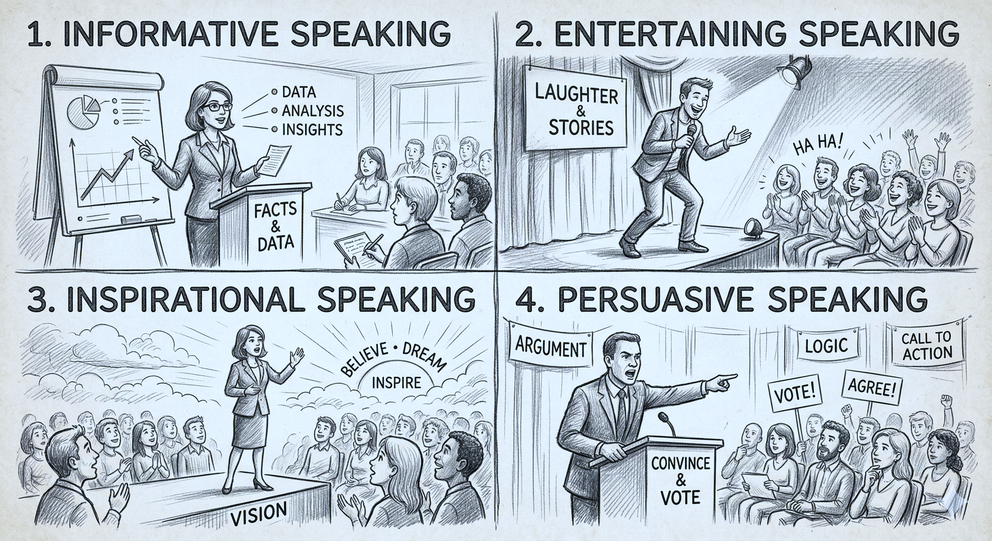

Slide 7
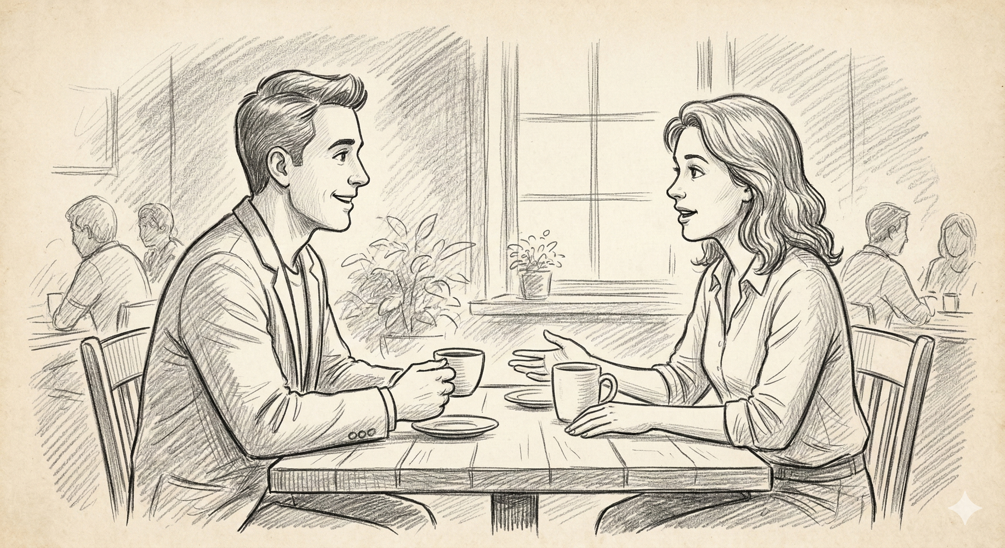

Slide 8
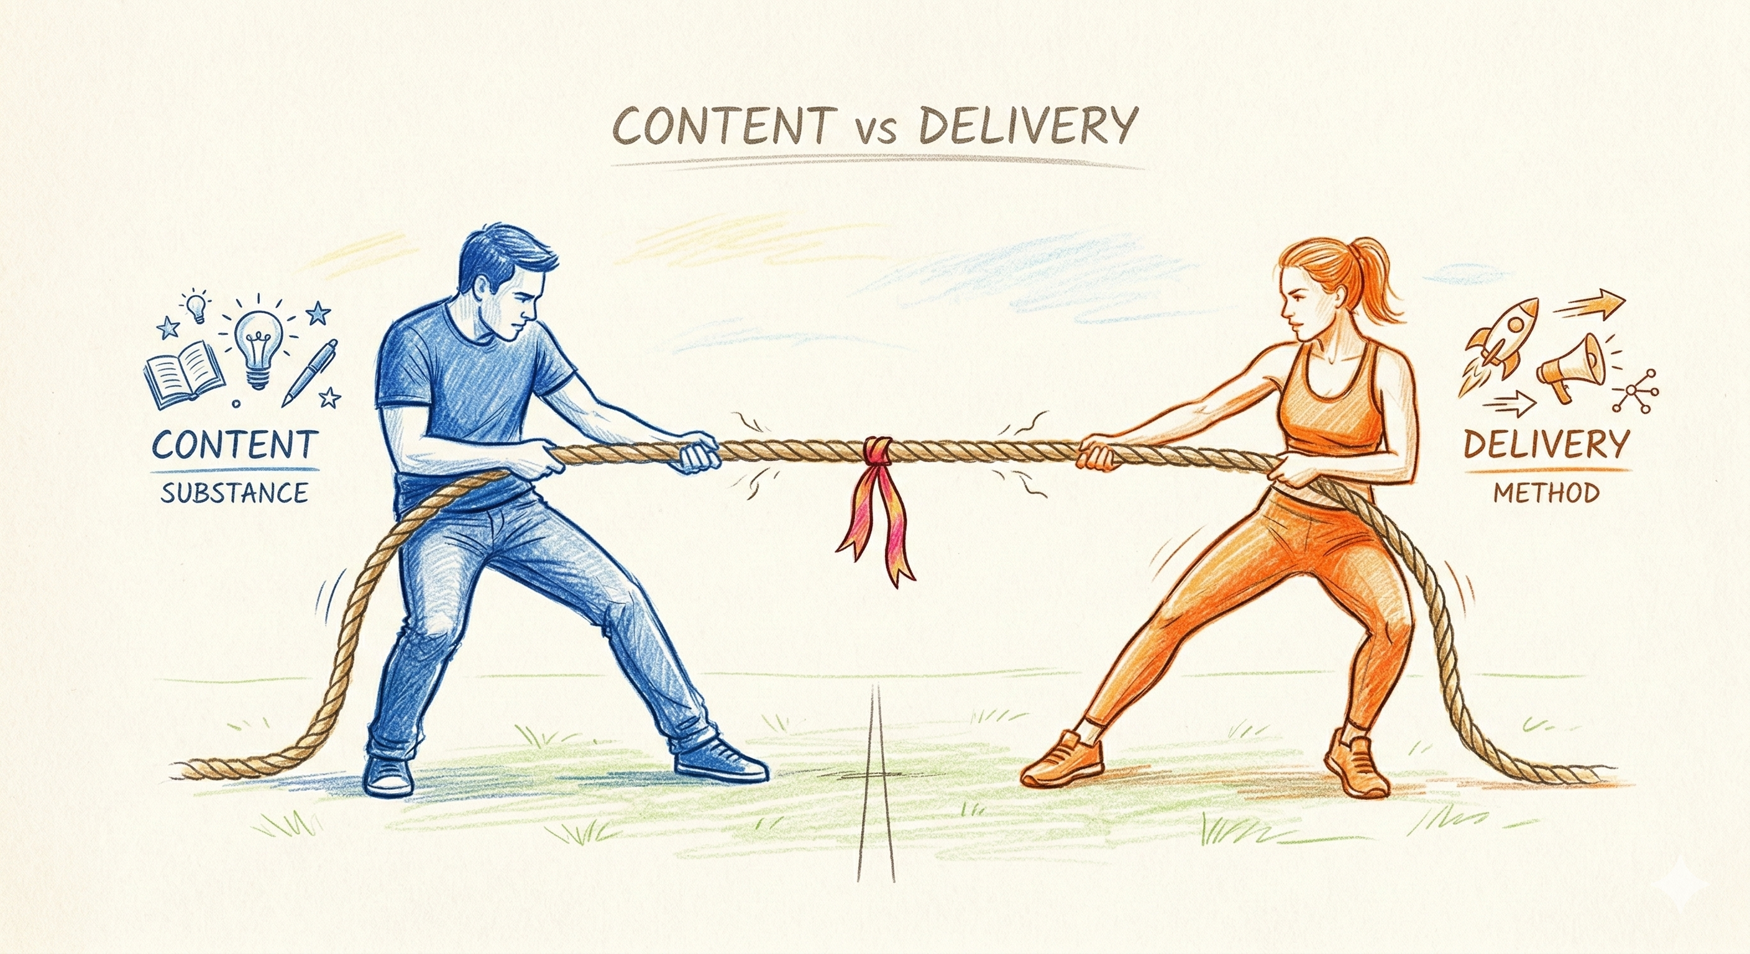

Slide 9
Notes:
What is the biggest enemy
Anxiety is the biggest enemy

Slide 11
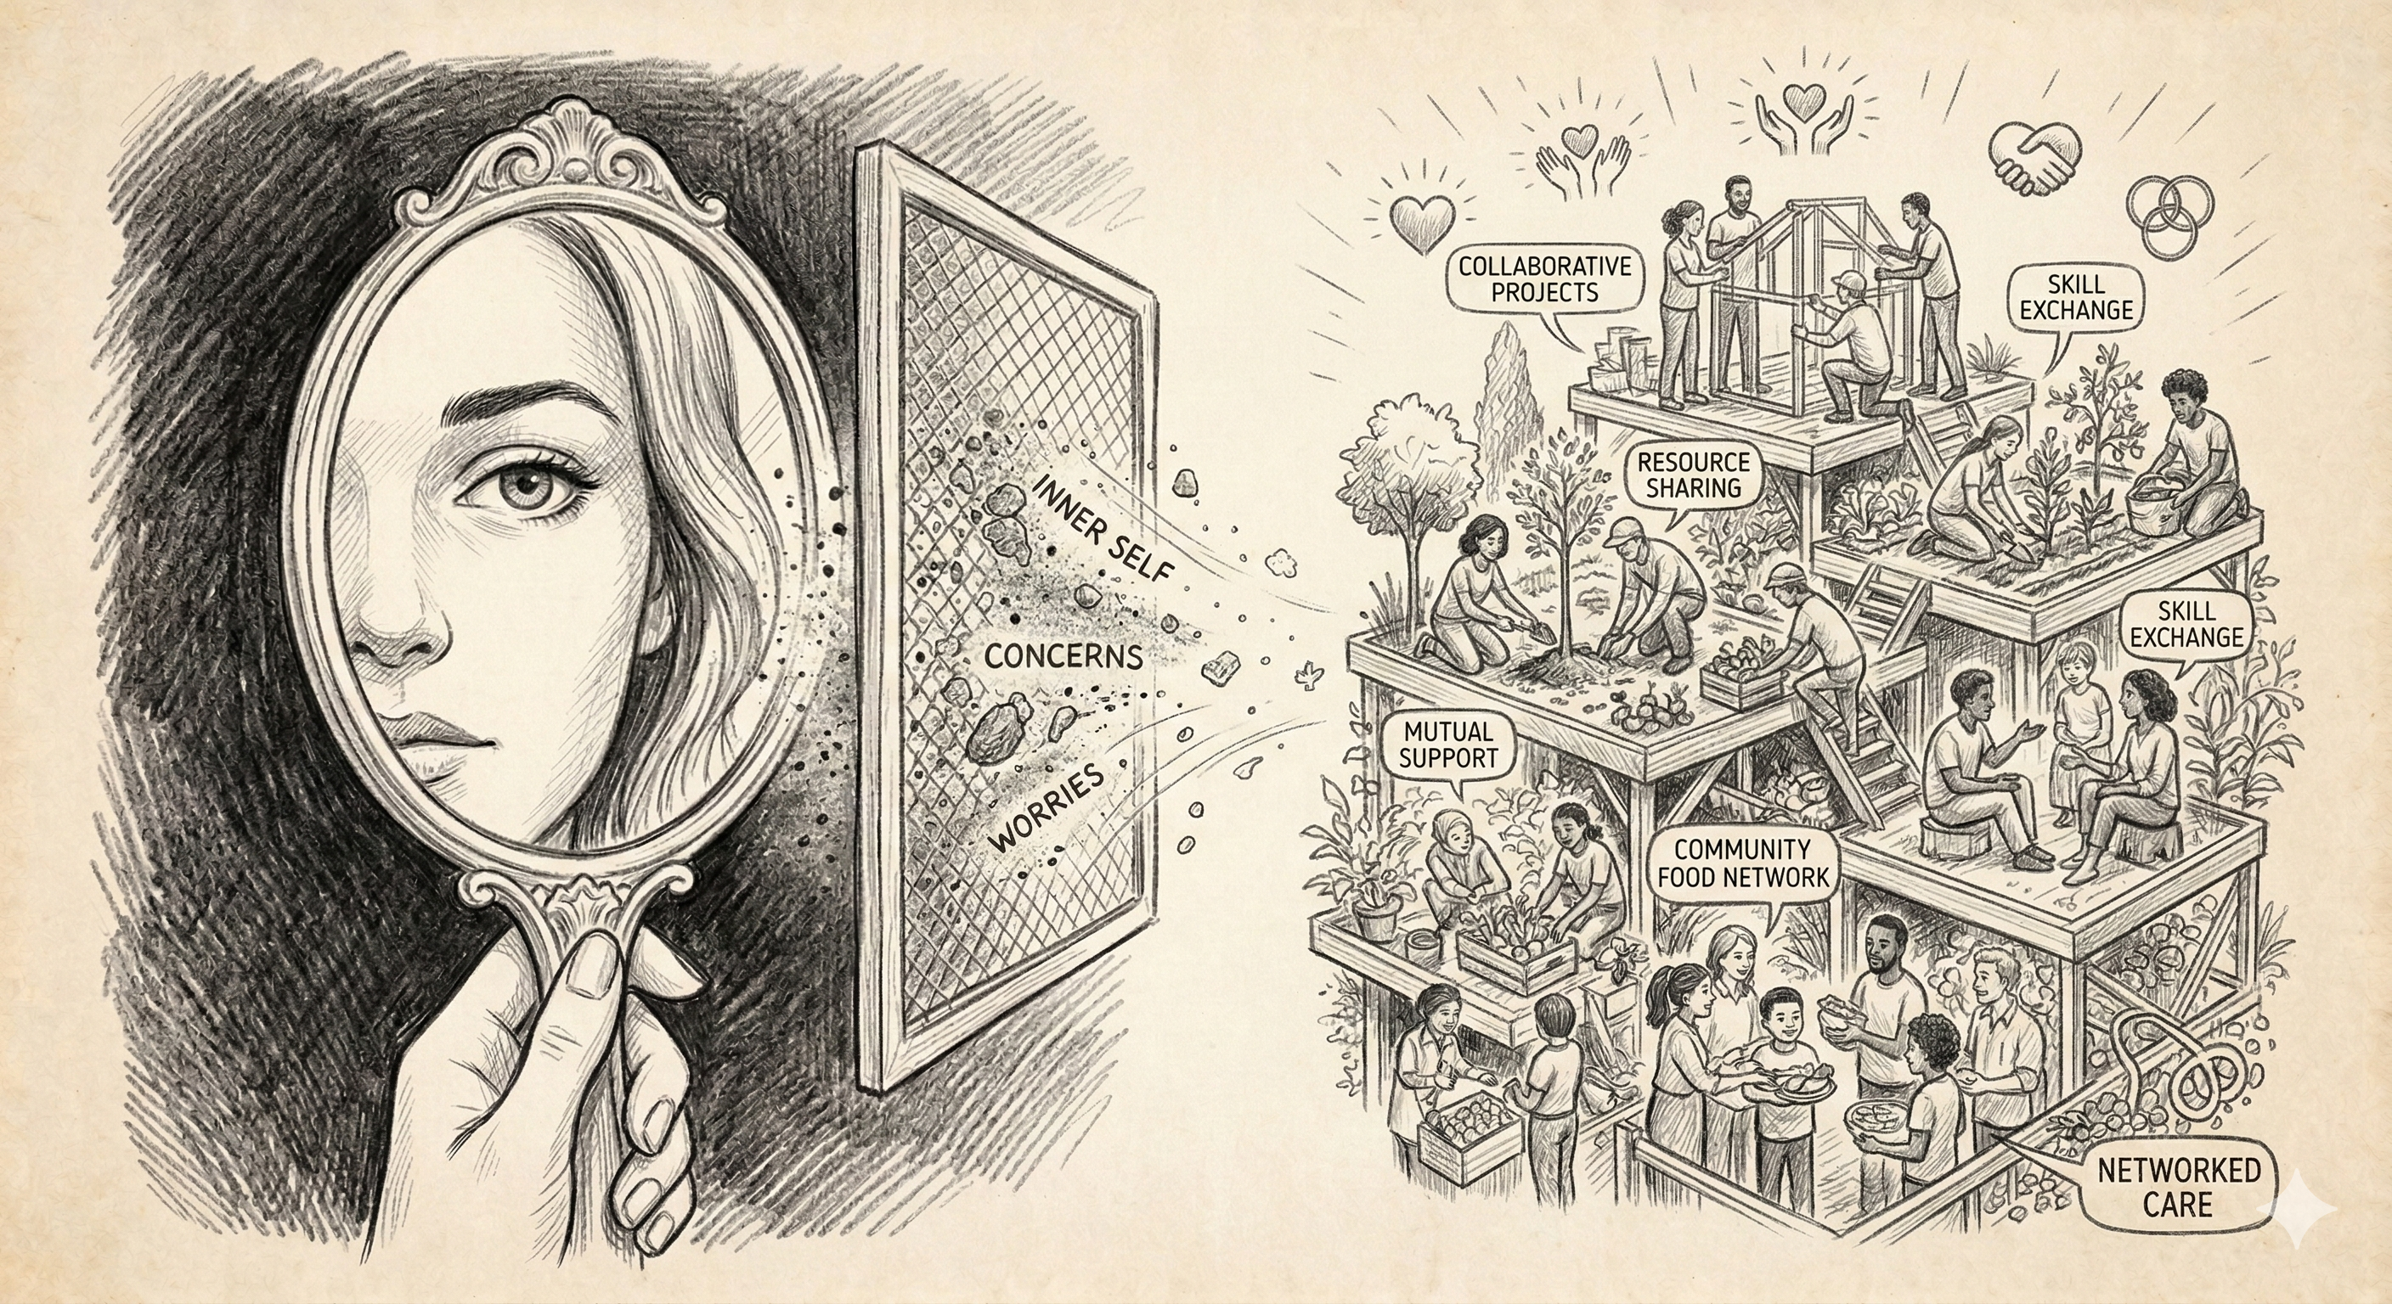
Notes:
Activity – Belly Breathing
think about how you are going to help them.

Slide 13

Notes:
Activity – of talking in spellings

Slide 15

Notes:
Tongue Twisters
I slit a sheet
A sheet I slit
On that Slitted sheet, I sit

Slide 17
Notes:
The authenticity Activity

Slide 19

Notes:
Trust Building

Slide 21

Notes:
Common Ground

Slide 23

Notes:
Contribution

Slide 25

Notes:
Impact

Slide 27


Slide 29

Notes:
Problem Solution Benefit
Umbrella Example

Slide 31

Notes:
The Goal – The Obstacle – The Transformation
Chakde India
The journey of becoming a CA
The Goal – Indpendent
Obstacle Time
Transformation – Become a non-perfectionist

Slide 33
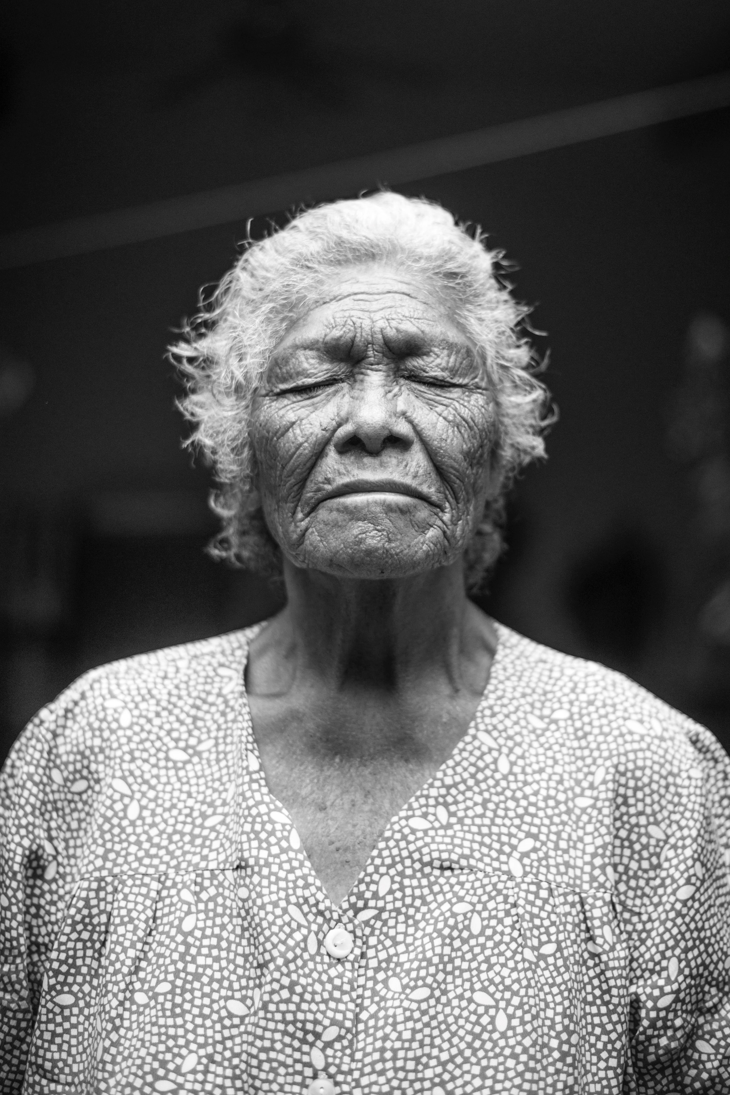
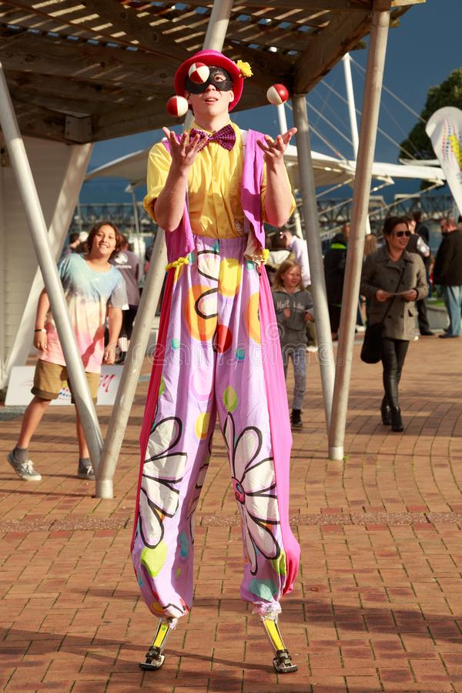
Notes:
Come back to anxiety
Happy
Sad
Naughty
Angry
Excited

Slide 34



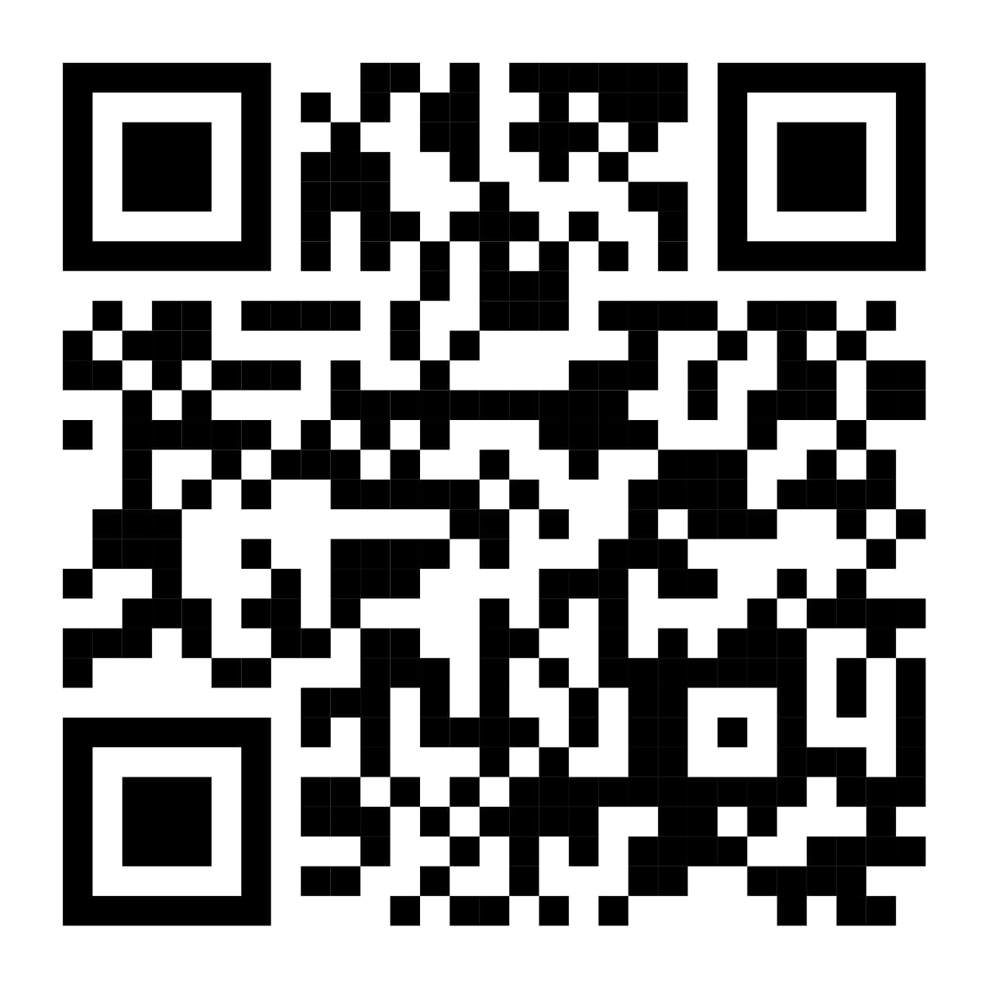
Follow me
ANUPRIYA CHOWDHARY
Storyteller, Author, Speaker, Coach

