Slide 1
The Institute of Chartered Accountants of India
Organised by : Commercial Laws & Economic Advisory Committee
Hosted by: Eastern India Regional Council
Two Day Conclave - Nuts & Bolts of Real Estate
13th & 14th March 2026 - R Singhi Hall, ICAI Bhawan, 7 Russell Street, Kolkata - 71

Slide 2

                Presentation By,
                Vinay Thyagaraj
                Partner M/s. Venu & Vinay
                Chartered Accountants,
                Bengaluru
RERA
Provisions
Consumer Protection
Rights

Slide 3
Presentation Overview - Contents
Real Estate Sector Challenges
Laws evolved over Real Estate Transactions
Present WB RERA Picture
RERA Applicability for Real Estate Project
Latest and important Circulars and Notification
RERA and Other Laws - Interplay
Judicial Rulings

Slide 4
LAWS EVOLVED WRT PROPERTY TRANSACTION
Contract Act 1872 –General – 154 years legacy
Transfer of Property Act,1882 – 144 years legacy
Indian Stamp Act, 1899 – 100 plus year legacy
Registration Act, 1908
Cooperative Societies Act 1912
Ownership Flats Act/ Apartment Act
Consumer Protection Act 1986
Real Estate(Regulation & Development) Act, 2016

Slide 5
STATEMENT OF OBJECTS AND REASONS OF THE ACT
Ensure Accountability Towards Allottees and Protect their Interest;
Infuse Transparency, Ensure Fair-play and Reduce Frauds & Delays;
Introduce Professionalism and Pan India Standardization;
Establish Symmetry Of Information between The Promoter And Allottee;
Imposing Certain Responsibilities On both Promoter And Allottees;
Establish Regulatory Oversight Mechanism to Enforce Contracts;
Establish Fast- Track Dispute Resolution Mechanism;
Promote Good Governance in the Sector which in turn would create investor confidence;

Slide 6
GOVERNANCE / AUTHORITY
The West Bengal Real Estate Regulatory Authority (WBRERA) is established under section 20 (1) of the Real Estate (Regulation and Development) Act, 2016 (Act No. 16 of 2016).
Objective: To regulate and promote the housing sector and to ensure sale of plot, apartment or building, as the case may be, or sale of real estate project, in an efficient and transparent manner and to protect the interest of consumers in the real estate sector and to establish a mechanism for speedy dispute redressal and for matters connected therewith or incidental thereto.
Registration of Real Estate Project with the Real Estate Regulatory Authority is compulsory under section 3 of the Real Estate (Regulation and Development) Act, 2016 (Act No. 16 of 2016).

Slide 7
Important Compliances
under RERA

Slide 8
Mandatory Compliances under RERA
Section | Provisions under the Act
3 | Prior Registration of Real Estate Project
4 (2)(L)(D) | Opening of Separate Bank Account For Each Project Deposit of 70 % of Amount realised from the Allottees into the RERA Separate Bank Account Obtaining Professional Certificates of Architects, Engineers and a Chartered Accountant in Practice before withdrawal of funds Such funds shall be withdrawn based on Percentage of Completion of the Project
11 and Rule 16(d) | Filing of Quarterly Progress Report with in 7 days from end of Each Quarter
4 (2)(L)(D) | Obtaining the Annual Audit under RERA with in 6 months from the end of the financial year (30.09.20xx)
6 and 7(3) | Obtain the Extension and Further Extension of the project – to keep the Registration valid (such application shall be made not be less than three months prior to the expiry of the registration granted)
11 | Engage, Transact only with RERA Registered Agents / Channel Partners

Slide 9
Mandatory Compliances under RERA
Section | Provisions under the Act
11(4)(d) | responsible for providing - maintaining the essential services, on reasonable charges, till the taking over of the maintenance of the project by the association of the allottees;
11(4)(e) | enable the formation of an association or society or co-operative society, as the case may be, of the allottees, or a federation of the same, under the laws applicable. (in case of absence of local laws, the association shall be formed within 3 months of majority allotments in the project)
11(4)(e) | execute a registered conveyance deed of the apartment, plot or building in favour of the allottee along with the undivided proportionate title in the common areas to the association of allottees or competent authority, as the case may be, as provided under section 17 of this Act
11(4)(g) | pay all outgoings until he transfers the physical possession of the real estate project to the allottee or the associations of allottees (a) Land Cost (b) Ground Rent, (c) Municipal Taxes, (d) Water, (e)Electricity charges (f) Maintenance charges, (g) Mortgage loan, interest, (h)Any other liabilities
14 | Defect Liability Period of 5 Years from the date of handover of the possession of the apartment or the common areas to the association of allottees
17 | (a) execute a registered conveyance deed in favour of the allottee along with the undivided proportionate title in the common areas to the association of the allottees or the competent authority, (b) hand over the physical possession of the plot, apartment of building, as the case may be, to the allottees and the common areas to the association of the allottees or the competent authority, (c) other title documents pertaining thereto within specified period as per sanctioned plans as provided under the local laws

Slide 10
RERA Registration is Mandatory
For Bankers to release the loan
Lenders to fund the project
Buyers to purchase the unit
Insurance company’s
Planning authority to release / Completion certificate

Slide 11
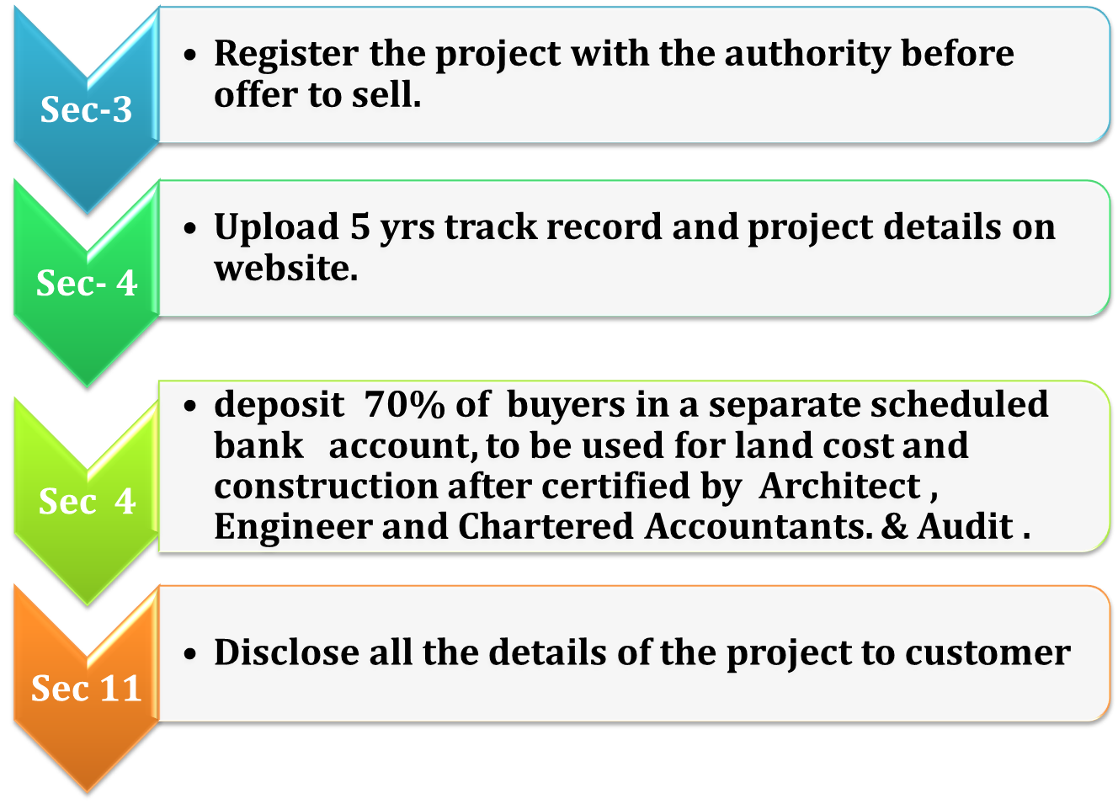
Obligation of Promoters

Slide 12
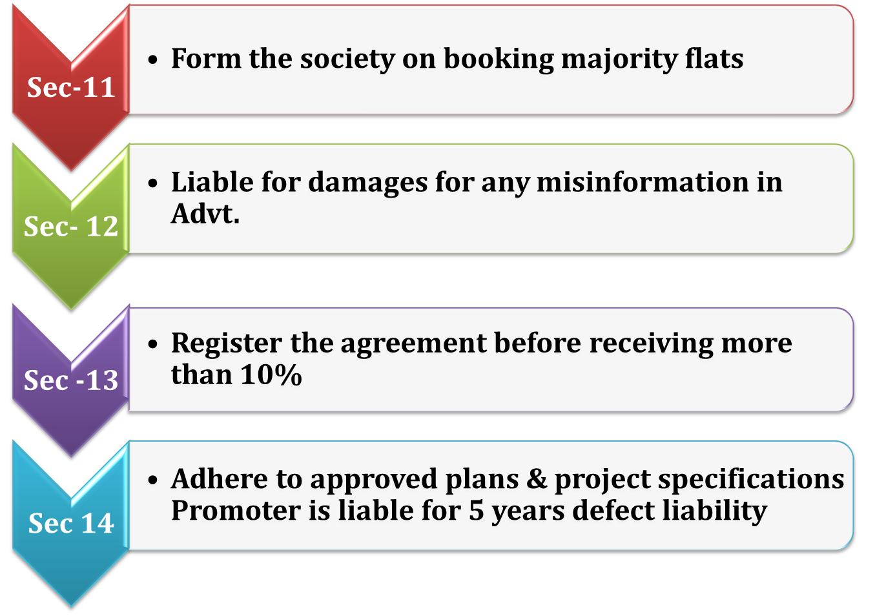
Obligation of Promoters

Slide 13
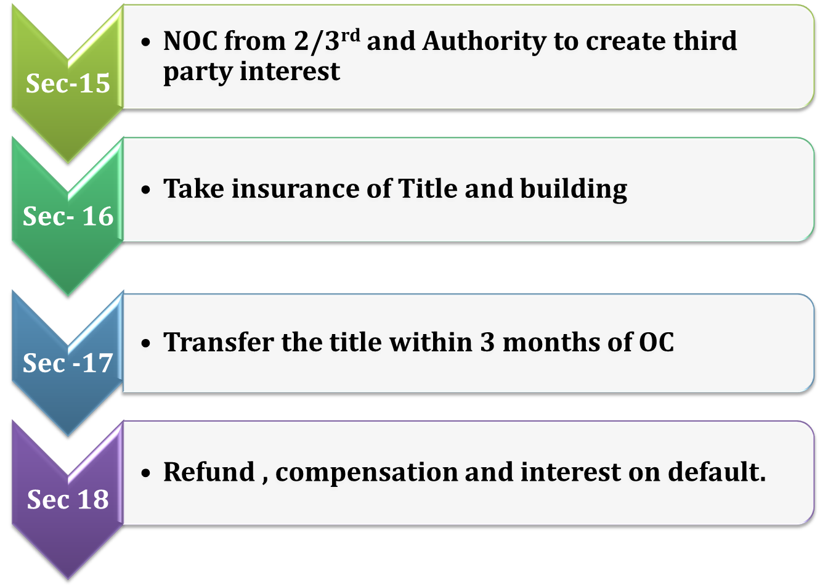
Obligation of Promoters

Slide 14
Project Registration Data
 | Completion Year
Registration year | 2023 | 2024 | 2024 | 2025 | 2025 | 2026 | 2027 | 2028 | 2029 | 2030 | 2031 | 2032 | 2034 | Grand Total
2023 | 30 | 194 | 194 | 246 | 246 | 216 | 120 | 101 | 17 | 3 | 2 |  |  | 929
2024 | 2 | 186 | 186 | 275 | 275 | 339 | 264 | 166 | 90 | 19 | 3 | 3 | 2 | 1349
2025 |  |  |  | 135 | 135 | 314 | 424 | 318 | 199 | 134 | 12 | 3 | 2 | 1541
2026 |  |  |  |  |  | 45 | 76 | 79 | 24 | 67 | 11 | 3 |  | 305
Grand Total | 32 | 380 | 380 | 656 | 656 | 914 | 884 | 664 | 330 | 223 | 28 | 9 | 4 | 4124

Slide 15
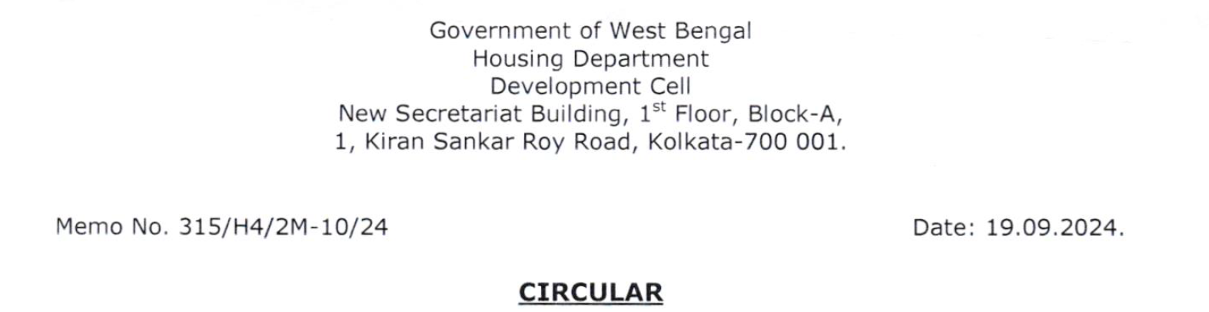
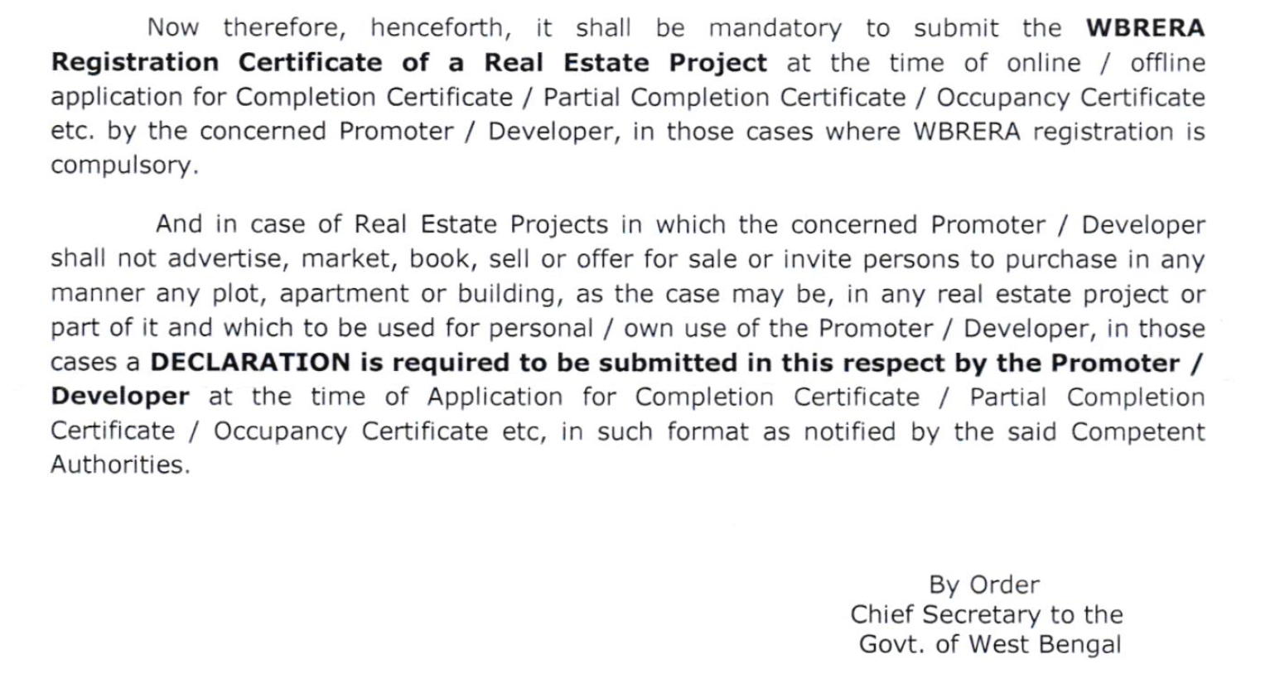

Slide 16
Section 6 – Extension – Importance of End Date
Application Submission 3 yeas prior to lapse of registration
Payment of Fees as per rule – 200 % of the Original Fees
Personal Hearing before the RERA Authority – Chairperson + members
West Bengal RERA New Extension Regulation Vide no 921 RERA dated 19-8-2025
Additional charges for delay in submission of the Application for Extension
Notarized Affidavit a Work milestone completion of the entire project till the completion date
The Applicant Promoter shall also upload the –Quarterly Update of Projects in the WBRERA website positively within 7 days from the end of each quarter and he shall also submit work Milestone on Notarized Affidavit to this Authority, both in hard and scan copies within 7 days after expiry of every 90 days from the date of approval of this extension stating in detail how such work has been done within said 9o days and how much work is pending after the said 9o days.

Slide 17
Section 6 – Extension
7. Authority may conduct inspection at any time without notice to ascertain the real facts and if any discrepancy / misrepresentation come to the notice of this Authority, stringent action shall be taken which may include revocation of extension, as per the provisions contained in the RERA Act.
8. Duly Approved by RERA Chairperson and 2 members

Slide 18
Section 7(3) – Extension
Running project under certain circumstances which were beyond the control of the promoter/developer and on fulfillment of certain further criterions within the provisions of the Acts and the Rules enumerated.
Thot the promoter developer has developed more thon 80% to 90% of the construction of that project;
Thot the promoter-developer shall declare through an Affidavit stoting the reason for such delay with cogent and sufficient proof in support of that declaration and shall also declare the date of further completion, if such extension is so granted/allowed by the Authority in respect of a particular project to the applicant.
For delay charges for submission of Extension application
For Late charges for execution in Extension applications

Slide 19
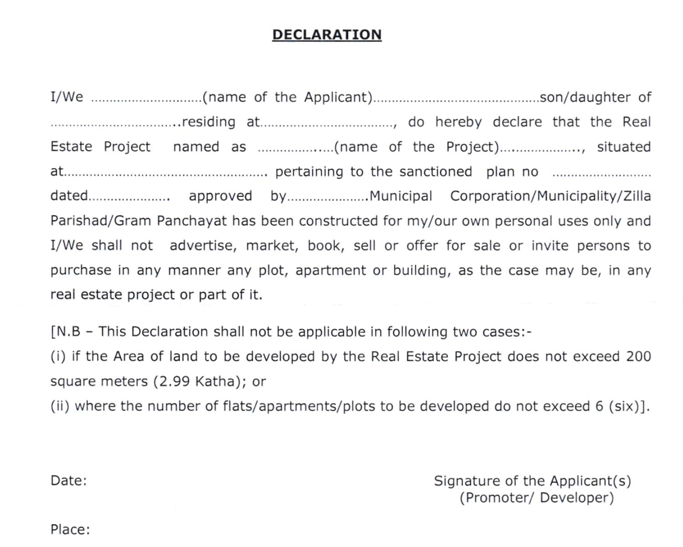
RERA REGISTRATION-NON-COMPLIANCE - SECTION 59

Slide 20

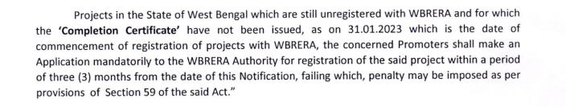


Question Frequently Asked
RERA Registration – for the real estate projects obtained the completion certificate
We frequently encounter the question: Why is RERA registration required for projects that have already received a completion certificate?
This question serves as a powerful reminder and encourages continuous reflection on the value and purpose of RERA: Why is registration under RERA required even for projects that have already received a completion certificate?

Slide 21
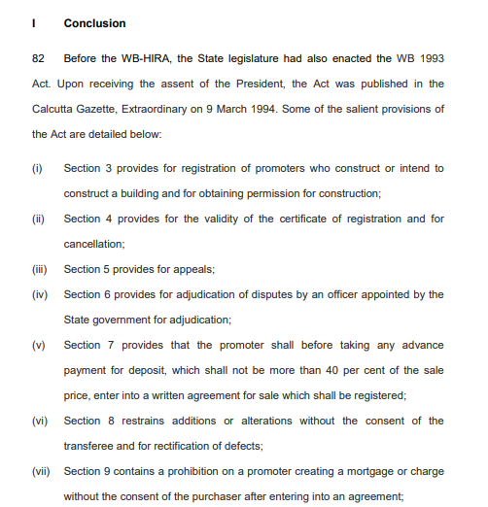
Supreme Court Judgement - Conclusion
From WB-HIRA to WB-RERA

Slide 22
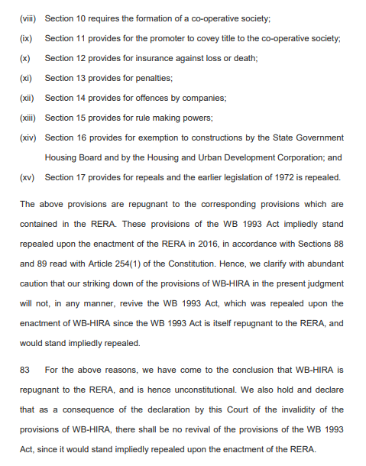
Supreme Court Judgement - Conclusion
From WB-HIRA to WB-RERA

Slide 23
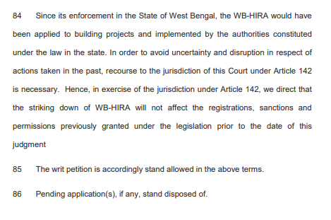
Supreme Court Judgement - Conclusion
From WB-HIRA to WB-RERA

Slide 24

The judgment by the Supreme Court of India on May 4, 2021, brought a significant shift in the regulatory framework for real estate projects in West Bengal. After the Supreme Court ruling, the registration of real estate projects in West Bengal was mandated to take place under WB RERA (West Bengal Real Estate Regulatory Authority), aligning the state’s regulatory framework with the provisions of the Real Estate (Regulation and Development) Act (RERA), 2016.
There are no registrations further made under West Bengal Housing Industry Regulation Act (WB HIRA) after May 2021 and the registrations are shown separately in the WB RERA Website which aims to enhance transparency, protect homebuyers’ interests, and streamline real estate project registrations and regulations across the country.

Slide 25
LATEST NOTIFICATION AND CIRCULARS
UNDER WB RERA

Slide 26
Sl No. | Notification Details | Dated
1 | Notice inviting Quotation (NIQ) from reliable agencies for carrying out publicity about WBRERA activities on various social media platforms. | Kolkata, 13/10/2025
2 | Extension of validity of the project registration under section 7(3) of the Real Estate (Regulation and Development) Act, 2016 | Kolkata, 19/08/2025
3 | Nomination of Nodal Officers regarding the resolution of public grievances of RERA projects. | Kolkata, 06/07/2025
4 | Extension of time regarding quarterly update of projects registered with WBRERA / erstwhile WBHIRA from 15.05.2025 to 31.05.2025. | Kolkata, 16/05/2025
5 | Order regarding Submission of Application for Project Extension. | Kolkata, 06/05/2025
6 | Extension of time regarding Quarterly Update of Real Estate Projects registered with WBRERA/erstwhile WBHIRA in the website of West Bengal Real Estate Regulatory Authority upto 15.05.2025 | Kolkata, 30/04/2025
7 | Extension of time regarding Quarterly Update of Real Estate Projects registered with WBRERA/erstwhile WBHIRA in the website of West Bengal Real Estate Regulatory Authority. | Kolkata, 04/04/2025
8 | Extension of time regarding Quarterly Update of Real Estate Projects registered with WBRERA / erstwhile WBHIRA in the website of West Bengal Real Estate Regulatory Authority upto 31.03.2025. | Kolkata, 06/03/2025
9 | Extension of time regarding Quarterly Update of Real Estate Projects registered with WBRERA / erstwhile WBHIRA in the website of West Bengal Real Estate Regulatory Authority upto 28.02.2025. | Kolkata, 31/01/2025
10 | Notification regarding some technical issues in WBRERA website | Kolkata, 09/01/2025

Slide 27
Sl No. | Notification Details | Dated
11 | Extension of time regarding Quarterly Update of Real Estate Projects registered with WBRERA / erstwhile WBHIRA in the website of West Bengal Real Estate Regulatory Authority | Kolkata, 26/12/2024
12 | Directions with regard to the Quarterly Update of Real Estate Projects registered with WBRERA / erstwhile WBHIRA in the website of West Bengal Real Estate Regulatory Authority | Kolkata, 06/12/2024
13 | Notification regarding remission of Stamp Duty and Registration Fee | Kolkata, 04/06/2024
14 | Circular regarding RERA Registration number mandatory in the Application for C.C. / Partial C.C. / O.C. in West Bengal | Kolkata, 30/09/2024
15 | Order Regarding Advertisement and other Publicities of Registered Projects | Kolkata, 25/07/2024
16 | Notification for Online Registration of Projects which have obtained Occupancy Certificate but not Completion Certificate as on 31.01.2023 | Kolkata, 13/05/2024
17 | Extended List (till 25.08.2023) of Real Estate Agent under PMLA, 2002 | Kolkata, 26/09/2023
18 | Awareness for Real Estate Agents made by Security Council 1718 Sanctions Committee – 1 | Kolkata, 25/08/2023
19 | Notification for Compulsory Registration before Advertisement, Sale and Booking etc. | Kolkata, 27/06/2023
20 | Notification for registration of Real Estate Projects under WBRERA | Kolkata, 14/06/2023

Slide 28
Sl No. | Notification Details | Dated
21 | Notice regarding Refund of Project / Agent Registration and Adjudication fees deposited to erstwhile WBHIRA | Kolkata, 27/04/2023
22 | Order relating to Application of Section 3 (1) of RERA Act beyond the Planning areas in the state of West Bengal | Kolkata, 22/03/2023
23 | Notification for ongoing Projects | Kolkata, 08/02/2023

Slide 29
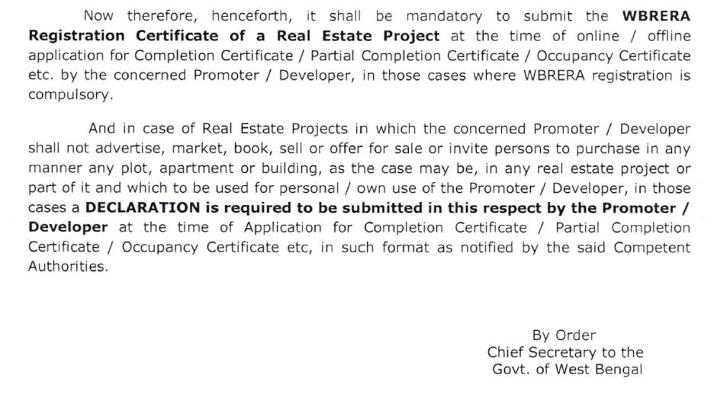
Circular regarding RERA Registration number mandatory in the Application for C.C. / Partial C.C. / O.C. in West Bengal dated 30-09-2024

Slide 30
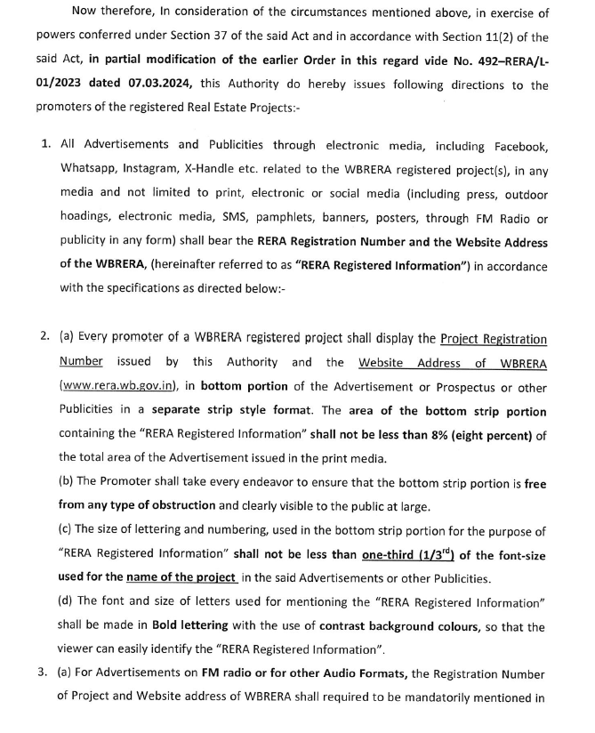
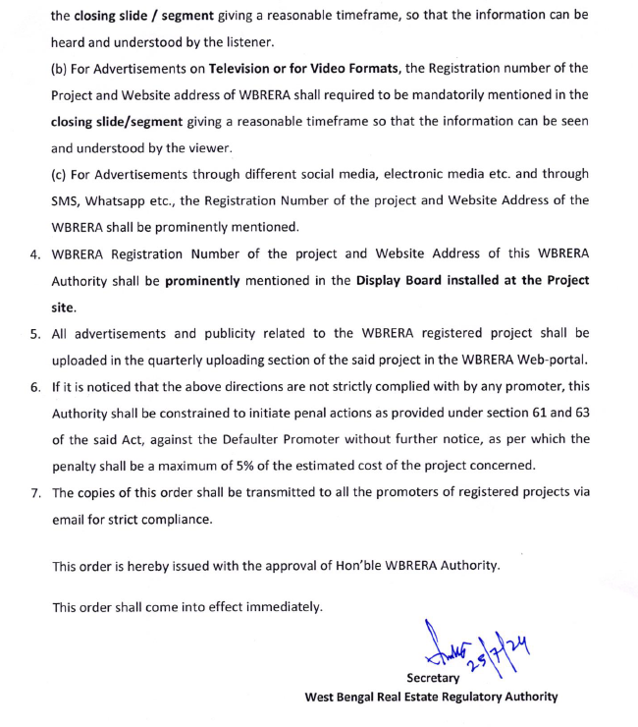
Order Regarding Advertisement and other Publicities of Registered Projects
dated 25-07-2024

Slide 31
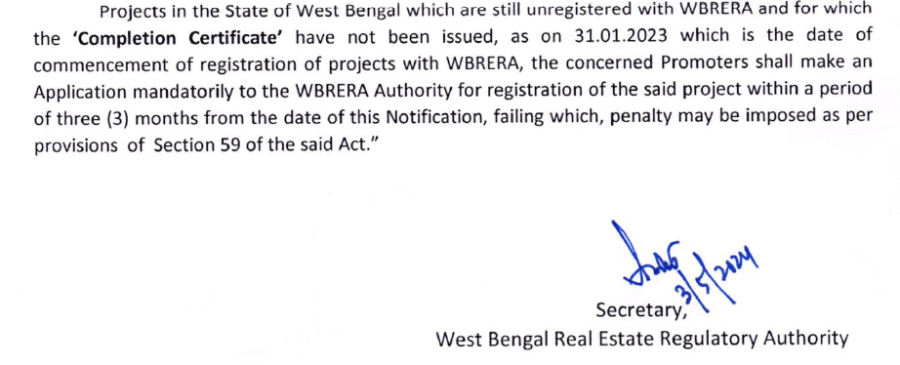
Notification for Online Registration of Projects which have obtained Occupancy Certificate but not Completion Certificate as on 31.01.2023 dated 13-05-2024

Slide 32
AGREEMENT OF SALE - AOS

Slide 33
AGREEMENT FOR SALE - AOS
Section 2(c)"agreement for sale" - means an agreement entered into between the promoter and the allottee;
Section 13 (1) A promoter shall not accept a sum more than ten per cent of the cost of the apartment, plot, or building as the case may be, as an advance payment or an application fee, from a person without first entering into a written agreement for sale with such person and register the said agreement for sale, under any law for the time being in force.

Slide 34
AGREEMENT FOR SALE - AOS
Section 13 (2) The agreement for sale referred to in sub-section (1) shall be in such form as may be prescribed and shall specify the particulars of development of the project including the construction of building and apartments, along with specifications and internal development works and external development works, the dates and the manner by which payments towards the cost of the apartment, plot or building, as the case may be, are to be made by the allottees and the date on which the possession of the apartment, plot or building is to be handed over, the rates of interest payable by the promoter to the allottee and the allottee to the promoter in case of default, and such other particulars, as may be prescribed.

Slide 35
WB RERA Rule 9- AGREEMENT FOR SALE -
WB RERA Rule 9(1) For the purpose of sub-section (2) of section 13 of the Act, the agreement for sale shall be in the Form in Annexure ‘A’ –
WB RERA Rule 9(2) Any application letter, allotment letter or any other document signed by the allottee, in respect of the apartment, plot or building, prior to the execution and registration of the agreement for sale for such apartment, plot or building, as the case may be, shall not be construed to limit the rights and interests of the allottee under the agreement for sale or under the Act or the rules or the regulations made thereunder.

Slide 36
WB RERA Rule 9- AGREEMENT FOR SALE -
WB RERA Rule 9(3) The Promoter shall not make any additions and alterations beyond the extent of 5(five) percent in the sanctioned plans, layout plans and specifications and the nature of fixtures, fittings and amenities described therein in respect of the apartment, plot or building, as the case may be, without the previous written consent of the Allottee

Slide 37

OTHER JUDICIAL RULINGS

Slide 38
Judgements by the WBREAT
Complaint No. | Parties to the case | Issue | Decisions
WBRERA / COM000934 | Yes Bank Limited vs Mega Resources Ltd and Ideal Real Estates (P) Ltd | 1.While the customer entered into the sale agreement, there was nothing in the records of the learned Regulatory Authority/WBHIRA that any mortgage had been created and obtained the possession of the apartment. 2.Later Debts Recovery Tribunal passed the order against the promoter. Promoter has taken and loan from the yes bank and the account became NPA. 3.Without the permission/two third confirmation of the allottees, the mortgage has been entered into by the promoter. | 1.Directed to stop all proceedings of Yes Bank including notice of auction 2.Bank is directed to take steps to vacate the physical possession of the flat 3.Any mortgage/charge created in respect of a project, the rights of an allottee shall remain unaffected.
WBRERA/COM000040 & COM000662 | M/s Maa Batai Construction vs Smt. Bharati Das & Asis Das | 1.Relief of termination of agreement of sale and refund the total amount paid with interest and compensation. 2. Promoter failed to complete the construction and handover the flat within schedule time | Ordered to refund back principal amount with interest.

Slide 39
Judgements
Complaint No. | Parties to the case | Issue | Decisions
 | The Bombay High Court, passed an order dated 5 January 2026 in a Second Appeal filed by M/s S. M. Infrastructures vs Fakhre Alam Shaikh. | Promoter received more than 10% of the consideration | No AFS signed | Demand letters issued without execution of AFS | Substantial consideration paid | LOA unilaterally terminated by Promoter | Complaint before MahaRERA | Termination set aside | To execute AFS | Appeal filed | Upheld MahaRERA Order | BHC upheld MahaRERA and MREAT orders Brief background - The appeal arose from a judgment of the MREAT dated 18 November 2024, which had affirmed the order passed by MahaRERA allowing the allottee’s complaint. In this matter, the promoter accepted a booking amount of Rs. 6 lakhs and thereafter continued to raise stage-wise demand letters, pursuant to which substantial payments were received from the allottee between 2014 and 2017. Despite receiving more than ten per cent of the agreed consideration, the promoter failed to execute and register an agreement for sale, while simultaneously continuing to demand and accept further amounts. Subsequently, alleging default on the part of the allottee in payment of outstanding dues, the promoter unilaterally cancelled the allotment and professed to terminate the contract. On this basis, the promoter claimed to have allotted the subject flat to another person, thereby asserting that third-party rights had been created and that the relief of execution of a registered agreement had become infructuous. Before the High Court, the promoter reiterated that the allottee was in default, that all flats in the project had been sold, and that third-party rights had been created, making it impossible to perform the contract. It was argued that the promoter was willing to refund the amounts received along with interest. The promoter further contended that between 2015 and 2017 the allottee had been repeatedly informed that the agreement for sale was ready for stamp duty and registration. | The Court stated that the MahaRERA and the Tribunal were justified in returning the findings that the promoter committed default in the discharge of its obligations. Appeal was dismissed with costs.

Slide 40
Judgements
Complaint No. | Parties to the case | Issue | Decisions
MahaRERA | 2026 | 1401 | The complaint was filed before MahaRERA by Yuvraj Kishan Chaudhari and three others against Neelkanth Palm Realty and another, seeking a determination as to whether “puzzle car parking” constitutes a common area under the Real Estate (Regulation and Development) Act, 2016. The Authority passed its order in this matter on 5 January 2026. | Whether puzzle car parking should be treated as part of the common areas of the project - Case of the Complainants - The complainants contended that 40 flat owners in the project were allotted puzzle parking by the respondent promoter. It was their understanding, as conveyed by the respondent, that such puzzle parking formed part of the common maintenance of the project. It was further stated that the puzzle parking was constructed in the common basement along with other ground and stacked parking spaces. The complainants emphasized that all 40 flat owners who were allotted puzzle parking had paid proportionate contributions towards common areas, the basement, and other amenities, in the same manner as other members of the society. The present complaint was filed seeking clarification as to whether puzzle car parking should be treated as part of the common areas of the project. Stand of the Respondent The respondent clarified before the Authority that puzzle car parking is, in fact, a common area. | Findings of MahaRERA on Maintainability MahaRERA observed that, in the present case, the dispute of the complainants was not with the respondent promoter or a real estate agent. At the very outset, therefore, the Authority held that the complaint was not maintainable under the provisions of the RERA Act. The Authority further noted that no provision of the Act confers jurisdiction upon MahaRERA to decide whether a particular amenity is a common area or otherwise. In the absence of specific jurisdiction under the Act, MahaRERA restrained from passing any order on the issue raised. The Authority stated that if the complainants desired such a determination, they were at liberty to approach the appropriate forum. Accordingly, the complaint was rejected.

Slide 41
Judgements
Complaint No. | Parties to the case | Issue | Decisions
BHC | RERA | 2026 | 0901 | The Bombay High Court Single Judge (N.J. Jamdar J) passed an Order dated 7 January 2026 in the matter in an IA in a second appeal filed by Propel Developers Pvt. Ltd. versus Mikunj Kiran Joshi and another matter. | Real Estate | Dispute Resolution | RERA | Payment of Interest | Till the actual delivery of possession or only till the date of offer of delivery of possession? In this matter, the substantial questions which arise for consideration are as under - Whether in respect of one and the same project and in matters arising out of identical facts-situation, one Bench of the Appellate Tribunal could take a contrary view on the aspect of the liability of the allottee to pay additional consideration upon purported increase in the carpet area, and the liability of the promoter to pay interest for the delay in delivery of possession, till the actual delivery of possession or only till the date of offer of delivery of possession, when one Honourable Member is a part of both the Benches, and, if not, whether failure to follow the earlier view or refer the matter to a larger Bench, vitiated the impugned judgment and order? Whether in the facts and circumstances of the case, the liability of the promoter to pay interest for the delayed delivery of possession of the subject flat, came to an end after two months of the offer to deliver the possession and, thus, the Appellate Tribunal was in error in directing the Promoter to pay interest till the actual delivery of possession? | The Court states that the question of entitlement of the respondents/allottees to the refund of the additional consideration alongwith interest, and interest for the delayed period of possession up to the date of actual physical delivery of possession, warrants consideration. The execution, operation, and implementation of the judgment and order of the tribunal is stayed till final hearing of the appeal subject to conditions inter alia that the promoter deposit the amount of additional consideration and GST before the tribunal.

Slide 42
Judgements
Complaint No. | Parties to the case | Issue | Decisions
MREAT | 2025 | 0801 | Deepak Sayaji Shinde vs M/s Swarajya Developers and Builders passed a judgment dated 23 December 2025. | The appeal arose from an order dated 24 February 2020 passed by the Maharashtra Real Estate Regulatory Authority in a complaint filed by the allottee. By the said order, the Authority disposed of the complaint on the ground that the land area and the project area were less than 500 square meters and that Section 3(2)(a) of the Real Estate (Regulation and Development) Act, 2016 exempted the project from mandatory registration with the Authority. Reliance on Earlier Tribunal Precedent and Submissions In the appeal, reliance was placed on the judgment of the Tribunal in Geetanjali Aman Construction v. Hrishikesh Ramesh Paranjpe. It was contended that the conditions relating to the area of the plot and the number of apartments for claiming exemption from project registration are not mutually exclusive, and that both conditions must be satisfied simultaneously in order to obtain exemption from registration under the Act. | Application of Larger Bench Decision The Tribunal observed that in Geetanjali Aman Construction vs Hrishikesh Ramesh Paranjpe the majority members of the larger bench of the Tribunal had held that once a project satisfies one of the conditions appearing that proceeds or succeeds the word “or” in the Clause, such project is not required to be registered. In view of the said majority decision of the larger bench, the Tribunal formed the opinion that the impugned order passed by the Authority did not warrant any interference in appeal. Pending Second Appeal Before the Bombay High Court - Geetanjali Aman Construction vs Hrishikesh Ramesh Paranjpe Please note that the Bombay High Court, in a second appeal filed by Hrishikesh Ramesh Paranjpe and another v. Geetanjali Aman Construction and others, has passed an order dated 5 January 2026. Considering that the issue involved pertains to the interpretation of Section 3(2)(a) of the RERA, the High Court observed that the matter could be disposed of finally at the admission stage and directed that it be heard finally on 6 February 2026.

Slide 43
ACCOUNTABILITY OF PROFESSIONALS
BOMBAY HC : 2nd APPEAL 13781 of 2018
M/s Sea Princess Realty Vs Allottees
Project : Gundecha Trillium
Possession Date : 31st December, 2016
MahaRERA order: 16.01.2018,
Decided - Interest for 6 months
MahaREAT order : 4th April, 2018
Conducted joint inspection & Allowed claim for interest for 1 year without relying on the certificate issued by the Architect which gave another date of completion.
Action against Architect for issuing wrong certificate of completion
Order for payment of interest on Delayed possession for 1 year.

Slide 44
RERA RULES CANNOT BE IN DEROGATION OF THE ACT
2020 SCC ONINE MAD 20120 4 LW 865
MADRAS HIGH COURT
SUBHASHINI THULASIRAM vs SPR & RG CONSTRUCTIONS PVT LTD.,
Held:
It is well settled law that the parent Act will prevail over the rules and there cannot be rules contrary to Act. Assuming Rule 2 (h) (ii) gives some relief to the 1st Respondent , it is contrary to Section 3 of the Act. When the Act has come into force on 01-05-2017, the first respondent should have complied with. The principle that the subordinate legislation cannot be in violation of the Act is supported by following decisions of the Apex Court :
Ramesh Mehta V Sanwal Chand Singhvi (2004) 5 SCC 409
Global Energy Ltd v Central Electricity Regulation Commission (2009) 15 SCC 570

Slide 45
REGISTRATION OF THE PROJECT EXEMPTED UNDER RULES
W.P 18843/2022
KARNATAKA HIGH COURT
Cambrian Technologies Pvt Ltd Vs KA RERA & ors., Order dt: 15-02-2023
Held:
The Rules exempt registration of the Project on account of filing of application for grant of OC as on the date of notification of Rules as per Rule 4 of KA RERA rules.
If the project is not required to be registered then the Authority would not get jurisdiction to entertain the compliant

Slide 46
DEVELOPMENT MANAGER TO BE TREATED AS PROMOTER
Gauri Datte Vs. Nirmal Developers and Shapoorji Pallonji Development Managers Private Limited
And 4 Other complainants
Maharashtra Real Estate Regulatory Authority
COMPLAINT No. CC00600000192886
Nirmal Developers is registered as promoter with RERA
Lucrative Properties Limited-LPL (Subsidiary and group company of Shapoorji Pallonji Private Limited)
Nirmal Developers appointed LPL as Development Manager under a Development Management Agreement.
Given exclusive rights to develop the project to LPL as Development Manager
5. Advertisement made showing both DM and Promoter Logos
6. DM agreement mentions – DM is responsible for sales, marketing, CRM, handover possession, assistance in formation of society on behalf of Developer
Ordered that Lucrative Properties Private Limited be added as a Promoter on the webpage of the project within thirty days of the order.

Slide 47
SECTION 2(ZK) - PROMOTER
a person who constructs or causes to be constructed an independent building or a building consisting of apartments, or converts an existing building or a part thereof into apartments, for the purpose of selling all or some of the apartments to other persons and includes his assignees; or
any development authority or any other public body in respect of allottees of
an apex State level co-operative housing finance society and a primary co-operative housing society…..
any other person who acts himself as a builder, coloniser, contractor, developer, estate developer….

Slide 48
RERA APPLIES TO LONG LEASES
2018 SCC OnLine Bom 2074
Lavasa Corporation Limited Vs Jitendra Jagdish Tulsiani & others
Held :
Upheld the decision of the MAHA Real Estate Appellate Tribunal holding that long term lease of '999 years', would definitely amount to sale and is thus covered under RERA.

Slide 49
APPLICABILITY OF RERA TO INDUSTRIAL UNITS
GMR Krishnagiri SIR Limited … Appellant
TN RERA …Respondent
TN RERA APELLATE TRIBUNAL
Appellant entered into MOU with TIDCO to develop SEZ
The object is to develop a specialised industrial area
The entire act and legislative history clearly mentioned about the sale of plots, apartments, etc. Therefore, the very purpose of the enactment is only for the regulation of sale of plots and apartments and not for any other purpose. Hence, the respondent, Real Estate Regulatory Authority, has rightly pointed out that the act has not differentiated plots into housing plots, commercial plots or industrial plots. So there is no infirmity on the findings of the respondent. Hence in such circumstances, this Tribunal comes to the conclusion that this appeal has no merits and not deserved to be allowed.

Slide 50
SC :CIVIL APPEAL NO(S). 3533-3534 OF 2017
INT & REFUND ON DELAYED POSSESSION BEYOND 3 YEARS
M/s. FORTUNE INFRASTRUCTURE (NOW KNOWN AS M/S. HICON INFRASTRUCTURE) V/s TREVOR D’LIMA & ORS.
Held
Upheld the decision of NCDRC that in the absence of date of Possession in the Agreement is not mentioned, 3 years will be reasonable time from the date of booking.
Authorities/ Appellate Tribunals have relied upon this and passed number of decisions.

Slide 51
RERA TO SUPERSEDE ONE SIDED AGREEMENT
MAHAREAT APPEAL NO. AT -10679
Mr. Sandeep Shivram Jadhav Vs Rahul Excellence
Date: 15th March, 2019
The order of MahaRERA for allowing the deduction of 20% of the agreement value by the Promoter as per the registered agreement, challenged.
Held
Adjudicating officer committed error in deducting 20% as per deduction clause in an agreement while allowing exit.
Section 18(1)(a) of RERA Act 2016 will prevail over said deduction clause of agreement which took place prior to application of provisions of RERA.
Any term or condition in an agreement which are against the spirit of provisions of RERA cannot be implemented as parties are governed by obligations and duties as per RERA.

Slide 52
RATE OF INTEREST PAYABLE BY PROMOTER AND ALLOTTEE AND TIMELINES FOR REFUND.
WB RERA Rule 17 -
The rate of interest payable by the promoter to the allottee or by the allottee to the promoter, as the case may be, shall be the State Bank of India Prime Lending Rate plus two per cent:
WB RERA Rule 18 –
Any refund of monies along with the applicable interest and compensation, if any, payable by the promoter in terms of the Act or the rules and regulations made thereunder, shall be payable by the promoter to the allottee within forty-five days from the date on which such refund along with applicable interest and compensation, if any, becomes due

Slide 53
OFFENCES AND PENALTIES – UNDER RERA ACT
RERA Provision | Promoter | Agent | Allottee
Non-registration of project/agent with RERA and continue to do so | Up to 10% of project cost and imprisonment of 3 years for continuous default | Penalty of INR10,000 per day during default tenure up to 5% of property cost
False information while making an application to RERA | Up to 5% of the estimated project cost
Non-compliance with any provisions of the Act | Up to 5% of the estimated project cost | Up to 5% of the property cost
Non-compliance with the aforesaid order of RERA | Up to 5% of the estimated project cost | Up to 5% of cost property cost | Up to 5% of cost property cost
Non-compliance with the aforesaid order of the Appellate Tribunal | Up to 10% of cost and imprisonment of up of up to 3 years or both | Up to 10% of cost and imprisonment of up of up to 1 years or both | Up to 10% of cost and imprisonment of up of up to 3 years or both

Slide 54
RERA – BIG PICTURE
Regulation
  Sec 3 to Sec 8 – Registration, Rejection, Extension, Revocation
  Advertisement, Modification, Transfer, Agents, Agreement for Sale, Transfer of Titles
  70 / 30 Collections
  Compliances – Quarterly Filing
  Annual Audit
  Follow mandatory Practices under RERA
Promotion
  Sec 32 of the Act
  Recommendations to the Government to improve the RE –
  Single window clearance
  Encourage investments
  Grading of the projects -
  Digitization of land records for conclusive property titles with title guarantee
Efficient
  Timely delivery of the project
  Equal Rate of Interest
  Professional involvement –
  Architect
  Engineer
  Chartered Accountant
Transparent
  Information available online
  Functions and Duties of Promoters
  Rights and Duties of Allottees
Protect The Interest Of Consumers
  Adjudication mechanism –
  AO, Appellate
  Conciliation of disputes

Slide 55
POST RERA PRACTICES
Prior Registration of Real estate projects is mandatory – every project required to obtain the registration from RERA Authority before marketing, advertise, collect advance, invite people etc
Authority either grants or rejects the application for registration within 30 days – further the Act mention the deemed registration if the Authority fail to issue the registration within 30 days of the application
Details of registration granted by RERA for the project available on RERA portal
Details of the Project including Number/ types of apartments or plots booked, approvals granted, NOC’s, the status of the project etc are published by the Authority on RERA Portal
Sanctioned plan, layout plan, stage-wise schedule of completion of the project including the provisions for civic infrastructures like water, sanitation and electricity available on RERA portal
RERA Registration Number shall be displayed on Project Site
All advertising or marketing collaterals shall carry Rera Registration Number, RERA Website address - Print, hoarding, social media, SMS, Television etc
RERA Registration number shall be displayed prominently on advertising or marketing collaterals.
Promoter is responsible for obtaining leasehold certificate, commencement and completion/ occupancy certificate / completion certificates for all projects

Slide 56
POST RERA PRACTICES
Shall provide Estimated Cost of the Project while application for registration. Means the promoters of the project shall prepare the comprehensive plan considering the various aspects / situation / risks in the life cycle of development of project.
Landowner and Developer both are responsible under the Act as Promoter and liable to deliver to the allottees in terms of the agreement entered.
Financial management under the Act is mandatory since inception to completion - collection, deposit and withdrawal of money
70 % amount realised from the allottees shall be deposited into RERA Designated Project Bank Account
Amount shall be withdrawn based on % of completion of development work
Withdrawal of money from RERA Designated Project Bank Account shall be supported by Architect, Engineer and CA certificates certifying the % of completion of development work
RERA Annual Audit Due date is 30th Sep of every year (6 months from the end of financial year) – Applicable to all projects since inception to completion.
RERA Audit report shall be uploaded along with quarterly updates (Sep quarter)

Slide 57
POST RERA PRACTICES
Quarterly Updates due date - 15 days from the end of the quarter
Any modification in the sanctioned plan shall require Section 14 Compliance – there cannot be unilateral decision of the promoter. Promoter shall obtain the consent from the allottees for any modification in plan.
Change of promoter / transfer of rights requires Section 15 compliance
2/3rd Consent of Allottees required for modification of plan or change of promoter
Extension application for End Date (renewal) for project is mandatory. Means every promoter shall plan and develop the project and deliver with in timelines provided.
File application for extension 3 months before End Date
All Compliances shall be in place (Quarterly updates, Annual Audit etc to seek for extension of end date)
Extension of Registration in accordance with Section 6 of the Act
Revocation of Registration of Project by authority as per Section 7 - Suomoto or based on complaint received
Display of defaulter list on the website of the Authority and inform to all other states about such defaulter

Slide 58
POST RERA PRACTICES
Formation of Allottees Association once major bookings are to be done as per Section 11 – it is mandatory for the promoter to enable the formation of Association of Allottees once major booking in the project is done. Such Association shall be in accordance with the local applicable laws.
Responsible for compensation for loss or damage caused due to incorrect/ false statement made in prospectus or notice of advertisement or in relation to the model apartment, plot or building – Section 12
Communication to Allottees from time to time about progress of development works in the project through any medium
Mention of schedule of development of the projects part of Agreement for Sale
Mention the Carpet Area in all documents (marketing, offer documents, agreement, sale deed etc) – Carpet Area is the unit of measurement under RERA.
Car Park allotment only for exclusive use of private residence of the project. Such car parks shall be allotted in terms of sanctioned plan
No Escalation in price once the agreement is entered with the allottees except in case of increase in statutory levies. Means promoter shall consider all possible escalation cost during the tenure of development of the project as part of estimate cost of the project.

Slide 59
POST RERA PRACTICES
Defect Liability is for 5 years - consider the cost of attending / rectifying such defects as part of the cost of the project. Such defects shall be attended with in 30 days of notice by the allottees in the project.
Title Defect - Lifetime warranty
Appointment of RERA Registered Agent only to promote / market the RERA Registered project
Periodical training of Agents / Channel partners and train them on importance of communication with customers
Filing of completion application on receipt of Completion certificate and completion of developments works and all obligations as per Agreement for sale
Change of RERA Project designated Bank Account with prior approval of the Authortiy.
Promoter Shall not collect more than 10 % of cost of the unit without entering into Agreement of Sale with the allottees
Agreement for Sale shall be registered
Follow Agreement of sale (mandatory) format as notified by RERA
Cash collection is not permitted as per Agreement for Sale

Slide 60
POST RERA PRACTICES
After executing an agreement for sale, not to mortgage or create a charge on the apartment, plot or building
Cancellation of allotment only in terms of the agreement for sale
Execute a registered conveyance deed of the apartment, plot or building within 3 months from the date of issue of Occupancy Certificate
Providing and maintaining essential services until handover the maintenance to the Association of allottees
Handing over of the common areas, project land to the Association of Allottees as per Section 17 of the Act
Penalties for noncompliance are based on % of Estimate Cost of the Project Sec 59 to Sec 68 of the Act
Proper clauses in Joint Development Agreement in relation to roles, responsibilities, mandatory deposit of landowner share of realization of money from the allottees into the project designated bank account, restrictions on withdrawal and utilisation for the development of project and all other compliances under RERA shall be deliberated and mentioned.
Construction insurance and Title Insurance is mandatory for the Project
Same Rate of interest as compensation (maximum of SBI MCLR + 2%) in case of delay by promoter for completion or delay of payment of installment by allottees.
Speedy dispute redressal mechanism and timely disposal of complaints under the Act.
Promoter can forfeit only booking amount in case of cancellation by the Allottee.

Slide 61

For any clarifications, write to -
Vinay@vnv.ca
9341246770

