Slide 1
West Bengal Government Land Portals
  banglarbhumi.gov.in
  wbregistration.gov.in
  edistrict.wb.gov.in

Slide 2
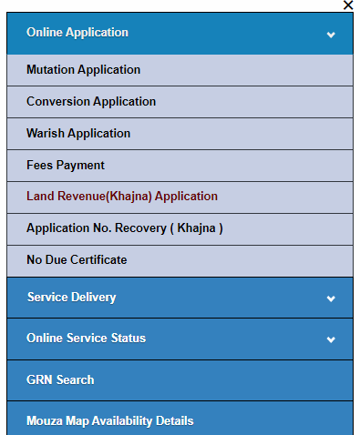
Services at banglarbhumi.gov.in
  Know your property service – Searching of any Khantian or Plot information.
  Khazana Payment
  RS to LR and vice versa information
  Application for Mutation, Conversion

Slide 3
Services at wbregistration.gov.in
  Obtaining market value of any land or flat
  Searching of any deed
  Generation of query for property registration
  Payment of Stamp duty and registration fees for property registration

Slide 4
Services at edistrict.wb.gov.in
  Obtaining certified copy of deed
  Obtaining certified copy of ROR (Khatian)

Slide 5
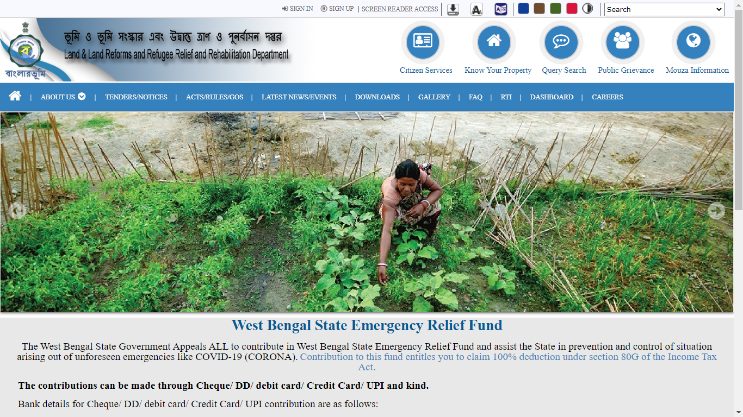
banglarbhumi.gov.in

Slide 6
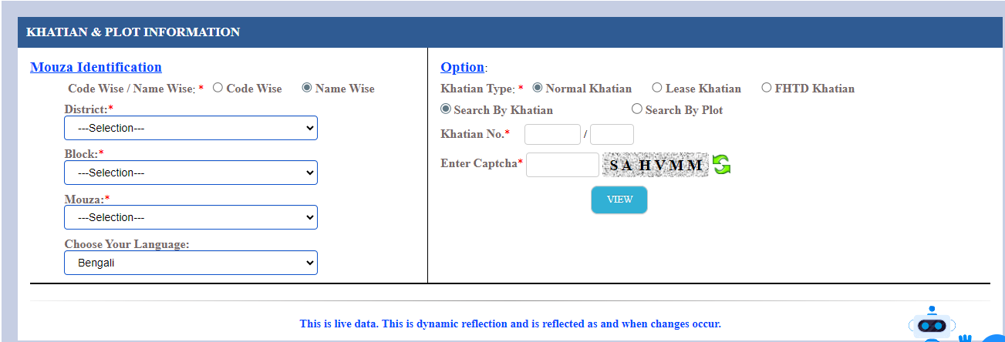
Khatian and Plot Information

Slide 7
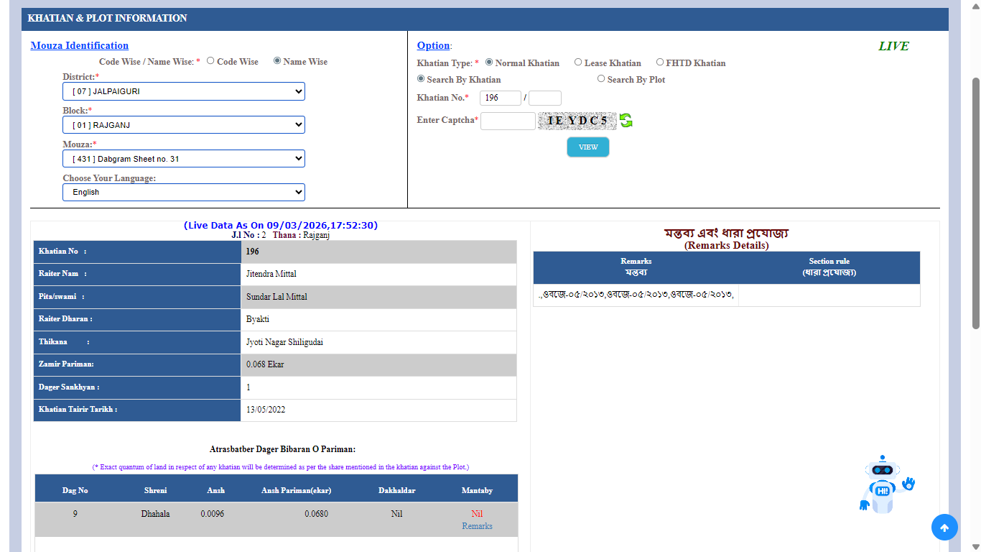

Slide 8
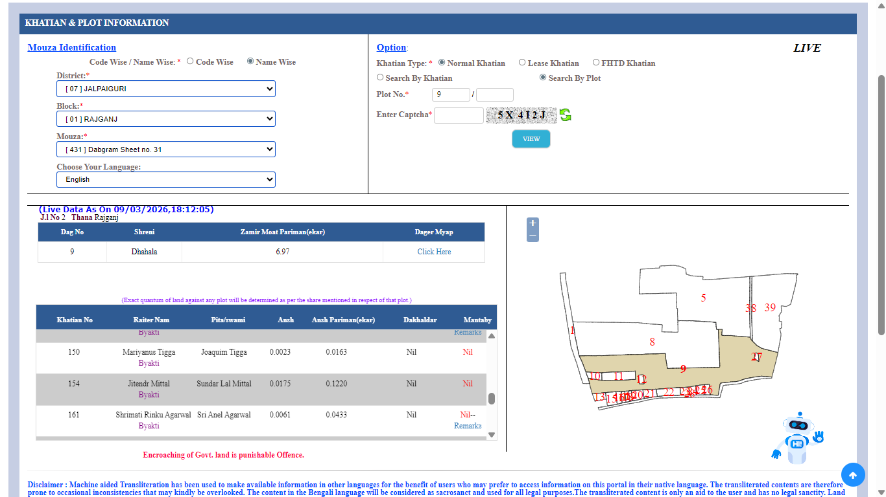

Slide 9
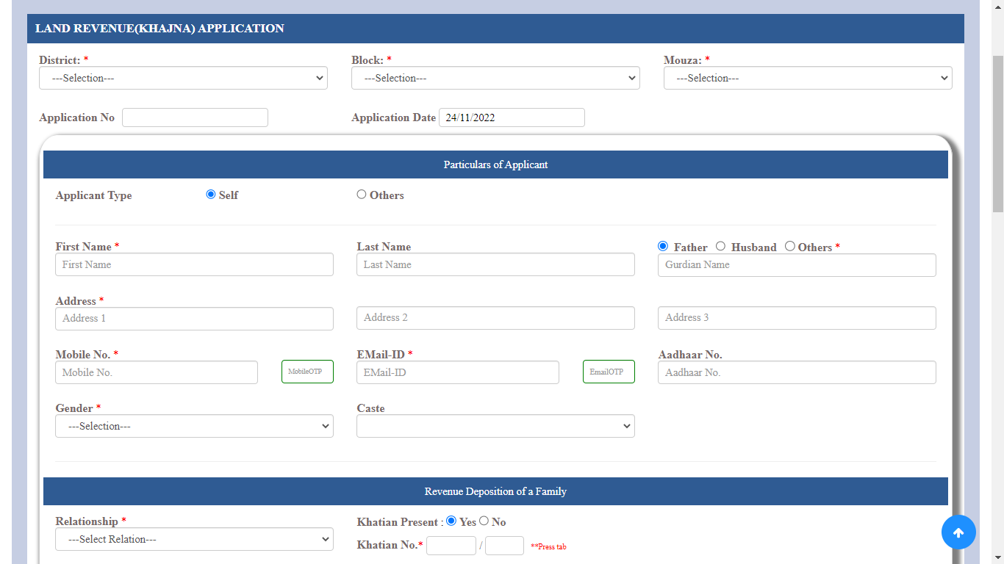
Khazana Payment (Part 1)

Slide 10
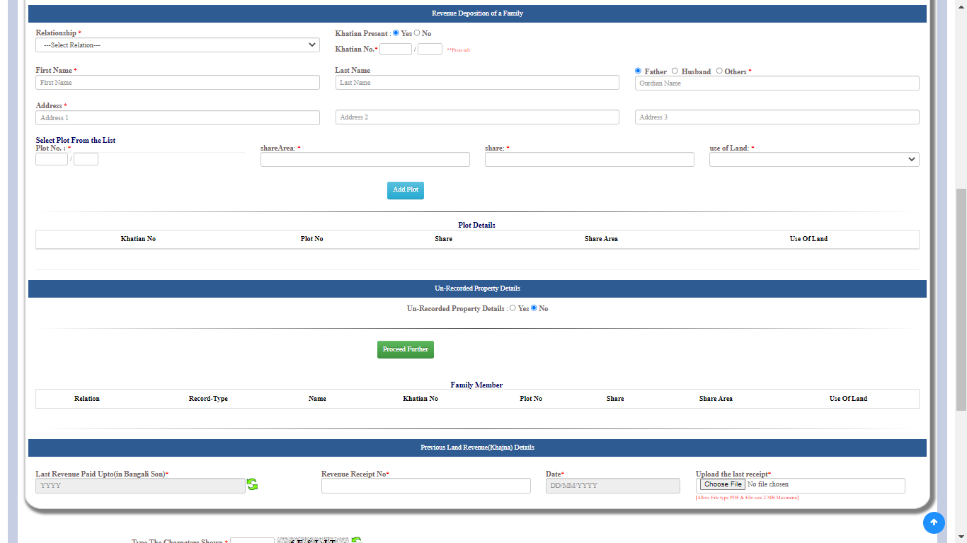
Khazana Payment (Part 2)

Slide 11
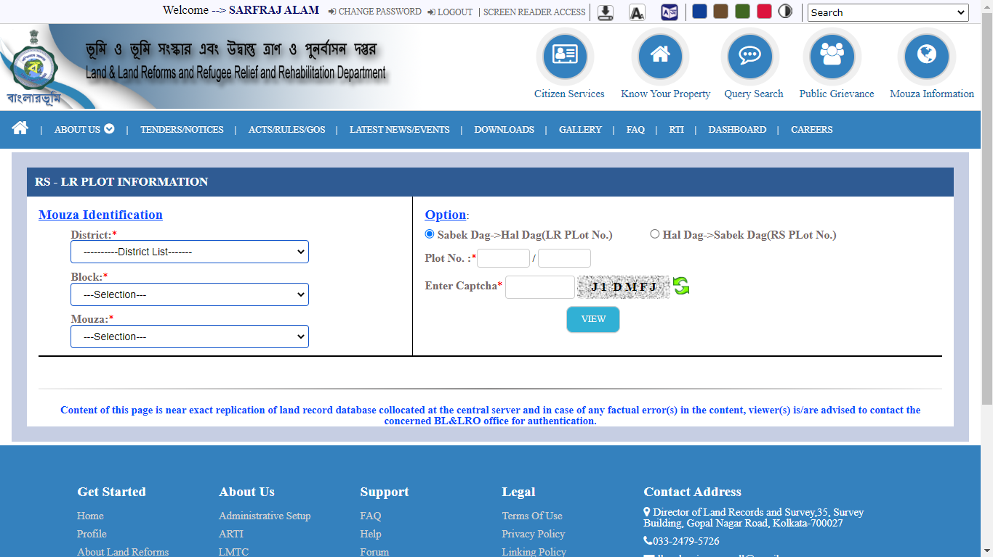
RS – LR Information

Slide 12
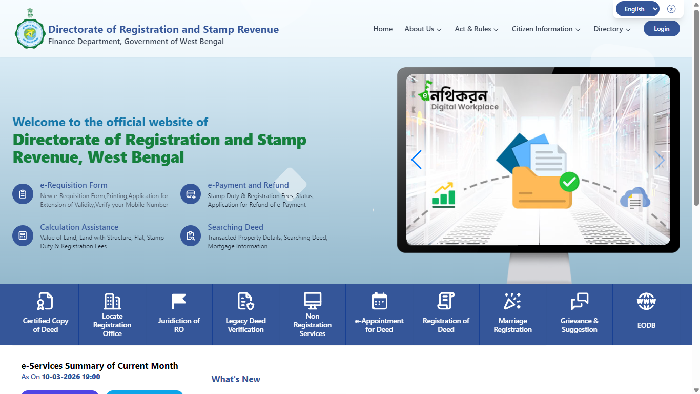
wbregistration.gov.in (igr.wb.gov.in)

Slide 13
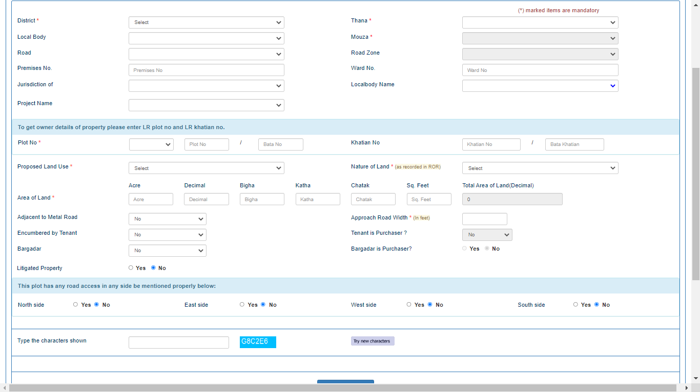
Market Value of Land

Slide 14
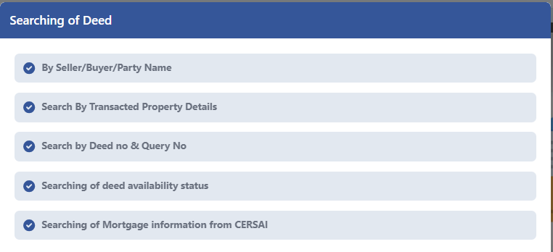
Searching of Deed

Slide 15
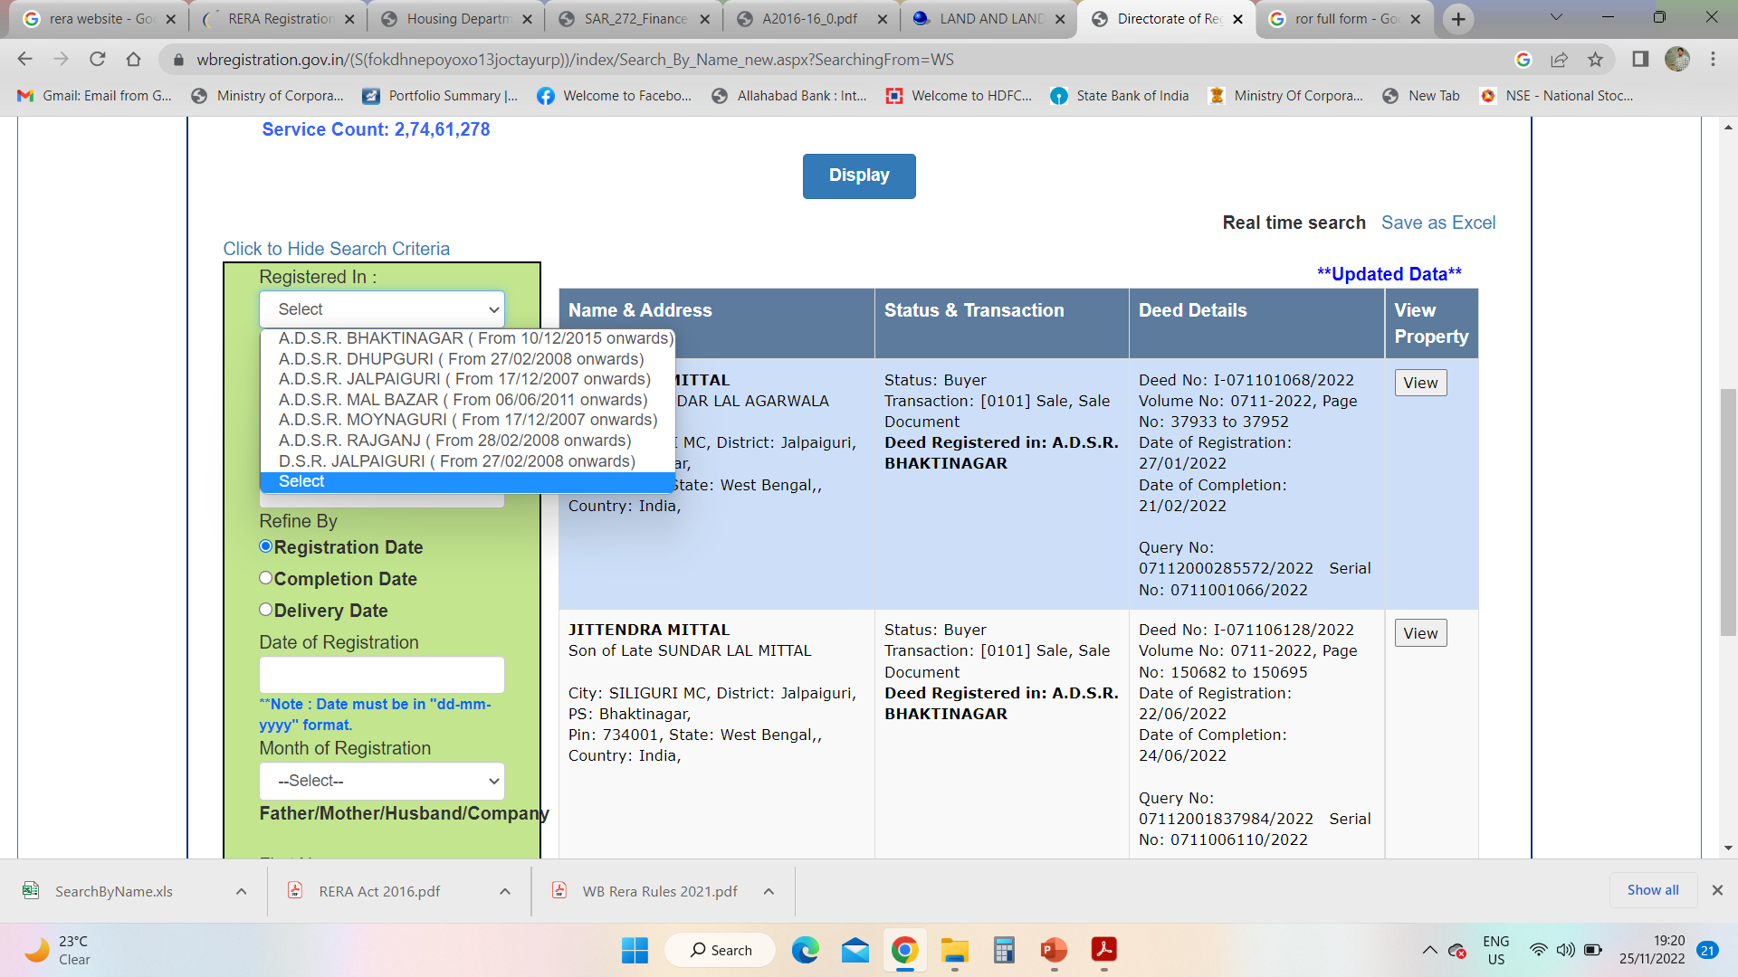
Online Search availability list

Slide 16
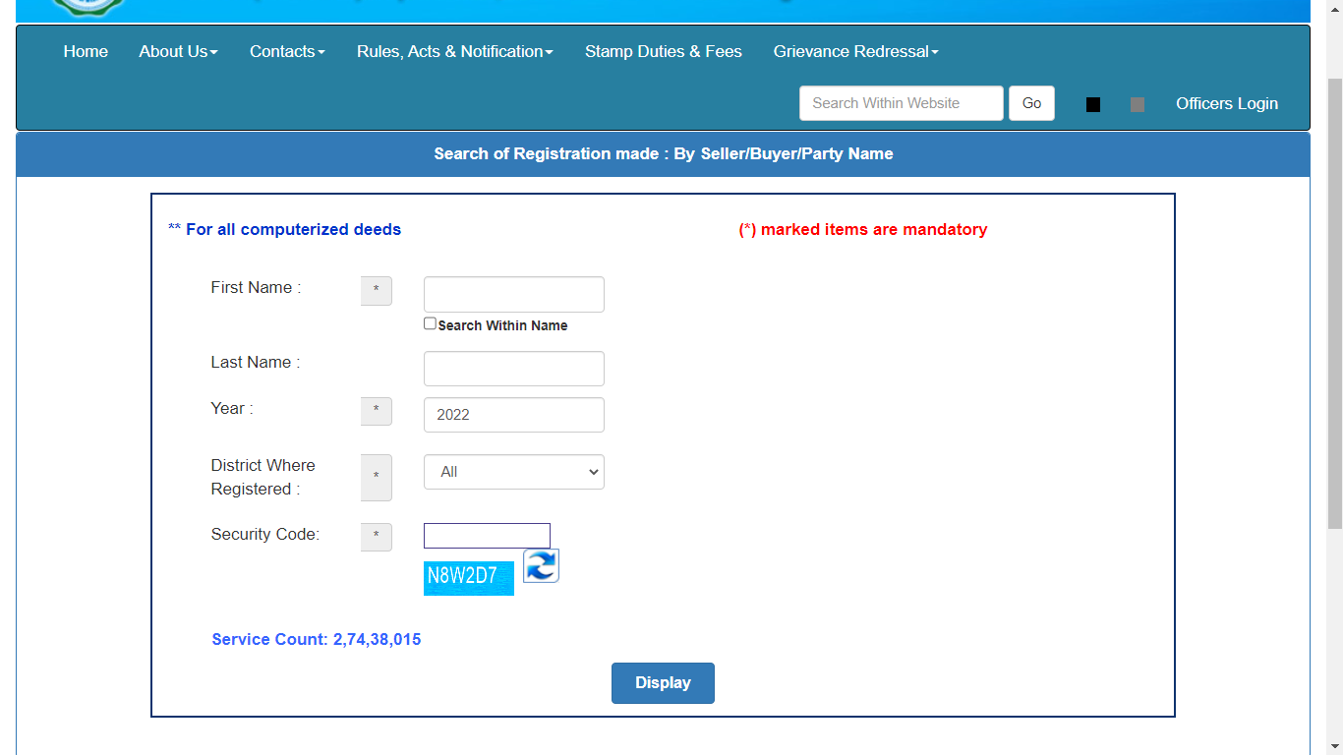
Searching by Name

Slide 17
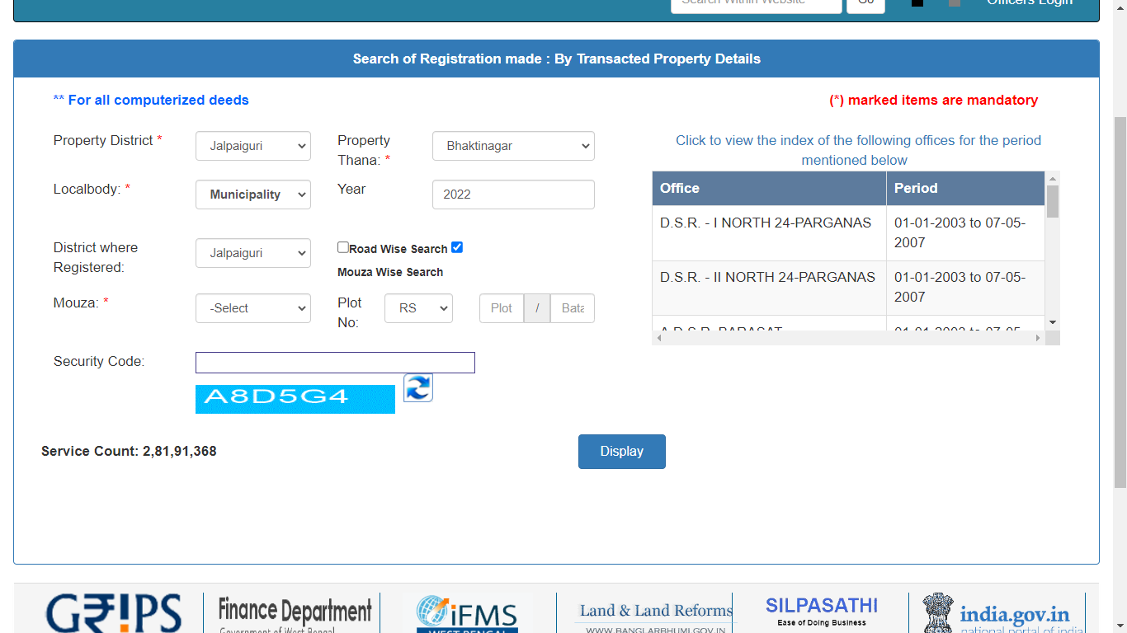
Searching by Property Details

Slide 18
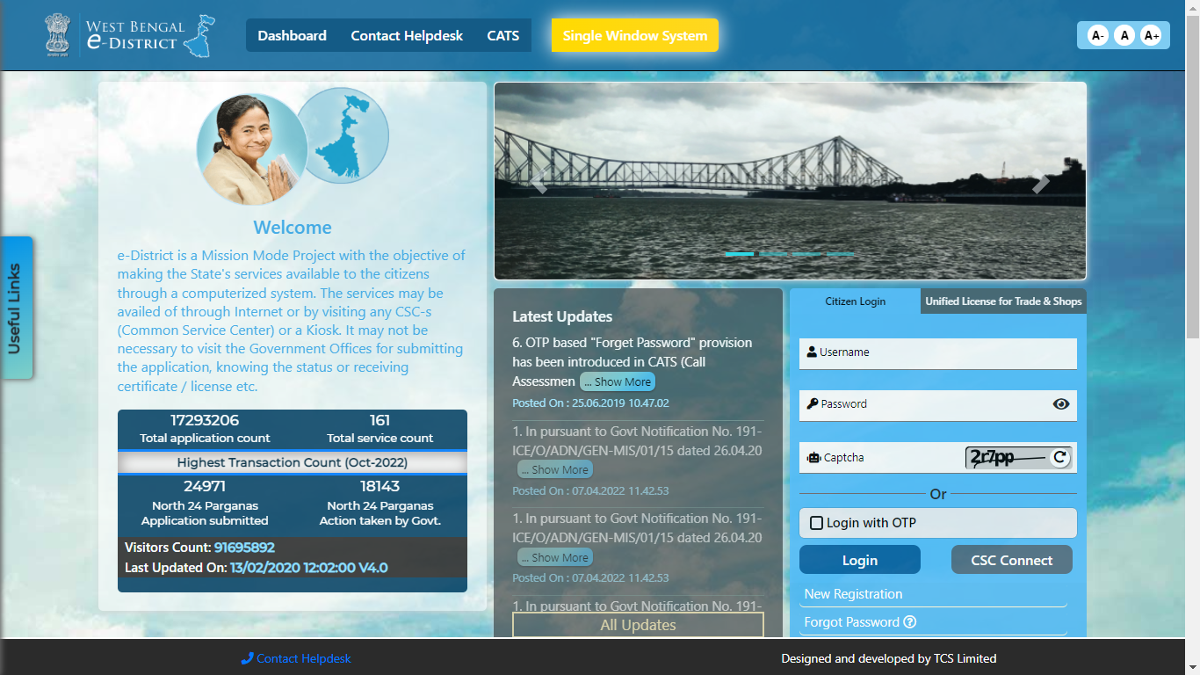
edistrict.wb.gov.in

Slide 19
  Obtaining certified copy of deed

Slide 20
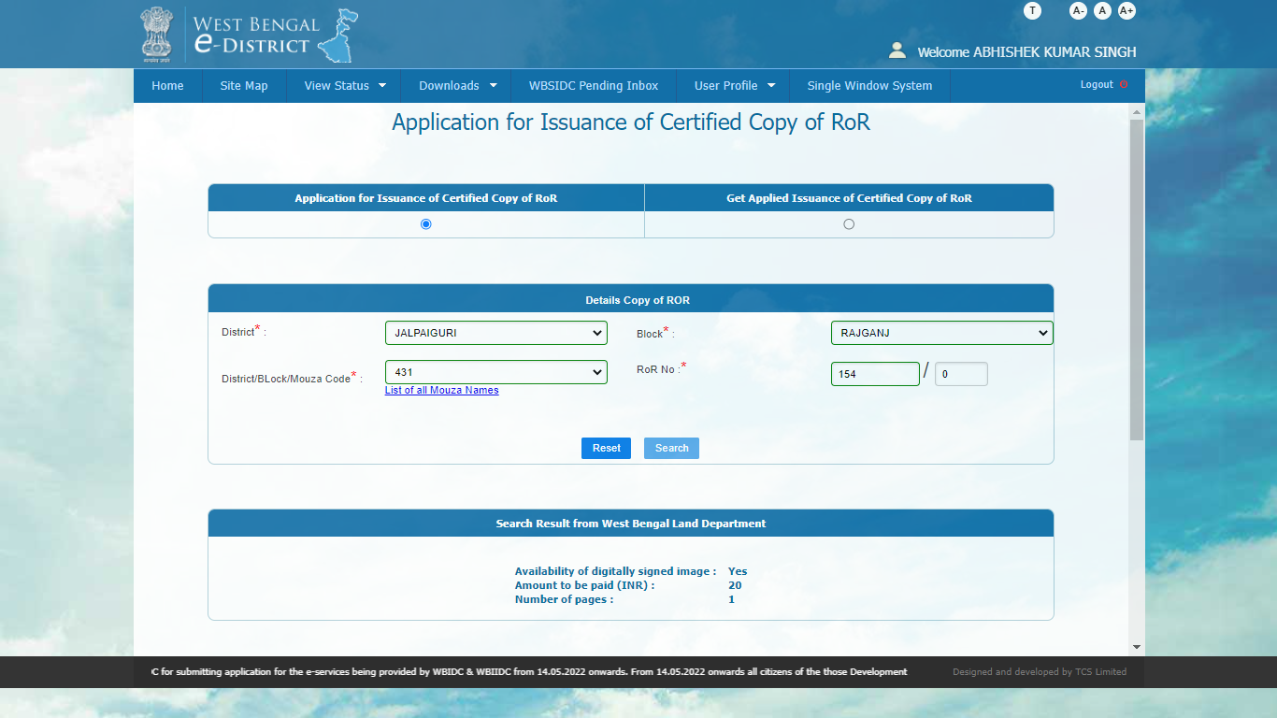
  Obtaining certified copy of ROR (Khatian)

Slide 21
Central Government Website
  cersai.org.in

Slide 22
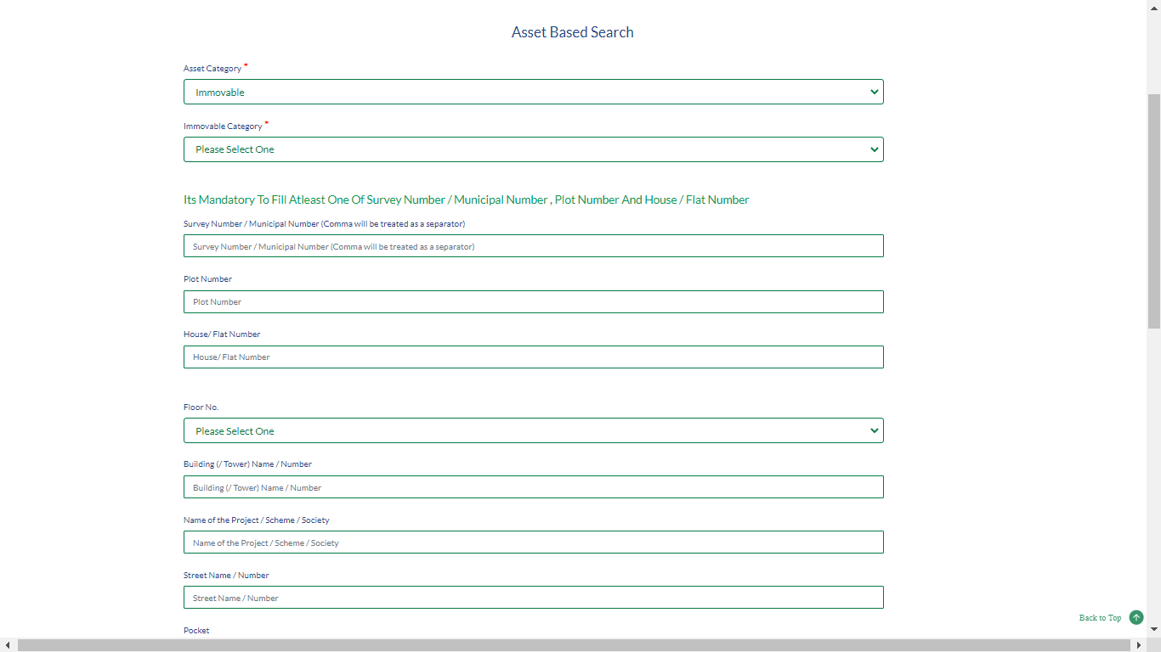
Assets based search at cersai

Slide 23

CA SARFRAJ ALAM
9749390001
alam.sarfraj@gmail.com

