Slide 1

कर सेतु
PRACTICAL IMPLICATIONS: TRANSITION FROM IT ACT 1961 TO IT ACT 2025
The transition from the Income Tax Act, 1961 to the Income Tax Act, 2025 represents one of the most significant transformations in India's tax administration history. This comprehensive reform aims to modernize tax collection, enhance transparency, and streamline dispute resolution mechanisms. For litigation practitioners and taxpayers alike, understanding the practical implications of this transition is crucial for navigating the evolving legal landscape effectively.

Slide 2
The Income Tax Act,1961
Major 65 amendments
4000 individual changes (provisos, explanations, clauses)
The Income Tax Act,2025

Slide 3
MAJOR PRACTICAL IMPACT AREAS OF INCOME TAX TRANSITION PROVISIONS
22 Savings Clauses
General Philosophy of Transition
Tax Payments, Collection and Refunds
Furnishing of Income Tax Returns
Other Forms & Compliance Statements
Reassessment of Income Escaping Assessment
TDS Compliance
Appeals, Revision and Alternate Dispute Resolution
Set-off/Carry Forward of Losses and Deductions
Issues concerning Non-Resident Indians (NRIs)
Miscellaneous
Relevant savings clauses in IT Act,2025
536(2)(c) and 536(2)(d)
536(2)(c) and 536(2)(d)
536(2)(c), 536(2)(e) , 536(2)(k)
536(2)(m), 536(2)(n) ,536(2)(o)

Slide 4
GENERAL PHILOSOPHY OF TRANSITION

Slide 5
‘
‘TAX YEAR’ V.S. ‘ASSESSMENT YEAR’
A ‘tax year’ is a period of twelve months contained in a financial year. It replaces the term ‘previous year’ used in the Income-tax Act, 1961.
The concept of “Tax Year” is applicable from 01 April 2026, i.e., for income earned during FY 2026-27 onwards and this will be referred to as Tax Year 2026-27 under the Income Tax Act 2025

Slide 6
TAX PAYMENTS, COLLECTION AND REFUNDS
DETERMINATION OF TDS ON CONTRACTS SPANNING BETWEEN MARCH-APRIL,2026

Slide 7
FURNISHING OF INCOME TAX RETURNS

Slide 8
OTHER FORMS & COMPLIANCE STATEMENTS

Slide 9
REASSESSMENT PROCEEDINGS

Slide 10
REASSESSMENT PROCEEDINGS

Slide 11
TDS COMPLIANCE
Quarter | Period of TDS | Governed By | Form | Due Date of Filing of TDS Return
Q4 of FY 2025–26 | Jan–Mar 2026 | IT Act, 1961 | 24Q / 26Q / 27Q / 27EQ | 31st May 2026
Q1 of FY 2026–27 | Apr–Jun 2026 | IT Act, 2025 (New Rules, 2026) | Salary TDS Return – Form 138 (in place of Form 24Q) Non-Salary TDS Return – Form 140 (in place of Form 26Q) | 31st July 2026
Q2 of FY 2026–27 | Jul–Sep 2026 | IT Act, 2025 (New Rules, 2026) | Non-Resident Return – Form 144 (in place of Form 27Q) TCS Return – Form 143 (in place of Form 27EQ) | 31st October 2026

Slide 12
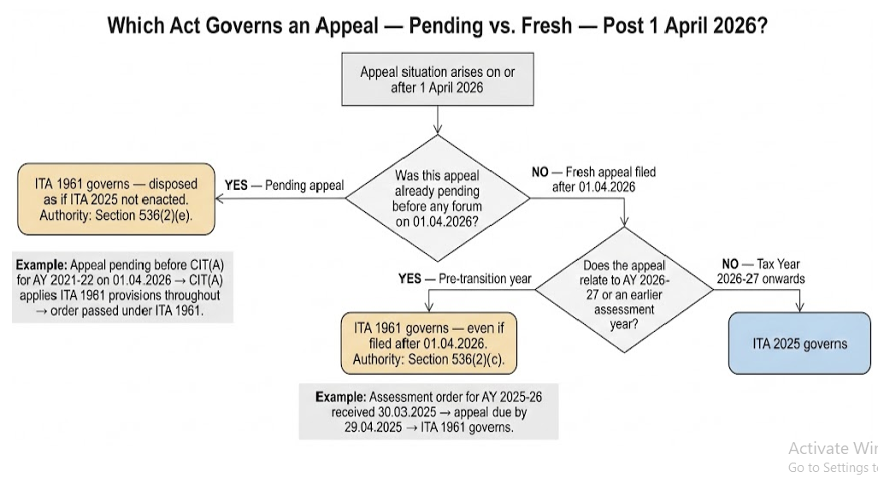
PENDING ASSESSMENTS & APPEALS

Slide 13
PENDING ASSESSMENTS & APPEALS
Section 536(2)(c) provides that proceedings initiated on or after 1 April 2026 in respect of a tax year beginning before 1 April 2026 shall be carried out in accordance with the provisions of the repealed Act. Accordingly, even if an appeal is filed after the commencement of the Income-tax Act, 2025, where it relates to Assessment Year 2026–27 or any earlier assessment year, such appeal shall be governed by and disposed of under the provisions of the Income-tax Act, 1961
If the Income-tax Appellate Tribunal remands a case on or after 1 April 2026 in respect of any tax year beginning before the said date, the remand proceedings will continue to be governed by ITA 1961 as the remand is only a continuation of the original assessment proceedings.

Slide 14
SET-OFF/CARRY FORWARD OF LOSSES AND DEDUCTIONS

Slide 15
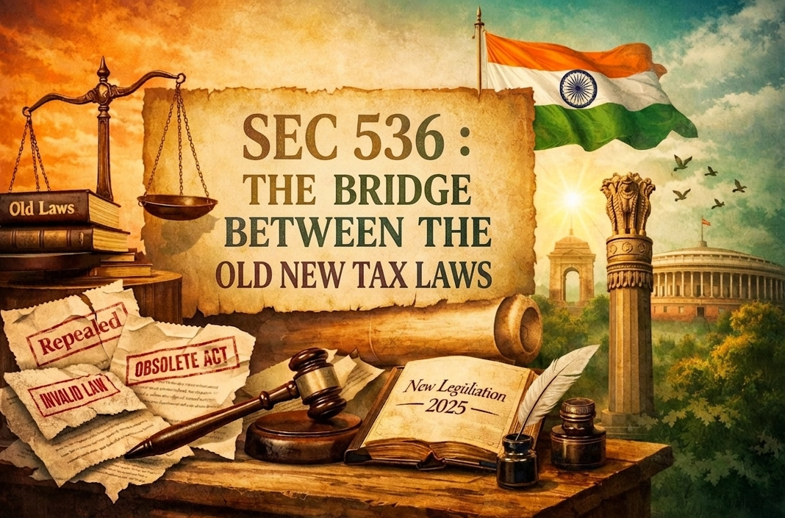

Slide 16
SEC 536(2) OF THE INCOME TAX ACT,2025
536(a)
nothing shall affect the previous operation of the repealed Income-tax Act and orders or anything duly done or suffered thereunder
536(b)
nothing shall affect any right, privilege, obligation or liability acquired, accrued or incurred under the repealed Income-tax Act or orders under such repealed Act
536(c)
the provisions of the repealed Income-tax Act shall continue to apply to any proceeding pending on the date of commencement of this Act and to any proceedings initiated on or after the 1st April, 2026 (including notices, assessment, reassessment, recomputation, rectification, penalty, reference, revision and appeals) in respect of any tax year beginning before the 1st April, 2026 and such proceedings shall be carried out as per the procedure specified in the repealed Income-tax Act

Slide 17
SEC 536(2) OF THE INCOME TAX ACT,2025
536(d)
any proceeding for the imposition of a penalty in respect of any tax year beginning before the 1st April, 2026, may be initiated and any such penalty may be imposed under the repealed Income-tax Act, as if this Act had not been enacted
536(e)
any proceeding pending on the commencement of this Act before any income-tax authority or any other authority constituted under the repealed Income-tax Act, Appellate Tribunal, or any court, by way of application, appeal, reference or revision or by any other means, shall be continued and disposed of as if this Act had not been enacted
536(f)
any election or declaration made, or option exercised, by an assessee under any provision of the repealed Income-tax Act and in force immediately before the commencement of this Act shall be deemed to have been an election or declaration made, or option exercised, under the corresponding provision of this Act

Slide 18
SEC 536(2) OF THE INCOME TAX ACT,2025
536(g)
  where in respect of any proceeding relating to any tax year beginning before the 1st April, 2026,—
  (i) a refund falls due after commencement of this Act; or
  (ii) default is made after such commencement in the payment of any sum due under such proceeding,
  the provisions of this Act, relating to interest payable by the Central Government on refunds and interest payable by the assessee for default, shall apply for the period after the commencement of this Act;
  where any deduction has been allowed or any amount has not been included in the total income of any person, subject to fulfilment of certain conditions for any tax year beginning before the 1st April, 2026, and in case of violation of such conditions in any tax year beginning on or after 1st April, 2026, any sum (on account of deduction earlier allowed or amount not included) was required to be included in the total income of such subsequent tax year under the repealed Income-tax Act if it had not been so repealed, then such sum shall be—
  (i) deemed to be the income of the tax year in which the violation takes place; and
  (ii) included in the total income of the said person under the same head of income as it would have been included under the repealed Income-tax Act
  Example: A capital gain exemption under section 54 or section 54F availed in the assessment year 2023-24 is to be taxed in the tax year 2027-28 due to breach of conditions contained in the repealed Act.
536(h)

Slide 19
SEC 536(2) OF THE INCOME TAX ACT,2025
536(i)
  any sum payable under the repealed Income-tax Act may be recovered under this Act without prejudice to any action already taken for the recovery of such sum under repealed Income-tax Act.
any agreement entered into, appointment made, approval given, recognition granted, circular, direction, instruction, notification, order or rule or any scheme framed therein issued under any provision of the repealed Income-tax Act shall, so far as it is not inconsistent with the corresponding provisions of this Act, be deemed to have been entered into, made, granted, given or issued under the corresponding provision of this Act and shall continue in force accordingly.
536(j)
where the period provided for any application, appeal, reference or revision under the repealed Income-tax Act had expired on or before the commencement of this Act, nothing in this Act shall be construed as enabling any such application, appeal, reference or revision to be made under this Act by reason only of the fact that a longer period therefor is prescribed or provision is made for extension of time in suitable cases by the appropriate authority;
536(k)

Slide 20
SEC 536(2) OF THE INCOME TAX ACT,2025
any amount of credit, in respect of tax paid, allowable to be carried forward in the case of an assessee, under the provisions of section 115JAA or 115JD of the repealed Income-tax Act for the tax year beginning before the 1st April, 2026, had the Income-tax Act, 1961 (43 of 1961) not been repealed,— (i) shall be deemed to be the amount eligible for credit under corresponding provision of this Act in the case of said assessee; and (ii) credit for the tax paid under the repealed Income-tax Act shall be allowed under this Act for the period for which it would have been allowed under the repealed Income-tax Act if the assessee otherwise continues to satisfy the conditions as specified in the corresponding provisions of this Act in such tax years.
536(l)
any amount of loss under the source or head of income specified in column B of the Table given below and referred to in the section of the repealed Income-tax Act specified in column C of the said Table, brought forward for the tax year beginning before the 1st April, 2026 had the Income-tax Act, 1961 (43 of 1961) not been repealed, shall be set off and carried forward against the income computed under this Act, in the manner provided in the respective section of the repealed Income-tax Act specified in column C of the said table, for the tax years beginning on or after the 1st April, 2026 .
536(m)
any amount of loss under the head capital gains, whether related to a long-term capital asset or a short term capital asset, referred to in section 74 of the repealed Income-tax Act, brought forward from the tax year beginning before the 1st April, 2026 had the Income-tax Act, 1961 (43 of 1961) not been repealed, shall be carried forward and set off, in accordance with the manner provided in the repealed Income-tax Act, against the income under the head “Capital gains” computed under this Act for any tax year beginning on or after the 1st April, 2026 upto eight financial years immediately succeeding the financial year in which such loss was first computed under the repealed Income-tax Act.
536(n)

Slide 21
SEC 536(2) OF THE INCOME TAX ACT,2025
any set off of loss or allowance for depreciation made in any tax year beginning before the 1st April, 2026 in the hands of the amalgamated company, successor company or the successor limited liability partnership, in accordance with the provisions of section 72A of the repealed Income-tax Act, shall be deemed to be the income of the amalgamated company, successor company or the successor limited liability partnership, as the case may be, chargeable to tax under this Act for the year in which any of the conditions specified in that section are not complied with.
536(o)
any set off of accumulated loss or unabsorbed depreciation allowed in any tax year beginning before the 1st April, 2026 to the successor co-operative bank, in accordance with the provisions of section 72AB of the repealed Income-tax Act, shall be deemed to be the income of the successor co-operative bank chargeable to tax under this Act for the year in which any of the conditions specified in that section are not complied with.
536(p)
any amount of profits or gains arising out of transfer of capital asset not charged under the head “capital gains” by virtue of the provisions contained in section 47(iv), (v), (xiii), (xiiib) or (xiv) of the repealed Income-tax Act in any tax year beginning before the 1st April, 2026 shall be deemed to be the income chargeable under the head “Capital gains” under this Act, for the tax year— (A) in which the transfer took place if any of the conditions laid down in section 47A(1)(i) or (ii) of the repealed Income-tax Act are satisfied; or (B) in which any of the conditions laid down in section 47(xiii), (xiiib) or (xiv) of the repealed Income-tax Act are not complied with, as the case may be .
536(q)

Slide 22
SEC 536(2) OF THE INCOME TAX ACT,2025
536(r)
where any allowance or part thereof, under section 32(2) or 35(4) of the repealed Income-tax Act, is to be carried forward to tax year beginning on the 1st April, 2026, had the Income-tax Act, 1961 (43 of 1961) not been repealed, then, the allowance or part thereof shall be added to the amount of capital allowances referred to corresponding provisions of this Act for the tax year beginning on the 1st April, 2026 and deemed to be part of that allowance, or if there is no such allowance for that tax year, be deemed to be allowance for that tax year.
the deduction referred to in sections 35ABA, 35ABB, 35D, 35DD, 35DDA, 35E or the first proviso to section 36(1)(ix) of the repealed Income-tax Act, shall, on fulfilment of the conditions mentioned in the said provisions, continue to be allowed under this Act for tax year beginning on or after the 1st April, 2026 had the Income-tax Act, 1961 not been repealed and such deduction shall be added to the amount of deferred revenue expenditure allowance referred to corresponding provisions of this Act for the tax year beginning on or after the 1st April, 2026 and deemed to be part of that allowance, or if there is no such allowance for a tax year, be deemed to be that allowance for that tax year .
536(s)

Slide 23
SEC 536(2) OF THE INCOME TAX ACT,2025
536(t)
credit balance in the provision for bad and doubtful debts account made under section 36(1)(viia) of the repealed Income-tax Act standing on the last day of the tax year beginning on 1st April, 2025 shall be added to the amount credited to the provision for bad and doubtful debts accounts referred to in the corresponding provisions of this Act for the tax year beginning on the 1st April, 2026 and deemed to be part of amount credited to the provision for bad and doubtful debts accounts, or if there is no such amount credited for that tax year, be deemed to be amount credited for that tax year
536(u)
any scheme which has been notified under the provisions of the repealed Income-tax Act with a view to eliminating the interface with the assessee or any other person, the said scheme shall be deemed to have been made—
(i) under the corresponding provisions of this Act; or
(ii) under section 532 where there is no such corresponding provision, and shall continue in force accordingly; and
536(v)
where a search has been initiated under section 132 or requisition is made under section 132A prior to the commencement of this Act, the provisions of repealed Income-tax Act, shall continue to apply to any proceedings connected in respect of such search or requisition, as the case may be, as if this Act has not been enacted.

Slide 24
SEC 536(3) OF THE INCOME TAX ACT,2025

Slide 25
SEC 536(4) OF THE INCOME TAX ACT,2025 “Doctrine of “Savings” on Repeal”
QUOTE
“(4) Without prejudice to the provisions of sub-section (2), the provisions of section 6 of the General Clauses Act, 1897 (10 of 1897) shall apply with regard to the effect of repeal.”
UNQUOTE
If any unforeseen situation is not covered by that section, section 6 of the General Clauses Act, 1897 shall apply with regard to the effect of the repeal of ITA 1961. This ensures the continued protection of
accrued rights and
liabilities
beyond those expresslystated.

Slide 26

Section 6 of the General Clauses Act, 1897
Accrued Rights & Liabilities
Past Legal Proceedings
Punishments & Penalties
Cases and legal actions initiated under repealed law continue unaffected
Sanctions imposed under repealed law remain enforceable
Legal rights and obligations that existed before repeal remain valid

Slide 27

THANK YOU
PRESENTED BY : CA ANUP KUMAR SANGHAI
SANGHAI & CO.
Chartered Accountants
Centre Point,
21, Hemanta Basu Sarani
Kolkata-700 001
Contact No. : 9830026214
Email: sanghaianup@gmail.com

