Slide 1
Basic Valuation concepts
Seminar on valuation under companies Act & Income Tax Act
organized by
ICAI(EIRC), Kolkata
DATED 4-4-2026
CA MANISH GADIA
B.COM, FCA, DISA(ICAI), RV-SFA(IBBI)
REGISTERED VALUER (IBBI)
E: manish@jmpassociates.com
M- 98303 28772

Slide 2

CA MANISH GADIA- REGD. VALUER (IBBI)

Slide 3
VALUATION IS REQUIRED AT EVERY STAGE OF LIFE CYCLE OF THE COMPANY
NEW SHARE ALLOTMENT AFTER INCORPORATION
PRIVATE EQUITY PLACEMENT OR VENTURE CAPITAL INVESTMENT AT THE
EXPANSION STAGE
INITIAL PUBIC OFFERING
DEBT RESTRUCTURING
SHARE TRANSFER
MERGER & ACQUISATION, DEMERGER
WINDING UP OR LIQUIDATION
CA MANISH GADIA, REGISTERED VALUER (IBBBI) M 98303 28772 E: manish@jmpassociates.com

Slide 4
Requirements for VALUATION OF SHARE & SECURITIES for different purpose
SAME BUSINESS HAS DIFFERENT VALUE BASED ON DIFFERENT PURPOSES.
      A single valuation can not serve more then one purpose : -
Investment Decision Making:
Mergers and Acquisitions (M&A):
Financial Reporting and Accounting:
Risk Assessment:
Capital Budgeting:
Financial Planning and Strategy:
Shareholder Value Maximization:
Corporate Finance:
Legal and Regulatory Compliance:
Employee Stock Options & sweat share issue:
CA MANISH GADIA, REGISTERED VALUER (IBBI) M 98303 28772 E: manish@jmpassociates.com

Slide 5
KEY VALUE DRIVERS IN A BUSINESS FOR VALUATION
Fair Value of Assets (NAV):
Revenue Growth Sustainability
Earnings and Profitability:
Scalability of Business Model
Cash Flow Quality
Operating Leverage
Cost of Capital (Risk Profile)
Capital Efficiency (ROCE, ROIC)
Future Growth Prospects:
Company Size and Scale:
Industry and Sector Performance:
Market & Economy Conditions:
Market Sentiment:
Regulatory Environment:
Global and Geopolitical Factors:
Management Quality & Governance
Brand, IP & Intangibles
CA MANISH GADIA, REGISTERED VALUER (IBBI) M 98303 28772 E: manish@jmpassociates.com

Slide 6
KEY COMPLEXITIES IN THE VALUATION OF BUSINESS ENTERPRISES
Limited Market Data and Limited Financial Information
Lack of Transparency and Lack of Marketability
Subjectivity in Valuation Approaches and other factors
Control and Minority Interests
Non-Operating Assets and Liabilities
Future Growth Prospects
Bias and Conflict of Interest
Tax Considerations
Unique Business Models
Management Quality
Regulatory and Legal Issues
CA MANISH GADIA, REGISTERED VALUER (IBBI) M 98303 28772 E: manish@jmpassociates.com

Slide 7
MYTHS OF ENTERPRISE VALUATION
Business should be valued only when it is required to be sold
Valuation provides a precise value of share & securities
No need for outside valuer, the owner can value their business themselves.
Comparison with local competitor
No valuation in case of loss in business
Valuer uses specific formula for valuation
Valuation depends on good negotiation power
A single Valuation can serve purpose for long term.
Valuation is worthless as it involves lot of assumption
CA MANISH GADIA, REGISTERED VALUER (IBBI) M 98303 28772 E: manish@jmpassociates.com

Slide 8
What are the different ways and techniques to increase and enhance the value of any business enterprises
Improve Quantity of Cash Flows (Growth)
Improve Quality of Cash Flows (Stability)
Reduce Risk (Lower Discount Rate)
Build Strategic Assets & Moat (IP, Brand, Systems)
Improve Profitability & Capital Efficiency
Structure the Business for Valuation (Very Important)
Storytelling with Substance (Market Perception)
Time & Discipline (The Silent Multiplier)
CA MANISH GADIA, REGISTERED VALUER (IBBI) M 98303 28772 E: manish@jmpassociates.com

Slide 9
1.What are the different ways and techniques to increase and enhance the value of any business enterprises
Improve Quantity of Cash Flows (Growth)
  Practical Techniques
    Revenue diversification (new products, new geographies)
    Recurring / annuity income (AMC, subscriptions, long-term contracts)
    Pricing power (branding, differentiation, IPR)
    Cross-selling & upselling
    Scalable business model (same cost base, higher revenue)
👉 Valuation impact: Higher revenues = higher enterprise value.
“Growth without scalability increases turnover, not valuation.”
CA MANISH GADIA, REGISTERED VALUER (IBBI) M 98303 28772 E: manish@jmpassociates.com

Slide 10
2. Improve Quality of Cash Flows (Stability)
  Techniques
  Reduce customer concentration
  Long-term contracts
  Repeat customers
  Lower volatility in margins
  Remove one-time / non-recurring income
  Strong working capital discipline
👉 Valuation impact: Stable cash flows get higher multiples.
“Markets pay premiums for certainty, not excitement.”
CA MANISH GADIA, REGISTERED VALUER (IBBI) M 98303 28772 E: manish@jmpassociates.com

Slide 11
3. Reduce Risk (Lower Discount Rate)
  Techniques
  Strong corporate governance
  Independent board & systems
  Clear succession planning
  Reduced promoter dependence
  Legal, tax & regulatory compliance
  Strong internal control system and SOP
  ESG practices
👉 Valuation impact: Lower risk = lower discount rate = higher value.
“Risk reduction creates value even without growth.”
CA MANISH GADIA, REGISTERED VALUER (IBBI) M 98303 28772 E: manish@jmpassociates.com

Slide 12
4. Build Strategic Assets & Moat (IP, Brand, Systems)
Techniques
  Register IPR (patents, trademarks, copyrights)
  Own the brand inside the company (not personally)
  SOP-driven operations
  Technology integration
  Data ownership & analytics
  Network effects
👉 Valuation impact: Moat converts profits into defensible profits.
“IP turns earnings into sustainable earnings — and that changes valuation completely.”
CA MANISH GADIA, REGISTERED VALUER (IBBI) M 98303 28772 E: manish@jmpassociates.com

Slide 13
5. Improve Profitability & Capital Efficiency
Techniques
  Cost optimisation (without killing growth)
  Automation & tech
  Better vendor negotiation
  Improve ROCE & ROE
  Asset-light models – reduce capex
  Improve working capital cycle
👉 Valuation impact: Better margins and capital efficiency attract premium multiples.
“Two businesses can earn the same profit — the one using less capital is more valuable.”
CA MANISH GADIA, REGISTERED VALUER (IBBI) M 98303 28772 E: manish@jmpassociates.com

Slide 14
6. Structure the Business for Valuation (Very Important)
Techniques
  Separate personal vs business expenses
  Clean balance sheet
  Remove related-party distortions
  Ring-fence assets and IP
  Professional management structure
👉 Valuation impact: Clean structure = higher investor confidence.
“Messy books don’t just reduce valuation — they destroy credibility.
CA MANISH GADIA, REGISTERED VALUER (IBBI) M 98303 28772 E: manish@jmpassociates.com

Slide 15
7. Storytelling with Substance (Market Perception)
Techniques
  Clear equity story
  Transparent disclosures
  Consistent communication
  Align vision with numbers
  Professional valuation reports
👉 Valuation impact: Markets value clarity.
“Valuation is where numbers meet narrative”
CA MANISH GADIA, REGISTERED VALUER (IBBI) M 98303 28772 E: manish@jmpassociates.com

Slide 16
8. Time & Discipline (The Silent Multiplier)
Techniques
  Start early (3–5 years before IPO / exit)
  Consistent performance
  Predictable execution
  No shortcuts
👉 Valuation impact: Time reduces uncertainty.
“Valuation rewards patience more than ambition
CA MANISH GADIA, REGISTERED VALUER (IBBI) M 98303 28772 E: manish@jmpassociates.com

Slide 17
DIFFERENT VALUATION METHODS FOR VALUATION OF TRANSPORT INDUSTRY AND PSUs

Slide 18
A. Income Approach
Focuses on future economic benefits.
Discounted Cash Flow (DCF)
Projects future free cash flows
Discounts them to present value using WACC
Key drivers:
Revenue growth
Operating margins
Capital expenditure
Working capital
Terminal value
DCF is conceptually sound but highly assumption-sensitive.
DCF is directional, not decisive
CA MANISH GADIA, REGISTERED VALUER (IBBI) M 98303 28772 E: manish@jmpassociates.com

Slide 19
B. Market Approach
Values a business relative to comparable companies or transactions.
1. Comparable Company Analysis (CCA)
EV/EBITDA
EV/Sales
P/E
2. Comparable Transaction Method (CTM)
Past M&A deal multiples
Market approach reflects real investor sentiment and market expectations.
CA MANISH GADIA, REGISTERED VALUER (IBBI) M 98303 28772 E: manish@jmpassociates.com

Slide 20
C. Asset / Cost Approach
Focuses on underlying assets.
Net Asset Value (NAV)
Replacement Cost Method
Liquidation method
Typically, relevant for:
Asset-heavy businesses
Investment companies
Liquidation scenarios
CA MANISH GADIA, REGISTERED VALUER (IBBI) M 98303 28772 E: manish@jmpassociates.com

Slide 21
COMPLEXITIES IN VALUATION OF AS PER DCF METHOD

Slide 22
Factors to be considered while doing DCF Method Valuation
Projection of the Financial statement
Deciding the Time Horizon:
Working Capital and new Capital Expenditures requirement:
Calculating free cash flow (FCFF, FCFE)
Discount Rate (Cost of Capital): Depends on company's risk profile, market conditions, Equity risk premium, and the specific project or investment. WACC
Terminal Value: Gordon’s Growth Model
Risk and Growth Factors: Beta determination, CSR
Tax Implications:
Consistency and Realism:
Sensitivity Analysis:
CA MANISH GADIA, REGISTERED VALUER (IBBI) M 98303 28772 E: manish@jmpassociates.com

Slide 23
FCFF is the cash available to both equity and debt holders, while FCFE is the cash available only to equity holders after accounting for debt-related items and capital expenditures. Both metrics are crucial in financial analysis and valuation, providing insights into a company's ability to generate cash and its capacity to reward its investors.
FCFF
FCFE
DCF Method of Valuation
Discounting Rate
FCFF- WACC
FCFE - Ke

Slide 24
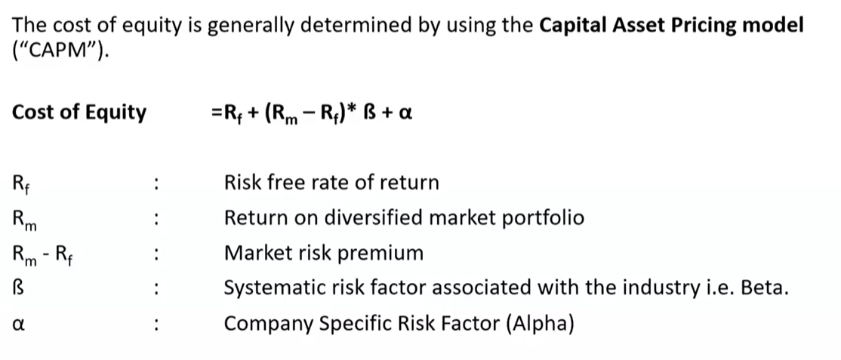
CAPITAL ASSET PRICING MODEL (CAPM)
CA MANISH GADIA, REGISTERED VALUER (IBBI) M 98303 28772 E: manish@jmpassociates.com

Slide 25

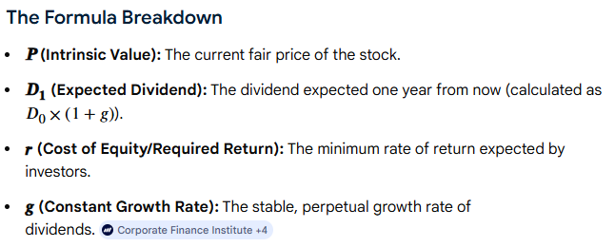
Gordon Growth Model (GGM)
The Gordon Growth Model (GGM) calculates the intrinsic value of a stock based on a perpetual, constant growth rate of dividends.

Slide 26
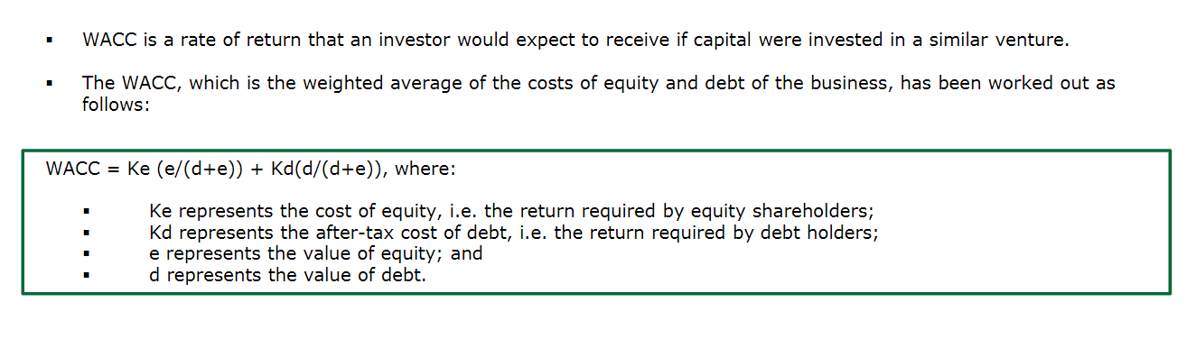
Discount Rate – WACC
CA MANISH GADIA, REGISTERED VALUER (IBBI) M 98303 28772 E: manish@jmpassociates.com

Slide 27
KEY TAKEAWAYS
🔹 Business enterprises & India Context
“India has 6 crore MSMEs, but less than 1% are valuation-ready.”
“MSMEs are the backbone of India, but valuation is still their weakest muscle.”
“India doesn’t lack entrepreneurs; it lacks valuation-ready enterprises.”
🔹 Valuation – Core Philosophy
“Valuation is not about past profits; it’s about future confidence & predictability.”
“A good business earns profits; a great business earns multiples.”
🔹 Action-Oriented Takeaways
“Valuation is a habit, not an event.”
“IP protection is cheaper than valuation dilution.”
“Think like an investor long before you meet one.”

Slide 28

CA MANISH GADIA
B.COM, FCA, DISA(ICAI), REGD. VALUER(IBBI)
5, RAJA SUBODH MULLICK SQUARE
2ND FLOOR, KOLKATA- 700013
E: manish@jmpassociates.com
M- 98303 28772
Linkedin : linkedin.com/in/manishgadia

