Slide 1
Australian Accounting & SMSF
17 April 2026 ICAI – COE Kolkata
Notes:
Like India we have Pension schemes with a aim for retirement benefits.

Slide 2
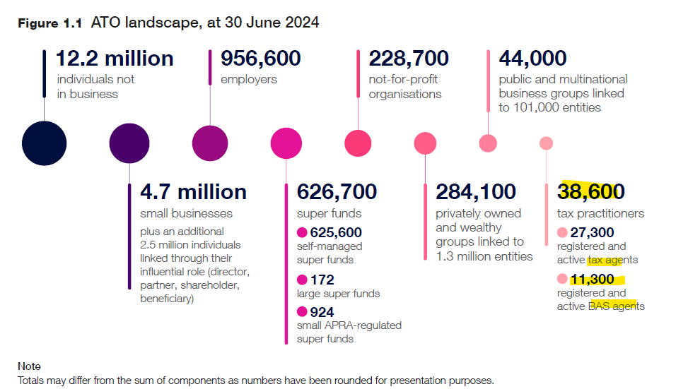
Australian Accounting - Landscape
Notes:
In Australia the Highest Income tax rate is at 45% when you earn more that $190,000

Slide 3
WHY AUSTRALIAN TAXATION
Shortage of Accountants in Australia:
Australia's accountant shortage drives outsourcing to countries like India, Vietnam, and the Philippines.

Slide 4
Outsourcing Opportunities
Many outsourcing firms have emerged in the last 5-10 years to address Australia's talent gap especially in INDIA, Vietnam & Philippines

Slide 5
Nature of work outsourced
Book keeping
Payroll
Audit Assistance
Tax return work
  Individuals
  Partnerships
  Trust
  Private companies
  Self Managed Superannuation Fund

Slide 6
What you should know
Financial year 01 July to 30 June
Income Tax Assessment Act 1997
Australian Tax office (ATO)
GST - 10%
ABN, ACN’ TFN number
Tax agent, BAS agent
Small Business
Franking Credits
Business Activity Statements
ASIC

Slide 7
What is Superannuation?
Australia’s compulsory retirement savings system
  Designed to provide income in retirement
  Contributions made during working life
  Preserved until a condition of release is met
  Supported by significant tax concessions
  Governed under SIS Act and Income Tax Assessment Acts

Slide 8
Why Superannuation Exists
Reduce reliance on the Age Pension from Government
  Encourage long-term retirement savings
  Provide dignity and financial security in retirement
  Tax incentives encourage compliance
  Highly regulated to prevent misuse

Slide 9
Superannuation Fund Types
Type of Fund | Overview | Key Features
Industry Super Funds | Non-profit industry-based funds | Low fees, simple default options
Retail Super Funds | For-profit financial institutions | Wide investment choices, higher fees
Corporate Super Funds | Employer-sponsored funds | Tailored benefits for employees
Public Sector Super Funds | Government employee funds | Defined benefits, low fees
Annuity Funds | Guaranteed retirement income funds | Income certainty, less flexibility
Pooled Superannuation Trusts | Collective investment vehicles | Diversification, professional management
Self-Managed Super Funds (SMSF) | Member-managed private super funds | Full control, high responsibility & compliance

Slide 10
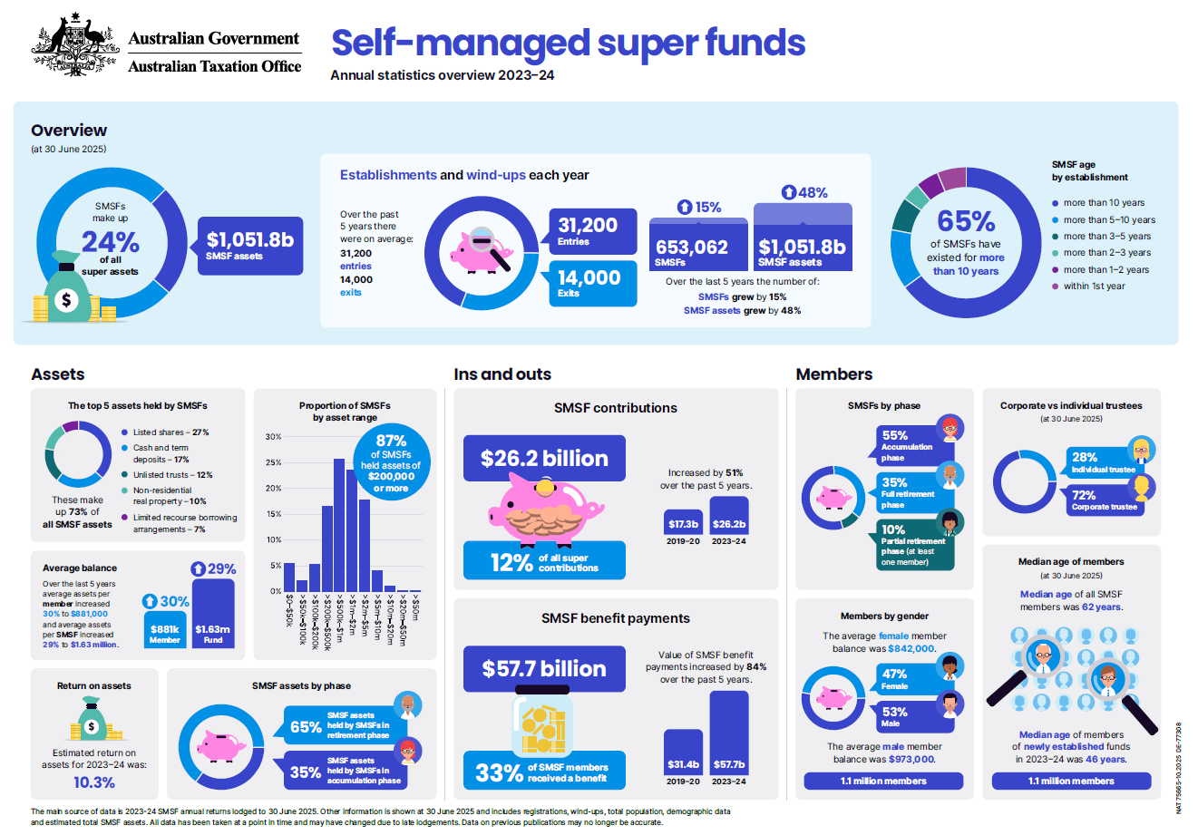

Slide 11
What is an SMSF?
A self‑managed super fund (SMSF) is a trust set up solely to provide retirement benefits to its members.
  Established solely to provide retirement benefits
  Up to 6 members only
  Members are trustees or directors of trustee company
  Trustees control investment decisions
  Trustees carry full legal responsibility

Slide 12
Trustee Responsibilities
Understand and comply with superannuation law
  Act honestly, prudently and in members’ best interests
  Prepare and maintain financial records
  Ensure assets are held separately
  Arrange annual audit and lodge SMSF Annual Return

Slide 13
TRUSTEES & STRUCTURE TYPE
Who can be a trustee
Members are eligible to be a trustee if they're:
at least 18 years old
not under a legal disability such as mental incapacity
not a disqualified person
Type of Trustee
Individual Trustee
Corporate trustee

Slide 14
Compare Trustee Structure
Feature | Individual Trustees | Corporate Trustees
Structure | Members act as trustees | Company acts as trustee; members are directors
Asset Ownership | Assets in individual names | Assets in company name
Setup Cost | Lower cost | Higher cost (company setup & ASIC fees)
Administration | More paperwork when members change | Easier; no asset title changes
Continuity | Issues if trustee dies/incapacitated | Company continues regardless of director changes
Compliance Penalties | Penalties per trustee | Penalty applies once to company
Asset Protection | Less separation from personal assets | Stronger legal protection
ATO/Advisor Preference | Less preferred | Generally recommended

Slide 15
SMSF – DIY Fund with Professional Support
• SMSFs are also known as Do-It-Yourself (DIY) super funds as trustees retain full responsibility and legal accountability.
• However, trustees commonly engage professionals for support:
  SMSF Auditor – Annual audit, compliance check, reports breaches to ATO
  Financial Adviser – Assess suitability, investment strategy, compliance advice
  Tax Agent – Prepare & lodge SMSF annual return, tax advice, ATO representation
  Accountant – Set up systems, prepare accounts & operating statements
  Administrator – Set up SMSF, daily administration & reporting
  Legal Practitioner – Trust deed, legal advice, disputes & proceedings
  Market Valuer – Independent valuation of SMSF assets
  Actuary provider – Actuarial certificates & pension-related calculations

Slide 16
Regulator Bodies involved in SMSF
Australian Tax office (ATO)
  The Australian Taxation Office regulates self-managed super funds' (SMSF) compliance with super and tax laws to safeguard retirement income. Superannuation Industry (Supervision) Act 1993 (SISA).
Australian Securities & Investment commission (ASIC) regulates:
  Australian financial services (AFS) licensees and their financial advisers who must be registered with ASIC
  registered SMSF auditors
  Australian companies, including companies that are corporate trustees of an SMSF

Slide 17
Governing rules
Individual trustees and directors of the corporate trustee must follow the rules in:
  the SMSF trust deed
  tax and super laws under Superannuation Industry (Supervision) Act 1993 (SISA).
In addition, directors of the corporate trustee must follow the rules in the:
  company's constitution
  Corporations Act 2001.

Slide 18
SMSF Residency & Ownership Condition
A self-managed super fund (SMSF) is an Australian superannuation fund if it meets all 3 of these residency conditions at all times during the financial year:
  established or has assets held in Australia
  central management and control ordinarily in Australia
  active members.
Ownership of All fund assets must be:
  kept separate from the personal assets of trustees and directors
  in the name of the fund or the name of the individual trustees 'as trustees for' the fund.

Slide 19
Set up of SMSF
To Legally establish SMSF
  choose your SMSF's structure
  appoint trustees
  check your SMSF is an Australian superannuation fund
  create the trust deed
  Register with ATO within 60days to Apply for ABN and TFN
  Setup SMSF Bank account
  hold assets
  Get electronic service address from SMSF massaging provider
  Notify ATO of ESA to monitor/track Rollover/contribution
  Create Investment Strategy
  Members to provide SMSF details like ESA, Bank details to Employer to contribute
  Prepare an Exit plan and review regularly (some common exit situations are
    Relationship breakdown between trustees
    Lack of time to manage SMSF
    Poor performing investment
    All member left smsf
    Death of trustee

Slide 20
SMSF INVESTMENTS
All SMSF Investments must:
meet the sole purpose test
be made on a commercial arm's length basis and always reflect true market value
show clear legal ownership by the fund
meet specific restrictions on investments.
Common List where SMSF Invest:
  Term Deposit
  Shares in Listed companies
  Shares in Listed companies (Overseas)
  Managed Investments
  Unit Trust
  Real estate Properties (with LRBA Loan if required)
  Crypto Currency
  Investment in collectables (Art work)
  Investment in Gold

Slide 21
Possible Inflow/Outflow of Money in SMSF
INFLOW | OUTFLOW
Member related Inflow | Member related Outflow
CONTRIBUTION | ROLLOVER-OUT
ROLLOVER IN | PENSION
INSURANCE PROCEED | LUMPSUM PAYOUT
 | Member Insurance premium
 | Div293 Tax
Fund related Inflow | Fund related Outflow
BANK INTEREST | ACCOUNTANCY FEES
DIVIDEND | AUDIT FEES
TRUST DISTRIBUTION | INVESTMENT EXPENSES
RENTAL INCOME | ATO SUPERVISORY LEVY
SALE OF ASSET | PURCHASE OF ASSET
TAX REFUND | ADMINSTRATION FEES
 | ACTUARY FEES
 | ASIC FEES (FOR CORPORATE TRUSTEE)
 | PAYG INSTALMENTS (Qtrly)
 | GST (if registered for GST)
 | FINAL TAX PAYMENT

Slide 22
Contribution
Contribution
Concessional Contribution (Before Tax)
Non-Concessional Contribution (After Tax)
Other
Contribution
Employer Contribution
Personal Concessional Contribution
Personal Non concessional Contribution
Downsizer Contribution
Super Guarantee Charges (SGC) – 12% of Ordinary Earnings
Govt Co Contribution
Voluntary Contribution – Salary Sacrifice
Spouse Contribution
Concessional Cap - $30,000 (From 01 Jul 2024)
NCC Cap- $120,000 (From 01 Jul 2024)
Downsizer - $300000 (Lifetime)

Slide 23
Tax on SMSF 15%
Self-managed super funds (SMSFs) must pay tax on their assessable income.
The most common types of assessable income are:
  assessable contributions,
  net capital gains
  interest
  dividends
  rent.
A complying superannuation fund that follows the laws and rules for SMSFs qualifies for a concessional tax rate of 15%.
Complying SMSFs are entitled to a capital gains tax (CGT) discount of one-third if the relevant asset had been owned for at least 12 months.
The SMSF will pay tax on net capital gains, which is calculated as:
  your total capital gains for the year
  minus any capital losses for that year and any unapplied capital losses from earlier years
  minus the CGT discount of 33.33% and any other concessions (if eligible).
SMSF Deductible Expense:
  management and administration fees
  audit fees
  Australian Securities & Investments Commission (ASIC) annual fee.
  Supervisory Levy
  Accounting fees
  Investment expense
  Member Insurance premiums

Slide 24
Withdrawals
When you meet the retirement condition of release, you can usually choose to withdraw your super as
either a:
  super lump sum (able to withdraw some or all of your super in one or more 'lump sum' payments)
  super income stream (A super income stream involves a series of regular payments from your super fund which are paid at least annually)
  combination of both.
Account Based Pension:
An account-based income stream allows you to draw a regular income once you retire. Member must withdraw a minimum amount each year – based on your age and account balance – or the income stream stops, in which case there may be income tax implications.
Transition to retirement income stream (TRIS)
A transition to retirement income stream (TRIS) allows members who have reached their preservation age of 60 years of age to access their superannuation benefits without having to retire or leave their job. The preservation age of 60 years is the minimum age a member can access their preserved super benefits without meeting another condition of release.
you may be able to receive regular payments (an income stream) from SMSF while you continue working. You can do this by starting a transition to retirement income stream (TRIS). This will allow you to either:
  reduce your working hours without reducing your income
  continue working and salary sacrifice to boost your super.
Minimum pension as per min pension rules & Maximum of 10% of account balance can be withdrawn in TRIS each year.
Your super income stream stops for income tax purposes if your fund doesn't make the minimum annual payment.

Slide 25
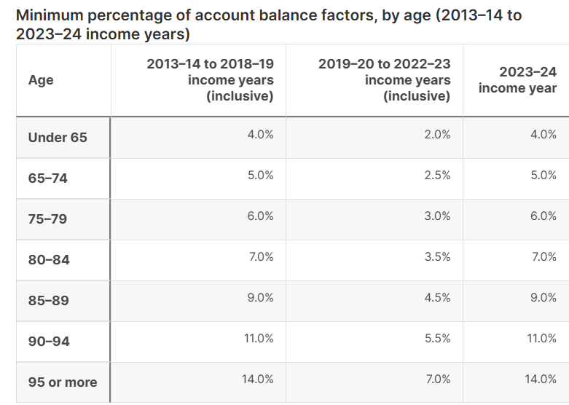
Minimum Pension

Slide 26

Q & A
THANK YOU
Rathnakumar R
Head of Operations
The Super Accountants

