Slide 1


Firebase apps for CAs
Build, deploy & host web apps—step-by-step guide for CA firms.
CA Rajendra Rampuria
Mobile: 9831401999 | Email: rajendra@rrampuria.com
CA Rajendra Rampuria | 9831401999 | rajendra@rrampuria.com

Slide 2
Welcome: Deploying & Hosting Web Apps Using Firebase
Welcome to our session on deploying and hosting web apps with Firebase. We’ll start with a brief orientation to the end-to-end workflow, then transition into practical, step-by-step deployment activities. This sets the foundation for the hands-on learning journey ahead and ensures everyone is ready to follow along.
CA Rajendra Rampuria | 9831401999 | rajendra@rrampuria.com

Slide 3
Why this matters for CAs
For CAs, web apps and Firebase Hosting make digital services faster, safer, and scalable.
Enable secure client portals for uploads and queries
Provide real-time dashboards for cashflow and compliance status
Automate workflows (onboarding, reminders, document checklists)
Support remote-first collaboration with role-based access controls
Reduce infra overhead with scalable, managed hosting
CA Rajendra Rampuria | 9831401999 | rajendra@rrampuria.com

Slide 4
What is Firebase?
Firebase is a comprehensive app development platform by Google.
It provides backend services such as hosting and real-time databases, helping teams simplify app deployment and ongoing management.
CA Rajendra Rampuria | 9831401999 | rajendra@rrampuria.com

Slide 5
Why Firebase instead of traditional hosting
  Real-time database: Sync data across devices.
  Developer productivity: Integrated auth, storage, functions; CI/CD hosting, fast releases.
  Security rules: Granular access control; built-in analytics for CA firms.
  Scalability: Auto-scaling backend on Google infrastructure.
5
CA Rajendra Rampuria | 9831401999 | rajendra@rrampuria.com

Slide 6
What can CA firms build?
Client-facing web apps that centralize documents, messages, and task status.
Automated reporting tools that pull data, validate inputs, and generate outputs faster.
Schedulers and trackers to streamline appointments, expenses, and follow-ups.
  Client Portal
  Automated Reporting
  Appointment Scheduler
  Expense Tracker
  Compliance Checklist
6
CA Rajendra Rampuria | 9831401999 | rajendra@rrampuria.com

Slide 7
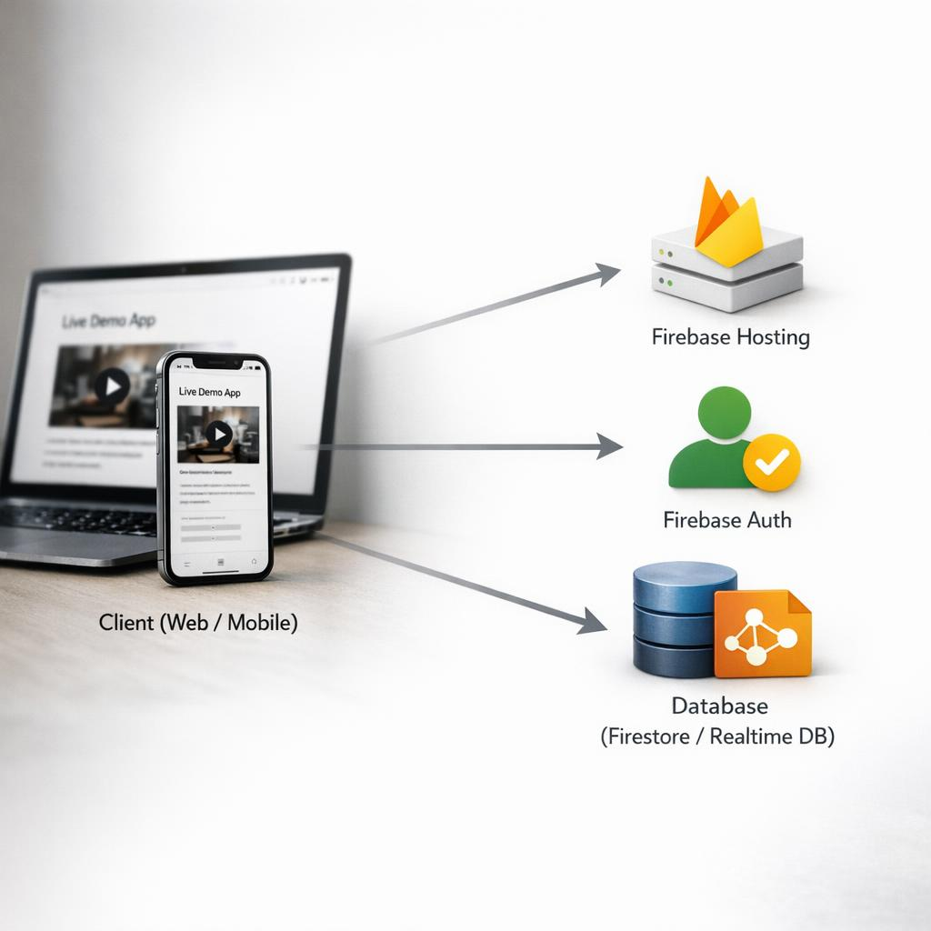
Live architecture
App UI served from hosting.
Users sign in via authentication.
App reads/writes data to the database.
These components work together to power the end-to-end live demo in Firebase.
7
CA Rajendra Rampuria | 9831401999 | rajendra@rrampuria.com

Slide 8
Practical deployment steps
Quick guide: TaskFlow + Firebase (Full checklist next slide)
Create project + Realtime DB (asia-southeast1, test mode)
Register web app → copy Firebase config → paste into HTML
Test in Chrome → confirm tf_users / tf_tasks nodes
Deploy via CLI (Node.js → init hosting → deploy)
Setup
Create Firebase project, enable services, install Firebase CLI
Development
Initialize app, configure hosting, add required Firebase SDKs
Testing
Run Firebase Emulators and validate auth, rules, and APIs
Publishing
Deploy to Hosting, verify routing, and set up basic monitoring
CA Rajendra Rampuria | 9831401999 | rajendra@rrampuria.com

Slide 9
Firebase setup & deployment checklist
Setup (one-time)
1) Install Node.js (LTS)
2) Install CLI: npm i -g firebase-tools
3) Authenticate: firebase login
4) Create: C:\TaskFlow\public
5) Copy app file to public; rename taskflow_app.html → index.html
6) Init: cd C:\TaskFlow → firebase init hosting (Answers: Project=taskflow-rrampuria; Public=public; SPA=N; Overwrite index.html=N)
Deployment demo (repeatable)
7) Deploy: firebase deploy --only hosting
8) Verify: open https://taskflow-rrampuria.web.app → hard refresh (Ctrl+Shift+R) → confirm change
9) Update loop: edit index.html → save → firebase deploy --only hosting → open URL → hard refresh → confirm
10) Optional safe preview: firebase hosting:channel:deploy demo → open preview URL
Install
1
Node.js LTS + Firebase CLI
Login
2
firebase login
Folder
3
C:\TaskFlow\public\index.html
Init
4
firebase init hosting
Deploy
5
firebase deploy → web.app URL
Update
6
Edit index.html → deploy again
CA Rajendra Rampuria | 9831401999 | rajendra@rrampuria.com

Slide 10
Result: your app is live
Deployed to Firebase Hosting. Your app is now accessible via a secure URL.
Ready for users to interact with immediately—live, stable, and available for production use.
10
CA Rajendra Rampuria | 9831401999 | rajendra@rrampuria.com

Slide 11
Custom domain setup
Customize your web app’s URL by linking it to a domain name that reflects your CA firm’s branding. This provides a more professional appearance for clients and stakeholders.
CA Rajendra Rampuria | 9831401999 | rajendra@rrampuria.com

Slide 12
Multiuser system for CA office
Firebase supports multiuser authentication for CA office teams.
Role-based access controls ensure users see only what they are permitted to access.
Admins can manage different users and assign appropriate permissions by role.
A consistent permission model helps maintain security and governance as the user base grows.
CA Rajendra Rampuria | 9831401999 | rajendra@rrampuria.com

Slide 13
Real-time database use cases
Instant status updates: Keep engagement milestones, timesheets, and approvals current across teams.
Collaborative workpapers: Co-author checklists, evidence, and notes with conflict-free sync.
Event-driven automation: Trigger notifications, tasks, and SLA timers when data changes.
  Live client portal: Show document requests, uploads, and comments in real time.
  Shared dashboards: Surface KPIs and risk flags as they occur.
  In-app context: Link conversations to records for faster decisions.
13
CA Rajendra Rampuria | 9831401999 | rajendra@rrampuria.com

Slide 14
Security rules
Firebase security rules control read/write access. “Test mode” (open rules) is only for quick setup and is NOT secure—anyone with the URL/app config can potentially read/write. Real protection starts when rules require authentication and validate what each user is allowed to access.
Safe baseline example (Realtime DB):
{
"rules": {
".read": "auth != null",
".write": "auth != null"
}
}
Then tighten per-user (and separate client vs staff/admin access) using auth.uid-based paths, least privilege, and rule reviews/versioning.
CA Rajendra Rampuria | 9831401999 | rajendra@rrampuria.com

Slide 15
Cost advantage
Firebase is cost-effective from day one, with a generous free tier that helps CA firms launch quickly and validate use cases with minimal spend.
As needs grow, pay-as-you-go pricing scales with demand and reduces infrastructure expenses by limiting up-front investment, operational overhead, and capacity overprovisioning.
15
CA Rajendra Rampuria | 9831401999 | rajendra@rrampuria.com

Slide 16
Productivity gains
Using Firebase accelerates development and deployment through managed infrastructure and streamlined tooling. This enables CA firms to focus more time on service delivery and innovation, and less on platform operations and maintenance.
CA Rajendra Rampuria | 9831401999 | rajendra@rrampuria.com

Slide 17
Risks & precautions
Risks: Data access misconfiguration, compliance gaps (GDPR/PII), reliance on Google-managed services, potential outages, and variable usage-based costs can affect control, availability, and predictability.
Precautions: Apply least-privilege IAM and Security Rules, enable audit logging, define data residency/retention, encrypt sensitive fields, set budgets/alerts, implement backups, and design an exit plan (abstraction, export tests).
17
CA Rajendra Rampuria | 9831401999 | rajendra@rrampuria.com

Slide 18
Future for CA firms
Client portals and mobile apps for document exchange, status updates, and secure messaging.
Workflow automation using Firebase triggers for reminders, approvals, and task routing.
Real-time dashboards for engagement, turnaround time, and compliance milestones.
  Faster onboarding and fewer follow-ups.
  Automated compliance nudges and deadlines.
  Better visibility for partners and clients.
  Foundation for new digital services.
18
CA Rajendra Rampuria | 9831401999 | rajendra@rrampuria.com

Slide 19
My advice to CA firms
Adopt tech stepwise; pilot with one team/service line.
Start small: practical apps cut effort (onboarding, docs, reminders).
Use Firebase for auth, secure sync, audit logs; build security in (MFA, roles, encryption, backups).
Continuous learning: train staff, review, iterate for growth.
CA Rajendra Rampuria | 9831401999 | rajendra@rrampuria.com

Slide 20

Thank you + Q&A
Thank you for your attention. We will now open the floor to questions and discussion to clarify and expand on any topics covered.
CA Rajendra Rampuria
Mobile: 9831401999 | Email: rajendra@rrampuria.com
CA Rajendra Rampuria | 9831401999 | rajendra@rrampuria.com

Slide 21
Conclusion
Firebase offers chartered accountants a practical, secure, and scalable platform to build and host web applications that enhance productivity and client service.
Embracing these tools will position your firm for success in a digital future.
CA Rajendra Rampuria | 9831401999 | rajendra@rrampuria.com

