Slide 1

ICAI
Accounting Standards
Continuing Professional
Education
2024-25
AS 1: Disclosure of Accounting Policies
AS 5: Net Profit or Loss, Prior Period Items & Changes in Accounting Policies
Practical Insights | Common Errors
Presented by CA Ayush Agarwal
Date: 23.04.2026

Slide 2
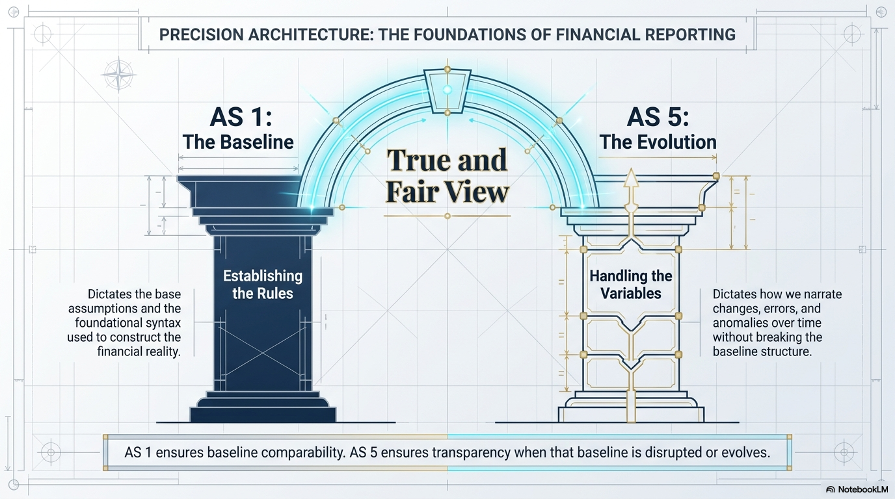

Slide 3
AS-1: Disclosure of Accounting Policies

Slide 4
AS-1 – Scope, Objective & Applicability
Objective
Applicability
To ensure that significant accounting policies adopted in preparation of F/S are disclosed, enabling users to understand and compare statements.
Key emphasis:
Disclosure ≠ Justification
Consistency across periods
All 'significant' policies — not all policies
Changes must be disclosed with impact
Mandatory for ALL enterprises on which Accounting Standard applies
Irrespective of:
Size
Nature of business
Sector
Notes:
Why AS 1
Accounting Standard cannot and do not cover all possible areas of accounting – Enterprises having freedome
AS permits more than one policy/ treatment for particular area.

Slide 5
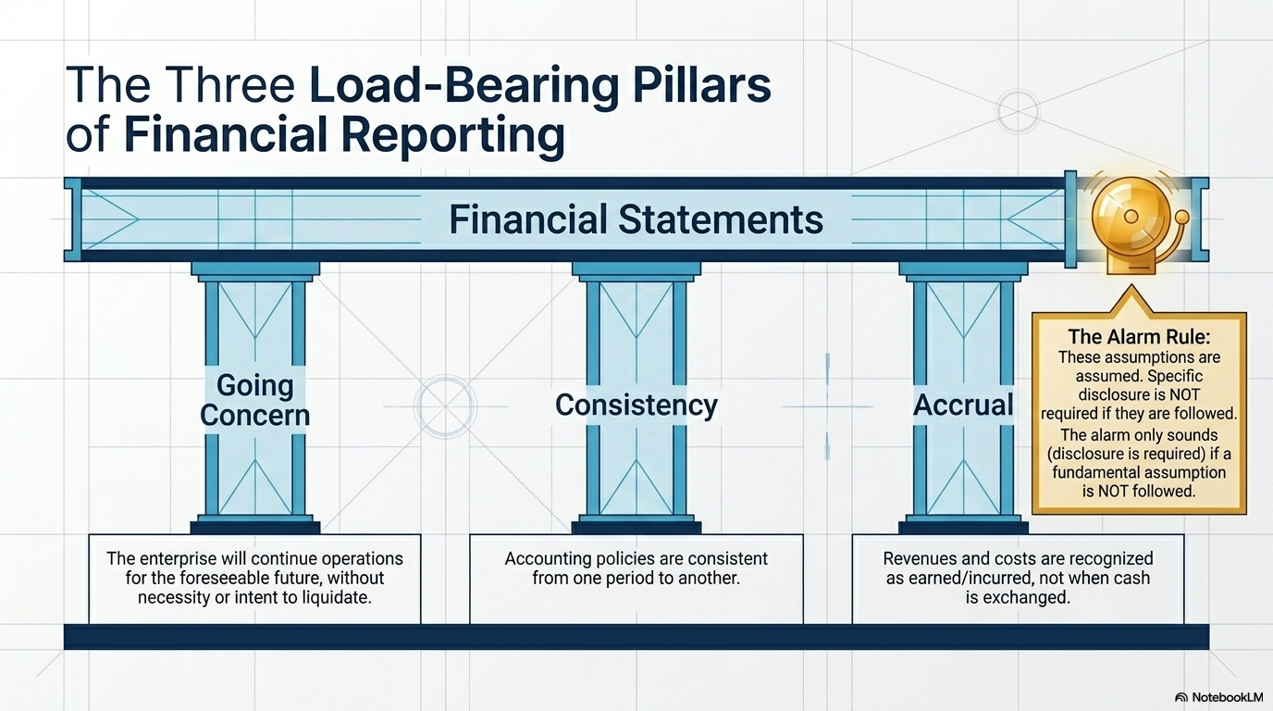

Slide 6
AS-1: What Constitutes an 'Accounting Policy'?
Accounting policies are the specific accounting principles and the methods of applying those principles adopted by an enterprise in preparation of financial statements.
AREAS REQUIRING DISCLOSURE OF ACCOUNTING POLICIES
Valuation of inventories
Recognition of PPE/ Intangible Asset
FIFO / Weighted Average; NRV test
Cost Model; Revaluation Model
Revenue recognition
Treatment of government grants
Percentage completion / Completed contract
Capital approach vs Income approach
Valuation of investments
Foreign currency transactions
Cost method / Market value / Lower of cost or fair value
Exchange rate used; treatment of exchange differences
Retirement benefits
Deferred taxation
Gratuity, leave encashment – actuarial / AS-15 method
Timing differences – DTA/DTL recognition under AS-22
★ The standard uses the term 'significant accounting policy' but does not define 'significant' — a deliberate latitude that requires professional judgment.

Slide 7
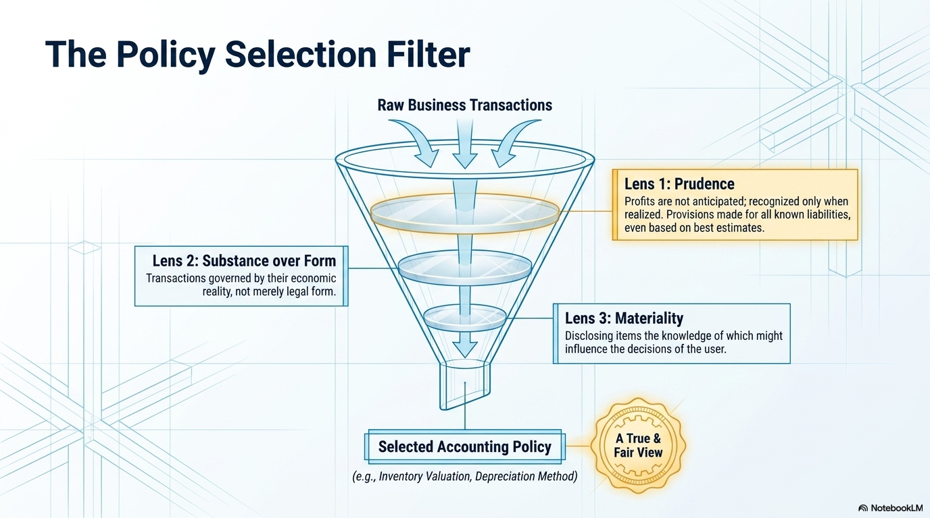

Slide 8
AS 1 — Common errors found in practice
1) Boilerplate policies
2) Significant policy omitted
3) Policies scattered
• Policy note copied from another client / prior year without matching actual transactions.
• Example: foreign currency policy disclosed even when entity has no such exposure, while an important lease / grant policy is omitted.
• No policy for revenue, employee benefits, investment valuation, or provisions even though balances are material.
• Some in Note 1, some inside PPE note, some in management discussion. AS 1 prefers one place for significant policies.
4) Fundamental assumption not disclosed
5) Inconsistent wording vs numbers
6) Materiality ignored
• Going concern problems exist, but no disclosure of departure / uncertainty is made.
• Policy says “FIFO”, schedule works on weighted average; policy says accrual basis but material items are recognised on payment basis.
• Long note on immaterial matters but no meaningful disclosure on material estimates and policy choices.

Slide 9
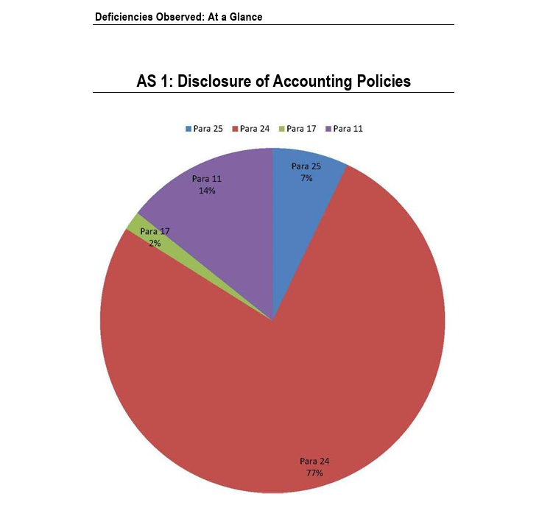
AS 1 — Common errors found in practice – Based on Report of FRRB

Slide 10
Mandatory Disclosures based on ICAI ASB Announcement:
Revised MSME Classification & AS Applicability
Council Decision — 433rd Meeting, August 2024 · Effective: April 1, 2024

Slide 11
What MSMEs Must Disclose ?
Additional Requirements from the ICAI ASB Announcement (2024)
MANDATORY DISCLOSURES FOR MSMEs AVAILING EXEMPTIONS
(1)
Disclose MSME Status in Notes
An MSME availing any exemption/relaxation must disclose by way of a note to its financial statements that it is an MSME and has complied with Accounting Standards insofar as they are applicable to an MSME.
(2)
Transition: Ceasing to be an MSME
When an MSME no longer qualifies in the current period, the relevant standard applies from the current period. Prior period figures need not be revised. The fact that it was an MSME in the previous period and availed exemptions must be disclosed in the notes.
(3)
Two-Year Lock-in Before Re-Qualifying
An entity that was previously not an MSME and subsequently becomes one shall not qualify for exemptions until it remains an MSME for two consecutive years.
(4)
Partial Exemption Disclosure
If an MSME opts not to avail exemptions in respect of any (but not all) Accounting Standards, it shall specifically disclose the Standards in respect of which it has availed the exemption or relaxation.
(5)
No Misleading Partial Exemption
Partial exemption and disclosure shall not be permitted to mislead users of financial statements.

Slide 12
AS 5: Net Profit or Loss for the Period, Prior Period Items & Changes in Accounting Policies

Slide 13
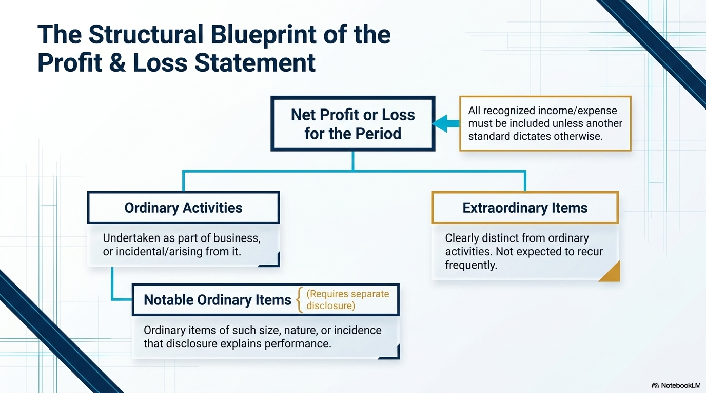

Slide 14
AS 5: Overview & Three Pillars
AS 5
Objective: Uniform classification and disclosure in Statement of Profit & Loss
AS 5 prescribes classification and disclosure of certain items in the P&L so that all enterprises prepare and present P&L on a uniform basis, enhancing comparability across periods.
PILLAR I
Ordinary Activities
PILLAR II
Extraordinary Items
PILLAR III
Prior Period Items
Revenue from operations
Manufacturing/trading costs
Administrative expenses
Finance costs & depreciation
Items arising in ordinary course of business
Gains/losses clearly distinct from ordinary activities
Material and not expected to recur frequently
Examples: earthquake loss,
Must be disclosed separately on face of P&L
Errors/omissions in prior period F/S
Recognised in current period P&L
Separately disclosed — NOT taken to reserves
Distinct from changes in estimates

Slide 15
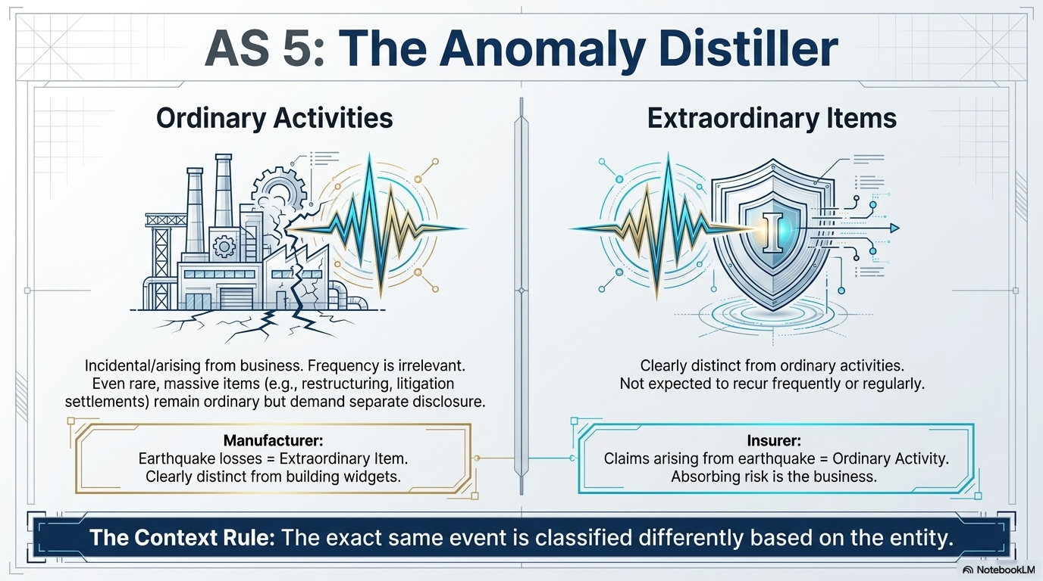

Slide 16
AS 5: Prior Period Items — Definition & Treatment
Separate disclosure in P&L; NOT direct adjustment to reserves
Definition: Income or expenses arising in the current period as a result of errors or omissions in the preparation of financial statements of one or more prior periods.
What QUALIFIES as Prior Period?
Audit Traps & Disclosure Requirements
Mathematical errors in prior year F/S
Misapplication of accounting policy discovered later
Omission of material items (accruals, provisions)
Wrong classification subsequently corrected
NOT Prior Period:
Changes in estimates (useful life, provision amounts) — these are current period items
New information about conditions existing at prior period date (crystallisation of contingency)
AS 5 Treatment:
Include in P&L of current period; disclose separately by nature and amount. No restatement of comparatives under AS framework.
Common Audit Traps:
Prior period errors adjusted directly to reserves (WRONG)
Estimate changes mislabelled as prior period items
No note with year of original omission and nature
FRRB publications frequently highlight wrong routing of prior-period expenses

Slide 17
AS 5: Changes in Accounting Policies
AS 5
When permissible, how to treat & mandatory disclosures
When is a Change in Accounting Policy Permissible?
Required by Statute
Required by Accounting Standards
More Appropriate Presentation
Companies Act amendment mandating Schedule II depreciation
New/revised AS issued by ICAI — entity must comply
Change results in more relevant and faithful representation
Mandatory Disclosure Requirements on Any Change
Nature of the change
Reason for the change (justification)
Quantified impact on current period profit/loss
If impact not quantifiable — statement to that effect
Apply change prospectively (AS framework — not retrospective)
Distinguish from change in accounting estimate (prospective always)
AS 1: update accounting policy note to reflect new policy
AS 5: quantify financial impact — 'Had previous policy been followed, profit would have been ₹___ lakhs higher/lower'

Slide 18
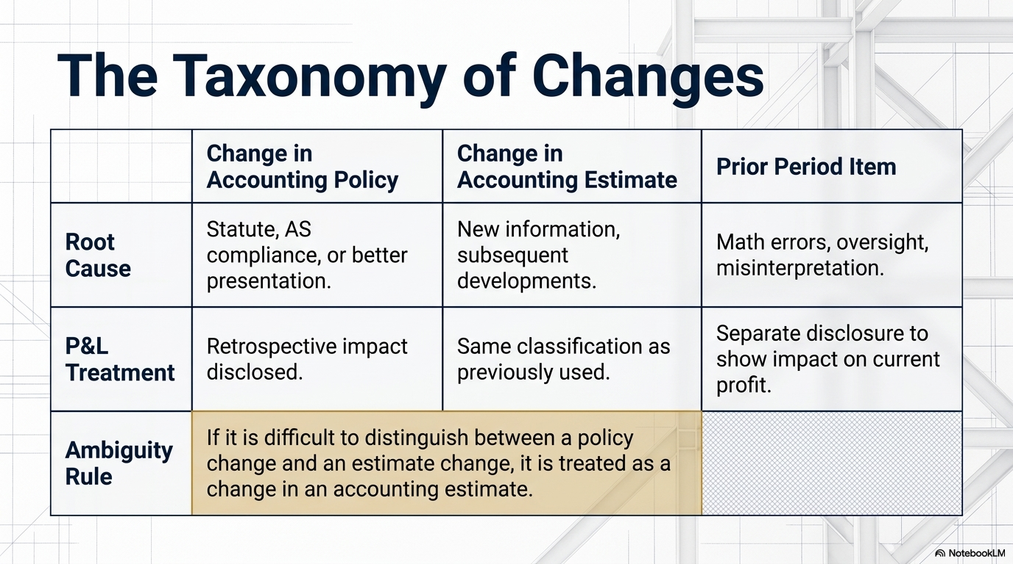

Slide 19
Pre-Signoff Checklist: AS 1 & AS 5 — Audit / Finalisation
Use before signing the financial statements
AS 1 Checks
AS 5 Checks
Are all significant accounting policies disclosed in one place?
All income/expenses routed through P&L unless another AS permits otherwise?
✓
✓
Do policy notes reflect actual measurement bases used in schedules (not copied templates)?
Have prior period items been identified, quantified, and separately disclosed?
✓
✓
If going concern / accrual / consistency is not followed — is the fact disclosed clearly?
Have estimate changes been kept separate from prior period items?
✓
✓
Are policy notes entity-specific? Foreign currency policy present only if transactions exist?
Every material unusual item separately disclosed where size/nature requires?
✓
✓
Are material policies for revenue, inventory, depreciation, investments, employee benefits covered?
Policy change justified and financial impact quantified?
✓
✓
Any change in policy? → Disclose nature, reason, and rupee impact.
✓
✓

Slide 20
Common Mistakes Under AS 5
AS 5
Prior period misclassification, policy change omissions & estimate errors
Prior Period Items Absorbed in Current Year Expenses
⚠ Error: Error discovered (missed provision, wrong expense) silently absorbed in current costs without note disclosure. ✔ Fix: Identify and disclose separately on face of P&L or in Notes. Give year of original omission and nature.
Confusing Policy Change with Estimate Revision
⚠ Error: Revision in useful life or provision % disclosed as 'change in accounting policy' when it is only an estimate change. ✔ Fix: Change in estimate = prospective. Change in policy = disclose with quantified effect. Do not mix these up.
Missing Quantification of Policy Change Impact
⚠ Error: Nature of policy change disclosed but financial impact NOT quantified as required by AS 5. ✔ Fix: Always state: 'Had the previous policy been followed, profit would have been higher/lower by ₹___ lakhs.'
Ordinary Items Labelled as Extraordinary
⚠ Error: NPA provisions, standard write-offs, or recurring penalties disclosed as extraordinary items. ✔ Fix: Extraordinary items must be clearly distinct from ordinary activities and clearly non-recurring.

Slide 21
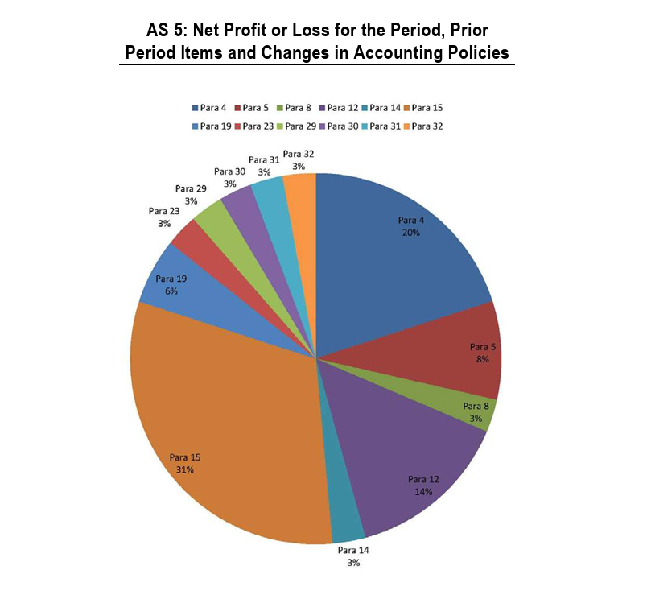
AS 5 — Common errors found in practice – Based on Report of FRRB

Slide 22
Key Takeaways
AS 1
Accounting policies form the backbone of financial statements — disclosures must be specific, honest, and current. Generic notes are non-compliant.
AS 1
If any of the three fundamental assumptions — Going Concern, Consistency, Accrual — is not followed, it MUST be disclosed with reasons.
AS 5
Prior Period items must be disclosed separately. They are not ordinary current-year transactions — burying them misleads users.
AS 5
Always distinguish: Change in Accounting Policy (may be retrospective + must quantify impact) vs Change in Accounting Estimate (prospective only).
AS 1 & AS 5
The quantified impact of any change is not optional — it is mandatory under both Standards. 'Not practicable' is a last resort, not a default.

Slide 23
Thank You
Questions Welcome
AS 1 | Disclosure of Accounting Policies | AS 5 | Net Profit/Loss, Prior Period & Policy Changes
CA AYUSH AGARWAL
Email: caayushagarwal26@gmail.com

