Slide 1

Accounting Standards
AS 17 · AS 18
Presented By: CA Anupam Sarda
Partner at: D J A S & Co.

Slide 2
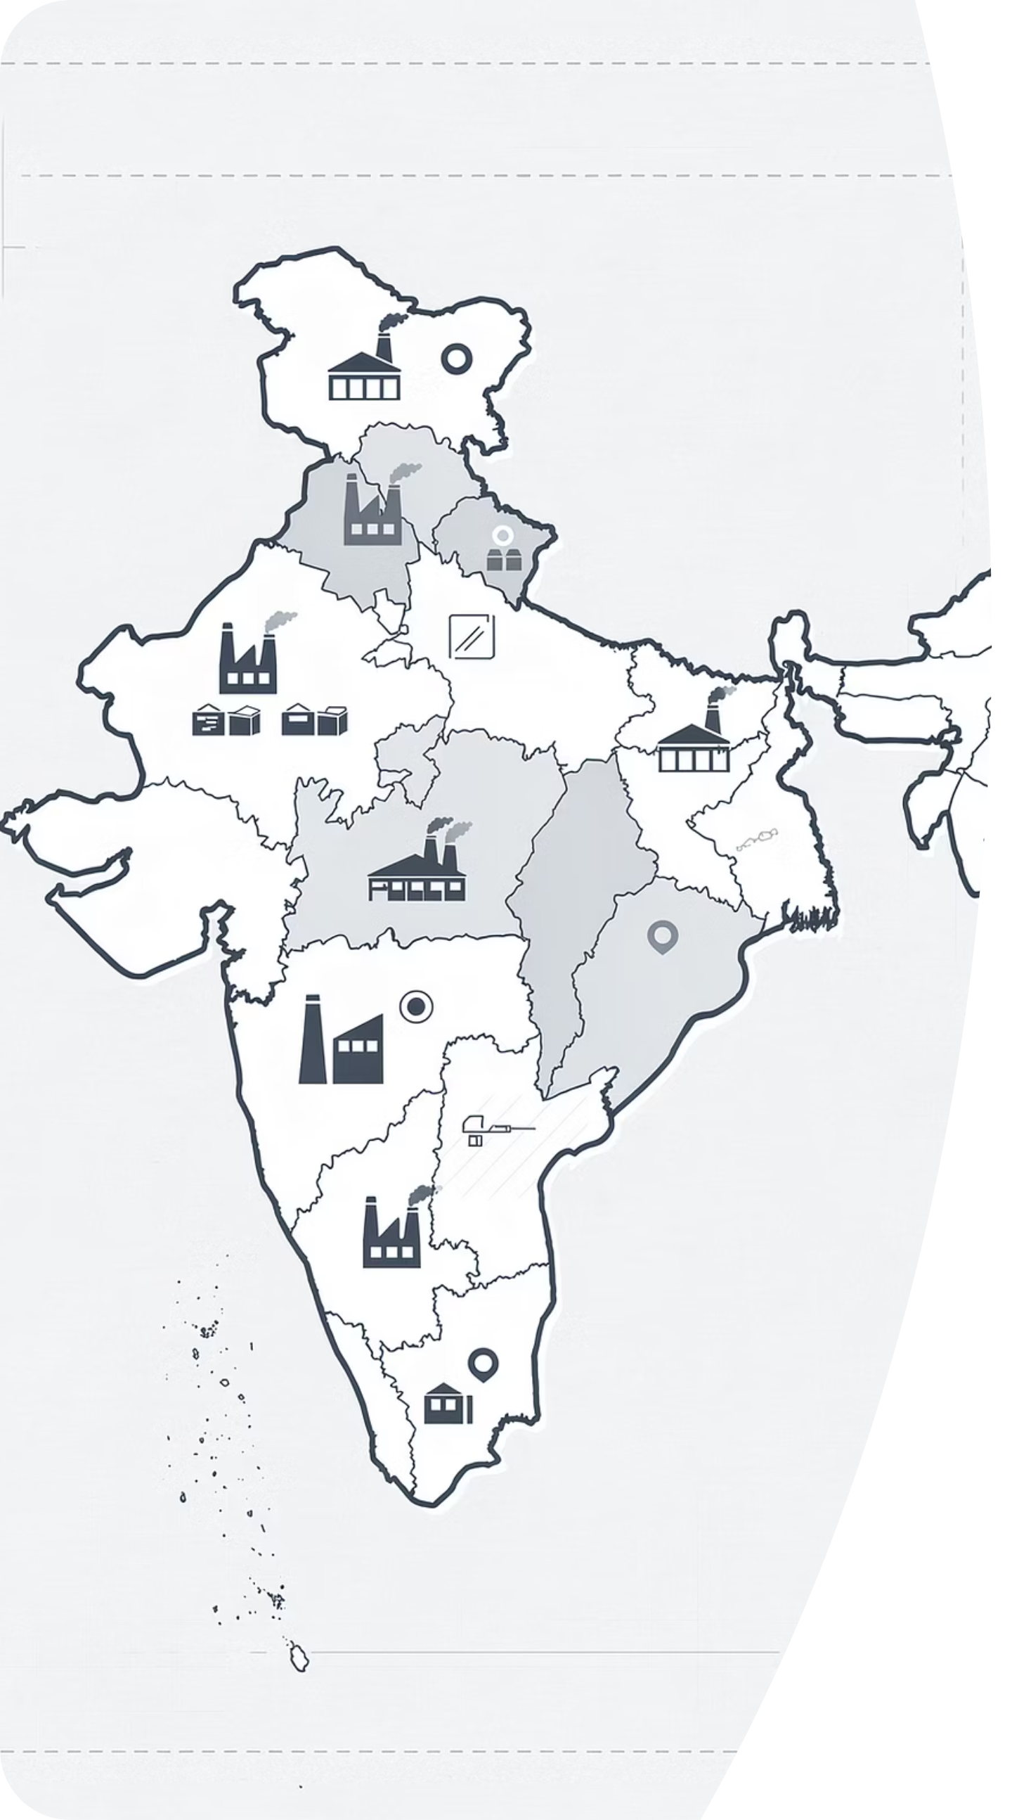
AS 17 — Segment Reporting

Slide 3
AS 17 — Applicability & Exemptions
1
2
Applicability
Exemptions
Mandatory for all listed entities and those in the process of listing.
Also mandatory for other entities if turnover exceeds ₹50 Crores or borrowings exceed ₹10 Crores.
Applies to both standalone and consolidated financial statements.
However, where an enterprise prepares both, segment information need only be presented in the consolidated financial statements — not required separately in the standalone financial statements.
This is not mandatory for Small and Medium Sized Companies, and Micro, Small and Medium sized non-company entities.
Such Companies are however encouraged to comply with the Standard.

Slide 4
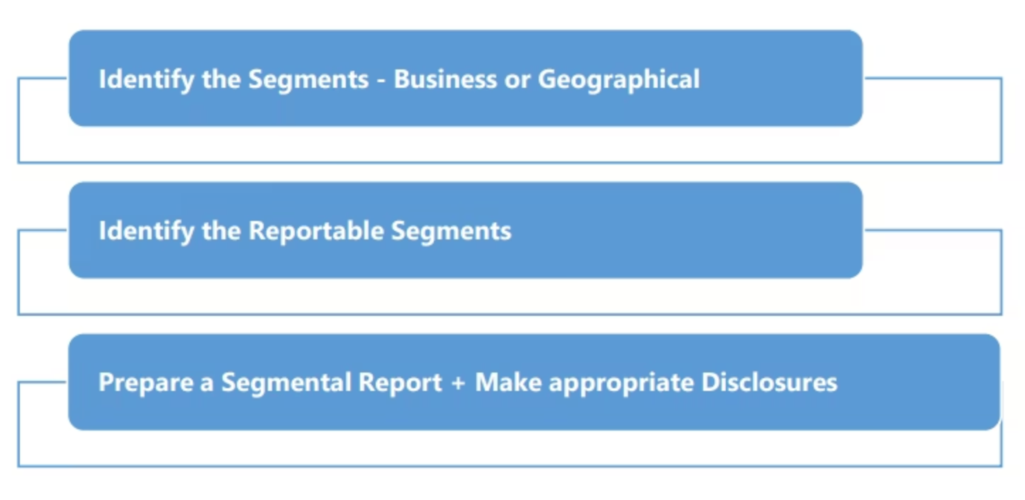
How to Apply AS-17?

Slide 5
Types of Segment & Why Report It?
Two Types of Segments
Why It Matters
Helps investors assess profitability by division
Reveals which segments are growing vs. declining
Enables better risk assessment across geographies
Prevents aggregation that hides poor-performing units
Supports informed capital allocation decisions
Business Segment
Distinct products/services with different risks & returns. E.g., Telecom vs. Retail vs. Energy within one conglomerate.
Geographical Segment
Operations in different economic environments. E.g., India vs. EU vs. North America — each with unique regulatory and currency risks.
"Segment reporting strips away the comfort of consolidated numbers and shows where value is truly being created."

Slide 6

Identifying Reportable Segments — The 10% & 75% Rules
Check 75% Rule
Ensure reportable segments cover ≥75% revenue
Disclose Formats & Reconcile
Apply 10% Thresholds
Primary/secondary format with reconciliation
Revenue, result, or assets ≥10%

Slide 7
AS 17 — Reportable Segments: Example
Example
A company has 6 segments with total revenue of ₹500 Cr:
Segment A: ₹150 Cr (30%) ✓ Reportable
Segment B: ₹100 Cr (20%) ✓ Reportable
Segment C: ₹80 Cr (16%) ✓ Reportable
Segment D: ₹70 Cr (14%) ✓ Reportable
Segment E: ₹60 Cr (12%) ✓ Reportable
Segment F: ₹40 Cr (8%) ✗ Below 10% threshold
Segments A–E cover ₹460 Cr = 92% of total revenue → 75% rule satisfied. Segment F is combined with others as "All Other Segments".
"The 10% rule is a floor, not a ceiling — management judgement determines the full picture."

Slide 8


AS 17 — Reportable Segments: Continuity & Restatement
It provides specific guidelines to ensure consistency and comparability in segment reporting, particularly regarding segments that meet or no longer meet the threshold criteria over time.
Continuity Rule
A segment that was identified as reportable in the immediately preceding period, having met the 10% thresholds, must continue to be reported as a separate segment in the current period. This applies even if its revenue, results, and assets no longer individually meet those 10% thresholds in the current period, ensuring consistent reporting for investors.
Restatement for Comparative Purposes
If a segment becomes reportable in the current period because it now satisfies the 10% thresholds, any preceding-period segment data presented for comparative purposes should be restated. This restatement should reflect the newly reportable segment as a separate entity, even if it did not meet the 10% thresholds in the prior period, unless such restatement is impracticable.

Slide 9
AS-17: Segment Revenue, Expense, and Assets
Understanding these key terms is crucial for accurate segment reporting and assessing a segment's performance.
1
2
3
Segment Revenue
Segment Expense
Segment Assets
Revenue directly attributable to a segment, plus a reasonable share of revenue from inter-segment transactions.
Expense directly attributable to a segment, plus a reasonable share of expenses related to operations of different segments.
Assets employed by a segment in its operating activities that are directly attributable or can be reasonably allocated.
Does NOT include: Extraordinary items, interest income, or dividends from investments (unless financial services is the segment's primary activity).
Does NOT include: Income tax expense, extraordinary items, or interest expense (unless financial services is the segment's primary activity).
Does NOT include: Assets used for general enterprise purposes (e.g., corporate assets), income tax assets, or investments in other segments.

Slide 10

AS 17 — Primary & Secondary Disclosures
Companies are required to present segment information in two formats: a primary format based on the dominant source of risks and returns, and a secondary format providing additional details.
1
2
Primary Format Disclosure
Secondary Format Disclosure
This is the main reporting format, determined by whether business segments or geographical segments are the predominant source of risk and returns.
This format provides supplementary information for the segment type that is not chosen as primary, offering further granularity.
Segment Revenue (external & inter-segment)
Segment Result (profit/loss)
Carrying Amount of Segment Assets & Liabilities
Cost to acquire segment assets
Depreciation & Amortisation
Non-cash Expenses-Other than Depreciation and Amortisation.
Segment Revenue (external)
Segment Assets
Cost to acquire segment assets
The level of detail in secondary disclosures is generally less than in the primary format.
These disclosures enable users to better understand the various activities of an enterprise and the environments in which it operates, fostering more informed decision-making.

Slide 11
AS 17 — Primary Disclosures & Real-World Application
Segment Revenue
Segment Result
External sales + inter-segment transfers. Excludes extraordinary items, interest/dividend income (unless financial segment).
Revenue minus expense. Operating profit/loss. Excludes income tax, head-office expenses, and financing costs.
Segment Assets & Liabilities
Reconciliation Required
Operating assets/liabilities directly attributable or reasonably allocable. Excludes income tax assets/liabilities and corporate borrowings.
Segment revenue, result, assets, and liabilities must be reconciled to enterprise totals. Unallocated items shown separately.
"A diversified conglomerate without segment reporting is like a menu without prices — you cannot make an informed choice."

Slide 12
AS 17 — Reliance Industries( Primary Reporting )
Primary Segment Information — FY 2024-25 (₹ in crore)
Particulars
O2C
Oil and Gas
Retail
Digital Services
Others
Unallocable
Total
1. Segment Revenue
External Turnover
6,25,928
19,957
3,26,872
50,318
48,099
—
10,71,174
Inter-Segment Turnover
993
5,254
4,071
1,03,801
7,760
—
—
Value of Sales and Services (Revenue)
6,26,921
25,211
3,30,943
1,54,119
55,859
—
10,71,174
Less: GST Recovered
21,915
330
39,900
22,783
6,110
—
91,038
Revenue from Operations (Net of GST)
6,05,006
24,881
2,91,043
1,31,336
49,749
—
9,80,136
2. Segment Result before Interest and Taxes
Segment Result
47,257
15,840
19,070
39,717
530
(3,024)
1,19,390
Finance Cost
—
—
—
—
—
—
(24,269)
Interest Income
—
—
—
—
—
—
10,896
Profit before Tax and Share of Profit/(Loss) of Associate and JV
—
—
—
—
—
—
1,06,017
Current Tax
—
—
—
—
—
—
(12,758)
Deferred Tax
—
—
—
—
—
—
(12,472)
Profit after Tax (before adjustment for Non-Controlling Interest)
—
—
—
—
—
—
80,787
Share of Profit/(Loss) of associate and JV
—
—
—
—
—
—
522
Share of (Profit)/Loss transferred to Non-Controlling Interest
—
—
—
—
—
—
(11,661)
Profit after Tax (after adjustment for Non-Controlling Interest)
—
—
—
—
—
—
69,648
3. Other Information
Segment Assets
4,40,859
35,863
2,18,219
5,98,015
3,44,853
3,12,312
19,50,121
Segment Liabilities
1,95,845
13,806
87,554
2,43,664
57,263
13,36,989
19,50,121
Capital Expenditure
26,573
1,154
33,696
38,438
25,104
6,142
1,31,107
Depreciation/Amortisation and Depletion Expense
7,731
5,348
6,024
25,284
7,996
753
53,136
(All figures in ₹ Crore, FY 2024-25 — Source: Reliance Industries Annual Report)

Slide 13
AS 17 — Reliance Industries (Secondary Reporting)
Secondary Segment Information (₹ in crore)
Particulars
2024-25
1. Segment Revenue – External Turnover
Within India
6,86,534
Outside India
3,84,640
Total
10,71,174
2. Non-Current Assets
Within India
14,16,943
Outside India
33,908
Total
14,50,851
(V) Secondary Segment Information — All figures in ₹ Crore, FY 2024-25 — Source: Reliance Industries Annual Report

Slide 14
AS 17 — Tata Motors: Segment Reporting
Primary Segment Information — For the year ended 31st March 2025 (₹ in Crore)
Particulars
Commercial Vehicle
Passenger Vehicle
Unallocable
Total Tata & Brand Vehicle
Vehicle Financing
Jaguar Land Rover
Intra-segment elimination
Total
Others
Inter-segment elimination
Total
Revenues — External revenue
74,049
47,807
15
1,21,871
46
3,14,032
–
4,35,949
3,746
–
4,39,695
Revenues — Inter-segment/Intra-segment revenue
1,006
638
576
2,220
1
–
(2,213)
8
–
(2,273)
(2,273)
Revenues — Total revenues
75,055
48,445
591
1,24,091
47
3,14,220
(2,213)
4,35,957
6,010
(2,273)
4,39,695
Segment results (EBITDA) — Earnings before income
6,814
472
(516)
6,770
(2)
27,764
(19)
34,513
939
(118)
35,334
Segment results
6,814
472
(516)
6,770
(2)
27,764
(19)
34,245
939
(118)
35,066
Reconciliation to Profit/(loss) before tax — Other income/(expense)
–
–
–
–
–
–
–
–
–
–
2,766
Finance costs
–
–
–
–
–
–
–
–
–
–
(4,815)
Compulsorily convertible preference share measured at Fair Value gain
–
–
–
–
–
–
–
–
–
–
84
Foreign exchange
(266)
(51)
(30)
(347)
(32)
(171)
–
(550)
–
–
(550)
Share of Profit of equity accounted investees (net)
–
–
189
189
–
(32)
–
161
126
–
287
Profit/(loss) before tax
–
–
–
–
–
–
–
–
–
–
33,780
Profit after tax from discontinued operation
(4,275)
Profit before tax after discontinued operation
29,505
Capital expenditure
2,103
4,179
–
6,282
58
34,388
(44)
40,664
(198)
45
40,531
Depreciation and amortisation expense
2,046
2,899
160
5,105
41
18,105
(32)
23,219
127
(90)
4,275
Segment assets — Segment assets
33,329
22,463
1,484
57,746
8,122
2,20,711
(203)
2,85,926
5,532
(1,611)
2,89,847
Assets classified as held for sale
–
–
–
–
–
–
–
–
–
–
5,534
Investments in equity accounted investees
–
–
1,139
1,139
–
3,428
–
4,567
987
–
5,554
Reconciliation to total assets — Current and non-current tax assets (net)
2,456
Deferred tax assets (net)
2,456
Other unallocated financial assets
(42,993)
Total assets
2,62,852
Segment liabilities — Segment liabilities
26,147
18,201
1,477
40,825
22
1,41,273
(480)
1,83,074
3,106
(570)
1,80,220
Reconciliation to total liabilities — Borrowings
62,499
Current tax liabilities (net)
2,146
Deferred tax liabilities (net)
2,146
Other unallocated financial liabilities
30,544
Total liabilities
2,77,555
Source: Tata Motors Annual Report FY 2024-25. All figures in ₹ Crore.

Slide 15
AS 17 — Tata Motors (Secondary Reporting) (1/2)
Entity-Wide Disclosures — For the year ended 31st March 2025 (₹ in Crore)
Particulars
Year ended March 31, 2025
Year ended March 31, 2024
Total Revenues
14,852
10,114
Earnings before other income (excl. incentives), finance costs, foreign exchange loss (net), exceptional items and tax
(256)
(792)
A. Net Sales to External Customers by Geographic Area (by location of customers)
Particulars
Year ended March 31, 2025
Year ended March 31, 2024
(a) India
1,18,630
1,23,843
(b) United States of America
94,087
67,496
(c) United Kingdom
54,520
55,009
(d) Rest of Europe
51,307
55,528
(e) China
55,354
57,184
(f) Rest of the World
65,797
74,956
Total
4,39,695
4,34,016
B. Non-Current Assets by Geographic Area (Property, Plant & Equipment, Intangible Assets, Other Non-Current Assets (non-financial) and Goodwill)
Particulars
Year ended March 31, 2025
Year ended March 31, 2024
(a) India
35,254
33,184
(b) United States of America
471
477
(c) United Kingdom
1,41,066
1,17,760
(d) Rest of Europe
7,475
7,932
(e) China
334
382
(f) Rest of the World
2,955
2,979
Total
1,88,555
1,62,703
Source: Tata Motors Annual Report FY 2024-25 | Continued on next slide →

Slide 16
AS 17 — Tata Motors (Secondary Reporting) (2/2)
Information About Product Revenues — For the year ended 31st March 2025 (₹ in Crore)
C. Product Revenue Breakdown
Particulars
Year ended March 31, 2025
Year ended March 31, 2024
(a) Tata and Fiat Vehicles
— Commercial Vehicles
60,517
70,925
— Passenger Vehicles
32,955
40,165
— Electric Vehicles
14,852
10,114
Corporate
15
15
(b) Tata Daewoo Mobility Company Limited (formerly known as Tata Daewoo Commercial Vehicle Company Limited)
5,532
6,039
(c) Finance revenues
46
94
(d) Jaguar Land Rover vehicles
3,14,032
3,02,756
(e) Others
(3,254)
3,912
Total
4,39,695
4,34,016
Source: Tata Motors Annual Report FY 2024-25. All figures in ₹ Crore.

Slide 17
AS 17 — ITC Limited: Segment Reporting (1/3)
Primary Segment Information — FY 2025 vs FY 2024 (₹ in Crores)
1. Segment Revenue — Gross
Particulars
2025 External
2025 Inter Segment
2025 Total
2024 External
2024 Inter Segment
2024 Total
FMCG - Cigarettes
35,893.57
–
35,893.57
33,667.97
–
33,667.97
FMCG - Others
22,005.27
9.85
22,015.12
20,892.48
9.67
21,002.15
FMCG - Total
57,898.84
9.85
57,908.69
54,560.45
9.67
54,570.12
Agri Business
12,244.00
7,919.79
20,163.79
8,523.79
7,600.64
16,124.43
Paperboards, Paper and Packaging
6,575.88
1,848.70
8,424.58
6,474.74
1,869.67
8,344.41
Others
4,224.04
64.07
4,288.11
3,691.55
65.82
3,757.37
Segment Total
80,942.76
9,842.41
90,785.17
73,350.53
9,545.80
82,896.33
Eliminations
–
–
(9,842.41)
–
–
(9,545.80)
Gross Revenue from sale of products and services
–
–
80,942.76
–
–
73,350.53
2. Segment Results
Particulars
2025
2024
FMCG - Cigarettes
21,091.35
20,071.04
FMCG - Others
1,590.23
1,789.91
FMCG - Total
22,681.58
21,860.95
Agri Business
1,540.30
1,278.33
Paperboards, Paper and Packaging
883.11
1,372.34
Others
670.73
642.70
Segment Total
25,775.72
25,154.32
Eliminations
1.75
(196.06)
Total
25,777.47
24,958.26
Unallocated corporate expenses net of unallocated income
(1,332.06)
(1,106.89)
Profit before Interest etc. and taxation
24,445.41
23,851.37
Finance Costs
(45.06)
(39.11)
Interest earned on loans and deposits, income from current and non-current investments; profit and loss on sale of investments etc. – Net
2,416.17
2,573.59
Share of profit/(loss) of Associates & Joint Ventures
110.42
14.43
Exceptional Items
–
–
Profit before tax
26,926.94
26,400.28
Tax expense
(6,890.47)
(6,209.46)
Profit for the year from continuing operations
20,036.47
20,190.82
Profit for the year from discontinued operations
15,016.01
560.54
Profit for the year
35,052.48
20,751.36
Source: ITC Limited Annual Report FY 2024-25 | Continued on next slide →

Slide 18
AS 17 — ITC Limited: Segment Reporting (2/3)
Other Information — Segment Assets & Liabilities FY 2025 vs FY 2024 (₹ in Crores)
3. Other Information — Segment Assets & Liabilities
Particulars
2025 Segment Assets
2025 Segment Liabilities
2024 Segment Assets
2024 Segment Liabilities
FMCG - Cigarettes
10,584.67
5,729.56
9,751.86
5,442.84
FMCG - Others
13,016.19
2,432.70
12,992.81
2,491.34
FMCG - Total
23,600.86
8,162.26
22,344.67
7,934.18
Agri Business
7,904.83
2,176.83
5,850.07
1,467.72
Paperboards, Paper and Packaging
9,908.98
1,384.96
9,596.76
1,287.23
Others
2,736.44
1,101.44
2,362.07
1,091.82
Segment Total
44,151.11
12,825.59
40,153.57
11,780.95
Discontinued operations
–
–
9,899.97
1,319.74
Unallocated Corporate Assets/Liabilities
43,939.57
4,867.15
41,772.62
3,835.50
Total
88,090.68
17,692.74
91,826.16
16,936.19
Source: ITC Limited Annual Report FY 2024-25. All figures in ₹ Crores.

Slide 19
AS 17 — ITC Limited: Segment Reporting (3/3)
Capital Expenditure, Depreciation & Geographical Information — FY 2025 vs FY 2024 (₹ in Crores)
4. Capital Expenditure & Depreciation and Amortisation
Particulars
2025 Capital Expenditure
2025 Depreciation and Amortisation
2024 Capital Expenditure
2024 Depreciation and Amortisation
FMCG - Cigarettes
300.23
297.55
544.32
291.59
FMCG - Others
530.42
590.28
675.67
567.89
FMCG - Total
860.65
887.83
1,219.99
859.48
Agri Business
168.68
91.14
143.61
81.42
Paperboards, Paper and Packaging
452.42
400.79
872.47
359.93
Others
336.17
133.49
46.56
109.03
Segment Total
1,817.92
1,513.25
2,282.63
1,409.91
Discontinued Operations [Refer Note 30(viii)]
432.61
304.26
877.68
298.34
Unallocated
360.10
133.07
286.83
108.14
Total
2,610.63
1,950.58
3,447.14
1,816.39
5. Non Cash Expenditure other than Depreciation
Particulars
2025
2024
FMCG - Cigarettes
43.83
5.31
FMCG - Others
131.21
110.61
FMCG - Total
175.04
115.92
Agri Business
50.47
58.60
Paperboards, Paper and Packaging
36.07
34.67
Others
9.56
7.00
Segment Total
271.14
216.19
6. Geographical Information
Particulars
2025
2024
1. Revenue from external customers
— Within India
66,439.35
61,030.88
— Outside India
14,503.41
12,319.65
Total
80,942.76
73,350.53
2. Non-Current Assets
— Within India
23,825.55
29,781.42
— Outside India
277.76
2,314.83
Total
24,103.31
32,096.25
Source: ITC Limited Annual Report FY 2024-25. All figures in ₹ Crores.

Slide 20

AS 18 — Related Party Disclosures

Slide 21

AS-18 Who Is a Related Party? The Companies Act, 2013 Perspective
Under the Companies Act, 2013 Section 2(76), "related party," with reference to a company, means:
1.
2.
3.
4.
A director or his relative.
A Key Managerial Personnel (KMP) or his relative.
A firm in which a director, manager, or his relative is a partner.
A private company in which a director or manager or his relative is a member or director.
5.
6.
7.
8.
A public company in which a director or manager holds, along with his relatives, more than two per cent. of its paid-up share capital.
Any body corporate whose Board of Directors, managing director, or manager is accustomed to act in accordance with the advice, directions, or instructions of a director or manager (excluding professional advice).
Any person on whose advice, directions, or instructions a director or manager is accustomed to act (excluding professional advice).
Any company which is:
A holding, subsidiary, or an associate company of such company.
A subsidiary of a holding company to which it is also a subsidiary.
An investing company or the venturer of the company.
Such other person as may be prescribed (Discussed later)

Slide 22
AS-18 Who Is a Related Party? Accounting Standard Perspective.
AS 18 defines related parties based on their ability to control, jointly control, or significantly influence the financial and operating decisions of another entity.
1
Entities Under Control / Common Control
This includes a parent entity, its subsidiaries, fellow subsidiaries, and any entity where common control exists.
Associates & Joint Ventures
2
associates and joint ventures of the reporting enterprise and the investing party or venturer in respect of which the reporting enterprise is an associate or a joint venture.
Individuals with Control or Influence
3
individuals owning, directly or indirectly, an interest in the voting power of the reporting enterprise that gives them control or significant influence over the enterprise, and relatives of any such individual
Key Management Personnel (KMP)
4
Persons having the authority and responsibility for planning, directing, and controlling the activities of the enterprise and relatives of such personnel.
Entities Influenced by KMP/Individuals
5
This includes enterprises owned by directors or major shareholders of the reporting enterprise and enterprises that have a member of key management in common with the reporting enterprise.

Slide 23

Key Distinction: Key Management Personnel (KMP)
How KMP is defined differently under the Companies Act (Rules) vs. AS-18
Companies Act (Rules)
AS-18
For the purposes of sub-clause (ix) of clause (76) of section 2 of the Act, a director other than an independent director or key managerial personnel of the holding company or his relative with reference to a company, shall be deemed to be a related party.
Key management personnel are those persons who have the authority and responsibility for planning, directing and controlling the activities of the reporting enterprise. For example, in the case of a company, the managing director(s), whole time director(s), manager and any person in accordance with whose directions or instructions the board of directors of the company is accustomed to act, are usually considered key management personnel.
Explanation
A non-executive director of a company is NOT considered as a key management person under this Standard by virtue of merely his being a director unless he has the authority and responsibility for planning, directing and controlling the activities of the reporting enterprise. The requirements of this Standard are NOT applied unless he falls in any of the five categories of Related Party Relationship.

Slide 24
AS 18: When a Relationship is NOT a Related Party
Certain relationships are explicitly deemed NOT to constitute related parties, even if there might seem to be an apparent connection. This distinction is crucial for accurate disclosure.
Common Directors
Economic Dependence
Normal Dealings with Specific Entities
Two companies are not considered related parties merely because they share a common director, unless that director is able to significantly influence the policies of both companies in their mutual dealings.
A single customer, supplier, franchiser, distributor, or general agent with whom an enterprise transacts a significant volume of business is not deemed a related party solely due to the resulting economic dependence.
Providers of finance, trade unions, public utilities, government departments, and government agencies are not considered related parties by virtue only of their normal dealings with an enterprise, even if these dealings may influence the enterprise's decisions.

Slide 25
AS 18:'Control'
An enterprise is considered to "control" another entity if it possesses the power to determine the composition of its board of directors or governing body. This definition is crucial for identifying related party relationships.
Control over Companies
Control over Non-Companies
An enterprise controls a company if it has the power, without external consent, to appoint or remove all or a majority of its directors. This power is deemed to exist if:
For non-company enterprises, control is established if the enterprise has the power, without external consent, to appoint or remove all or a majority of the members of its governing body. Similar conditions apply:
A director's appointment requires the enterprise's favour.
Appointment necessarily follows from a position held within the enterprise.
The director is nominated by the controlling enterprise or its subsidiary.
A member's appointment requires the enterprise's favour.
Appointment necessarily follows from a position held within the enterprise.
The member is nominated by the controlling enterprise.

Slide 26

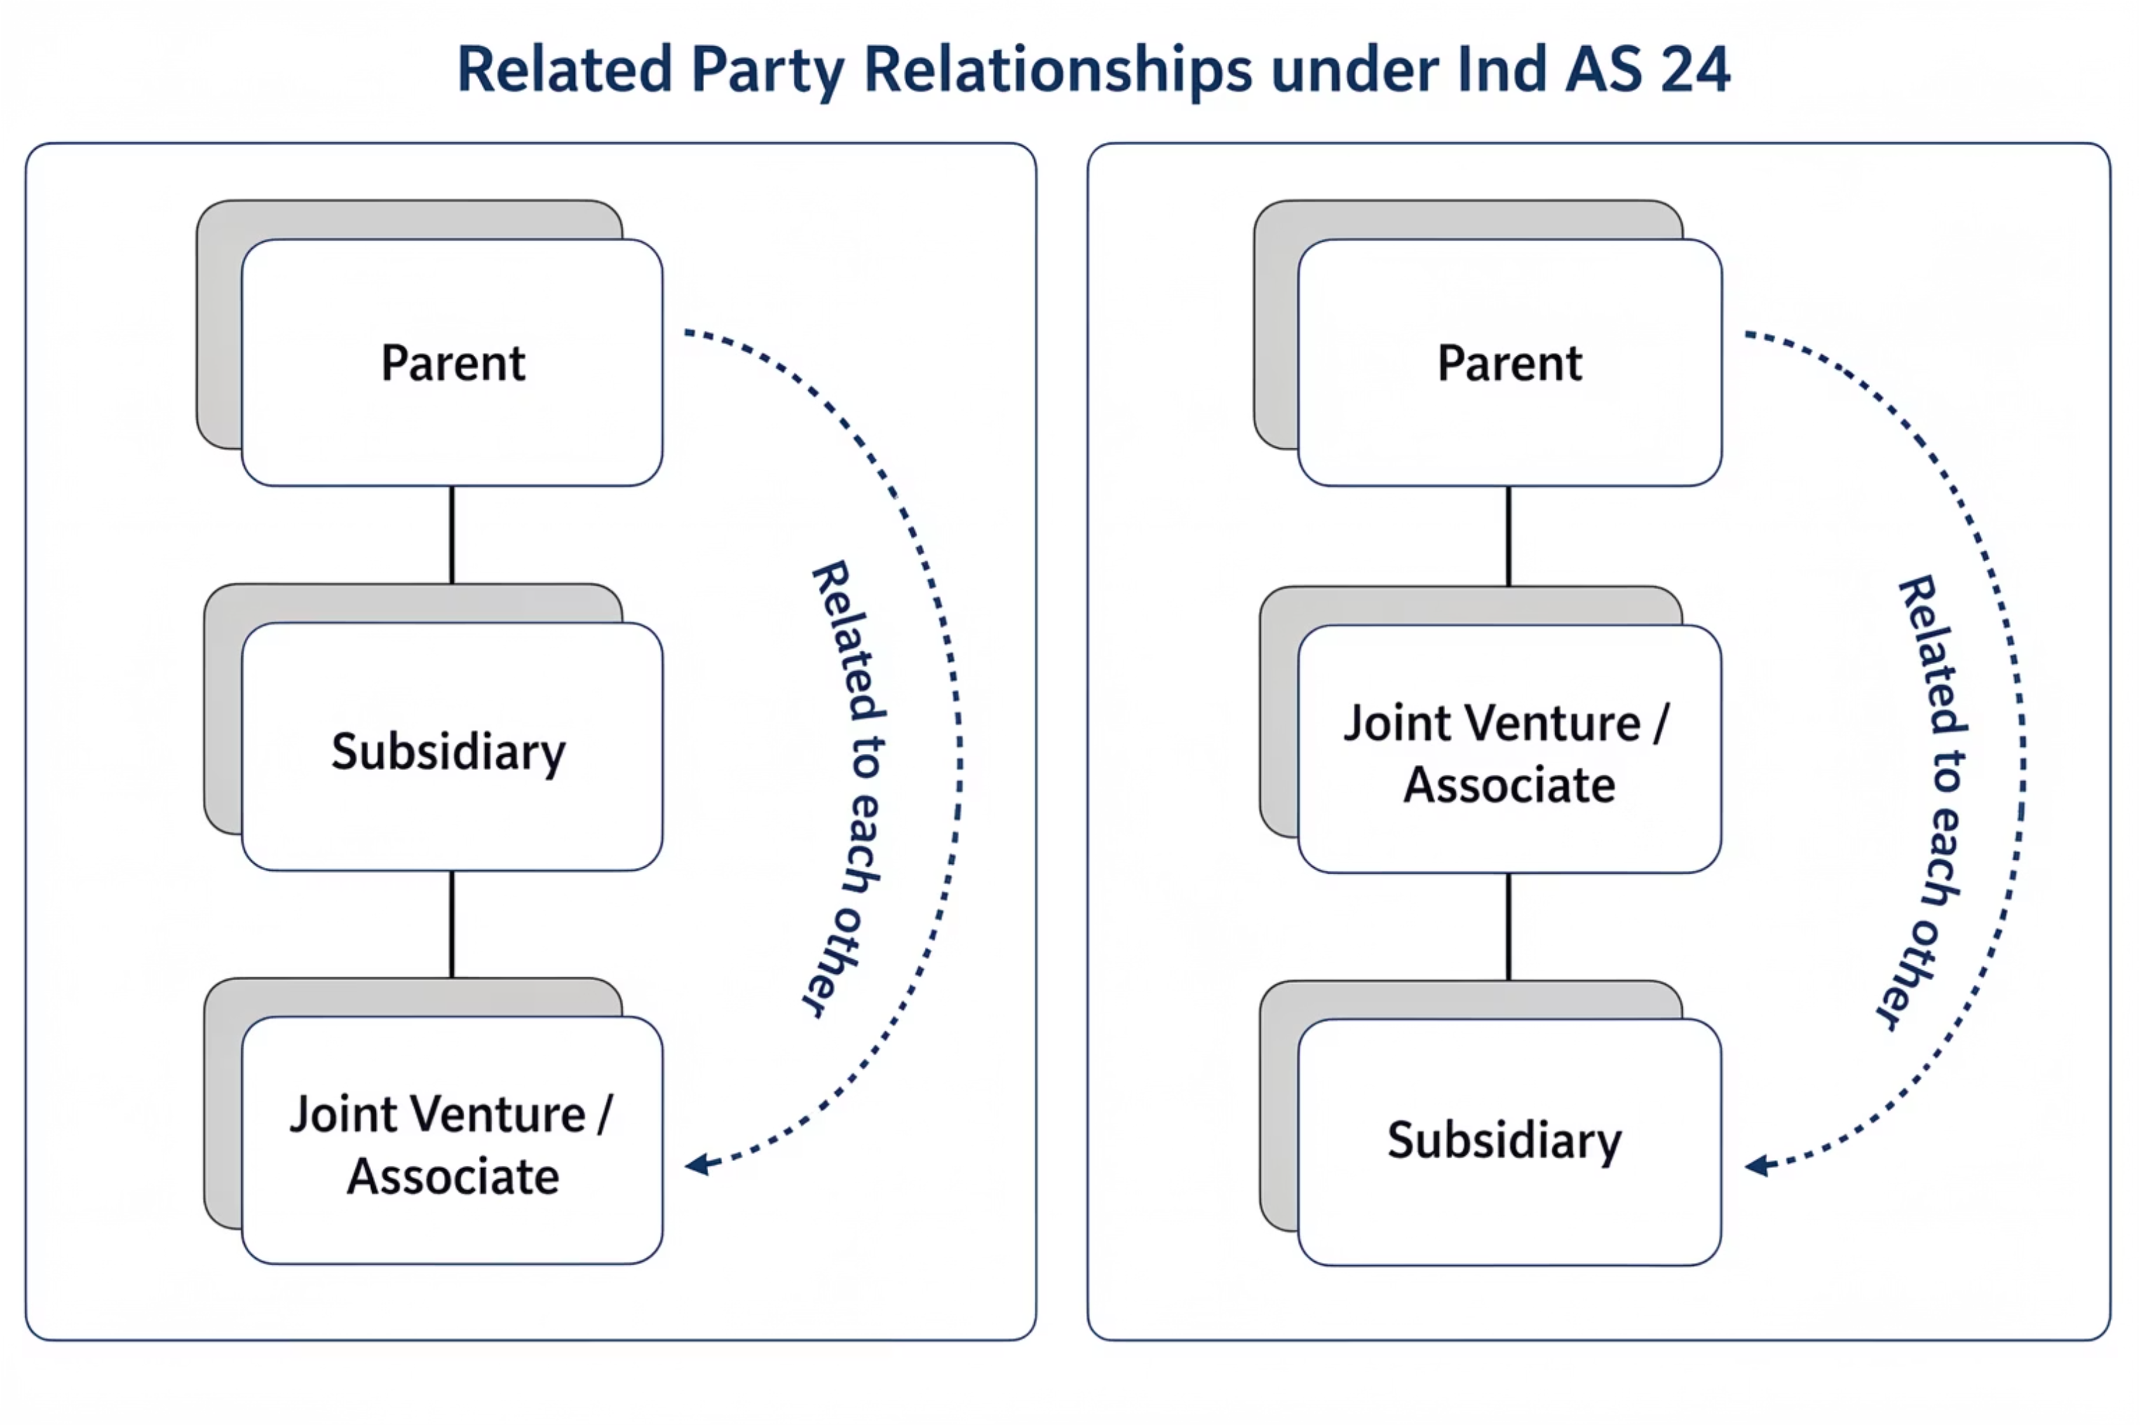
AS 18 — Related Party Relationships: Control Structure
Key Principle — AS 18: Regardless of the order or structure, all three entities (Parent, Subsidiary, and Joint Venture/Associate) are related to each other. All transactions between any of these parties must be disclosed in the financial statements of the reporting enterprise.

Slide 27




S 18: 'Substantial Interest'
'Substantial Interest' is a critical factor in establishing related party relationships. It specifically refers to the capacity of an individual or entity to exert significant influence over an enterprise's financial and operating decisions, primarily through the power of their voting rights.
What Constitutes 'Substantial Interest'?
An individual or their relative(s) is deemed to have a substantial interest in an enterprise if they own, directly or indirectly, 20% or more of the voting power of that enterprise. This numerical threshold is a cornerstone for identifying potential influence.
This definition is particularly relevant for:
Situations where Key Management Personnel (KMP) or their close relatives hold a significant, but not controlling, ownership stake in another business entity.
Assessing whether an individual, through their voting power, has the ability to participate in and guide the financial and operating policy decisions of an enterprise.
Indirect Control — How Substantial Interest Works
Individual / KMP
Enterprise A
Enterprise B
Holds 20%+ voting power directly
Substantially influenced by the Individual
Controlled by Enterprise A (Indirect Control)
The Individual is deemed to have Substantial Interest in Enterprise A, making Enterprise B a related party through indirect control.

Slide 28



AS 18: Understanding 'Significant Influence'
Share Ownership & Presumption of Influence
The 20% Rule
These presumptions can be rebutted if it can be clearly demonstrated otherwise. For instance, even with less than 20% ownership, significant influence can be proven through other means, such as a strategic agreement or statutory rights.
An investing party holding 20% or more of the voting power is presumed to have significant influence.
It's also important to note that substantial or majority ownership by a third party does not automatically negate an investing party's ability to exercise significant influence, particularly if they still hold a crucial minority stake or maintain strong board representation.
Conversely, less than 20% voting power presumes no significant influence.
Illustrative Examples
✅ Significant Influence — Rebutted Presumption
❌ No Significant Influence — Presumption Holds
Investor Co.
Investor Co.
Holds only 15% voting power
Holds only 15% voting power
Board Representation
No Board Seat
Has 2 out of 5 board seats + veto rights on key decisions
No participation in policy decisions, purely passive investor
Enterprise A
Enterprise A
Significant Influence EXISTS despite <20% stake
No Significant Influence
Reason: Board representation & statutory rights rebut the presumption of no influence.
Reason: No board representation, no strategic rights — presumption of no influence stands.
*key decision does not means all decisions of the company

Slide 29
AS-18 Disclosure
Always Disclose (Even Without Transactions)
When Transactions Occur, Disclose:
Where control exists, disclose the name of the related party and nature of the relationship — regardless of whether any transactions occurred during the period.
Name of the transacting related party
Nature of the relationship
Description and volume of transactions
Outstanding balances at balance sheet date
Provisions for doubtful debts from related parties
Amounts written off or written back
This is because a control relationship itself can affect the enterprise's independence in financial and operating decisions.
"Non-disclosure of related party transactions is not just a compliance failure — it is a breach of investor trust."

Slide 30
AS-18: Examples of Related Party Transactions
AS 18 requires disclosure of all material transactions between related parties that could influence the financial statements of the reporting enterprise. The following are common categories of such transactions:
Purchases / Sales of Goods
Purchases / Sales of Fixed Assets
Transactions involving finished goods, raw materials, or components between related parties.
Transfer of property, plant, and equipment, including land and machinery, between related entities.
Rendering or Receiving of Services
Agency Arrangements
Exchange of administrative support, technical assistance, or consulting services with related parties.
Transactions where one party acts as an agent on behalf of a related party, including commission-based dealings.
Leasing or Hire Purchase
Transfer of Research & Development
Agreements for the lease or hire purchase of assets, including both operating and finance lease arrangements.
Sharing, licensing, or transfer of intellectual property, know-how, or R&D outcomes between related parties.
Licence Agreements
Finance — Loans & Equity Contributions
Arrangements granting the right to use patents, trademarks, copyrights, or other intangible assets.
Providing or receiving loans, advances, or equity investments, whether in cash or in kind.
Guarantees & Collaterals
Management Contracts
Issuing or receiving financial guarantees, indemnities, or collateral security for related party obligations.
Agreements for the management of operations or deputation of key personnel between related entities.

Slide 31
AS-18: When Disclosure is NOT Required
Accounting Standard 18 outlines specific scenarios where related party disclosures are not warranted, primarily to avoid conflicts with legal obligations or to prevent redundant reporting.
Confidentiality Duties
Intra-group Transactions in Consolidated Financial Statements
When providing such disclosures would conflict with the reporting enterprise’s duties of confidentiality as specifically required by a statute or by any regulator or similar competent authority.
No disclosure is required in consolidated financial statements in respect of intra-group transactions. This is because consolidated financial statements present information about the holding and its subsidiaries as a single reporting enterprise, where such transactions are eliminated.
For example, banks are obliged by law to maintain confidentiality in respect of their customers’ transactions.
State-controlled Enterprises
Disclosure is not required in the financial statements of state-controlled enterprises as regards related party relationships with other state-controlled enterprises and transactions with such enterprises, due to the inherent nature of their operations.

Slide 32
The Significance of Related Party Issues
Understanding related party issues is crucial for transparent financial reporting. These relationships, though common, can significantly influence an entity's financial position and operating results, often in ways that are not immediately obvious to external stakeholders.
Common in Business
Distorted Arm's-Length Principle
Related party relationships, such as those with subsidiaries or associates, are a normal and strategic feature of commerce and business operations.
Transactions between related parties may not reflect market terms, potentially misrepresenting financial performance (e.g., free provision of management services or extended credit).
Influence Beyond Transactions
Dependent Transactions
The mere existence of a related party relationship can affect an enterprise's financial decisions and operating results, even if no direct transactions occur. For example, a subsidiary might stop dealing with a third-party supplier because a fellow subsidiary now offers similar services.
Some transactions might only take place due to the related party link, creating dependencies. For instance, a manufacturing unit might sell its entire production to its holding company at cost, a deal an unrelated party might not accept.

Slide 33
Case Study: KMP of Subsidiary in Parent's CFS
When preparing Consolidated Financial Statements (CFS), a key question arises: Is a Key Management Personnel (KMP) of a subsidiary automatically considered a related party for the parent company's CFS?
Group-Level Related Parties
Assessing Group-Level Influence
In CFS, the focus is on parties related to the group as a whole. Therefore, disclosure is only required for transactions with parties who are related parties of the group level.
A KMP of a subsidiary is considered a related party for the group if they have authority and responsibility for planning, directing, and controlling activities at a group level.
Indicators of Group Influence
Holding a management role at the parent entity level.
The subsidiary being very significant, implying influence at a broader group level.

Slide 34

Case Study: AS-18 & Non-Monetary Benefit
Explore a real-world scenario involving non-monetary benefits to Key Management Personnel (KMP) and its disclosure under AS-18.
Scenario
A KMP is provided a lavish property by the entity. Annual depreciation is INR 10,000, while the market rental of a similar property is INR 100 Lakhs per annum.
AS-18 Disclosure Mandate
AS-18 requires disclosure of related party relationships, transactions, and outstanding balances necessary for users to understand their potential effect on financial statements.
AS-18 Disclosure for Non-Monetary Benefits
The entity must disclose the depreciation (INR 10,000) recognised in the period, as this reflects the cost incurred by the entity for providing the benefit.
Fair Value & Good Governance
While AS-18 does not mandate disclosure of the fair value of the benefit (INR 100 Lakhs), providing this information is considered good corporate governance, if reliably measurable.

Slide 35

AS-18: Related Party Status Changes & Disclosure
Understanding the disclosure requirements for related party relationships that commence or cease during a reporting period is crucial, as AS-18 presents certain ambiguities.
Dynamic Relationships
Ambiguity in Standards
Related party relationships can begin or end within a financial reporting period, leading to questions about the scope of disclosure for relationships and transactions.
AS 18 do not explicitly state if the related party relationship must exist at the reporting date or at the time of the transaction for disclosure.
When to Disclose?
General Practice
It is unclear whether transactions should be disclosed if parties were related at the time of the transaction but not at the reporting period end, or vice-versa.
Disclosures under AS-18 should be made for transactions that occurred during the period when the parties were related, irrespective of their relationship status at the reporting date.

Slide 36
AS-18: Comparative Disclosures for Changing Related Party Status
Navigating the disclosure of related party transactions when their status changes between reporting periods requires careful consideration to ensure clarity and compliance.
Current Year Related, Prior Year Not
Prior Year Related, Current Year Not
If a party is a related party in the current year but was not in the prior year, transactions with that party in the prior year are not disclosed as comparative related party information.
If a party was related in the prior year but is not in the current year, transactions with that party are disclosed in the comparative column for the prior period.
Disclosure is only required for periods when the parties were related.
If needed, an additional explanation can be provided for clarity on the change in status.
The current financial year column will not include transactions, as the party is no longer related.
This maintains the principle of disclosing transactions only when the relationship existed.

Slide 37
AS-18: Disclosure — Aggregation & Materiality
AS 18 provides guidelines on when related party transactions can be aggregated for disclosure and defines materiality, ensuring that significant transactions are not obscured.
Aggregation of Similar Items
Items of a similar nature may be disclosed in aggregate by type of related party, but only if separate disclosure isn't necessary for understanding the financial statements.
Avoid Obscuring Significant Transactions
Purchases/sales of goods should not be aggregated with purchases/sales of fixed assets. Material transactions with individual parties must also be disclosed separately.
Materiality — Nature & Size
Materiality depends on the facts and circumstances of each case, evaluating both the nature and size of the item(s).
Materiality by Size
A related party transaction exceeding 10% of total related party transactions of the same type (e.g., purchase of goods) is ordinarily considered material.
Materiality by Nature
Transactions not in the normal course of business are ordinarily considered material, irrespective of their size.

Slide 38
Example: AS 18 — Tata Motors & Tata Technologies
Let's examine a practical example of AS 18 application focusing on transactions within a large Indian conglomerate.
Related Parties
Transaction Details
Tata Motors Limited: A major automobile manufacturer.
Tata Motors engages Tata Technologies for designing and developing advanced software solutions for its new electric vehicle (EV) platform.
Tata Technologies Limited: A global engineering and product development digital services company, significantly owned by Tata Motors.
AS 18 Disclosure
Importance of Disclosure
Tata Motors must disclose the existence of the related party relationship, the nature of the transaction (software development services), and the value of services procured from Tata Technologies.
Ensures transparency for investors, allowing them to assess if the transaction was conducted at arm's length or if the related party relationship influenced the terms of engagement.
This case highlights how AS 18 sheds light on intra-group transactions, vital for fair financial reporting in complex corporate structures.

Slide 39

AS-18 Case Study: Satyam Computers — The Disclosure Failure
The Failure
Why It Matters
Satyam hid related-party transactions, falsified accounts, and undisclosed loans to promoter-controlled entities. It also failed to disclose key AS 18 transactions involving Maytas-linked companies, masking the conflict of interest.
Proper AS 18 disclosure could have flagged the fraud much earlier and helped protect investors from being misled. The scandal triggered major regulatory reform in India, including stricter disclosure norms and oversight.
AS 18 disclosure can expose conflicts early and prevent serious market abuse.

Slide 40

Key Takeaways
AS 17
Follow the management approach — report segments as reported internally. Apply 10% thresholds rigorously and ensure 75% revenue coverage.
AS 18
Disclose control relationships always, even without transactions. Aggregation is permitted but must not obscure material individual transactions.
"Accounting Standards are not bureaucratic hurdles — they are the language of trust between enterprises and their stakeholders."

Slide 41

Thank You
Presented By: CA Anupam Sarda
Partner at: D J A S & Co.
Contact No:9836041458
Email: info@djas.in

