Slide 1

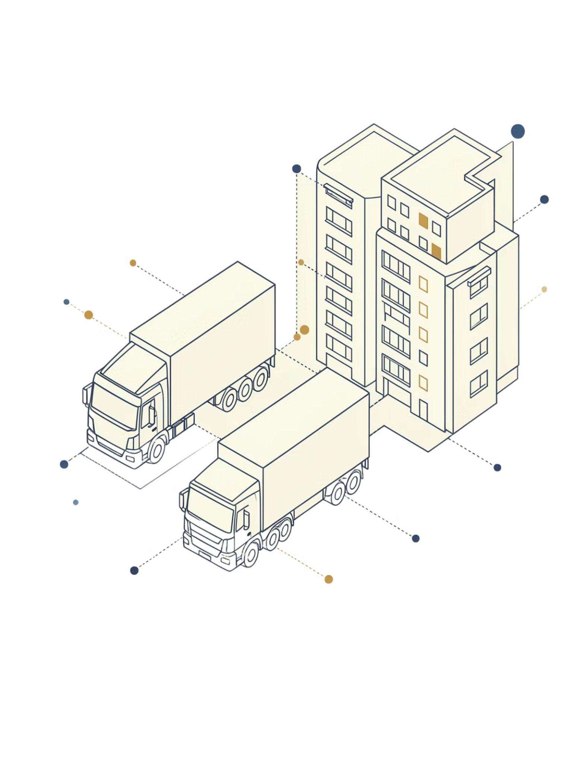
EIRC – RRC, Jaipur Case Study Summary
GST on Renting of Residential Dwelling & Multilevel GTA Supply Chains
Case Study: M/s Global Logistics
Gagan Kedia, [FCA, LLB, CS]
Partner, H N A & Co. LLP

Slide 2



Three Re-structuring Proposals
Situation 1
Situation 2
Situation 3
Renting residential building to an individual Mr. X @ ₹5,00,000/month
Fleet of 70 trucks to be given on hire to M/s A2Z Logistics (GTA) @Rs 20,000 p.m. per truck
Fleet of 30 trucks to be given on hire to M/s ABC Suppliers (Intermediary) who will further sub-leases to various other GTAs
Mr. X intends to use it as hostel for students & working professionals
A2Z will use these trucks for its transportation business

Slide 3
Situation 1 — Renting of Residential Building to Mr.X
The Queries
Query 1
Query 2
Query 3
Is renting to Mr. X exempt as "renting of residential dwelling for use as residence" ?
Can exemption be denied because Mr. X uses it commercially (hostel business) and “use as residence is not satisfied”?
If taxable - what is the applicable GST rate?
Period – F.Y. 2021-22 & onwards
Unconditional Exemption: Entry No. 12 of Notification No. 12/2017-Central Tax (Rate) dated 28.06.2017
"Services by way of renting of residential dwelling for use as residence.“

Slide 4
The State of Karnataka V. Taghar Vasudeva Ambrish - SC
To avail the benefit of exemption under entry 12 -
3 Conditions
1. Service of Renting
2. Subject matter is Residential Dwelling
3. It should be used as a residence

Slide 5
2nd Condition – The renting services must pertain to renting services.
As per CBIC Education Guide dated 20/06/2012
“4.13.1 What is a residential dwelling?
The phrase ‘residential dwelling’ has not been defined in the Act. It has therefore to be interpreted in the terms of normal trade parlance as per which it is any residential accommodation, but does not include hotel, motel, inn, guest house, camp-site, lodge, house boat, or places meant for temporarily stay.”
  Any building, structure, or part of the building or structure other than offices or factories, that is used of intended to be used as home, residence, or sleeping place by one or more persons
  Any records e.g. layout plans and records available with local authority.

Slide 6
3rd Condition – Such residential dwelling must be used as residence.
No further condition that the tenant or lessee must itself use it as residence.
It’s an activity specific exemption and not person specific exemption
The legislative intent behind this entry – Where residential dwelling is rented out and ultimately used as residence, irrespective of the person using it – should not suffer 18% GST.
PURPOSIVE INTERPRETATION OF ENTRY 12
Attaching the meaning to the provisions which serve the purpose behind such provision.
Predominant in this case as the literal interpretation may not serve the purpose or may lead to absurdity.

Slide 7
Entry 12: No longer an unconditional exemption entry
Notification No. 04/2022-CT(Rate) dated 13.07.2022: Amended Entry 12 of Notification 12/2017-CT(Rate) by inserting after the words 'as residence' the words [w.e.f. 18/07/2022]
“except where the residential dwelling is rented to a registered person”
Notification No. 05/2022-CT(Rate) dated 13.07.2022: Amended Notification No. 13/2017-CT(Rate) [the RCM Notification] by inserting Entry No. 5AA: [w.e.f. 18/07/2022]
“Service by way of renting of residential dwelling by any person to any registered person”
Notification No. 15/2022-CT(Rate) dated 30.12.2022: Inserted an Explanation to Entry 12 providing that exemption shall be available even where a registered person rents a residential dwelling, if:
(i) The registered person is the proprietor of a proprietorship concern and rents the residential dwelling in his personal capacity for use as his own residence; and
(ii) Such renting is on his own account and not that of the proprietorship concern.
Notification No. 04/2024-CT(Rate) dated 12.07.2024 inserted Entry No. 12AA in Notification No. 12/2017-CT(Rate)
“Supply of accommodation services having value of supply less than or equal to twenty thousand rupees per person per month provided that the accommodation service is supplied for a minimum continuous period of ninety days.”
Circular No. 228/22/2024-GST – Entry 12AA – retrospective effect from 01/07/2017.

Slide 8
Situation 2 - Hiring 70 Trucks to M/s A2Z Logistics (Registered GTA)
Queries Raised
01. Whether this can be treated as "Transportation of Goods by Road, other than GTA" & fall under exemption?
Entry No. 18 of Notification 12/2017-CT(R) [w.e.f 01/07/2017]
“Services by way of transportation of goods- (a) by road except the services of-(i) a goods transportation agency; (ii) a courier agency;
(b) by inland waterways.”
Entry No. 22(b) of Notification 12/2017-CT(R) [w.e.f 01/07/2017]
“Services by way of giving on hire- (b) to a goods transport agency, a means of transportation of goods; or”
02.Whether GST would be applicable on such Truck Hiring services?
03. What would be the applicable rate of GST?
04. Would your answer differ if M/s A3Z Logistics is a Transporter other than GTA?

Slide 9
Situation 3 - Hiring 30 Trucks to M/s ABC Suppliers – sublets to various GTAs.
Queries Raised
01.GST applicability if trucks are given on hire to an intermediary who further sub-leases them?
Entry No. 22(b) of Notification 12/2017-CT(R) [w.e.f 01/07/2017]
“Services by way of giving on hire—
(a) to a State transport undertaking, a motor vehicle meant to carry more than twelve passengers;
(aa) to a local authority, an Electrically operated vehicle meant to carry more than twelve passengers;
(b) to a goods transport agency, a means of transportation of goods; or
(c) motor vehicle for transport of students, faculty and staff, to a person providing services of transportation of students, faculty and staff to an educational institution providing services by way of pre-school education and education upto higher secondary school or equivalent.”

Slide 10
Situation 3 - Hiring 30 Trucks to M/s ABC Suppliers – sublets to various GTAs.
Queries Raised
02. Whether the principal to “ultimate use” can be applied to link the transaction to transportation activity and claim any exemption?
Purposive Interpretation - State of Karnataka Vs. Taghar Vasudeva Ambrish
Para 40 and 41 of Commissioner of Custom(Import), Mumbai V. M/s Dilip Kumar and Company
40. After considering the various authorities, some of which are adverted to above, we are compelled to observe how true it is to say that there exists unsatisfactory state of law in relation to interpretation of exemption clauses. Various Benches which decided the question of interpretation of taxing statute on one hand and exemption notification on the other, have broadly assumed (we are justified to say this) that the position is well settled in the interpretation of a taxing statute: It is the law that any ambiguity in a taxing statute should enure to the benefit of the subject/assessee, but any ambiguity in the exemption clause of exemption notification must be conferred in favour of revenue.
41. After thoroughly examining the various precedents some of which were cited before us and after giving our anxious consideration, we would be more than justified to conclude and also compelled to hold that every taxing statue including, charging, computation and exemption clause (at the threshold stage) should be interpreted strictly. Further, in case of ambiguity in a charging provisions, the benefit must necessarily go in favour of subject/assessee, but the same is not true for an exemption notification wherein the benefit of ambiguity must be strictly interpreted in favour of the Revenue/State.

Slide 11
Situation 3 - Hiring 30 Trucks to M/s ABC Suppliers – sublets to various GTAs.
Queries Raised
03. What would be the correct classification and GST rate applicable in such arrangement?
SAC 9966 - Rental services of transport vehicles with operator – GST Rate 18%
[Sr. No. 10, Notification 11/2017-CT(Rate) as amended by Notification 20/2019-CT(Rate) dt. 30.09.2019]
Truck hired without the operator – unresolved issue; CBIC has not issued any clarifications
However, The supply likely falls under SAC 9973 (Sr. No. 17(vi), Notification 11/2017-CT(Rate))
“(vi) Leasing or rental services, with or without operator, other than (i), (ii), (iii), (iv) and (v) above.”
FOOD FOR THOUGHT
Entry 23 – Toll
Entry 24 – Warehousing of Rice
School

Slide 12
Thank You..!!
Get in touch :
E – GAGAN@HNAINDIA.COM
M - 9830682188

