Slide 1
KOLKATA | 16th May, 2026
AI in GST
The Future of Compliance is Here
CA Kedar Pande
Chhatrapati Sambhajinagar

Slide 2
Today's Agenda
01
AI & GenAI – A Quick Foundation
04
Notice Replies using AI
02
GST Reconciliation with AI
05
GST BOT for Office Staff and Clients
03
Certificate Templates with AI
06
GSTR-9 & 9C Preparation with AI

Slide 3
AI & GenAI – A Quick Foundation
What is AI?
What is GenAI?
LLMs & Prompts
AI (Artificial Intelligence) lets machines simulate human thinking — reasoning, learning, and decision-making — without explicit programming.
Generative AI creates new content (text, images, code) by learning patterns from massive datasets. Tools: ChatGPT, Claude, Gemini, Copilot.
Large Language Models (LLMs) are the engine behind GenAI tools. Your prompt is the instruction — better prompts = better output.

Slide 4
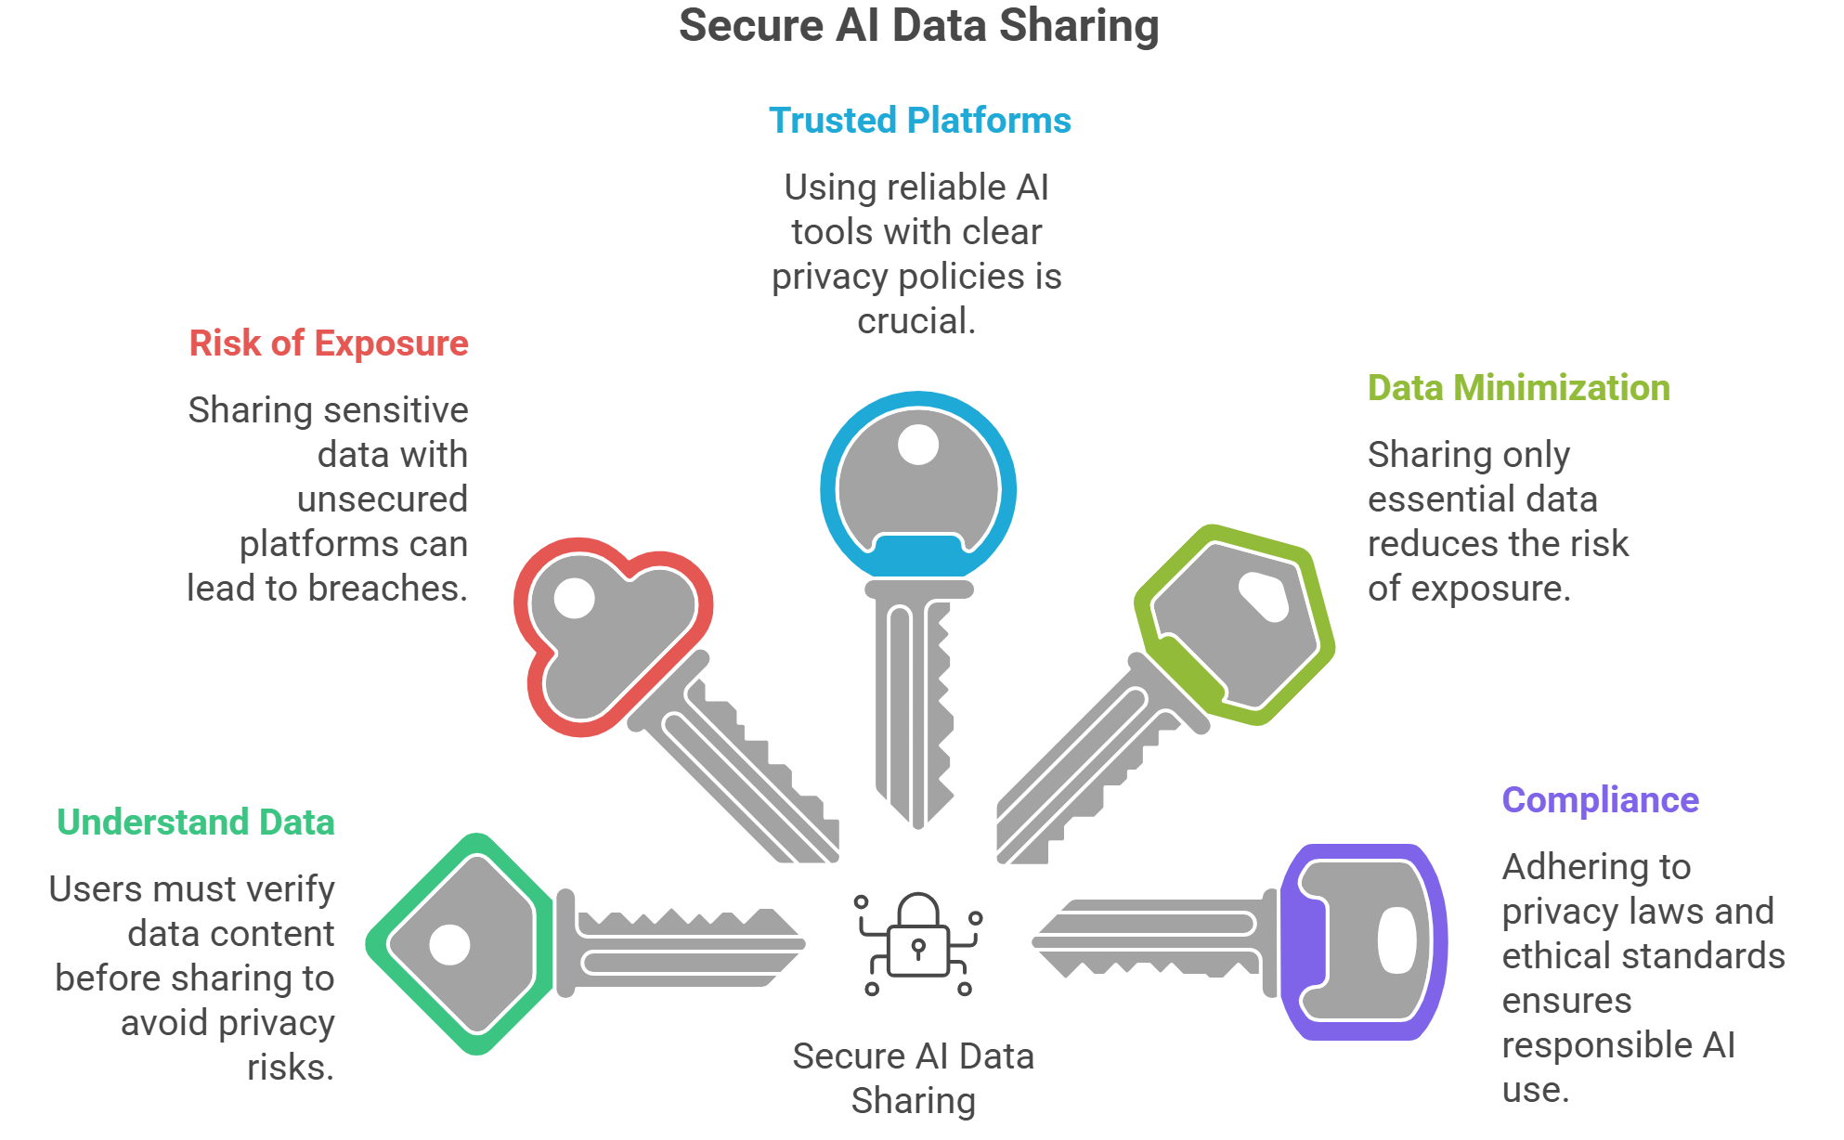
AI and Privacy

Slide 5
01 | GST Reconciliation with AI
❌ The Old Pain
✅ AI-Powered Reco
Manual matching of GSTR-2A/2B vs purchase register — hours of VLOOKUP
Missing ITC due to vendor non-filing not caught in time
Thousands of invoices — mismatches buried in Excel sheets
Month-end crunch leaves no time for proper reconciliation
Risk of notices for excess ITC claimed
Upload GSTR-2B JSON + purchase register → AI auto-matches invoices
Flags mismatches, GSTIN errors, and rate differences instantly
AI drafts follow-up messages to vendors for pending invoices
ChatGPT / Claude can analyze Excel data and highlight anomalies
Demo: Paste table in Claude → ask 'find mismatches > ₹10,000'

Slide 6
02 | Document Templates with AI
CAs issue dozens of certificates and prepares a lot of documents.
GST Registration, Composition, Export/LUT, GTA, Nil-rated declarations. AI drafts them in seconds.

Slide 7
03 | Notice Replies using AI
1
2
3
4
Upload Notice
AI Summarises
AI Drafts Reply
CA Reviews & Signs
▶
▶
▶
Paste notice text or upload PDF to Claude / ChatGPT
AI extracts issue, section cited, demand amount & deadline
AI generates legally worded reply with relevant case laws & sections
Professional review, client facts added, final letterhead sign-off
Notice Types AI handles well:
GST Scrutiny (ASMT-10) • DRC-01 / DRC-01C • ITC Mismatch Notice
GSTR-1 vs GSTR-3B Discrepancy • E-way Bill Violation • Registration Cancellation SCN

Slide 8
04 | BOT for Training the Staff on GST and Staff queries
Prepare a BOT using AI for staff training and answering queries of staff as well as clients

Slide 9
05 | GSTR-9 & 9C Preparation with AI
GSTR-9 | AI Workflow
GSTR-9C | AI Workflow
Feed all 12 months GSTR-1 + 3B data to AI
AI consolidates table-wise turnover & tax paid
Auto-identifies amendments, credit/debit notes across periods
Maps Table 6 (ITC availed) vs Table 8 (ITC per 2B) discrepancies
AI drafts explanations for differences in Table 9
Highlights late fee, interest liability if any
Upload P&L + Balance Sheet → AI maps to GSTR-9C turnover tables
AI reconciles accounting turnover vs GST turnover with reasons
Identifies turnover from exempt, nil-rated, non-GST supplies
Maps audited ITC vs ITC as per GSTR-9 (Part IV)
Drafts auditor's remarks & reconciliation notes
Flags potential audit risk areas before filing

Slide 10
06 | Compliance Workflow Automation
Using Programs like Power Automate and Zapier, GST filing workflows can be automated

Slide 11
Key Takeaways
🤝
AI is your co-pilot — not a replacement. CA judgment remains non-negotiable.
⚡
Speed matters: Reconciliation, notices & returns that took days can now take hours.
🛡️
Always verify AI output — check legal sections, GSTIN data, financial figures.
📚
Prompt quality determines output quality — invest time in learning effective prompting.
🚀
Start small: Use AI for one task this week. Scale as confidence grows.

Slide 12
Thank You!
Questions? Let's discuss!
CA Kedar Pande
Faculty – AICA | ICAI | Practicing CA – Chhatrapati Sambhajinagar
📞 7588661199 ✉️ kedarpande@gmail.com

