Slide 1
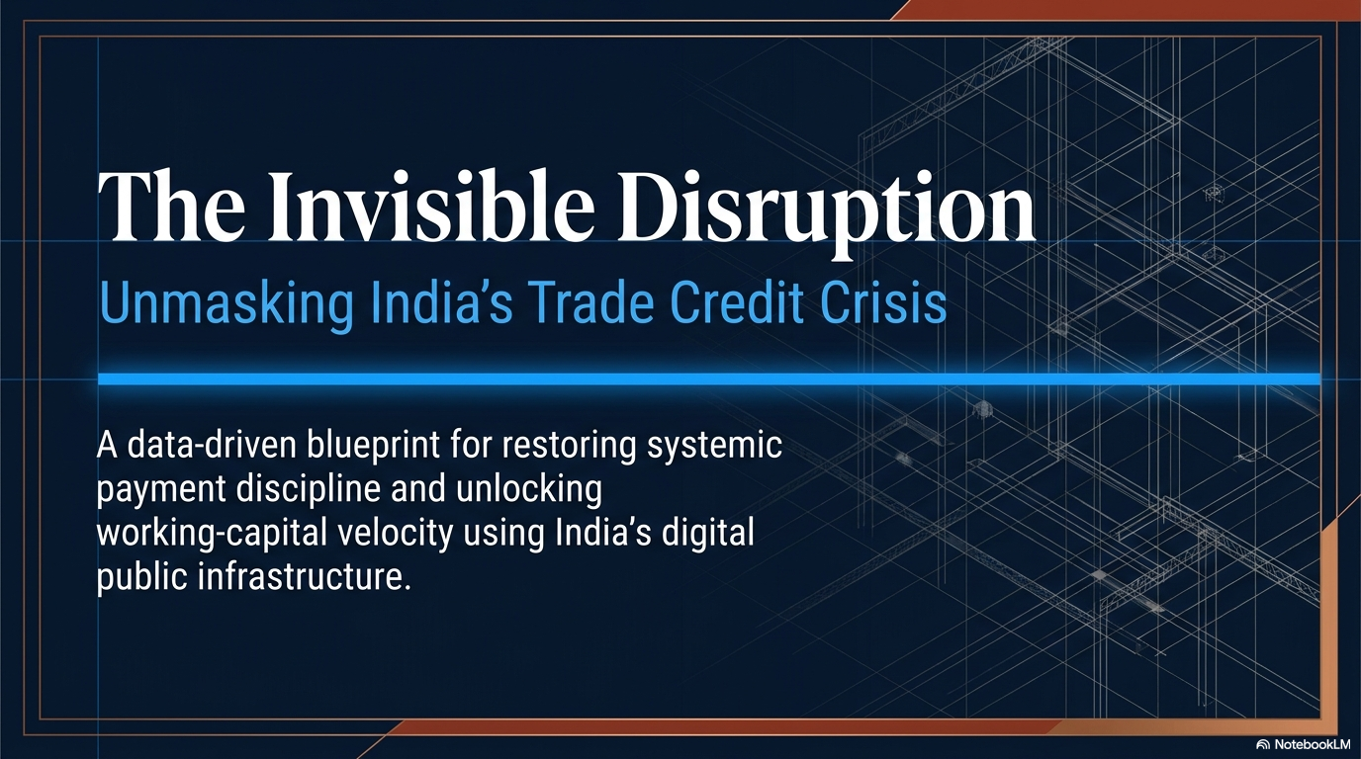
p
MSME Working Capital Finance and Trade Credit
MSME Working Capital Finance and Trade Credit
MSME Working Capital Finance and Trade Credit
EIRC of ICAI | 18th May, 2026
B.L.Chandak
Ex-DGM, SIDBI

Slide 2
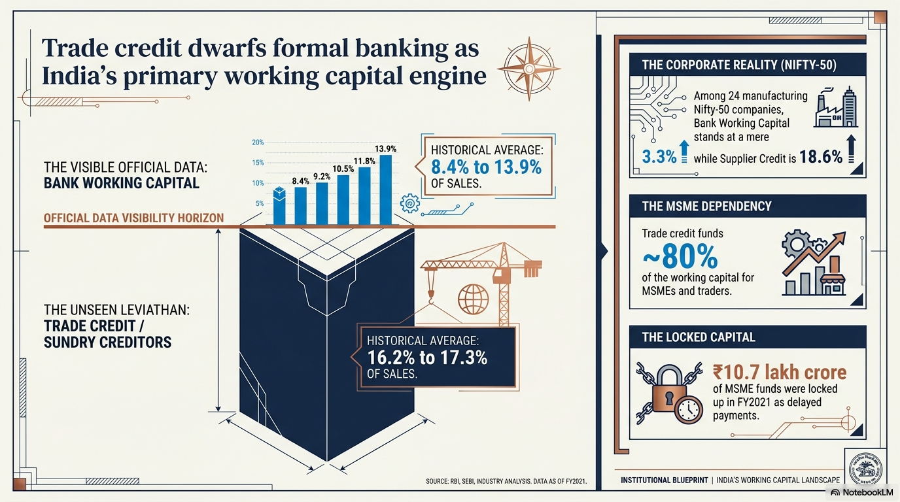

Slide 3
Cumulative Trade Credit & Bank Credit Analysis
Sr. No.
Company Types
Timeline
Avg. Sales per company
per annum (₹ Crore)
Avg. Number of Companies
Avg. Bank Working Capital/Sales (%)
Avg. Sundry Creditors/Sales (%)
Avg. Sundry Debtors/Sales (%)
1
Public Ltd.
1985-09
152
2,156
13.9
16.2
15.9
2
Public Ltd.
2011-23
602.7
10,417
8.4
17.3
14.5
3
Private Ltd.
1987-04
7.9
1,061
10.8
15.9
18.6
4
Private Ltd.
2012-19
8.3
2,72,171
8.3
15.6
17.4
5 Nifty-50 (24 Cos.) 2013-23
23.6 lakh company –years data-based analysis
80,626
24
3.3
18.6
7.9
Companies’ reduced reliance on working capital from bank.
A Brickwork Ratings study of 760 large companies found that 92 of them had negative or low working capital need [ September 2019].
Rs 10.7 Trillion outstanding locked up in delayed payments to MSMEs. [D&B Study]
About 1% of MSMEs registered with TReDS.
Bill outstanding at any point of time Rs 15 trillion (TReDS discount volume Rs 1.3 trillion in FY 2023).

Slide 4
Negative WC, Sundry Creditors & Debtors as % of Sales (Nifty 50)
Annual average (2013 to 2023) as % of sales
Nifty 50 Comp. | Sundry Creditors | Sundry Debtors | Inventory % | Negative WC | Bank WC
Bajaj Auto Ltd. | 11.0% | 5.3% | 3.6% | -2.2% | 0.0%
Britannia Industries Ltd. | 9.4% | 2.4% | 7.0% | 0.0% | 0.6%
Eicher Motors Ltd. | 14.3% | 2.7% | 7.1% | -4.6% | 0.4%
Hero Motocorp Ltd. | 11.8% | 6.0% | 3.9% | -1.8% | 0.2%
Hindustan Unilever Ltd. | 17.8% | 4.0% | 7.7% | -6.2% | 0.2%
J S W Steel Ltd. | 26.5% | 5.8% | 19.0% | -1.7% | 2.3%
Maruti Suzuki India Ltd. | 12.0% | 2.4% | 4.3% | -5.4% | 0.5%
Reliance Industries Ltd. | 17.6% | 3.0% | 13.5% | -1.1% | 2.0%
Tata Motors Ltd. | 25.1% | 5.3% | 12.1% | -7.7% | 3.1%
Vedanta Ltd. | 17.6% | 4.1% | 11.9% | -1.6% | 2.4%
Negative working capital – JIT, products marketing.
Surplus WC credit – can be used for treasury operations and lower bank WC.
Rs. 10.7 trillion locked up in delayed payments to MSMEs – Dun & Bradstreet & GAME Report 2022
Brickworks Ratings (2019 study) – top 760 companies sundry creditors outstanding Rs 3.3 Trillion.
92 companies – low or negative working capital.

Slide 5
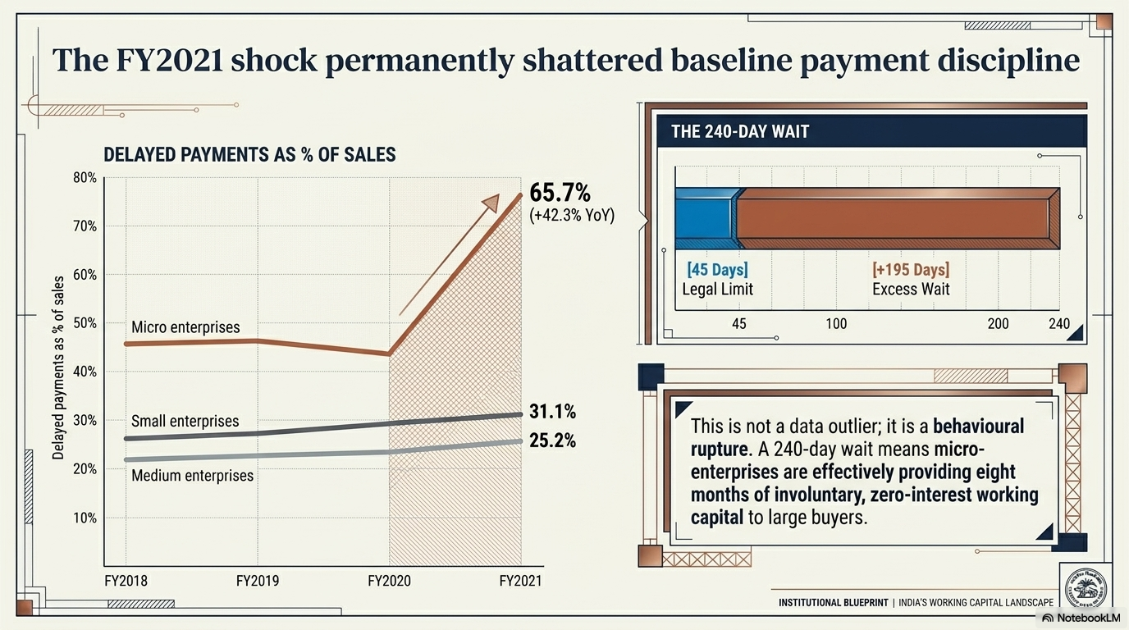

Slide 6
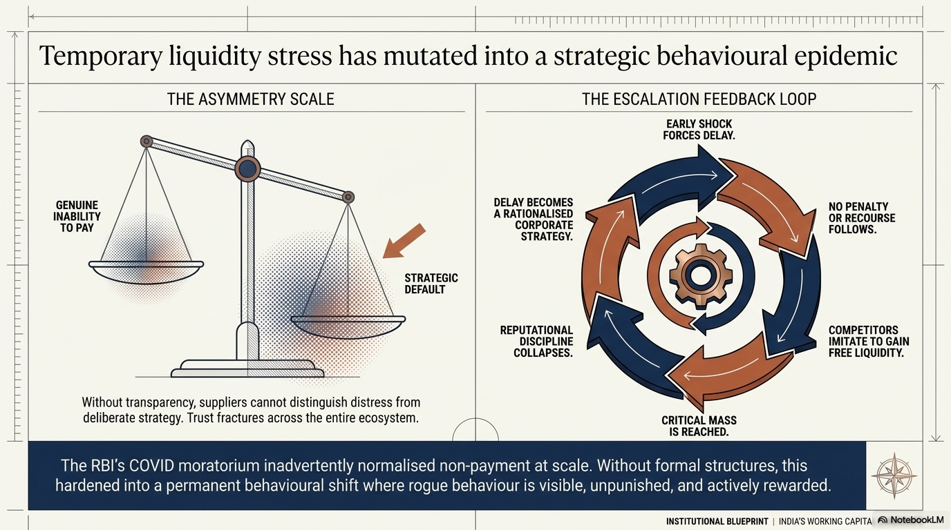

Slide 7
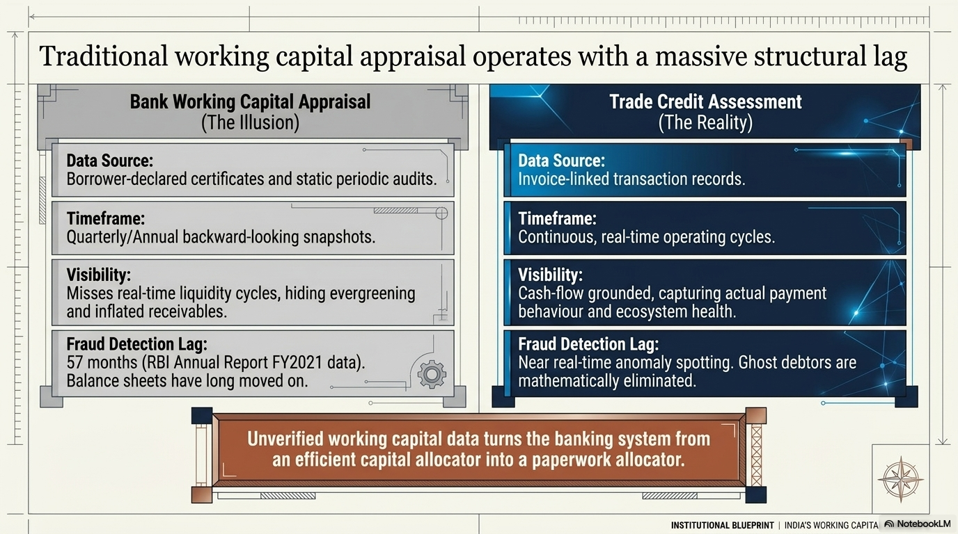

Slide 8
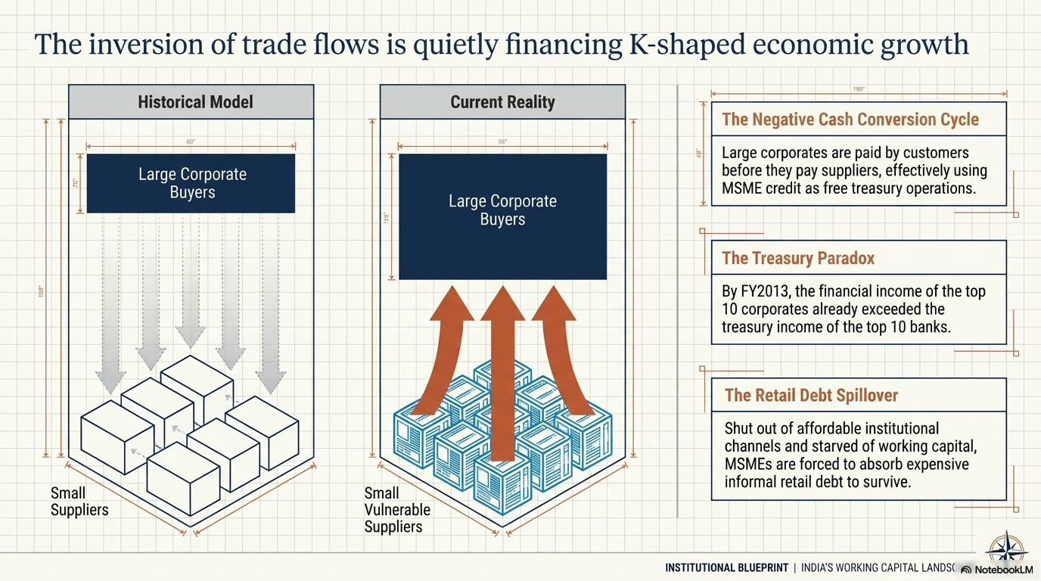

Slide 9
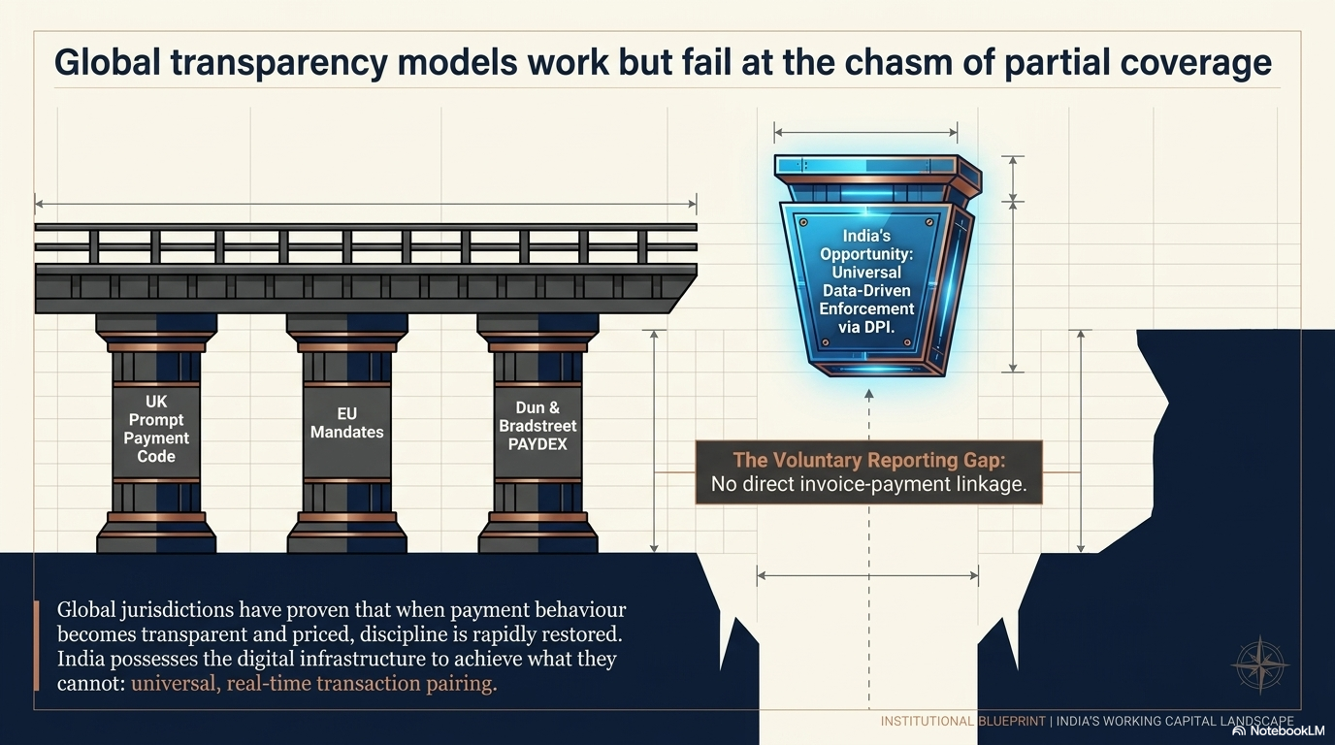

Slide 10
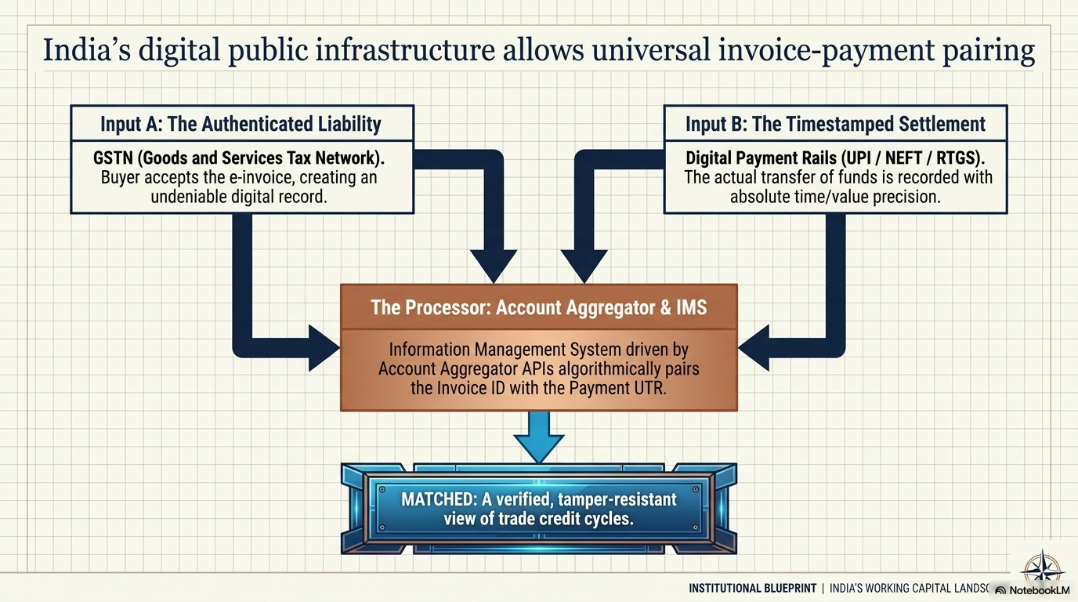

Slide 11
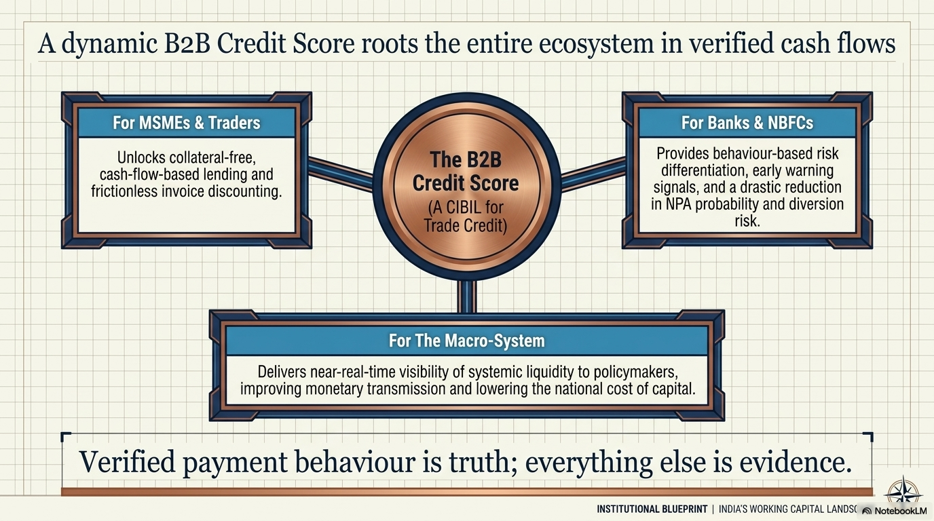

Slide 12
