Slide 1
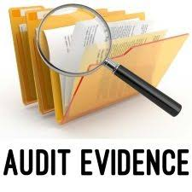

SA 230, 500, 501, & 505
CA Krishanu Bhattacharyya, FCA, Social Auditor, DISA(ICAI), CISA (WBUT)

Slide 2
AGENDA
Initiating with Basics
Legal Requirement for SA
Go To
SA 230
Go To
SA 501
Go To
SA 500
Go to
SA 505
Go To
Authority attached to Go To
Practical Aspects related to SA
Observations by ICAI QRB
Go To
Landmark Judgement
Go To
Few NFRA Order Extracts
Go To
Theoretical Highlights of Audit Documentation
Theoretical Highlights of 500 Series

Slide 3

Authority Attached to SA

Slide 4
AASB, ICAI issues Standards
SA are issued with a view to securing compliance by professional accountants on matters which, in opinion of the Council, are critical for the discharge of their functions.
It is the duty of the professional accountants to ensure that the standards/ statements/general clarifications are followed in the engagements undertaken by them – PARA 11 of “Preface to Standards on Quality Control, Auditing, Review, Other Assurance and Related Services”

Slide 5
Words and Expressions requiring reference to SA (Few Examples only…..)
Words and Expressions | Relevant SAs
Obtained Information | SA 500 – Audit Evidence
Obtained Explanations | SA 580 – Written Representations
Branches | SA 600 – Using the work of another auditor
Observations/ Qualifications | SA 700, SA 705, SA 706 – dealing with form and content of audit reports
Examined the | SA 450 – Evaluation of Misstatements
Necessary for the purpose of | SA 315 and SA 330 – Risk Assessment and Responses thereto

Slide 6
Commonly used SAs for various audit procedures
(Few Examples only…..)
Audit Procedures | Relevant SAs
Letter of Engagement | SA 210
Stock/ Investments/ Pending Litigations | SA 501 – Audit Evidence : Additional Considerations
Compliance of applicable laws – e.g. Section 43B, 40(a) of I. Tax Act, CARO, GST, etc. | SA 250 – Consideration of Laws and Regulations in Audit of F.S.
Opening Balances and Comparatives | SA 510 and SA 710
External Confirmations | SA 505
Going Concern and Subsequent Events | SA 570 and SA 560
Documentation of all of the above | SA 230 Go To

Slide 7

Legal Requirements relating to SA
(CARO 2020, Companies Act, 2013 & Income Tax Act, 1961)

Slide 8
Why is Compliance of Auditing Standards Mandatory while doing Company Audits? – Binding Provisions of Companies Act, 2013

Slide 9
Sec. 143(9) of the Companies Act, 2013
Every Auditor shall comply with the Auditing Standards.

Slide 10
Sec. 143(2) of the Companies Act, 2013
Basic Requirements as to Financial Statements
The Auditor shall make the Report after taking into account, the following –
the provisions of the Act,
the accounting and auditing Standards,
matters which are required to be included in the Audit Report under the provisions of the Act / Rules / Order u/s 143(11)
best of his information and knowledge.

Slide 11
Sec. 143(10) of the Companies Act, 2013
The Central Government may prescribe the Standards of Auditing, as recommended by the ICAI, in consultation with and after examination of the recommendations made by the National Financial Reporting Authority.
Till such Auditing Standards are notified, Standards of Auditing specified by the ICAI shall be deemed to be the Auditing Standards

Slide 12
How does the Auditing Standards aid in conducting Audit of a Financial Statements?

Slide 13
The SA’s contain items designed to support the auditor in obtaining reasonable assurance.
The SA’s require, that the auditor exercise professional judgment and maintain professional skepticism and shall:
Identify and assess risks of material misstatement, whether due to fraud or error, based on an understanding of the entity and its environment, including the entity’s internal control.
Obtain sufficient appropriate audit evidence about whether material misstatements exist, through designing and implementing appropriate responses to assessed risks
Form an opinion on the financial statements based on conclusions drawn from the audit evidence obtained.

Slide 14
Reporting Flow
Preparation of FS by MGT
Independent Examination by Auditor
Collection of Audit Evidence (Sufficient & Appropriate)
Reporting that Opinion by way of Audit Report
Forming an Opinion

Slide 15
Why is Compliance of Auditing Standards Mandatory for CARO applicable companies? – Binding Provisions of CARO, 2020

Slide 16
SA 500 Implications
For any matter to be reported in CARO, sufficient and appropriate audit evidence along with proper documentation is required – Hence SA 500 & SA 230 comes into play!
Few Examples:
  Maintaining Records relating to PPE
  Maintenance of Cost Records
  Defaults in Loan Repayment
  Related Party transactions
  And the list goes on with every clause of CARO 2020….

Slide 17
SA 501 Implications
Whether Physical Verification of Inventory has been conducted at reasonable intervals by the Management and whether coverage and procedures performed by the management is appropriate;
whether any discrepancies of 10% or more in the aggregate for each class of inventory were noticed and if so, whether they have been properly dealt with in the books of account.

Slide 18
Why is Compliance of Auditing Standards Mandatory while doing Tax Audits? – Binding Provisions of sec 44AB of Income Tax Act, 1961

Slide 19
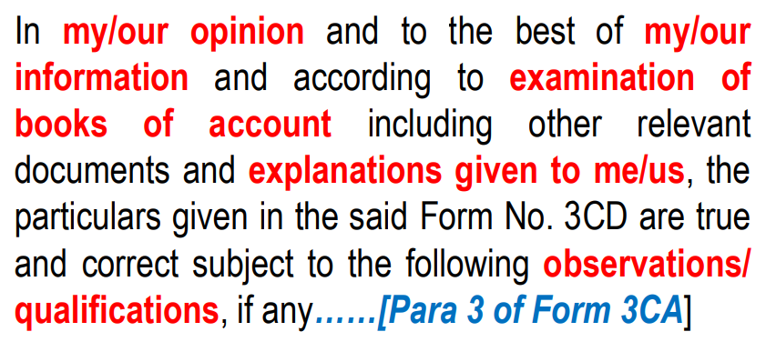

Slide 20
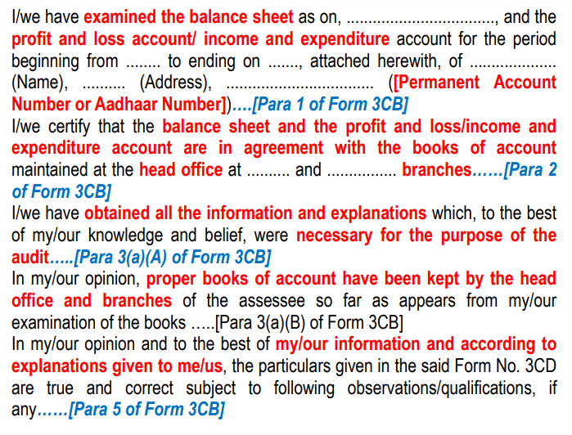
S
Go To

Slide 21
Key Observations
ICAI QRB

Slide 22
QRB REPORTS
The Report highlights the key findings observed in the audit quality reviews conducted, the approach for review, overall trend, expectations and other focus areas in respect of various areas.
Key findings are reported as under ;
Standards on Auditing
Accounting Standards
Other Relevant Laws and Regulations including CARO.

Slide 23
QRB OBSERVATIONS ON SA 230
Lack of audit documentation for audit procedure performed and audit evidence required by SA 200, 240, 250, 260, 320, 330, 500, 530, 610, 720 and SQC-1;
Failure to prepare documentation for work performed, indicates that the firm has not carried out appropriate audit procedures.

Slide 24
Lack of adequate audit evidence for audit procedure performed for reporting under CARO;
No evidence of review of audit work papers by way of sign-off by the Engagement Partner on manual print outs maintained in the physical working paper file;
Time sheets of assistants and conclusion of the observations noted were not signed by the Audit assistants, Partner in Charge, Signing Partner

Slide 25
Lack of adequate audit evidence for audit procedure performed for reporting under CARO;
Work papers (WP) and quantitative reconciliation of stock records were not tied up with the financial statements.

Slide 26
The firm has not documented the audit procedure performed during the course audit for identifying and assessing risks(SA-315);
Proper documentation was not kept on record in respect of working papers and observations made during the course of audit(SA-220).
On reviewing the documentation on hand with the firm, the firm has not kept the documentation as required by SA-230
The firm has not documented the audit procedure performed during the course of audit as required under SA-330.
In audit working papers of the staff, the name of the audit staff and date of work performed not mentioned.
Work papers (WP) and quantitative reconciliation of stock records were not tied up with the financial statements.

Slide 27
In many of the working papers there is no indication of review of audit work, date and extent of such review.
In respect of some of the audit observations, there is no evidence of follow up management discussions and conclusion of such observations.
Documentation with regards to the test of controls(Para 8-17 of SA-330)
Audit Evidence
Audit Sampling(Para 6-15 of SA-330)
There is no formal documentation available in the audit files for test of control and complete evidence of determining the operating effectiveness of the control(SA-330,SA-500,SA-530)

Slide 28
QRB OBSERVATIONS ON SA 500, 501 & 505
Failure to attend physical inventory counting and not performing audit procedures over the entity’s final inventory records.
Failure to prepare audit documentation for analytical procedures, audit sampling, and identifying related party transaction;
Failure to obtain sufficient external confirmations and alternative audit procedure in case of not using external confirmation.

Slide 29
Failure to obtain written representations from management in specific form and appropriately dated and signed;
Bank Reconciliation statement had not been taken for all the bank accounts.
No documentation maintained for the procedures followed for selection, preparation and sending out for external confirmations.
Management representation letter had been obtained for the general points not on other specific items.

Slide 30
Confirmations received were not having any evidence of acknowledgement of the date, time and person/department receiving the confirmation and were not directly addressed.
The audited balances brought forward to the next year was not tested and documented.
No documentation to confirm related party relationships and transactions
No Representation Letter was obtained for issuance of for engagements like Tax Audits, Certifications, etc.,

Slide 31
No risks on Going Concern had been identified by the Engagement Team and no documentation for evaluating Going Concern.
Failure to obtain audit evidence for reporting requirement under Companies Act, 2013 regarding disqualification of director
The usage of phrase ‘RPT are based on the information available with Company and relied upon by the auditor’ to be avoided.
S
Go To

Slide 32
It is noticed that means of selecting items for testing for the purpose of designing of test of
Control and test of details has not been documented by the audit firm.
It was noted that the firm has Accounting Standard checklist updated. However no links to the working papers to ensure the compliances are verified at the transaction level.
The Audit evidence for the verification of litigations and claims are inadequate. Refer para 9 of SA-501 and Para A 20 and A 21.
It was noted that the firm did not clearly document application of Analytical Procedure that includes the consideration of comparisons of the entities financial information with comparable information for prior period, anticipated results of the entity and similar industries information etc

Slide 33
Landmark Judgement – “Working Papers are property of Auditors…”
Chantrey Martin (A CA Firm) vs Martin Case (1953)

Slide 34
Plaintiff & Defendent
Plaintiffs are a firm of chartered accountants – Chantrey Martin
Defendant was in their employment - Martin
Judgement
Audit working papers are property of Auditors subject to any legal / ethical requirement
Judicial Bench
In The Supreme Court of Judicature, Court of Appeal
Before Lord Justice Somervell and Lord Justice Jenkins

Slide 35
Martin was the employee of Chantrey Martin , and has taken advance salary .
Case Facts
Later on the company dismisses him for breach of contract and claim the advance paid to him
Martin counter claim the irregularities in the books of accounts of the company. He made an application for the production of certain documents relating to the auditing of the client company’s accounts, but for which Chantrey Martin claimed privilege on the ground that they were the property of the company client.
S
Go To

Slide 36

NFRA – Extracts of Few Recent Judgements

Slide 37
CA Firm Sundaresha & Associates – Statutory Auditor of Tanglin Developments Limited & Subsidiary of Coffee Day Enterprise Limited for F.Y 2018-19
Imposed Penalty of Rs. 1 Crore and debarment of 2 years to the Firm for being appointed as Statutory or Internal Auditors.
Imposed Penalty of Rs. 5 Lakhs and debarment of 5 years to the engagement partner CA C Ramesh for being appointed as Statutory or Internal Auditors.
Non- Compliance with SA 230, 500, 505, 550 & 700.

Slide 38
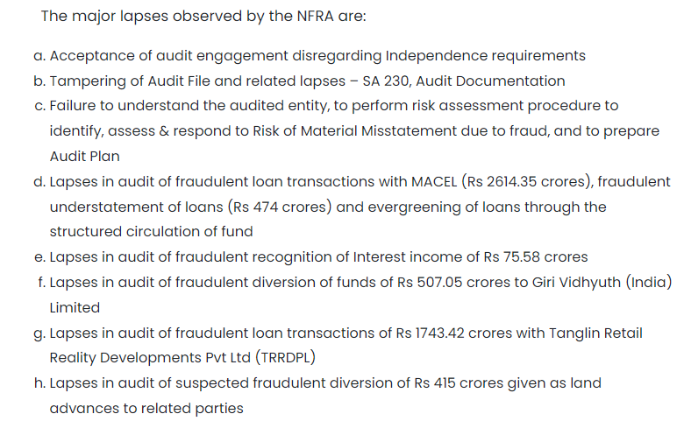

Slide 39
CA Akash Goel of CA Firm Akash Goel & Co – Statutory Branch Auditor of Dewan Housing Finance Limited for F.Y 2017-18
(Order No. NF-21/1/2022/01 | Date: 31.03.2023)
Imposed Penalty of Rs. 1 Lakhs and debarment of 1 years to the engagement partner CA Akash Goel for being appointed as Statutory or Internal Auditors.
Failure to ascertain from the Company whether the requirements of Sections 139 of the Act in respect of such appointment have been duly complied with

Slide 40
Failure to exercise due diligence and being grossly negligent in the conduct of professional duties, because of the lapses and omissions
Failure to obtain sufficient information which is necessary for the expression of an opinion or its exceptions are sufficiently material to negate the expression of an opinion
Failure to invite attention to material departure from the generally accepted procedures of audit applicable to the circumstances, because he certified in his report that the audit is done as per SAs mandated under section 143 of the Act and committed the lapses and omissions

Slide 41
Basis of Judgement :
In the absence of such proof documented in the audit file, the inevitable conclusion is that the requirements of the SAs are not met. The above facts are evidence that the EP did not follow the requirements of SA 230 and the audit documentation does not give evidence of the nature, timing and extent of audit procedures performed, results of those audit procedures and conclusions reached during the audit. Hence the charges in para 26 regarding non-compliance with SA 230 stand established.
Para 6 & 9 of SA 500 in not designing and performing audit procedures to obtain sufficient appropriate audit evidence and not evaluate the reliability of information produced by the company.

Slide 42
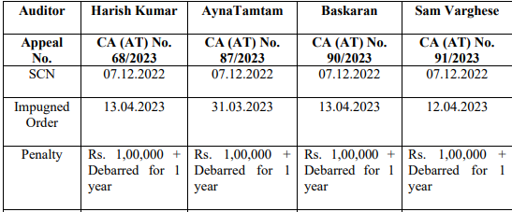
Partners Harish Kumar T. K, Anya Tampton, M Baskaran & Sam Varghese of CA Firm K. Varghese & Co.
– DHFL Branch Auditors
(Order passed by NFRA in April 2023 & sustained by NCLAT via COMPANY APPEAL (AT) NO. 68 of 2023)

Slide 43
Allegations on all four which paved the path for penalty:
Acceptance of audit engagement without valid authorization and without complying with ethical requirements; and issuing audit report in violation of the Act
Failure to comply with Standards on Auditing (SAs) – SA 210, 230 & 700

Slide 44


https://nfra.gov.in/document-category/orders/
S
Go To

Slide 45
SA 230
Audit Documentation

Slide 46
Scope & Effective Date
This standard deals with auditors responsibilities in preparation of audit documentation while auditing financial statements. Specific documentation requirements of other Standards on auditing do not limit its scope.
It is effective on or after 01.04.2009.

Slide 47
Objective to prepare Audit Documentation
It provides sufficient & appropriate records for the basis of audit report
It evidences that the audit was planned and performed in accordance with the SA’s and other legal requirements

Slide 48
Few Related Definitions
Audit Documentation
The record of audit procedures performed, relevant audit evidence obtained and conclusions the auditor reached (working papers, work papers)
Audit File
One or more folders or other storage media in physical or electronic form, containing the records that comprise of the audit documentation for a specific engagement.
Experienced Auditor
An Individual (whether Internal or external to the firm) who has practical audit experience and a reasonable understanding of audit processes, SAs and applicable legal and regulatory requirements, the business environment in which the entity operates and auditing and financial reporting issues relevant to the entity’s industry.

Slide 49
Form, Content & Extent of Audit Documentation
An auditor should prepare audit documentation sufficient to enable an experienced auditor having no previous connection with the audit to understand the below mentioned key points:

Slide 50
Nature, timing and extent of audit procedures
Identifying characteristics of specific items and matters tested
Who performed the audit and the date of completion
Who reviewed the report, the date and extent of review

Slide 51
Results of the audit procedures performed and evidence obtained
Document discussions of significant matters.
Nature of the significant matters – when and with whom discussed

Slide 52
Significant matters arising during the audit
Document how the inconsistencies have been addressed.
In case of departure from the standard, the relevant requirements and the reason for departure, the alternative audit procedures performed to achieve the aim of that requirement.

Slide 53
Matters arising after the date of the Auditor's Report
If, in the exceptional circumstances, auditor performs new or additional audit procedures or draws new conclusions after the date of the auditor’s report, the auditor shall document:

Slide 54
1
Circumstances encountered
2
Newer additional procedures performed, evidence obtained, conclusions reached and its effect on auditor’s report.
3
When and by whom the resulting changes to audit documentation were made and reviewed.

Slide 55
Few Additional but Important key Points
Assembling of the final Audit file should be completed on a timely basis after the date of the auditor’s report.
After assembling the same, the auditor shall not delete or discard documentation of any nature before the end of its retention period.
In case the auditor finds it necessary to modify existing or add new documentation post assembly, he should specify the reasons for them and when and by whom it was made and reviewed.

Slide 56
Application and Other Explanatory Material
Timely preparation enhances quality, review, evaluation of the audit evidence and conclusions reached before finalisation of the auditor’s report. Documentation prepared after audit work is less accurate than that prepared during audit
Form, content and extent depends on size and complexity of the entity, nature of procedures performed, risks, exceptions, audit methodology, tools used and professional judgment.

Slide 57
Audit documentation may be recorded on paper or on electronic or other media. Examples: Audit programmes, checklists, analysis, correspondence.
Audit documentation should not include superseded drafts of working papers and financial statements, notes reflecting incomplete and preliminary thinking
Oral explanations can clarify or explain information contained in audit documentation.
It is not necessary nor practicable for the auditor to document every matter considered or professional judgment made.

Slide 58
Judging the significance of a matter requires an objective analysis of the facts and circumstances.
The identifying characteristics should be recorded which helps serve a number of purposes
Summary describing significant matters identified during the audit and how they were addressed, or that includes cross-references to other relevant supporting audit documentation that provides such information.

Slide 59
Documentation also includes records prepared by the entity’s personnel.
Retention period of audit engagements is no shorter than seven years from the date of the auditor’s report.
Unless otherwise stated audit documentation is the property of the auditor. He may make disclosures but these should not affect his independence nor invalidate his work.

Slide 60
Few Examples of Audit Documentation
Engagement letter.
Audit programs.
Analyses of various account balances
through comparatives and corroborative.
Issues memoranda.
Checklists.

Slide 61
Few Examples of Audit Documentation
Summaries of significant matters.
Letters of confirmation and representation.
Correspondence (including e-mail) concerning significant matters.
Abstracts or copies of the entity’s records/contracts/ agreements.
S
Go To

Slide 62
SA 500
Audit Evidence

Slide 63
Scope & Effective Date
This standard explains what constitutes audit evidence in an audit of financial statements, and deals with the auditor’s responsibility to design and perform audit procedures to obtain sufficient appropriate audit evidence to be able to draw reasonable conclusions on which to base the auditor’s opinion.
It is effective on or after 01.04.2009.

Slide 64
Objective to Obtain Audit Evidence
To design & perform audit procedures in such a way as to enable the auditor to obtain sufficient appropriate audit evidence to be able to draw reasonable conclusions on which to base the Auditor’s opinion

Slide 65
Few Related Definitions
Accounting Records
The records of initial accounting entries and supporting records, such as checks and records of electronic fund transfers; invoices; contracts; the general and subsidiary ledgers, journal entries and other adjustments to the financial statements that are not reflected in journal entries; and records such as work sheets and spreadsheets supporting cost allocations, computations, reconciliations and disclosures.
Appropriateness
(of audit evidence)
The measure of the quality of audit evidence; that is, its relevance and its reliability in providing support for the conclusions on which the auditor’s opinion is based.

Slide 66
Audit Evidence
Information used by the auditor in arriving at the conclusions on which the auditor’s opinion is based. Audit evidence includes both information contained in the accounting records underlying the financial statements and other information
Management’s Expert
An individual or organization possessing expertise in a field other than accounting or auditing, whose work in that field is used by the entity to assist the entity in preparing the financial statements
Sufficiency (of Audit Evidence)
The measure of the quantity of audit evidence. The quantity of the audit evidence needed is affected by the auditor’s assessment of the risks of material misstatement and also by the quality of such audit evidence.

Slide 67
Requirements of the Standard
The Auditor shall perform audit procedures to obtain sufficient appropriate audit evidence to support auditor’s opinion in the Audit Report.
Audit evidence is cumulative in nature and is primarily obtained from the audit procedures (Compliance & Substantive)
Other sources of audit evidence include the firm’s quality control procedures for client acceptance & continuances

Slide 68
Why Sufficient & Appropriate Audit Evidence
Such is required to provide “Reasonable Assurance” to the auditor that the Financial Statements taken as a whole is free from material mis-statements and thereby reduces audit risk to an acceptable low level

Slide 69
Sufficiency
Measurement of quantity of audit evidence
Effected by auditor’s risk assessment procedures
Appropriateness
Measurement of quality of audit evidence
Emphasis on the relevance & reliability of audit evidence
Quality of audit evidence
Is influences by the source of audit evidence

Slide 70
Sources of Audit Evidence
Either Internal or External
Level of Assurance would depend upon source and nature of audit evidence

Slide 71
Audit Procedures to Obtain Audit Evidence
Risk Assessment
Compliance Test
Substantive Test

Slide 72
Risk Assessment
Audit Risk
Inherent Risk
Control Risk
Detection Risk

Slide 73
Inherent Risk
Susceptibility of an assertion to a mis-statement that could be material assuming that there are no related controls
The entity’s internal control system will not prevent or detect & correct on time a material mis-ststement
Detection Risk
That the auditor will not detect a mis-statement that could be material
Control Risk

Slide 74
Compliance Test
Whether Internal Control Exists?
Whether such are effective in detecting & preventing risks of material mis-statements?
Whether such was effective throughout the period?

Slide 75
Substansive Test
Inspection
Observation
External Confirmation
Re-calculation
Re-performance
Analytical Procedures
Inquiry

Slide 76
Inspection
Also includes physical verification of an asset.
Examination of records both internal & external, in paper, electronic or other media

Slide 77
Observation
But is limited to a point in time at which the observation takes place and by the fact that the act of being observed may affect how the process or procedure is performed.
Obtaining audit evidence w.r.t. performance of a process / procedure

Slide 78
External Confirmation
Mainly relevant for assertions to account balances but not confined to such.
Evidence obtained as a direct written response to an auditor by a third party

Slide 79
Re-calculation
Can be performed either manually or electronically.
Checking of mathematical accuracy of documents or records

Slide 80
Re-performance
Auditor’s independent execution of procedures or controls that were originally performed as a part of entity’s internal control

Slide 81
Analytical Procedures
Also encompass the investigation of identified fluctuations and relationships that are inconsistent with other relevant information or deviate significantly from predicted amounts
Analytical procedures consist of evaluations of financial information made by a study of plausible relationships among both financial and non-financial data.

Slide 82
Inquiry
Used extensively throughout the audit in addition to other audit procedures
Seeking information of knowledgeable persons, both financial and non- financial, within the entity or outside the entity
May range from formal written inquiries to informal oral inquiries. Evaluating responses to inquiries is an integral part of the inquiry process

Slide 83
While Performing Audit Procedures the auditor shall consider the relevance and reliability
Information produced using Work by Management’s Expert
Information Produced by Entity
1. Verify for Accuracy and completeness
2. Evaluate for Sufficiency in details
1. Evaluate the competence & Objectivity
2. Obtain an Understanding
3. Evaluate the appropriateness

Slide 84
Rules for Reliability of Audit Evidence
Internal evidences are reliable, if internal controls are effective.
External evidences are more reliable than Internal evidences

Slide 85
Audit Evidence is more reliable when it exists in documentary form, whether paper, electronic or other medium
Original documents are more reliable than photocopies
Evidences obtained directly by the auditor is more reliable

Slide 86
Relying on the work of a Management Expert
Evaluate the competence, capability and objectivity of the expert.
Obtain an understanding of the work of the expert
Evaluate the appropriateness of the expert’s work as audit evidence for relevant assertions.

Slide 87
Using Information produced by the Entity
Obtain audit evidence regarding accuracy and completeness of audit evidence.
Evaluating whether the information is sufficiently precise and detailed for audit purpose.

Slide 88
Criteria for Selecting Items for Testing to obtain Audit Evidence
An effective testing is designed to provide appropriate audit evidence sufficient for auditor’s purpose.
While selecting the items for testing, the auditor is required to consider relevance, sufficiency and reliability of items selected.

Slide 89
Means available for Selection of Items
Selection Means
100 %
Specific Items
Audit Sampling

Slide 90
When to opt for 100%?
There is significant risk an other means do not provide the sufficient appropriate audit evidence
Population consists of small number of high value items
Repetitive nature of calculation / process performed by the information system make 100% examination cost effective

Slide 91
When to opt selecting specific Items?
Factors for Consideration
Understanding the entity, assessed risk of material mis-statement and characteristics of population being selected
Inclusions
High Value or Key Items
Interpretation
It does not constitute audit sampling and as such do not provide evidence as to remainder of the population.
All Items over a certain amount
Items to obtain information about matters such as the nature of the entity of transactions

Slide 92
When to opt for Audit Sampling?
Factors for Consideration
Purpose of audit procedure to be considered
Do’s
Determine a sample size which is sufficient to reduce sampling risks to acceptable low level
Samples to be selected in such a way that each sampling unit in the population has a chance of selection
Characteristics of the population from which sample is drawn to be evaluated
The application of audit procedures to less than 100% of items within a population of audit relevance such that all the sampling units have a chance of selection in order to provide the auditor with a reasonable basis on which to draw conclusions about the entire population
Definition

Slide 93
Inconsistency in / Doubt over reliability of Audit Evidence
Resolve the conflict by extending audit procedures
Doubts over reliability of Information
Inconsistency between two sources
S
Go To

Slide 94
SA 501
Audit Evidence – Specific Consideration for Selected Items

Slide 95
Scope & Effective Date
This standard deals with specific considerations by the auditor in obtaining sufficient appropriate audit evidence with respect to certain aspects of inventory, litigations & claims and segment information.
It is effective on or after 01.04.2010.

Slide 96
Objective
Presentation & Disclosure of Segment Information
Existence & Condition of Inventory
Completeness of litigations & Claims involving the Entity

Slide 97
Inventory
Requirement
Physical Attendance while inventory counting
Ascertain the physical existence of the inventory
Identifying the obsolete, damaged or ageing inventory
Evaluate Management’s Instructions & Procedures such as :
Method of collection of used physical inventory counts record
Procedures used to estimate physical quantities
Accounting for unused physical inventory counts record
The accurate identification of the stage of completion of work-in-progress

Slide 98
Matters to be considered while planning for Physical Verification
Nature of Inventory
Materiality of Inventory
Timing of Physical Counting
Risk of Material Mis-statement
Nature of Internal Controls w.r.t. Inventory
Stage of Completion of W-I-P

Slide 99
Special Circumstances | Auditor’s Duty Thereon
If the physical inventory counting is conducted at the date other than the date of financial statements | To ascertain whether the changes in inventory between the count date and the date if the financial statements are properly recorded
If the auditor is unable to attend physical inventory counting due to unforeseen circumstances | Observe some physical counts on an alternative date and Perform audit procedures on interviewing transaction
Where the attendance at physical inventory counting is impracticable | Adopt alternative audit procedures. In case the auditor is unable to adopt alternative audit procedures, the auditor shall modify his opinion in the auditor’s report
Where the inventory is under the custody & control of the 3rd party | Obtain external confirmation from that party on behalf of the entity in regards to the quantity & the condition of the inventory. Perform inspection or other appropriate procedures

Slide 100
Litigations & Claims
Auditor’s Duty | Audit procedure
To identify the litigations & claims | Inquiring with management, in-house legal counsel
 | Reviewing minutes of meetings of those charged with governance & correspondence between the entity & its external counsel
 | Reviewing Legal Expense Account
Assess the risk of material misstatement due to existing litigations or claim | Seek direct communication with the entity’s external legal counsel through a letter of enquiry
 | In case law, regulation or the respective legal professional body prohibits the entity’s external legal counsel from communicating directly with the auditor

Slide 101
Auditor’s Duty | Audit procedure
To obtain written representation | It is obtained by the Auditor
 | It is collected from the Management
 | Properly accounted for & disclosed in accordance with the applicable financial reporting framework

Slide 102
Segment Information
Auditor’s Duty | Audit procedure
Obtain an understanding of the methods used by the management in determining segment information | Evaluate such methods
 | Check whether such methods are likely to results in disclosure in accordance with the applicable Financial reporting framework
 | Perform analytical procedures
S
Go To

Slide 103
SA 505
External Confirmations

Slide 104
Scope & Effective Date
This standard deals with the auditor’s use of external confirmation procedures to obtain audit evidence. It does not address inquiries regarding litigation and claims.
It is effective on or after 01.04.2010.

Slide 105
Objective to prepare Audit Documentation
To design & perform such procedures to obtain relevant & reliable audit evidence

Slide 106
Few Related Definitions
External Confirmation
Audit evidence obtained as a direct written response to the auditor from a third party (confirming party), in paper form, or by electronic or other medium.
Positive Confirmation Request
A request that the confirming party respond directly to the auditor, indicating whether the confirming party agrees or disagrees with the information in request, or providing the requested information.
Negative Confirmation Request
A request that the confirming party respond directly to the auditor, only if the confirming party disagrees with the information provided in the request.

Slide 107
Non-Response
A failure of the confirming party to respond , or fully respond, to a positive confirmation request, or a confirmation request returned undelivered.
Exception
A response that indicates difference between information requested to be confirmed, or contained in the entity’s records, and information provided by the confirming party

Slide 108
Procedure for External Confirmation
Determining the information to be confirmed or requested
Selecting the appropriate confirming party
Designing the confirmation requests, including determining that requests are properly addressed and contain return information for responses to be sent directly to the auditor
Sending the requests, including follow-up requests when applicable, to the confirming party

Slide 109
Factors to be considered while designing confirmation requests
The assertions being addressed.
Specific identified risks of material misstatement, including fraud risks.
The layout and presentation of the confirmation request.
Prior experience of an audit or similar engagements.
The method of communication (for example, in paper form, or by electronic or other mediums).

Slide 110
Management’s authorization or encouragement to the confirming parties to respond to the auditor. Confirming parties may only be willing to respond to a confirmation request containing management’s authorization.
The ability of the intended confirming party to confirm or provide the requested information (for example, individual invoice amount versus total balance)

Slide 111
Management’s Refusal to Allow the Auditor to Send a Confirmation Request
If the auditor concludes that management’s refusal to allow the auditor to send a confirmation request is unreasonable, or the auditor is unable to obtain relevant and reliable audit evidence from alternative audit procedures
The auditor shall communicate with those charged with governance in accordance with SA 260. The auditor also shall determine the implications for the audit and the auditor’s opinion in accordance with SA 705

Slide 112
If management refuses to allow the auditor to send a confirmation request, the auditor shall:
Inquire as to management’s reasons for the refusal, and seek audit evidence as to their validity and reasonableness
Evaluate the implications of management’s refusal on the auditor’s assessment of the relevant risks of material misstatement, including the risk of fraud, and on the nature, timing, and extent of other audit procedures
Perform alternative audit procedures designed to obtain relevant and reliable audit evidence.

Slide 113
Decoding Results & Actions Thereon
Non-Responses
In the case of each non-response, the auditor shall perform alternative audit procedures to obtain relevant and reliable audit evidence.

Slide 114
Reliability of Responses to Confirmation Requests
If the auditor identifies factors that give rise to doubts about the reliability of the response to a confirmation request, the auditor shall obtain further audit evidence to resolve those doubts
If the auditor determines that a response to a confirmation request is not reliable, the auditor shall evaluate the implications on the assessment of the relevant risks of material misstatement, including the risk of fraud, and on the related nature, timing, and extent of other audit procedures.

Slide 115
When a Response to a Positive Confirmation Request is Necessary to Obtain Sufficient Appropriate Audit Evidence
If the auditor has determined that a response to a positive confirmation request is necessary to obtain sufficient appropriate audit evidence, alternative audit procedures will not provide the audit evidence the auditor requires. If the auditor does not obtain such confirmation, the auditor shall determine the implications for the audit and the auditor’s opinion in accordance with SA 705

Slide 116
Negative Confirmations
Negative confirmations provide less persuasive audit evidence than positive confirmations. Accordingly, the auditor shall not use negative confirmation requests as the sole substantive audit procedure to address an assessed risk of material misstatement at the assertion level unless all of the following are present:
(a) The auditor has assessed the risk of material misstatement as low and has obtained sufficient appropriate audit evidence regarding the operating effectiveness of controls relevant to the assertion;
(b) The population of items subject to negative confirmation procedures comprises a large number of small, homogeneous, account balances, transactions, or conditions;
(c) A very low exception rate is expected; and
(d) The auditor is not aware of circumstances or conditions that would cause recipients of negative confirmation requests to disregard such requests.
S
Go To

Slide 117



Slide 118

Kindly free to contact me at:
M: 9831208273 / 9831144828
E-Mail: krishanufca.b@gmail.com

