Slide 1
succession planning
FOR proprietorshipS & small firms:
SIGNIFICANCE & STRATEGIES
Jayraj S. Sheth
12th June 2026
ICAI – Eastern India Regional Council
Growth Summit 2026 - Kolkata

Slide 2

Today’s Journey
Why
What
How
When
Interactive - humble attempt to Share and Learn Together

Slide 3
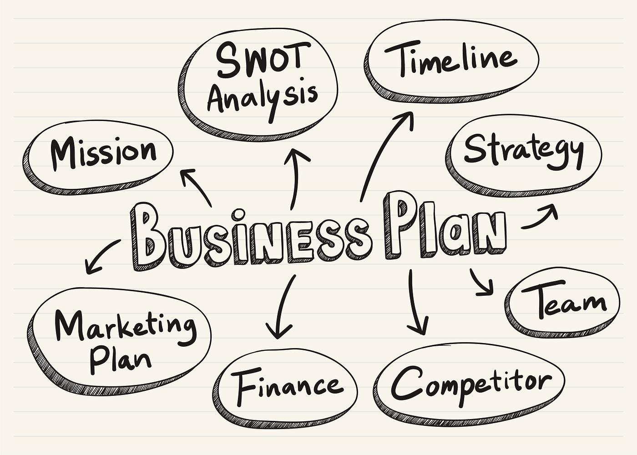
What are you currently doing?
‘Profession’ – Individual / Group of Individuals
serving society based on personal relationships ?
‘Professional Business’ ?
        Institution – Firm, LLP, Pvt Ltd. Co.
        Multiple partners & locations
        Standardized operations
        Commercial motives - taking risk
        Aspiring for structured growth, scale, continuity,
        transferability and profitability
        Balancing Ethics with strategic realism
‘Entrepreneurial’ mindset is embedded in a ‘Business’

Slide 4
PSF Service Verticals
Rocket Science
Gray Hair
Procedure
Commodity
Except Rocket Science, all Verticals are generally scalable

Slide 5
Typical service lines of a CA Firm
Regulated | Not Regulated
Statutory Audit | Tax & Regulatory (SEBI, FEMA, PMLA, IBC etc.):
Tax Audit | Advisory / structuring / planning (incl. Strategy, M&A)
Forensic Audit / Investigation | Advocacy / Representation (not as AR)
Concurrent / Internal Audit of specified entities | Compliance/Compliance support (incl. Risks/Controls)
Special purpose Audits / Certifications | Litigation / Litigation support
Limited Reviews /Quarterly Audits | Accounting / Accounting advisory (incl. Managed Servc.)
‘Authorised Representative’ under Tax Laws | Due Diligence; Transformation / Implementation
Valuation | Succession Planning / Family Office
 | Management Assurance / Consultancy (incl. Govts.)
 | Financial Services - Investment Banking / Fund raising / Wealth Management
 | IPO support, ESG Consultancy etc.
These evolve continuously with new laws and changing times – emergence of MDPs

Slide 6
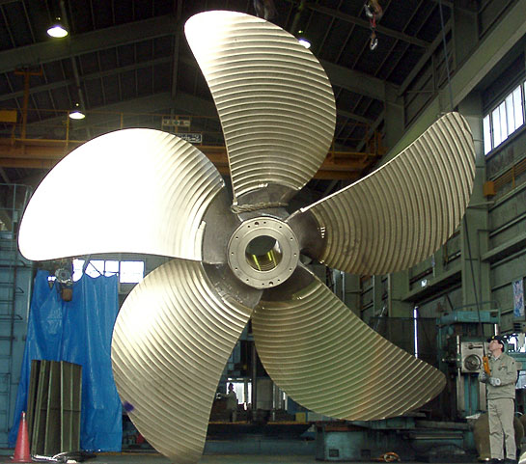
Five Key Drivers of Growth for a CA Firm
Client Management – Deliverables, Quality, Relationships
Business / Practice Development
People Management & Development
Practice Management – Operations, Risk, Processes & Systems
IP / Knowledge / AI
These Drivers Build the ‘Brand’ of the Firm
At the Center of these Drivers are: Vision, Values and Culture

Slide 7

Why do we seek Growth ?
Happiness, Joy & Peace
Satisfaction
Recognition, Power, Position, Fame
Money / Wealth
Channelize energy and creativity
Build an institution / business of eminence
Provide employment /career opportunities to others
Leave behind a legacy
Growth is a Journey – throughout the life

Slide 8

It is not the Strongest of the species that survives,
nor the most Intelligent.
But the one most Responsive to Change
Responsiveness means readiness for: AI, merger, talent and governance
Paraphrased by Leon C. Megginson based on Charles Darwin’s theory of “Origin of Species”

Slide 9
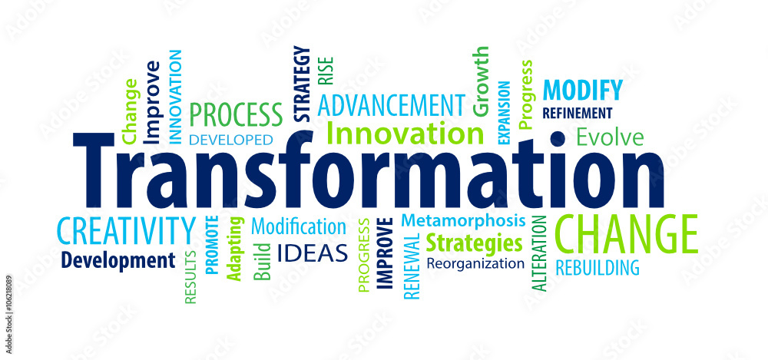
Growth Booster – Sustainability Tonic

Slide 10

Life cycle of every Business Entity / Vertical
Creation Consolidation
  SUCCESSION Expansion
Consequence of failure to implement ‘succession’ -
risk of business cycle ending prematurely

Slide 11

Why Succession & Transformation?
“What Got You Here, Won’t Get You There” - Marshall Goldsmith
VUCAD world – Volatile, Uncertain, Complex, Ambiguous, Disruptive
Heightened competition all around – especially the Big 4
Digital and AI centric world
Ubiquitous world
Coping with diverse & growing aspirations of Millennials/Gen Z
Challenges of heightened attrition
Rising / diverse expectations of clients – continuity, responsiveness…
Dealing with competent and large in-house teams of clients
Succession & Transformation fuel future-readiness and Growth

Slide 12

What does Succession & Transformation mean ?
Moving from founder-centric to institution-centric operations
Moving from reactive to strategic thinking
Expanding newer service lines beyond assurance and tax
Building a strong future-ready talent pool
Embracing technology – integrating digital tools, AI, cloud
Aligning with global best practices
Creating scalable and sustainable delivery models
Creating ‘VALUE’ for all stakeholders – clients, employees….
Professionalise the Firm while preserving ethics, trust and values
This Photo by Unknown Author is licensed under CC BY

Slide 13

Are you experiencing some of these Symptoms?...
Partner centricity - Ageing partner base - business continuity risk
Broken pyramid - weak mid-tier – overworked partners
Seasonality burnout of Partners & Staff
Talent drain – also unable to attract fresh talent
Missing clients’ expectations – high client attrition
Over dependence on a few anchor clients
‘My client’ v. ‘Firm’s client’ – hoarding v. sharing
Compliance heavy revenue mix
Higher risks & lower fees
Time to Introspect & Diagnose

Slide 14

…Are you experiencing some of these Symptoms?
Financial instability – conducting other businesses in parallel
Inability to keep updated with rapid changes
Decline in Quality of Service
Struggling for Growth – revenues, people, geographies
Inability to invest in technology upgradation
Risk of extinction – lack of institutionalisation
Erosion of Goodwill / Reputation / Value
Desiring to optimally monetise Value of Practice
Midlife crisis / children pursuing other opportunities
Symptoms vary depending on your Age and Stage of Practice

Slide 15

What is Succession of a CA Firm?
Not a one-time event – it’s a strategic process across all levels in all teams
Involves smooth transfer of power, leadership, and continuity in any business based on merit, training, clear designation, ethics and wise counsel
Succession in a ‘professional business’ is quite different from that in a ‘business’ due to the interplay of:
  personal reputation and relationships
  trust and credibility
  client acceptance
  personal competence - knowledge and skills
  regulations –ICAI, Companies Act, Tax Laws, etc.
Succession is a wisely planned and executed journey

Slide 16

Core Elements of Succession
Preparedness of successor – vision, values, leadership, competency
Merit v. bequeathal
Continuity of Purpose, Values and Ethics
Internal acceptance – avoiding conflicts
Ownership (control) v. management - governance mechanism
External Mentors / Advisory Board / Executive Council
Gradual transition of power – shadowing, joint decisions, transfer
Drive, discipline, innovation, excellence
An in-depth and a 360-degree perspective is desirable covering ownership, management and client relationships

Slide 17

Steps in Succession Planning - Macro
Do an honest and thorough SWOT Analysis of Firm, Self, Partners & Key Leaders
Communicate – purpose, benefits, process, challenges
Involve Partners / key Leaders in the planning process
Re-state Vision at least till 2030 - growth, areas of service, market positioning
Re-state core Values – ensure alignment with Culture
Align business strategy with aspirations of Self/Partners
Use Mentors and Well Wishers as sounding boards

Slide 18
Steps in Succession Planning – People Related
Begin separating ‘ownership’ & ‘management’ where feasible –
elevate some Leaders for ‘management’ roles
Re-assess rewards /incentives of Partners / key Leaders
Introduce shadow equity / quasi profit share to test future partners
Identify potential internal successors – groom, graduate, phased equity
Identify potential lateral hires
Invest in leadership development, mentoring, and gradual
distribution and transition of various responsibilities

Slide 19

Steps in Succession Planning – Others
Plan for transition of key assignments / clients
Upgrade own skills – attend EDPs / focused seminars/conferences
Be prepared to address ‘resistance to change’
Invest in technology (incl. AI tools) and building SOPs
Revamp ELs, compliance calendars, DMS, cyber hygiene etc.
and expand service offerings & geographies
Do ‘Important’ Things When They are ‘Not Urgent’
Do not wait till they become an ‘Emergency’

Slide 20
Common Myths / Hurdles in Succession Planning
“I” will lose my ‘independence’ – You will become “inter-dependent”
“I” wish to be by own boss – Choose between being a boss v. a leader who leads and creates leaders
“I” will lose my control if I share equity – Control will shift to Policies and Procedures
“I” will lose my take home if I share equity – You will take home more from a larger Cake
Clients won’t stay without “Me” – Clients stay for outcomes, solutions, access, team, continuity, trust and process-based work styles
Succession = retirement – Succession is an insurance – start while growing
“I” still have time to plan merger – Right time is contextual - avoid procrastination
Reimagine – Realign – Reignite – Adopt ‘Change Management’ Approach

Slide 21

Other modes of Succession Planning
Lateral hiring of professional leaders & grooming for future
Gradual winding down – transferring client relationships
Strategic alliance / network / affiliation with other Firms
De-merger of specialized verticals
Monetisation via partial stake sale
Acquisition by a larger CA Firm
Merger with a like minded CA Firm
Move on to industry or other larger Consulting / CA / Law Firm
Realise Value before it is eroded
This Photo by Unknown Author is licensed under CC BY-SA

Slide 22
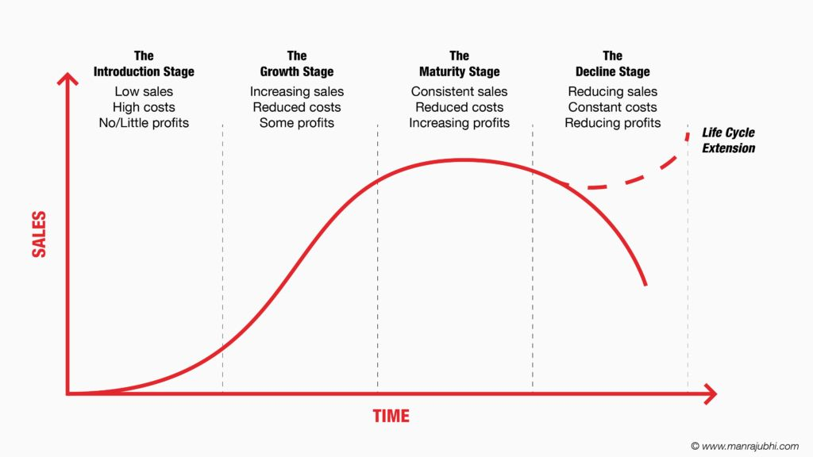
Timing of Merger / Sell-out
Most Firms think of Merger or stake sale when they have entered Declining Stage - Thus, losing out on Valuation & Bargaining Power !
The best time to get Optimal Value is when the Firm is still in the
Upward Trajectory of Growth before reaching Maturity

Slide 23

Work towards becoming Merger/Acquisition ready / worthy…
Standardise processes that outlast individuals
Strengthen Quality and Knowledge Management
Upgrade IT infrastructure and skills
Gradually and wisely ease out:
  unwarranted service lines
  expensive / risk prone assignments / clients
  expensive resources who can’t be uplifted
Transition clients to other Key Leaders
Become more visible on social media and at events
Undertake market benchmarking of Staff comps
Become a Network Member to ‘experiment’ and ‘learn’ ?

Slide 24

…Work towards becoming Merger/Acquisition ready / worthy
Look beyond legacy practice areas – ESG, IPO support, etc.
Introduce Performance Management System with appropriate
KRAs, KPIs and Behavioural Attributes
Introduce PLI (Performance Linked Incentives) / Variable Pay
Identify Skill Gaps and execute PDP (Personal Development Plans)
for Partners/ Key Leaders and other Staff
Aim to: a) increase revenue per FTE b) achieve zero bad debts,
c) quicker realization of fees d) improve quality of clients
Prepare for achieving Synergies - Become “Investible”

Slide 25
Two Fronts to Navigate
Own Self Organisational Level

Slide 26

Navigating with Own Self…
Be entrepreneurial - Take “Risk” – overcome Fear of Failure
Be Passionate
Be Aspirational
Be a Visionary and a Thought Leader
Embrace “Collaborative” & “Synergistic” mindset
Dissolve “I” – Ego; Adopt “We” Approach
Shift from “My Client” To “Firm’s Client” – Hoarding To Sharing
Introspect, Diagnose and Transform

Slide 27

…Navigating with Own Self
Be responsive to Change
Widen your Horizon
Be prepared to work with / under Younger Leaders
Move from “Controlling” Mindset to “Empowering” Mindset
Be prepared to Up-skill, Re-skill and Cross-skill continuously
(e.g. AI tools, Sectoral depth, Client C-suite conversations)
Build merit-based succession beyond family lineage
Invest in appropriate Mentoring & Coaching

Slide 28
Navigating at Organisational Level
Garner initial seed capital to invest adequately in Talent, Technology and Infrastructure (TTI) – Build ‘Firm Development Reserve’
Design well thought out strategy for technology adoption and upgradation
Laterally hire talent in the age group of 35 to 45 at Leadership level who :
- are passionate & aspirational
- are tech savvy
- have relevant experience and competency for strategic thinking & execution
- believe in delivering ethically (and not ‘manage’ or ‘fix’ or ‘organise’)
Attract talent from Tier 2 & 3 cities / towns
Shift focus to clients who are fast growing, PE backed, patient and ethical
Chase/follow clients as they grow to keep competition away and mine more work

Slide 29

Pillars of Change Management
Strategy & Capabilities
Organisational Structure
People Practices
Rewards & Incentives
Processes & Technology – across the Organisation
Data / AI / Knowledge Management / Information Security
Strengthen or Rebuild all these Pillars Inside Out

Slide 30

Are you ready ?

Slide 31


Jayraj S. Sheth
Mumbai
Email: jayraj.sheth@jsconsultancy.co
Mob: 9987590682

Slide 32


