Slide 1

RECENT ASB INITIATIVES
CA. (Dr.) Sanjeev Kumar Singhal
Chairman, Accounting Standards Board

Slide 2
Agenda
S.No. | Topics
1. | Overview of Ind AS 117, Insurance Contracts
2. | Overview of proposed Ind AS 118, Presentation and Disclosure in Financial Statements
4. | Other Initiatives

Slide 3

OVERVIEW OF IND AS 117
Insurance Contracts

Slide 4
BACKGROUND
IRDAI Mandate:
Press release dated March 30, 2026, mandated preparation and presentation of financial statements by insurers in accordance with Ind AS
Effective Date: April 1, 2026
Parallel reporting for a period of two years (or specified period), comprising financial statements prepared in accordance with Ind AS alongside financial information under the existing accounting framework.
To facilitate smooth transition, for insurers facing challenges in immediately shifting to Ind AS, a provision has been made to grant forbearance for one-year

Slide 5
What is an insurance contract
A contract under which one party (the issuer) accepts significant insurance risk from another party (the policyholder) by agreeing to compensate the policyholder if a specified uncertain future event (the insured event) adversely affects the policyholder
 | Significant insurance risk
ISSUER ACCEPTS | By agreeing to compensate on the occurrence of an insured event | POLICYHOLDER

Slide 6
SCOPE
Insurance contracts issued (ie sold)
Reinsurance contracts held (ie acquired)
Investment contracts with discretionary participation features issued
Similar economic characteristics as insurance contracts (for example, long duration, recurring premiums, the amount or timing of the return is contractually determined at the discretion of the issuer)
Commonly linked to the same pool of assets as, or share in the performance of, insurance contracts.
Scope exclusions
product warranties,
financial guarantee contracts and
fixed-fee service contracts.

Slide 7
LEVEL OF AGGREGATION
Requirements of Ind AS 117 are applied to a group of contracts rather than on a contract‑by‑contract basis.
In grouping insurance contracts, a company is required to identify portfolios of contracts and to divide each portfolio into:
(a) a group of contracts that are onerous at initial recognition, if any;
(b) a group of contracts that at initial recognition have no significant possibility of becoming onerous subsequently, if any; and
(c) a group of remaining contracts, if any.
In addition, a group of contracts cannot include contracts issued more than one year apart.

Slide 8
RECOGINITION
Ind AS 117 requires a company to recognise a group of insurance contracts it issues from the earliest of the following:
(a) | (b) | (c)
The beginning of the coverage period; | The date on which the first payment from a policyholder is due; and | For a group of onerous contracts, when the group becomes onerous.

Slide 9
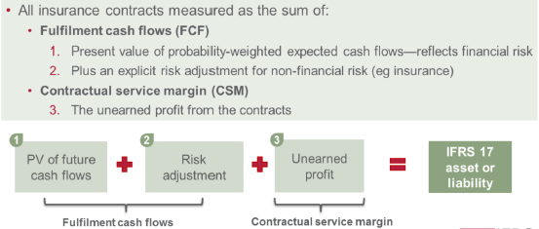
Measurement of insurance contracts

Slide 10
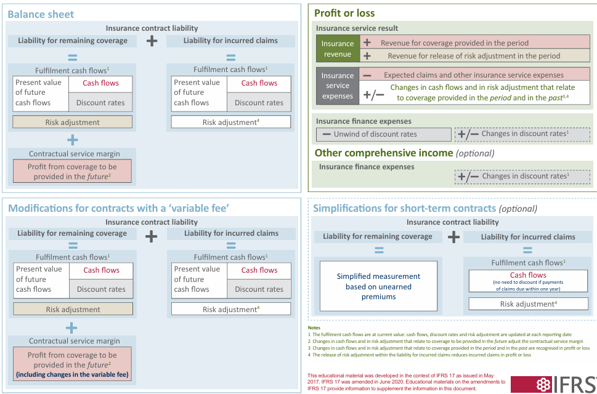
Ind AS 117/IFRS 17 ACCOUNTING MODEL

Slide 11

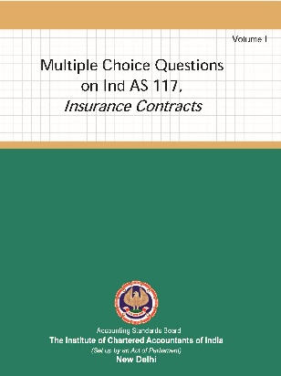
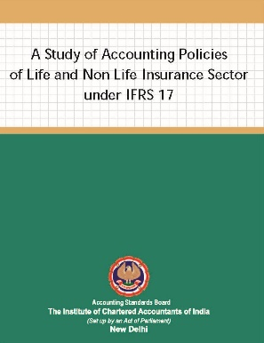
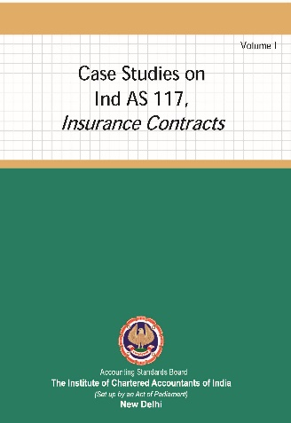
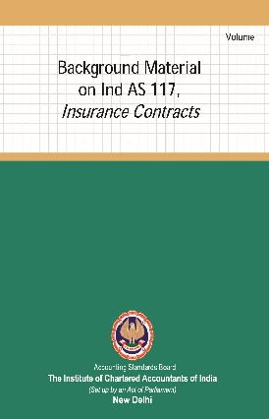
ICAI – ASB ACTION PLAN
Development of Educational Material on Ind AS 117
To address the implementation issues that are encountered frequently, EDM to be developed
Publications released on Ind AS 117
Background Material on Ind AS 117, Insurance Contracts- Volume 1
MCQs on Ind AS 117, Insurance Contracts- Volume 1
Case Studies on Ind AS 117, Insurance Contracts- Volume 1
Volume II of above publications is expected to be released shortly.
Publications on Insurance Research Projects
Publication on ‘A Study of Accounting Policies of Life and Non-Life Insurance Sector under IFRS 17’ issued
Publication on Transition Related Research project proposed to be released.

Slide 12

ICAI – ASB ACTION PLAN
IRDAI Joint Expert Group
IRDAI had constituted a Joint Expert Group (JEG) comprising representatives from IRDAI, NFRA, SEBI, ICAI and IAI to examine and address issues arising during the implementation of Indian Accounting Standards by insurers.
Technical Group (TG) on Insurance
To address various issues in transition and implementation on Ind AS 117 on an urgent basis, a Technical Group has been constituted.
Inputs on referred issues relating to implementation of Ind AS in insurance sector have been submitted to JEG.
Draft Format of Report on Independent Validation of Processes Adopted for Implementation of Ind AS submitted to IRDAI.

Slide 13

ICAI – ASB ACTION PLAN
Self‑Paced Course on Ind AS 117
A comprehensive self‑paced course on Ind AS 117, structured into 10 modules, has been recorded to facilitate flexible, on‑demand learning.
The complete program was officially launched on 1st July 2026.
5-day Course on Ind AS 117
Regular batches of 5-day intensive course on Ind AS 117 are being conducted offering practice-oriented insights into the standard’s requirements.
So far, two such batches have been conducted.
Workshop on Ind AS 117 organized by IRDAI was hosted by the ASB of ICAI at ICAI BKC, Mumbai on June 5, 2026.
Other Proposed Initiatives
Training Programmes
Faculty Development Programmes

Slide 14

OVERVIEW OF PROPOSED IND AS 118 presentation and disclosure in the financial statements

Slide 15
the new requirements
New required subtotals in the profit or loss, including ‘operating profit’
Disclosures about management-defined performance measures (MPMs)
Enhanced requirements on grouping of information (aggregation and disaggregation)
Better information for better decisions
– increases comparability, transparency and usefulness of information

Slide 16
Complete set of financial statements
A statement of profit and loss
A balance sheet
A statement of changes in equity
A statement of cash flows
Notes
Comparative information in respect of the preceeding period
A balance sheet as at the beginning of the preceeding period
Primary financial statements

Slide 17
Categories and subtotals in the statement of profit and loss
Investors’ concerns
Difficulty comparing financial performance because companies’ statement of profit and loss vary in content and structure
Ind AS 118 introduces
Three new defined categories to provide a consistent structure of the statement of profit or loss:
  Operating
  Investing
  Financing
  plus income taxes and discontinued operations
Two new required subtotals to enable analysis:
  operating profit
  profit before financing and taxes

Slide 18
New required subtotals
Operating profit or loss- The total of all income and expenses classified in the operating category.
Gives a complete picture of a company’s operations.
Profit before financing and income taxes - The total of operating profit or loss and all income and expenses classified in the investing category.
Gives a picture of a company’s performance before the effects of its financing.

Slide 19
Statement of profit and loss for most companies
Revenue |  | Operating
Cost of sales
Gross profit
Other operating income |  | Operating
Selling expense |  | Operating
Research and development expenses
General and administrative expenses
Goodwill impairment loss
Other operating expenses
Operating profit
Share of profit and gains on disposal of associates and JVs |  | Investing
Profit before financing and income taxes
Interest expense on borrowings and lease liabilities |  | Financing
Interest expense on pension liabilities and provisions
Profit before income taxes
Income tax expense
Profit from continuing operations
Loss from discontinued operations
PROFIT
It is assumed that the company presents some operating expenses by function and some by nature.
Subtotals highlighted in green are required and highlighted in orange are examples of additional subtotals.
A company presents additional subtotals if necessary to provide a useful structured summary of the company’s income and expenses
Ind AS 118 will be applied differently by companies with specific business activities, such as banks, insurers and investment property companies.
Income taxes
Discontinued operations

Slide 20
What is in the operating category?
Income and expenses:
All income and expenses from a company’s operations, regardless of whether they are volatile or unusual in some way
from its main business activities, but not limited to it
that do not meet the requirements for classification in other categories –the Default category
Works for all business models
Provides complete picture of company’s operations

Slide 21
WHAT IS IN THE INVESTING CATEGORY
Income and expense arising from:
cash and cash equivalents
other assets if they generate a return individually and largely independently of the entity’s other resources
investments in associates, joint ventures and unconsolidated subsidiaries
the income generated by the above assets;
the income and expenses that arise from the initial and subsequent measurement of these assets, including on derecognition of the assets; and
the incremental expenses directly attributable to the acquisition and disposal of these assets—for example, transaction costs and costs to sell the assets.
FOR ENTITIES OTHER THAN SPECIFIED MAIN BUSINESS ACTIVITY

Slide 22
WHAT IS IN THE FINANCING CATEGORY
INCOME AND EXPENSES THAT ARE FINANCING BY NATURE
Liabilities arising from transactions involving only the raising of finance
-Initial and subsequent measurement of liabilities
-derecognition
Directly attributable incremental expenses—for example, transaction costs
Liabilities arising from transactions that do not involve only the raising of finance
interest income and expenses including the effects of changes in interest rates, but only if the entity identifies such income and expenses for the purpose of applying other requirements in Ind AS.
For example- in relation to a long term provision- periodic unwinding of the discount on the liability (Ind AS 37) the effects of changes in the disc rate used to measure the liability are financing. However, changes in the share-based payment liability are not financing.
Notes:
That are financing in nature given in BC 159. Example provision example given in BC165.
BC 167 However, not all IFRS Accounting Standards require an entity to disaggregate income and expenses arising from changes in the carrying amount of a liability into separate amounts for interest income and expenses (including the effects of changes in interest rates) and other types of income and expenses. For example, IFRS 2 Share-based Payment does not require an entity to disaggregate the income and expenses arising from changes in the carrying amount of a share-based payment liability into components for service costs, interest expense and other changes in that liability.

Slide 23
Requirements for specific companies
Entities with specified main business activities
For some companies, financing and investing activities are their main business activities – for example banks and insurers
These companies include income and expenses in their operating profit that for other companies would be included in the investing or financing categories
Operating category
Investing category
Specific income and expenses
Financing category
Specific income and expenses

Slide 24
Examples of statements of profit or loss for other entities
Statement of profit or loss for a bank
Interest revenue |  | Operating
Interest expense
Net interest income
Fee and commission income |  | Operating
Fee and commission expenses |  | Operating
Net fee and commission income
Net trading income
Net investment income
Credit impairment losses
Employee benefits
Depreciation and amortisation
Other operating expenses
Operating profit
Share of profit or loss of associates and joint ventures |  | Non-main Investing and financing
Interest expense on pension and lease liabilities
Profit before income taxes
Income tax expense
PROFIT
Statement of profit or loss for an insurer
Insurance revenue |  | Operating
Insurance service expenses
Insurance service result
Investment revenue |  | Operating
Credit impairment losses
Insurance finance expenses
Net financial result
Other operating expenses
Operating profit
Share of profit or loss of associates and joint ventures |  | Investing
Profit before financing and income taxes
Interest expense on borrowings and pension liabilities |  | Financing
Profit before income taxes
Income tax expense
PROFIT

Slide 25
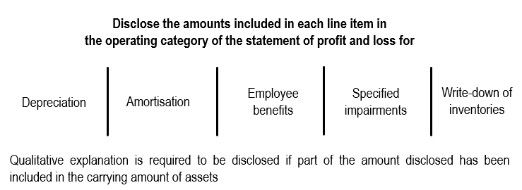
Disclosure of specified expenses by nature
Presentation and disclosure of expenses in the profit or loss
Under Ind AS 1, only nature-wise classification of expenses is permitted. While, under IAS 1, function-wise and nature wise both are permitted.
IFRS 18: Requires an entity to classify and present expenses in the operating category in line items in a way that provides the most useful structured summary of its expenses, using characteristics of nature or function or both.
Reason for no change: It is not a free choice of an entity to present the line items based on their nature or function. An entity needs to consider how to use the characteristic of nature and function to provide the most useful structured summary of its expenses.

Slide 26
Management-defined Performance Measures (MPMs)
Investors’ concerns
Investors find MPMs useful but they have concerns about lack of transparency of how these measures are calculated
Examples of alternative performance measures (APMs) or non-GAAP measures used today
Adjusted operating profit
Adjusted profit or loss
Adjusted EBITDA
Free cash flow
Return on equity

Slide 27
Management-defined Performance Measures (MPMs)
Subtotals of income and expenses not required or specifically exempted by Ind AS
Included in public communications outside financial statements
Measures that communicate management’s view of a company’s financial performance

Slide 28
Disclosures for MPMs
Ind AS 118 introduces requirements to disclose in a single note
  Reconciliation back to Ind AS-defined subtotal
  Explanation of why the MPM is reported
  Explanation of how the MPM is calculated
  Explanation of any changes to the MPM

Slide 29
Grouping – aggregation and disaggregation – of information
Investors’ concerns
some companies don’t provide enough detailed information
important information is obscured
Ind AS 118 introduces
enhanced requirements for grouping of information, including requirements for presenting and disclosing operating expenses
guidance on whether information should be in the primary financial statements or the notes
disclosures about items labelled as ‘other’

Slide 30
Principles of aggregation and disaggregation
Aggregate and disaggregate assets, liabilities, equity, income, expenses or cash flows into items:
based on shared characteristics;
disaggregate items based on characteristics that are not shared;
to present line items in the PFS to provide useful structured summaries;
to disclose information in the notes to provide material information and
ensure it does not obscure material information
Notes:
Characteristics such as nature, function, measurement basis or another characteristic such as frequency of occuring, location, size
B78 and B79

Slide 31
Aggregation, disaggregation and meaningful labels
Aggregate based on shared characteristics
Single dissimilar characteristic can be enough to disaggregate if resulting information is material
Use meaningful labels
use the label ‘other’ only when unable to find a more informative label
label as precisely as possible (eg ‘other operating expenses’)

Slide 32

Way forward IN VIEW OF PROPOSED IND AS 118
Schedule III of the Companies Act, 2013 is being revised to align with proposed Ind AS 118.
MCQs and Case Studies on Ind AS 118 are also being developed.
Other knowledge dissemination initiatives are also being undertaken on the proposed Standard.

Slide 33

Other recent initiatives

Slide 34
Other recent initiatives
Applicability of ‘Guidance Note on Financial Statements of Non-Corporate Entities’ and ‘Guidance Note on Financial Statements of Limited Liability Partnerships’ made mandatory for annual reporting periods 2025-26 onwards. FAQs for Non-Corporate Entities have already been issued. MCQs, Case Studies in this regard are under formulation.
Proposed Ind AS 119, Subsidiaries without Public Accountability: Disclosures, has been approved by the Council and recommended to the National Financial Reporting Authority (NFRA).
ASB is closely working with RBI, IRDAI, DoT, IBA, MCA, Govt. of India to provide inputs on various issues referred by them.
Under ICAI’s MoU with C&AG, the ASB is actively supporting training initiatives for C&AG officers in financial reporting standards. 9 residential programmes (4 for entry-level officers, 1 for Autonomous Body wing and 4 advanced programmes for senior officers), have been conducted with comprehensive background material prepared by ASB.

Slide 35


