Slide 1

Seminar on Ind AS - EIRC
Ind AS 117: Insurance Contracts
Speaker: CA Maithreyi Swaminathan
Independent Director
Chartered Accountant, India – Rank holder in both Inter and Final
Company Secretary, India – Silver Medallist, Rank holder in both Inter and Final
Social Auditor
Certificate Course on Oil and Gas Accounting, University of Texas at Dallas
Member of the ICAI Financial Reports Review Group, Technical Reviewer for ICAI Research Committee
Member of ICSI NIRC Women’s Empowerment Committee (2024)
Maithreyi Swaminathan has 3 decades of rich corporate experience in India and abroad working as CFO for large Fortune 500 corporations. She is the Founder of “Global ESG Advisors” providing consulting in various fields of Finance and ESG.
She is renowned for providing solutions to complex issues in the fields of accounting, compliance, reviewing ERP systems, conducting need assessment and training and helping her clients develop world class teams. She brings value to her clients through her strategic thinking and effective communication. She mentors a number of aspiring leaders to achieve their ambitions
Contact Number: +91 99115 43115 Email ID: my3swami@gmail.com

Slide 2
Ind-AS 117
Insurance Contracts

Slide 3
Agenda
Ind AS 104 vs Ind AS 117 – what has changed?
Ind AS 117 concepts
Measurement models
Presentation and disclosure
Transition and implementation challenges

Slide 4
Key features
Applies to all insurance
contracts (as against
insurance companies)
Far more prescriptive than Ind AS 104
Complex cash flow forecast, calculation of risk adjustment etc
More transparent and useful information
Better information about profitability
Comprehensive accounting model for all insurance contracts to measure them at current value, reporting estimated future payments on a discounted basis and using a discount rate that reflects the characteristics
of insurance cash flows

Slide 5
What is changing
Insurance Obligations and Risk
Insurance revenue
Insurance performance
More transparent and useful information
Reported on earned basis and
excludes deposit
Distinguish between
insurance service result and
investment result
Profits cannot be booked on Day 1

Slide 6
Ind as 117 journey till 2026

Slide 7
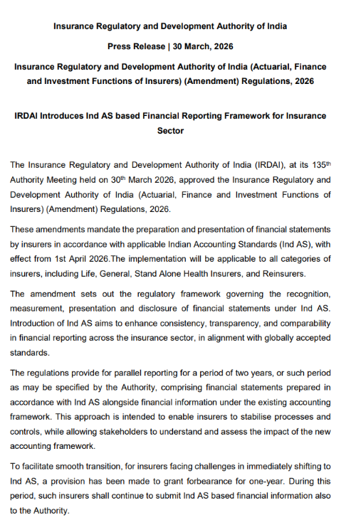
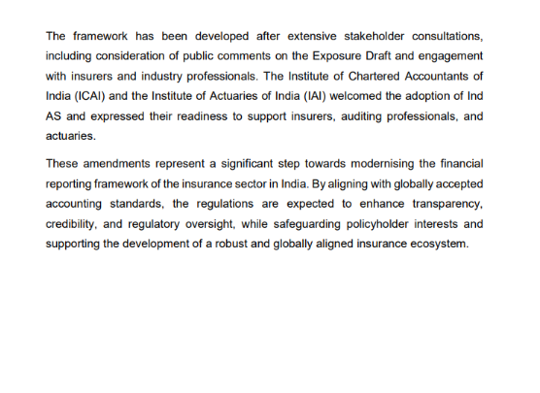
Ind AS 104 was included to ensure India’s standards were IFRS-compliant, but insurance companies were exempted due to IRDAI’s regulatory authority and pending IFRS 17 adoption. In practice, insurers never applied Ind AS 104, but its presence in the framework avoided a gap in convergence with global standards.

Slide 8

Ind as 117 vs ind as 104

Slide 9

Ind as 117 vs ind as 104

Slide 10
Ind-AS 117
Objective

Slide 11
objectives
To establish principles for :
-Recognition
-Measurement
-Presentation
-Disclosure
of insurance contracts

Slide 12
Ind-AS 117
Core Principles

Slide 13
Ind as 117 measurement models – which one when?
General Measurement Model
Variations to the General Measurement Model
-Default approach
-Used at transition and at live/production
-Both life and general insurance
-Aka BBA (Building Blocks Approach)
Variable Fee Approach (Mandatory)
(Insurance Contracts with Direct Participation Features)
Premium Allocation Approach (Optional)
(Liability for Remaining Coverage)
MUST be used if at inception of a contract:
Policyholder contractually participates in clearly identified pool of underlying items &
Policyholder receives substantial share of the returns on underlying items &
Changes in policyholder returns vary substantially with changes in underlying items.
MAY be used if at inception of group:
No material difference to GMM or
(ii) Coverage period of group is max one year (Many GI contracts and annual renewal life contracts)
(Note: Other preferences may also impact the decision)

Slide 14
Ind as 117 measurement models – illustrative examples of product types
General Measurement Model
Variations to the General Measurement Model
Long Term Business
Life examples:
Whole life
Term assurance
Protection
Annuities
Reinsurance written
Non Life examples
Multi-year motor
Warranty cover
Adverse development cover/Loss Portfolio transfers
Variable Fee Approach (Mandatory)
(Insurance Contracts with Direct Participation Features)
Premium Allocation Approach (Optional)
(Liability for Remaining Coverage)
Unit Linked (UL)
Variable Annuity (VA) and equity index-linked contracts
Unitised with profits
• Short term general insurance business
• Short term life and certain group contracts
Judgements re possible breaches of VFA
requirements:
• For VA, guarantee aspects.
• For UL, if death benefit sufficient to justify insurance contract treatment.
Judgements re possible breaches of PAA
requirements:
• For annual renewable business, whether guarantee at renewal date

Slide 15
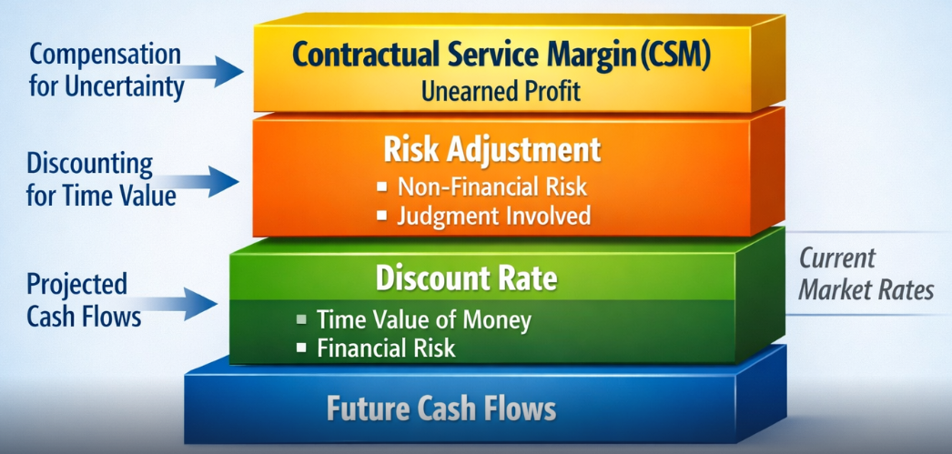
Building blocks approach

Slide 16
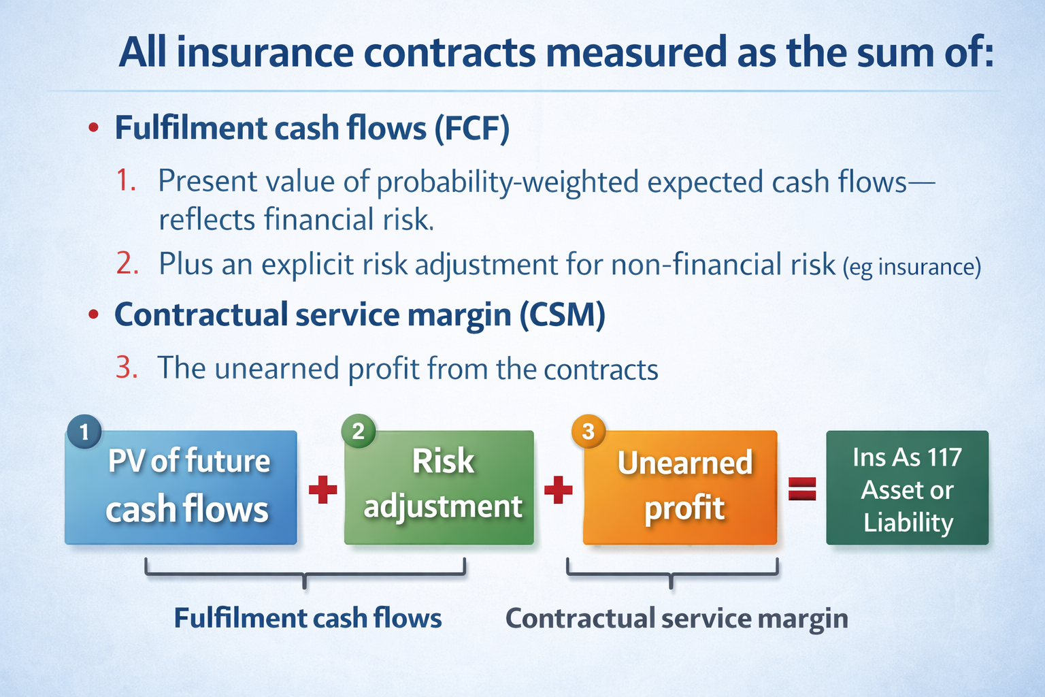

Slide 17
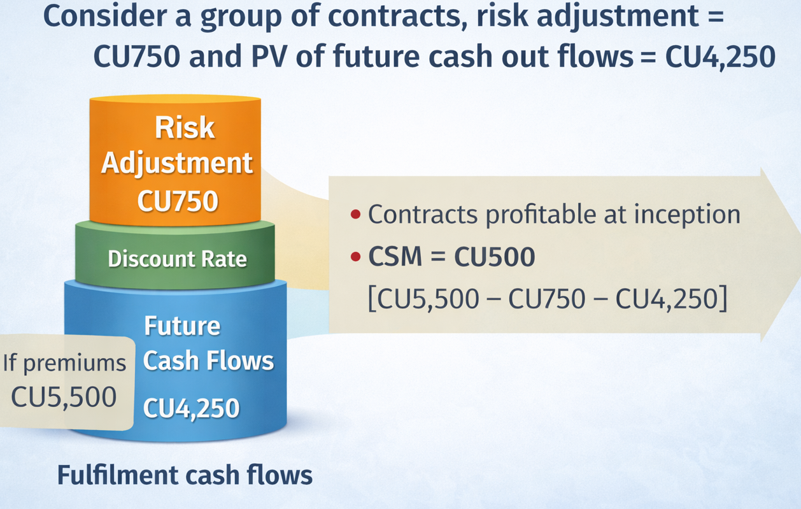
Ind as 117 contractual service margin – initial recognition

Slide 18

Coverage units
The release of CSM is over the coverage period based on ‘Coverage Unit’
Accordingly, the CSM amount to be recognized in P&L in a reporting period is determined based on ‘Coverage Units provided in the period’
CSM amount is allocated EQUALLY to each Coverage Unit
Recognize Profit as it is ‘earned’ (by spreading the CSM over time)

Slide 19
Ind as 117 balance sheet basics

Slide 20
Ind as 117 Profit and loss basics

Slide 21
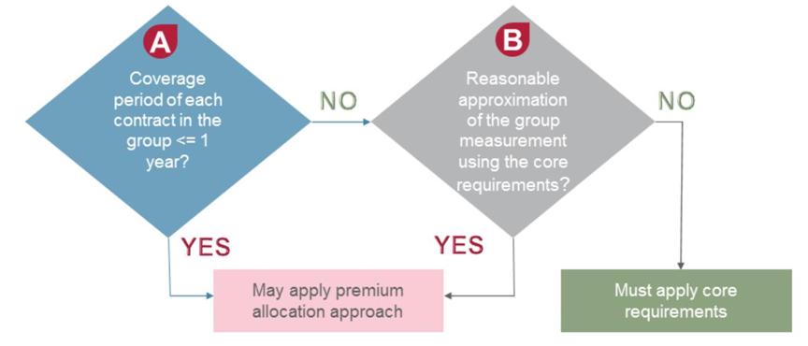
Premium allocation approach – eligibility criteria

Slide 22
PAA – what are the simplifying options?
Para 56
Para 59(a)
Para 59(b)
No adjustment of LFRC for time value of money
Recognition of insurance acquisition cash flow as expense when incurred
No adjustment of PVFCF for incurred claims for time value of money
Option
Lack of significant financing component
Coverage period of each contract less than a year
Claims cash flows expected to be paid in less than a year
Condition

Slide 23
Insurance contracts with direct participation benefits – condition for VFA
Policyholder participates in a share of a clearly identified pool of underlying items;
Policyholder gets a substantial share of the fair value returns on the underlying items;
Change in the amounts to be paid to the policyholder vary with the change in fair value of the underlying items

Slide 24
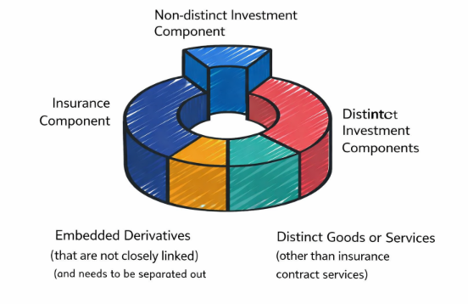
Separating non insurance components
- Ind AS 117 requires an entity to identify and separate ….. non-insurance components within an insurance contract - This is because these non-insurance components need to be accounted for under other Ind ASs
- Ind AS 117 requires an entity to identify and separate ….. non-insurance components within an insurance contract - This is because these non-insurance components need to be accounted for under other Ind ASs
Para 10 to 13 (r/w Para B31 to B35)
Para 10 to 13 (r/w Para B31 to B35
Ind AS 117 requires an entity to identify and separate non-insurance components within an insurance contract- This is because these non-insurance components need to be accounted for under other Ind ASs
Ind AS 109 – Distinct investment components and embedded derivatives that are not closely linked
Ind AS 115 – Distinct goods and services
Ind AS 117 – Insurance component
- Non distinct investment component - VFA

Slide 25
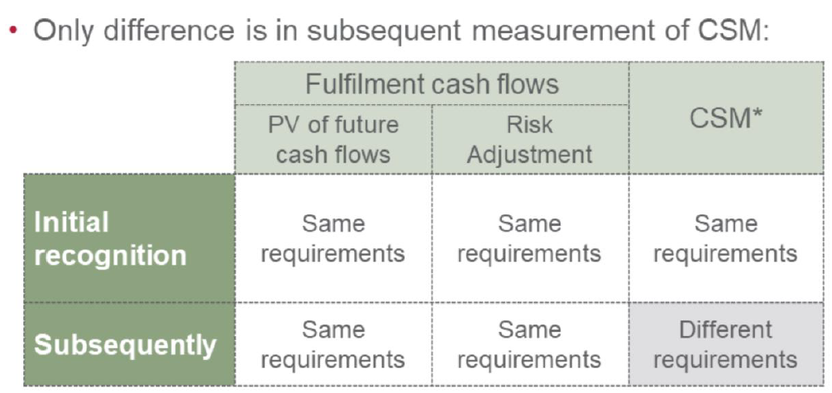
Core requirements vs vfa

Slide 26
Ind-AS 117
Level of aggregation for grouping insurance contracts

Slide 27
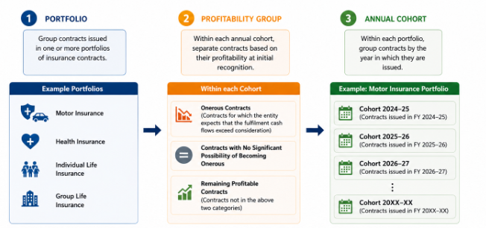
Initial recognition
Para 14-24

Slide 28


Why are insurance contracts grouped?
Typically contracts are recognized and measured at individual level
Insurers usually rely on issuing a number of similar contracts to manage risk (risk pooling). Accounting for individual contracts may not reflect this.
Aggregation cannot happen at a very high level, otherwise accounting treatment for profit and loss cannot be separately captured, recognized and measured

Slide 29
Ind-AS 117
Transition approaches

Slide 30
Transition approach
1. Full retrospective (preferred)
2. Modified retrospective (practical relief)
3. Fair value (when historical records not available)

Slide 31
Ind-AS 117
In Conclusion

Slide 32
Professional judgements
Discount rates
Expected cash flows
Risk adjustment
CSM release pattern
Experience adjustments
Onerous contracts

Slide 33
Practical issues
Actuarial dependency
System changes
Data quality
Coordination between finance and actuarial teams
Internal controls
Audit implications
Regulatory reporting alongside financial reporting

Slide 34
What to remember
Ind AS 117 is principle-based, not rule-based.
Profit is deferred through the CSM.
Current estimates drive measurement.
Expected cash flows replace historical assumptions.
Risk Adjustment is explicit.
Discounting is mandatory.
Grouping and annual cohorts are fundamental.
PAA is a simplification, not the default.
Actuarial and finance functions must work together.
Judgments, controls, and disclosures are as important as calculations.

Slide 35


Faculty Contact Details: my3swami@gmail.com
+91 99115 43115

