Slide 1

The AI Ready
Chartered Accountant
Presented by
CA Sanjib Sanghi, CCM, ICAI

Slide 2

What is AI — and why does a CA need it?
AI in one line -
Machines performing tasks that normally require human intelligence -
learning, reasoning, prediction, language and decision support.
Why CAs should care
01
Data volume
02
Client expectations
03
Quality & risk
04
Advisory shift
AI will not replace the CA who thinks. It will expose the CA who refuses to learn.
Notes:
Use this slide to demystify AI. Emphasize that AI is a professional assistant, not a magic wand.

Slide 3
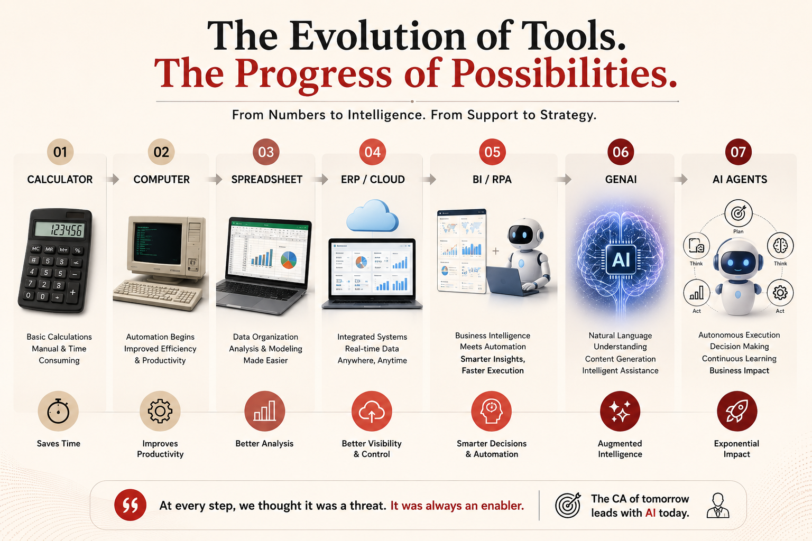
If every technology increased the value of accountants, why should AI be any different
Common reaction at each stage
It removed drudgery, improved speed and lifted expectations.
Reality
“Will this reduce our role?”
Notes:
Tell the story as a cycle: fear, adoption, productivity, new services. AI is the next turn of that cycle.

Slide 4
What AI can replace vs what it cannot
AI CAN REPLACE / REDUCE
THE HUMAN EDGE
✓ Repetitive data entry
★ Professional judgement
✓ First draft of letters/replies
★ Ethical responsibility
✓ Basic reconciliations
★ Client trust & empathy
✓ Pattern detection & anomaly flags
★ Negotiation & leadership
✓ Summaries of long documents
★ Contextual interpretation
✓ Standard checklists and reminders
★ Accountability before law/regulator
AI gives answers.
A CA must ask: Is it correct? Is it complete? Is it compliant? Is it commercially sensible?
Notes:
The profession must not compete with AI on speed. Compete on judgement, integrity and problem framing.

Slide 5
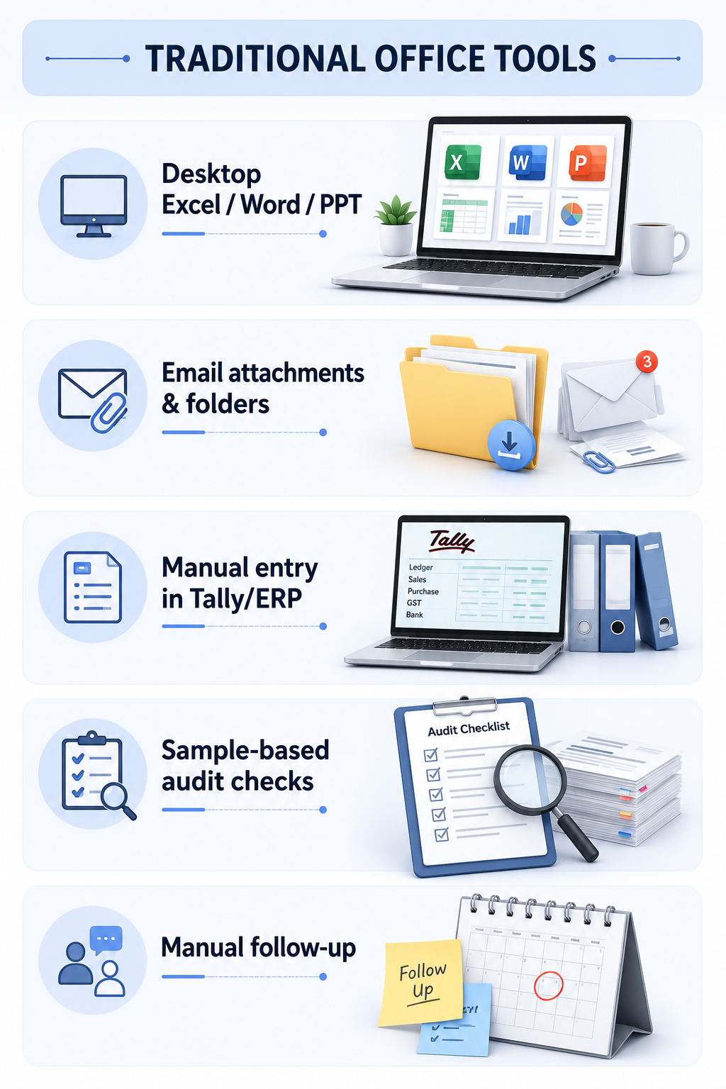
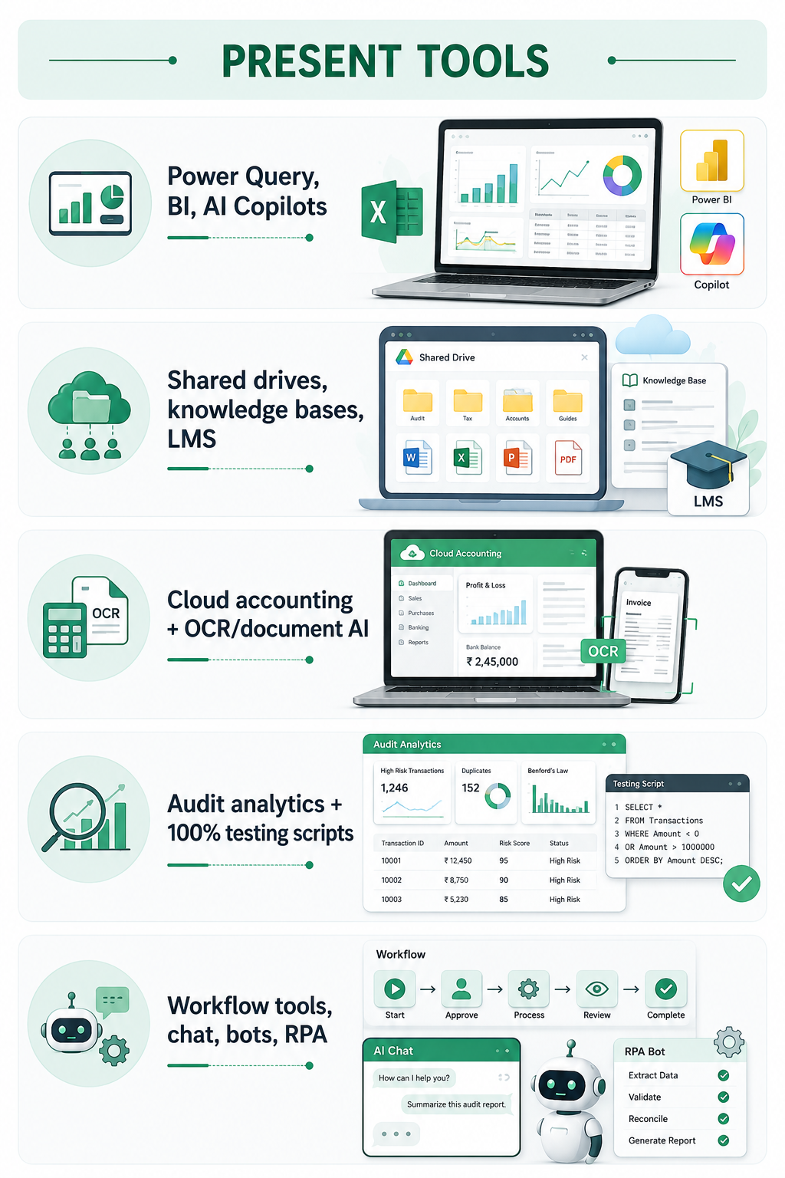
Office tools have changed — so must the use cases
USE CASES FOR CA OFFICES
Automated MIS, variance reports, dashboards
Central templates, client trackers, training repository
Invoice capture, bank feeds, GST/e-way matching
Exception reports, risk scoring, fraud indicators
Due-date reminders, document collection, status dashboards
Notes:
Frame the adoption question around use cases, not tool names. Tool names will change; process thinking will remain.

Slide 6
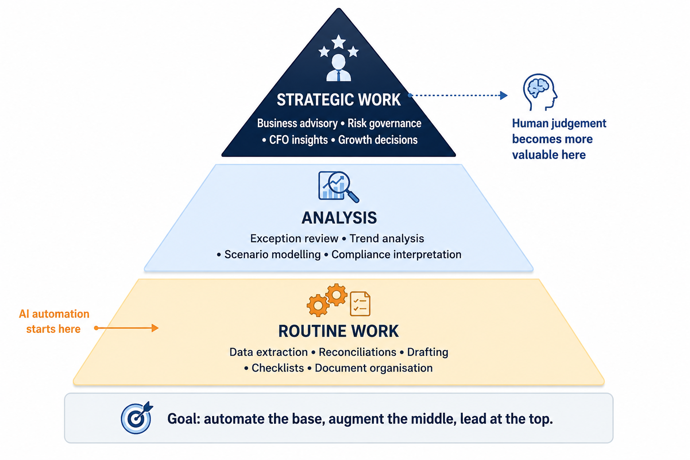
The CA Value Pyramid
Notes:
This is the central message of the presentation: not fewer CAs, but more strategic CAs.

Slide 7
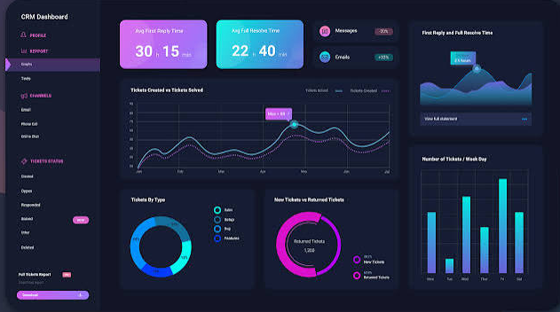
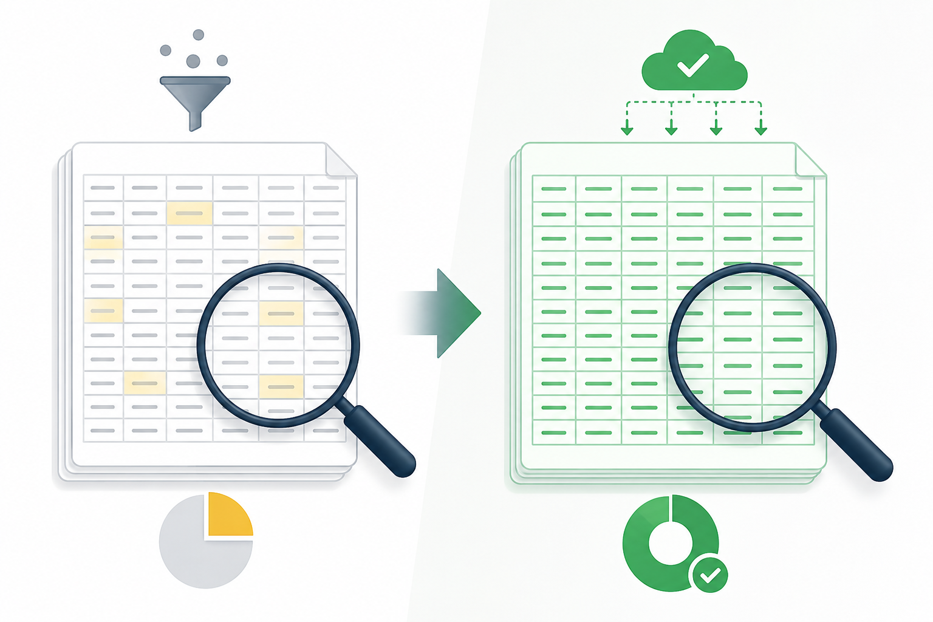
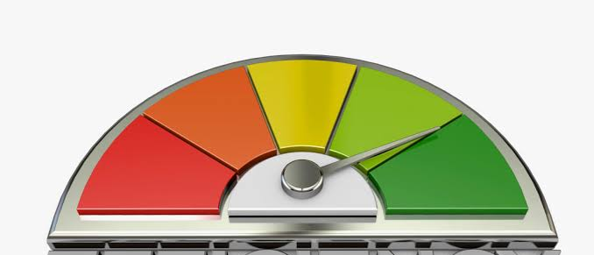
From sampling to 100% testing — the audit lens changes
EFFICIENCY
VISUALISATION
DATA COVERAGE
Less time on repetitive extraction, matching, drafting and formatting.
Dashboards turn ledgers and transactions into trends, risks and questions.
Move from sample testing to full-population checks and anomaly reports.
Save hours
See faster
Test deeper
Before: “Which samples should we check?”
Now: “Which exceptions require judgement?”
Notes:
Do not overpromise. AI is not a substitute for audit evidence and scepticism, but it changes the coverage and speed of risk identification.

Slide 8
The AI-ready skill stack
01
Prompt engineering
02
APIs & connectors
Ask better questions, provide context, define role, format, boundaries and verification.
Connect ERP, GST, banks, documents, CRM and dashboards into live workflows.
03
Curiosity
04
Process Understanding
Keep experimenting; today’s “nice to have” becomes tomorrow’s basic expectation.
Know the process before automating it. A messy process becomes faster chaos.
05
Domain knowledge
06
Business understanding
Tax, audit, law, accounting standards and ethics are the control layer.
Convert output into decisions, priorities, cash flow and risk conversations.
Formula: AI Readiness = Curiosity × Domain Knowledge × Process Clarity × Governance
Notes:
Prompt engineering is not typing clever sentences. It is structured thinking. APIs are not for tech teams only; they are the new plumbing of professional work.

Slide 9
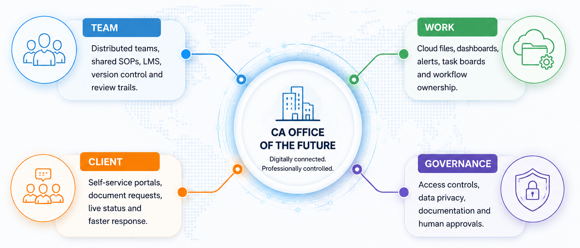
The world is connected — work must be connected too
Notes:
Add a governance warning: connected does not mean careless. Data access, confidentiality and professional standards must be designed into workflows.

Slide 10
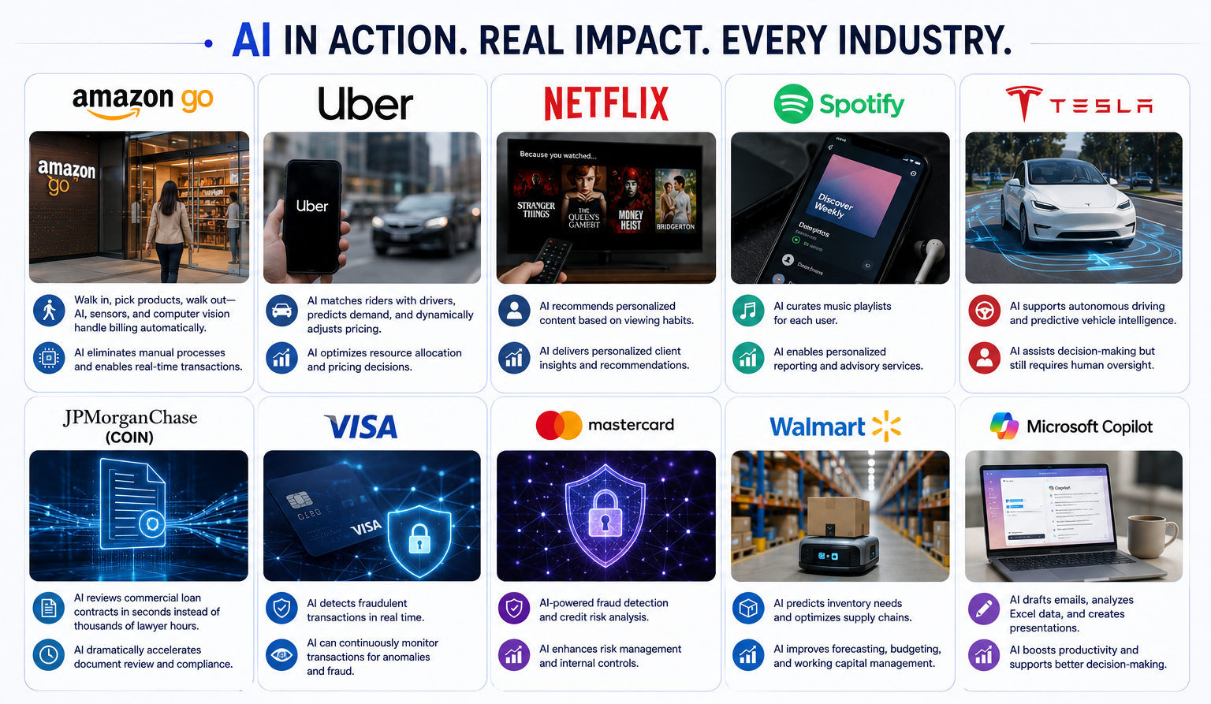

Slide 11


Slide 12
AICA pathway: Learn, Implement, Lead
LEVEL 1
LEVEL 2
LEVEL 3
Foundation & practical literacy
Implementation & consulting capability
Future advanced pathway
AI basics, prompt engineering, RAG, ML/data, automation, Excel AI, finance/audit use cases, ethics and connectors.
Advanced AI skills to design and deploy AI solutions at client offices; AI agents, connectors/MCP, app integrations, computer vision, workflow automation, dashboards, offline GPTs and capstone work.
Official Level 3 syllabus/details are awaited; position it as the next step for advanced specialisation once announced.
CA Members must take advantage of this exceptional course.
10
Notes:
Use this slide as a call to action: start with Level 1, build one office use case, document the process, and then go deeper through Level 2 and beyond.

Slide 13

The Future CA will not do more work
The Future CA will make AI do more work
Ask yourself this – If AI becomes free tomorrow, what is my value?
Never forget your Human edge in the AI era! That is your CA Value!

