Slide 1


Power BI

Slide 2




Excel

Slide 3

What is Power BI ?

Slide 4
What is Power BI ?
Power BI is a collection of software services, apps, and connectors that work together to turn your unrelated sources of data into coherent, visually immersive, and interactive insights. Your data might be an Excel spreadsheet, or a collection of cloud-based and on-premises hybrid data warehouses.
Power BI lets you easily connect to your data sources, visualize and discover what's important, and share that with anyone or everyone you want.

Slide 5

Who is more Powerful ?
Excel

Slide 6
Who is more Powerful ?
Excel
Easy to Learn
Data Size
Cost Effective
Cloud Base
Visualizations
More Security

Slide 7
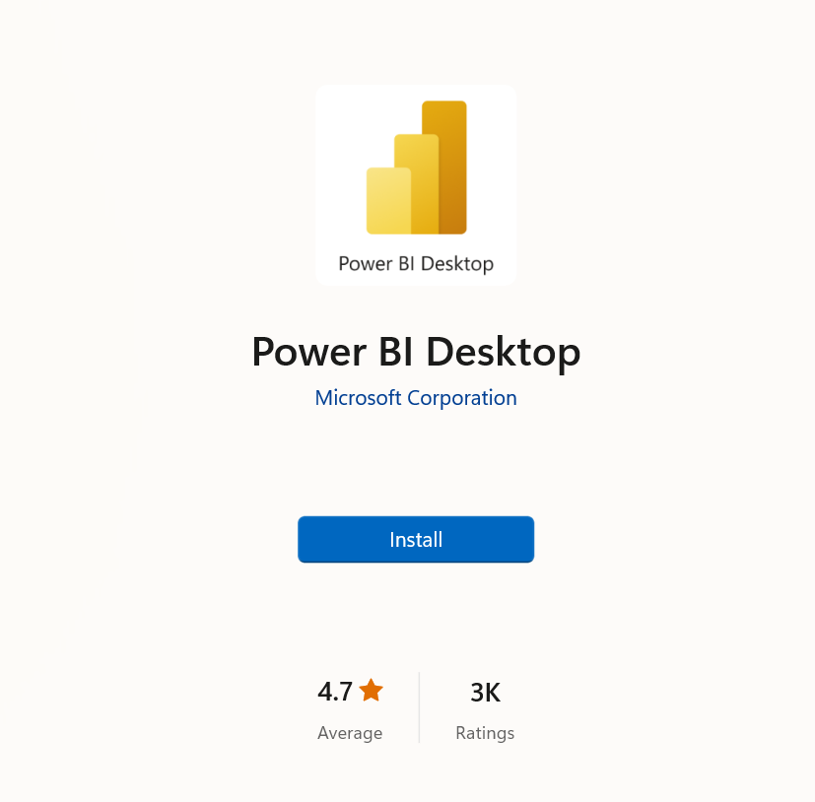
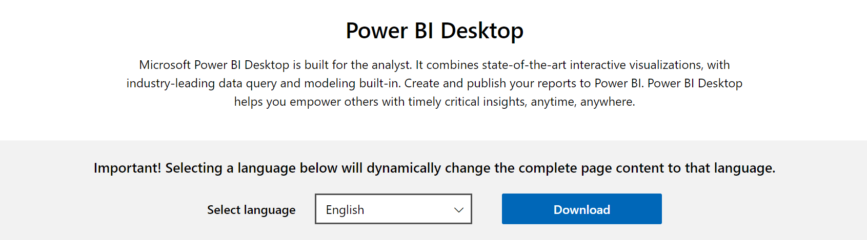
Downloading Power BI
https://powerbi.microsoft.com/en-us/downloads/

Slide 8
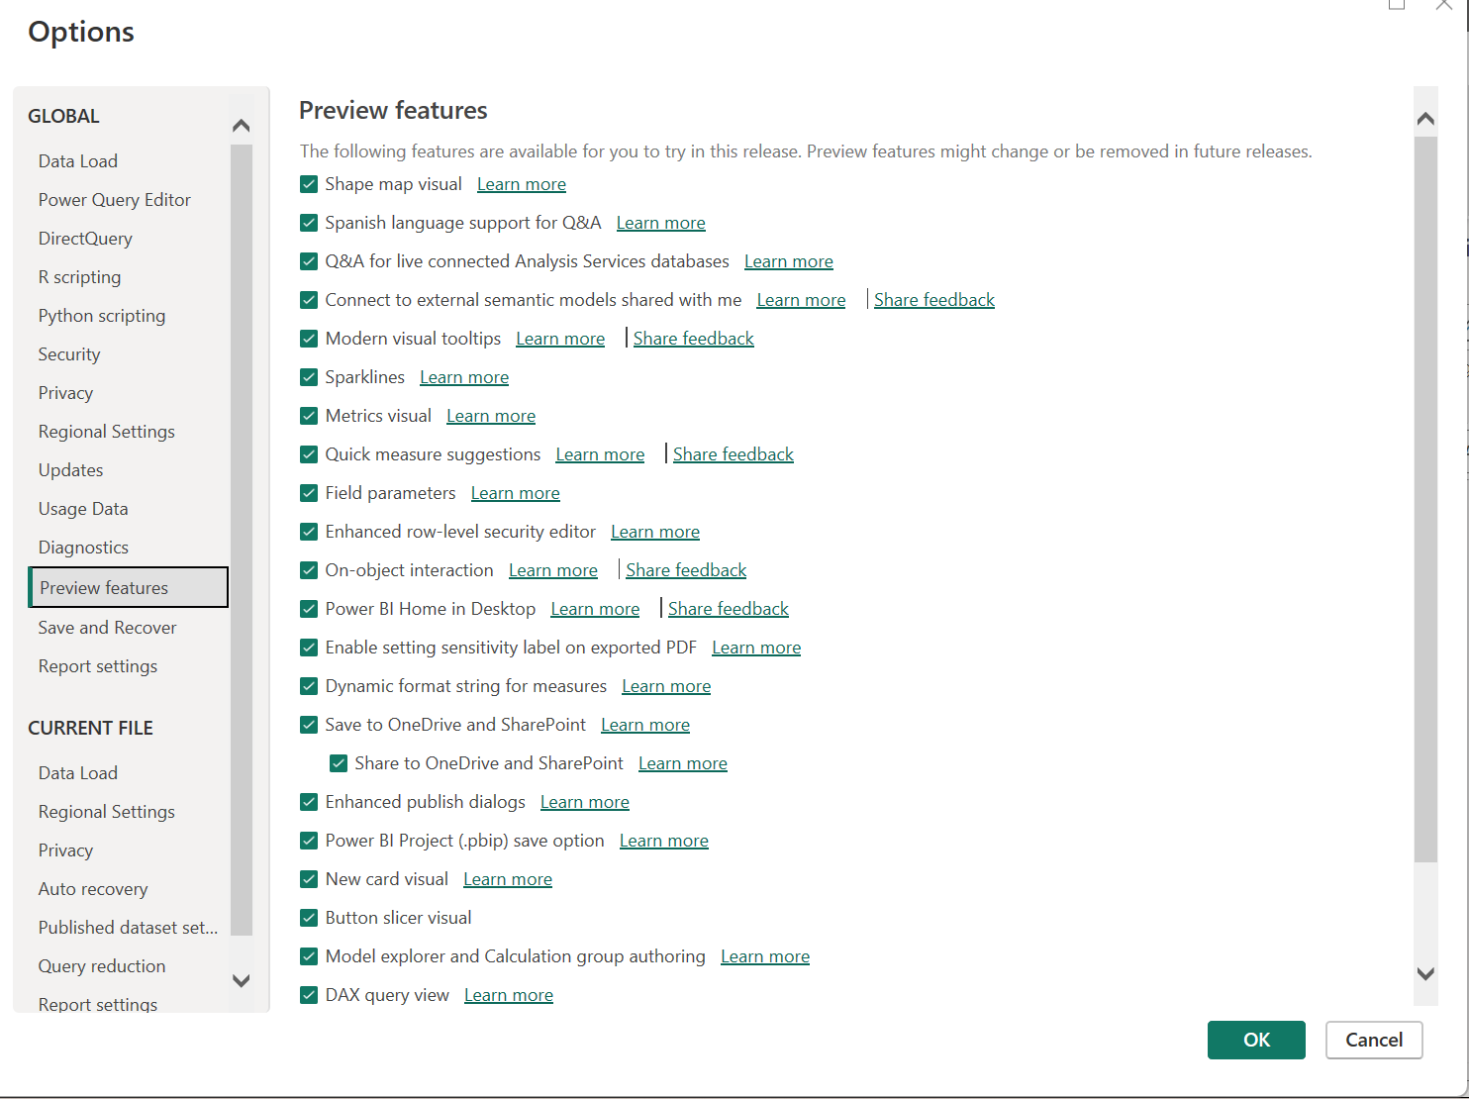
Two Setting after opening BI
Global → Preview features
Select all

Slide 9
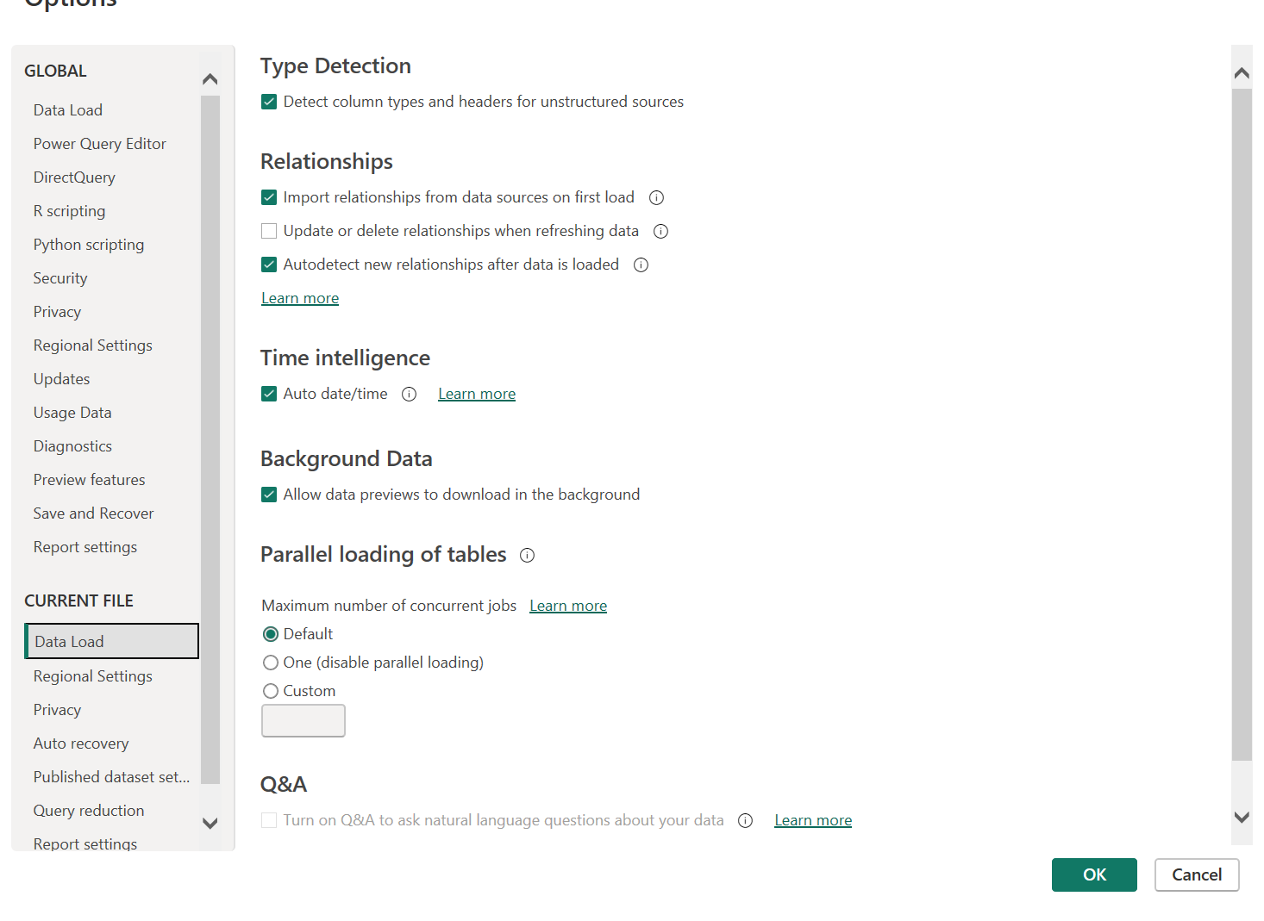
Two Setting after opening BI
Global → Preview features
Current file→ Data load
Select all
Deselect 2

Slide 10
Front end and Backend
Front end
Data, Model and Report
DAX
Back end
Power Query

Slide 11
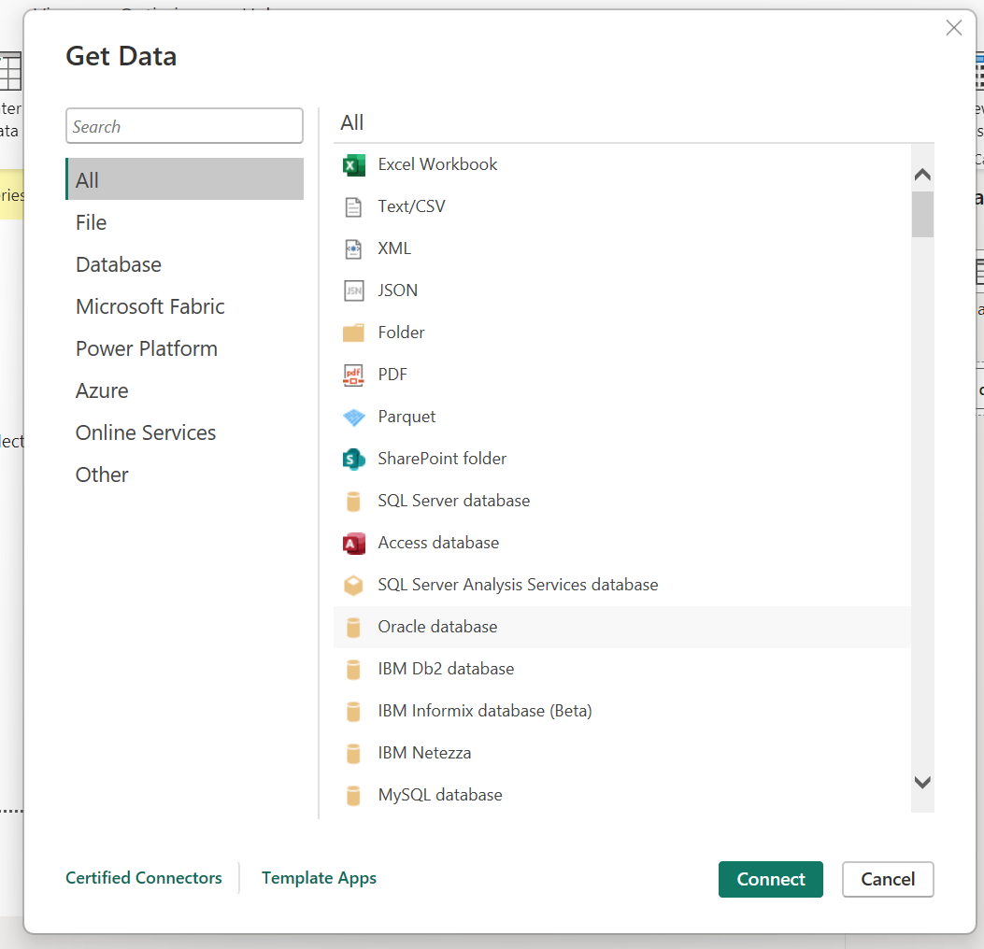
Type of Data connectors

Slide 12

Basic Concept
Load
Transformation

Slide 13
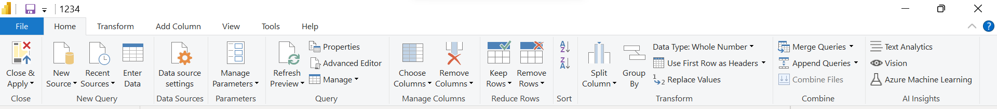
Power Query Editors
Also available in Excel

Slide 14
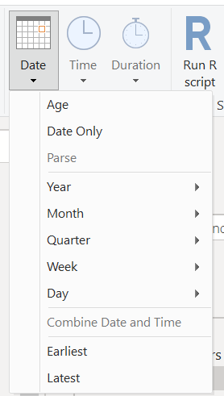
Date tools

Slide 15


Basic Concept
Raw
Data
Meaningful
Data

Slide 16
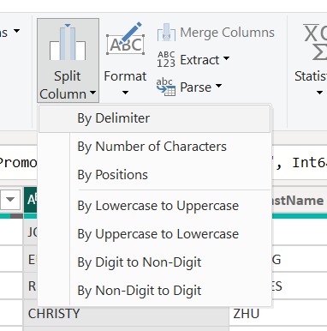
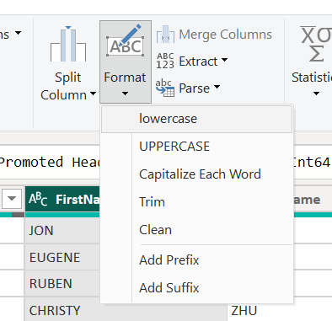
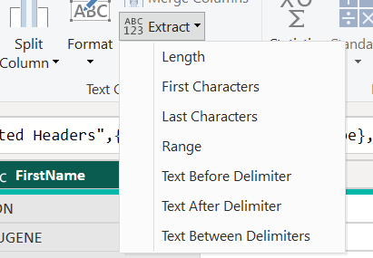
Text tools

Slide 17
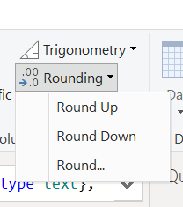
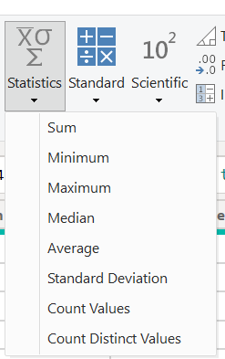
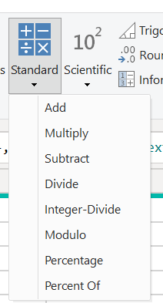
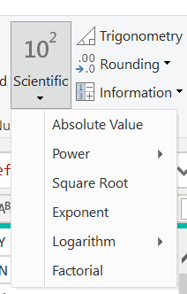
Number tools

Slide 18
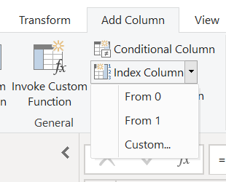
Index columns
Index column

Slide 19
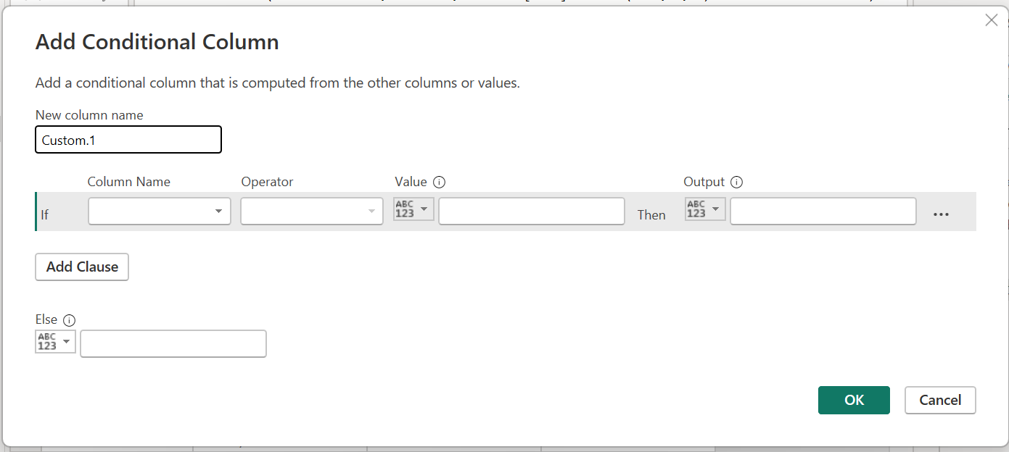
Conditional columns
Conditional column

Slide 20
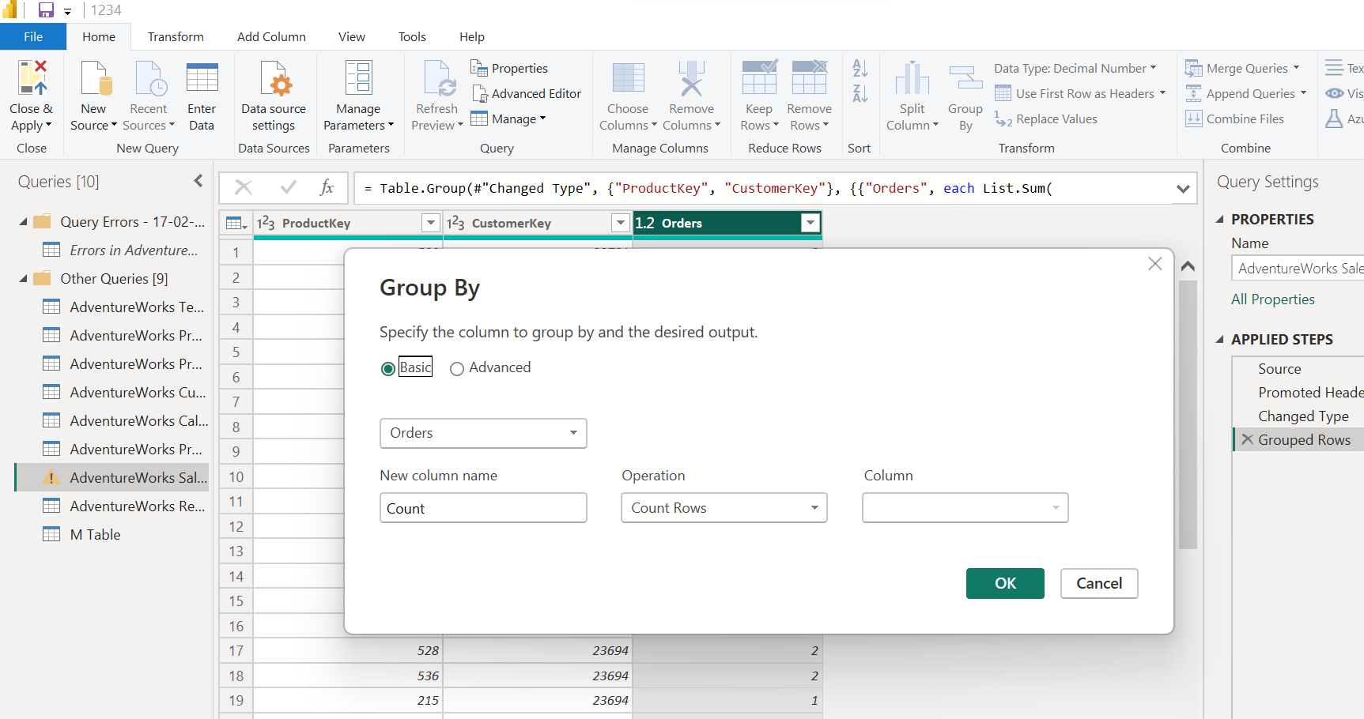
Group by and Aggregating

Slide 21
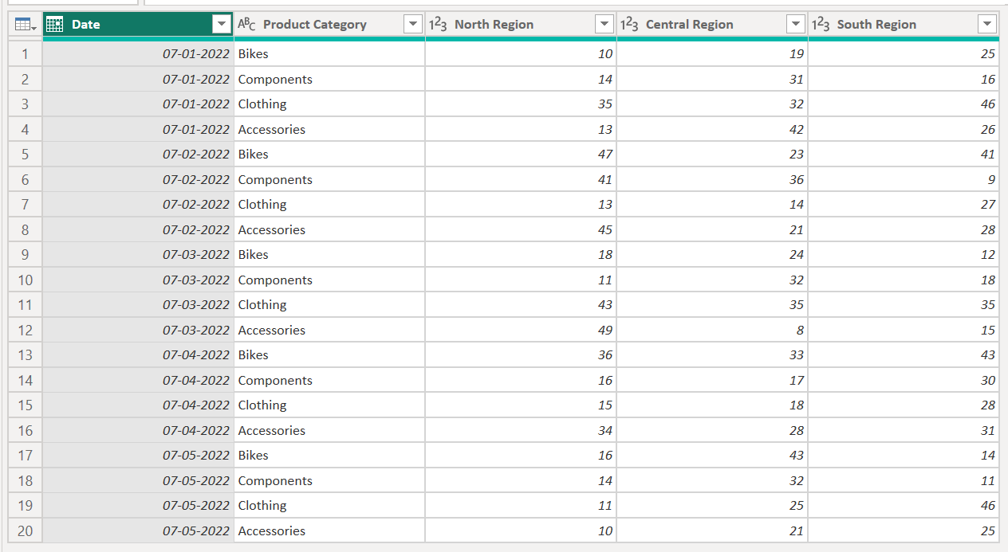
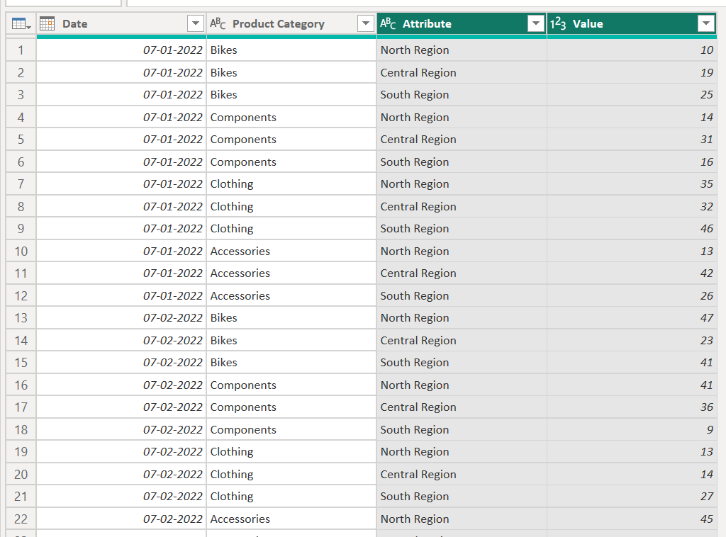
Pivot and Unpivot
UnPivot
Pivot

Slide 22
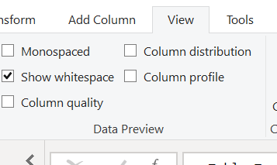
Column Profile

Slide 23
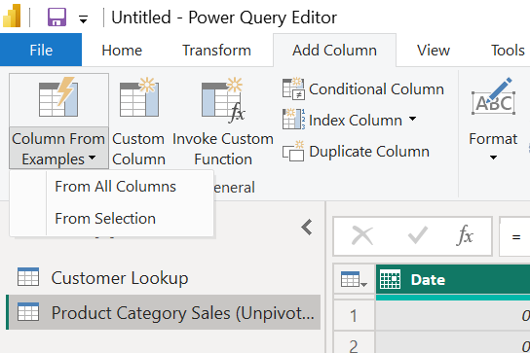
Column By Examples

Slide 24
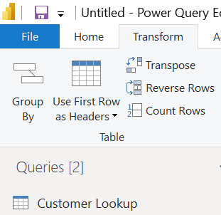
Promoted Headers

Slide 25
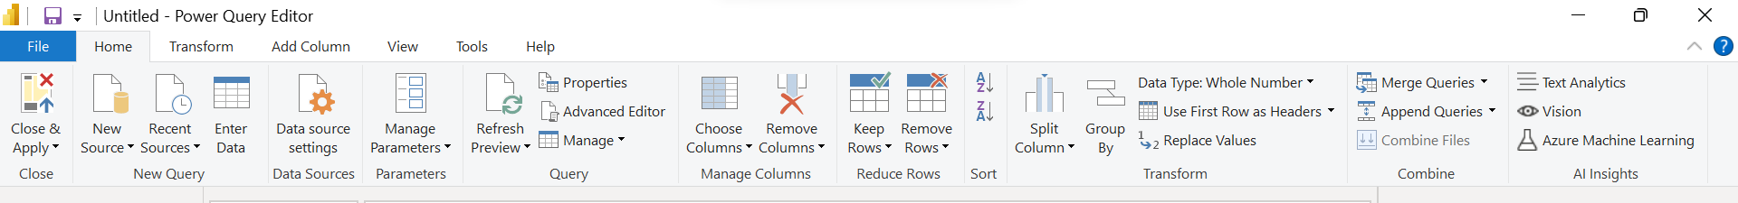
Merging and Appending Queries
Merging queries This means that data is added to the matching rows in the base or first table from the second and subsequent tables. (Merging adds columns to an existing table/query)
Appending Queries Rows will be appended one after the other. (For example, appending a query with 150 rows with another query with 250 rows will return a result set of 400 rows). (Merging adds rows to an existing table/query)

Slide 26
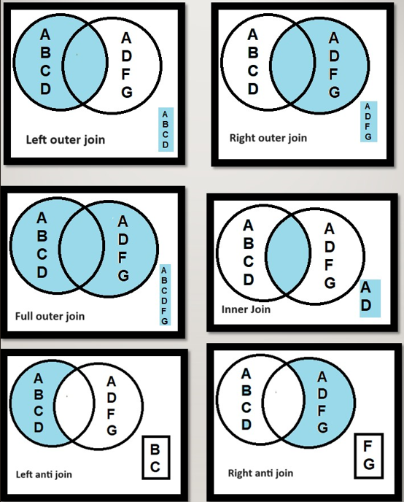
Merging and Appending Queries (Contd..)

Slide 27
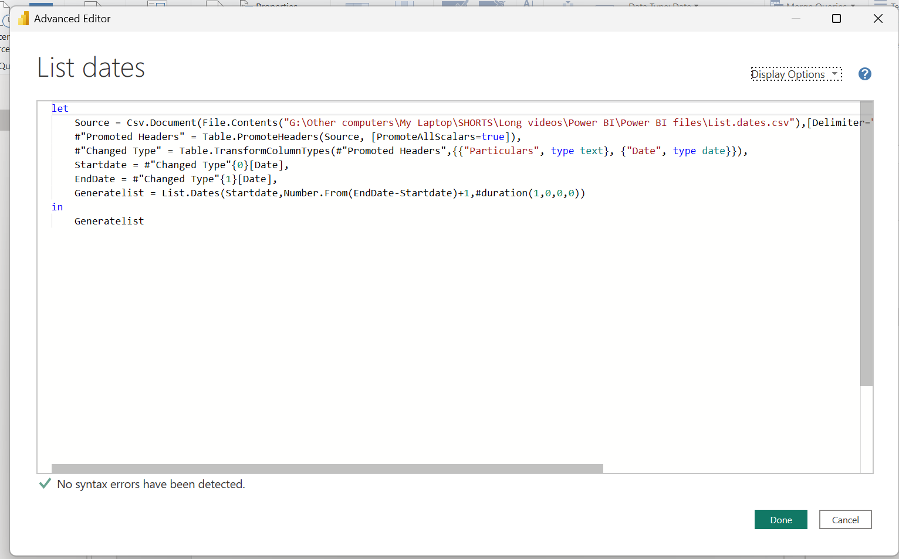
Advance editor

Slide 28


Power Query Pros

Slide 29
Power Query Pros
Unpivot
Split Data into rows
Build Once and Refresh

Slide 30
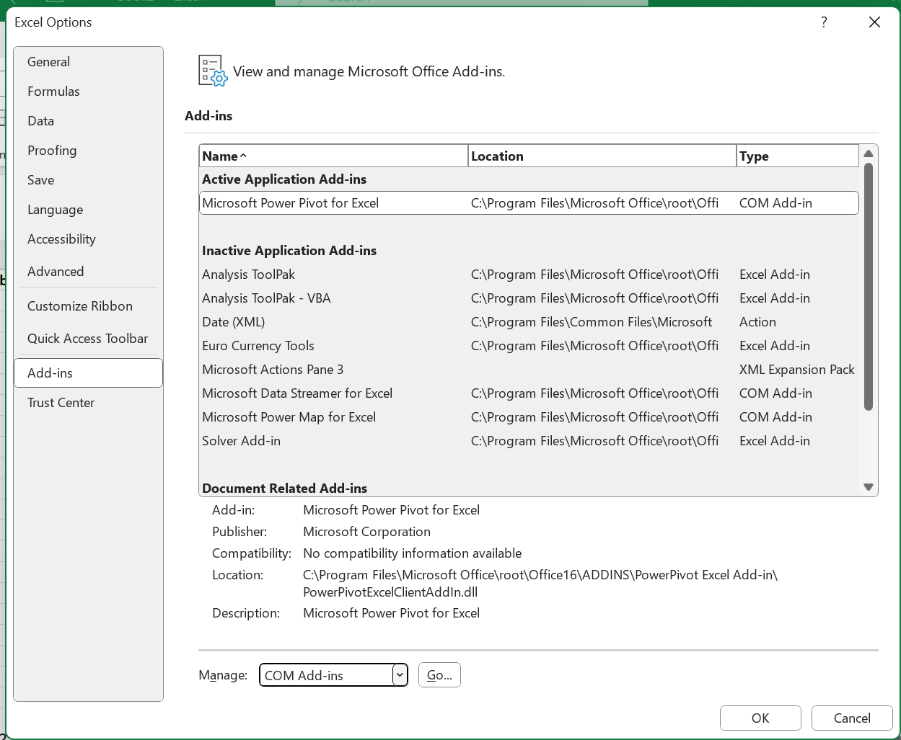
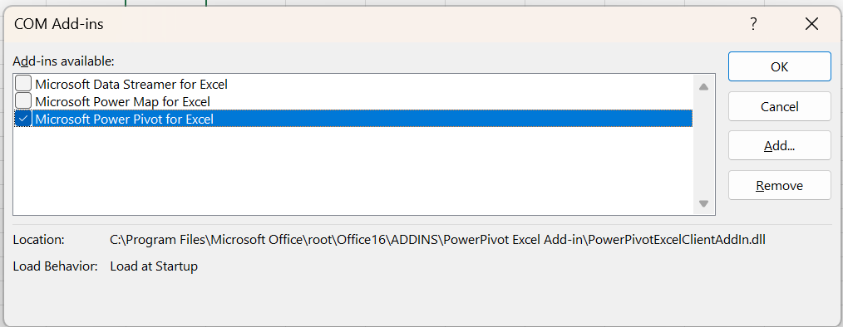
Power Pivot

Slide 31
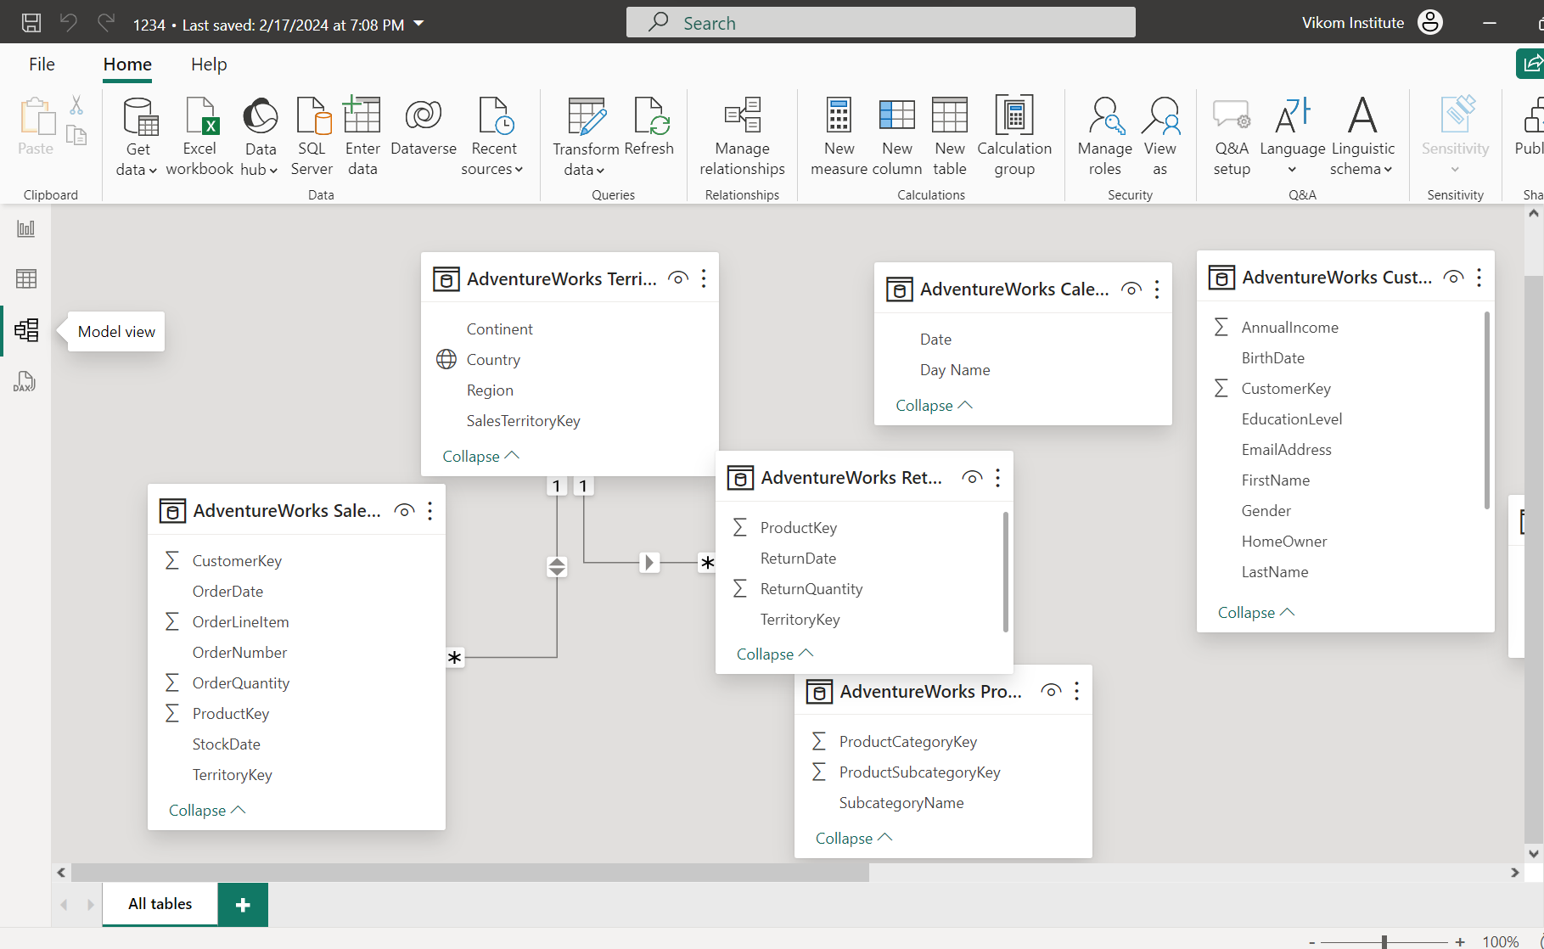
Manage Relationship

Slide 32
Manage Relationship (Contd)
The four options, together with their shorthand notations, are described in the following bulleted list:
One-to-many (1:*)
Many-to-one (*:1)
One-to-one (1:1)
Many-to-many (*:*)
Primary Key – Unique record
Foreign key – Many side of relationship

Slide 33
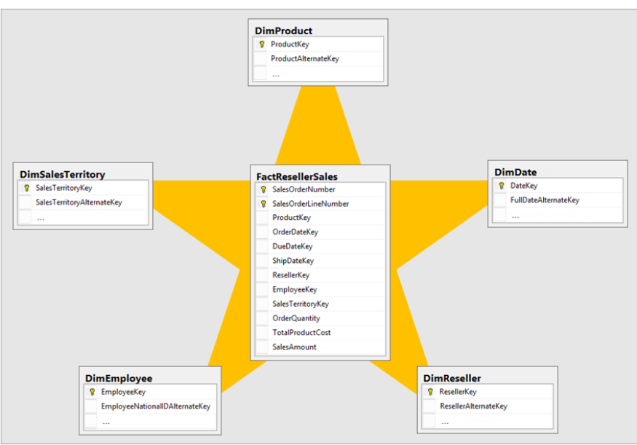
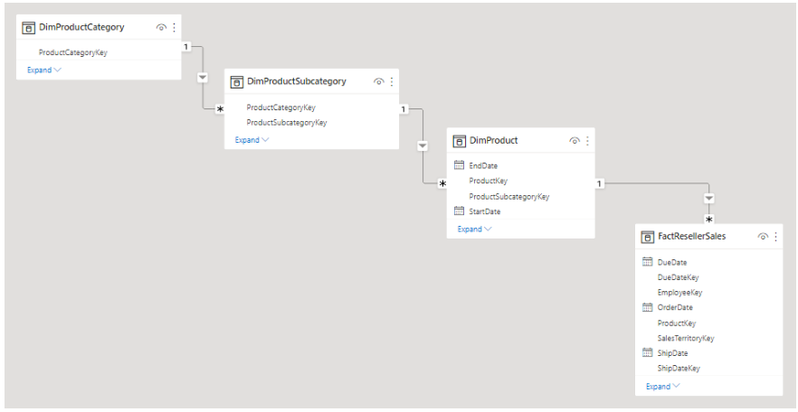
Manage Relationship (Contd)
Snow Flake overview
Star schema overview

Slide 34
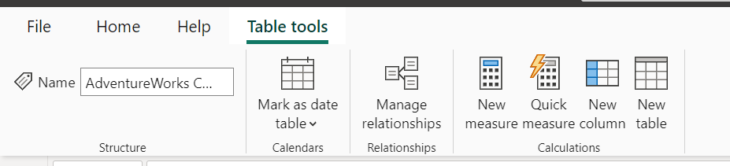
Calculated Column (New Column)

Slide 35
Power BI Functions

Slide 36
Power BI Functions (Contd..)
Note : While the list I provided is quite comprehensive, there may indeed be additional functions not covered here. For the most accurate and up-to-date information on Power BI functions, I recommend consulting the official Microsoft documentation.
You can find the official documentation for Power BI functions on the Microsoft website at the following link: Power BI DAX Function Reference
This documentation provides a complete list of functions along with detailed explanations, syntax, parameters, and examples of usage. It's the most reliable source for information on Power BI functions.

Slide 37
Operators

Slide 38
If function (Income Tax)
0 Tax
(I-2.5L)*5%
(I-5L)*20% + 12500
(I-10L)*30% + 112500
0
2.5L
5L
10L

Slide 39
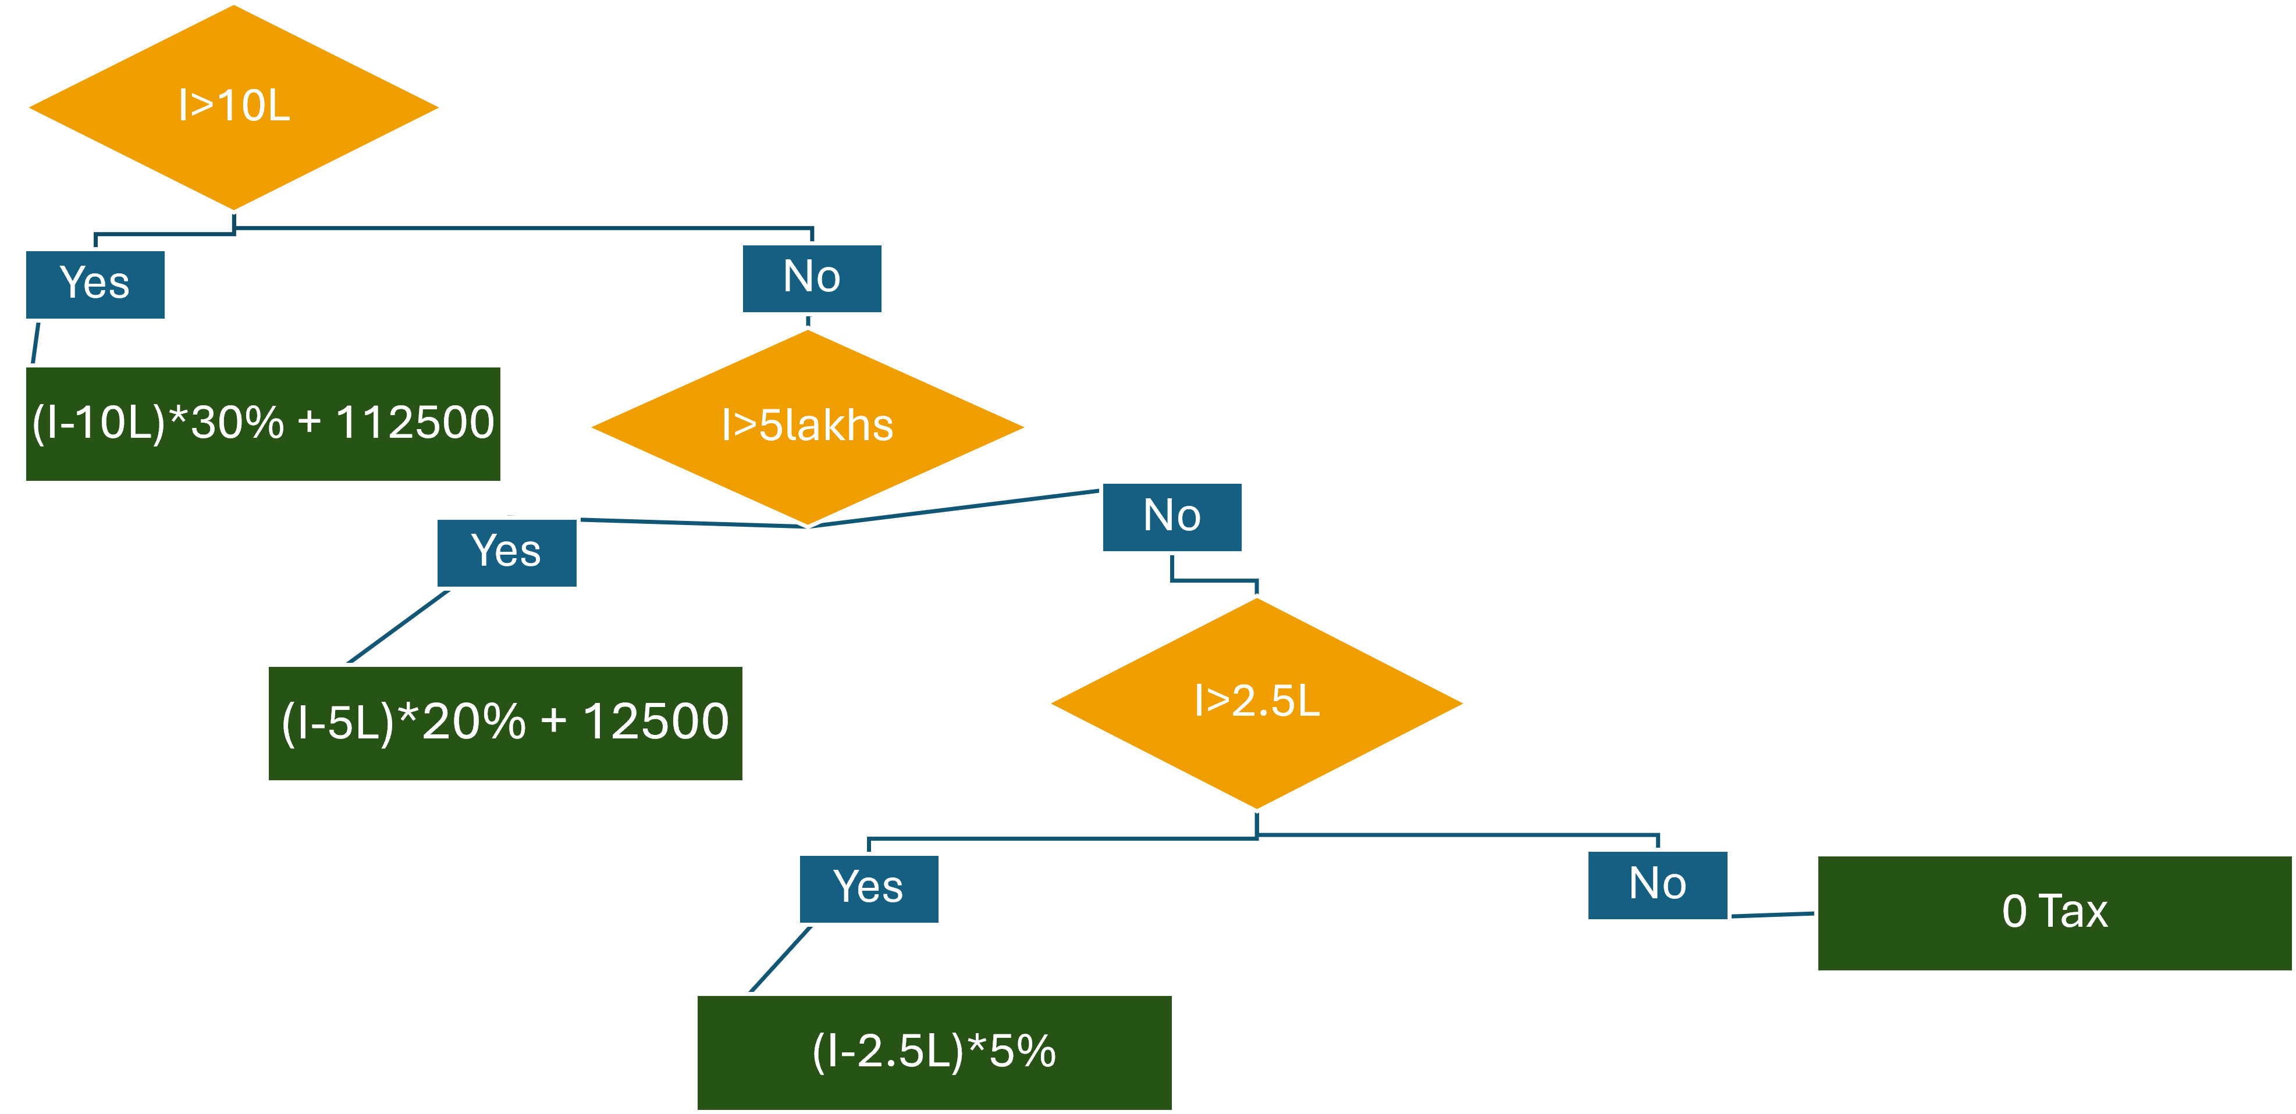
If function (Income Tax)

Slide 40
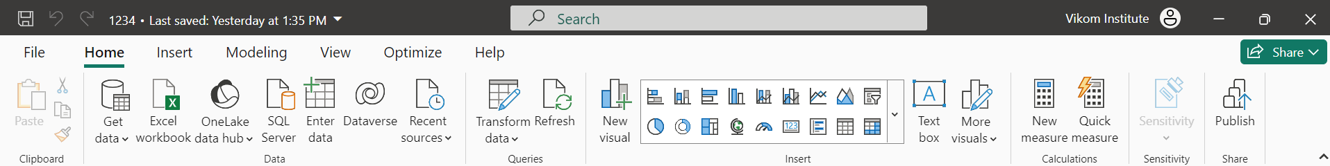
Measures

Slide 41
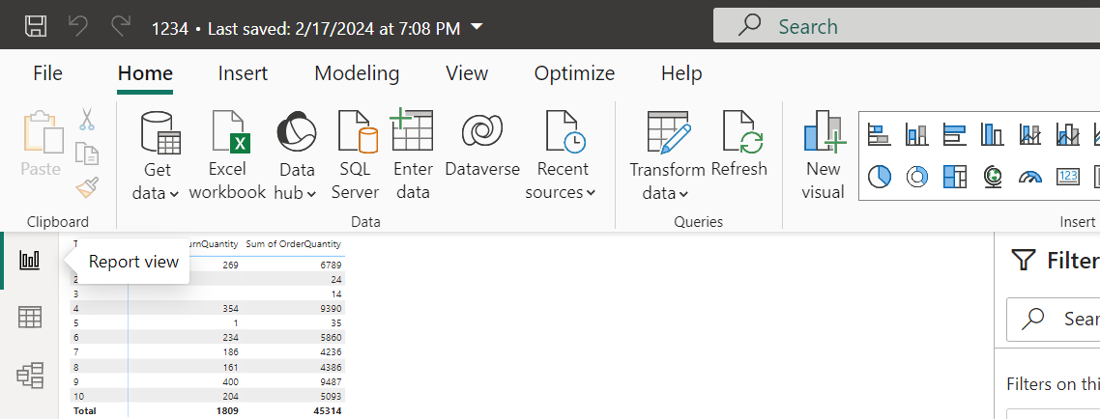
New Table

Slide 42
Very Important Functions (DAX)
Very Important
Calculate
Related
All

Slide 43
Related Function (DAX)
Like a Vlookup and Xlookup
Fetch Data from another Table

Slide 44
Calculate Function (DAX)
Evaluating an expression in a modified filter context. Only apply to measure

Slide 45
All Function (DAX)
Returns all the rows in a table, or all the values in a column, ignoring any filters that might have been applied. This function is useful for clearing filters and creating calculations on all the rows in a table.

Slide 46
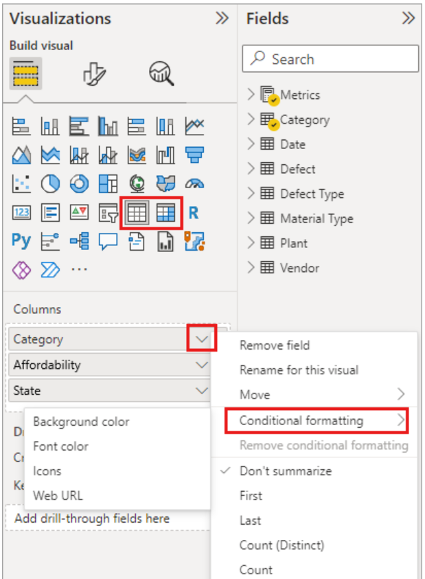
Conditional Formatting
To apply conditional formatting, select a Table or Matrix visualization in Power BI Desktop or the Power BI service. In the Visualizations pane, right-click or select the down-arrow next to the field in the Values well that you want to format. Select Conditional formatting, and then select the type of formatting to apply.
Conditional formatting overrides any custom background or font color you apply to the conditionally formatted cell.
Source : https://learn.microsoft.com/en-us/power-bi/create-reports/desktop-conditional-table-formatting

Slide 47
Time Intelligence function

Slide 48
Iterator's function

Slide 49
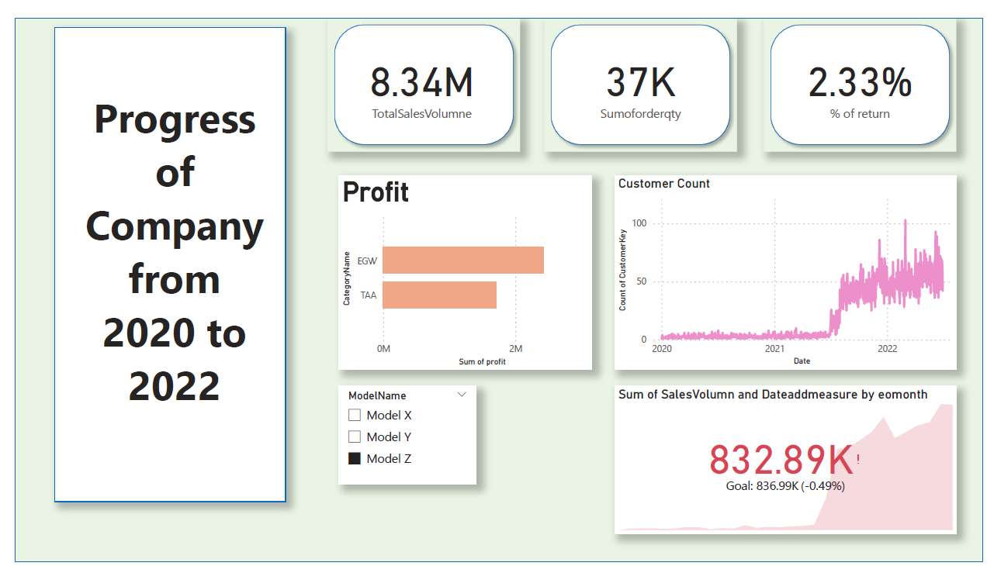
Dashboards

Slide 50
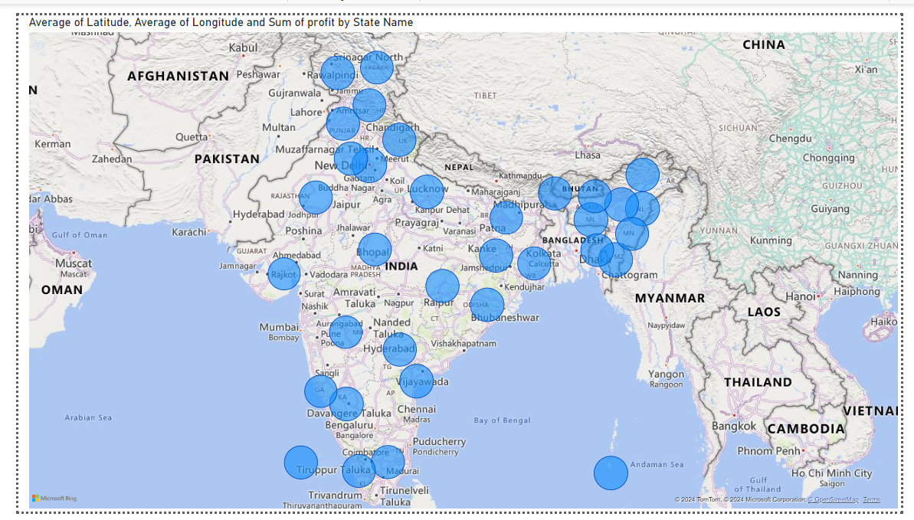
Dashboards

