Slide 1
Power Automate

Slide 2
What is Power Automate Desktop?
Definition
Who Uses It?
Key Benefit
Power Automate Desktop (PAD) is Microsoft's free Windows RPA tool that automates repetitive tasks — no coding needed. Drag-and-drop actions build powerful automations.
Business analysts, IT teams, accountants, HR professionals, and anyone who wants to eliminate repetitive manual steps on Windows.
Save hours weekly. PAD records, builds, and runs flows on your PC — replacing manual, repetitive steps with reliable automation.
Free with Windows 11
500+ Built-in Actions
No Code Required
Cloud + Desktop Integration
Attended & Unattended
Power Automate Desktop is included FREE with all Windows 11 licenses and available as a free download for Windows 10.
Power Automate Desktop — Training
2 / 18

Slide 3
Installation & First Launch
1
Download PAD —
Go to make.powerautomate.com → Click 'Install Power Automate' OR search 'Power Automate' in Microsoft Store on Windows 11.
2
Sign In —
Use your Microsoft 365, Work, or School account. Free Microsoft accounts (Outlook, Hotmail) also work for basic flows.
3
Launch the App —
Open Power Automate Desktop from Start Menu. You'll see the Home screen with My Flows and template examples.
4
Create First Flow —
Click '+ New flow', give it a name, and the Flow Designer opens — your main workspace for building automations.
Tip: Windows 11 users may already have PAD installed — search 'Power Automate' in the Start Menu first before downloading.
Power Automate Desktop — Training
3 / 18

Slide 4
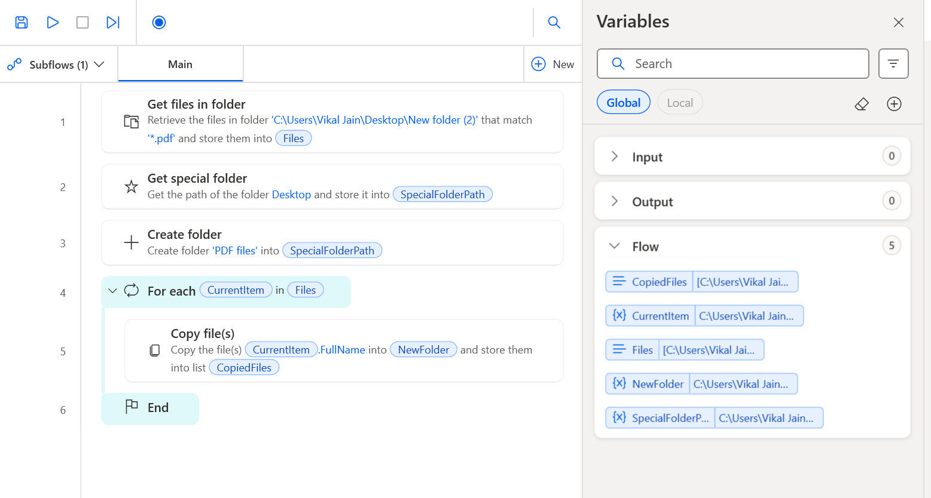
Move PDF files from Folder

Slide 5
Main Properties of CurrentItem
%CurrentItem.____%
Property | Meaning | Example
FullName | Full file path | C:\Folder\File1.pdf
Name | File name with extension | File1.pdf
Directory | Folder path only | C:\Folder
Extension | File type | .pdf
Size | File size (bytes) | 102400
CreationTime | Created date | 01-01-2026
LastAccessTime | Last opened | 05-01-2026
LastWriteTime | Last modified | 10-01-2026
Attributes | File type info | Archive/Hidden etc.

Slide 6
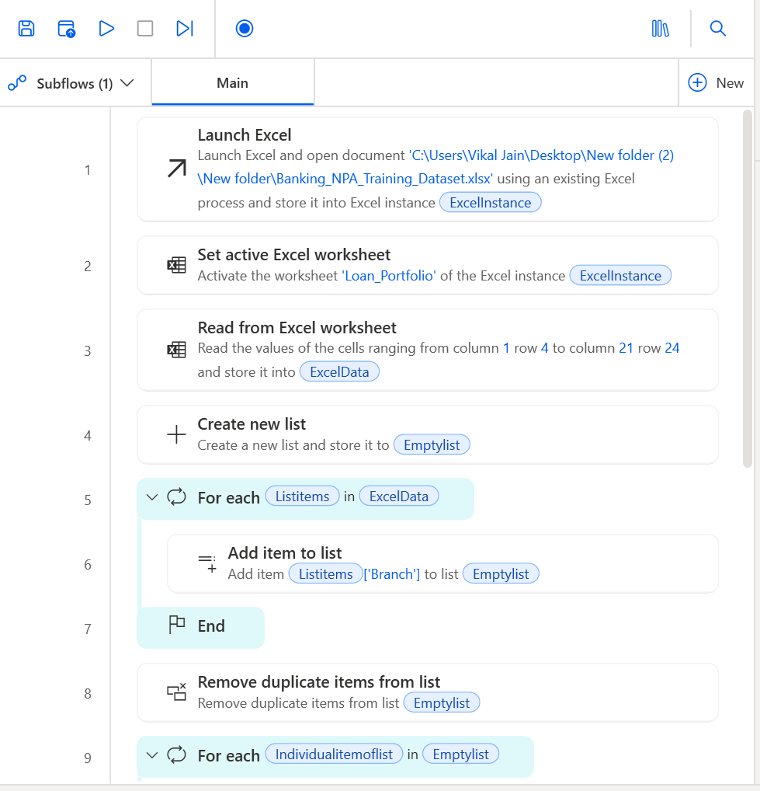
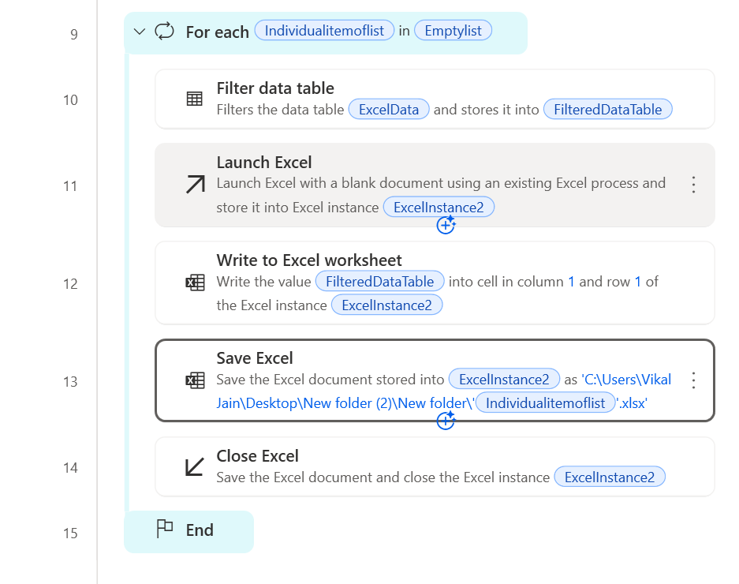
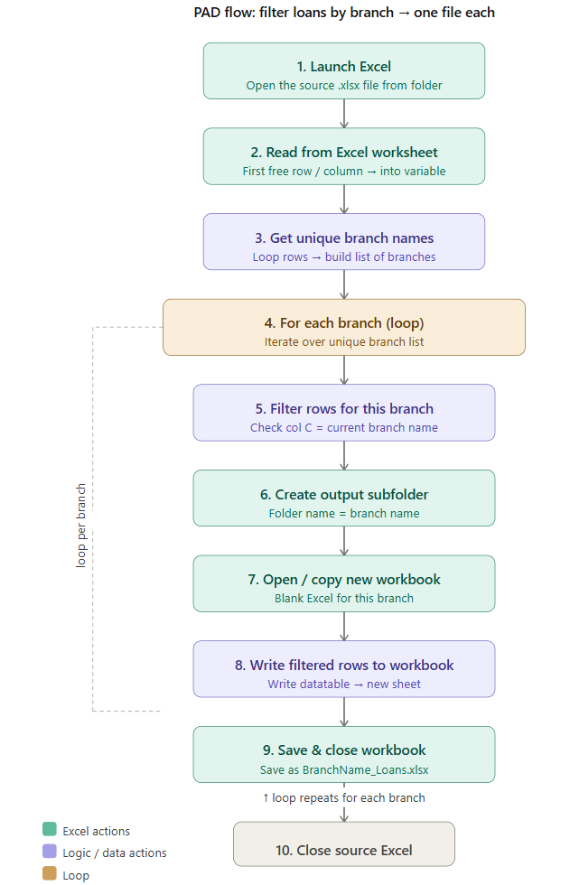
Filter Branch in Excel

