Slide 1


The Institute of Chartered Accountants of India
Digital Competency Maturity Model (DCMM)
12th April, 2023
R. Singhi Hall, ICAI Bhawan
CA Sanjib Sanghi
Vice Chairman, EIRC of ICAI
Chairman EICASA, EIRC of ICAI

Slide 2

DCMM - Digital Competency Maturity Model
Digital Competency is the measure of an individual’s or firm’s skill and knowledge on the use of computers and related technology.
It involves being –
    Inclusive- A roadmap for developing Digital Competencies.
    Informed- A framework for assessing and improving Digital Literacy and Skills.
    Engaged- The use of digital technologies for Collaboration & Communication.
    Balanced- A Balanced Approach to Digital Technology use by encouraging self-reflection, and the development
    of healthy digital habits and boundaries.
    Alert- More Alert and proactive in managing Digital risks and threats, such as Cyberbullying and Identity theft.

Slide 3

How To Evaluate Your Firm?
When you go to test the Digital Competency of Your Firm –
If you have taken good steps towards digitization, you score well.

Slide 4

Digital Competency Maturity Model Version 2.0
As provided by the Digital Accounting and Assurance Board (DAAB) of The Institute of Charted Accountants of India (ICAI), Digital Competency Maturity Model is a set of standards of digitalization which the firms can evaluate on a self-assessment basis and build a strategy for elevating, to leverage the opportunities which will unfold in the digital era.
DCMM 1.0
DCMM 2.0
Go to ICAI Digital Learning Hub and Login using your SSP Portal
2017
2020
Click here to go to the website

Slide 5

Importance Of DCMM
What Will You Learn?
Digital Competency Maturity Model enables firms to –
Rate their current level of maturity on digital competency
Identify areas where competencies are strong or lacking, and then develop a road map for achieving a higher level of maturity

Slide 6
Three Dimension Approach
to Self Evaluate the Digital Competency of Professional
Firm’s Digital Maturity
Automation of Internal Processes
Skills & Talent Development
Automation of Audit Processes

Slide 7

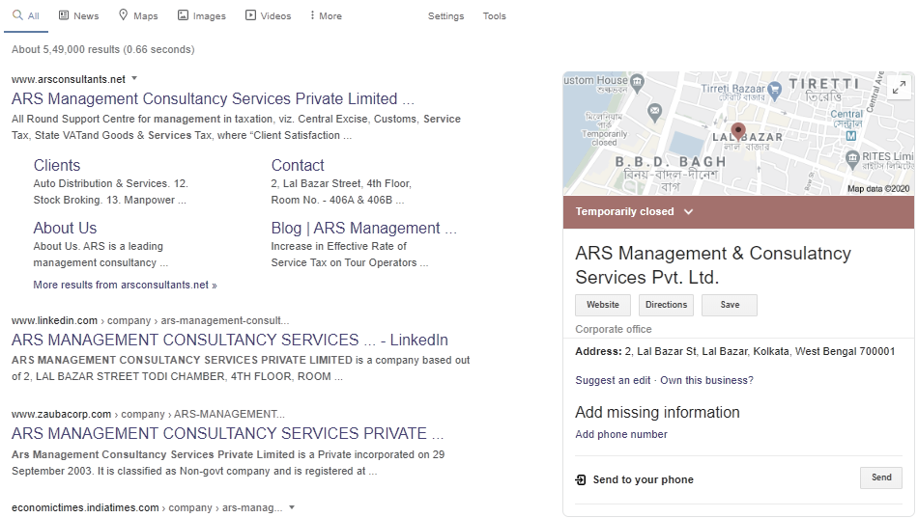
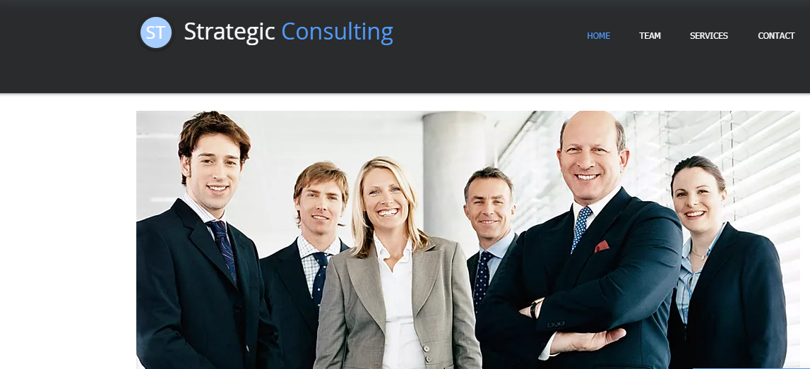
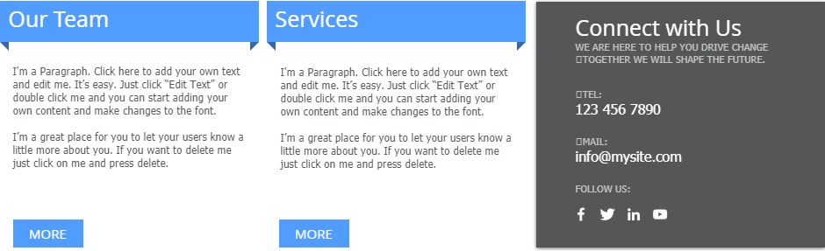
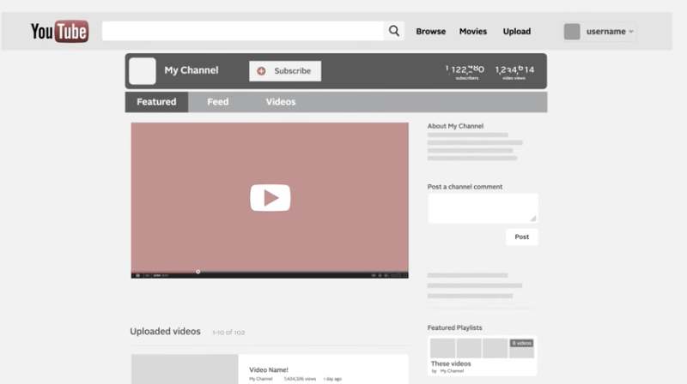
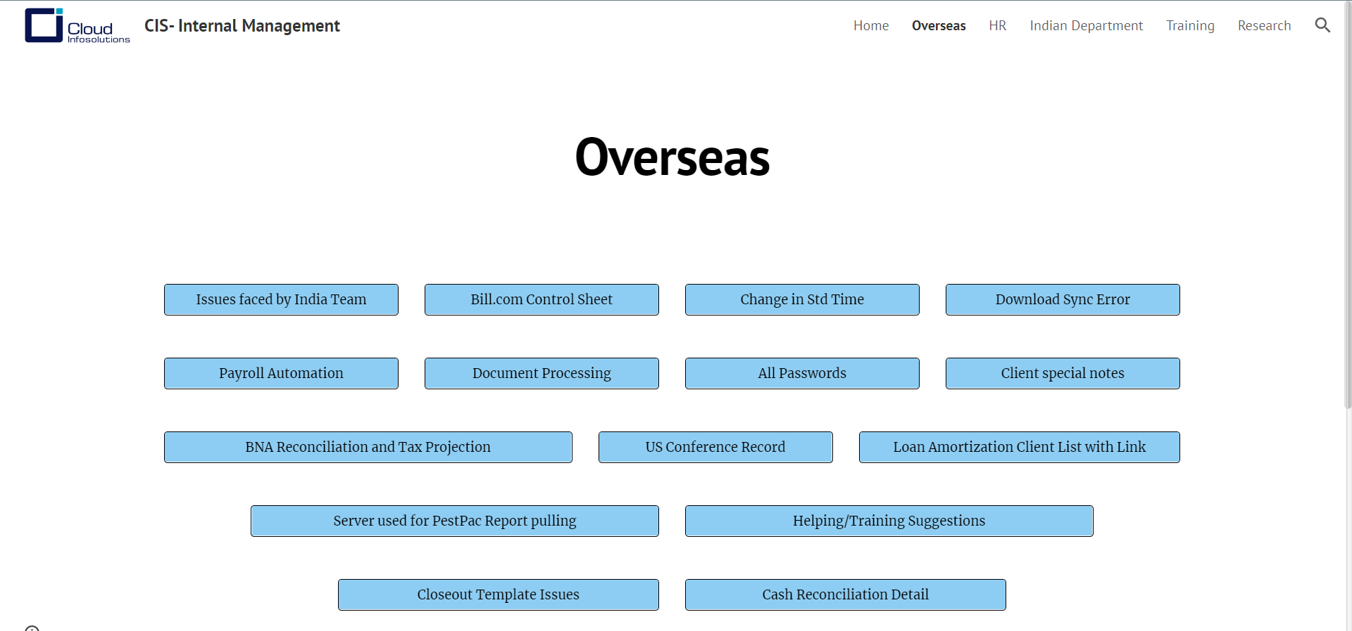
Few Practical Steps To Follow
Grow Clientele Digitally
Build Digital Visiting Card
Build Impactful Website
Social Media Presence
Have Internal Intrasites

Slide 8
About The Course
The Course has 325 Questions Divided into 4 Sections
DCMM
Section A
148 Questions
Section B
57 Questions
Section D
18 Questions
Section C4
33 Questions
Section C1
34 Questions
Section C
102 Questions
Section C2
22 Questions
Section C3
13 Questions

Slide 9







About The Course
SECTION A:
Automation of the firm’s Internal Processes
SECTION B:
Talent Development relating to Digital Competencies
SECTION C1:
Audit Processes and Nature of Audit Services
SECTION C2:
Tax and Compliance Services
SECTION C3:
Accounting and Support Function Services
SECTION C4:
Management Consultancy Services
SECTION D:
Adaptation of Advanced and Emerging Technologies

Slide 10

Few Questions from the Course
Starting here, you need to give basic answers to these basic questions

Slide 11
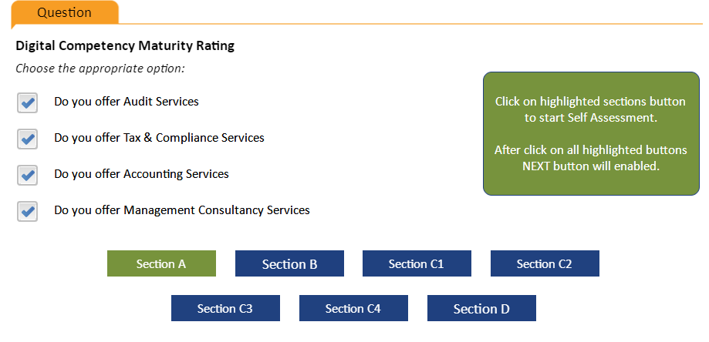
Few Questions from the Course

Slide 12
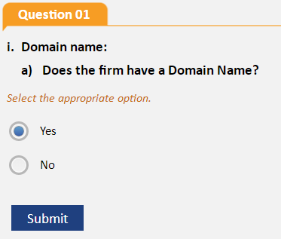
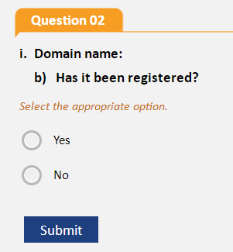
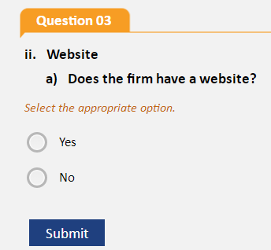
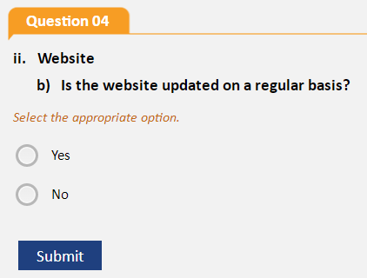
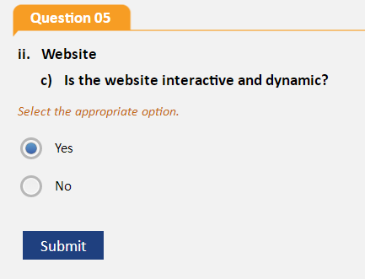
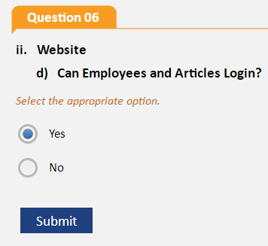
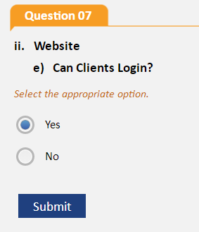
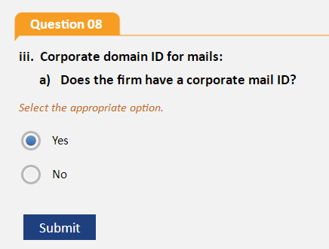
Few Questions from the Course

Slide 13
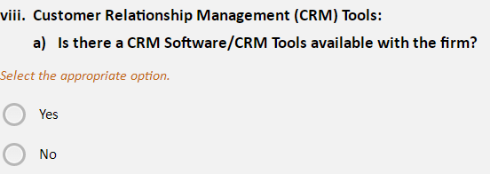
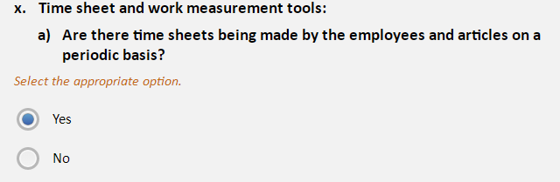
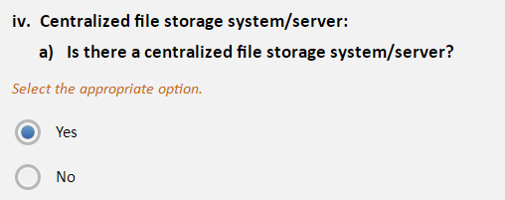
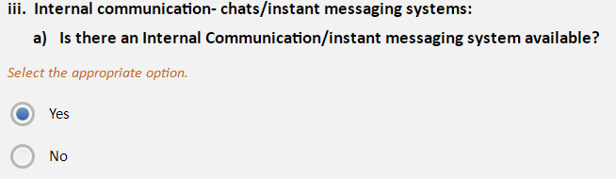
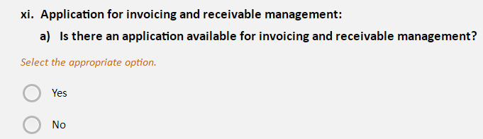
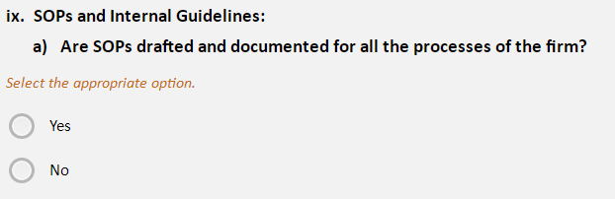
Few Questions from the Course

Slide 14
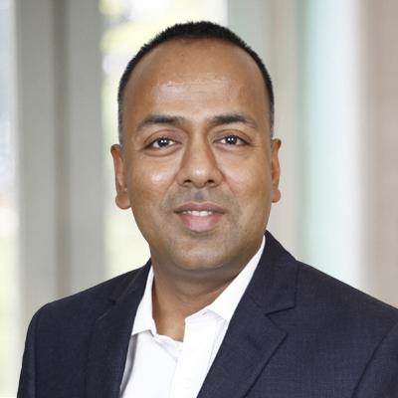
Thank You!
Please contact me for any Queries.
Fellow Chartered Accountant with 24+ years of experience as an entrepreneur in International FinTech Industry.
Founder, Digital Accountants & Author, “The Digital Professional” – Using Technology to Simplify Work
Founder, Bhavishya Kiran Trust – a social initiative that trains individuals in software skills that are essential for securing decent jobs.
Co-Chairman of the IT Committee of the Merchants’ Chamber of Commerce & Industry (MCCI)
Advisor of the IT Committee of the Direct Tax Professionals’ Association (DTPA)
A Charter member of TIE Kolkata
Senior Vice President of MSME Development Forum, West Bengal.
CA Sanjib Sanghi
B.Com (H) FCA, DISA, GNIIT
M : +91 9831434000
Email: sanjib@cloudinfosolutions.com
Website: www.digitalaccountants.com
CA Sanjib Sanghi
https://in.linkedin.com/in/sanjibsanghi
M. 9831434000

