Slide 1

Geo-political risks a new agenda in internal audit
CA. Sidheshwar Bhalla
Former President
The Institute of Internal Auditors, India
October 3, 2026

Slide 2
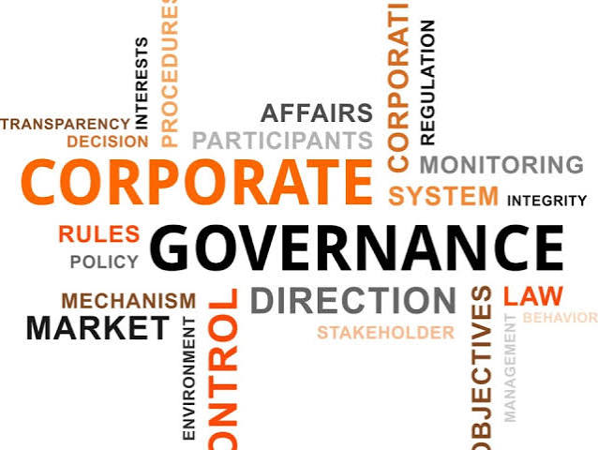

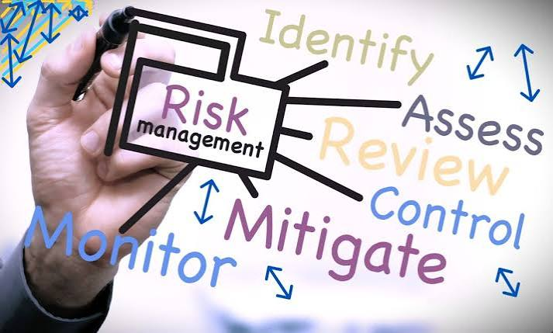
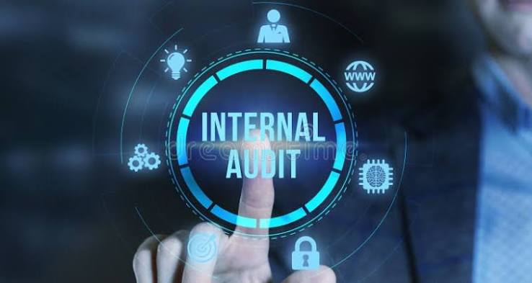

storyline
Corporate Governance
Risk Management
Geo-Political Risks
Smart Internal Audit Program

Slide 3

Corporate Governance
3

Slide 4

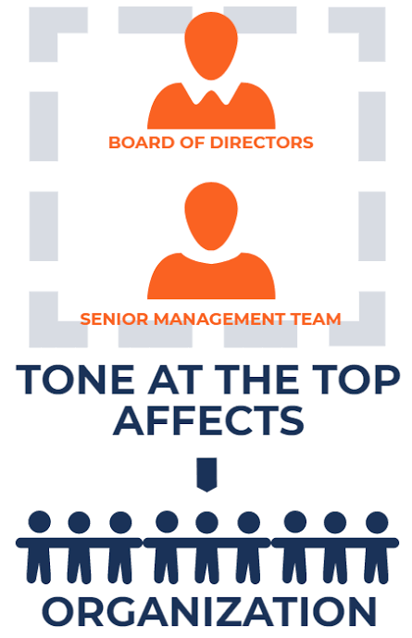
CORPORATE GOVERNANCE
Corporate governance broadly refers to the mechanisms, processes by which corporations are controlled and directed.
The tone from top management is particularly important because it sets an example for all others in and around the organization!
A sound, ethical tone at the top permeates and inspires an organization. It must, however, be supported and enforced by checks and balances that, in times of temptation, would strengthen those inclined to stray!

Slide 5
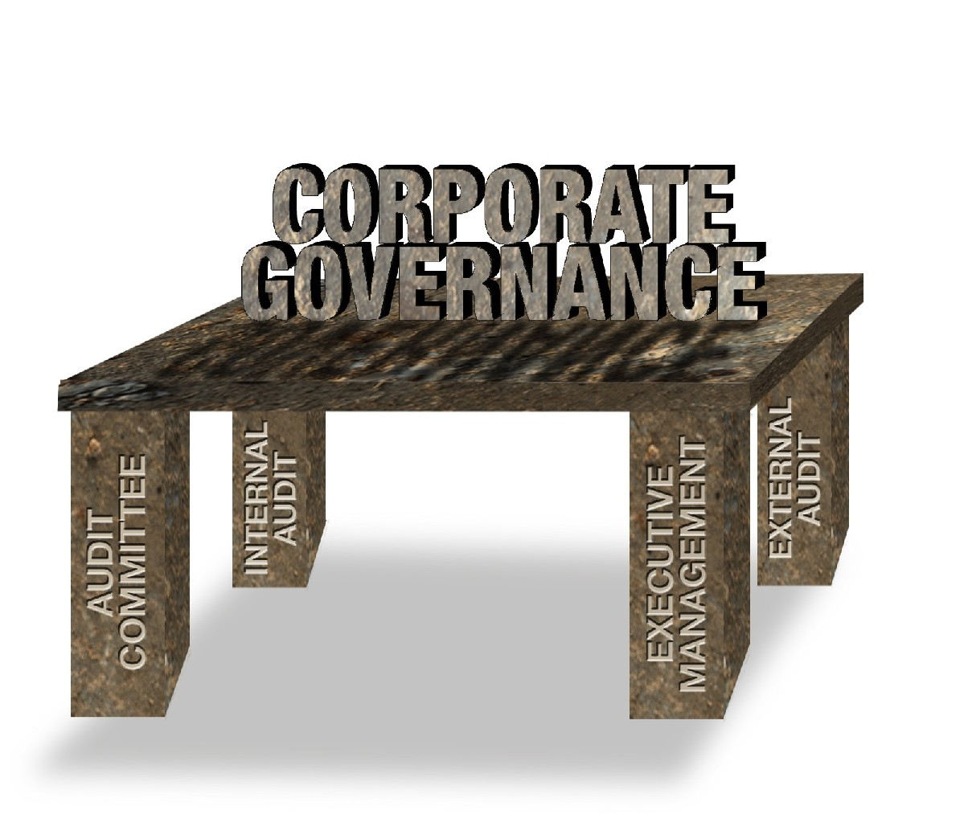
Cornerstones of Corporate Governance

Slide 6


India…Era of Corporate Governance
SEBI (LODR) Role of RMC
DPDP
GST
RPT
IFC
SEBI (LODR)
Regulations
2015
Narayan Murthy Committee
Amended clause 49
Naresh Chandra Committee
DCA Report
MATURITY/ SUSTAINABILITY
DCA - Task Force On Corporate Excellence
Clause 49
Kumar Mangalam Birla Committee
CII
1991…….………….1999
2000
2001……………..………………………..2012
2013……...2015….....2017….…...2021…….….2025
2027
INITIATIVES

Slide 7
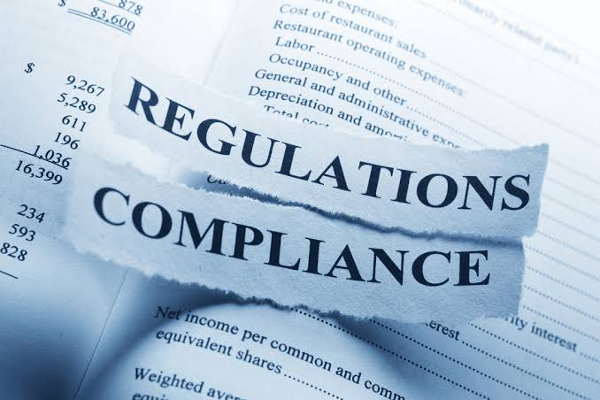
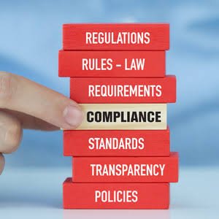
The changing regulatory landscape
IFC | LODR
Basel II | Contract Risk
IS Governance | Sarbanes-Oxley
Cyber risk | J-SOX
OH&S | GDPR
Ind AS | IFRS
ESG | Fraud risk
Directors’ responsibilities | Tax risk

Slide 8
The four pillars of compliance
Compliance with contractual obligations (Commercial/ Financial/ Regulatory)
Compliance to Service Level Agreement (SLA)
1
Corporate Polices, code of ethics and conduct, Delegation of Authority, POSH etc.
Functional Standard Operating Procedures/ Manuals
Internal Company notifications, circulars
Policies
&
Procedures
4
Landscape
2
Contractual Terms
Statutory & Regulatory
Internal Control over Financial Reporting (SOX, J-SOX, Clause 49, IFC)
Indian Accounting Standards
Generally Accepted Accounting Principles (US GAAP)
International Financial Reporting Standards
3
Corporate and Commercial Laws: Companies Act, SEBI Laws, PML etc.
Financial Laws: GST, Direct Tax, FDI etc.
HR, Labour, EHS: PF, Minimum Wages, Foreign Labor, E-waste, etc.
Data Privacy Laws (GDPR, DPDP).
Financial
Reporting

Slide 9

Risk Management

Slide 10

Risk management defined
A structured, consistent and continuous process for identification and assessment of risks, undertaking control assessment and continuous monitoring of exposure of the risk
Risk Management
Risk Management is critical to value creation, offering shareholders improved stability and predictability

Slide 11
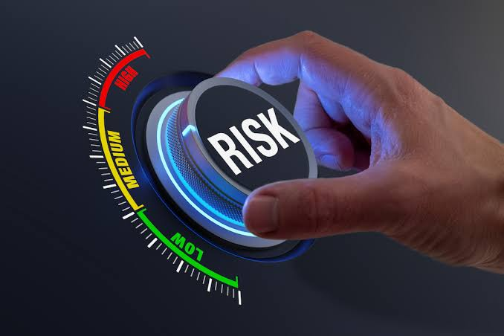
Risk management – AN OVERVIEW
Organizations' Vision & Mission
Why the company / business unit exists
Strategic Objectives
Articulate what an Organisation seeks to do to achieve its vision
Organization Structure & Processes
The way company operates to achieve its objectives
The sub-processes that are needed to achieve the objectives
Processes/ Sub Processes
What could go wrong which would hamper achievement of the vision/ mission/ strategic objectives
Risks

Slide 12
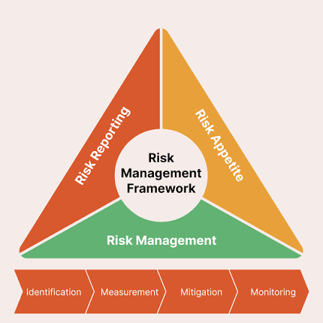
Risk Management Framework comprises of...
Risk Strategy
Risk Strategy
Risk Strategy
Risk Structure
Risk Structure
Risk Structure
Risk Portfolio
Risk Portfolio
Measuring & Monitoring
Risk Portfolio
Risk Optimizing

Slide 13
Illustrative geo-political Risks (1/2)
In an interconnected yet increasingly unpredictable world
Risk Strategy
Types of Geo-Political Risk
Transmission Channels
Event
Unanticipated
Thematic
Supply Chain
Regulatory Shifts
Financial Markets
Elections
War
Climate, Cyber
Cross border blockades
Sudden Tariffs
Currency depreciation
S. No. | Risk | Impact
1 | Complex, fragmented regulatory and tax environment Minimum global tax is adopted by many countries. Eg Base erosion & Profit Shifting). | Global sourcing and supply chain economics are in flux, and regulatory and tax compliance has become more complex and costly. Investment in the green transition is under question.
2 | Fast-moving and politicized technology landscape Characterized by changing alliances and rapid growth of AI. Regulators are struggling to keep pace with new Gen AI solutions, and a rolling back of regulations could leave AI models out of control. | National security concerns are influencing decisions over technology partners and suppliers and challenging the notion of a global IT infrastructure. Intellectual property and data security are under threat. Unregulated digital and Gen AI solutions could harm ethical reputations. Lack of global leadership makes it hard to achieve globally harmonized regulatory standards.

Slide 14
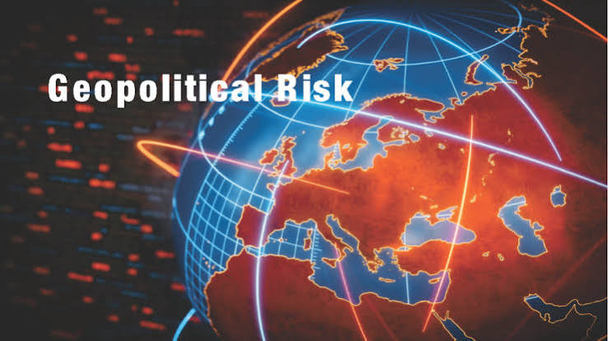
Illustrative geo-political Risks (2/2)
In an interconnected yet increasingly unpredictable world
Risk Strategy
S. No. | Risk | Impact
3 | Shifts in power, economic centers and trade New trade alliances and investment hubs are redefining global power dynamics. | Investment decisions, supply chains and global footprint under pressure.
4 | Multiple threats to supply chains, assets and infrastructure Geopolitical rivalries, trade protectionism, competition for resources, cyberattacks, climate events place strains on globally exposed businesses. Wars, tensions pose threats to shipping choke points. | Supply chains are under pressure, and companies face shortages of key resources.
5 | Demographic, technological and cultural pressures on workforces Aging population, falling birth rates (developed markets), changing worker preferences, culture wars, AI integration and reskilling. | Companies face an escalating talent shortage in mature economies, changing work preferences of younger generations. Challenges in adopting AI. Increasingly polarized environment, companies are faced with a need to be explicit about ‘social’ issues.

Slide 15
Illustrative geo-political events
Risk Strategy
    Geopolitical Risk is the threat that international conflicts, political instability, and government policy shifts pose to economic stability and business operations.
Event | What Happened | Global Impact
Russia Ukraine War (2014-Present) | Russia annexed crimes in 2014 and launched a full-scale invasion of Ukraine in 2022. | Triggered severe western sanctions, disrupted global grain and energy markets.
US China Trade and Tech War (2018-Present) | US imposed steep tariffs on Chinese goods, followed by export controls on semiconductors and advanced AI hardware. | Forced global manufacturers to re-route supply chains and pursue ‘friendshoring’ (moving production to allied nations).
Middle East Conflict Escalations | Renewed warfare involving Israel, Hamas, Iran. | Threatened shipping lanes in the Red Sea and Strait of Hormuz causing energy price volatility.
Cyber Warfare
Biological Warfare
Cold War
Proxy War

Slide 16
Sectoral heat map analysis of geo-political risks
Potential impact
Risk Strategy
Sector / Risk | Shifts in power, economic centers and trade | Complex, fragmented regulatory and tax environment | Fast-moving and politicized technology landscape | Multiple threats to supply chains, assets and infrastructure | Demographic, technological and cultural pressures on workforces
Consumer & Retail
Energy, Natural Resources & Chemicals
Financial Services
Industrial Manufacturing & Automotive
Infrastructure & Transport
Life Sciences
Technology, Media & Telecom

Slide 17
Role of internal auditor
Risk Strategy
Assessing Interconnected Risks
Evaluate how geopolitical events cascade into operational, financial, and cyber vulnerabilities rather than treating political risk in isolation
Evaluating Supply Chain Resilience
Review supplier dependencies, identify single points of failure in volatile regions, and test contingency plans
Monitoring Regulatory Compliance
Test controls around shifting international trade restrictions, tariffs, complex cross-border sanctions
Promoting Scenario Planning
Collaborate with risk management to ensure leadership simulates major geopolitical disruptions (trade wars / regional conflicts) before they happen
Advising the Board
Inform board and audit committee whether company’s strategic goals and risk management frameworks adequately account for global volatility

Slide 18
Smart Internal Audit Program

Slide 19
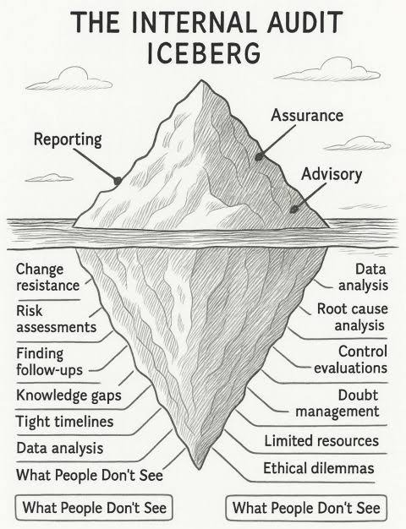
INTERNAL AUDIT
    ‘Internal auditing is an independent, objective assurance and consulting activity that adds value to and improves an organization’s operations. Internal Audit helps an organization accomplish its objectives by bringing a systematic, disciplined approach to evaluate and improve the effectiveness of risk management, control, and governance processes’
Transaction Based Audit
Continuous Control Monitoring
Process Based Audit
Internal Audit of Artificial Intelligence
Risk Based Audit
Risk to Strategy

Slide 20




SMART – DIA (Digital, Intelligent and Analytical) INTERNAL AUDIT PROGRAM
For sharper, efficient and greater coverage
Smart DIA, IT
To make business more resilient against the uncertainties
  Advanced data analytics tool to provide exceptional reporting for effective internal auditing
Risk & Resilience
  To cover risks at an enterprise level, review the effectiveness of the mitigation plans and integrating the same with Internal Audit
Focus on anti fraud controls
Eye of Forensic
  Applying knowledge and repository of fraud risks to focus on anti-fraud controls
360° Coverage
Statutory
Compliance
To align business with regulatory compliance
Internal Financial Controls (IFC) Incl. IT & Cybersecurity
  To cover the risk of legal and financial exposure to the Company due to legal and statutory non compliances
  Internal financial controls
  IT & Cybersecurity controls
  ERP application controls
  Operating effectiveness of the identified controls
To be able to do a deeper audit
Operational Auditing
  Health & Safety
  Volatility in prices
  Identification and recommending process automation
  Sector Insights & Multidisciplinary and SME

Slide 21
Internal Audit – illustrative areas
Environment, Social Governance (ESG)
Audit of Automated Processes
Culture Audit
Social Media
Risk Management
Auditing Strategy
Cyber Security
Data Privacy
Compliance

Slide 22

Questions...comments...concerns…
CA. SIDHESHWAR BHALLA
Former President
The Institute of Internal Auditors, India
E-mail: bhallasidheshwar@gmail.com;
Mobile: +91 98997 87786
…THANK YOU !!!

