Slide 1
GSTR-9 & GSTR-9C
Complexities & Issues Relating to Input Tax Credit
Technical Session
Statutory framework • Reconciliation • GSTN validations • Practical case studies
CA Surabhi Bohra
EIRC, 9th October, 2026
1
Notes:
Respected dignitaries on the dais, esteemed senior members, fellow Chartered Accountants, and dear professional colleagues,A very good afternoon to all of you. First of all, I would like to express my sincere gratitude to the organisers for giving me this opportunity to be a part of today’s GST workshop and to share my thoughts on a subject that continues to be one of the most challenging and discussion-worthy areas of GST compliance — Input Tax Credit and its reporting in GSTR-9 and GSTR-9C.Friends, GST has now evolved considerably since its introduction. Over the years, we have witnessed significant changes in statutory provisions, rules, departmental interpretations, judicial pronouncements, and the GST return filing system.Yet, despite this evolution, Input Tax Credit continues to remain an area where the law, accounting records, return disclosures, and departmental expectations do not always appear to align seamlessly.As Chartered Accountants, we know that the challenge is not merely to determine whether an ITC claim is legally admissible. The real challenge often lies in ensuring that the credit is correctly availed, appropriately reversed wherever required, accurately reconciled with the books of account and GSTR-2B, and properly disclosed in the annual return and reconciliation statement. GSTR-9 and GSTR-9C are not merely annual compliance forms; they are important instruments for examining the consistency of an organisation’s entire GST reporting framework.A difference between the books of account, GSTR-3B, GSTR-2B, and GSTR-9 may appear to be a simple reconciliation issue. However, depending on the underlying facts, it may have implications for eligibility of credit, interest liability, tax exposure, refund claims, or even departmental scrutiny.Our responsibility, therefore, extends beyond matching figures. We must understand the nature of each difference, identify its legal implications, determine the appropriate corrective action, and ensure that the disclosures are supported by proper documentation.
In today’s session, my endeavour will be to focus not only on the statutory provisions but also on the practical issues that we encounter while preparing, reviewing, GSTR-9 and GSTR-9C, particularly in relation to Input Tax Credit. I hope we will be able to approach these issues from both perspectives — the perspective of statutory compliance and the perspective of practical professional judgement. I also look forward to an interactive discussion, because in a dynamic law like GST, professional deliberation and the sharing of practical experiences are among our most valuable learning tools. With these words, let us begin our discussion. Thank you, and I wish all of us a fruitful and enriching session.

Slide 2
Session Objectives
Understand the legal architecture governing ITC - Annual-Return reporting & Reconciliation
Distinguish ITC claimed, reversed, reclaimed, available and carried into a subsequent financial year.
Decode the interaction between
GSTR-3B,GSTR-2B, books,
GSTR-9 Table 6/7/8 and
GSTR-9C Tables 12/13/14.
Identify reconciliation differences that are merely timing / classification differences versus differences that may indicate tax exposure.
Develop a defensible working-paper approach for professional review and client sign-off.
Notices related to 9 & 9C reporting
Primary sources: CGST Act/Rules; CBIC Circular 170/02/2022-GST; GSTN FY 2024-25 FAQ. | 2
Notes:
Today, we will be discussing Input Tax Credit issues in GSTR-9 and GSTR-9C.Friends, in my view, the real challenge in annual GST compliance is not merely filing the return or ensuring that the figures match. The real challenge is understanding why the figures do not match, whether the difference has a legal implication, and what corrective action is required.
We frequently encounter situations where the ITC as per books differs from GSTR-3B, the credit appearing in GSTR-2B differs from the credit availed, or the annual return reflects figures that do not reconcile with the financial statements.
The important question is: Does every difference indicate an excess claim of ITC? And conversely, does a perfect numerical reconciliation necessarily establish that the ITC is legally admissible?The answer to both questions is no.
Therefore, today, I would like to approach the subject from three perspectives: the statutory entitlement to ITC, the reconciliation of ITC across returns and books, and the professional responsibility of identifying and documenting discrepancies.
My endeavour will be to focus on the practical issues, the areas of litigation and interpretational difficulty, and some case studies that we encounter in our professional assignments.With that, let us begin.

Slide 3
1. ITC Reporting Architecture — Legal Provision
Legal entitlement
Reporting Sequence
GSTR-3B: Availment, Reversal and reclaim
GSTR-9: Annual consolidation and year-wise ITC mapping
Annual return is a reporting/reconciliation exercise—No option of Availment, Reversal or Reclaim
GSTR-9C: Reconciliation of GSTR-9 with AAFS
Every unexplained difference should be classified with reasons thereof.
Section 16: Eligibility and conditions for ITC availment
Section 16(4): Statutory time limit
Section 17 : Apportionment and Blocked credits
Section 34: Supplier Invoices, credit/debit notes and corresponding ITC consequences
Rules 37, 37A, 38, 39, 42 & 43: Reversal / Re-availment mechanics
Sources: CGST Act, 2017; CGST Rules; CBIC Circular 170/02/2022-GST. | 3
Notes:
Before we start discussing individual tables, I would like to draw your attention to one fundamental principle. ITC eligibility and ITC reporting are two different questions.
Section 16 determines the basic conditions for entitlement to credit. Section 17 deals with apportionment and blocked credits. Section 16(4) prescribes the applicable time limit, while Rules 37, 37A, 42 and 43 deal with specific reversal and re-availment situations.GSTR-3B captures the periodic availment and reversal of credit. GSTR-9 consolidates the annual position, while GSTR-9C seeks to reconcile the return with the relevant financial records. The mistake we sometimes make is to start with the return table and then try to adjust the numbers until everything matches.
I would suggest the reverse approach: first identify the underlying transaction, then determine its legal treatment, establish when the credit was availed or reversed, and finally decide where it belongs in the annual return.
Tables 6, 7 and 8 must therefore be read together, but they should not be treated as interchangeable figures. Table 6 addresses ITC availed, Table 7 deals with reversals and ineligible credit, and Table 8 presents other ITC-related information and reconciliation data. The reporting requirements and table instructions applicable to the relevant financial year must always be checked before finalisation. This distinction between the legal position and the reporting position will be the thread running through our entire discussion.

Slide 4
2. GSTR-9: ITC Tables — 6,7,8, 12 & 13
Table | Core purpose | Professional focus
6 | ITC availed in GSTR-3B during FY | Nature of claim - Current FY vs Preceding FY; reclaims
7 | ITC reversed / ineligible | Reversals- Rule 37/37A, 38, 39, 42 & 43, Tran-I and Tran-II, Any Other; Ineligible- Sec.17(5)
8 | Other ITC information | GSTR-2A/2B Vs ITC availed in 3B (Table 6B of GSTR-9)
12 | ITC of FY reversed in next FY | Reversal of current year ITC in subsequent year
13 | ITC of FY availed in next FY | ITC availed in Subsequent-year for current FY
Caution Points-
Do not attempt to make every table mathematically equal to another table
No availment, reversal or reclaim
Just reporting no adjustment
Proper working paper with Invoice wise matching (Useful for scrutiny/assessment/audit/notices)
Consider the timeline for availment sec 16(4)
For FY 2024-25, GSTN introduced specific Table 6A1 / 6A2 logic in the annual-return FAQ.
GSTN FAQ on GSTR-9/9C for FY 2024-25. | 4
Notes:
Let us now move to Table 6, which is often the starting point of our annual ITC reconciliation. At first glance, Table 6 may appear to be a simple classification of ITC. However, the real difficulty arises when the credit availed during the year includes preceding-year invoices, reclaims of previously reversed credit, and credits relating to different categories of inward supplies. We must distinguish between four concepts: ITC that is legally available, ITC reflected in the relevant portal data, ITC actually availed in GSTR-3B, and ITC reported in the annual return. These four figures need not always be identical. For FY 2024-25, particular attention is required to the Table 6A1 and 6A2 reporting logic explained in the applicable GSTN guidance. A credit that was originally claimed and subsequently reversed cannot automatically be treated as though the original claim never occurred. Equally, a reclaim should not be casually merged with fresh ITC without examining the applicable reporting instructions. Our working paper should establish the complete trail: original invoice, original claim, reversal, subsequent fulfilment of the relevant condition, and reclaim. The objective is not merely to arrive at the correct total. It is to ensure that the composition of that total is also correct.

Slide 5
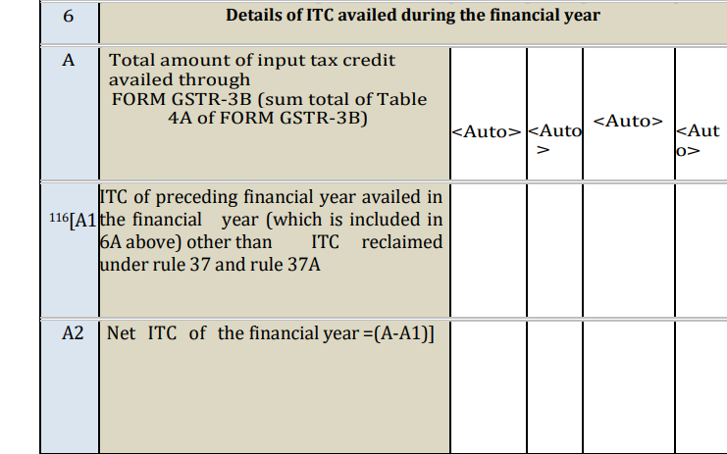
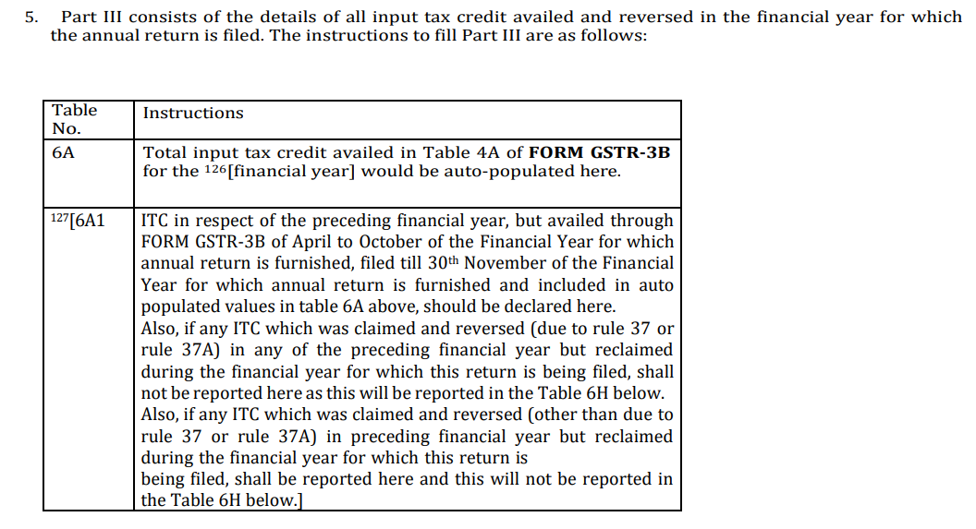









3. Table 6 — The 'ITC Availed'
Table 6A1- ITC of P-FY
6A2 –ITC of the C-FY
Table 6A - ITC availed through GSTR-3B of C-FY;
GSTN FY 2024-25 FAQ; CBIC Circular 170/02/2022-GST. | 5

Slide 6
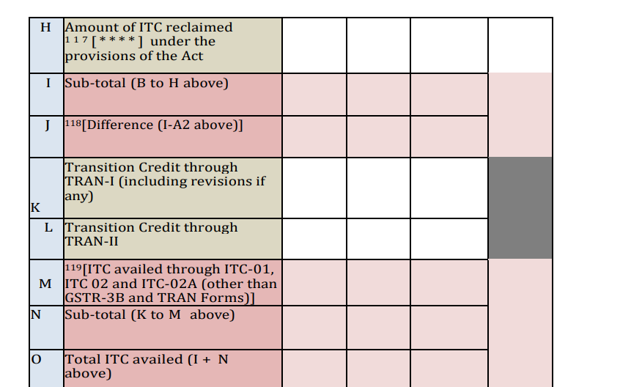
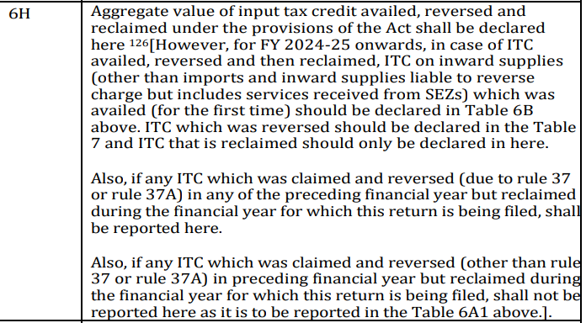






Table 6B–6H then classifies Nature of ITC.
Classification errors can create apparent reconciliation differences even where the total claim is correct.
Table 6H is particularly important for reclaims: Trace the original claim → reversal → eligibility event → reclaim.
Do not treat '2B available' as synonymous with 'ITC legally available' or 'ITC actually availed'.
Notes:
This brings us to one of the most important areas of annual ITC reporting: reversals and reclaims. Let us consider Rule 37 first. Where the prescribed payment condition relating to the value of supply and tax is not fulfilled within 180 days, the applicable proportionate ITC reversal and subsequent re-availment provisions need to be examined. The professional question is not limited to whether a reversal has been made. We must also establish the amount requiring reversal, the period in which it was made, and whether the conditions for subsequent re-availment have been fulfilled.Rule 37A requires a separate analysis. It concerns the specified situation where the supplier has reported the invoice or debit note but has not furnished the corresponding return in GSTR-3B within the prescribed framework. Although both provisions can result in reversal and subsequent reclaim, their triggering conditions are different. They should not be combined into a single undifferentiated reconciliation bucket. For every material item, I would recommend maintaining an invoice-wise record of the original ITC, the reason for reversal, the month of reversal, the event restoring eligibility, and the month of reclaim.There is also an important annual-return consideration. The applicable GSTN guidance for FY 2024-25 specifically addresses certain Rule 37 and Rule 37A reclaims and their reporting in Table 6H of the subsequent year’s GSTR-9.Therefore, the annual return must reflect the prescribed reporting treatment rather than merely the net balance appearing in the ITC ledger.

Slide 7
5. Rule 37 — 180-Day Reversal
Technical checkpoints
GSTR-9 implications
Has consideration + tax actually been paid?
Is payment partial? Reversal is proportionate to amount not paid.
Was reversal made in the prescribed return?
Has the underlying invoice subsequently become eligible for re-availment?
Is the reclaim correctly segregated from fresh ITC?
Rule 37 reversal has a distinct reporting bucket.
Do not net the reversal against unrelated current-year ITC.
Reclaim is a separate event and should be supported by invoice-level evidence.
Ageing from books should be reconciled with GST return reversals.
Vendor advances / set-offs / contra entries require transaction-specific analysis.
Sources: Rule 37 as amended by Notification 26/2022-CT; GSTN FY 2024-25 FAQ. | 7

Slide 8
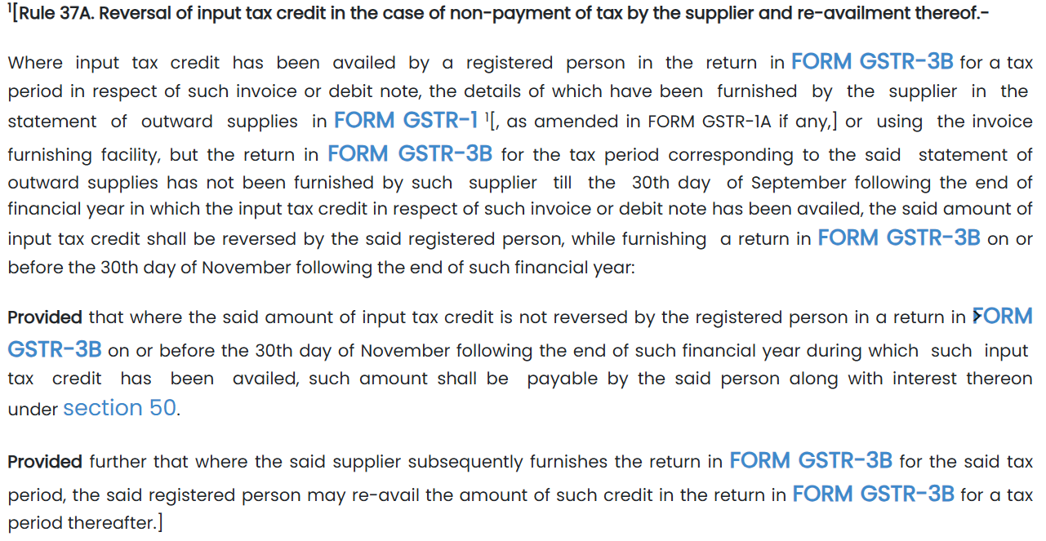
6. Rule 37A — Supplier Default Is a Separate Reconciliation Population
Rule 37A applies where ITC was availed on an invoice/debit note reported by the supplier in GSTR-1/IFF, but the supplier has not furnished the corresponding GSTR-3B by the prescribed 30 September checkpoint.
Recipient must reverse the relevant ITC in GSTR-3B on or before 30 November following the end of the relevant FY; otherwise the amount becomes payable with interest.
Subsequent supplier compliance enables re-availment, subject to the rule.
For annual-return purposes, maintain a dedicated Rule 37A register: invoice, supplier 2B appearance, supplier GSTR-3B status, reversal month, reclaim month and evidence.
Rule 37A should not be mixed with Rule 37 (payment to supplier) merely because both produce a reversal.
Notification 26/2022-Central Tax inserting Rule 37A. | 8

Slide 9
4. Reversal & Reclaim — Case- I
Example 1 - Mr A has claimed Rs 100 (IGST) in the month of April C-FY and reversed the same in October C-FY due to nonpayment to Supplier within 180 days as per rule 37 of CGST Rule 2017.
The same has been reclaimed in March C-FY as payment has been made on 4th March C-FY.
The reporting will be in the GSTR 9 for C-FY as under –
Original claim in Table 6B of GSTR 9 for C-FY
Reversal of same in Table 7A of GSTR 9 for C-FY
Reclaim in Table 6H of GSTR 9 for C- FY
GSTN FAQ FY 2024-25, Examples 1–3. | 6

Slide 10
4. Reversal & Reclaim — Case- II
If any ITC pertaining to preceding FY (2023-24) was claimed and reversed in the P- FY but reclaimed(due to rule 37/37A) in the C-FY .
ITC reclaimed should not be reported in Table 6A1 of GSTR 9 for CFY.
This needs to be reported in Table 6H of GSTR 9 for FY 2024-25.

Slide 11
4. Reversal & Reclaim — Case- III
How the value of ITC will be reported if ITC pertaining to C-FY has been claimed, reversed and reclaimed in the same C-FY
ITC claim should be reported in Table 6B,
Reversal should be reported in Table 7 (Table 7A to 7H, as the case may be) and
Reclaimed should be reported in 6H.

Slide 12
7. Rules 42 & 43 — Annual True-Up Is Not Simply a 'Table 7 Exercise'
Monthly reversal under Rules 42/43 is provisional in nature; the annual calculation may produce an incremental reversal or a re-credit.
Reconcile the annual computation with monthly GSTR-3B reversals and identify whether the year-end adjustment is already embedded in Table 7.
Separate common-input/input-service reversals from blocked credit under Section 17(5).
Check turnover definitions and exempt-supply components used in the annual computation rather than merely agreeing the final amount to the ledger.
Where re-credit / additional reversal arises, document the calculation as a standalone working paper because the GSTR-9 number alone does not explain the mechanics.
CGST Rules 42 & 43; CBIC Circular 170/02/2022-GST. | 9
Notes:
I now come to an area that generates considerable practical difficulty: the reconciliation of GSTR-2B with Table 8A of GSTR-9.A common approach is to compare the ITC claimed with the amount appearing in Table 8A and treat the difference as excess ITC.In my view, that approach is incomplete.Table 8A is a portal-derived population. It must be analysed with reference to the applicable year’s form instructions and the underlying invoice-level data.Differences may arise because of late supplier reporting, amendments, credit notes, differences in reporting periods, or the distinct data sources applicable to imports and reverse-charge transactions.Therefore, a positive or negative difference is a starting point for investigation; it is not, by itself, a final conclusion on eligibility.I would recommend preparing an invoice-level reconciliation with separate reason codes for timing differences, amendments, credit notes, imports, reverse-charge supplies, ISD credits, and other relevant categories.For imports, the Bill of Entry and relevant customs data must be examined. For reverse-charge transactions, we need to trace the liability, payment of tax and corresponding credit.The most important principle is that we should not force the numbers to match by making an unsupported adjustment.Every material difference should either be satisfactorily explained with evidence or escalated for a substantive eligibility and tax-risk assessment.

Slide 13
8. Section 17(5) — 'Ineligible ITC' Versus 'Reversal of ITC'
Issue | Question to answer | Common error
Blocked ab initio | Was the credit legally barred from inception? | Calling every blocked credit a 'reversal'
Wrongly availed ITC | Was eligible credit actually availed but later found incorrect? | No transaction-level evidence
Temporary reversal | Was credit reversed because a condition was temporarily unmet? | Treating it as permanently lost
Reclaim | Has the statutory condition subsequently been fulfilled? | Netting reclaim against fresh ITC
Professional point: classification affects the annual-return trail. A tax officer may use an apparent mismatch as a starting point; the working paper must establish the legal character of the difference.
CGST Act, Section 17(5); CBIC Circular 170/02/2022-GST. | 10

Slide 14
9. Table 8 — Why the Reconciliation Often 'Does Not Work'
Table 8A is a portal-derived population and should be downloaded / examined invoice-wise rather than treated as an accounting balance.
Timing differences arise because supplier reporting, recipient availment and annual-return periods do not necessarily coincide.
Credit notes, amendments, invoices reported after year-end and other supplier-side changes can alter the portal population.
Import of goods and reverse-charge transactions follow different data paths and should be reconciled separately.
A negative / positive difference is a diagnostic signal—not by itself proof of excess ITC or ineligible ITC.
Use a bridge: opening population + additions – deletions ± timing / classification adjustments = closing population.
GSTN FY 2024-25 FAQ; CBIC Circular 170/02/2022-GST. | 11
Notes:
The next set of issues relates to the year to which the ITC belongs.Where an invoice pertains to an earlier financial year but the credit is availed in a subsequent year, we need to examine the applicable statutory time limit, the actual period of availment, and the reporting requirements for both years.We must also distinguish a fresh claim from a reclaim of credit that had previously been reversed.Credit notes require similar care. A GST credit note and a commercial credit note without a corresponding GST adjustment may have different implications for the recipient’s ITC. We should therefore trace the original invoice, the credit note, its legal nature, its accounting treatment, the the portal impact and any corresponding reversal.Imports and reverse-charge transactions should be reconciled separately from ordinary domestic purchases. In the case of imported goods, the Bill of Entry and IGST paid through customs are central to the verification. In reverse-charge cases, the tax liability and corresponding ITC must be traced independently.The broader message is this: a single purchase-register reconciliation cannot adequately address every category of ITC. The underlying transaction and the applicable statutory mechanism must determine the reconciliation method.

Slide 15
10. GSTR-2B vs GSTR-9 Table 8A — Invoice-Level Bridge
Difference driver | What to check | Evidence
Invoice reported late | Supplier filing month vs invoice FY | GSTR-1/IFF history / 2B
Credit note | Original invoice + CN timing | Supplier documents + 2B
Amendment | Original vs amended document | GSTR-1 amendment trail
Import of goods | BOE / ICEGATE vs portal data | Bill of Entry / ICEGATE
RCM | Tax payment and corresponding ITC | 3B + challan + invoice
ISD | Distribution and recipient accounting | ISD invoice / 2B
Do not use a single 2B download as the sole evidence for an annual reconciliation where historical amendments / late reporting affect the population.
GSTN FY 2024-25 FAQ; CBIC Circular 170/02/2022-GST. | 12

Slide 16
11. ITC of Earlier FY Availed in a Later FY
Analytical questions
Annual-return consequence
Which FY does the invoice legally / economically belong to?
In which FY was ITC first availed?
Was the earlier-FY ITC within Section 16(4) time limit?
Was it already reported / reversed in the earlier annual return?
Is the later-year claim a fresh claim or a reclaim?
Preceding-FY ITC should not be hidden inside current-FY ITC without classification.
FY 2024-25 FAQ introduced explicit 6A1 / 6A2 reporting logic.
Table 13 is relevant to specified prior-FY ITC availed subsequently; check the applicable year's notified form and instructions.
Maintain a year-wise ITC roll-forward rather than relying on a single ledger.
Source: GSTN FY 2024-25 FAQ; Section 16(4). | 13
Notes:
We now move to GSTR-9C, where the nature of the reconciliation changes.In GSTR-9, our primary concern is the annual reporting of ITC availed, reversed and other relevant information. In GSTR-9C, we must examine whether the reported position can be reconciled with the books of account and the relevant financial statements. Consider a situation where GST is recorded in the purchase ledger, but the corresponding amount does not appear in the ITC claimed through GSTR-3B.There could be several reasons. The credit may not yet have been availed; it may relate to a capitalised asset; it may be ineligible; it may relate to reverse-charge supplies; or it may have been reversed through an accounting entry.Each possibility requires a different treatment.For Table 12, I would recommend beginning with a clear definition of the ITC population contained in the books and then preparing a bridge to the amount reported in GSTR-9.Gross ITC, reversals and reclaims should be separately mapped before arriving at the net position.Table 14 presents another important consideration. Even where reporting has been relaxed for the applicable financial year, the underlying reconciliation between expense heads and ITC should not be ignored where relevant to the engagement.The fact that a table is optional for a particular year does not necessarily eliminate the need for supporting working papers.Ultimately, GSTR-9C reconciliation should explain the difference, not merely disclose it.

Slide 17
12. Credit Notes — Where ITC Reconciliation Becomes Counter-Intuitive
Supplier GST credit note reduces the supplier's output tax subject to Section 34 conditions; recipient's corresponding ITC consequence must be traced.
Commercial credit notes without GST adjustment raise a different question: whether there is any corresponding ITC reversal under GST law.
Timing of the supplier's credit note, recipient's reversal, and annual-return reporting can fall in different FYs.
Do not force a one-to-one reconciliation between purchase-register net expense and Table 8 without separately identifying GST credit notes.
Case file should contain: original invoice, GST credit note, reason, recipient accounting entry, 2B impact and GSTR-3B reversal.
CGST Act, Section 34; GSTN annual-return instructions. | 14

Slide 18
13. Imports & RCM —Outside the Normal Purchase-Reconciliation Bucket
Import of goods
RCM / import of services
ITC is linked to IGST paid through Bill of Entry.
Reconcile with customs / ICEGATE data, not merely supplier 2B.
Check amendments / supplementary Bills of Entry where applicable.
Table 6 and Table 8 treatment should be traced to the notified form structure.
Liability and ITC can occur through different return fields.
Tax payment is a prerequisite to ITC under the relevant RCM provisions.
Reconcile tax paid → eligible ITC → subsequent reversal / reclaim.
Maintain separate RCM register to avoid mixing with ordinary inward supplies.
Source: CBIC Circular 170/02/2022-GST; CGST Act/Rules. | 15

Slide 19
14. GSTR-9C — ITC Reconciliation Is a Different Question
GSTR-9 | GSTR-9C | Question to be asked
ITC availed / reversed in annual return | ITC reconciliation with audited books / AFS | Do books support the return population?
Table 6/7/8 | Table 12 | Can the annual ITC be bridged to financial-statement accounting?
Table 13 (where applicable) | Table 12B/12C framework as applicable | Is the difference a timing item?
— | Table 14 | Can expense-head ITC be demonstrated?
Do not confuse 'ITC as per GSTR-9' with 'GST appearing in the purchase ledger'. Financial accounts may contain GST-inclusive expenses, capitalisation, reversals, provisions and non-creditable components.
GSTR-9C notified form / instructions; GST Council and CBIC materials on annual-return relaxations. | 16
Notes:
Let us now test these principles through the case studies in the presentation.In the first case, ITC of ₹10 lakh is claimed and reversed in FY 2024-25 under Rule 37, and the credit is reclaimed in FY 2025-26 after the relevant condition is fulfilled.The question is whether we should look only at the net credit or separately trace the claim, reversal and reclaim.The answer is that the events must be independently traceable, with the prescribed annual-return treatment applied to each relevant financial year.In the second case, the books reflect ITC of ₹1.20 crore, whereas GSTR-9 reflects ₹1.10 crore.The difference is ₹10 lakh. But does this automatically mean that ITC of ₹10 lakh has been wrongly claimed or that tax of that amount is payable? Certainly not. The case study identifies possible components, including ITC booked but not claimed, capitalised assets, blocked credit, reverse-charge timing differences, and reversals already reflected in the books.Our task is to quantify each component, establish documentary support, and identify the residual amount that remains unexplained. The third case involves Table 8A being ₹50 lakh lower than ITC availed.Here, the correct approach is to split the difference into relevant categories, perform invoice-level matching, examine supplier reporting and amendments, and independently test legal eligibility.Only after this exercise can we determine whether any residual difference represents a genuine tax risk.These examples demonstrate why a reconciliation difference should be treated as an investigative finding, rather than an automatic conclusion.

Slide 20
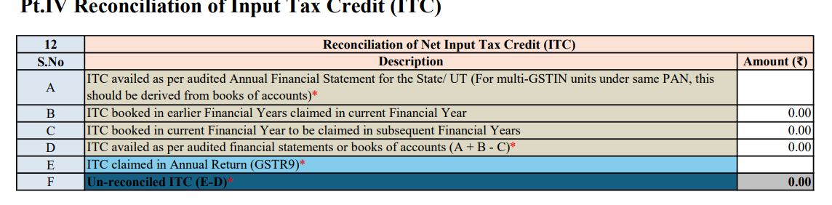
15. GSTR-9C Table 12 — Books vs GSTR-9: Build the Bridge, Don't Guess
Start from the ITC figure embedded in the audited financial statements / books and define exactly what the ledger includes.
Identify ITC booked in the current FY but availed later; identify prior-FY ITC booked earlier but availed current FY.
Separate capital goods, expense GST, RCM, imports and non-creditable GST where the accounting treatment differs.
Reconcile net of reversals only after separately mapping gross ITC and reversal populations.
An unreconciled difference should be supported by a documented reason code: timing, classification, accounting treatment, eligibility, omission, or actual excess claim.
GSTR-9C instructions; GST Council material on Table 12B/12C. | 17

Slide 21
16. GSTR-9C Table 14 — Optional Reporting Does Not Mean 'No Working Required'
Table 14 has been treated as optional under successive annual-return relaxations; however, the underlying ITC reconciliation remains professionally valuable.
The table is expense-head oriented and is intended to reconcile ITC declared in GSTR-9 against GST embedded in expense heads in the books.
If filed, every relevant expense head on which GST has been paid / was payable should be appropriately considered; the list is indicative.
Even when not populated, maintain an internal expense-head ITC reconciliation where the engagement risk warrants it.
Recent litigation has also considered whether non-furnishing of Table 14 can itself constitute a discrepancy; the issue should be analysed with the applicable year's notification and the facts of the case.
Notifications/annual-return relaxations; Pepsico India Holdings Pvt. Ltd. litigation discussed in cited sources. | 18

Slide 22
17. Case Study 1 — ₹10 Lakh ITC: Claim → Reversal → Reclaim
Event | Amount | FY | Treatment
Invoice ITC claimed | ₹10,00,000 | 2024-25 | Claimed in GSTR-3B
Reversed due to Rule 37 | ₹10,00,000 | 2024-25 | Reversal in 3B / annual return
Supplier paid / condition restored | — | 2025-26 | Eligibility restored
ITC reclaimed | ₹10,00,000 | 2025-26 | Reclaim in GSTR-3B
Discussion: Is the FY 2024-25 annual-return population '₹10 lakh net' or should claim and reversal be separately visible?
GSTN's FY 2024-25 FAQ specifically addresses Rule 37/37A reclaims and directs the next-year reclaim to Table 6H of the next year's GSTR-9.
Audit evidence: original invoice, payment ledger, supplier confirmation / bank proof, reversal return and reclaim return.
GSTN FY 2024-25 FAQ. | 19

Slide 23
18. Case Study 2 — Books ₹1.20 Cr vs GSTR-9 ₹1.10 Cr
Potential cause | ₹ lakh | How to test
ITC booked but not yet claimed | 6 | Subsequent GSTR-3B / 2B
ITC on capitalised assets | 4 | Fixed-asset register + tax invoice
Blocked / non-creditable GST | 3 | Sec.17(5) review
RCM timing difference | 2 | RCM liability + ITC trail
Reversal already netted in books | 5 | Journal entries + 3B reversal
Other / unexplained | ? | Escalate before filing
Professional conclusion: the ₹10 lakh difference is not a tax demand merely because the two totals differ. First identify the accounting perimeter and the tax-return perimeter.
Illustrative case study; methodology based on GSTR-9C reconciliation principles. | 20

Slide 24
19. Pre-Filing ITC Checklist
☐ GSTR-3B Table 4A/4B totals agreed month-wise to books / ITC register.
☐ Gross ITC, reversals and reclaims are separately mapped.
☐ Rule 37 and Rule 37A populations are independently tested.
☐ Rule 42/43 annual true-up is documented.
☐ Section 17(5) review is transaction-based.
☐ Prior-FY ITC and subsequent-FY reclaims are separately identified.
☐ GSTR-2B / Table 8A differences have reason codes.
☐ Imports reconciled to Bills of Entry / customs data.
☐ RCM liability and corresponding ITC are reconciled.
☐ Credit notes and amendments have been tested.
☐ GSTR-9C Table 12 bridge agrees to books / AFS.
☐ Any residual difference is either explained or evaluated for tax / interest exposure.
Professional checklist — to be adapted to the applicable FY and notified forms. | 22

Slide 25
21. Risk-Based Review — Where Should we spend time?
Area | Risk signal | Recommended depth
Rule 37/37A | Large reversals / repeated reclaims | Invoice + vendor + return trail
17(5) | Recurring blocked-credit categories | Ledger sampling + legal classification
Table 8 | Large unexplained 8A / 6A variance | Invoice-level bridge
Prior-FY ITC | Material 6A1 / 13 values | Year-wise roll-forward
9C Table 12 | Large books vs return variance | Account-head + timing bridge
Unexplained residual | No documentary reason code | Escalate before finalisation
Risk framework for professional review; not a statutory scoring system. | 23

Slide 26
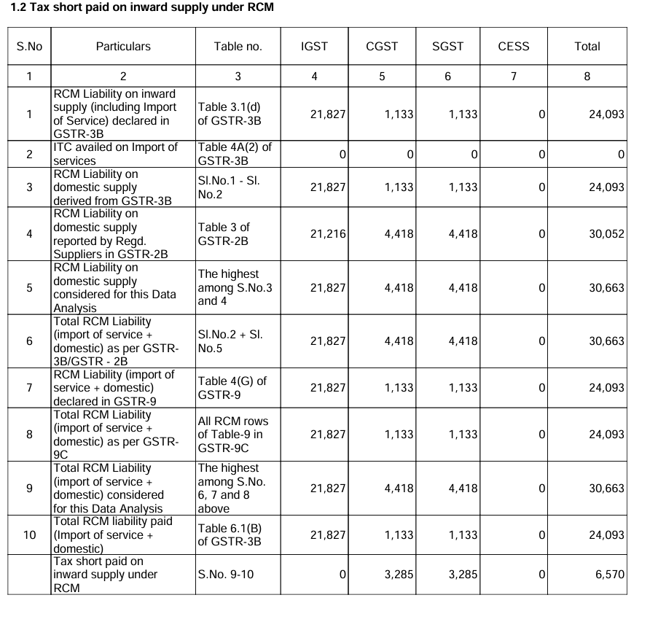
Notices involving 9 & 9C values

Slide 27
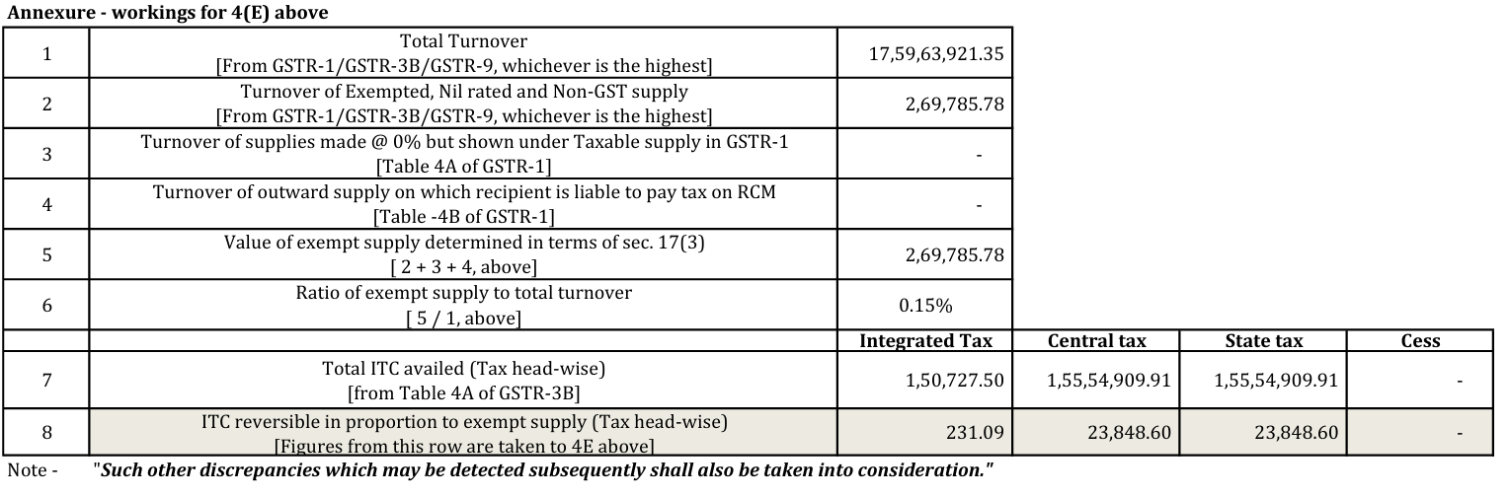
Notices involving 9 & 9C values

Slide 28
22. Closing Takeaways
The annual return should be approached as a year-wise ITC roll-forward—not as a mechanical copy of GSTR-3B.
Reversal and reclaim are separate events; the reason for reversal determines the reporting path.
Portal matching is evidence, not the legal test of eligibility.
GSTR-9C asks a different question: can the ITC reported in the annual return be reconciled to the accounting records?
An unexplained difference is a professional review point—not automatically a tax liability.
Maintain a defensible reconciliation file that can survive departmental scrutiny.
End of presentation | 24

Slide 29
Key Primary References
CGST Act, 2017 — Sections 16, 17, 34, 44, 50, 54 and related provisions.
CGST Rules, 2017 — Rules 37, 37A, 42, 43, 80 and relevant GSTR-9/9C instructions.
CBIC Notification No. 26/2022-Central Tax dated 26.12.2022 — insertion of Rule 37A and amendments to Rule 37.
CBIC Circular No. 170/02/2022-GST dated 06.07.2022 — reporting of correct ITC / reversals in GSTR-3B and GSTR-1.
GSTN — FAQ on GSTR-9/9C for FY 2024-25, including Table 6A1/6A2 and Rule 37/37A reclaim examples.
Applicable annual-return notifications / forms / instructions for the relevant financial year should be checked immediately before filing.
Primary sources — verify the notified form and instructions applicable to the relevant FY. | 25

Slide 30
Thank You
CA Surabhi Bohra

