Slide 1


Creating BIG Indian CA Firms
New Age Audit Firm
NETWORKING
CORPORATE FORM OF PRACTICE
MERGERS
EMERGING PROFESSIONAL OPPORTUNITIES
CA Dayaniwas Sharma
Central Council Member

Slide 2

Discussion Points
S.No | Particulars
1 | Statistics
2 | Current Focus Areas of Practice
3 | Knowing the World
4 | ICAI way forward for FIRMS
 | Networking Guidelines
 | Corporate Form of Practice
 | Mergers & Multidisciplinary Practice (MDP)
 | MRA’s and MOU’s
5 | Opportunities to Explore
CA Dayaniwas Sharma

Slide 3
Chartered Accountants in India
Analysis of Chartered Accountants ACA & FCA and COP & Non COP
S.No. | Particulars | ACA | FCA | Total
1 | No. of CA’s as on 01/01/19 No. of CA’s as on 31/03/21 No. of CA’s as on 01/01/22 No. of CA’s as on 01/07/22 | 1,79,558 2,23,344 2,41,746 2,49,672 | 93,525 1,03,737 1,11,147 1,10,075 | 2,73,083 3,27,081 3,52,893 3,59,747
 | Percentage – 1/1/19 Vs 1/7/22 3 Years | 39% Increase | 18% Increase
S.No. | Particulars | COP | Non COP | Total
2 | No. of CA’s as on 01/01/19 No. of CA’s as on 31/03/21 No. of CA’s as on 01/01/22 No. of CA’s as on 01/07/22 | 1,31,990 1,51,139 1,52,565 1,55,909 | 1,41,093 1,75,942 2,00,328 2,03,838 | 2,73,083 3,27,081 3,52,893 3,59,747
 | Percentage – 1/1/19 Vs 1/7/22 | 18% Increase | 44% Increase
CA Dayaniwas Sharma

Slide 4
Let’s Know the Statistics
No. of Partners | Firm Count | Percentage
1 | 63,019 | 70.65
02 to 05 | 23,968 | 26.87
06 to 10 | 1,784 | 2.00
11 to 15 | 303 | 0.34
16 to 20 | 71 | 0.08
21 to 30 | 34 | 0.04
31 to 50 | 11 | 0.01
50 above | 10 | 0.01
 | 89,200 | 100
“The future belongs to the competent.
Get good, get better, be the best.”
- Brian Tracy
CA Dayaniwas Sharma

Slide 5
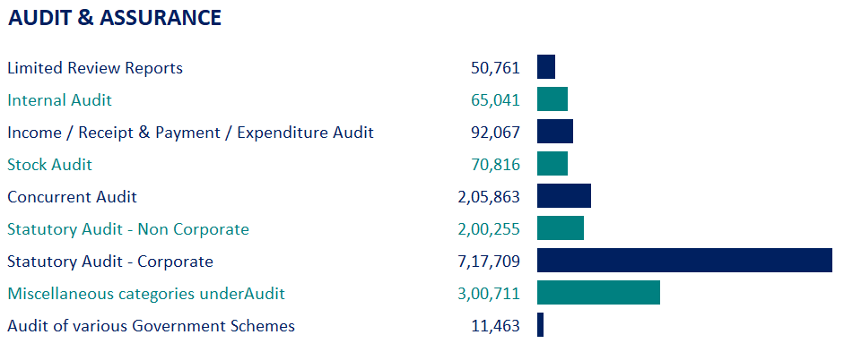
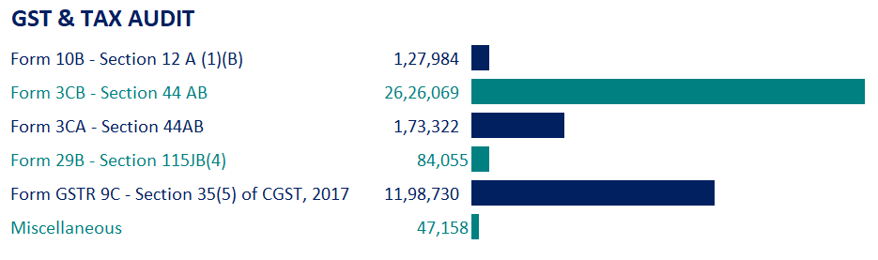
Let’s Know the Statistics
CA Dayaniwas Sharma

Slide 6
Current Focus Areas
Types of Audit in India
Internal Audit
Statutory Audit
Companies Act Audit
Income Tax Audit
GST Audit
Bank Audits
Project Finance
Direct and Indirect Representation
IND AS
System Audits
CA Dayaniwas Sharma

Slide 7
Opportunities to Explore
Dashboard, Data analytics and MIS Reporting ESG Reporting Virtual CFO MSME Support Services International Liaison for Book Keeping and MIS Reporting State and Country Industrial Policy Forensic Accounting and Investigation Services Internal Processes Assessment and Regulatory Compliances Services FDI and FEMA Compliances including IEC and Customs Compliances
CA Dayaniwas Sharma

Slide 8
Global Accounting Bodies
Did you know…..
7 Continents 195 Countries 162 Accounting Bodies
1 Accounting Body in India 3.87 lakhs members of ICAI
There are 162 accounting bodies all over the world.
What is more to be a ICAI Member? MOUs and MRAs
CA Dayaniwas Sharma

Slide 9

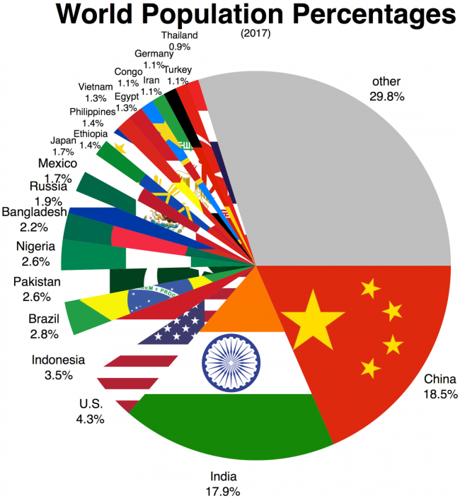
World around Chartered Accountants
US CPA | ICAI | China CPA | Canadian CPA
664,000+ | 387,000+ | 300,000+ | 217,000+
Australia CAP | ICAEW –UK | CA – Singapore | CA ANZ
158,000 | 181,000+ | 32,000+ | 120,000
IIA | CISA | South African ICA | CIMA
200,000 | 115,000 | 40,000+ | 110,500+
6,64,532
2,00,000+
1,15,000
3,87,110
CA Dayaniwas Sharma

Slide 10
Knowing the World
Threshold limits for companies around the world to be eligible for audit exemption
No. | Country | Turnover | Assets | Employee count
1 | Malaysia | ≤ 0.1 Million | < 0.3 Million | ≤ 5
2 | Singapore | ≤ 10 Million | < 10 Million | ≤ 50
3 | United Kingdom | < 10.2 Million | < 5.1 Million | < 50
4 | Ireland | < 8.8 Million | < 4.4 Million | ≤ 50
5 | Australia | < 25 Million | < 12.5 Million | < 50
Audit requirement in the USA
There are no legal requirements for privately held entities to have audited financial statements.
They may be required as a condition of outside financing agreements or other contracts.
CA Dayaniwas Sharma

Slide 11


Approach to Making BIG
ICAI way forward for FIRMS
A. Networking Guidelines
B. Corporate Form of Practice
C. Mergers & Multidisciplinary Practice Firms (MDP)
D. MRA’s and MOU’s
“The difference between who you are and who you want to be, is what you do.”
CA Dayaniwas Sharma

Slide 12
A. Networking Guidelines, 2021
Coverage in revised guidelines
Preamble
Concerns relating to growth of Indian CA firms
Why Networking?
Three models of networking – Options offered to Members
A - Alliance Model
B - Network Model – sub-divided into:
  B1 – Network of firms without Lead firm concept
  B2 – Network of firms with Lead firm concept
CA Dayaniwas Sharma

Slide 13
Preamble
Guidelines for Networking were issued in 2005 and then revised in 2011. In last 15 years, close to 100 networks of CA firms have been formed. Networking has not been popular despite tangible benefits
Need to strengthen Indian CA firms and create large Indian CA firms
ICAI has noted the bottlenecks in networking and has tried to mitigate the same in revised Guidelines which hopefully will encourage practising Members to go for Networking
Considered by the Council at its 397th meeting held on 9th-11th January, 2021 at Kumarakom, Kerala and thereafter at its 398th meeting held on 9th-10th February, 2021 at New Delhi.
CA Dayaniwas Sharma

Slide 14

Concerns relating to Growth of India CA Firms
Majority CA firms are SMPs
Large number of firms have confined practice to audit and taxation
Many firms have audits allotted through the ICAI-PDC empanelment process
Attachment with firm name dissuades Merger or Network due to fear of Loss of Identity
Client switches over to larger firm when his business needs increase
Need of the hour is to venture into non-traditional practice areas, specialism and forming large structure by networking
CA Dayaniwas Sharma

Slide 15

Why Networking ???
Prime Minister’s vision to create 100 Big Indian CA firms
Opportunity of Pooling of Resources, Expertise, Combined Strength and Showcasing Pan India Presence
Currently if we consider
Firms having Partners between 16-50+ Partner
It totals to 126 Firms only and amounts to 0.14% of total firms
CA Dayaniwas Sharma

Slide 16












Why Networking ???
MARKET PENETRATION & DEVELOPMENT
RESOURCES
PEOPLE
SERVICE LINES
ASSETS
COST OPTIMIZATION
CA Dayaniwas Sharma
Central Council Member

Slide 17
Making of
Big Firms
Approach I
Alliance Model
Approach II
Network Model

Slide 18
Options Proposed
Approach I | Approach II
A | B
Different firms coming together to form an Alliance with a new name of Alliance and continuing to practice independently and can showcase as an Alliance to the world | Different firms coming together to form a Network with a new Network name and practicing in the name of firms belonging to Network. This Model is sub-divided into following two options:
 | B1 | B2
 | Network of firms in existing model by practising in individual firm name | Network of firms with a Lead firm acting on behalf of constituent firms of Network
Proposed models of networking –
Options offered to Members
CA Dayaniwas Sharma

Slide 19
The 3 R’s Model
R
R
R
APPROACH I | APPROACH II
A Alliance Model | B1 Network Model | B2 Lead Firm in Network Model
Registered Not Recognised Partially regulated | Registered To be Recognised Regulated | Registered To be Recognised Regulated
New Approach | Existing Model | New Approach
CA Dayaniwas Sharma

Slide 20
Alliance Model – A
Key | Explanation
1. Purpose | Firms come together for Mutual Benefits
2. Name Style | Name will be “ABCD” or “ABCD & Alliance”
3. Registration | ICAI will register and allot Alliance Registration Number (ARN)
4. Independent Practice | Constituent firms can carry on practice as independent firms
5. Branding | Display of Alliance name in professional stationery to be permitted
6. Practices to Follow | Alliance may direct constituent firms to follow best practices
7. Multiple Members | Firms of one Alliance cannot become Member of another Alliance or a Network
8. Empanelment Process & Purpose | All firms in Alliance can apply for empanelment separately as individual firms. Their coming together is basically for non-audit services. For audit practice, they all remain as independent practitioners
9. Independence | “Independence” issues will have to be kept in mind i.e. if one firm does statutory audit of an entity, another constituent firm cannot do internal audit. If one firm does audit work, another constituent firm cannot perform non-audit services of same client. Rotation of audit amongst constituent firms will not be permitted
CA Dayaniwas Sharma

Slide 21
Alliance Model – A
Key | Explanation
10. Referral | Referral of professional work and sharing of fees/ cost permitted
11. Signing | A partner of firm that gets appointment will sign reports
12. Firm Responsible in Delinquency | In case delinquency occurs in a particular assignment, then the firms/ partners that have jointly executed the assignment will be accountable. Therefore, division of work needs to be well documented.
13. Code of Ethics | Whatever is taboo for a firm under Code of Ethics, is taboo for the Alliance as well i.e. whatever cannot be done by a firm, cannot be done by Alliance as well
14. Joining & Exit | Firms are free to join and exit Alliance.
15. Reconstitution | Reconstitution has to be registered with ICAI
16. Work Completion | If one firm leaves Alliance, it will not deprive other firms from completing the work
17. Bye-laws of Alliance | Alliance should have its own bye-laws which should not contradict CA Act, CA Regulations, Code of Ethics and Council Guidelines
18. Agreement Filing | Alliance shall have to submit to ICAI copy of internal agreement signed by an authorised partner of all constituent firms
CA Dayaniwas Sharma

Slide 22
Network Model – B1
Key | Explanation
1. Purpose | Firms come together for Mutual Benefits by pooling resources, showcase their combined strength, and have uniform policies, technology and collaterals, and showcase themselves as ONE Big Unit
2. Name Style | Name will be “ABCD” or “ABCD & Affiliates” or “ABCD Network”
3. Registration | ICAI will register and allot Network Registration Number (NRN)
4. Independent Practice | Constituent firms are bound by internal integration agreement, and practice as independent firm, subject to internal agreement. Network’s decision prevails upon other firms
5. Branding | Display of Network name in professional stationery to be permitted
6. Multiple Members | Firms of one Network cannot become Member of another Network or Alliance
7. Empanelment Process | All firms belonging to Network can apply for empanelment separately as individual firms. ICAI will put in efforts for recognition of the combined strength and resources
8. Independence | “Independence” issues will have to be kept in mind i.e. if one firm does statutory audit of an entity, another constituent firm cannot do internal audit. If one firm does audit work, another constituent firm cannot perform non-audit services of same client. Rotation of audit amongst constituent firms will not be permitted
CA Dayaniwas Sharma

Slide 23
Network Model – B1
Key | Explanation
09. Referral | Referral of professional work and sharing of fees/ cost permitted
10. Signing | A partner of firm that gets appointment will sign reports
11. Firm Responsible in Delinquency | In case delinquency occurs in a particular assignment, then the firms that have jointly executed the assignment will be accountable. Therefore, division of work needs to be well documented.
12. Code of Ethics | Whatever is taboo for a firm under Code of Ethics, is taboo for the Network as well i.e. whatever cannot be done by a firm, cannot be done by Network as well
13. Joining & Exit | Firms are free to join and exit Alliance.
14. Reconstitution | Reconstitution has to be registered with ICAI
15. Work Completion | If one firm leaves Network, it will not deprive other firms from completing the work
16. Quality Control | Quality control is well documented and complied with, which is applicable to network as well as to individual constituent firms.
17. Integration Agreement | Firms will be bound by Network’s internal integration agreement.
18. Assignment Signing | Individual firms take up professional work on their own, and a partner of said firm can sign the reports and documents
CA Dayaniwas Sharma

Slide 24
Network Model – B1
Key | Explanation
19. Bye-laws of Alliance | Network will have its own bye-laws which should not contradict CA Act, CA Regulations, Code of Ethics and Council Guidelines
20. Agreement Filing | Network shall have to submit to ICAI copy of internal agreement signed by an authorised partner of all constituent firms
CA Dayaniwas Sharma

Slide 25
Lead Firm in Network Model – B2
Key | Explanation
1. Purpose | Firms come together for Mutual Benefits by pooling resources, showcase their combined strength, and have uniform policies, technology and collaterals, and showcase themselves as ONE Big Unit
2. Name Style | Constituent firms will choose one of the firms as Lead firm e.g. A & Co. is selected as Lead Firm, then name of Network will be “A & Co. & Affiliates” or “A & Co. Network”
3. Registration | ICAI will register and allot Network Registration Number (NRN)
4. Independent Practice | Constituent firms are bound by internal agreement recognising one of the firms as Lead firm, depending upon specialism and expertise required for each assignment. Network’s decision prevails upon other firms
5. Branding | Display of Network name in professional stationery to be permitted
6. Multiple Members | Firms of one Network cannot become Member of another Network or Alliance
CA Dayaniwas Sharma

Slide 26
Lead Firm in Network Model – B2
Key | Explanation
7. Empanelment Process | Lead firm is entitled to apply for empanelment in its own name, but by way of internal agreement, it will be on behalf of entire Network. When Lead firm applies for empanelment, other constituent firms cannot apply. ICAI will put in efforts to get recognition of the combined strength and resources
8. Independence | “Independence” issues will have to be kept in mind i.e. if one firm does statutory audit of an entity, another constituent firm cannot do internal audit. If one firm does audit work, another constituent firm cannot perform non-audit services of same client. Rotation of audit amongst constituent firms will not be permitted
09. Referral | Referral of professional work and sharing of fees/ cost permitted
10. Signing | A partner of lead firm will sign reports and certificates, if the lead firm gets appointment in its name
11. Firm Responsible in Delinquency | In case delinquency occurs in a particular assignment, then the firms that have jointly executed the assignment will be accountable. Therefore, division of work needs to be well documented.
12. Code of Ethics | Whatever is taboo for a firm under Code of Ethics, is taboo for the Network as well i.e. whatever cannot be done by a firm, cannot be done by Network as well
CA Dayaniwas Sharma

Slide 27
Network Model – B2
Key | Explanation
13. Joining & Exit | Firms are free to join and exit Alliance.
14. Reconstitution | Reconstitution has to be registered with ICAI
15. Work Completion | If one firm leaves Network, it will not deprive other firms from completing the work. If Lead firm quits the network, after having secured professional work, then it will have to share the fees with other constituent firms. A clause to this effect can be incorporated in the internal agreement
16. Quality Control | Quality control is well documented and complied with, which is applicable to network as well as to individual constituent firms.
17. Integration Agreement | Firms will be bound by Network’s internal integration agreement.
18. Assignment Signing | Individual firms take up professional work on their own, and a partner of said firm can sign the reports and documents
19. Bye-laws of Alliance | Network will have its own bye-laws which should not contradict CA Act, CA Regulations, Code of Ethics and Council Guidelines
20. Agreement Filing | Network shall have to submit to ICAI copy of internal agreement signed by an authorised partner of all constituent firms
CA Dayaniwas Sharma

Slide 28
Contents of new Guidelines paper
Para 1 of the Paper outlines the purpose of revising the Guidelines so as to make it easier for the Indian CA firms to form network and also remove any impediments and bottlenecks that dissuade the firms from growing bigger by joining a network
Para 2 identifies the concerns by Council on growth of firms
Para 3 discusses the need for networking
Para 4 offers three models of networking viz.
  “The Guidelines for Alliance”
  “The Guidelines for Networking” (revised)
  “The Guidelines for Networking with Lead Firm concept”
Para 4 also gives a comparative table of features/ characteristics of the three models of Networking
Para 5 explains the guidance provided by Council to members at its February, 2021 meeting
CA Dayaniwas Sharma

Slide 29
Contents of new Guidelines paper
All the following three models of networking have separate Annexures to the common Paper:
Alliance Model,
Network Model, and
Network Model with Lead Firm concept
Each of these three Models have 3 Appendices each explaining -
Concept,
Modalities of Working, and
Naming provisions.
Each of these models have three forms –
for name approval,
for registration, and
for change in constitution
CA Dayaniwas Sharma

Slide 30
B. Corporate Form of Practice
Ref: 261 Meeting of Council decided to allow Members in Practice for form Corporate Form of Practice in pursuance to Section 2(2)(iv) of the Chartered Accountants Act 1949.
A opportunity for the Indian Chartered Accountants is to establish a Management Consultancy Company and provide a wide spectrum of services such as capital structuring and management, research and demand studies, cost control and value analysis, etc.
Definition of Management Consultancy and Other Services shall be as per Code of Ethics of ICAI.
CA Dayaniwas Sharma

Slide 31
B. Corporate Form of Practice
Benefits available to members on compliance with guidelines issues by ICAI are:
Retain full-time COP being the Managing Director/Whole-time Director/Manager of Management Consultancy Company.
No restrictions on the quantum of the equity holding of the member, either individually and/or along with his relatives, in such a company.
Relatives Means “Relative” as defined in Chartered Accountants Regulation, 1988
Such member shall be regarded as being in fill time practice and therefore can continue to do attest function either in individual capacity or in Proprietorship/ Partnership Firm.
Entitled to train articled/audit assistants.
Name of Management Consultancy Company is required to be approved by ICAI in compliances with Ethical Standards.
Please note that MCS shall neither be permitted to advertise nor use logo.
CA Dayaniwas Sharma

Slide 32
B. Corporate Form of Practice
The Expression “Management Consultancy and other services” shall not include the function of statutory or periodical audit, tax(both direct & indirect) representation or advice concerning tax matters or acting as liquidator, trustee, executor, administrator, arbitrator or receiver, but shall include the following:
Management Consultancy & Other Services
Financial Management planning and financial policy determination
Capital Structure planning and advice regarding raising finance
Working Capital Management
Preparing Project Reports and feasibility studies
Preparing cash budget, cash flow statements, profitability statements, statement of sources & application of funds etc
CA Dayaniwas Sharma

Slide 33
B. Corporate Form of Practice
Management Consultancy & Other Services
Inventory Management, material handling and storage
Market Research and demand studies
Price fixation and other management decision making
Management accounting Systems, cost control and value analysis
Control methods and management information and reporting
Business Policy, corporate planning, organisation development, growth and diversification
System Analysis and design, and computer related services including selection of hardware and development of software in all areas of services which can be otherwise be rendered by CA in practice.
CA Dayaniwas Sharma

Slide 34
C. Mergers and Multidisciplinary Firm
Merger and Demerger
Guidelines
Multidisciplinary Practicing Firms (MDP) guidelines and approval of MCA
CA Dayaniwas Sharma

Slide 35


Going local to global
In this dynamic era of our nation, we as Chartered Accountants , are the pillars of robust development and sustainability. We survive, thrive and adapt to the changes our economic landscape demands.
But why limit ourselves to only one country ?
Is it time to break the boundaries and go global ?
CA Dayaniwas Sharma

Slide 36

D. MOUs, MRAs and International Presence
In pursuance of global mobility of it’s members, ICAI has signed 19 (13 previous) MoUs & MRAs with accounting bodies across the globe.
The objective of signing such agreements is to facilitate mutual recognition of each others’ qualification and admit the members in good standing by prescribing bridging mechanisms between the Institutes.
ICAI International Presence:
International Chapters | 37
International Representative Offices | 27
Permenant Overseas offices | 2
How Many of Us have Thought of New Connections/ Relationships
CA Dayaniwas Sharma

Slide 37



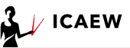
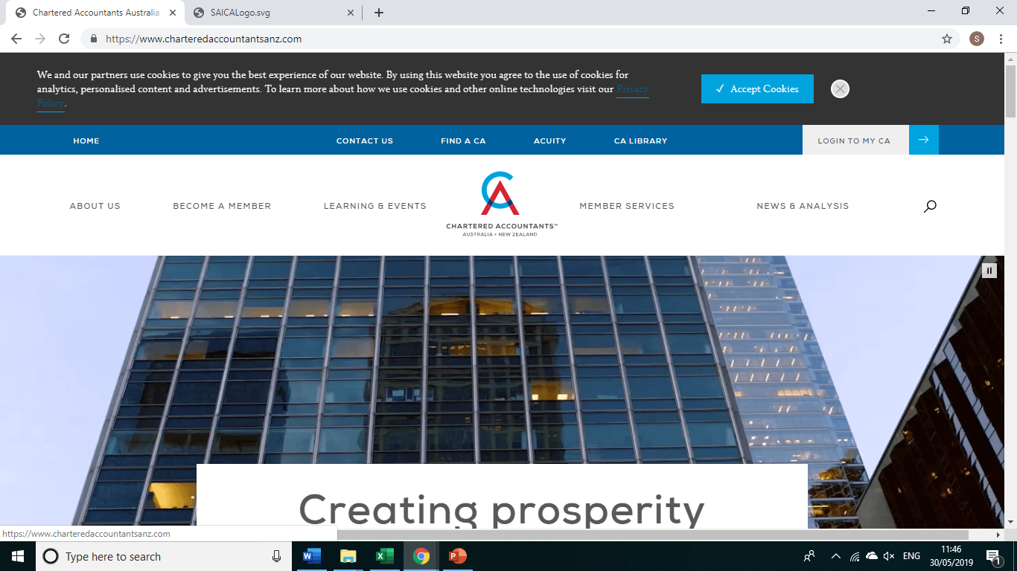





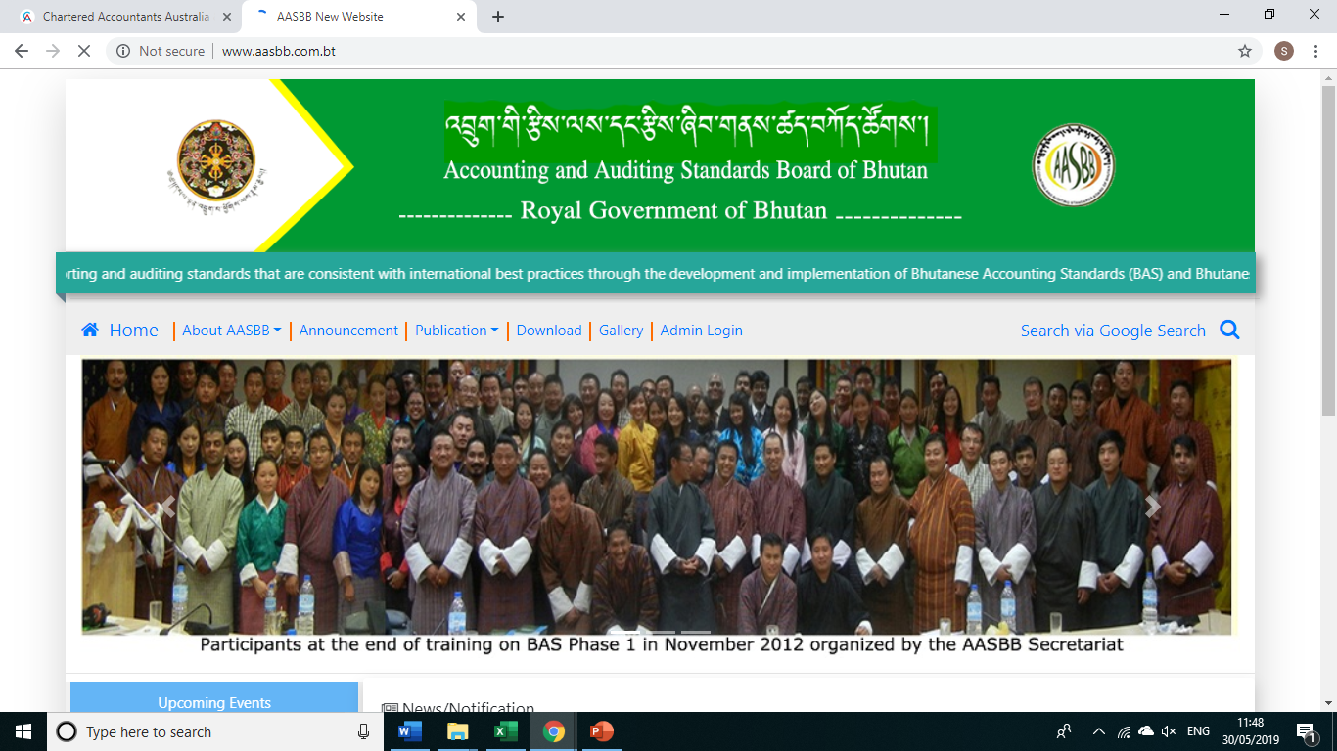
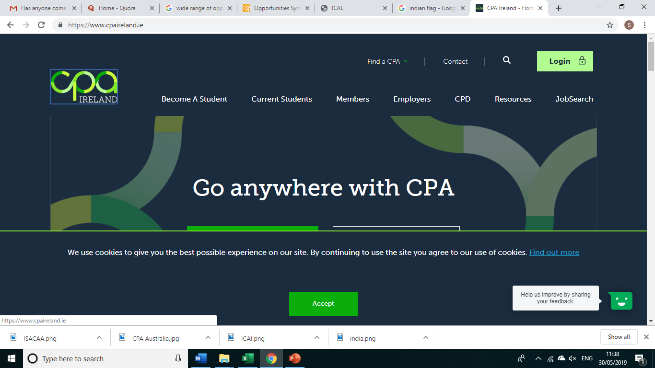
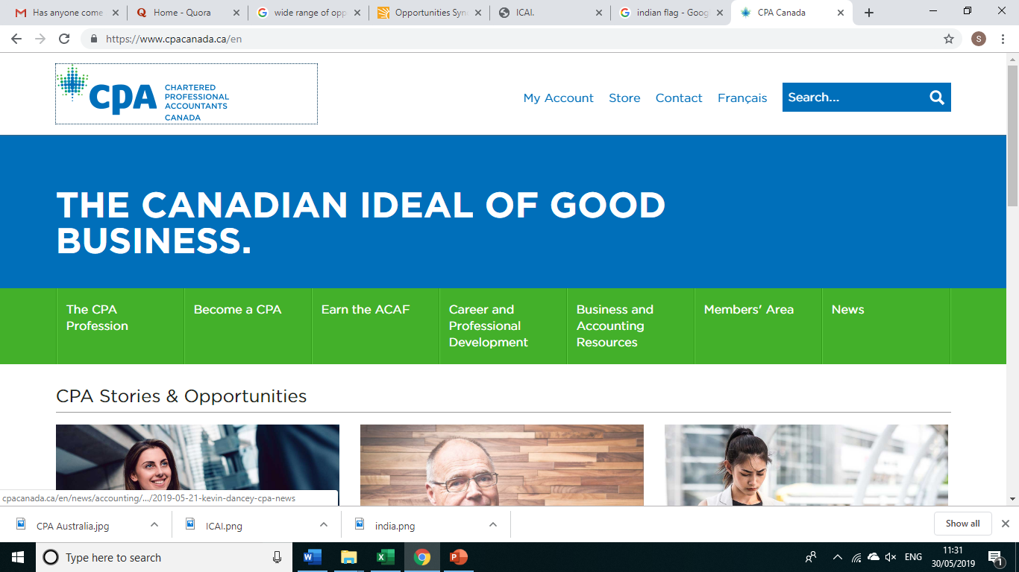

MOUs & MRAs
The 13 MoUs & MRAs with various accounting bodies will enable professional development, sharing of knowledge, technical expertise and protection of quality and integrity of accounting and finance profession.
CA Dayaniwas Sharma

Slide 38
MOUs & MRAs
SNo | Country | MoU or MRA | Criteria
1 | Canada | MoU with Chartered Professional Accountants of Canada | A qualified Chartered Accountant member of ICAI and remained registered with ICAI as member ICAI members are exempt from practical training module, Capstone 1 and 2, if they have– (i) > 2 years of post-qualification experience and a recognised degree; or (ii)>5 years of post-qualification experience without a recognised degree. Pass the final examination of CPA Canada (3 days Common Final Examination in physical format only)
CA Dayaniwas Sharma

Slide 39
MOUs & MRAs
SNo | Country | MoU or MRA | Criteria
2 | South Africa | MRA with the South African Institute of Chartered Accountants (SAICA) | ICAI members having 2 years of post-qualification experience are exempt from – (i) Initial Test of Competency (ii) Practical training requirements of SAICA Complete Assessment of Professional Competence Exam (APC) If the member, in good standing, fulfils the “competency requirements” of SAICA Competency Framework, membership of SAICA may be granted without completion of APC Examination. Competency Framework consists of parameters like – (i) Academic Transcripts (ii) Work Experience (iii) Portfolio of Work, etc.
CA Dayaniwas Sharma

Slide 40
Guidelines on Networking
MOUs & MRAs
SNo | Country | MoU or MRA | Criteria
3 | United Kingdom | MRA with Institute of Chartered Accountants of England and Wales (ICAEW) | A qualified Chartered Accountant of ICAI Pass ICAEW’s Advanced Level examinations (Corporate Reporting, Strategic Business Management and Case Study) Complete ICAEW’s Ethics Learning Programme (Note: Received approval from Govt. and ICAI yet to sign)
4 | Australia | Mutual Recognition Agreement (MRA) with CPA Australia | A qualified Chartered Accountant of ICAI Complete 1 CPA subject – Business Strategy and Leadership Complete 1 online module – Better Practice in Governance and Accountability Have the minimum pre-membership experience of ICAI; Be a member of good standing and compliance with all CPD regulations
CA Dayaniwas Sharma

Slide 41
MOUs & MRAs
SNo. | Country | MOU/MRA
5 | United States of America | License Agreement for IS Auditing Procedures and related content with ISACA
6 | Ireland | MRA with the Institute of Certified Public Accountants in Ireland (CPA Ireland)
7 | Australia & New Zealand | Pilot International Pathway Programme of Chartered Accountants Australia & New Zealand
8 | Bhutan | MoU with The Accounting and Auditing Standards Board of Bhutan
9 | Kenya | MoU with the Institute of Certified Public Accountants of Kenya (ICPAK)
10 | Bahrain | MoU with Bahrain Institute of Banking and Finance
11 | Tanzania | MoU with the National Board of Accountants and Auditors, Tanzania
12 | Nepal | MoU with the Institute of Chartered Accountants of Nepal (ICAN)
13 | Oman | MoU between ICAI and College of Banking & Financial Studies, Oman
CA Dayaniwas Sharma

Slide 42




Where is the Captain………
CA Dayaniwas Sharma

Slide 43

COME TOGETHER
CA Dayaniwas Sharma

Slide 44

CA Dayaniwas Sharma (FCA, DISA) Central Council Member +91 98852 00029 dayaccm@Lncofirm.com Hyderabad

